Slide 1
Calendar Curiosities
for 29 February
Tony Mann
29 February 2016

Slide 2
29 February
Why we sometimes have
an extra day in February
Some consequences
How to calculate the day of the week on which a date falls

Slide 3
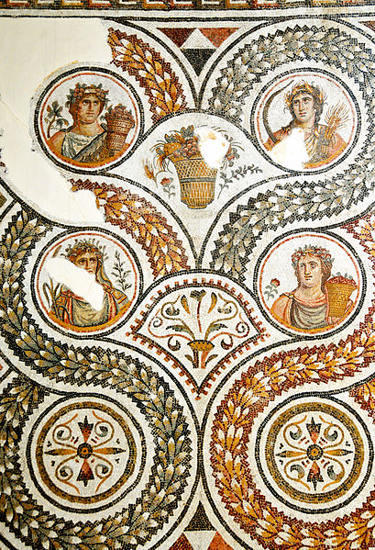
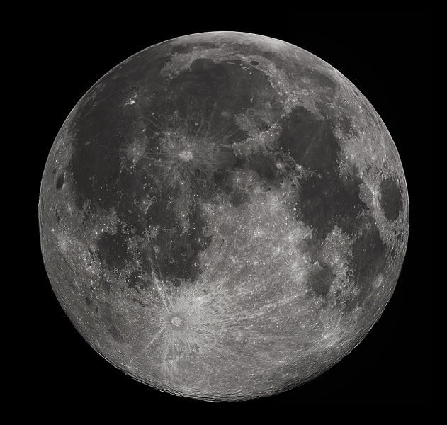
Two reference points

Slide 4
The Moon
Period of moon’s orbit round earth ≈ 29.5 days
12 lunar months
≈ 354 days
13 lunar months
≈ 383.5 days

Slide 5
The Metonic Cycle
19 years
12 with 12 lunar months
7 with 13 lunar months

Slide 6
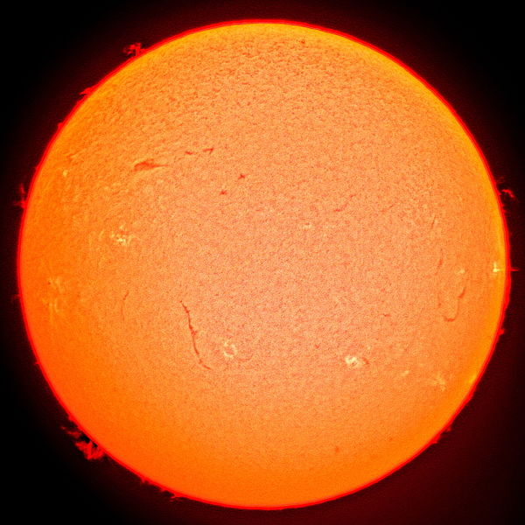
The Sun
Period of earth’s orbit
≈ 365¼ days
Tropical year – period between vernal equinoxes
Sidereal year – time taken by earth to return to identical point of orbit

Slide 7
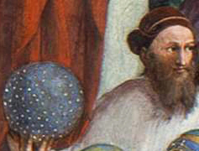
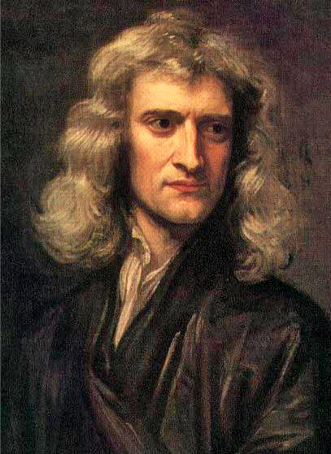
Precession of the Equinoxes

Slide 8
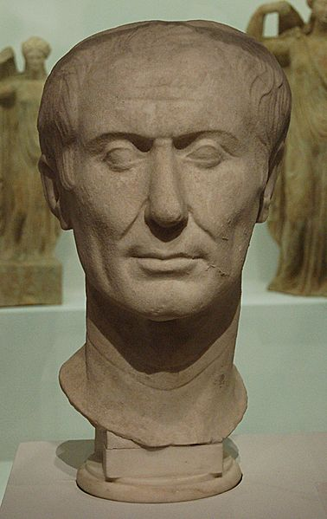
The Julian Calendar, 46 BCE

Slide 9
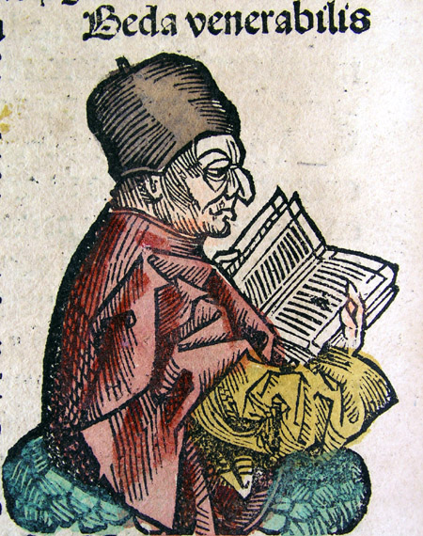
Easter
“The Sunday following the full Moon which falls on or after the equinox will give the lawful Easter”
The Venerable Bede

Slide 10
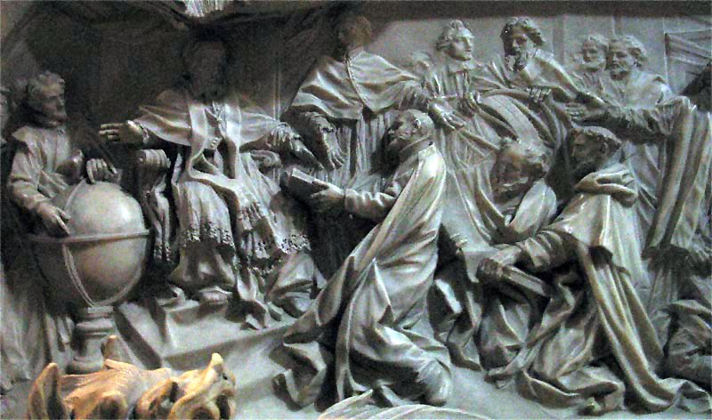
Pope Gregory XIII, 1582

Slide 11
Gregorian Calendar
A century year is a leap year
only if the year number is divisible by 400

Slide 12
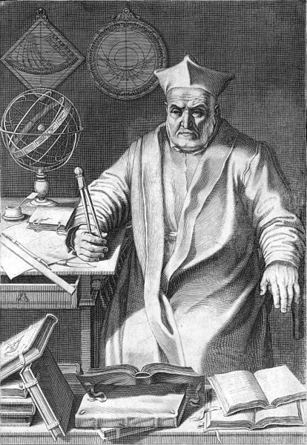
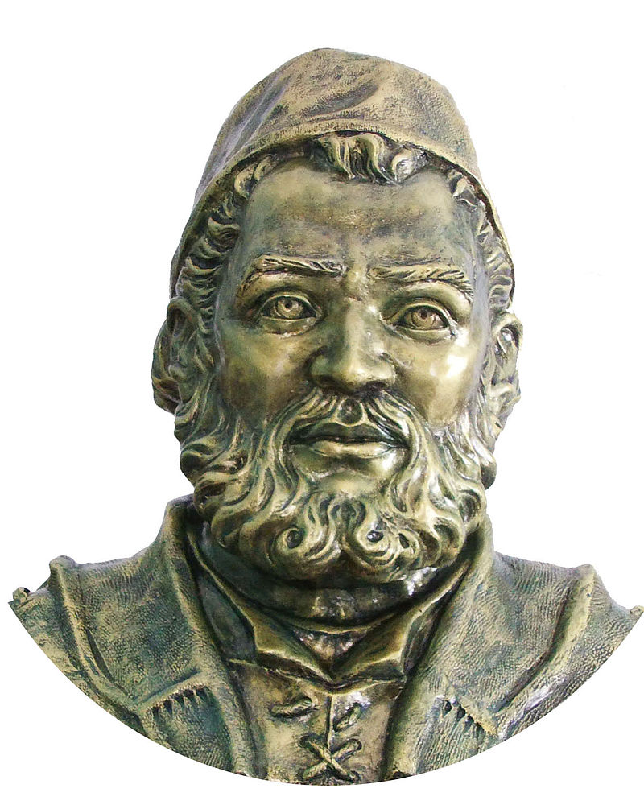
Aloysius Lilius and Christopher Clavius

Slide 13
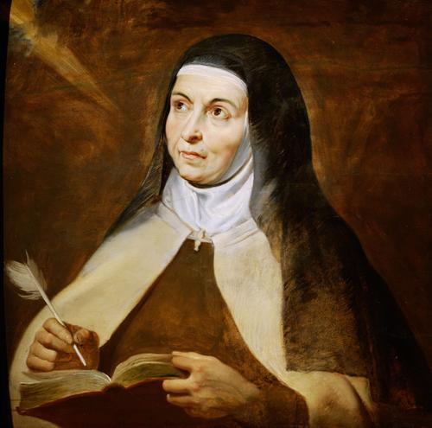
St Teresa of Avila
(died 4 or 15 October 1582)

Slide 14
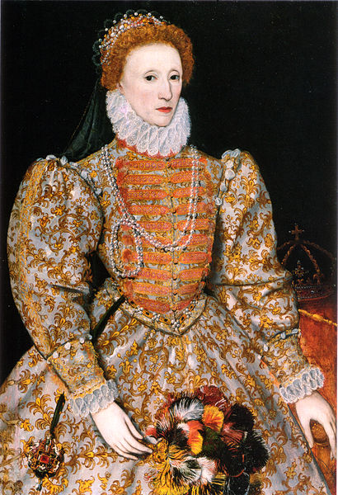
England
As Caesar and Sosigenes
The Vulgar Kalendar did make,
So Caesar’s pere, our true Empress,
To Dee this work she did betake.

Slide 15
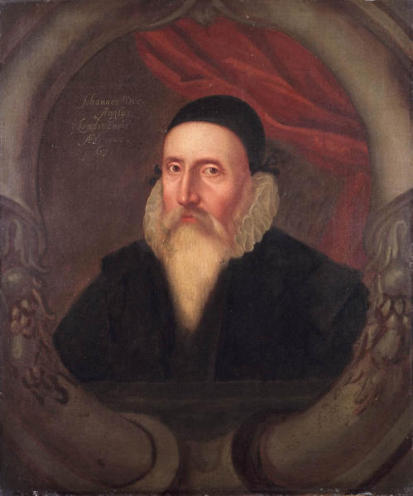
Dee’s Proposal

Slide 16
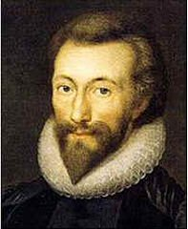
John Donne on Clavius

Slide 17
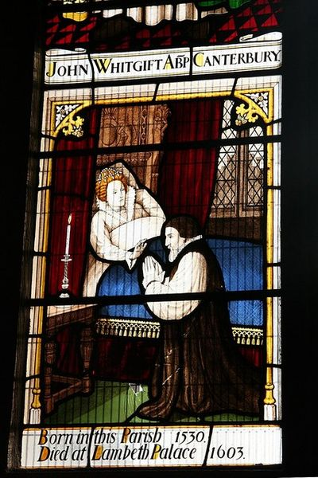
John Whitgift
(died 29 February)

Slide 18
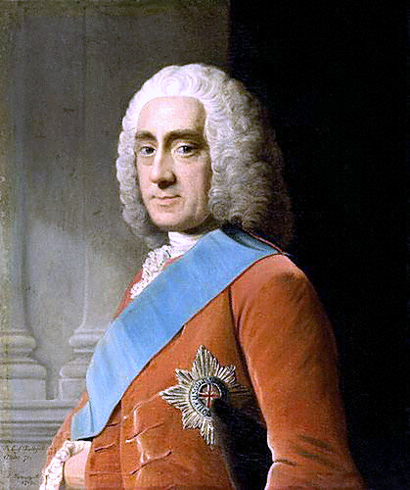
Philip Stanhope, 4th Earl of Chesterfield
They thought I was informed, because I pleased them; and many of them said, that I had made the whole very clear to them; when, God knows, I had not even attempted it.

Slide 19
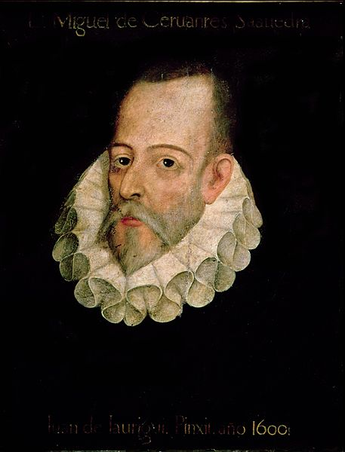
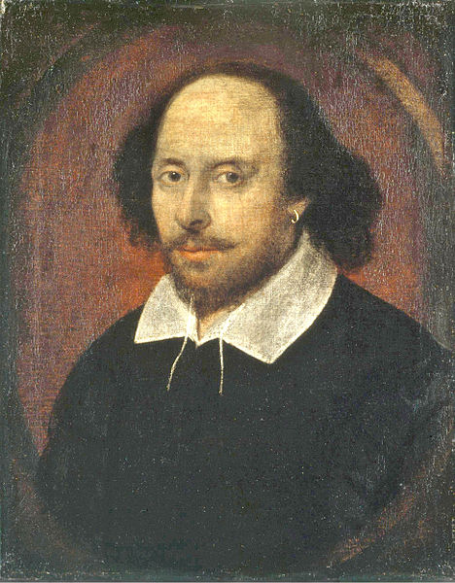
Miguel de Cervantes,
died 23 April 1616
William Shakespeare,
died 23 April 1616

Slide 20
Arithmetic
365 = 7 x 52 + 1

Slide 21
Arithmetic – Julian Calendar
3 x 365 + 366 = 1461
1461 = 7 x 208 + 5

Slide 22
Arithmetic – Gregorian Calendar
303 x 365 + 97 x 366 = 146,097
146,097 = 7 x 20,871 + 0

Slide 23
Arithmetic – Gregorian Calendar
1 January over 400 years
56 Mondays
58 Tuesdays
57 Wednesdays
57 Thursdays
58 Fridays
56 Saturdays
58 Sundays

Slide 24
Arithmetic – Gregorian Calendar
13th of month over 400 years, 4800 months
685 Mondays
685 Tuesdays
687 Wednesdays
684 Thursdays
688 Fridays
684 Saturdays
687 Sundays

Slide 25
Arithmetic – Gregorian Calendar
13th of month over 400 years, 4800 months
685 Mondays
685 Tuesdays
687 Wednesdays
684 Thursdays
688 Fridays
684 Saturdays
687 Sundays

Slide 26
Estes Family, Provo, Utah
Children of Louise and David Estes include:
Xavier, born 29 February 2004
Remington, born 29 February 2008
Jade, born 29 February 2012

Slide 27
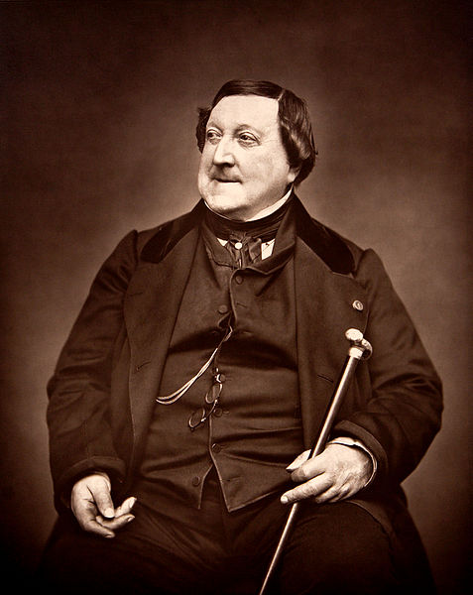
Gioachino Rossini
Born 29 February, 1792
Wrote all his operas before his ninth birthday
50th birthday in 2000
Died 13 November 1868
(a Friday!)

Slide 28
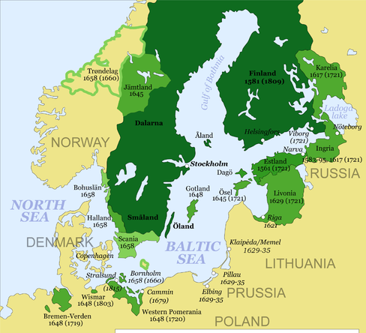
Sweden
Plan:
No leap years between 1700 and 1740
Reality:
1700 – not leap year
1704, 1708 – leap years
1712 – leap year
+ extra day

Slide 29
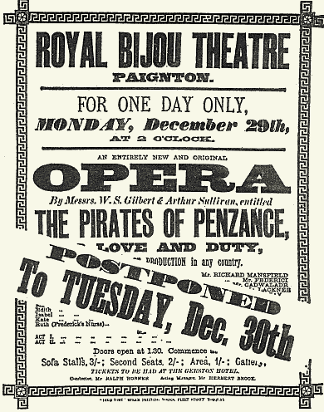
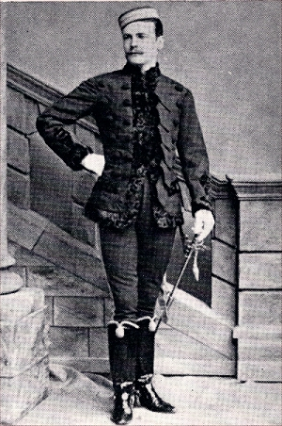
The Pirates of Penzance

Slide 30
The Pirates of Penzance
How quaint the ways of Paradox!
At common sense she gaily mocks!
Though counting in the usual way,
Years twenty-one I’ve been alive,
Yet, reckoning by my natal day,
I am a little boy of five!

Slide 31
Coming of Age
Born 29 February in:
UK – legal birthday in common year is 1 March
New Zealand – 28 February
USA – unclear!

Slide 32
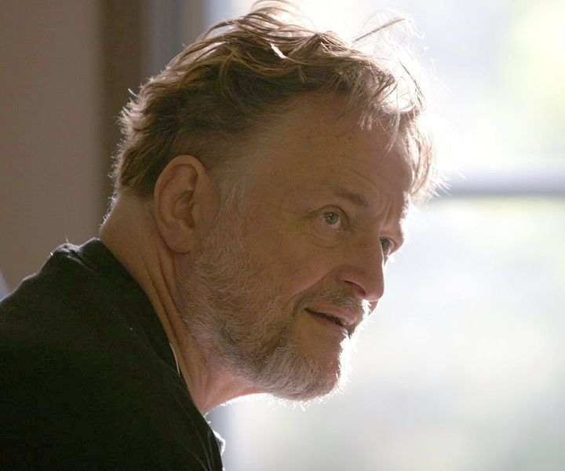
Conway’s Doomsday Method

Slide 33
Conway’s Doomsday Method
2016 – Doomsday is Monday
4 April (4/4)
6 June (6/6)
8 August (8/8)
10 October (10/10)
12 December (12/12)
are all Doomsdays

Slide 34
Conway’s Doomsday Method
Example – 25 December 2016
12 December is Doomsday (Monday in 2016)
19 December is Monday
26 December is Monday
So 25 December is Sunday

Slide 35
Conway’s Doomsday Method
Example – 1 October 2016
October 10 is Monday
3 October is Monday
2 October is Sunday
So 1 October is Saturday

Slide 36
Conway’s Doomsday Method
Odd months:
Short months – subtract 4
5 September (5/9)
7 November (7/11)
Long months – add 4
7 March (7/3)
9 May (9/5)
11 July (11/7)
are all Doomsdays

Slide 37
Conway’s Doomsday Method
January / February
Last day of January and February is a Doomsday
Except: in leap year
32 January is Doomsday

Slide 38
Conway’s Doomsday Method
Example: 1 January 2016
2016 leap year so 32 January is Doomsday (Monday)
25 January is Monday
18, 11, 4 January are Mondays
So 1 January was Friday

Slide 39
Conway’s Doomsday Method
Finding Doomsday
for a given year
REMEMBER:
Doomsday 2000 was Tuesday

Slide 40
Conway’s Doomsday Method
Doomsday advances 1 day every common year
and 2 days every leap year
Doomsday advances 1 day every twelve years
“A dozen years is but a day”

Slide 41
Conway’s Doomsday Method
100 years on takes Doomsday back 2 days
Unless we’re moving on to a leap year in which case it goes back only 1 day

Slide 42
Conway’s Doomsday Method
Example: 1 January 2101
Doomsday 2000 was Tuesday
Century rule – back 2 since 2100 not a leap year
So Doomsday 2100 is Sunday
Doomsday 2101 is Monday

Slide 43
Conway’s Doomsday Method
Example: 1 January 2101
Doomsday 2101 is Monday
January 31 is Monday (not leap year)
January 24, 17, 10, 3 all Mondays
1 January 2101 is Saturday

Slide 44
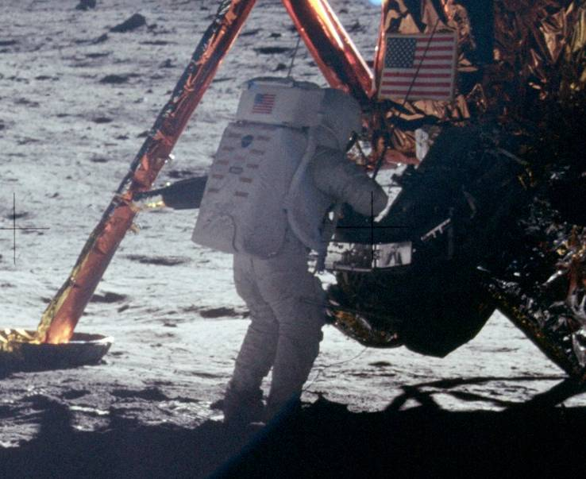
21 July 1969 – First step on Moon
Doomsday 1900 – Wednesday
1912, 24, 36, 48, 60 takes us to Monday

Slide 45
21 July 1969 – First step on Moon
1960 | Monday
1961 | Tue
1962 | Wed
1963 | Thu
1964 | Sat
1965 | Sun
1966 | Mon
1967 | Tue
1968 | Thu
1969 | Fri

Slide 46
21 July 1969 – First step on Moon
Doomsday 1969 – Friday
July – 31 days – so 11 July is Friday
18 is Friday
21 is Monday

Slide 47
Cervantes’s death: 23 April 1616
Doomsday 1600 – same as 2000 – Tuesday
1612 – Wed
1616 – Monday
4 April – Monday
23 April - Saturday

Slide 48
Julian Calendar
Doomsday (Julian) 1500 was Saturday
Dozen years rule still works
Going forward a century always takes Doomsday back 1 day

Slide 49
Shakespeare’s death: 23 April 1616
Julian Doomsday 1500 – Saturday
1600 – back 1 – Friday
1612 – Saturday
1616 - Thursday
4 April – Thursday
23 April - Tuesday

Slide 50
Conway’s Doomsday Method
Human friendly!
Little to remember, each step simple counting
Not the way you’d programme a computer!

Slide 51
Thank you for listening
a.mann@gre.ac.uk
@Tony_Mann

Slide 52
Acknowledgments and picture credits
Thanks to Noel-Ann Bradshaw
and everyone at Gresham College
Further reading
David Ewing Duncan, The Calendar (London: Fourth Estate, 1998)
Picture credits
Four seasons mosaic, Acholla, Tunisia: Dennis Jarvis, Wikimedia Commons, CC-BY-SA-2.0
Moon: Gregory H. Revera, Wikimedia Commons, CC BY-SA 3.0
Sun: HalloweenNight, Wikimedia Commons, CC BY-SA 4.0
Hipparchus: Raphael, The School of Athens, Wikimedia Commons
Sir Isaac Newton: Sir Godfrey Kneller, Wikimedia Commons
Julius Caesar, The Tusculum Portrait: Gautier Poupeau, Wikimedia Commons, CC BY 2.0
Venerable Bede, Nuremberg Chronicle, 1493: Wikimedia Commons
Gregory XIII by Camillo Rusconi (1658–1728): Rsuessbr, Wikimedia Commons, CC BY-SA 3.0
Aloysius Lilius by Giuseppe Capoano: Vizza, Wikimedia Commons, CC BY-SA 3.0
Christopher Clavius: engraving by Jean Leclerc (1585-1633) after a painting by Francisco Villamena (1566-1624), Wikimedia Commons
St Teresa of Avila: Peter Paul Rubens, Wikimedia Commons
Queen Elizabeth, unknown artist, Wikimedia Commons
John Dee, unknown artist: Wikimedia Commons
Archbishop Whitgift at the deathbed of Queen Elizabeth: Richard Croft, Wikimedia Commons, CC BY-SA 2.0
John Donne: Isaac Oliver, Wikimedia Commons
Philip Stanhope, 4th Earl of Chesterfield: Allan Ramsay, Wikimedia Commons
Miguel de Cervantes: doubtful portrait attributed to Juan de Jáuregui, Wikimedia Commons
William Shakespeare: Anonymous artist, Wikimedia Commons
Gioachino Rossini: Étienne Cardat (1828-1906), Wikimedia Commons
Sweden, 1700: M.K., Hayden120, P.S. Burton, Wikimedia Commons, CC BY 3.0
The Pirates of Penzance poster, en.Wikipedia.org
George Power as Frederic, The Pirates of Penzance, 1880: en.Wikipedia.org
John Conway, 2005: Thane Plambeck, Wikimedia Commons, CC BY 2.0
Neil Armstrong on the Moon: NASA, Wikimedia Commons

