Slide 1
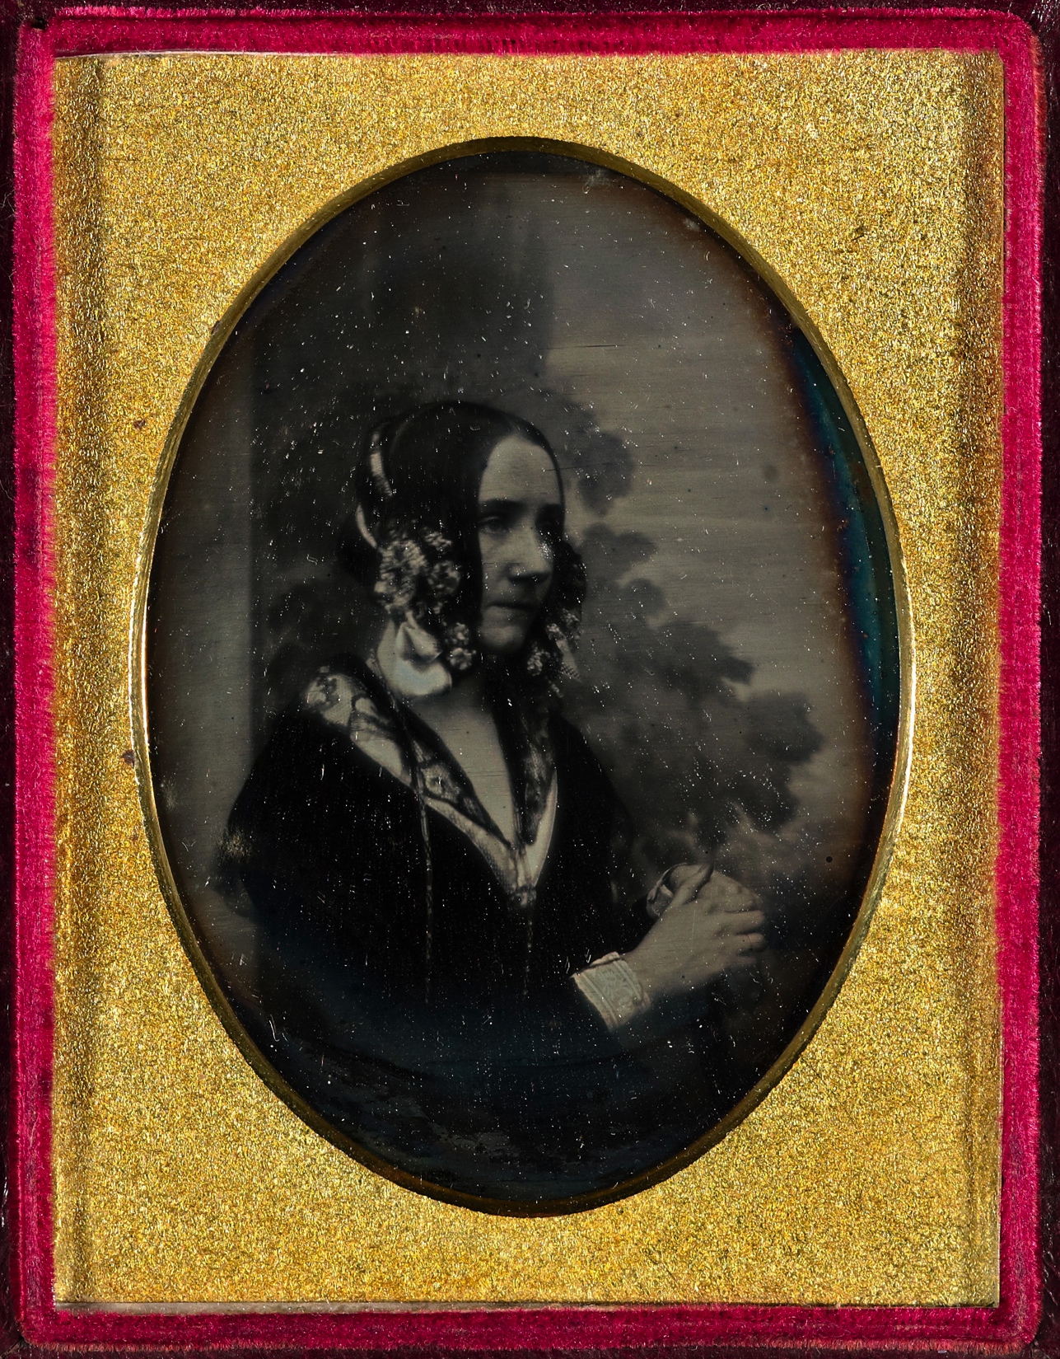
The scientific life of Ada Lovelace 1815 – 1852

Slide 2
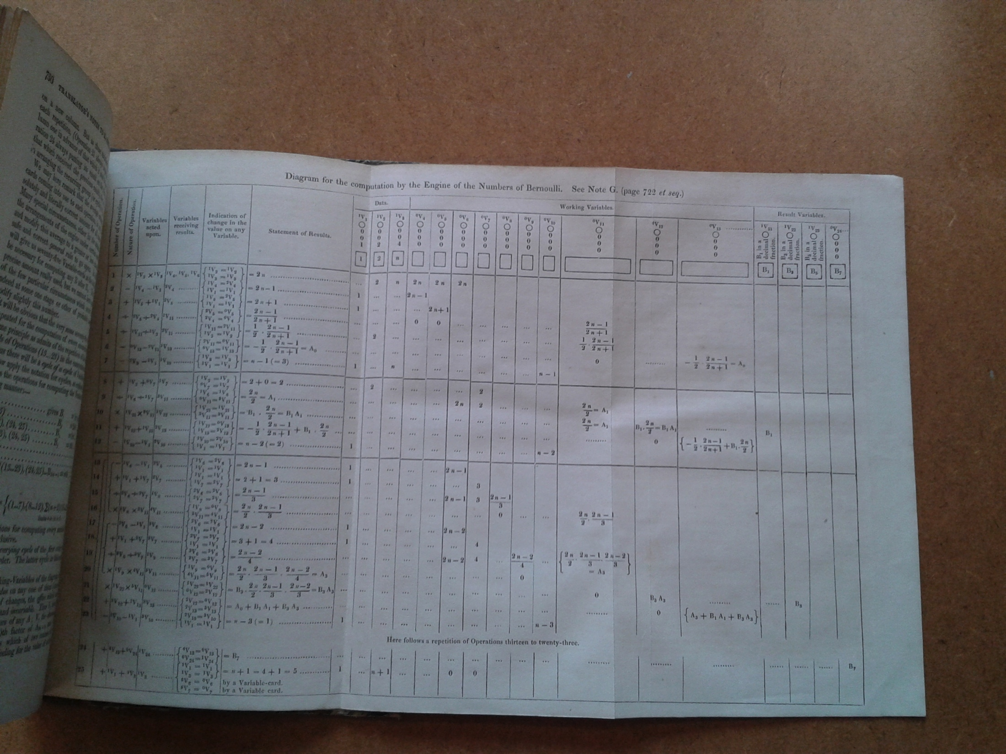
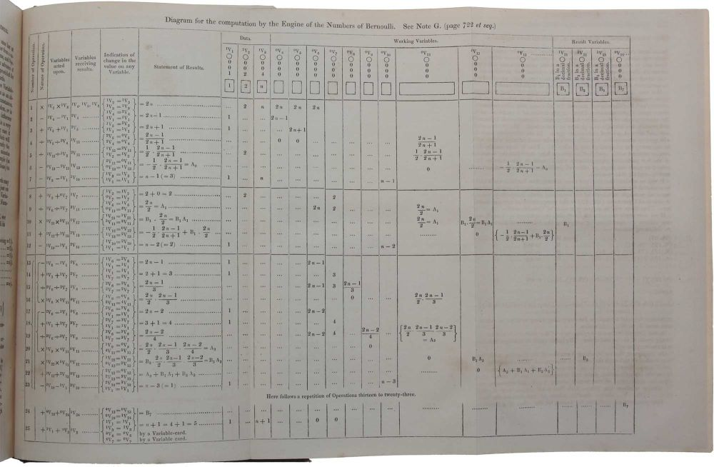

Slide 3
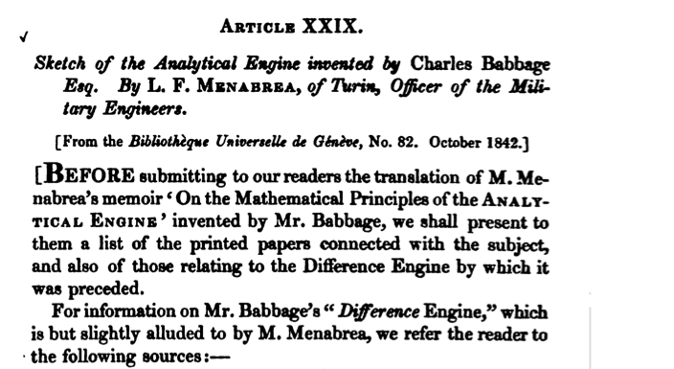
“Sketch of the Analytical Engine invented by Charles Babbage, Esq., by L. F. Menabrea, of Turin, Officer of the Military Engineers, Translation with Extensive Notes,” Taylor’s Scientific Memoirs III, Art. 29, 666-731, 1843

Slide 4
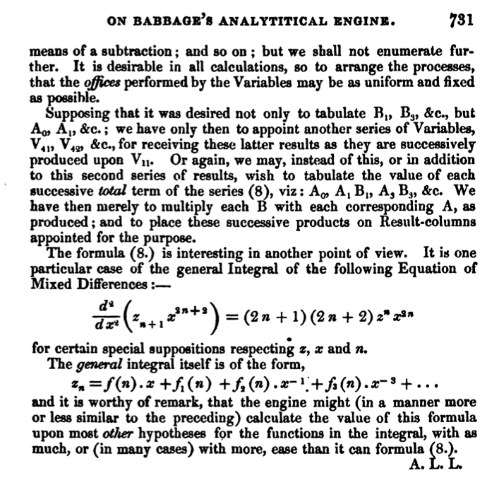
COMPUTER VISIONARY

Slide 6
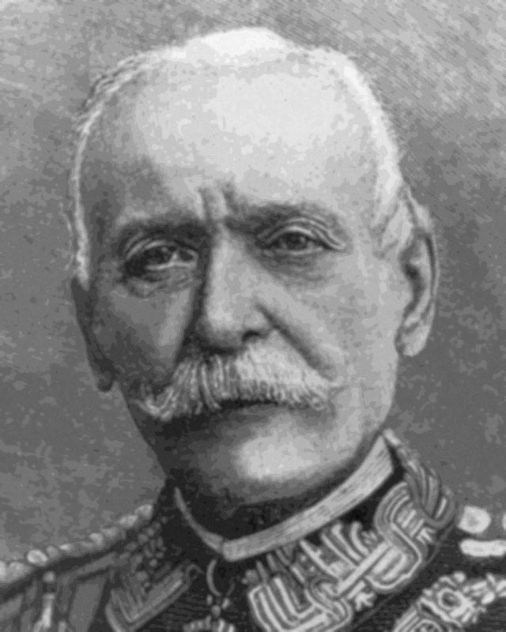
Charles Babbage 1791 - 1871 Federico Menabrea 1809 - 1896

Slide 7
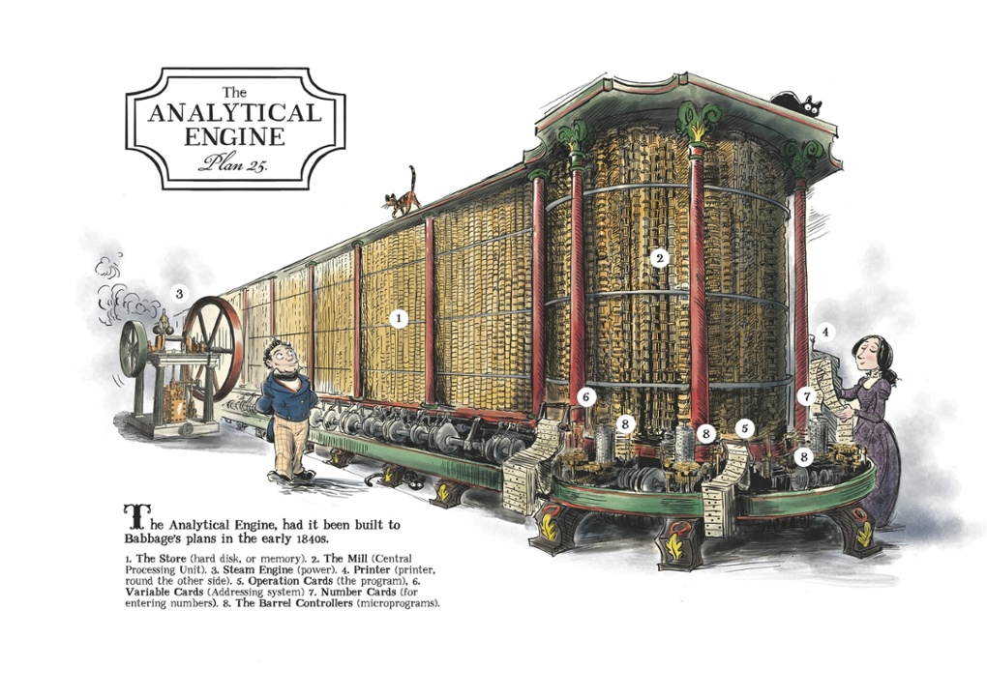

Slide 8
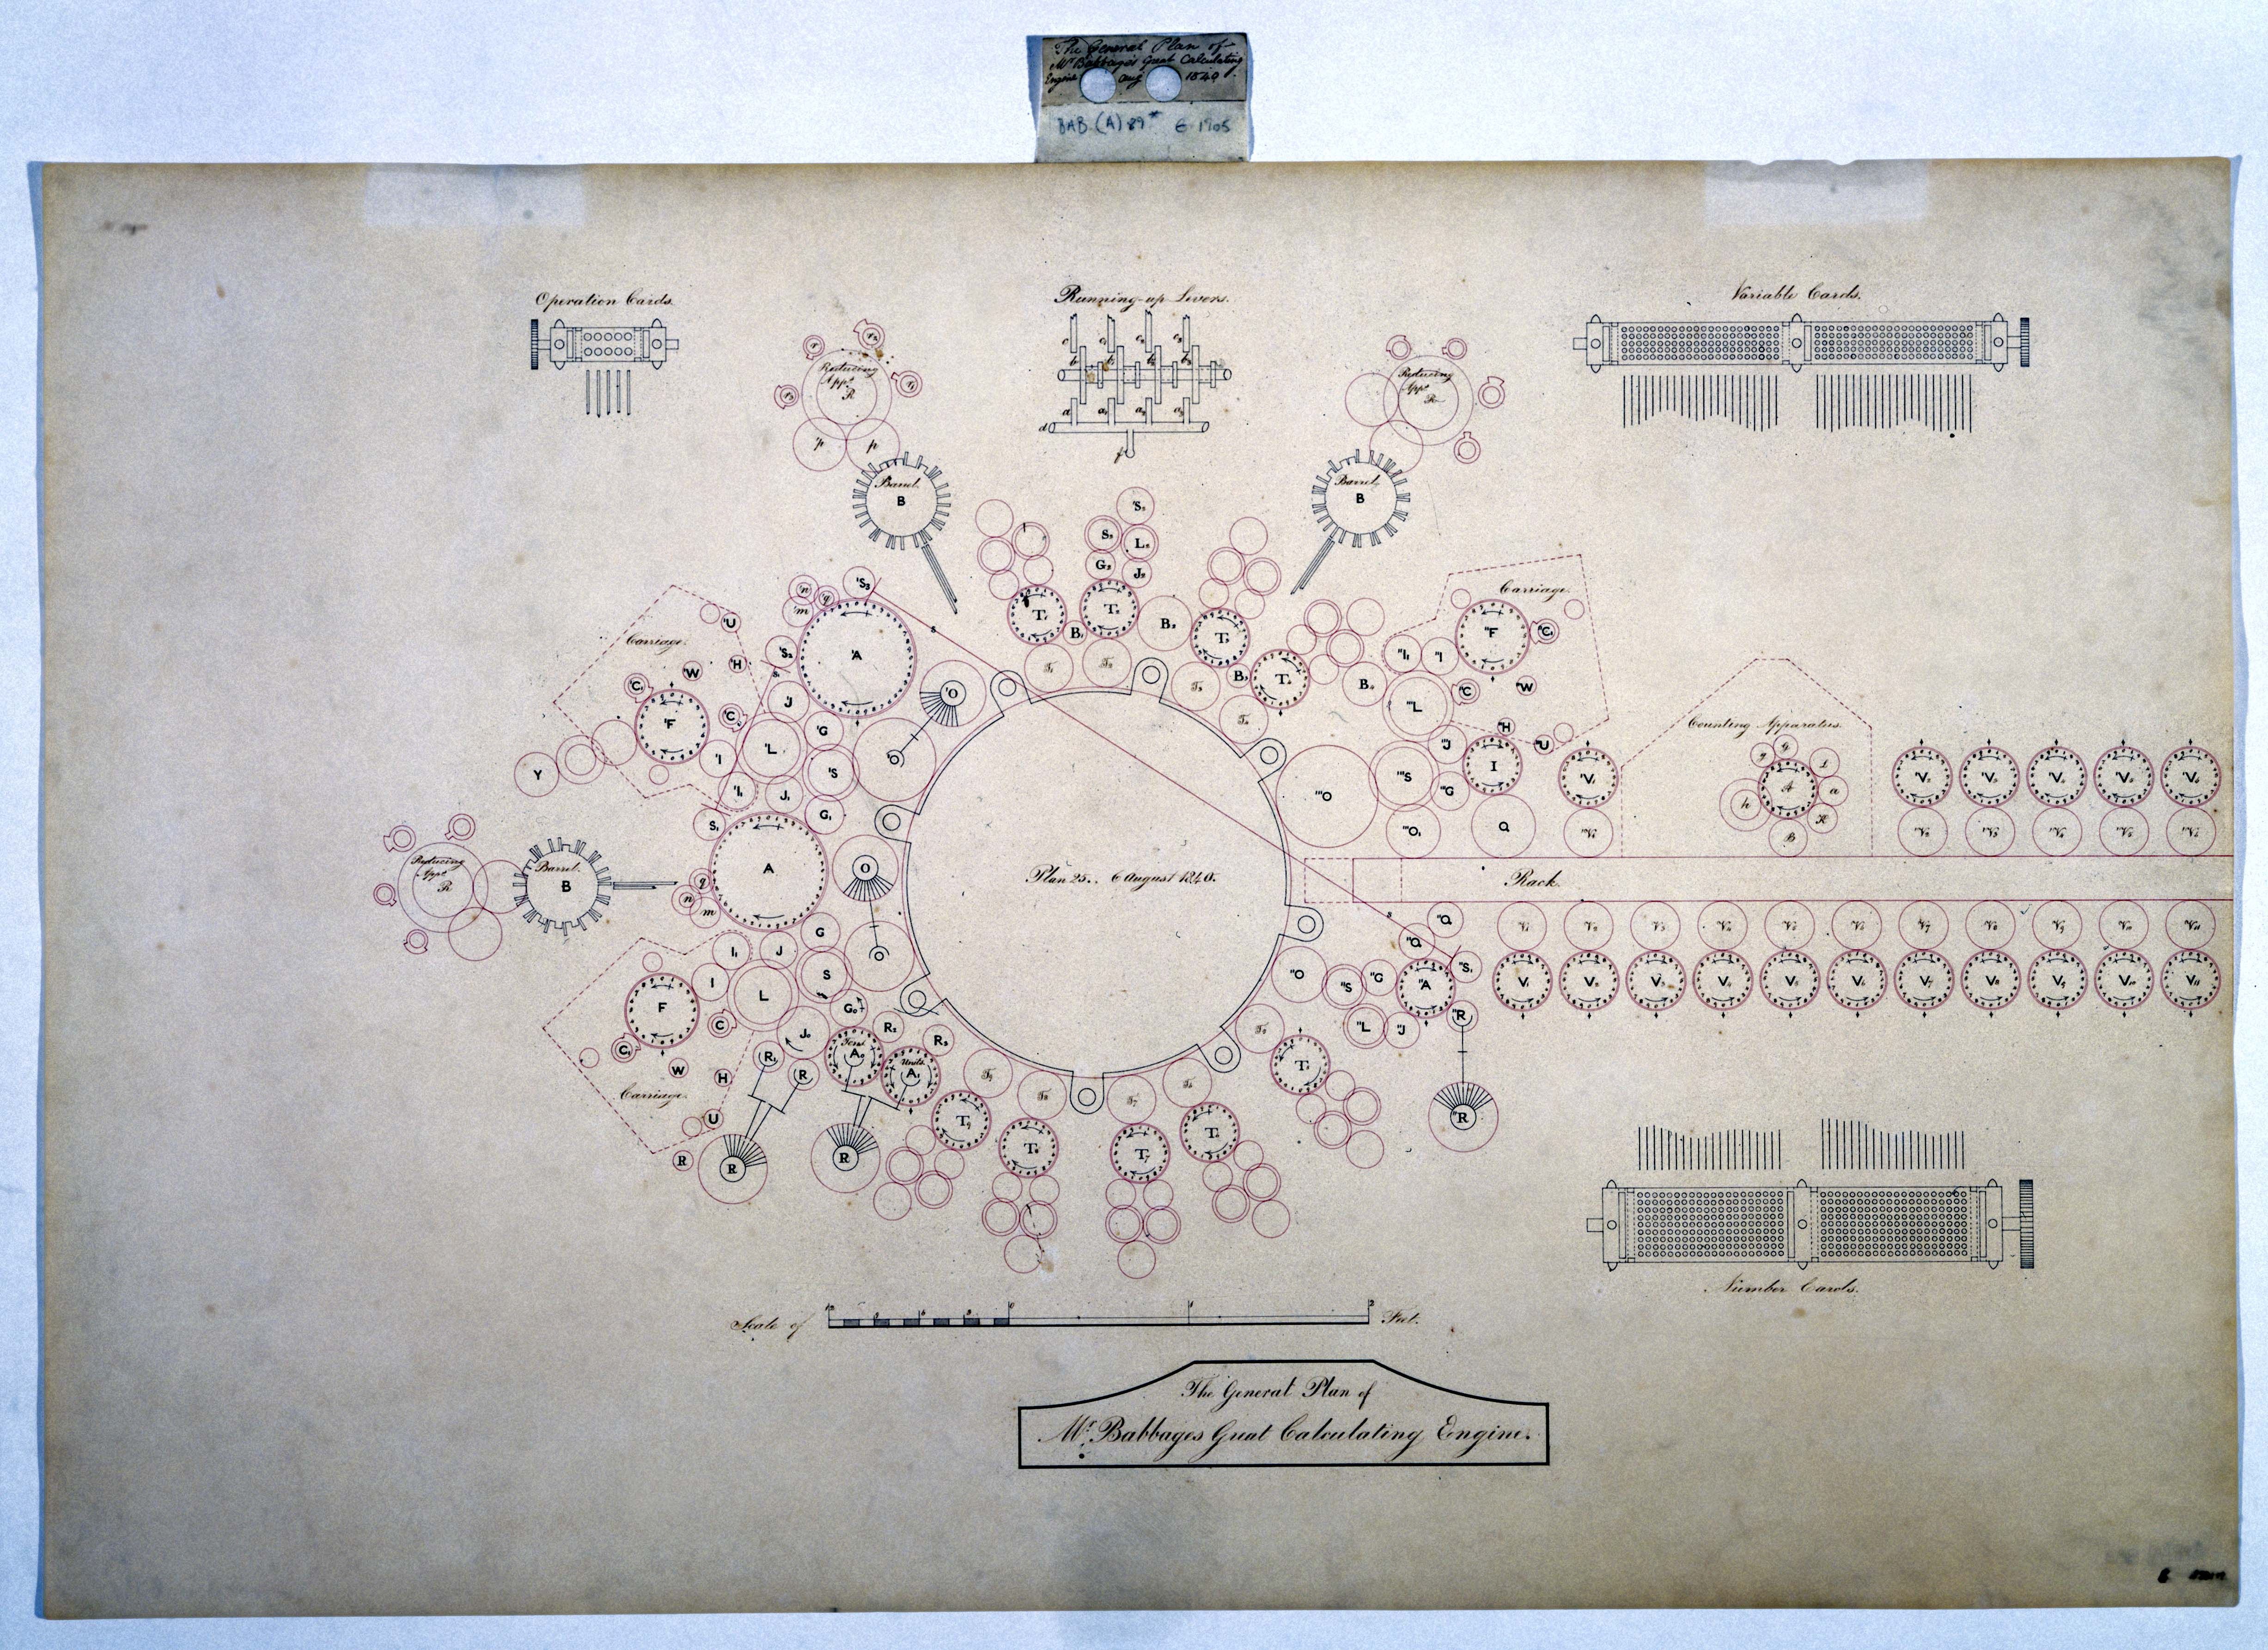

Slide 9
Difference engine
+, *, are operations
any sequence of operations is an operation.
any finite iteration of an operation is an operation
Calculated by methods of finite differences
Computes any primitive recursive function
Analytical engine
difference engine plus conditional branching
Computes any general recursive function
Hence Turing complete
Menabrea/Lovelace

Slide 11
To solve m x + n y = d m’ x + n’ y = d’ for x and y

Slide 12
To solve m x + n y = d m’ x + n’ y = d’ for x and y
the table presents a complete simultaneous view of all the successive changes which these columns severally pass through in order to perform the computation. AAL

Slide 13
Notes:
Babbage intended his computer to read and execute instructions one at a time from a deck of "operation cards." The famous table is not a specification for a card deck to compute the Bernoulli numbers. Instead, as Lovelace explained, it "presents a complete simultaneous view of all the successive changes" the various storage units of the Analytical Engine would "pass through" in computing the specific number B₇. When computing other Bernoulli numbers the engine would carry out different sequences of operations, leading to tables with more or fewer rows. The control logic to produce these variations is not present in the table itself. In modern terminology, the table might best be described as a trace of the machine's expected operation.
Considerable further work would be required to turn the calculation described by the table into a set of cards the Analytical Engine could read to calculate all the Bernoulli numbers. As well as the operation cards themselves, the control deck would have to include special cards to tell the machine when to "back up" the deck to repeat a sequence of operations. Babbage had not settled on a format for these cards, or even on a mechanism for reading backward. A separate deck of "variable cards" specifying the numbers to be operated on would also be needed, as an operation card could be reused at different stages of a calculation to process different data.

Slide 16
The complexity of programming “There are frequently several distinct sets of effects going on simultaneously; all in a manner independent of each other, and yet to a greater or less degree exercising a mutual influence.
Avoiding bugs “to perceive and trace them out with perfect correctness and success, entails difficulties whose nature partakes to a certain extent of those involved in every question where conditions are very numerous and inter-complicated”
Speeding things up “choose that arrangement which shall tend to reduce to a minimum the time necessary for completing the calculation”

Slide 17
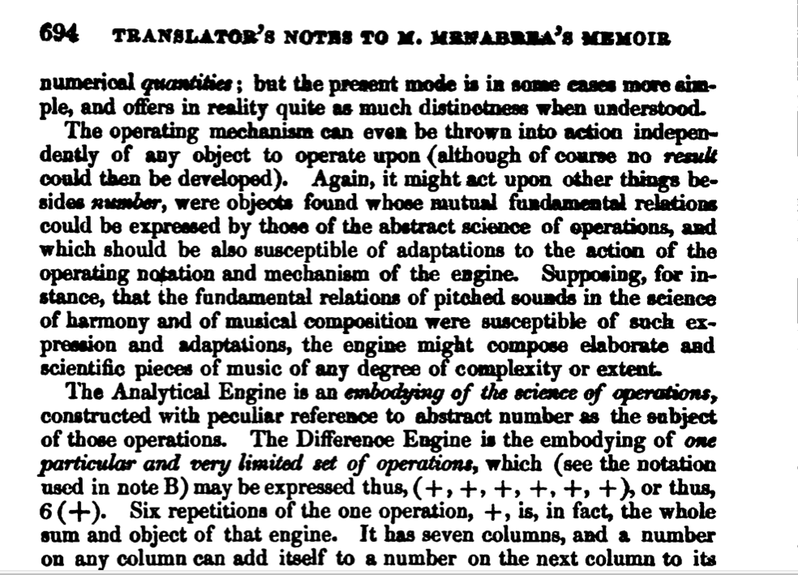

Slide 21
George Gordon, Lord Byron, 1788-1824
Annabella Milbanke, 1792-1860

Slide 22
G IMAGE OF AL as a child, portrait by D’Orsay, property of Somerville College

Slide 23
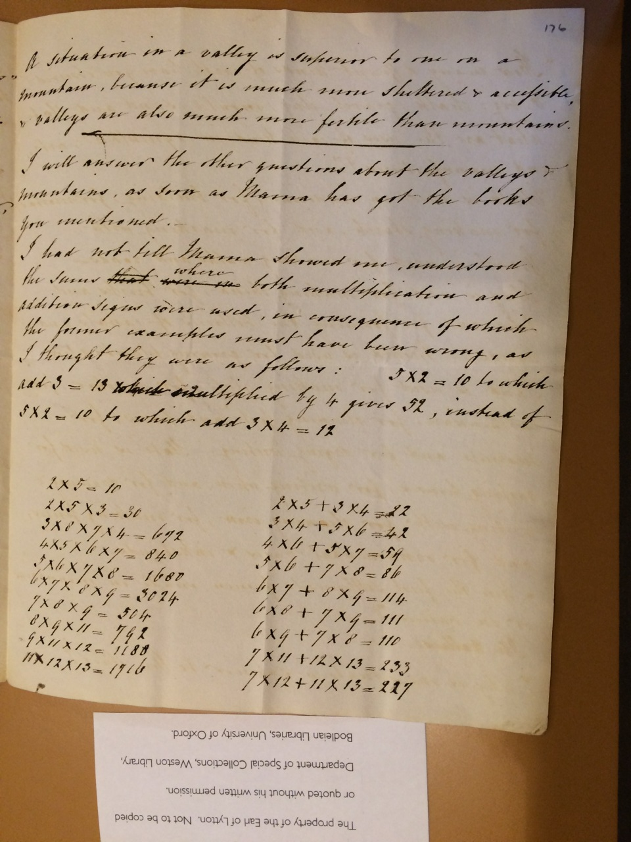

Slide 26
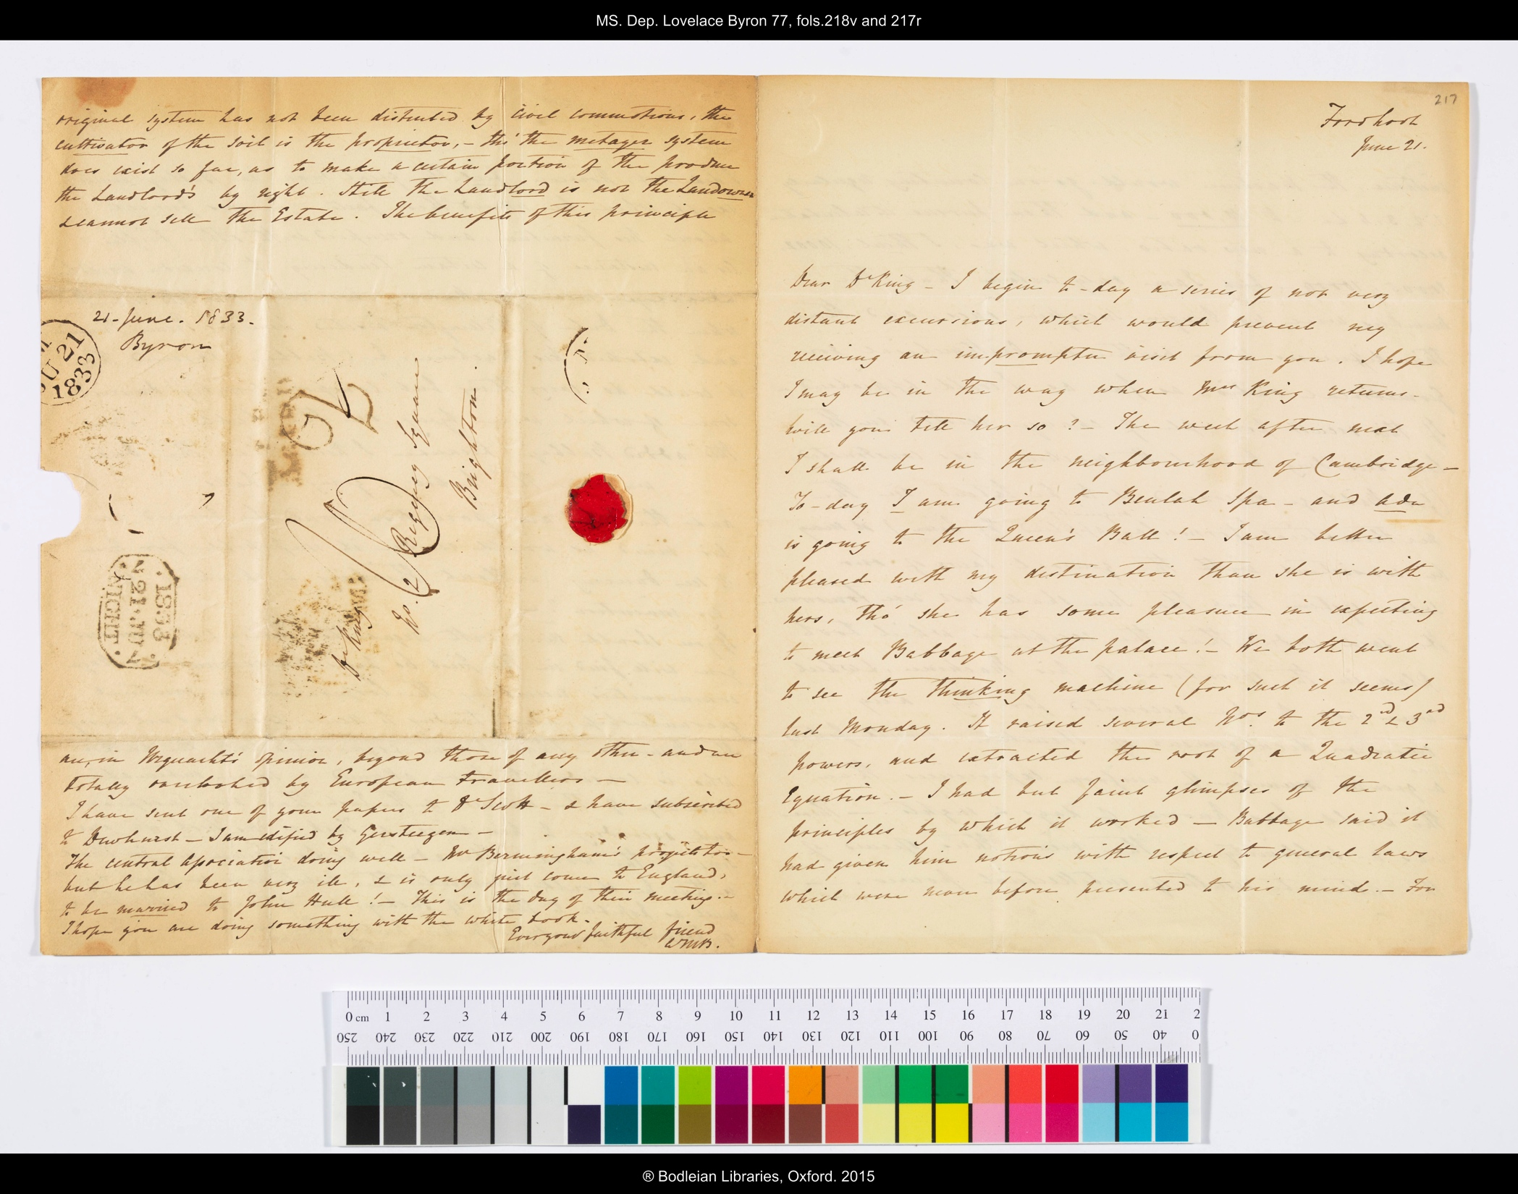
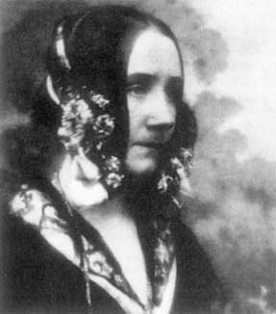
Ada, Countess of Lovelace 1815-1852

Slide 27
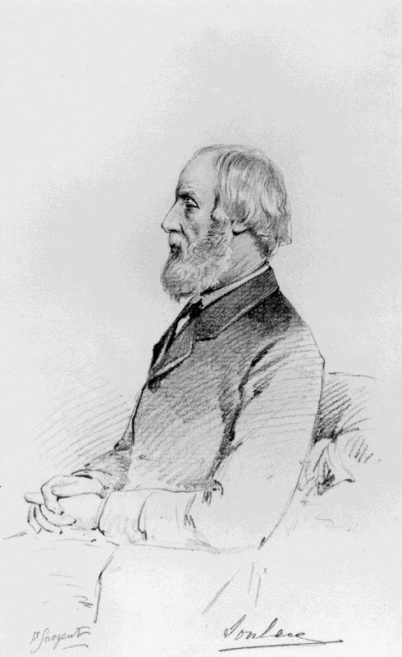

Slide 28
Augustus De Morgan 1806-1871 Had any young beginner, about to go to CambrIdge, shewn the same power, I should have prophesied first that his aptitude at grasping the strong points and the real difficulties of first principles would have very much lowered his chance of being senior wrangler, secondly, that they would have certainly made him an original mathematical investigator, perhaps of first rate eminence … ``

Slide 30
Augustus De Morgan 1806-1871 Had any young beginner, about to go to CambrIdge, shewn the same power, I should have prophesied first that his aptitude at grasping the strong points and the real difficulties of first principles would have very much lowered his chance of being senior wrangler, secondly, that they would have certainly made him an original mathematical investigator, perhaps of first rate eminence … ``

Slide 38
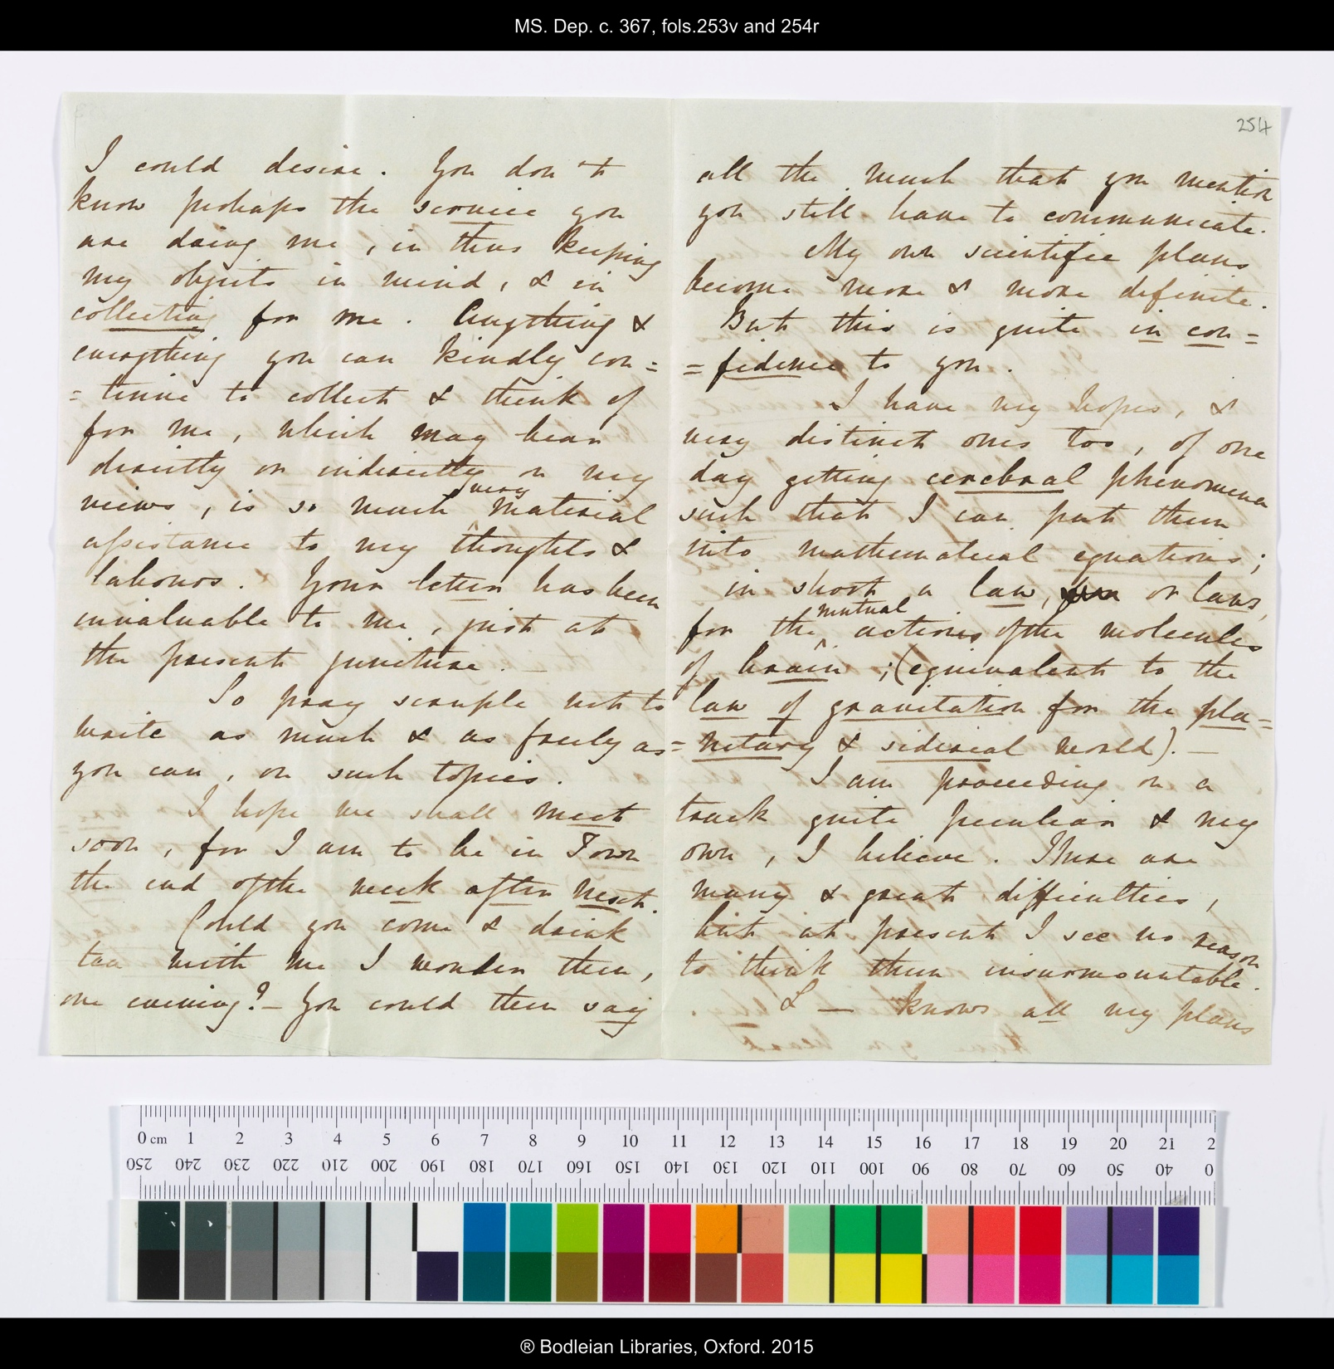
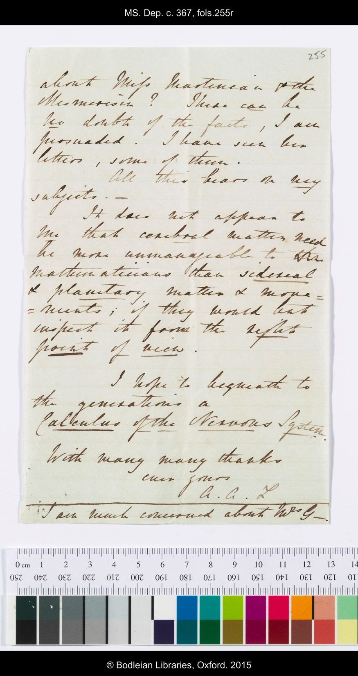

Slide 39
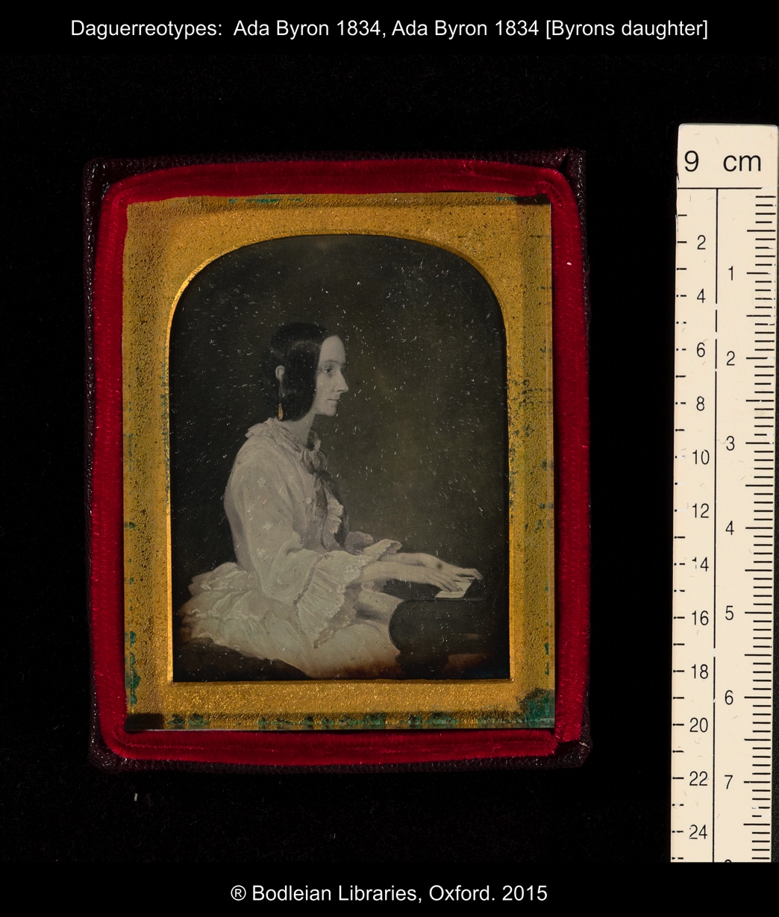

Slide 40
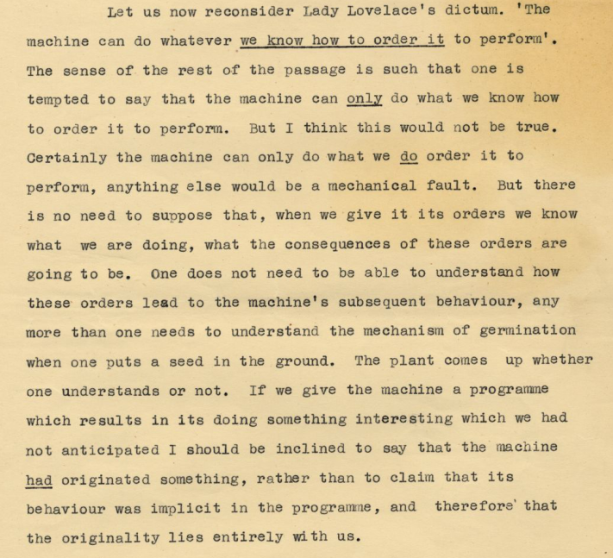
A M Turing, 'Can digital computers think?'.
BBC Third Programme, 15 May 1951.

Slide 42
We are accustomed to seeing pictures of sleekly streamlined modern electronic computers with similarly endowed, female operators poised at the controls. It is surprising then to find a book … starting off with a handsome, old-fashioned portrait of a nineteenth-century lady mathematician Bucholz, 1953
…had great difficulty getting beyond her probing "first queries" and acquiring a firm grasp of mathematical practice Stein 1985
… no evidence that Ada ever prepared a program for the Analytical Engine, but her correspondence with Babbage shows that she did not have the knowledge to do so. Bromley, 1990
.. no exaggeration to say that she was a manic depressive with the most amazing delusions about her own talents, and a rather shallow understanding of both Charles Babbage and the Analytical Engine. Collier, 1991

Slide 43
I believe myself to possess a most singular combination of qualities exactly fitted to make me pre-eminently a discoverer of the hidden realities of nature ...the belief has been forced upon me.... Ada Lovelace 1841
I suppose many hundreds & thousands of such formulae will come forth from my pen, in one way or another. AAL 1841
It is difficult for all of us to grasp a mind set that integrates Plato, and Aristotle, the world of poetry and science Betty Toole 2001
She foresaw our use of CDs for music. James Essinger 2014
If it wasn’t for Ada Lovelace, there’s a chance that none of this [Silicon Valley] would even exist Walter Isaacson 2014

Slide 44
Images in this presentation used by kind permission of Geoffrey Bond, Sydney Padua, Somerville College, and the descendants of Ada Lovelace

Slide 45
Ada Lovelace’s mathematical archive, 500 digitisations
and transcripts, to be released on line, December 2015,
by the Clay Mathematics Institute

