Slide 1
Suffer the little children: the gradual improvement in child health is leaving newborns behind.
Christopher Whitty
Gresham College 2015
Painting- Ian Richie RA, Madonna & Child

Slide 2
In Thomas Gresham’s day infancy was very perilous. In London around one quarter would perish before their first birthday.
The Cholmondeley Ladies, C1600-1610. Tate.

Slide 3
“Africa is experiencing some of the biggest falls in child mortality ever seen, anywhere.” (Economist 2012)
In Africa, Asia and Latin America incidence of many major infectious diseases falling fast over the last decade.
Economic growth, but also a bold vision, generosity and well targeted science.

Slide 4
Under 5 child mortality rate Asia / 1000

Slide 5
Causes of childhood deaths, Africa 2010 (Liu et al 2012)

Slide 6
The proportion of deaths in the first 28 days increasing. Childhood deaths South Asia (Liu/CHERG 2012)

Slide 7
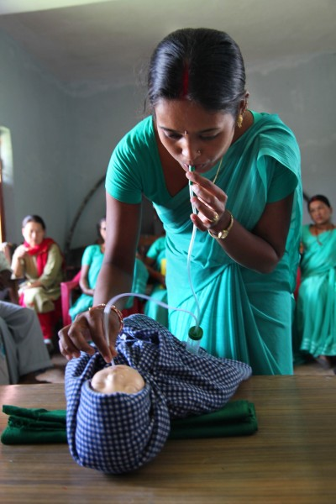
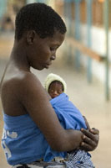
Neonatal mortality rates / 1000 live births. UNICEF 2015.
Japan 1.0
Finland 1.3
UK 2.8
USA 4.0
China 7.7
Brazil 8.4
Nepal 23
India 29
Afghanistan 36
Nigeria 37
Pakistan 42
Angola 46
SCF/WHO. Nepal/ Malawi

Slide 8
Global burden of neonatal deaths

Slide 9
Decline in neonatal and child mortality 1990-2013 (UNICEF 2015, percentage decline)

Slide 10
Change in neonatal mortality rate 1990-2009 (CHERG, PLOS 2011)

Slide 11
Your birth day the most dangerous day of your life: more than 1/3rd neonatal deaths. 73% in first week.
Mortality by day after birth (UNICEF)
Reduction in first day neonatal mortality- UK and USA

Slide 12
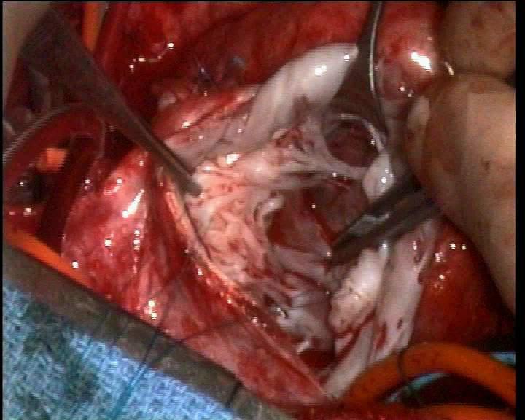
It is often popularly imagined large advances in neonatal mortality need large resources.
Remarkable advances in neonatal care at the leading edge of medical science.
Operations in the uterus, congenital heart disease, genotyping.
The great majority of the achievable advances globally are simple, cheap, available, proven.
Martin Elliott, Gresham Professor of Physic

Slide 13
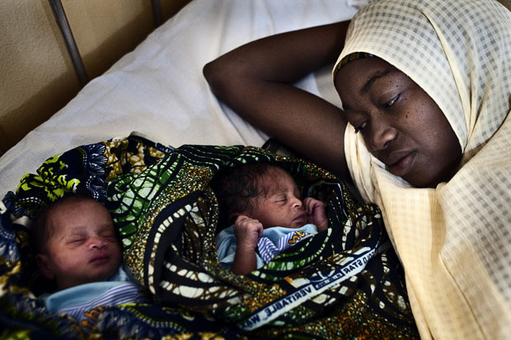
Multiple points we can intervene
Before conception.
Ante-natal care.
Premature babies.
At birth and resuscitation.
Post-natal care.
Many small incremental steps = big overall effects.
(photo credit Royal Prince Albert Hospital, Sydney
Pep Bonet / Noor/telegraph.co.uk)

Slide 14
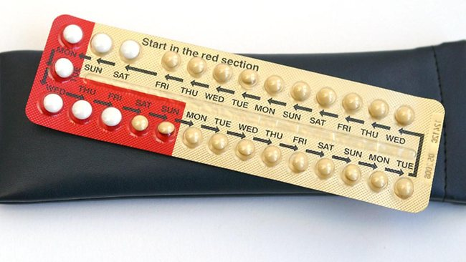
Contraception and birth spacing
Short inter-pregnancy intervals increase:
-maternal anaemia (32%)
-uterine rupture (3x)
-stillbirths (42%)
-prematurity

Slide 15
Pre-conception folic acid
Neural tube defects- anencephaly, encephalocoele, spina bifida.
Primary prevention- 46-62% reduction if fortification of food or supplementation.
Secondary prevention in previous NTD 70% reduction.
In low-income countries 29% of neonatal deaths due to congenital causes NTD, folic acid could reduce deaths by 13%.
(Blencowe et al)
Archiv fur Anatomie… 1839

Slide 16
Prevent neonatal tetanus
A terrible disease.
Immunization of pregnant women or women of childbearing age with at least two doses of tetanus toxoid reduces mortality from neonatal tetanus by 94%.
(Blencowe et al)
Painting- Sir Charles Bell

Slide 17
Maternal immunisation and neonatal tetanus. (M. Roper et al Lancet)

Slide 18
35 countries have eliminated neonatal tetanus since 2000 (WHO, data to mid 2014)

Slide 19
Maternal syphilis, stillbirth and neonatal mortality.
Around 1.4 million pregnant women globally estimated to have syphilis; of these, 80% had attended ANC.
Globally, around 521,000 adverse outcomes caused by maternal syphilis: approximately
212,000 stillbirths or foetal deaths
92,000 neonatal deaths
65,000 preterm or low birth weight infants.
Approximately 66% of adverse outcomes occurred in ANC attendees who were not tested or were not treated for syphilis.
(Newman et al 2013)

Slide 20
Syphilis can easily be detected, and treated.
“the number of [UK] persons ..infected with syphilis… cannot fall below 10% in the large cities” (Royal Commission on Venereal Disease 1913-16)
New point-of-care tests.
Treatment highly effective with penicillin- if early enough.
Very cost-effective.

Slide 21
Antenatal syphilis prevalence rates Fetal loss/stillbirth 21%, neonatal deaths 9.3% higher.
(Gomez et al, Newman et al)

Slide 22
The inverted pyramid of care- eg neonatal syphilis (after Schmid, Bull WHO)

Slide 23
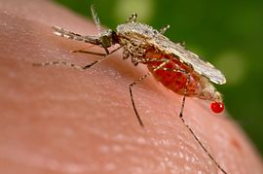
Malaria in pregnancy
In high malaria transmission areas the placenta usually gets infected.
This leads to small-for-dates babies, as well as maternal anaemia.
Intermittent antimalarials reduce low birthweight by around 27%.
Bednets reduce further.
(Radeva-Petrova D et al 2014)

Slide 24
Prematurity (<36 weeks)
Around 27% of all neonatal deaths- 1 million.
Dominant cause in high income countries.
In low-income smaller proportion, but about 6x higher mortality.
About 1.5 per 1000 births Europe, 10 per 1000 Africa.
St. Thomas’ neonatal unit

Slide 25
Steroids in preterm labour
In babies born at <36 weeks:
- steroids reduce mortality by 31% (since 1990s)
-in middle-income countries reduce mortality by 53%, morbidity by 37%
-coverage around 10% in countries with >90% of neonatal deaths
(Mwansa-Kambafwile et al 2010, Crowley et al 1990)

Slide 26
Magnesium sulphate (Epsom salts)
Prevention and treatment of seizures in women with eclampsia.
Foetal neuroprotection (reducing cerebral palsy) before anticipated early preterm.

Slide 27
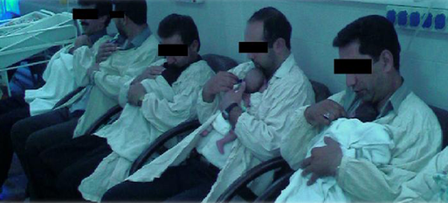
Kangaroo care in premature babies
Reduces mortality by around 50%.
Also reduces serious morbidity (RR 0.34).
(Lawn et al 2010. credits- Save the Children Nigeria, Iranian Hospital Dubai)

Slide 28
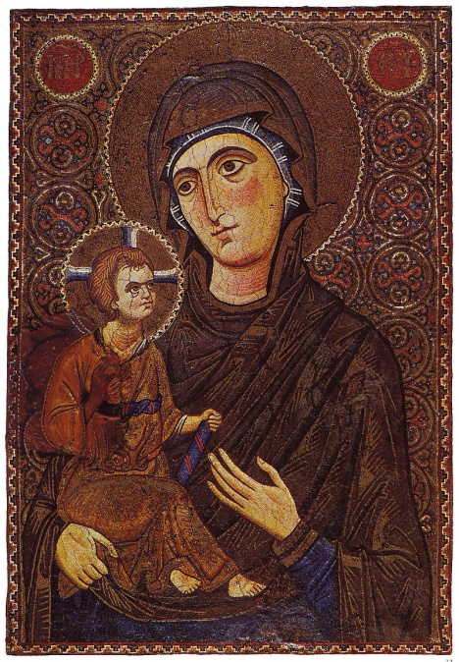
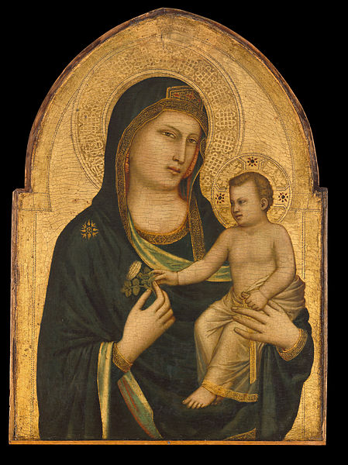
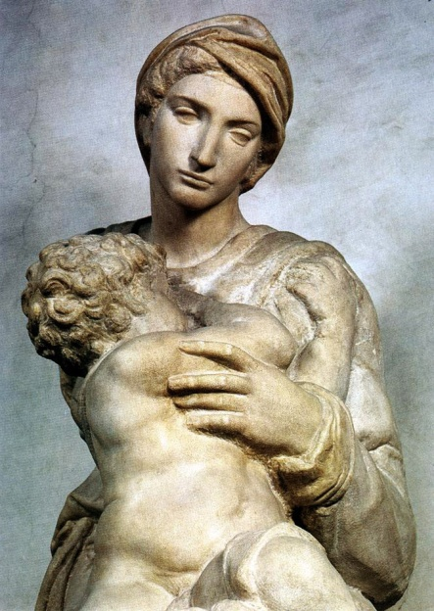
You think its natural… Mt. Sinai mosaic, Giotto, Michelangelo, Leonardo, Raphael, Marianne Stokes.

Slide 29
Cord care.
Clean birth kits and care essential- including reducing tetanus and neonatal sepsis.
23% reduction in neonatal mortality with chlorhexidine antiseptic.
Possible advantage to delayed (1-5 min) cord clamping.
(Imdad et al, McDonald et al, Cochrane reviews)
Haik project

Slide 30
Caesarean section and other birth interventions.
Caesarean section ancient.
CS probably the commonest surgical procedure in Africa.
CS reduces neonatal mortality in term breech.
Vacuum extraction probably superseded forceps.
Anaesthesia important- in Malawi neonatal mortality significantly lower with spinal than general anaesthetic; ketamine much higher (Fenton et al).
Al-Athār al-Bāqiyah `an al-Qurūn al-Khāliyah C 1040 CE

Slide 31
Helping newborns breathe.
Of 136 million babies born annually, around 10m require assistance to breathe.
814,000 neonatal deaths result from intrapartum-related events in term babies (previously “birth asphyxia”).
(Lee et al 2011)
WHO WPRO

Slide 32
The great majority of newborns need only simple resuscitation. (A Lee et al BMC 2011)

Slide 33
Simple neonatal resuscitation.
Neonatal resuscitation training in facilities reduces term intrapartum-related deaths by 30%.
Immediate newborn assessment and stimulation would reduce both intrapartum-related and preterm deaths by 10%.
Facility-based resuscitation would prevent a further 10% of preterm deaths.
Community-based resuscitation would prevent further 20% of intrapartum-related and 5% of preterm deaths.
(Lee et al 2011)
Basic resuscitation: airways clearing, head positioning, bag-and-mask.

Slide 34
Treatment of infections
Neonatal pneumonia common, meningitis not rare.
All-cause reduction in mortality 25% with oral antibiotics and around 40% for pneumonia-specific mortality.
Injectable antibiotics significantly better than oral.
The difficulty is often diagnosis.

Slide 35
Not just mortality, but also child development
Seale et al.

Slide 36
Its not all about adding. Many useless or dangerous things are traditional, and should stop.
Enemas and shavings.
Fluid and food intake restriction.
Routine intravenous fluids.
Early bathing.
Routine separation from mother.
Fundal pressure to facilitate second stage labour.
Routine suctioning
Application of various substances to the cord.
Pre-lacteals, artificial infant milk formula, other breast-milk substitutes.
International mother and baby initiative

Slide 37
Simple interventions that combined would significantly reduce neonatal mortality and morbidity.
Before birth
Contraception
Folic acid
Stop smoking
Tetanus immunisation
Syphilis test and treat
Malaria prevention
Magnesium sulphate*
Steroids in prematurity*
At or after birth
Kangaroo care*
Cord care
Better CS anaesthetics
Basic resuscitation
Treatment of infection
*= in prematurity

Slide 38
Why are we not doing better?
Evidence is good.
Policy is generally sensible.
BUT- changing practice and health system strengthening difficult and slow.
Spotting high-risk births and prematurity.
Funding.
Some evidence incentives work- eg Plan Nacer payment for results Argentina.

Slide 39
Annually around 6,000 children and young adults <20 years die in the UK. Most of those deaths happen in infants under 1 year. (Royal College of Paediatrics. 2012 data.)

Slide 40
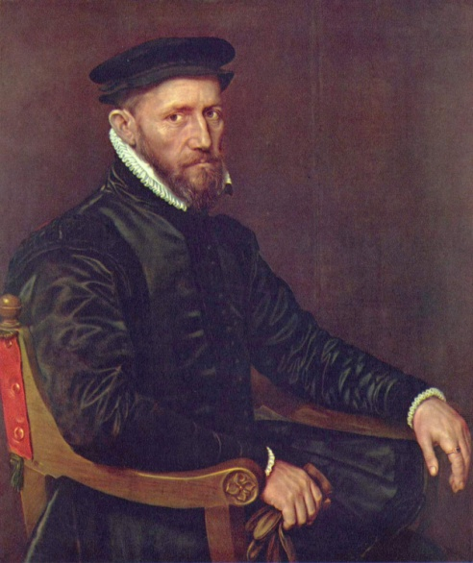
Infant mortality in London and UK since Gresham College founded. (Romola Davenport, unpublished)

Slide 41
20 years of infant mortality England and Wales (ONS 2015)
2,686 infant deaths in 2013.
Infant mortality rate 3.8 deaths / 1,000 live births. In 1983 the rate was 10.1, a 62% fall.
The neonatal mortality rate fell by 54%, from 5.9/1,000 in 1983, to 2.7/1,000 live births in 2013.
The postneonatal mortality rate fell by 72% over the same period, from 4.3/1,000 live births in 1983, to 1.2 in 2013.

Slide 42
Infant mortality rates- OECD (CDC 2014)

Slide 43
United Kingdom neonatal mortality since 1970 (ONS)

Slide 44
Known risk factors in the UK: prematurity
Around 2/3rds of infant deaths in the UK in babies <37 weeks.
More likely if mother:
-unusually young or old
-smoked in pregnancy
UK has some of the highest rates with 26% of women smoking shortly before pregnancy, 12% during pregnancy: Sweden 6.5% of women smoke at the beginning of pregnancy and 4.9% by the time the baby is due.
-materially disadvantaged

Slide 45
Infant mortality by socioeconomic background (England and Wales) (ONS 2011 data)

Slide 46
Infant mortality London. Socioeconomic status is not all.

Slide 47
UK neonatal mortality: multiple births (ONS 2015)
Neonatal mortality rate for multiple births almost 6x higher than for singletons.
13.8 deaths per 1,000 live births compared with 2.4 deaths per 1,000 live births.

Slide 48
Some risk factors will increase
Obesity- a risk factor for eclampsia, diabetes and indirectly prematurity.
‘High risk’ women surviving to childbearing age- and having children. For example congenital heart disease.

Slide 49
Potential advances include:
Non-Invasive Prenatal Testing (NIPT).
Near-patient rapid tests.
Risk stratification- making low-risk pregnancy non-medical.
Drug companies becoming less risk-averse in pregnancy allowing for disease-modifying drugs.
Stage | Obstetric | Cardiovascular
Preclinical | 3 | 303
Phase 1 | 5 | 104
Phase 2 | 5 | 163
Phase 3 | 3 | 73
Pre-registration | 1 | 17
Total | 17 | 660
Fisk & Atun.
Drug pipeline. PLOS Med.
(39x)

Slide 50
Improving health at the extremes of life- two of the great challenges for our generation.
We have the tools for major reductions in global neonatal mortality.
Once achieved it is largely irreversible.

