Slide 1
THE PSYCHOLOGY OF DOING NOTHING
He who hesitates is lost.
(Proverb)
Fools rush in.
(Proverb)

Slide 2
DECISION AVOIDANCE
What is decision avoidance?
Why does it matter?
What forms does avoidance take?
What can we do to protect ourselves from harmful avoidance?
When is inaction the highest form of action?

Slide 3
A contradiction …
We tend to think of emotion as driving us to destruction.
Emotion can also restrain us in ways that work against our long term interests.

Slide 4
All end in tears?
Anticipated regret: emotions of the future in the present.
Comparing what is with what might have been.
People tend to make choices that reduce negative emotions

Slide 5
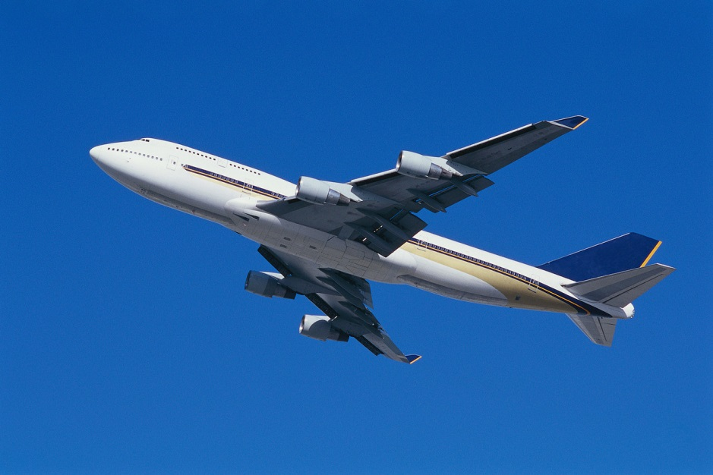
Which do you regret more?
Miss plane by 5 minutes?
Miss plane by 35 minutes?

Slide 6
FORMS OF AVOIDANCE
Discount the future
Procrastination
Omission
Delay choice
Status quo
Certainty
“Not broke”

Slide 7
DISCOUNTING THE FUTURE
Choose between:
£100, 000 now, or,
£120, 000 in a year’s time?
Attraction of discounting: instant gratification at expense of greater future benefit

Slide 8
PROCRASTINATION
To have an intention but fail to carry it out.
Attraction: temporary psychological shelter at the expense of deeper entanglement.

Slide 9
OMISSION
Reluctance to accept small risk or cost for a large benefit.
Mistakes of omission preferable to mistakes of commission.
Attraction: do no harm.

Slide 10
DELAY CHOICE
Seek easy way out that involves no action and/or no change
Demand more and more information
Buck passing
Tends to happen when all options are poor

Slide 11
STATUS QUO
Preference for the present over a more valuable future
Endowment effect – over-value what we have.
Preference for comfort zones

Slide 12
CERTAINTY
Choose between:
£500, 000 for sure, or,
50% chance to win £1 million or nothing at all?

Slide 13
Choose again….
£500, 000 for sure,
90% chance to win £1 million.

Slide 14
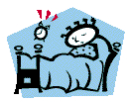
“Not broken”
Refusal to acknowledge emerging problems
Often takes a severe shock to force decision-makers to recognise reality a so called “wake-up” call.

Slide 15
AVOIDING COSTLY INACTION
How can we avoid costly inaction without falling into the opposite trap of recklessness?
Why worry about tomorrow when it may never come?
What should we do when there is too much information or where all options are dire?
When is wise to do nothing?

Slide 16
REMEDIES FOR COSTLY INACTION
Think ahead – the future has a habit of arriving.
Don’t agree to something just because it is distant.

Slide 17
Fix problems
while small,
better still – before they exist –
(the Ghost of Christmas Future).

Slide 18


Procrastination banished …
What exactly would success look like?
What needs to be done now?

Slide 19
Always do ….
what you are afraid to do. (Ralph Waldo Emerson)
Or, “Screw it: Let’s Do It” (Richard Branson)

Slide 20
Wish list….
Do it now ….

Slide 21
A journey of a 1,000 miles …

Slide 22
If a job is worth doing,
it is not always worth doing well.
(Tom Peters)

Slide 23
For sustained success
make a list of things you hate doing, and,
stop doing them.
(Tom Peters)

Slide 24
ULTIMATE SUCCESS
To care and not to care.
(T. S. Elliot)

Slide 25
Remedies for Omission
Calculate possible costs of inaction.
Do what you never expected to do.
Don’t be afraid to let unexpected events play out – “all success is by a winding stair” (Francis Bacon)

Slide 26
Remedies for temptation to delay
Is the decision really important?
(Many are not)

Slide 27
Intelligent Shortcuts
Ignore most information
For example:
flip a coin
“give me one good reason”
choose “least worst”
be guided by probability
reject choice

Slide 28
Remedies for Status Quo
Action this day. (Churchill)
The best time to plant a tree was twenty years ago. The next best time is now. (Anon)

Slide 29
Remedies for Risk Avoidance
Look for subtle signs of change. One falling leaf may signal autumn.

Slide 30
Remedies for risk avoidance
Be careful what value you put on what you already have – known as endowment.

Slide 31
When to Take Your Time
Some decisions don’t need to be made in a hurry.
Time brings clarity, allows emotions to cool and sets things in proportion.
Time may allow one party to grow their power.
Success happens because things coalesce in time

Slide 32
Patience ….
obtaineth all things.
(St Augustine)
Time unlocks every door.
(Chinese proverb)

Slide 33
But what is patience?
Merely that things are not a matter of time.
“Money flows from the impatient to the patient.” (Poker saying)
There is a difference between taking your time and being slow.

Slide 34
Above all
don’t reaction to everything that seems to demand a reaction.
Choosing not to do something me be as fateful as choosing to do something.
Retreat contains a nugget of aggression.

Slide 35
COMING SOON ….
“Knee deep in the big muddy.”
Escalation of Commitment

