Slide 1
The Gresham Lecture 2015
Dame Barbara Stocking
From Oxfam
to a Cambridge College

Slide 2
Oxfam
Working with others to overcome poverty and suffering
People
Over 5,000 staff in 53 poor countries
22,000 volunteers in shops
7,000 in summer for festivals, etc.
Income
Almost £370 million per year
About half from the British public
The rest from major institutions – DFID, UN etc

Slide 3
Humanitarian
Water, sanitation, public health, food security
Long Term Development
Agricultural production
Health, education
Campaigning
To change the rules of the world for poor people
Put poor women’s rights at the heart of what we do

Slide 4
Sudan: Water Tanks

Slide 5
Afghanistan

Slide 6
Iraq: Jameela selling incense

Slide 7
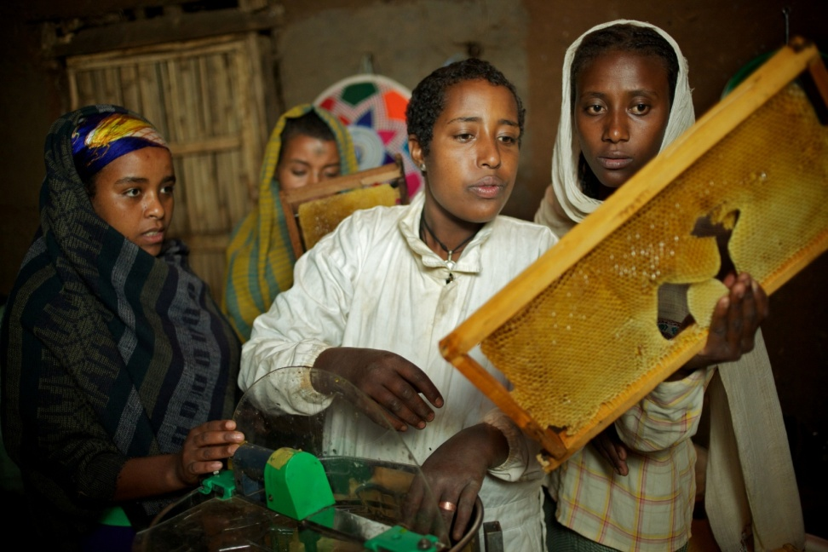
Aid vs Enterprise
Tanzania
Ethiopia – Honey Production

Slide 8
Access to Medicine

Slide 9
Uganda: Forced Eviction

Slide 10
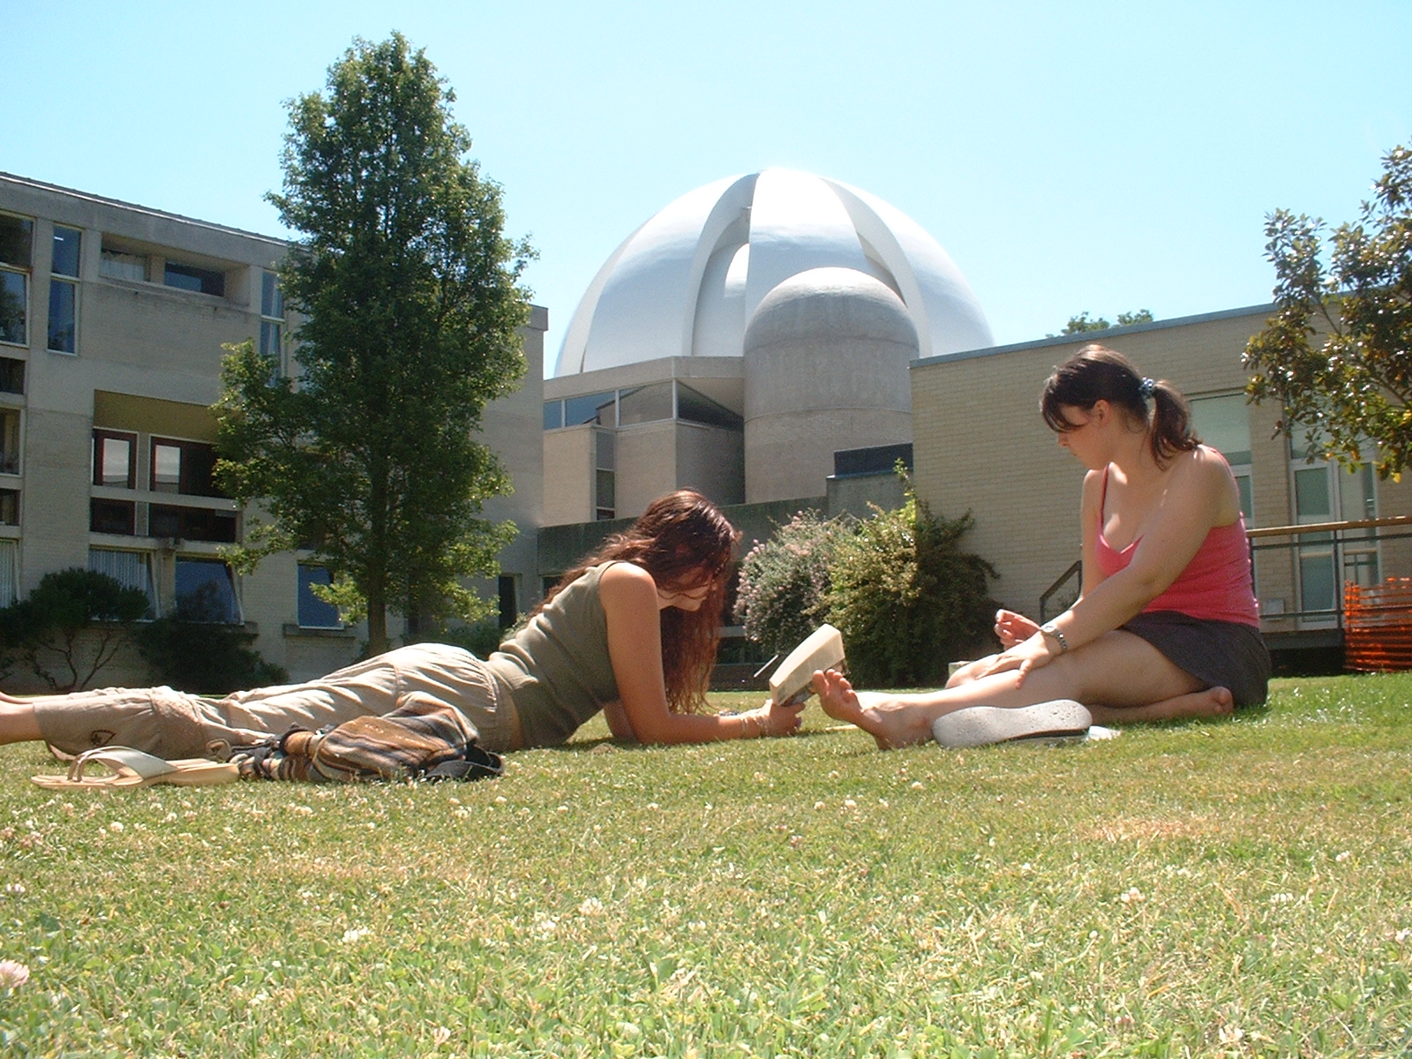

Slide 11
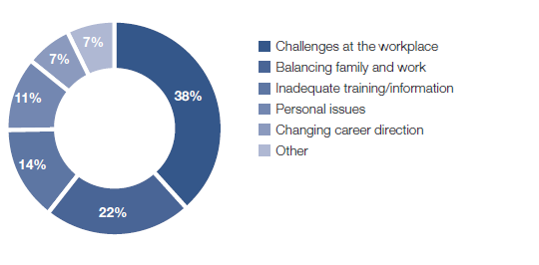
The Work Challenge

Slide 12
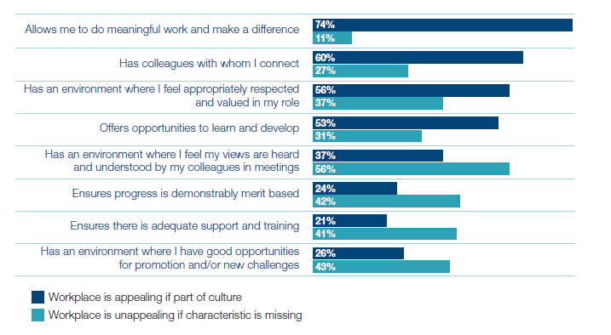
Appealing and Unappealing Work Places

Slide 13
What would help
Leadership coaching (62%)
Confidence building skills (60%)
Mentoring network (45%)
Life coaching (36%)

