Slide 3
How not to sign your name

Slide 4
Christopher Columbus signature, c. 1493

Slide 5
How to sign your name, 2014

Slide 6
‘A cursive rendition of the name’

Slide 7
Elvis’s own signatures

Slide 8
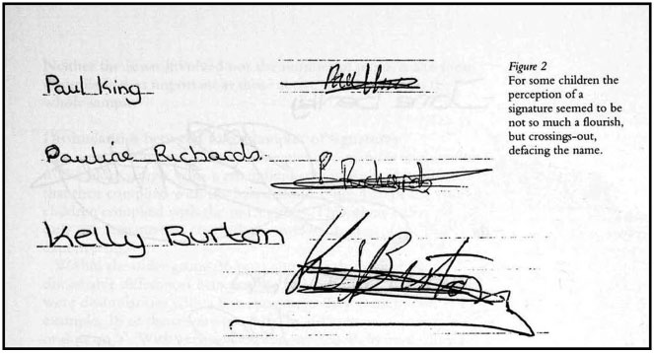
Children’s Signatures
(R. Sassoon, Art and Science of Handwriting)

Slide 9
Digital signature encryption path

Slide 10
William Penn Landing Marker

Slide 11
William Penn, ‘Turf & Twig’ statue (Newcastle, Delaware)

Slide 12
Charter of Richard III

Slide 13
Bronze seal, c. 1350

Slide 14
France: Royal notary’s paraphe 1479

Slide 15
Statute of Frauds, 1677

Slide 16
Hans Schneickert Bedeutung der Handschrift (1906)

Slide 17
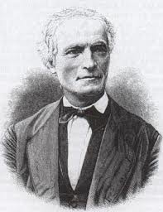
Jean-Hippolyte Michon Système de Graphologie (1875)

Slide 18
Ludwig Klages (1872-1956) Handschrift und Charakter (1917)

Slide 19
German graphology magazine, 1901

Slide 20
Moko signature of Tuhawaiki, New Zealand 1840

