Slide 1
Global distribution of Aedes aegypti Kraemer et al. eLife 2015

Slide 2
Aedes aegypti CDC Atlanta Georgia

Slide 3
Mosquito life cycle CDC Atlanta Georgia

Slide 4
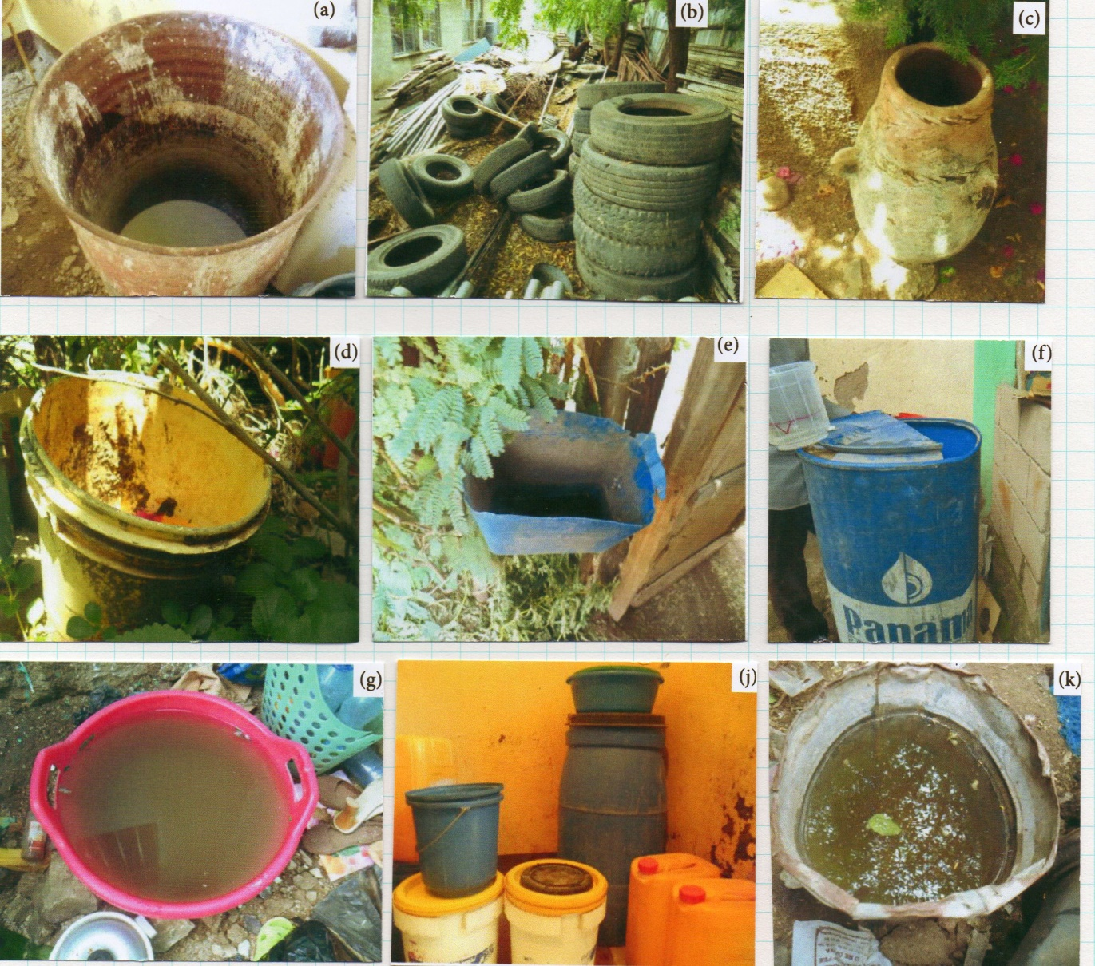
Some Aedes aegypti breeding places Dejene Getachew. Interdisciplinary Perspectives on Infectious Disease, 2015

Slide 5
Domestic mosquito breeding places (%)

Slide 6
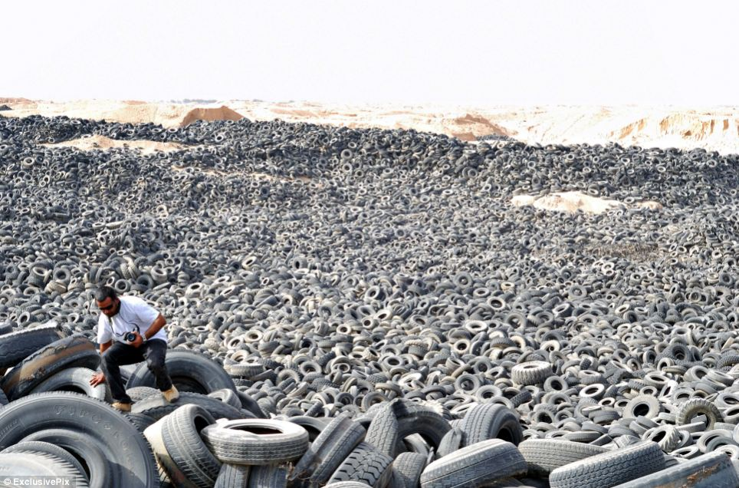

Slide 7
Mosquito life cycle CDC Atlanta Georgia

Slide 8
Aedes albopictus (Tiger mosquito) CDC Atlanta Georgia

Slide 9
Summer isotherm limitations for Aedes aegypti and A. albopictus
 | Aedes aegypti | Aedes albopictus
Temperature tolerance Field | 22.9-28.3⁰C | 17.0-23.7⁰C
Temperature tolerance Laboratory | 21.9-29.1⁰C | 22.3-29.5⁰C

Slide 10
Distribution of Aedes albopictus in Europe European Centre for Disease Prevention and Control in Europe

Slide 11
Distribution of Aedes aegypti in Europe European Centre for Disease Prevention and Control

Slide 12
Intervention methods Bowman et al. PLOS Neglected Tropical Diseases, 10, 2015

Slide 13
Public health intervention methods and control of dengue
Community managed clean up +++
Water covers +++
House screening +++
Insecticide fogging ++
Mosquito traps -
Larvicides -
I

Slide 14
Personal intervention methods and control of dengue
Indoor residual insecticides +
Bednets +
Knock down sprays +
Insecticide coils -
Repellents -

Slide 15
Mosquito warning poster in Singapore

Slide 16
Manipulation of male insects
Sterile males
Female to male conversion

Slide 17
Insect pathogens
Bacillus thuringiensis Bti
Wolbachia

Slide 18
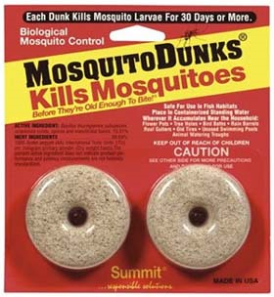
Bacillus thuringiensis (Bti)

Slide 19
Future problems
Spread of urbanization
Spread of farming
Deforestation
Encroachment on jungles
Lack of planning
Global travel
Ignorance
Political inaction and/or incompetence

