Slide 1
Picking Long-Term Discount Rates

Slide 2
agenda
views expressed are in no way endorsed by GAD
… or by UK actuarial profession - yet
critical points
higher returns DO reduce costs
possible forecasting approaches
actuary says market wrong - NOT
pricing simple financial contracts (Monte Carlo)
tentative conclusions

Slide 3
critical points
"two actuarial laws"
  don't know future (but must make assumptions)
    {when, which way, how far, how long}
  no such thing as free lunch over time
all the rest is merely commentary
very long-term can imply different restraints
  can't simultaneously aim "long" and "short"
"broadly right" better than "precisely wrong"
our answers should never just be scalars

Slide 4
higher returns DO reduce costs
Fund built-up from:
  contributions
  investment returns
Fund depleted by:
  benefits (plus premium payments and other expenses)
  investment returns
including discretion
this is reality … and so is volatility
accounting numbers are merely imaginary

Slide 5
simple financial contracts (1 of 6)
can we cope with simplicity in mark-to-market world?
new financial business, 2 single-premium contracts
  perpetuity (£1,000 pa in arrears) over 15 years
  pure endowment of £1,000 payable in 15 years
how much should basic cashflows cost?
expenses, profit and contingencies need to be added
10,000 random variables (fitted until end 2014)
  annual returns, spot yields and RPI inflation
  conventional gilts, Index-linked gilts and equities

Slide 6
simple financial contracts (2 of 6)
six asset portfolios
  CGs alone
  ILGs alone
  Equities alone
  Three 50:50 combinations
arbitrarily:
  CG discount rate is 1.25 times initial yield
  equ discount rate is 3.00 times initial yield
  ILG yield is initial yield + expected long inflation + 1% pa
first two multiples slightly lower than "reality"
… so we expect the fund to grow slightly too fast?

Slide 7
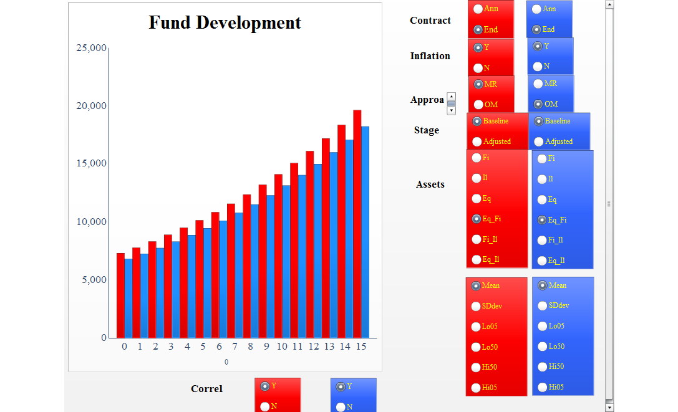
simple financial contracts (3 of 6)

Slide 8
simple financial contracts (4 of 6)
simplicity is harder than it looks
  technically known as Dolly Parton lemma
yes, fund did tend to run away
… implying that initial discount rate (price) was too low
OK, so what could/should we have done?
On next chart, in order, tabs are:
  correlYES
  correlDiff
  correlNOT
  correlSignificance

Slide 9
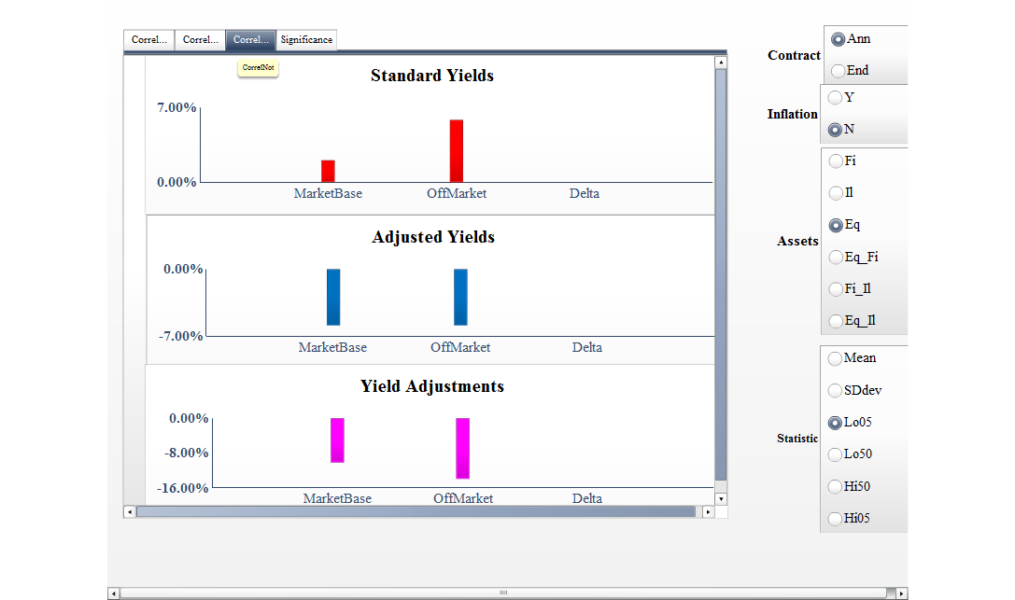
simple financial contracts (5 of 6)

Slide 10
simple financial contracts (6 of 6)
how could we even have guessed that in advance?
in DB pensions world, 1% pa difference is significant
  implying, say, 20% difference in capital
  at least £20 b (private sector) misallocated in UK
  personal estimate over 2009-2015

Slide 11
tentative conclusions
for prudence, one needs best estimate benchmark
  using bond yields alone may be imprudent
discount rates are
  simple
  readily available to anyone
  dangerous in wrong hands
maybe just discard discount rates for long-term projects?
more information on www,discrate.com
  soon to be updated
  to include all files used for these simulations

