Slide 1
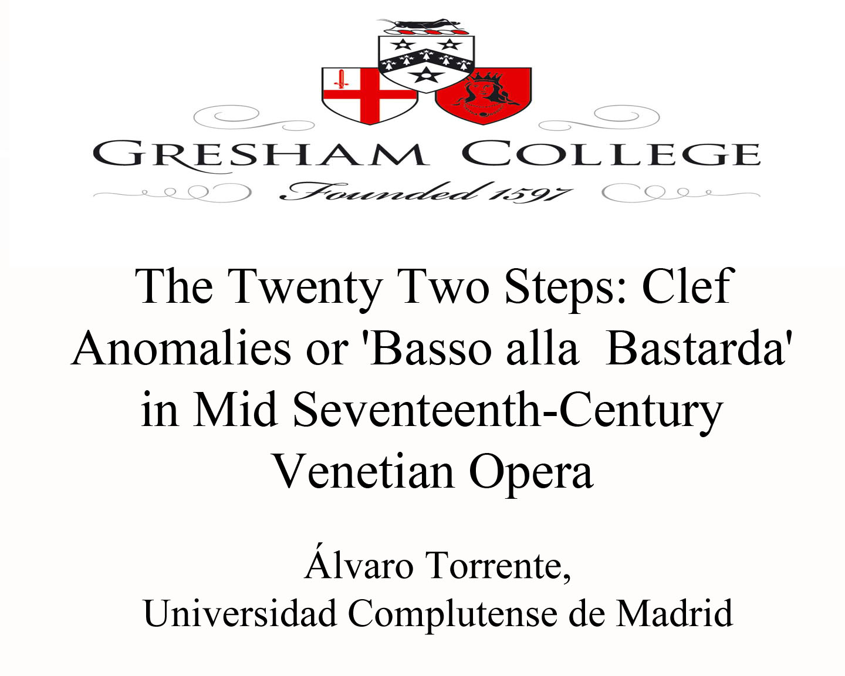

Slide 2
The twenty two steps Clef Anomalies or ‘Basso alla Bastarda’ in Mid Seventeenth-Century Italian Opera
Álvaro Torrente
Universidad Complutense de Madrid
Royal Holloway, University of London

Slide 3
The twenty two steps
A singer cannot claim “to be a real bass if he does not have a range of 22 notes from top to bottom with the same roundness of tone throughout”
Luigi Zenobi, Discorso sopra la musica (Napoli, ca. 1600), quoted from Richard Wistreich, Warrior, courtier, singer (Ashgate, 2007)
3

Slide 4
Eritrea: Theramene’s change of range
Act III, Scene 12; f. 92r
Alto
Act III, Scene 12; f. 93v
Baritone

Slide 5
Eritrea: Closing chorus

Slide 6
Orontea: Gelone’s change of range
Act I, Scene 6; f. 5v
Baritone
Act II, Scene 16; ff. 33v-34r
Alto

