Slide 1
Long Finance Spring Conference 2015
The Curious Case of Japan:
Why Macroeconomics Needs a Rethink

Slide 2
Agenda
14:30-15:00 Introduction – “The Study Of Money May Be The Root Of Much Madness” - Professor Michael Mainelli
15:00-15:35 Presentation – “The Curious Case of the Economist the West Forgot” - George Tait Edwards MBE
15:35-16:10 Presentation – “Rethinking - Lessons We Can Learn from the Success of the Japanese Growth System” - Professor Richard Werner
16:10-16:20 Break
16:20-17:00 Panel discussion – “Why Macroeconomics Needs A Rethink” - George Tait Edwards MBE, John Greenwood OBE, Chief Economist, INVESCO plc, Professor Richard Werner, University of Southampton
17:00-18:00 Reception

Slide 3
Introduction
“The Study Of Money May Be The Root Of Much Madness”
Professor Michael Mainelli
Executive Chairman, Z/Yen Group
Principal Advisor, Long Finance

Slide 4
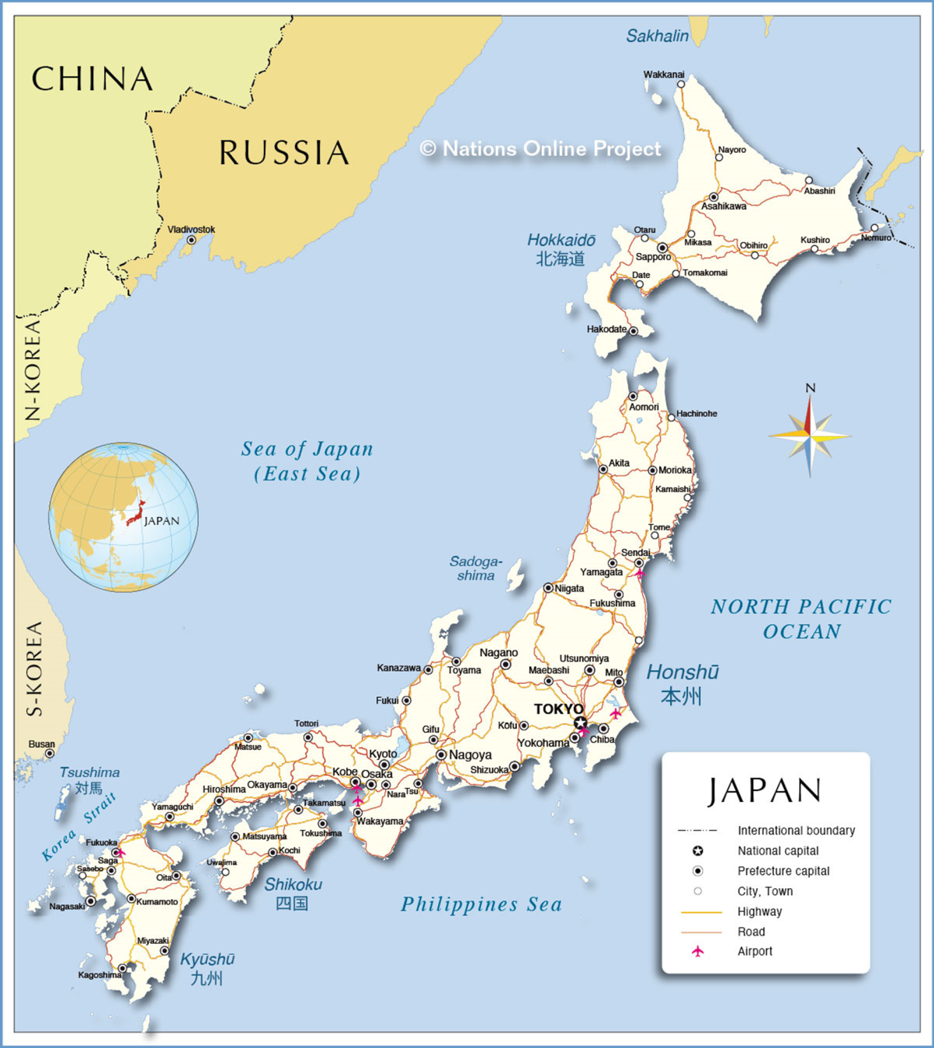
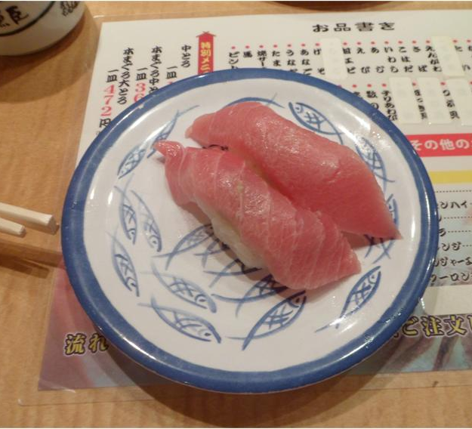
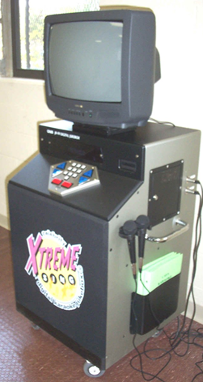
The Japanese Singularity

Slide 5
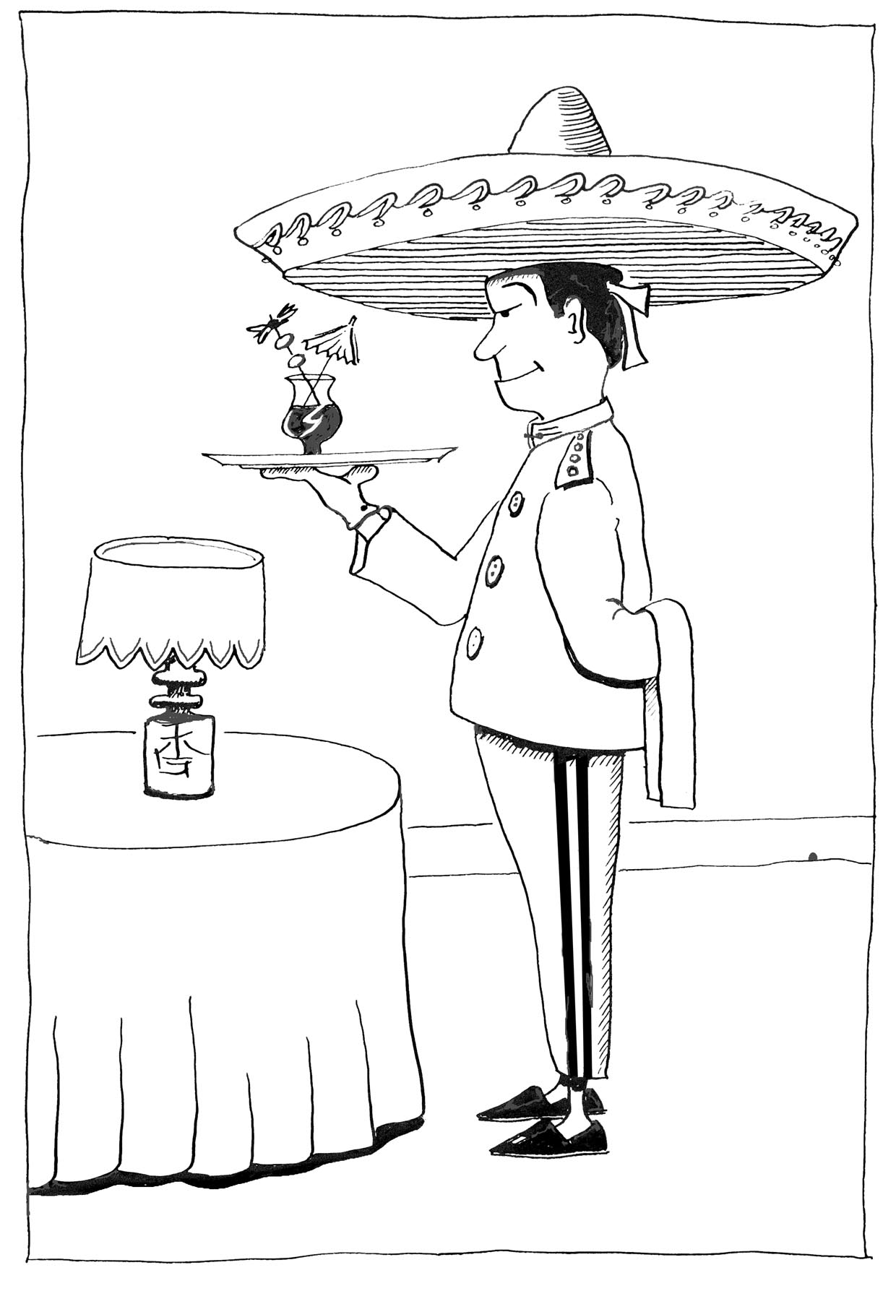
Lots To Learn

Slide 6
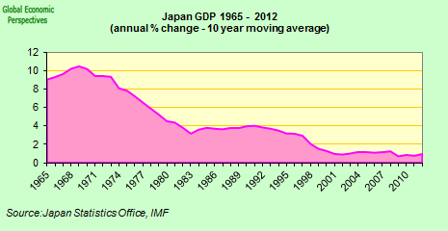
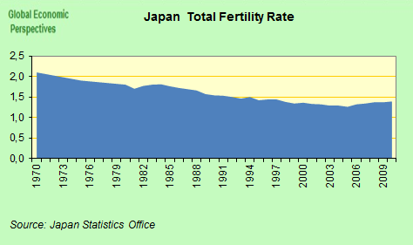
The Japanese Singularity
[Source:http://fistfulofeuros.net/afoe/japans-looming-singularity/]

Slide 7
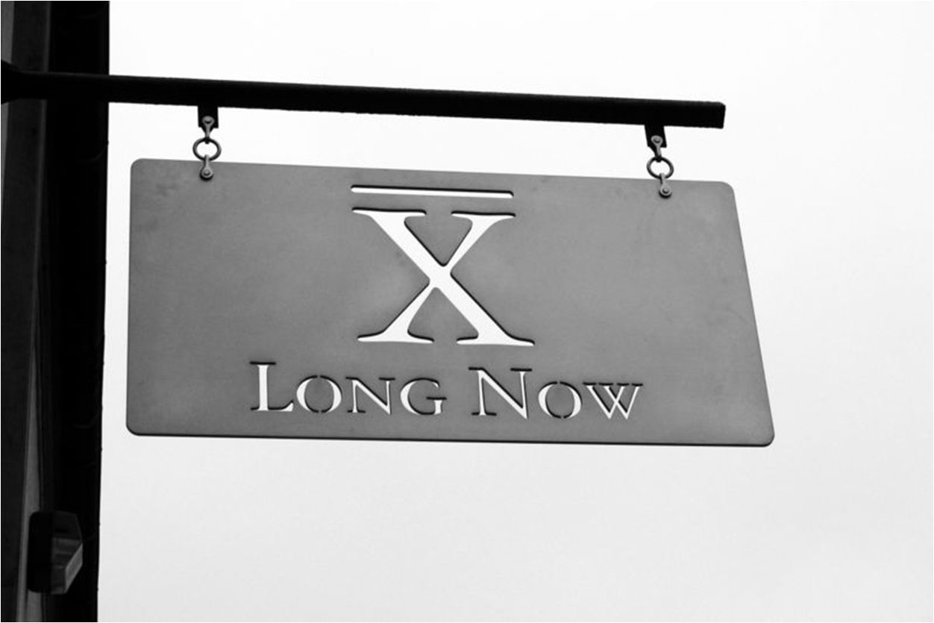
Impertinent Questions

Slide 8
About
‘When would we know our financial system is working?’
Objectives:
Expand Frontiers
Change Systems
Deliver Services
Build Communities
London Accord
Financial Centre Futures
Meta-Commerce
Eternal Coin

Slide 9
Single Prices?
P
Demand
Supply
P2
P1
Q
Liquidity Black Hole ‘Event Horizon’

Slide 10
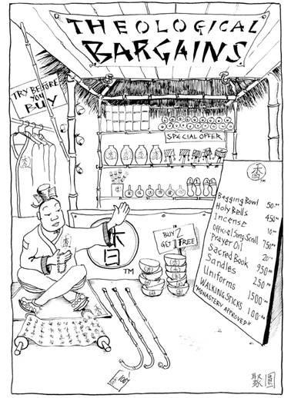
Lunacy, Heresy, Or Orthodoxy?
“Get a detailed grip on the big picture.” Chao Kli Ning

Slide 11
Simple Really
Brasil, India, Russia, China
economic activity
goods
markets
consumers
companies
access
characteristics
savings
liquidity = certainty (value, timing)
assets
confidence &
trust
property
financial
institutions
equities
regulators
commodities
credit:
default rates &
rating agencies
leverage
money supply

Slide 12
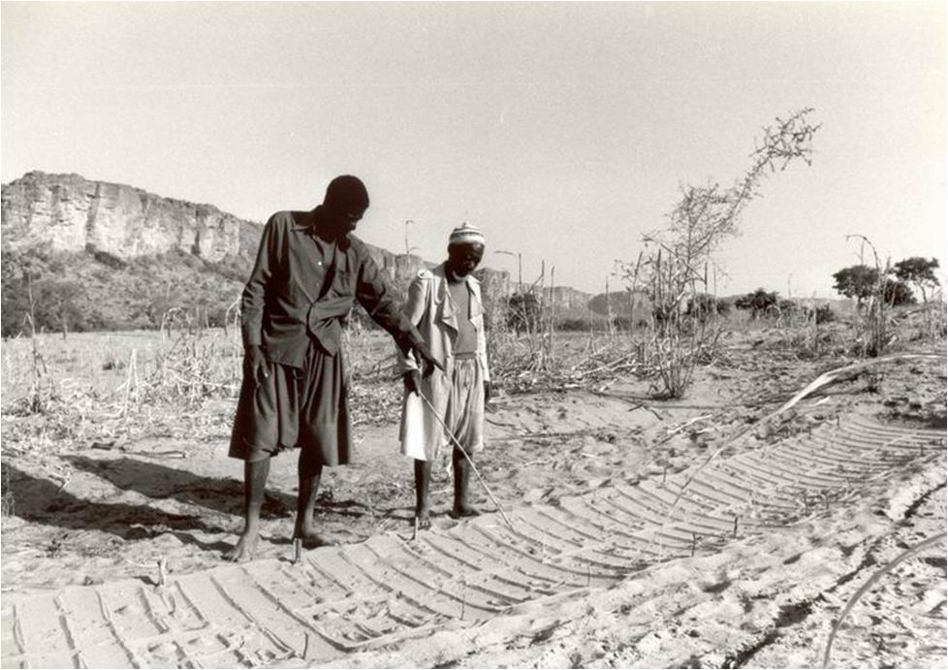
Nupe Sand Divining
[Source: http://www.necep.net/scripts/detail.php?id=89]

Slide 13
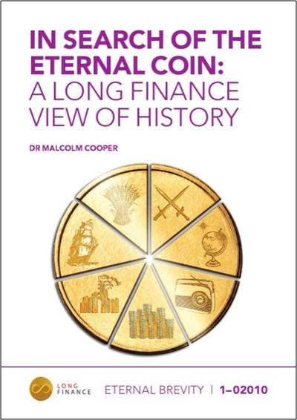
Money As Technology
“Money is a technology communities use to trade debts across space and time.”
“Tokens of indebtedness are social desires frozen at a point in time – tokens depend on the future persistence of the community and its values.”

Slide 14
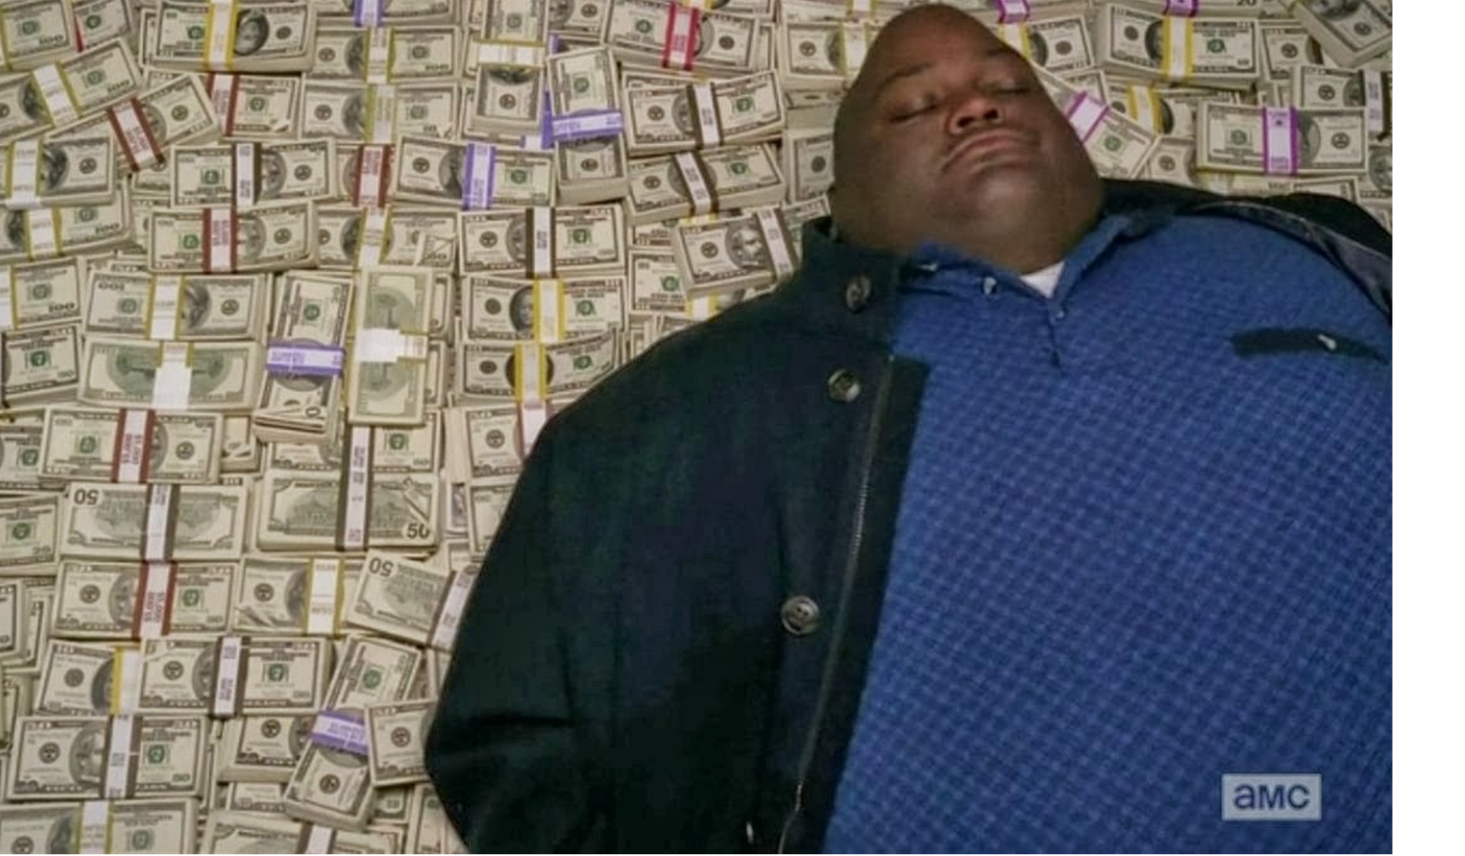
Most Attractive Thing In The World

Slide 15
Ignorance About Money
What is the value of money if one person holds all the cash?
What happens if you call your tax authority and tell them you just don’t feel part of the community but will call when you’re back in the mood?
What is the value of £1 in France versus a pound in the Shetlands?
Why can’t you go to your central bank and ask for a ‘bucket’ of GDP?
What happens to the value of a government’s money during a civil war?
If your nation won the ‘put your feet up for a century’ lottery – in what currency would you take your winnings?
Is the Euro a tax scrip?

Slide 16
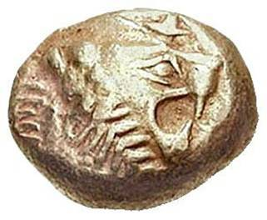
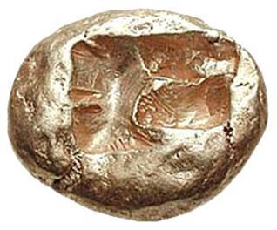
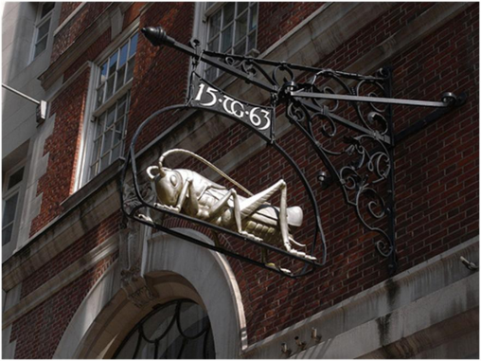
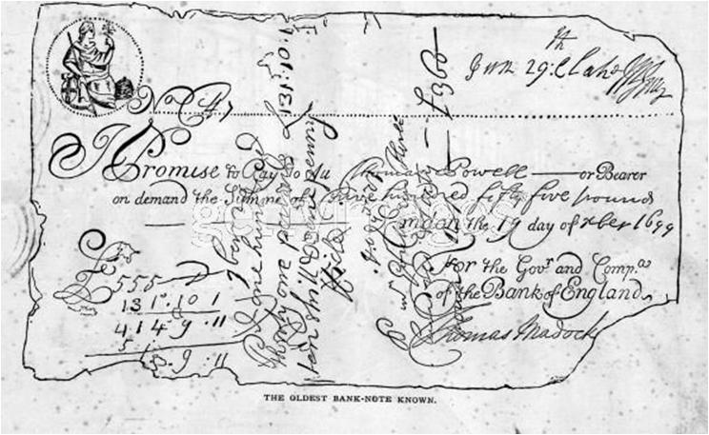
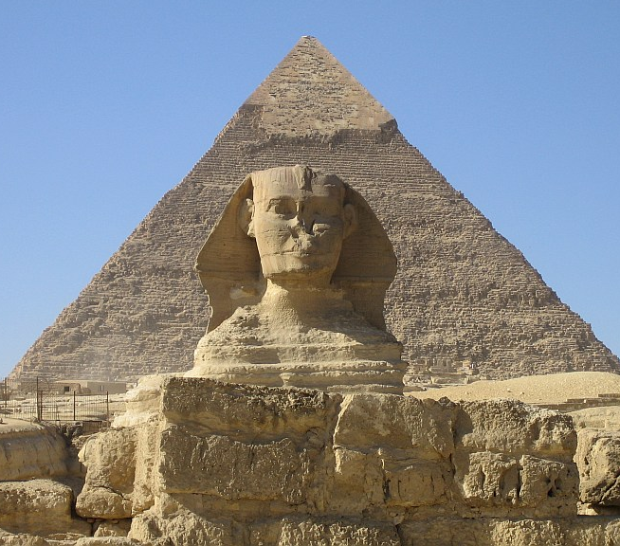
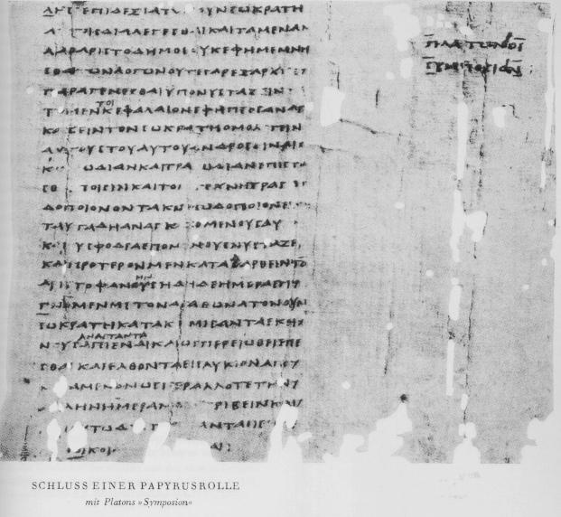
Evolution In Time & Space
Money 0.0 – communal village
Money 1.0 – social tokens
Money 2.0 – traded value, Mesopotamia
Money 3.0 – gold & silver 1.0, Lydia
Money 4.0 – bills of exchange, Northern Italy
Money 5.0 – fractional reserve goldsmiths
Money 6.0 – central banking 1.0 – cheques, 17th century
Money 6.5 – gold & silver 2.0, 19th & early 20th century
Money 6.0 – Richard Nixon & ultra-leverage
Money 7.0 – ?

Slide 17
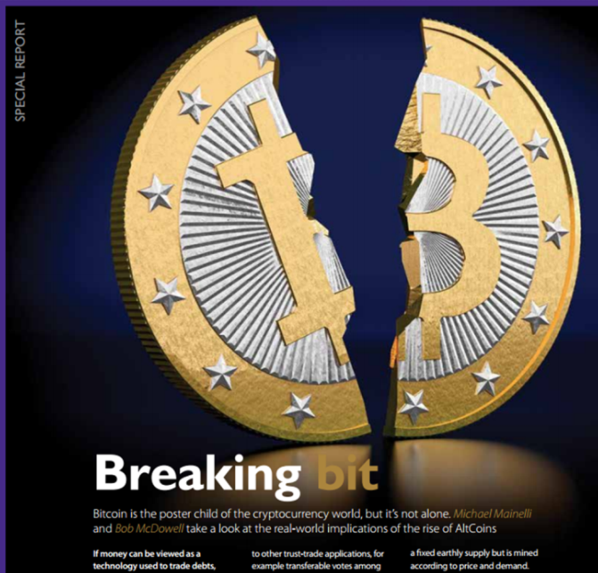
The Long-Term?
Theme | Service | Question
Trust | Identities | communities
Space | Transactions | services
Time | Debts | value-added

Slide 18
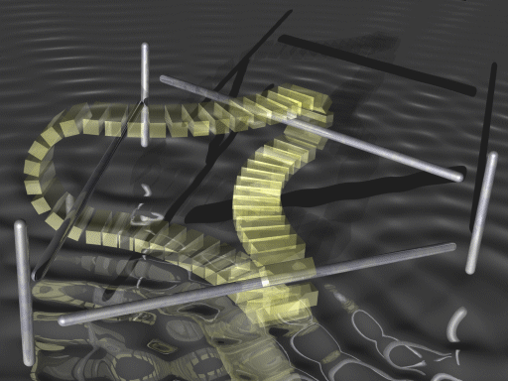
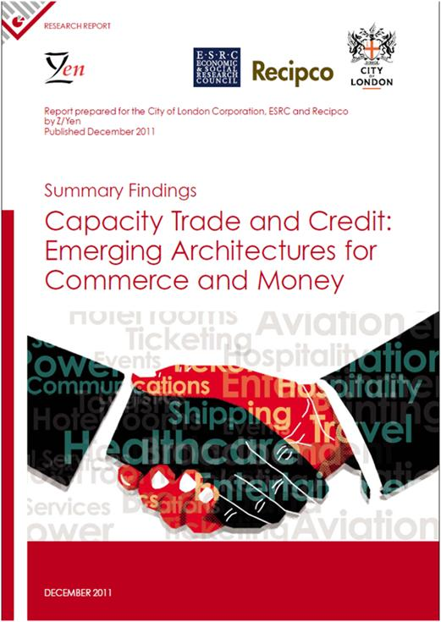
Trust-Time-Space
Money is the self-referential system upon which all our financial analysis is based:
community values
economic activity over space
debts over time
[Source: http://illusionsetc.blogspot.com/2005/08/moving-mobius-strip.html]

Slide 19
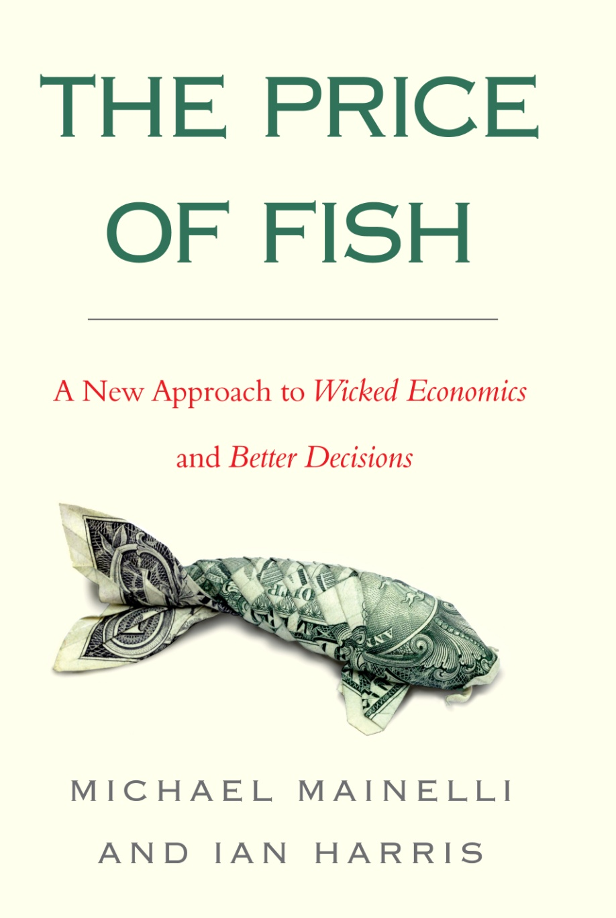
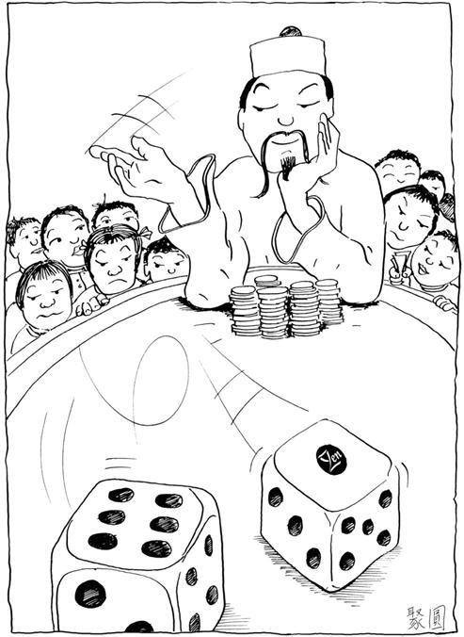
When Would We Know Macroeconomics Is Working?
Welcome to Knightian Ignorance
“Are You Not Thinking What I’m Not Thinking?”
“Get a big picture grip on the details.” Chao Kli Ning

Slide 20
Presentation
“The Curious Case of the Economist the West Forgot”
The Life and Times of Dr Osamu Shimomura (1910 - 1989) and his Harrod-Domar Model of a High Growth, Low Inflation Japanese Economy
George Tait Edwards MBE

Slide 21
Presentation
“Rethinking - Lessons We Can Learn from the Success of the Japanese Growth System”
Conventional and Inductive Economics
Professor Richard Werner, Director, Centre for Banking, Finance and Sustainable Development, University of Southampton

Slide 22
Break
Please come back
to your seats by 16:20

Slide 23
Panel Discussion
“Why Macroeconomics
Needs A Rethink”
George Tait Edwards MBE
John Greenwood OBE, Chief Economist, INVESCO plc
Professor Richard Werner, University of Southampton
Professor Michael Mainelli (Chair)

Slide 24
Closing Remarks
Professor Michael Mainelli
Chairman, Z/Yen Group
Principal Advisor, Long Finance

Slide 25
About
‘When would we know our financial system is working?’
Objectives:
Expand Frontiers
Change Systems
Deliver Services
Build Communities
London Accord
Financial Centre Futures
Meta-Commerce
Eternal Coin

Slide 26
Outlook 2015
Activities – discount rates, toolkit financing sustainable cities, much more on blockchains
The Pamphleteers Blog
http://www.longfinance.net/news/long-finance-blogs/the-pamphleteers.html
Long Finance Online Community - hear first about the latest news and events
www.longfinance.net/online-community.html

Slide 27
Thanks To Our Sponsors

