Slide 1
The Curious Case of The Economist the West Forgot
The Economic Understanding and
Towering Achievements of
Dr Osamu Shimomura
(27 November, 1910 - 29 June, 1989)
By George Tait Edwards MBE
Gresham College Spring Long Finance Conference 2.30pm 3 March 2015

Slide 2
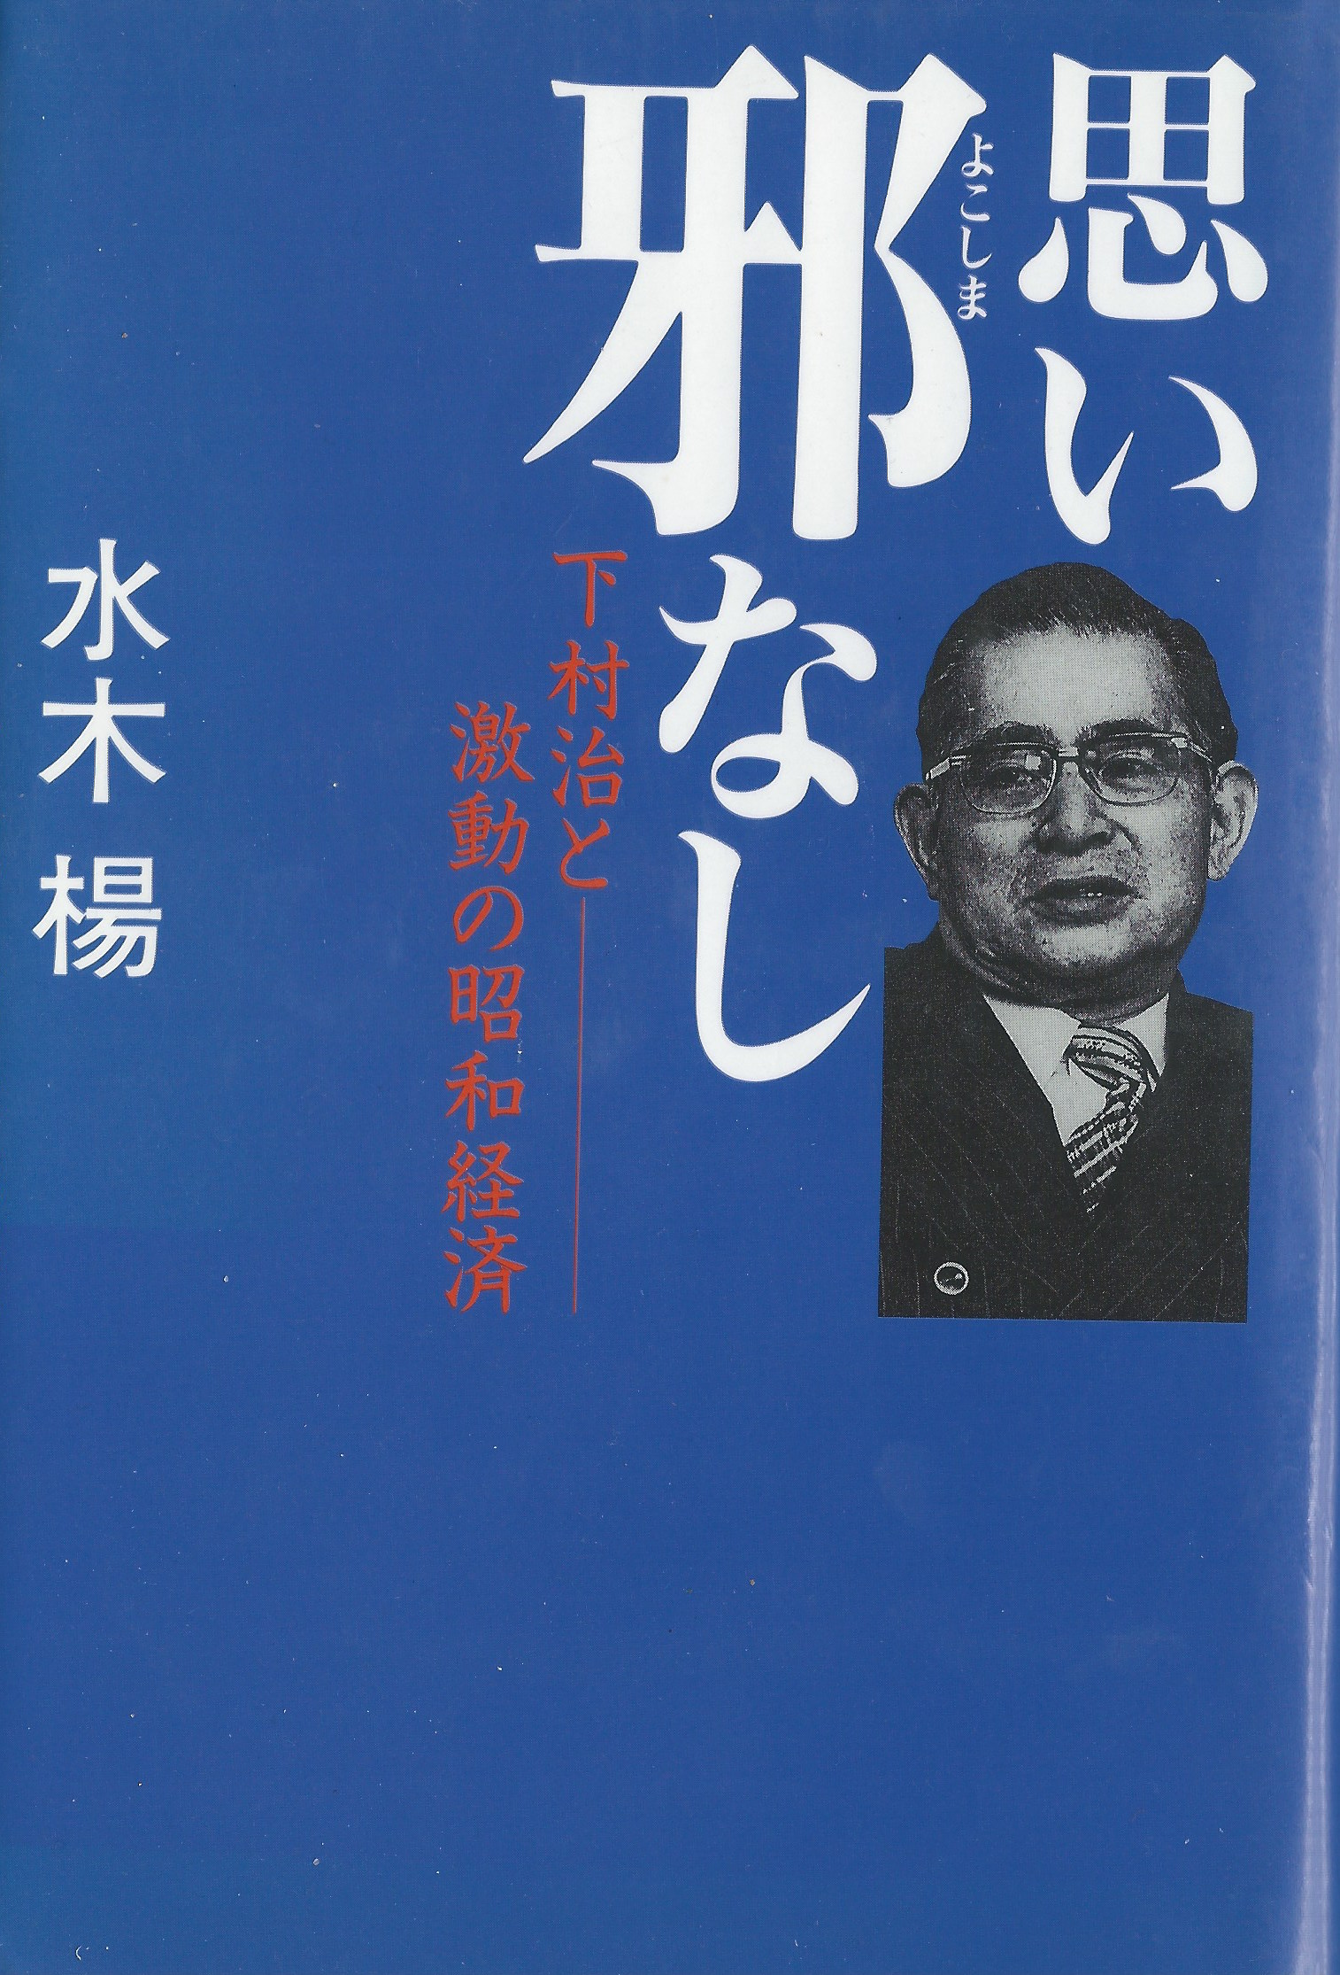
An image of “Japan’s most influential post-war economist” Dr Osamu Shimomura (1910-89) on the book cover of his best biography "Omoi
yokoshima nashi: Shimomura Osamu to gekido no Showa keizai” or
”Thoughts that bear no evil”(Japanese) by Yo Mizuki, Tankobon Hardcover, 1992.

Slide 3
Outline of Lecture 1 Who was Dr Osamu Shimomura, economist, 1910-89? 2 What did he do? 3 Why is he so significant? 4 Why does the West ignore him? 5 How long could that continue?

Slide 4
The timeline of Dr Osamu Shimomura’s life
Year Activity
1910 Born in Saga Prefecture, Kyushu, Japan -
27/11/1910.
1930-34 Economics Faculty, Tokyo Imperial University
1934 Japanese Ministry of Finance (MoF)
1936 Sent by MoF to New York for economic research
1938 Worked in and studied South Manchurian
Railway Company (the “Mantetsu”)
1945 Visit to USA via US-Japanese businessmen
Exchange Program
1946-59 Manager in Price Bureau in the MoF
Member of the Policy Committee of the BoJ
1960-66 Senior executive director of the DBJ
1964-74 First exec director of DBJ’s Research Institute of
Capital Formation
1975-79 Chairman of the Japan Economic Research Institute.
1989 Died June 29 1989

Slide 5
The Mantetsu, or South Manchurian Railway Company
This debt-funded company and colony resulted from Japanese defeat of the Russians in 1905 and Treaty of Portsmouth
Operated by Japanese Military
During the 1930s, Shinzo Abe’s grandfather oversaw the development of the Mantetsu
One of the most successful high-growth colonies in history
During the 1920s, Mantetsu provided over a quarter of Japanese government tax revenues
The world’s first Investment Credit Creation economy

Slide 6
Three major and different kinds of financial-industrial systems
Washington Consensus Neoclassical Zone, where restrictive monetarism reigns and is a dominant aspect of national cultures
Berlin Consensus Zone of the Industrial Banking Economies, where some public banks (the Sparkassen) collect 25% of saving and provide long-term finance for SME investment, i.e. Germany
Tokyo Consensus zone of the Investment Credit (“Shimomuran”) economies where (during the last 70 or so years) Government credit creation at the central bank, is canalised via intermediate banks to private corporate investment, eg in Japan, South Korea, Taiwan and China.

Slide 7
Washington Consensus Zone
National governments borrow to fund govt running costs
Real indebtedness by govt to third parties (lenders or banks)
Government downsizing
Privatisation, cuts in public services, economic stagnation and lower living standards
Relatively few banks collect most saving
No investment credit banks
High interest cost margin between CB cost of funds and market rates
No government industrial policy
Low or absent growth, reducing welfare, growing unemployment
Dominant neoclassical mindset by all active players
Need for a rethink about all that - otherwise, continuing cultural failure

Slide 8
Berlin Consensus Zone
German domination of the EU
ECB follows Washington Zone policy except in Germany
Where the Sparkassen (local Savings Banks) collect 25% of national saving through 431 local banks with 15,600 branches and provide local taps for SME investments
Sparkassen are public banks committed to the alleviation of poverty and the funding of SMEs
A Local saving intermediated into local SME investment is the major factor in German success
B No ECB foreign borrowing to rescue EU countries in difficulty - these monies were no-cost created fiat money

Slide 9
The Tokyo (Shimomuran) Consensus Zone (Japan, South Korea, Taiwan and China)
Purpose of financial system is funding investment
c10-20% of GDP pa is no-cost investment credit fiat-created by central banks
Credit source listed as “the savings of the people” but the people have nothing to do with it
Loans and discounts to banks have an interest rate = inflation rate of factory goods
This makes the loaned funds a counterpart of real resources
Earmarked credit for canalisation to private companies (“Convoy System”in Japan)
Tending to produce a continuous economic boom
Vast assets (of paper wealth) at the CB = interest-bearing loans payable by the borrowing banks
ICC provides continuously rising government tax receipts
Or as Modern Monetary Theory puts it
“Government receives back in taxes part of the fiat created credit funded by its own IOUs”

Slide 10
Once Upon a Time in the USA- FDR’s Economic Miracle 1938-44
Financed by FED investment credit creation
(allegedly financed by “the savings of the people”
2. Every investment required by war effort funded either by investment credit or War Bonds)
Economic growth averaged 12.2% for six years
ICC created the USA as a hegemonic power
Shimomura’s late 1945 USA visit may have assisted the development of his economic understanding

Slide 11
Alan Milward’s question
"Granted that the United States had peculiar advantages in the quantity of resources, in freedom of intervention from the enemy, and in the great quantity of slack which existed in the economy before 1940, it remains a logical and revealing approach to ask precisely why the productive effort in other economies fell short of that in America."
Alan Millward, "War, Economy and Society, 1939-45", (Harmondsworth: Penguin, 1977) p 75.

Slide 12
Japan’s Post War Circumstances were Dire
About 40% of the urban area destroyed in the 66 bombed cities
Over 600 major industrial facilities destroyed or badly damaged
Japanese wealth reduced by between a third and a quarter
Failure of the 1945 rice crop
2.5 million housing units destroyed, 8.5 million people homeless
About 760,000 SME premises destroyed

Slide 13
The Economic Context of Japanese Government Action
American banker Joseph Morrel Dodge was advisor to the US Occupation Authorities
He recommended Japanese Government should have a “Balanced budget” that forbade Keynesian government borrowing
So from Sept 1945 until 1964 the Japanese government did not borrow at all
BUT INSTEAD THEY CREATED FIAT INVESTMENT CREDIT AT THE BoJ
TO REBUILD THEIR INFRASTRUCTURE AND RE-EQUIP THEIR INDUSTRIES

Slide 14
Credit Creation by the Bank of Japan

Slide 15
Investment Credit Creation by Japanese Banking System
Mid- Pa increase Y/E Dependency BoJ loan
Year Bank advances on BOJ Loans Support
1946 72.3% 42% 72%
1947 15.8% 32% 47%
1948 79.9% 22% 28%
1949 100.9% 16% 19%
1949 66.0% 15% 18%
1950 51.3% 14% 16%
1951 45.7% 13% 15%
Source: Calculated from data on previous slide

Slide 16
SME and Corporate Priorities in the use of funds
1. Liquidity
2. Affordable work-in-progress and stock levels
3. Improve productivity within existing staff levels
4. Investment in plant and equipment

Slide 17
Liquidity and Business Confidence
Observed levels of % GDP of company funds in bank- Japan c30%, Germany c15%, UK c6-8%
Business confidence - a result of high company liquidity
Stockholding - highest when overtrading is not risky
Capital Investment - high when first three funding priorities are met

Slide 18
Major eras in BoJ Credit Creation
Era Primary Policy focus Secondary Policy Focus
1945-51 Fixing war damage Raising Government income
1952-59 Private ind investment Creating trading advantage
1960-68 Doubling living standards Improving social package
1969-85 Fixing trading adv. Increasing Japan’s status
1986-91 Funding asset bubble Power redistribution
1991-2010 BoJ independence Structural change in Japan 2011-15 21st cent Abenomics Re-establishing Shim’n econ.

Slide 19
The Five Major Forms of Credit Creation Inherent in the Work of the Three Master Economists J M Keynes, Dr Osamu Shimomura and Professor Richard Werner
1. Credit Creation for Consumers - Keynesian remedy for deficient demand
2. Investment Credit Creation - Shimomuran-Wernerian remedy for deficient supply - productive ICC Economics - See “new paradigm in economics” by Richard Werner
3. Financial Credit Creation - to stabilise a banking system and guarantee its liquidity
4. Speculative Credit Creation - to fund an unintended asset bubble e.g. in Japan 1986-91 - see Richard Werner’s book “Princes of the Yen”
5. Invention and Innovation Credit Creation - to fund rapid scientific advance and innovations in manufacturing

Slide 20
The Key Shimomuran Amendment to Keynes’ Savings-Investment Equation
Shimomura replaces the Keynesian saving-investment equilibrium condition with the equation
S+D = Is+Id
That is, Saving (S) plus Debt (D, equal to investment credits arising from investment credit creation at the Bank of Japan) equals Is (Investment financed by saving) plus Id (Investment financed by debt).

Slide 21
What did Shimomura do in his economic model of Japan?
He took three of John Maynard Keynes’ observations and structured these into a fresh economic understanding, a new Harrod-Domar model of the Japanese economy.
He eventually (in early 1961) presented that Model of the Japanese Economy and its equations to the joint meeting of the Japanese Economic Association and the Japanese Econometric Society.
His presentation was then published under the title “Seicho Seisaku No Kihon Mondai” (Basic Problems of Growth Policy) in Riron Keizaigaku, March 1961.

Slide 22
Professor Kenneth K Kurihara’s Conclusion
"If, therefore, greater investment can be financed partly by credits, there is no need for that 'abstinence' which the classical economists considered necessary for economic progress, any more than there is for that 'austerity' which some present day underdeveloped countries impose on already under-consuming populations at the constant peril of social unrest. Nor is it difficult, in such credit-creating circumstances, to agree with Keynes' observation that investment and consumption should be regarded as complementary rather than competitive."
(Kenneth K. Kurihara, The Growth Potential of the Japanese Economy, Baltimore, John Hopkins Press 1971 page 138)

Slide 23
Shimomuran Economics Will Ultimately Triumph in the West Because it
Re-establishes government as the main enabler of wealth creation and assists the continuation of political unions (eg, EU, UK)
Does not require a revolution in income distribution - it permits the rich to keep what they have acquired while enabling government to act in the interests of all their people - that’s a great advantage for everybody
More fully enables local invention to become local innovation - cf Shumpeter
Accelerates the adoption of more expensive greener sustainable economies
It reduces income differentials in practising nations
It offers a better path to prosperity than any other understanding.

Slide 24
My Conclusions
Shimomuran-Wernerian economics is the key to higher growth and the major path to prosperity for all economies
There is a timelag of up to 80 years in the spread of economic understanding and practice
Long-Term Investment Credit Debt is good for SMEs and all public and private companies but it is not a panacea
A “world of abundant capital” is made possible by Shimomuran-Wernerian economics - not a nation or a region but a world
Shimomuran economics may be Modern Monetary Theory in its greatest form - the creation of fiat credit for canalisation to SMEs and local private enterprises for the conversion of invention to innovation to bring about widely-shared continually higher living standards in a greener high technology world.
“Mea Culpa”
© George Tait Edwards 2015

Slide 25
and the rise of the
Tokyo Consensus
The Story of the Economic Bomb

