Slide 1
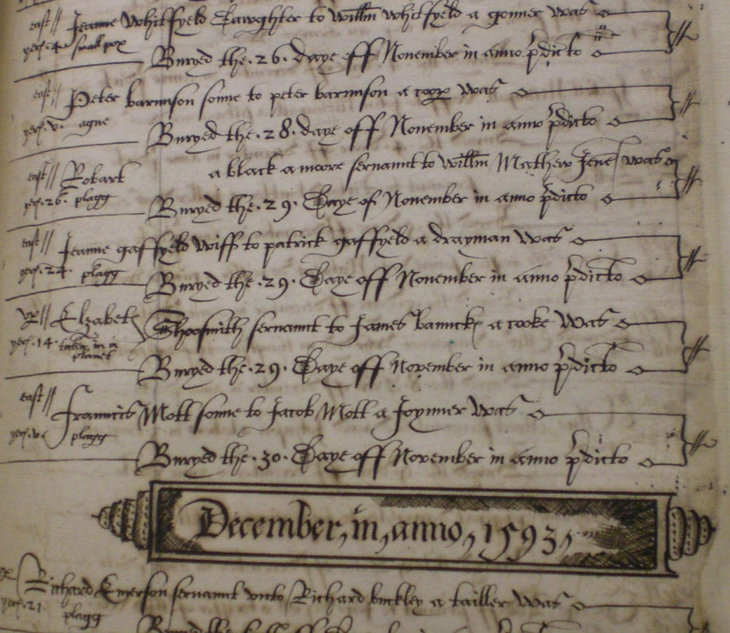
Parochial registration and the Bills of Mortality Gill Newton Cambridge Group for the History of Population and Social structure

Slide 2
Introduction
Graunt published his Observations within a year of experiencing a trio of personal tragedies that ensured he had personal experience of death reporting in London as well as an intellectual interest
He was a longstanding Londoner with a good grasp of social and economic conditions in the city and was well-placed to comment on the context of the Bills as well as to analyse their content
Today we shall consider some of Graunt’s remarks on the meaning and age-applicability of certain causes of death used in the London Bills in the light of additional age and cause of death information from parish registers, focusing on three case studies:
rickets
teeth
old age

Slide 3
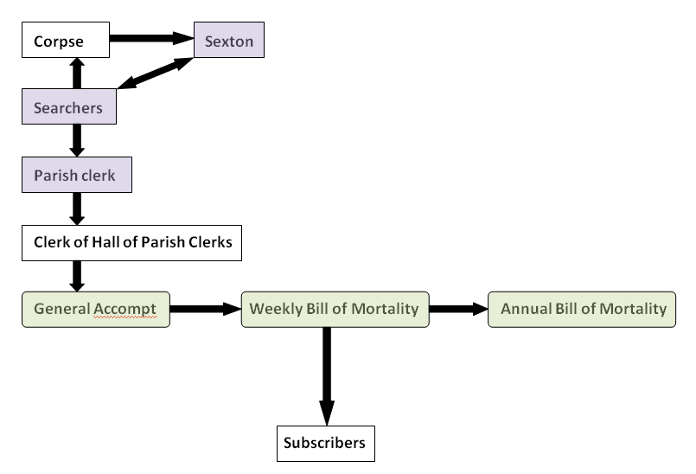
How causes of death were compiled for the Bills of Mortality

Slide 4
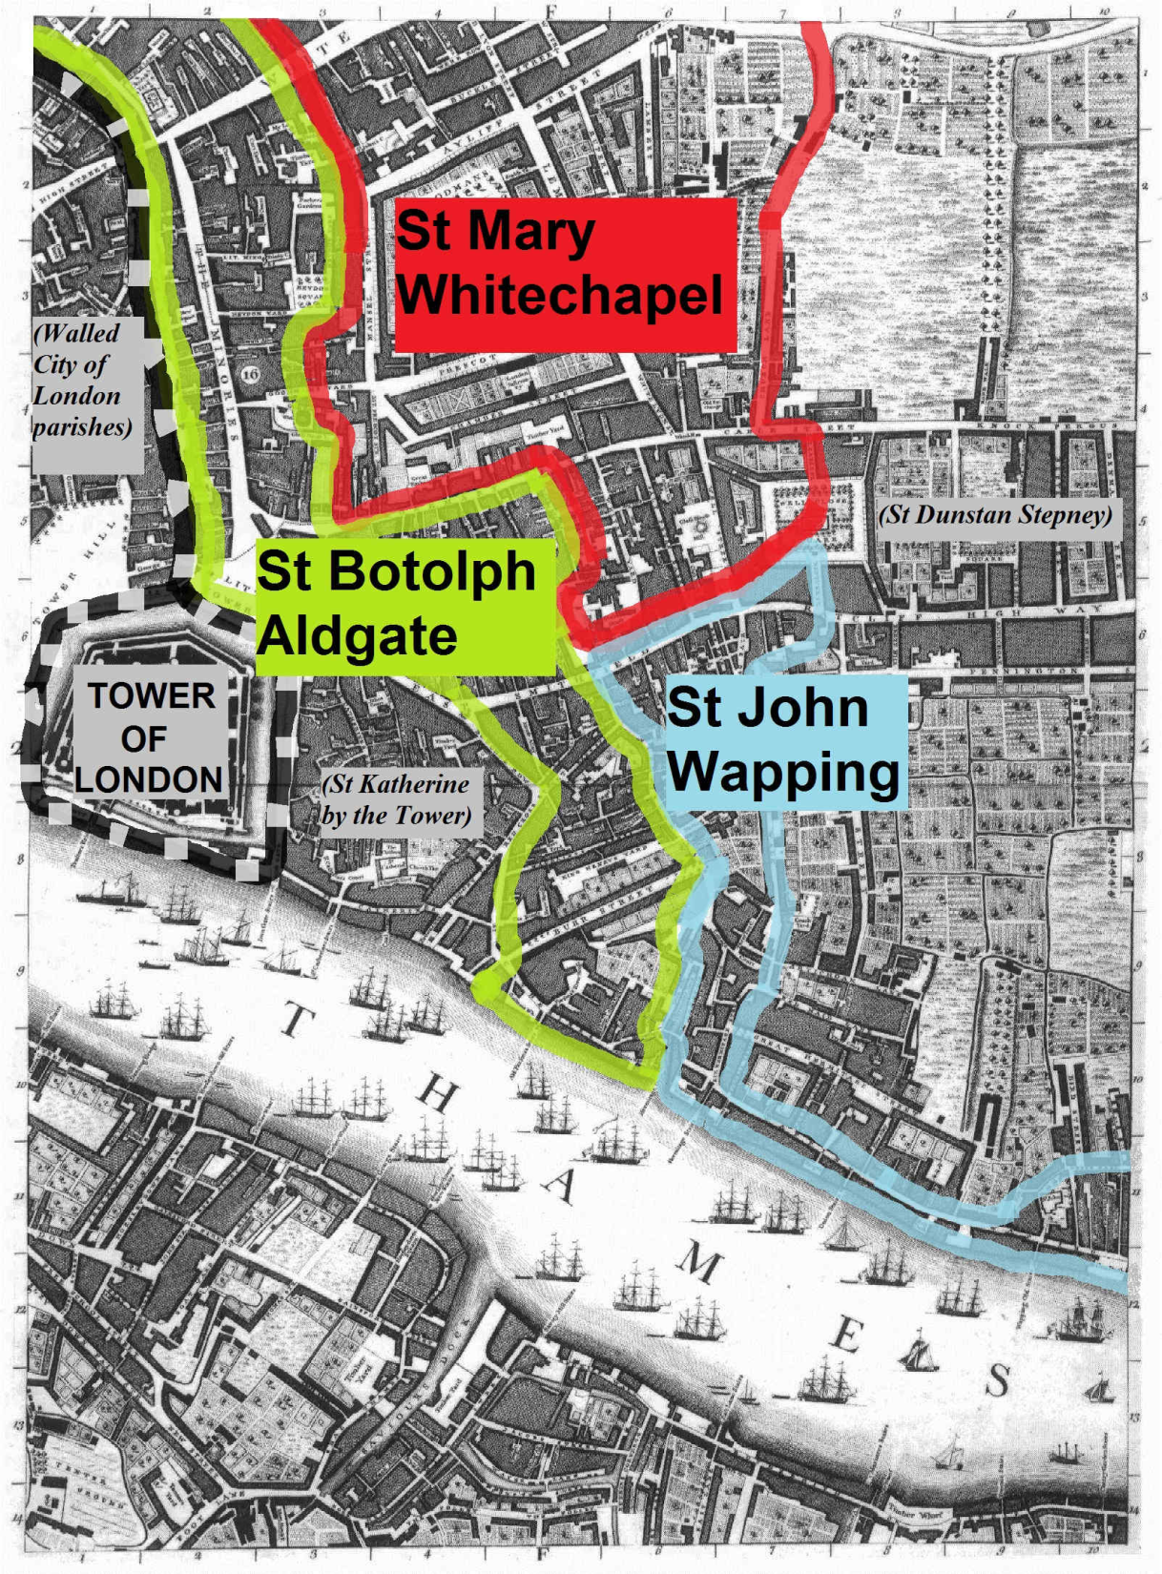
Map showing London parishes sampled for cause of death information and ages
Graunt’s home parish of St Michael Cornhill, about 1 mile west of this map in the city centre, was also sampled for causes of death (but not ages) in the 1650s and 1660s

Slide 5
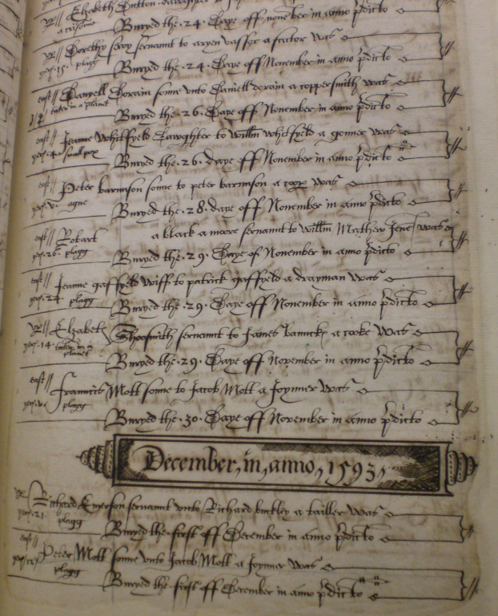
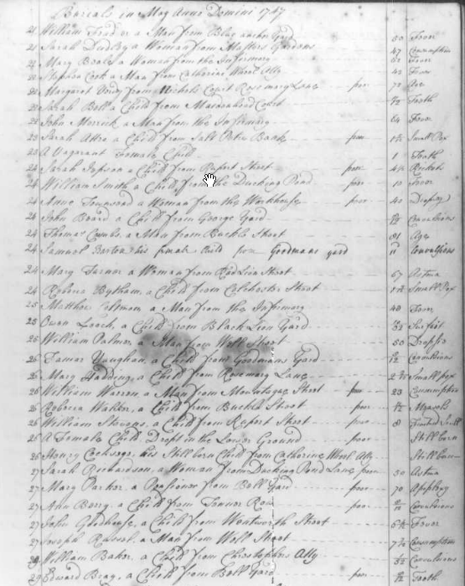
Parish burial registers with ages and causes of death 16th century: St Botolph Aldgate 18th century: St Mary Whitechapel

Slide 6
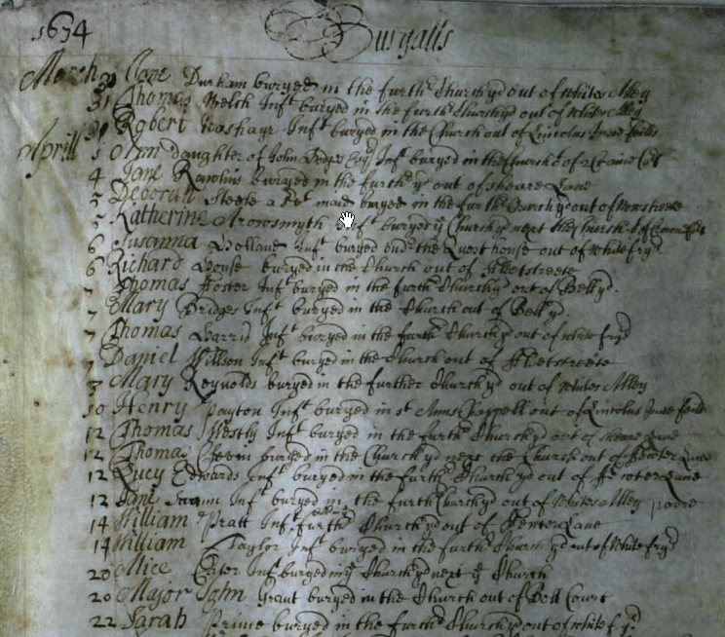
A more typical, less useful parish burial register 17th century St Dunstan in the West (where Graunt was buried)
Notes:
Interestingly, Graunt’s home parish of St Michael Cornhill records causes of death (but not ages) between October 1653 and March 1663. Graunt himself suffered three losses in the months prior to the publication of Observations in 1663 (New Style): his father Henry Graunt in March 1662 “aged” (age 70 according to Aubrey), his mother in May 1662 also “aged” and his daughter Frances in September 1662 of consumption.

Slide 7
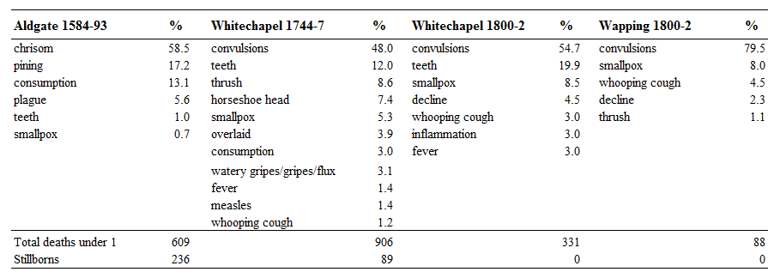
Main causes of death for infants under 1 year in London
The above causes account for > 95% of infant burials in each location (not including stillbirths)

Slide 8
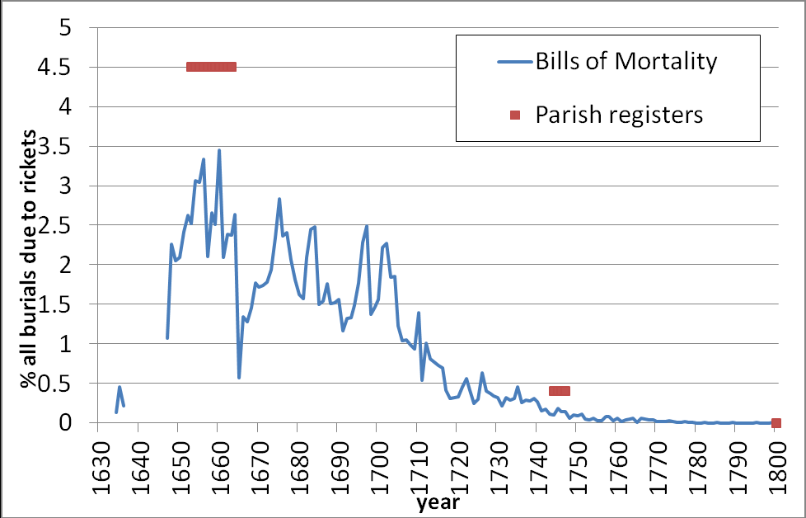
The decline of rickets burials in London

Slide 9
Ages of children dying of “teeth” in London and other urban parishes
Aldgate
1584-1593
Whitechapel
1744-1747
Leeds
1769-1799
nr Manchester
1794-1812
nr Liverpool
1801-1812
Whitechapel
1800-1802

Slide 10
Reported ages of persons dying of “old age”/ “aged”
Whitechapel
1744-1747
Leeds
1761-99
York
1770-99
Whitechapel
1800-03
Wapping
1800-02
Leeds
1801-12
York
1801-12
nr Liverpool
1801-12

Slide 11
Conclusions
Graunt’s evaluation of particular “casualties” provides useful clues into the range of medical conditions implied by Early Modern cause of death descriptors.
The Bills did not cross-tabulate causes of death by age, but some parish registers in London and other urban areas did record a cause of death and age for each burial, and from earlier dates. From these we can evaluate :
the causes of death to which deaths in particular age groups were attributed
and for easily identifiable infectious diseases, the age structure of mortality
The aggregated totals for causes of death in the Bills of Mortality conceal variation between individual London parishes in the descriptors the Searchers used.
Some cause of death descriptors are much more consistently applied to particular age groups (teeth) than others (old age) in different locations and/or time periods, and some descriptors fell out of use even when the underlying condition remained present (rickets, chrisom).

