Slide 1

The Creeping Paralysis of Drought
Carolyn Roberts
Frank Jackson Foundation Professor of Environment
The Knowledge Transfer Network

Slide 2

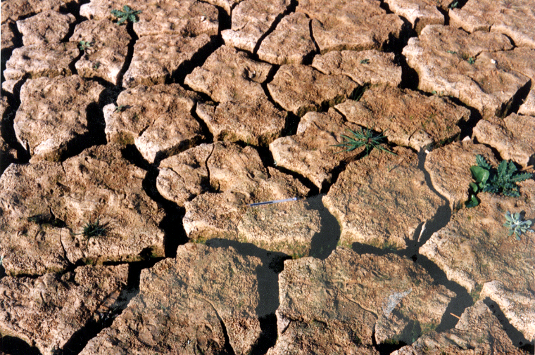
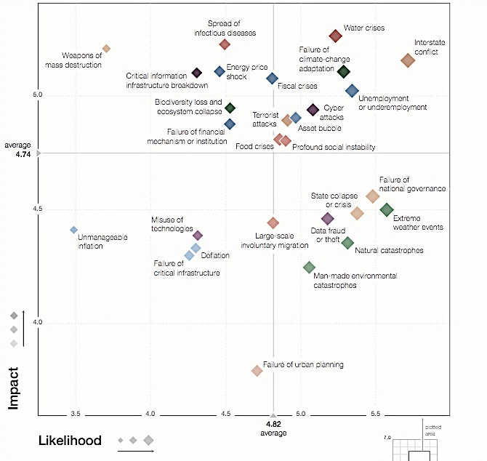
World Economic Forum’s Global Risks Report 2015.
Water crises
Extreme weather events

Slide 3
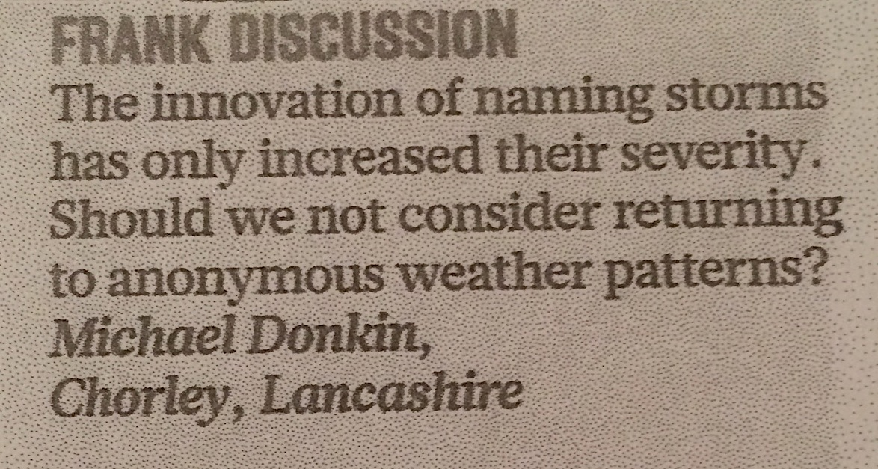
Sunday Times, 3rd January 2016

Slide 4
Davo Laninga AZ Monsoon film extract

Slide 5
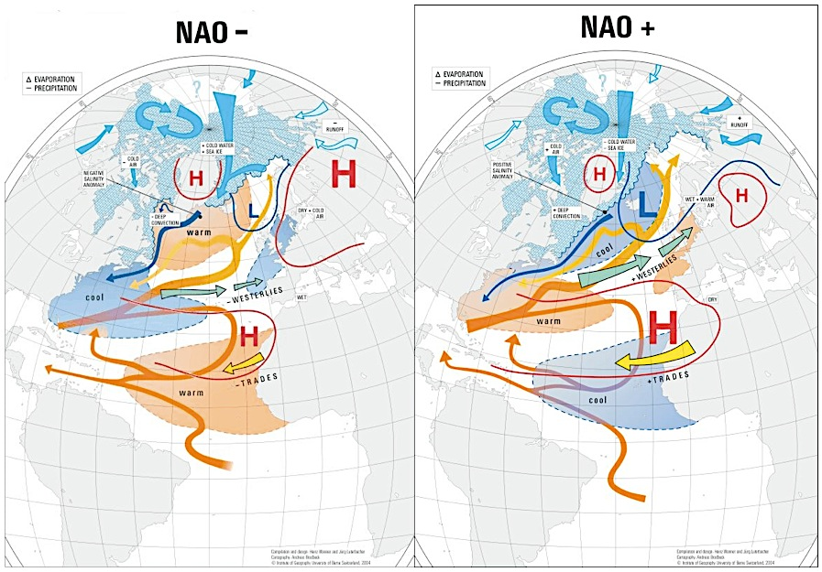
The UK
The UK

Slide 6
The vagaries of forecasting – winter 2016
1. Computer forecasting models
Currently they favour a positive North Atlantic Oscillation pressure pattern. Strongly favours a milder winter.
2. North Atlantic Sea Surface Temperatures
Temperatures west of the UK and south of Greenland are below average. This may reduce mobility across the Atlantic. Possibly favours a colder winter
3. El Niño Southern Oscillation
A moderate to strong El Niño is forecast to continue to the end of the year at least. Favours a milder winter.
4. Other teleconnections (pressure patterns)
These include the Pacific Decadal, Madden-Julian and Quasi-biennial Oscillations. The QBO is expected to be in a westerly phase. Favours a milder winter.
5. Solar activity
Below 2014 peak but still not very low levels which are though to increase the likelihood of colder winter. Possibly favours a milder winter.
6. Weather patterns during recent seasons
Cold winters have a tendency to come in clusters. Winters since 2008/09 have been more varied than during the preceding 20 years. Uncertain, but possibly favouring a colder winter.
The Weather Outlook, autumn 2015

Slide 7
Definitions of drought
Environmental/meteorological drought – some combination of reduced rainfall (proportion of normal or an absolute figure maintained for a period of days), low river flow and groundwater levels, and low soil moisture. Stress on wildlife, fish etc.
Agricultural drought – insufficient rainfall and soil moisture to support agricultural practices such as spray irrigation. Usually pre- environmental drought.
Water supply drought – low rainfall causes water companies to be concerned about customers’ supplies, and to follow drought plans. Reservoirs for some English customers could be in other areas (e.g. Wales)

Slide 8
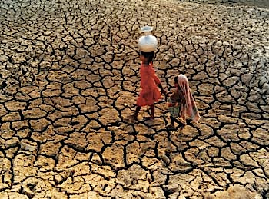

Slide 9
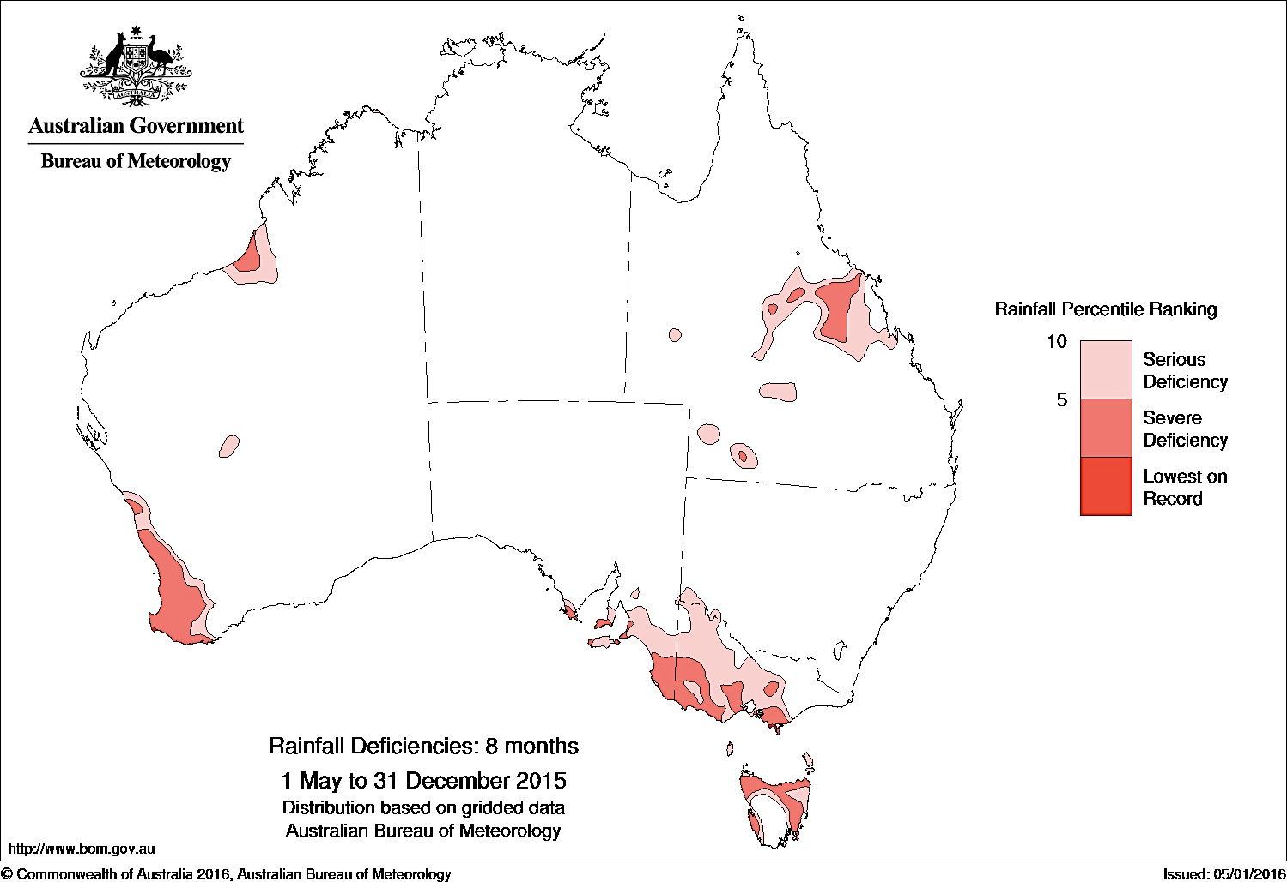
Notes:
Rainfall in eastern Australia has been very much below average for large areas for periods of about 3 years' duration (since the conclusion of the last La Niña in autumn 2012). Long-term deficiencies also exist in eastern Australia over the 17 years since 1998.

Slide 10
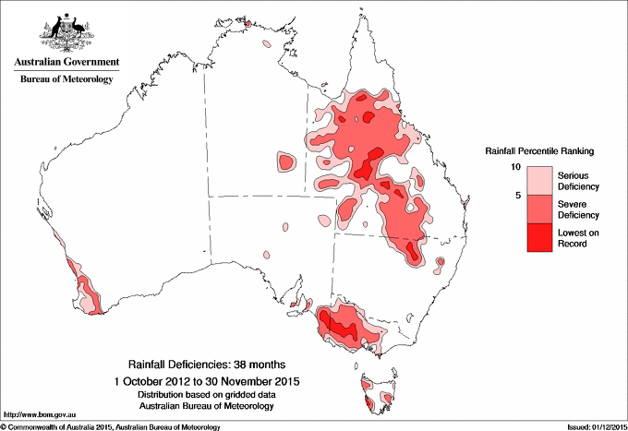

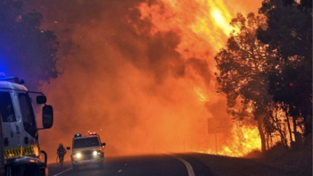
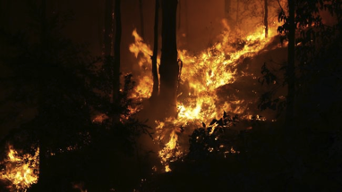

Slide 11
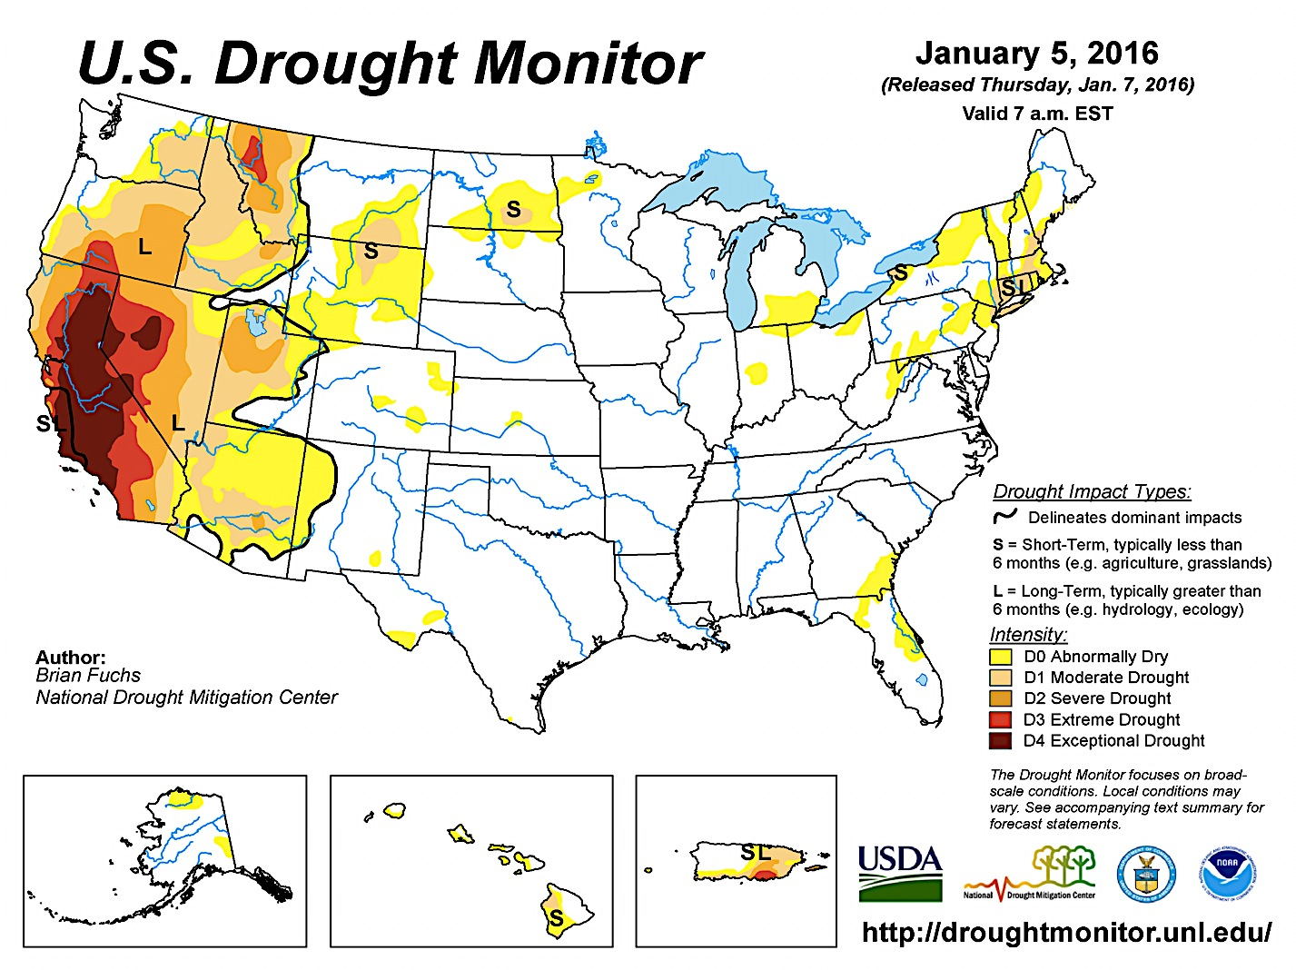

Slide 12
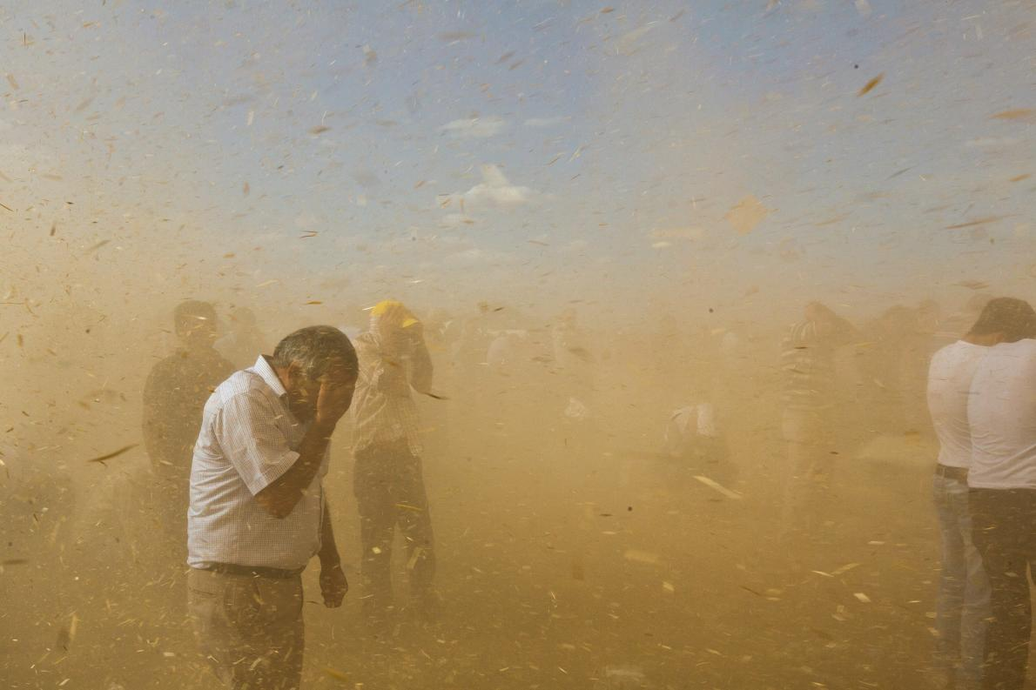
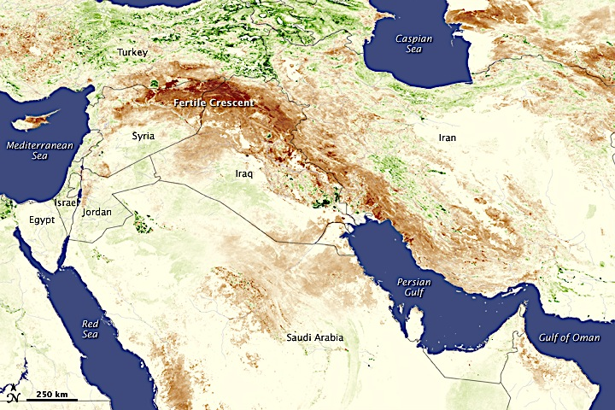


Slide 13
Syria’s civil war clip
https://www.youtube.com/watch?v=Um_0hydzXaM

Slide 14
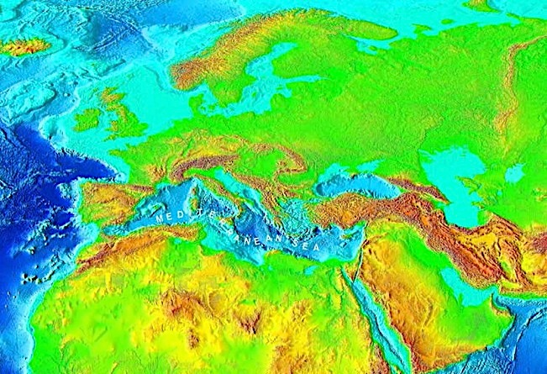
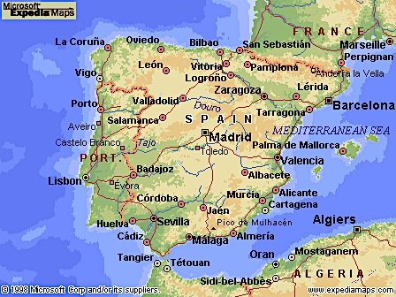
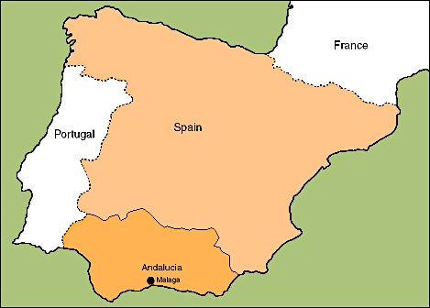
Drought in Andalucia, Spain, 1992-5

Slide 15
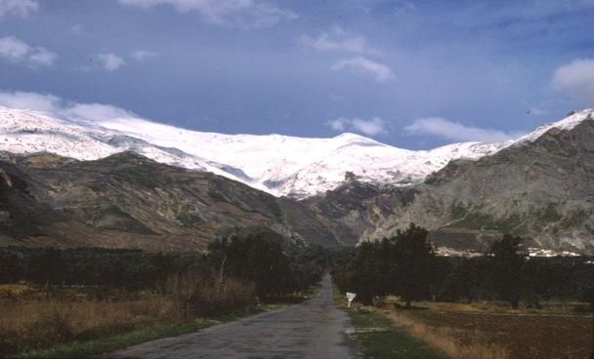
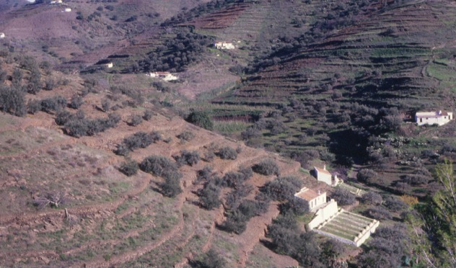
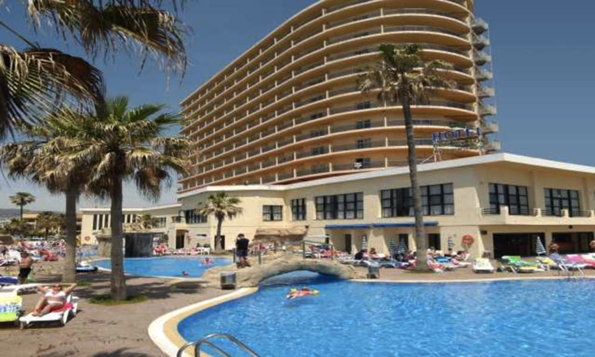
Sierra Nevada winter snows
Terraced farms with dry olive and vine cultivation. Citrus plantations further down
Beach resorts along the coast

Slide 16
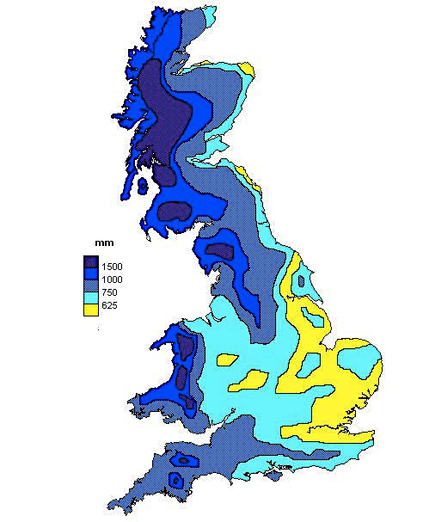

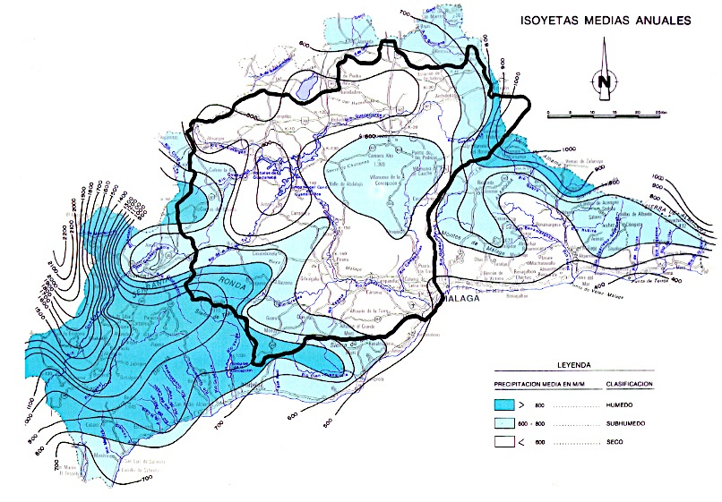
Annual Rainfall, mm
Dark blue >800mm
Pale blue 500-800mm
White <500mm

Slide 17
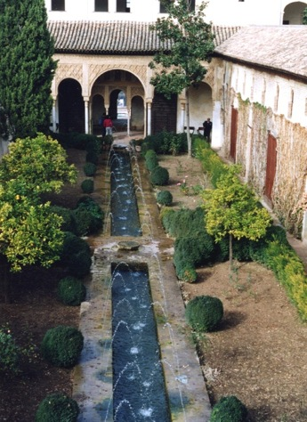

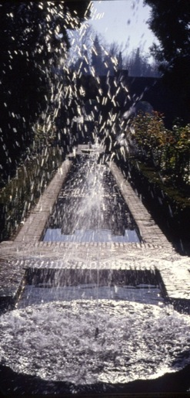
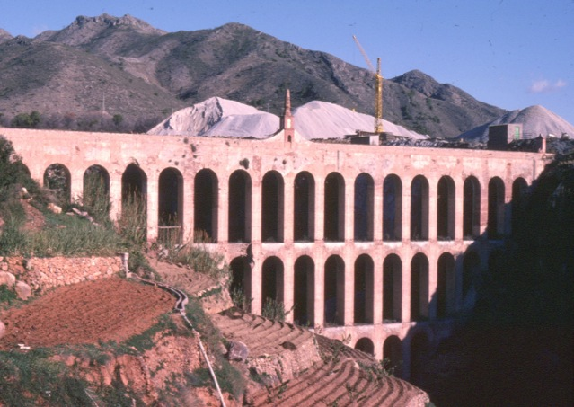
Historic approaches to water management in Andalucia
Arabic style water management
in the Alhambra
gardens, Granada
Aquaducts from Roman times onwards

Slide 18
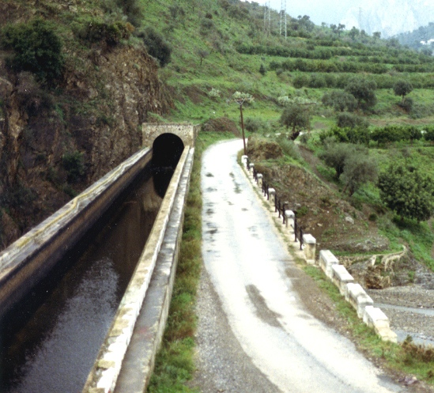
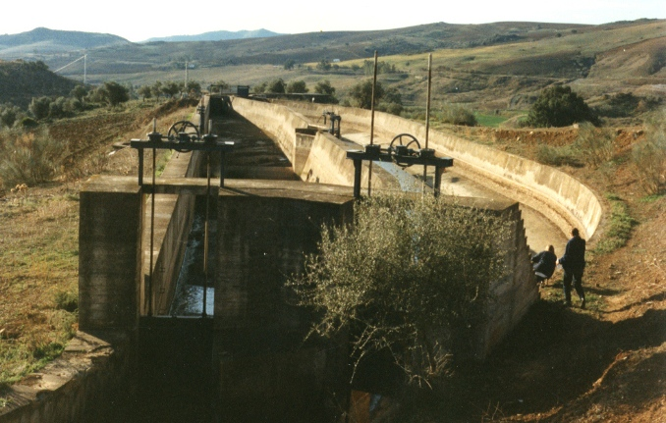
Modern irrigation channels take water down towards the coast from reservoirs and springs

Slide 19
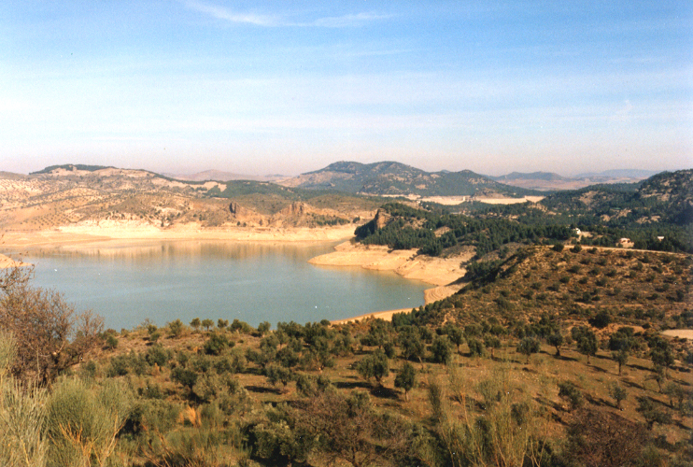
Reservoir levels - December 1993

Slide 20
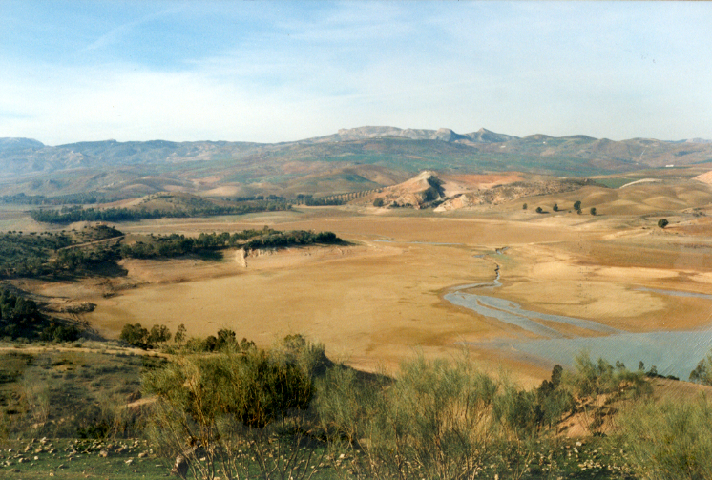
Reservoir levels - April 1995

Slide 21
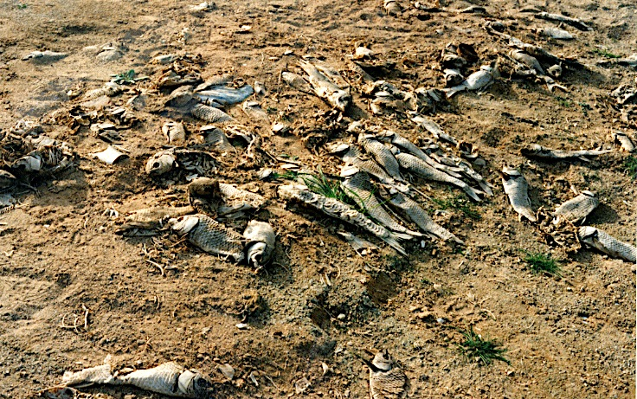
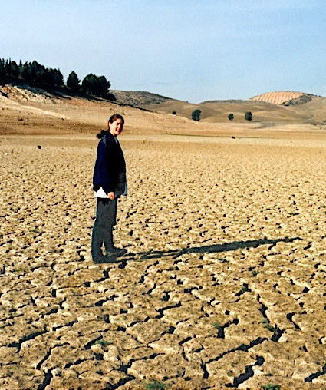
Reservoir levels - December 1995
Fish kill from deteriorating quality and high water temperatures – no humans died of thirst

Slide 22
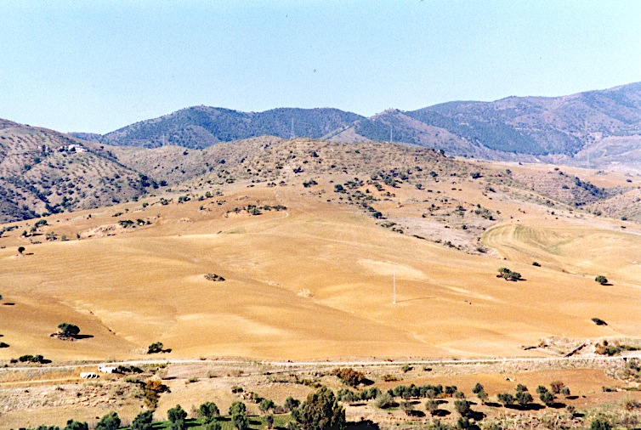
River Guadalhorce valley, 1995

Slide 23
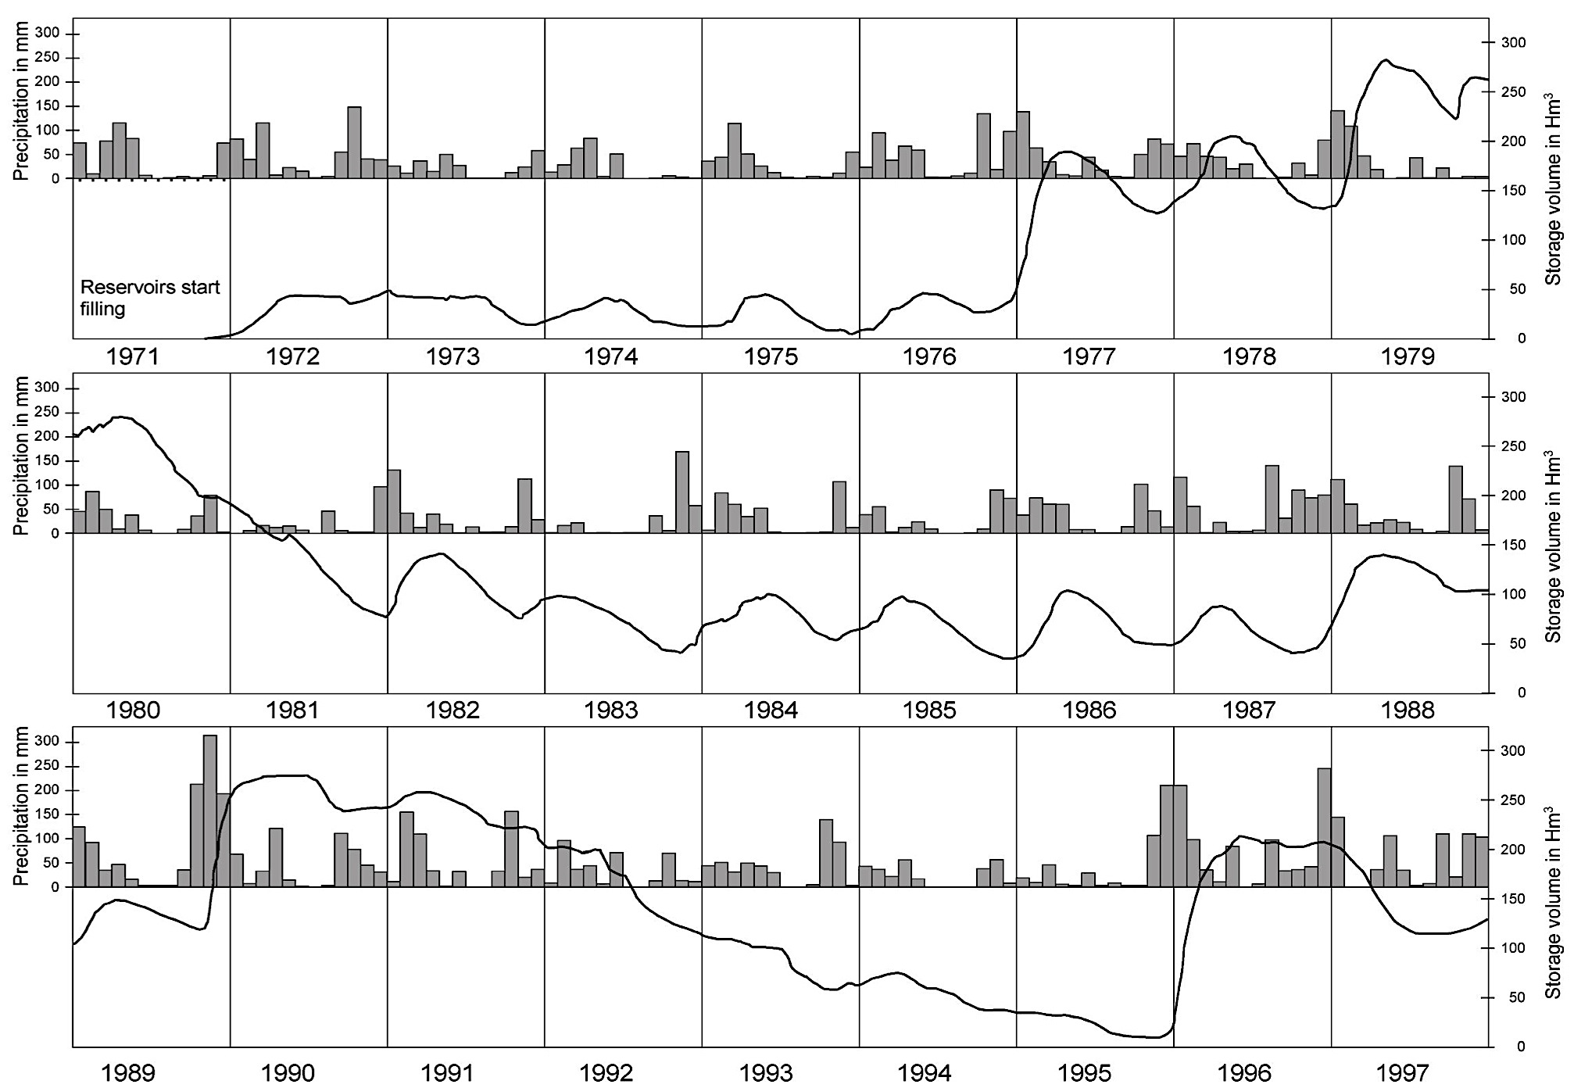
Anatomy of the drought

Slide 24
What were the human consequences?
Initially, reservoir levels were drawn down
Residents were asked (nicely) to reduce their use
Water supply for irrigation stopped in favour of urban areas: angry farmers, and reduced agricultural yields
Golf courses and hotels were protected
Groundwater pumping increased, resulting in falls in water table of up to 80m
Emergency groundwater drilling programme, on a grid pattern, including coastal aquifer, carbonate aquifers – the‘colander project’
Desalination was discussed but not implemented

Slide 25
More human consequences
Water restrictions began in houses (not hotels); initially a public awareness campaign, then rota cuts but people were reluctant to reduce their consumption
Pipeline construction started along the coast to adjacent catchments; stopped by protests alleging illegality
One shooting resulted; sheep carcasses were thrown into public supply
Water quality deteriorated dramatically – salty drinking water
Reservoir levels fell almost to zero – two more weeks would have been catastrophic

Slide 26
Salinity of water coming in to El Atabal Treatment Plant, Malaga, 1975-1996

Slide 27
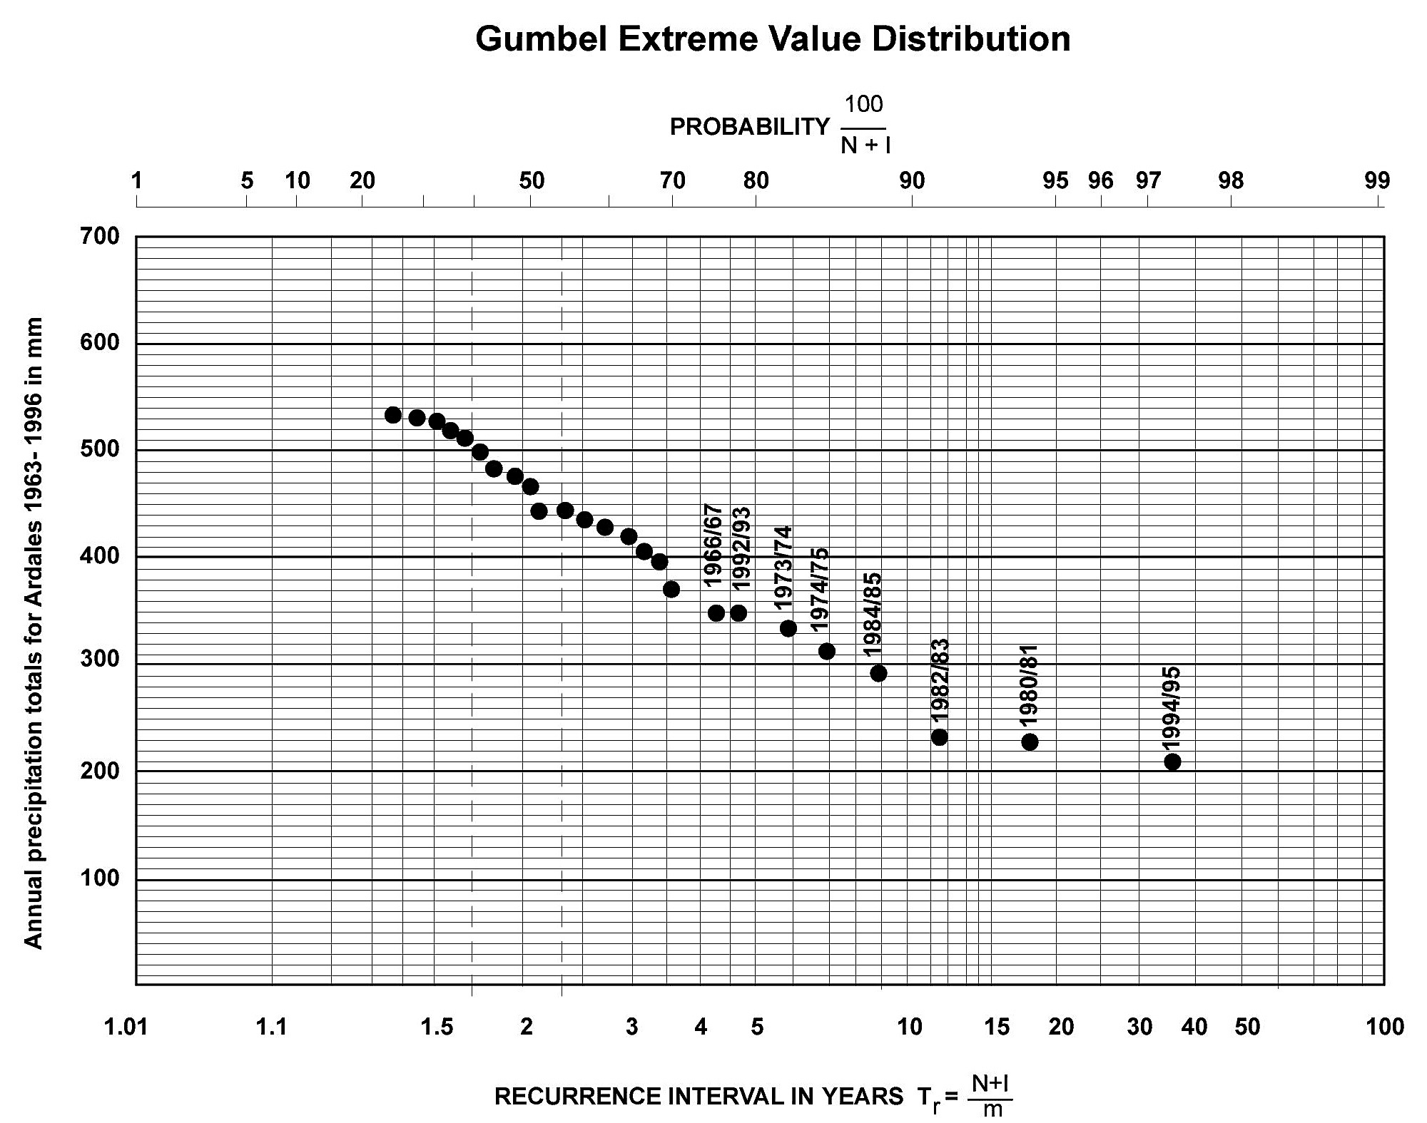
How extreme was the drought?

Slide 28
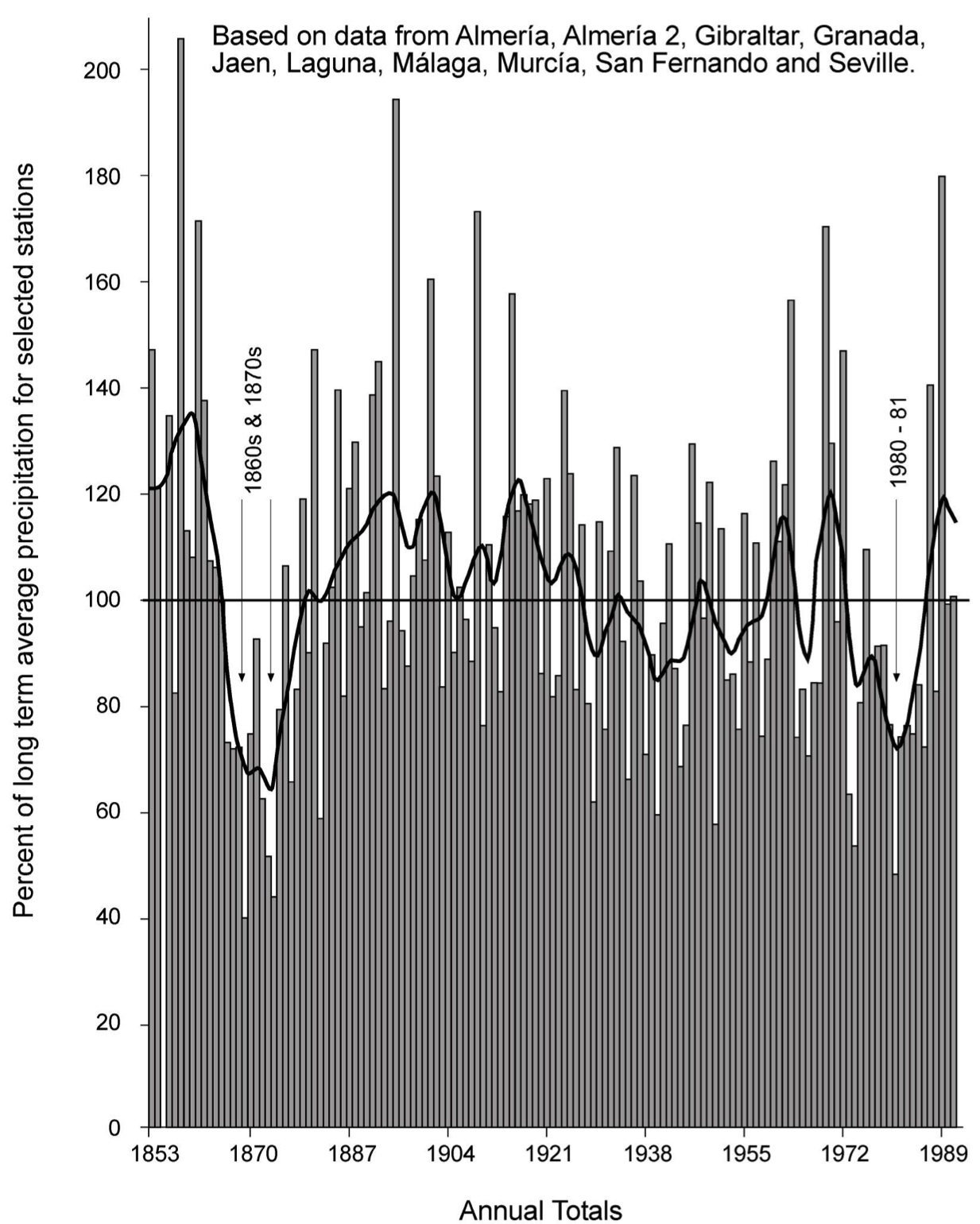
Long term rainfall records for Andalucia

Slide 29
Difficulties with recurrence intervals
We have only short records of rainfall (unusually long for Gibraltar)
Estimates of recurrence interval are almost always based on rainfall, rather than the river flows that feed reservoirs
Time series may be non-stationary, because of runs of wet and dry years, or climate change
Estimating is therefore challenging
What recurrence interval SHOULD we plan for to cope with drought?

Slide 30
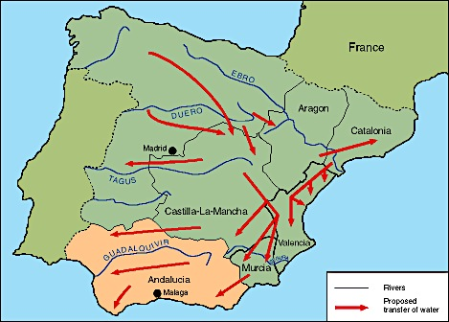
Proposed water transfers from the River Ebro to Southern Spain, National Water Plan 2000
1 billion cubic litres per annum?

Slide 31
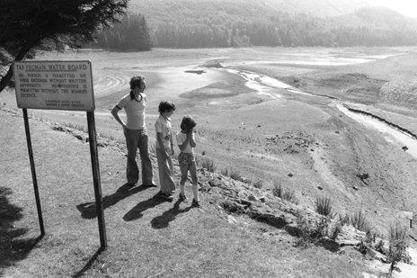
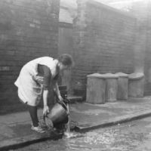
A memory test – past UK droughts
1975-1976 (lowest flows on record)
1989-1992 (low groundwater levels)
1995-1996 (mainly northern England)
2004-2006 (mainly south east England;
Hosepipe bans for 16 M people)
2010-2012 (widespread, driest 24 months for 100 years)
And for older members of the Gresham College audience:
1933-4
1920-21
Throughout the 1880s….

Slide 32

1975-6 drought in the UK

Slide 33
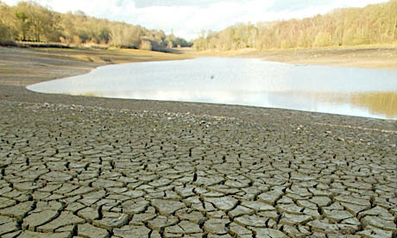
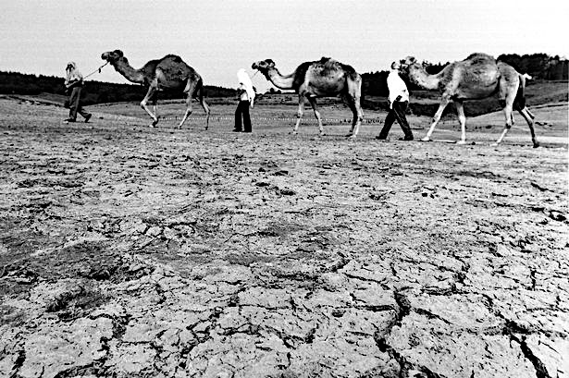
Camels from Longleat Safari park Wiltshire August 1976

Slide 34
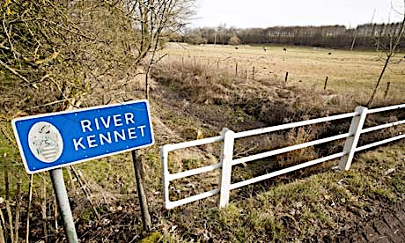

Slide 35
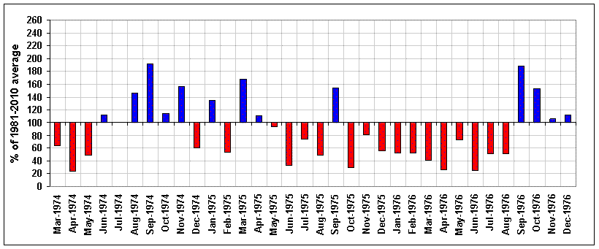
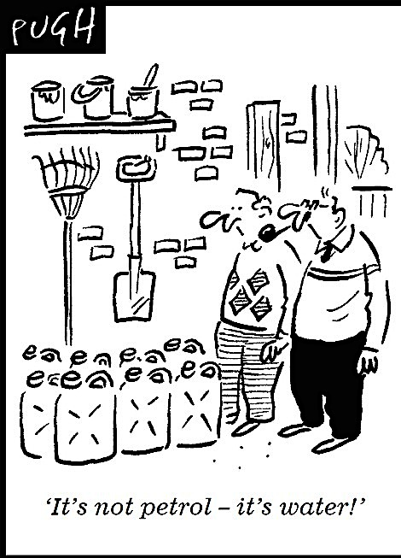
Average rainfalls in southern England, March 1974 to December 1976
Driest 16 month period on record
Intensely hot dry summer
Floods
Dry winter 1975

Slide 36
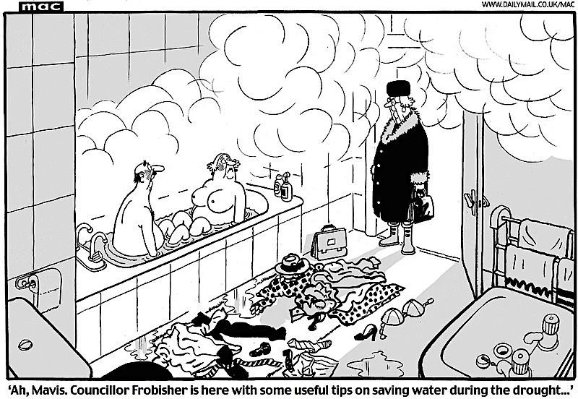

Slide 37
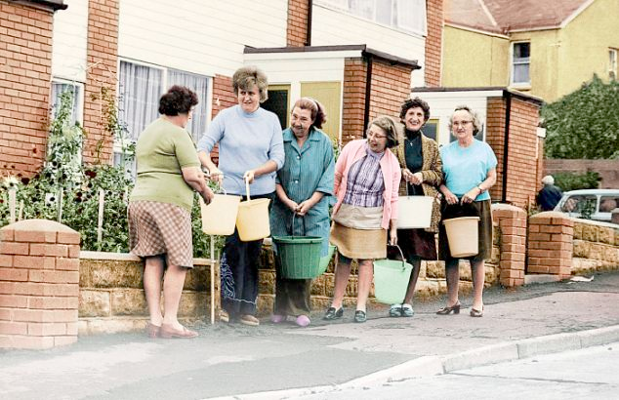

Slide 38
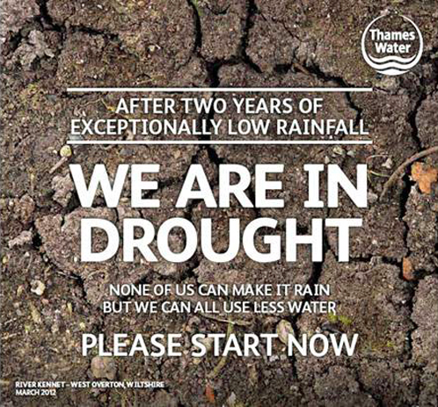
2010-2012

Slide 39
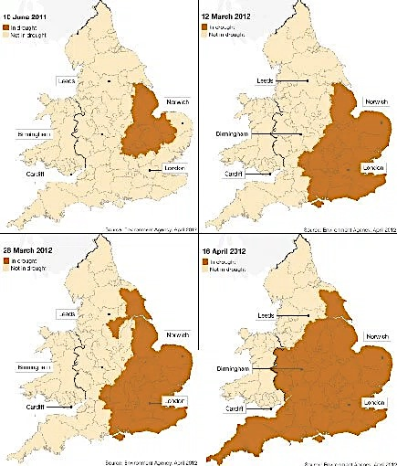
Creeping paralysis
15th June 2011
12th March 2012
28th March 2012
18th April 2012

Slide 40
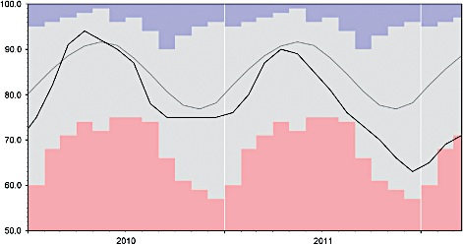
The 2010–2012 drought in Rutland Water
Blue- Highest levels ever recorded
Long term average
Recorded
Red- Lowest levels ever recorded
Weather
Volume 68, Issue 4, pages 88-95, 27 MAR 2013 DOI: 10.1002/wea.2101
http://onlinelibrary.wiley.com/doi/10.1002/wea.2101/full#wea2101-fig-0008
Notes:
End‐of‐month stocks in Rutland reservoir (% of capacity), 2010–March 2012. The blue and pink envelopes represent, respectively, the highest and lowest stocks recorded (1988–2009), whilst the grey trace is the long‐term average.
IF THIS IMAGE HAS BEEN PROVIDED BY OR IS OWNED BY A THIRD PARTY, AS INDICATED IN THE CAPTION LINE, THEN FURTHER PERMISSION MAY BE NEEDED BEFORE ANY FURTHER USE. PLEASE CONTACT WILEY'S PERMISSIONS DEPARTMENT ON PERMISSIONS@WILEY.COM OR USE THE RIGHTSLINK SERVICE BY CLICKING ON THE 'REQUEST PERMISSIONS' LINK ACCOMPANYING THIS ARTICLE. WILEY OR AUTHOR OWNED IMAGES MAY BE USED FOR NON-COMMERCIAL PURPOSES, SUBJECT TO PROPER CITATION OF THE ARTICLE, AUTHOR, AND PUBLISHER.

Slide 41
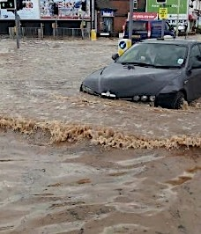
Flood warnings issued in drought areas in summer 2012
The wettest April to September 2012 for over 100 years caused flooding of over 4,500 homes and businesses. Sewers overflowed, rivers were polluted, agricultural runoff and storm overflows polluted beaches, and drinking water standards were almost compromised
Flooding in Loughborough, June 2012

Slide 42
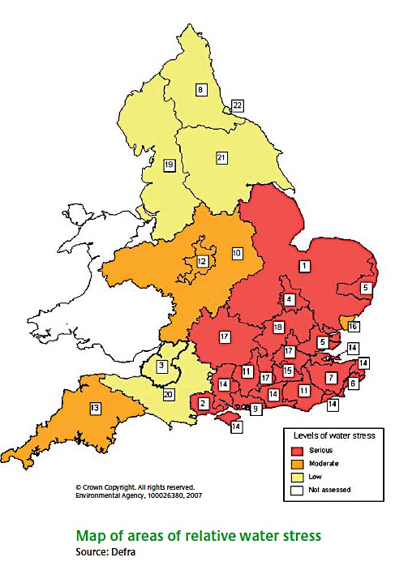
Areas of England already under water stress in 2007, according to the Environment Agency, for Defra
Notes:
The South and East of England already has water stress comparable to that experienced in Spain and Italy.

Slide 43
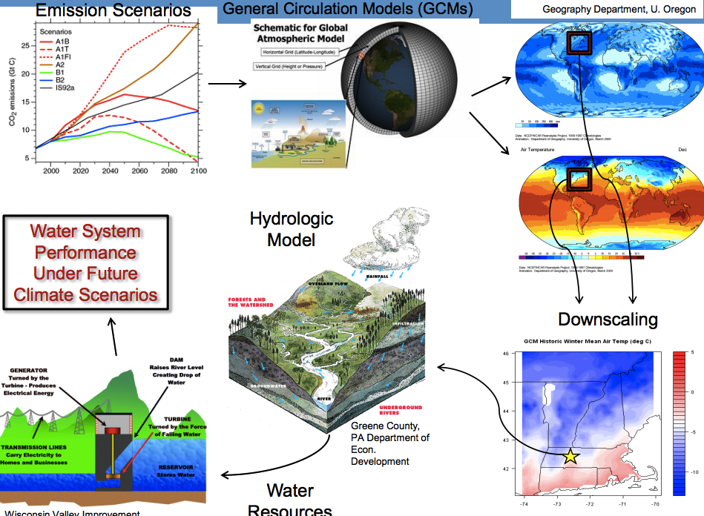
Casey Brown, University of Massachusetts

Slide 44
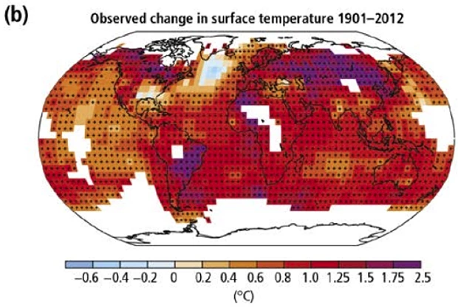

Slide 45


Mean Central England Temperature Anomalies, 1772 - 2015

Slide 46

Hotter and drier
Casey Brown, University of Massachusetts

Slide 47

Forecast global water stress by 2040, assuming population growth etc.
Notes:
One is left wondering whether the increased prevalence of drought in the Middle East will increase or decrease political instability? We have already seen evidence that the current dispute in Syria is drought driven.

Slide 48

Published by AAAS
J. W. Hall et al. Science 2014;346:429-430
Notes:
Linking economic growth, hydrologic variability, and investment in risk mitigation.The world's river basins with a population >2 million, colored according to GDP per capita of the population in the basin. The horizontal axis summarizes hydrologic variability. The vertical axis is a composite indicator of investment in infrastructure and institutional capacity. The colored contours are a linearly interpolated surface reflecting the association between variability, water security investments, and GDP. See supplementary materials for details.

Slide 49


Slide 50

A 2015 Californian drought plan?

Slide 51
“...resilience is generally understood as ‘‘the capacity of a system to absorb disturbance and still retain its basic function and structure’’. Such perspectives have offered a useful framework for understanding the relational dynamics of water systems, including how human–nature interactions within watersheds and cross-scalar spatial and organizational relations influence the direction and magnitude of change.”
Chappels and Medd, 2012; references removed for clarity

Slide 52
What does the plan need to cover?
Public water supplies
Private supplies
Agriculture and horticulture
Environment (fisheries, wetlands, wildlife)
Navigation
Infrastructure
Industry

Slide 53
What are the options?
Manage supply
Manage demand
Develop new sources and pipelines
Take more directly from rivers and restrict reservoir releases
Transfer bulk water between water companies
Desalination
Move water regionally
Build more storage
Public efficiency campaigns
Reduce leakage (targets)
Install water meters and hope this incentivises customers to use less
Reduce pressure in the pipes
Explore industrial use reductions
Temporary bans on use

Slide 54

Major trans-basin water schemes in England and Wales

Slide 55


Slide 56
What if it becomes an emergency?
Drought becomes an emergency if there is a threat of restrictions to public water supply – rota cuts or standpipes, (or total failure??) – how do we know?
Each water company has a Plan, which will be communicated in advance to local councils, emergency services and local resilience forums.
In an emergency the Environment Agency will monitor, report and act to reduce impact on the environment and people, and will support multi-agency arrangements. Local EA teams will work with resilience forums to ‘make sure that water companies have assessed the risk of drought properly and are taking the right steps to avoid or reduce emergency actions’.

Slide 57



Emergencies…

Slide 58

If a drought threatens, the Environment Agency produce a map showing the extent and severity, and any restrictions on supplies.
In severe incidents Cabinet Office Briefing Room (COBR) is activated.
Companies can impose emergency restrictions on domestic and industrial users

Slide 59
The scientist’s advisory role | Which Restaurant shall we go to? | What should we do about drought?
Pure Scientist | Here’s a set of guidelines on diet | Here is a set of reports about droughts
Science Arbiter | Feel free to ask me specific questions – for example how far is the nearest Thai? | What do you need to know about droughts in order to decide?
Issue Advocate | You will really like Italian food – go to Giovanni’s | You should increase expenditure on pipelines between river basins
Honest Broker of Policy Alternatives | Here is information on the price, distance and menu of all the restaurants around here | Here’s an analysis of the impacts of drought on water supplies, agriculture and ecology in the UK. You choose.
Roger Pielke Jr, (2007) The Honest Broker

Slide 60

Who are the Decision Makers?

