Slide 1
Fuelling the Debate: The English Corn Law returns, the Corn Laws and the birth of political economy
D’Maris Coffman, 10 December, Gresham College

Slide 2
Quick Overview
Why are we interested in grain markets?
  Birth of political economy
    (Adam Smith/David Ricardo/Thomas Malthus)
    Evidenced-based policy.
  Efficient-Markets Hypothesis (Holbrook Working)
Overview of English and Welsh grain markets
What are the Corn Returns?
What were the Corn Laws?
Two big debates in Political Economy:
  Repeal of the Corn Laws
  The Problem of ‘Corn Rents’ and the Commutation of Tithes

Slide 3
Adam Smith’s Wealth of Nations

Slide 4
Anatomy of British Grain Markets
Open Markets (25-50% of total)
  Market Towns (heavily regulated);
  Market Fairs (seasonal or annual).
Private Markets
  Over-the-counter (or ‘at the gate’);
  Middlemen, factors, jobbers kept ‘derivatives books’ with ‘cash-settled futures’;
  Other contracts were usurious, insofar as they advanced the farmers money for the payment of their rents, but complaints were infrequent.

Slide 5
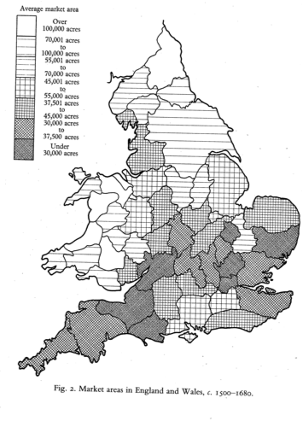
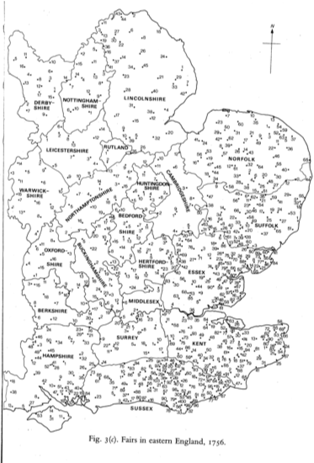
Market Towns and Market Fairs
Chartres (1990), p. 46, 181.

Slide 6
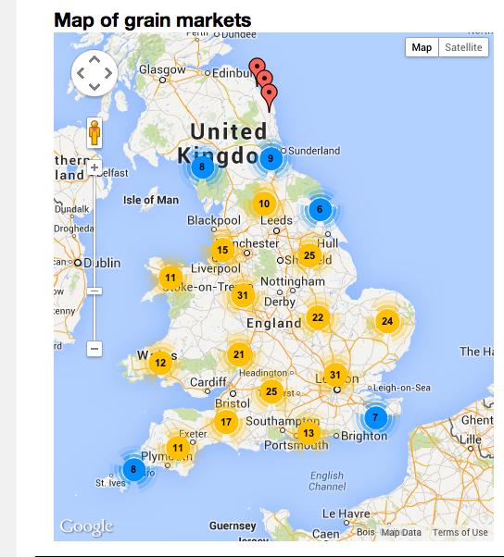

Slide 7
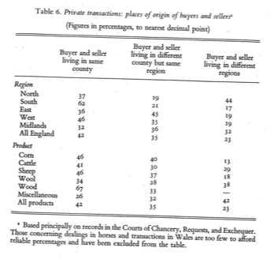
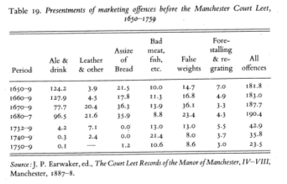
Private Marketing in England
Chartres (1990), pp. 99, 248.

Slide 8
What are the Corn Returns?
Established in 1685 under James II; re-established and enlarged in 1770/1 under George III.
Tracked five commodities (prices and quantities) in outports and major market towns; by the 1840s, up to 280 markets were tracked.
Trading factors in each market produced their trading accounts under oath; nominated persons than reported weighted averages to commissioners.
Despite problems, remarkable consistency and accuracy.

Slide 9
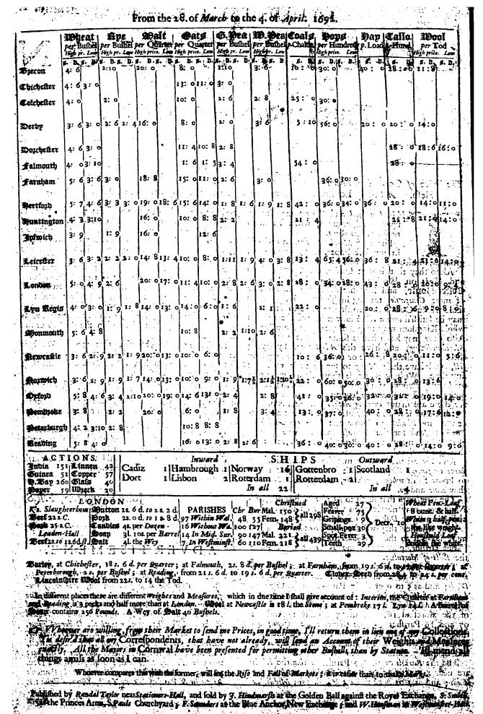
John Houghton’s Collection
One of 583 such price currents spanning period from 1692-1702

Slide 10
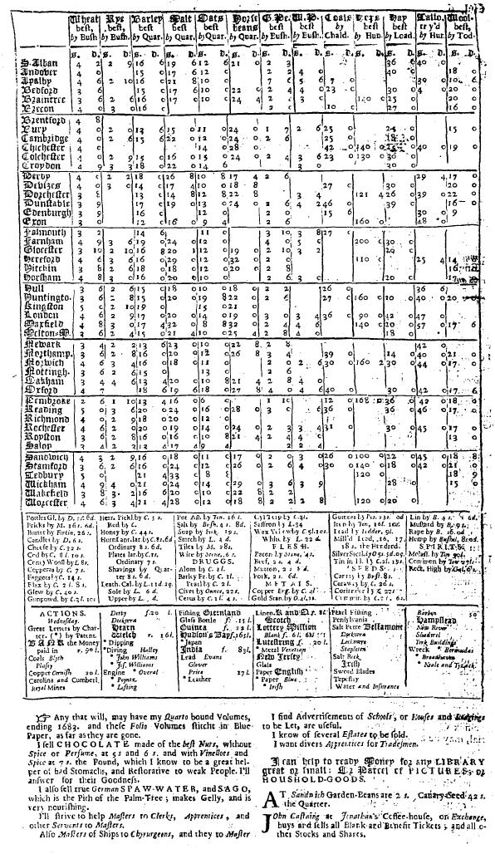

Slide 11
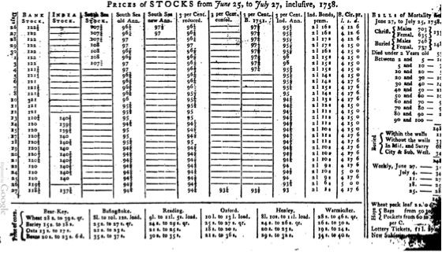
Universal Magazine, August 1758

Slide 12
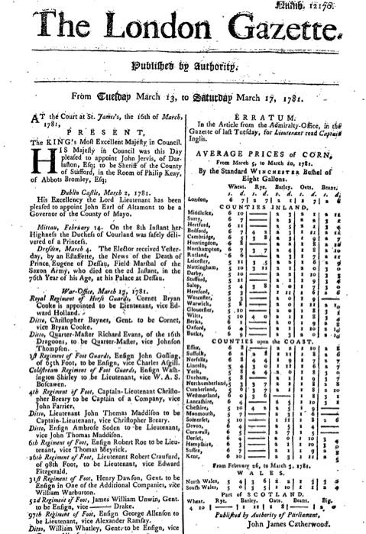

Slide 13
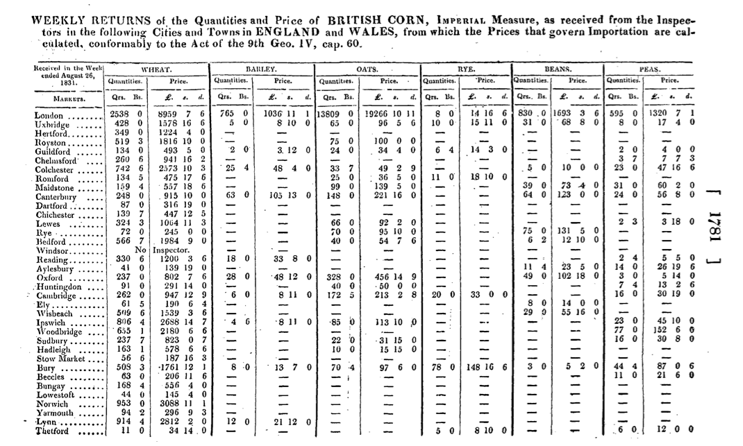
London Gazette (1831)

Slide 14
The Corn Returns Online
Supported by the Institute for New Economic Thinking, 2nd INET-CIGI grant round
Digitisation and data cleaning by D’Maris Coffman and Yuning Gao; site development by Louise Pryor
The data is available for download, but please register to get access to more than 10 markets at a time.
We would love to hear from you if you are interested in using our data for primary research.

Slide 15
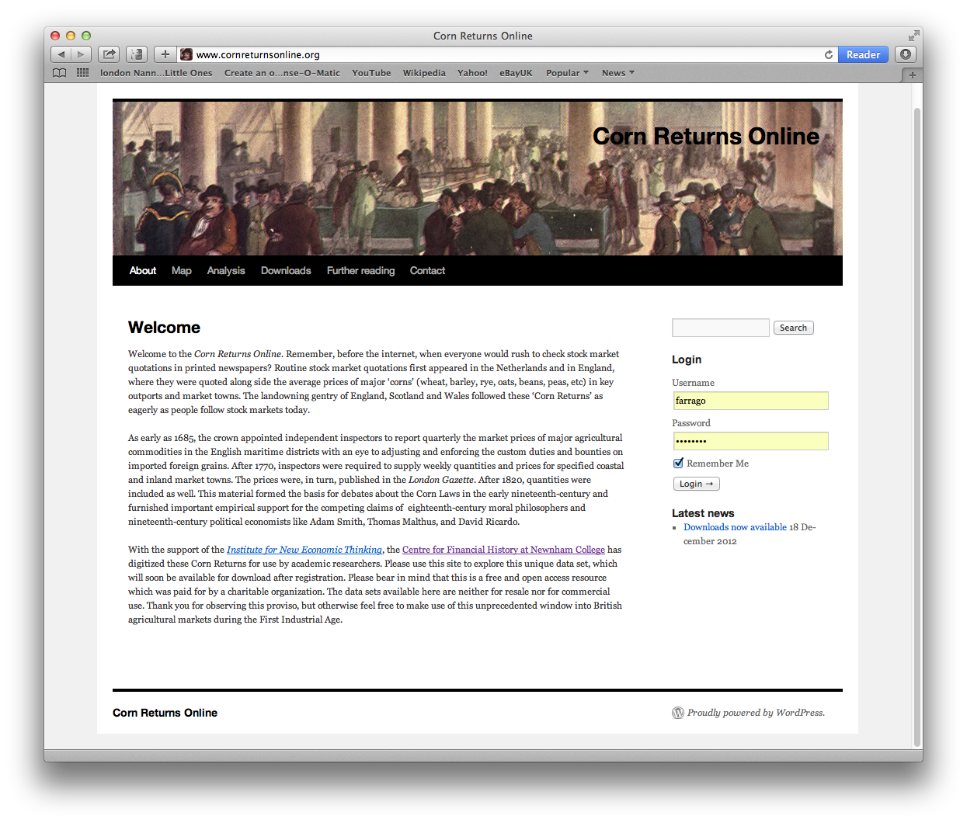

Slide 16
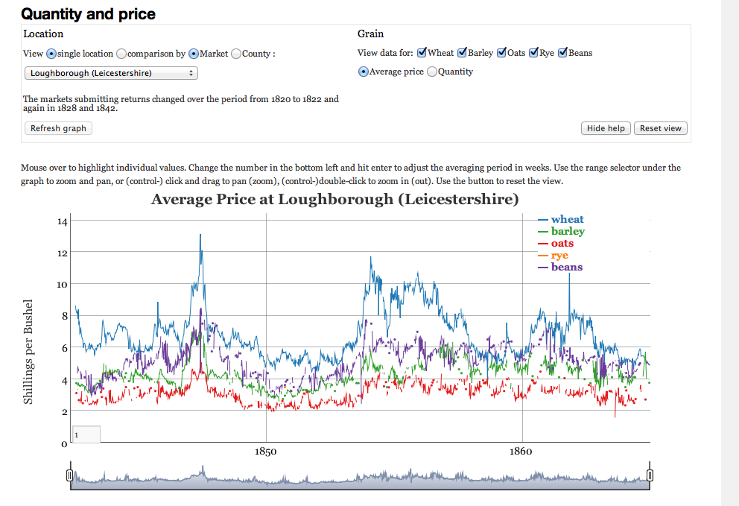
Data Analysis

Slide 17
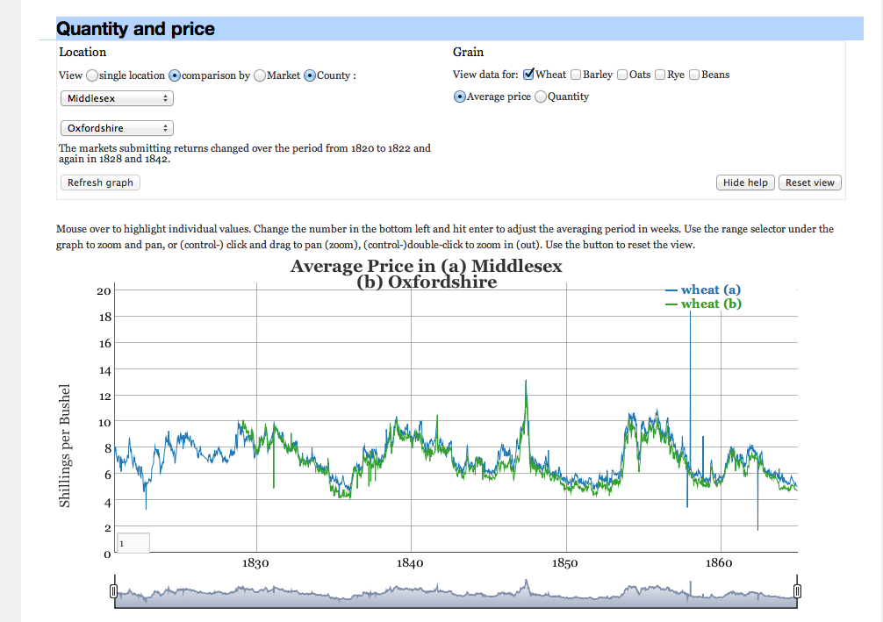

Slide 18
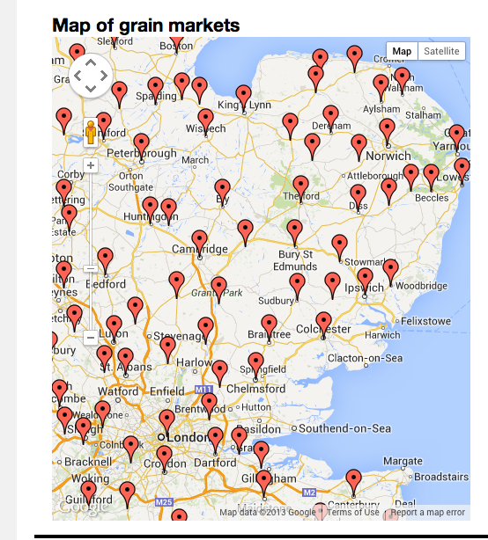

Slide 19
Research programme at CFH
What accelerated market integration?
  Coming of the canals?
  Railroads?
  Country banks and post offices?
How do we explain the different trajectories: Ireland versus England/Wales
Did the regulatory regime benefit the agricultural sector at the expense of the industrial one?
Methodological issues
Resolve classic debates in political economy

Slide 20
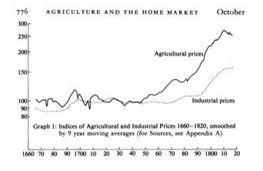
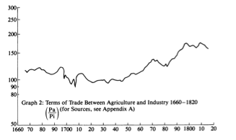
Agricultural versus Industrial Prices
O’Brien (1988), p. 776.

Slide 21
Corn Laws in their infancy
Date from the 1690s; not just a product of the Napoleonic Wars
Deliberate attempt to encourage capital investment in domestic agriculture;
Replaced the assizes on bread and beer as a way of protecting consumers and farmers alike against volatility and speculation in corn markets;
Tariffs on imported grains as well as export bounties to ensure price support;
For much of the early 18th century, bounties paid exceed tariffs collected by a considerable margin;
Implications for international competitiveness.

Slide 22
Corn Returns and Policy Choices
Initially collected in order to set the correct tariff on imported corn;
Also used to judge the effect of the changes of excise rates on agricultural prices and on the anticipated tax take;
Finally used to mediate debates about repeal of the Corn Laws in the 19th century.

Slide 23
Corn Returns and the Excise
Single largest household cash expense (Gregory King, 1695) for poor and lower middling sort.
Only well-off could afford to brew at home. This produced periodic calls for malt and hops taxes supported by reference to corn prices.
Beer production consumed a significant portion of English agricultural produce (barley, wheat, rye, oats, hops, molasses).
Contemporaries debated the effects of the excise fiercely, both in parliament and in the ‘public sphere’ via print petitions and pamphlets.
The authors made a distinction very early between legal and final incidence of the tax. Who really paid? Can the Corn Returns tell us?

Slide 24
View from a grain merchant
‘The first wherein I would give instance is the brewing trade, a trade or employment upon which depends the consumption of near one half of the corn produced annually in England (Peas only excepted). The which must needs be allowed to be much abated, and so my Lords, the Excise Accompts will inform your Lordships since it is to be seen that they brewed less the last year by 1,337,504 barrels of strong beer, then they did in the year 1688, which cannot but exceedingly affect the interest of the country farmers as your Lordships will soon perceive from what I have to say more on their behalf.’
(William Stockton, British Library Harley MS 1223, f. 192, 1694)

Slide 25
Gregory King’s Estimates of Average Household Diet (1695)
See Chartres (1990), p. 159.

Slide 26
How did the Corn Returns fuel debate?
They were used to decide if ports were open, what tariff was chargeable, and what, if any, bounty might be paid;
Widely reported in local newspapers, which copied relevant sections of the London Gazette;
Corn factors and industrialists used them to argue for repeal of the Corn Laws;
Farmers and landowners used them to argue for continuance;

Slide 27
Malthus versus Ricardo
Ricardo and Malthus disagreed on the concept of ‘economic rent’. Malthus held more closely to Smith, while Ricardo believed rent was the residual value in excess of the production value;
Not purely a theoretical argument;
Turns on movements of prices and rents;
Ha Joon Chang sees Corn Laws as responsible for English Industrial Revolution, though not all contemporaries agreed.

Slide 28
Commutation of tithes
Initially debated in the 1660s after the abolition of the Court of Wards;
Not adopted until 1836;
Included ecclesiastical lands and private landlords; 10% of produce;
Adam Smith remarked on this in Wealth of Nations.
Tithe Commutation Act of 1836.
Corn Returns introduced transparency in negotiations

Slide 29
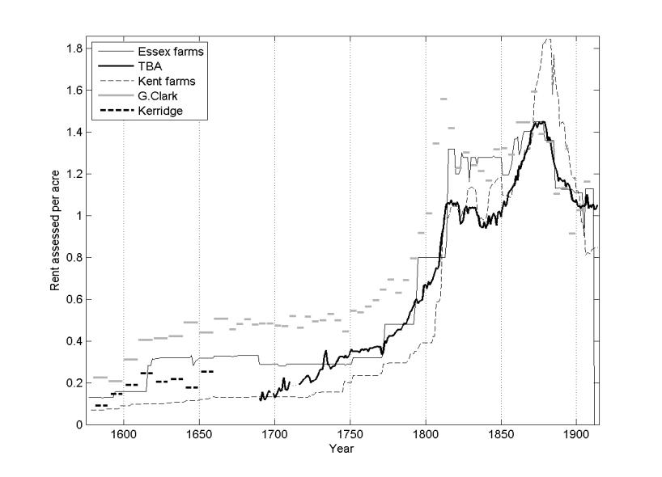
RBT Agricultural Rents compared with TBA , Clark and Kerridge (£ per acre)

Slide 30
Conclusions
Expensive and extensive undertaking by the early modern English state;
Used initially to regulate the corn bounties in the context of the Corn Laws, this data was eventually mobilised for evaluating changes in excise taxation as well;
Crucial to furnishing empirical support for the debates that led to the repeal of the Corn Laws;
Equally critical in the commutation of tithes.

Slide 31
Further Reading
W. Brunt and E. Cannon. ‘The truth, the whole truth and nothing but the truth: the English Corn Returns as a data source in economic history, 1770-1914,’ NHH Discussion Paper, ISSN: 0804-6824
Joan Thirsk (ed.), The Agrarian History of England and Wales, especially Volumes V, 1640-1750 (ed. J. Thirsk, Cambridge 1985) and VI, 1750-1850 (ed. G.E. Mingay, Cambridge 1989-90).
Lucy Adrian, ‘The nineteenth century Gazette Corn Returns from East Anglian Markets,’ Journal of Historical Geography, 3, 3 (1977) 217-236, esp. 218-220; see also the debate between Wray Vamplew and Lucy Adrian in Journal of Historical Geography, 4,3 (1978) 291-293.
D.A. Baker, ‘The marketing of corn in the first half of the 18th century’, Agricultural History Review 18 (1970)
Susan Fairlie, ‘The Corn Laws and British wheat production 1829-76’ in Economic History Review, 2nd series 22 (1969) 88-116.
C.R. Fay, The Corn Returns and Social England (Cambridge, 1932).
D. Ormrod, English Grain Exports and the Structure of Agrarian Capitalism 1700-1760 (Hull, 1985)

Slide 32
Acknowledgements
Institute for New Economic Thinking
Leverhulme Trust
Isaac Newton Trust
Cambridge Population Group
Centre for Financial History
Dr Louise Pryor (Centre for Risk Studies and Centre for Financial History, Cambridge) and Dr Yuning Gao (Tsinghua University)

