Slide 1


Might as well toss a coin!
How random numbers help us
find exact solutions
Tony Mann, 17 March 2014

Slide 4
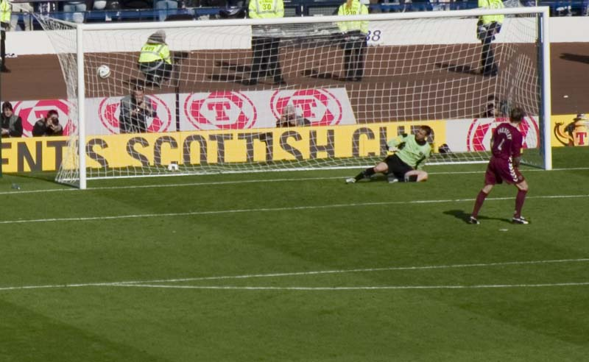

Slide 5
The Toss in Cricket
Match number | Toss won by | Match won by
1 | B | B
2 | B | B
3 | A | Drawn: A on top
4 | B | B
5 | A | Drawn: A on top
6 | A | A
7 | A | A
8 | A | A
9 | A | A
10 | B | A

Slide 6

A volunteer please!

Slide 7
Think of a random number between 1 and 50
with two digits, both of them odd
and not both the same

Slide 8
Your number is
37

Slide 9
My odds were
1 in 50
1 | 2 | 3 | 4 | 5 | 6 | 7 | 8 | 9 | 10
11 | 12 | 13 | 14 | 15 | 16 | 17 | 18 | 19 | 20
21 | 22 | 23 | 24 | 25 | 26 | 27 | 27 | 29 | 30
31 | 32 | 33 | 34 | 35 | 36 | 37 | 38 | 39 | 40
41 | 42 | 43 | 44 | 45 | 46 | 47 | 48 | 49 | 50

Slide 10
My odds were
1 in 50
 |  |  |  |  |  |  |  |  | 10
11 | 12 | 13 | 14 | 15 | 16 | 17 | 18 | 19 | 20
21 | 22 | 23 | 24 | 25 | 26 | 27 | 27 | 29 | 30
31 | 32 | 33 | 34 | 35 | 36 | 37 | 38 | 39 | 40
41 | 42 | 43 | 44 | 45 | 46 | 47 | 48 | 49 | 50

Slide 11
My odds were
1 in 50
11 |  | 13 |  | 15 |  | 17 |  | 19
31 |  | 33 |  | 35 |  | 37 |  | 39

Slide 12
My odds were
1 in 50
 |  | 13 |  | 15 |  | 17 |  | 19
31 |  |  |  | 35 |  | 37 |  | 39

Slide 13
My odds were
1 in 50
1 in 8
 |  | 13 |  | 15 |  | 17 |  | 19
31 |  |  |  | 35 |  | 37 |  | 39

Slide 14
Think of a random number
between 1 and 100

Slide 15
Your number is
an integer

Slide 16
Think of any random number you like
integer, rational, irrational, …
whatever

Slide 17
Your number is
expressible
in less time than
the age of the universe

Slide 18
What is the probability that an integer chosen at random is divisible by 7?
{1, 2, 3, 4, 5, 6, 7, 8, 9, 10, 11, 12,
13, 14, 15, 16, 17, 18, 19, 20, 21,
22, 23, 24, 25, 26, 27, 28, …}
Clearly it’s 1 in 7

Slide 19
What is the probability that an integer chosen at random is divisible by 7?
{1, 2, 3, 4, 5, 6, 7, 8, 9, 10, 11, 12,
13, 14, 15, 16, 17, 18, 19, 20, 21,
22, 23, 24, 25, 26, 27, 28, …}
Clearly it’s 1 in 7

Slide 20
What is the probability that an integer chosen at random is divisible by 7?
{1, 7, 2, 14, 3, 21, 4, 28, 5, 35,
6, 42, 8, 49, 9, 56, 10, 63, 11,
70, 12, 77, 13, 84, 15, 91, …}
Clearly it’s 1 in 7

Slide 21
What is the probability that an integer chosen at random is divisible by 7?
{1, 7, 2, 14, 3, 21, 4, 28, 5, 35,
6, 42, 8, 49, 9, 56, 10, 63, 11,
70, 12, 77, 13, 84, 15, 91, …}
Clearly it’s 1 in 2

Slide 22
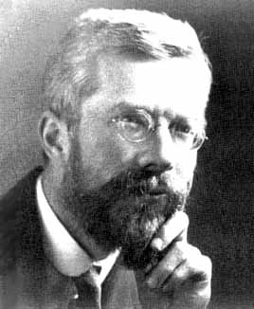
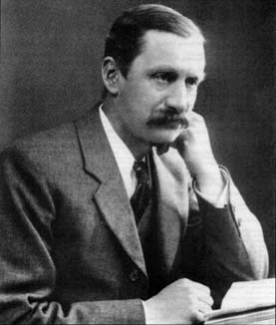
Fisher v Burnside

Slide 23
The Doomsday Argument
If I am the n^{th} person to have been born
then with 95% probability total number of humans who will ever live is < 20n
So human race can’t expect more than another 9000 years.
(Argument worked for estimating number of German tanks being produced in WW2!)

Slide 24
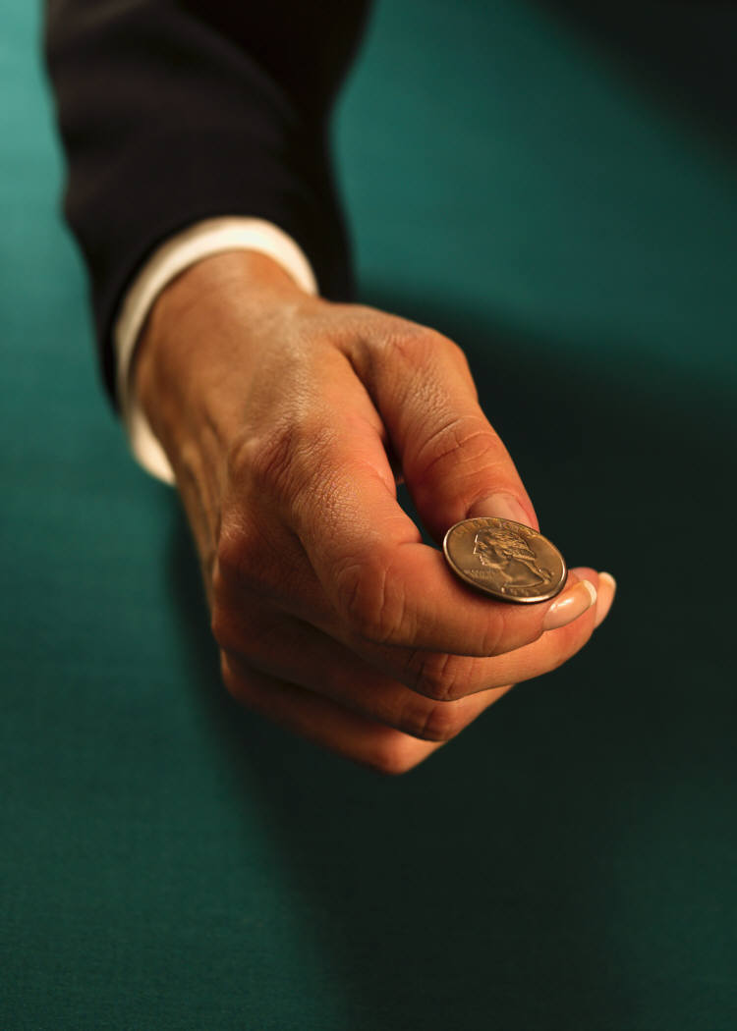
Can tossing a coin help with important decisions?

Slide 25

Buridan’s Ass

Slide 26
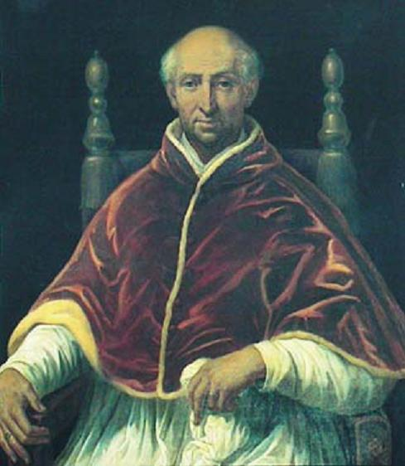
John Buridan and Pope Clement VI

Slide 27
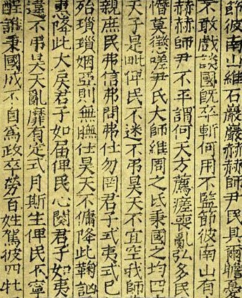
The I Ching

Slide 28
Coin-tossing to answer maths questions
What is the value of
π ?

Slide 29
π
Ratio of circumference of circle to diameter
Value 3.14159 26535 …

Slide 30
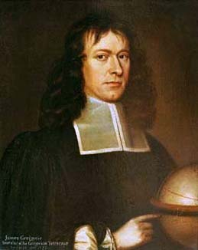
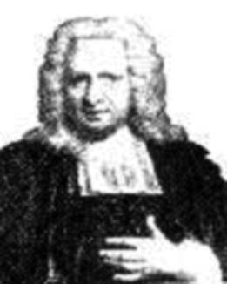
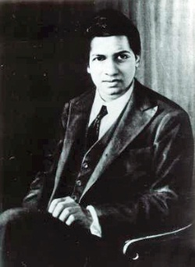

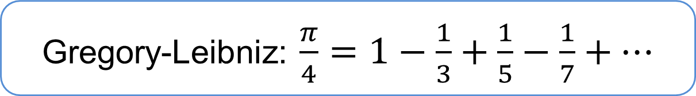
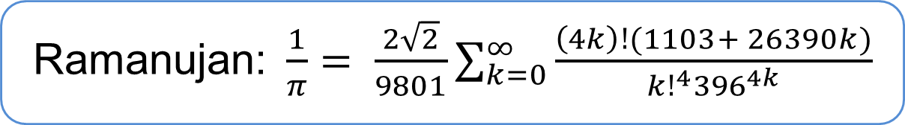
Formulae for π
Gregory-Leibniz: $\frac{π}{4}=1−\frac{1}{3}+\frac{1}{5}−\frac{1}{7}+…$
Machin: $\frac{π}{4}=4 \tan^{−1}{\frac{1}{5}}− \tan^{−1}{\frac{1}{239}}$
Ramanujan:$\frac{1}{π}= \frac{2\sqrt{2}}{9801}\sum_{k=0}^{∞}{\frac{\left(4k\right)!(1103+ 26390k)}{{k!}^{4}{396}^{4k}}}$

Slide 31
Finding π by throwing darts
Circle of radius 1 in square of side 2
Area of square = 4
Area of circle = π
Probability randomly chosen point in square lies inside circle is π/4

Slide 32
Our method
Generate two random numbers x and y between 0 and 1
Is x² + y² < 1?
Do this repeatedly and count proportion lying within quarter-circle
This gives an estimate for π/4

Slide 33
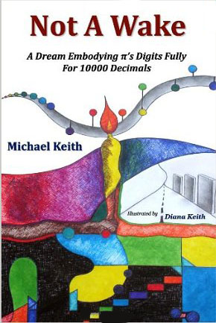
If you really want to know π
How I wish I
Could calculate pi.
May I have a large
container of coffee?

Slide 34
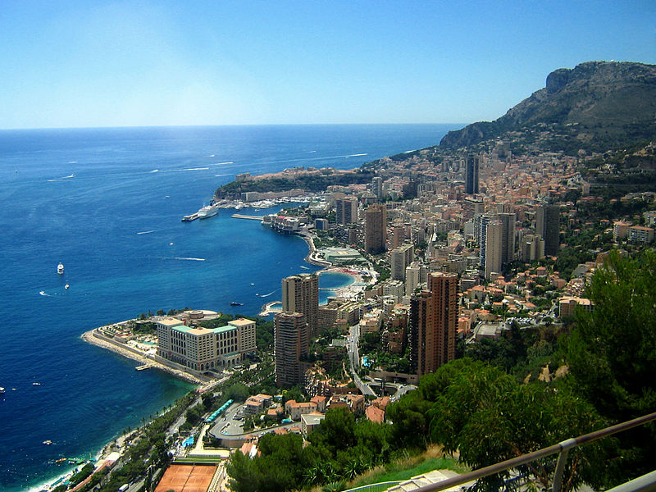
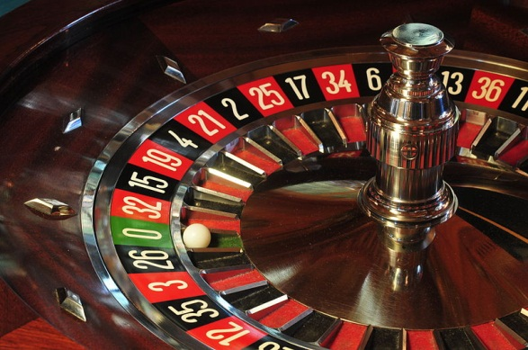
The Monte Carlo Method
Use random numbers to get an approximate solution
We don’t need any sophisticated maths or a formula for the answer to our problem!

Slide 35
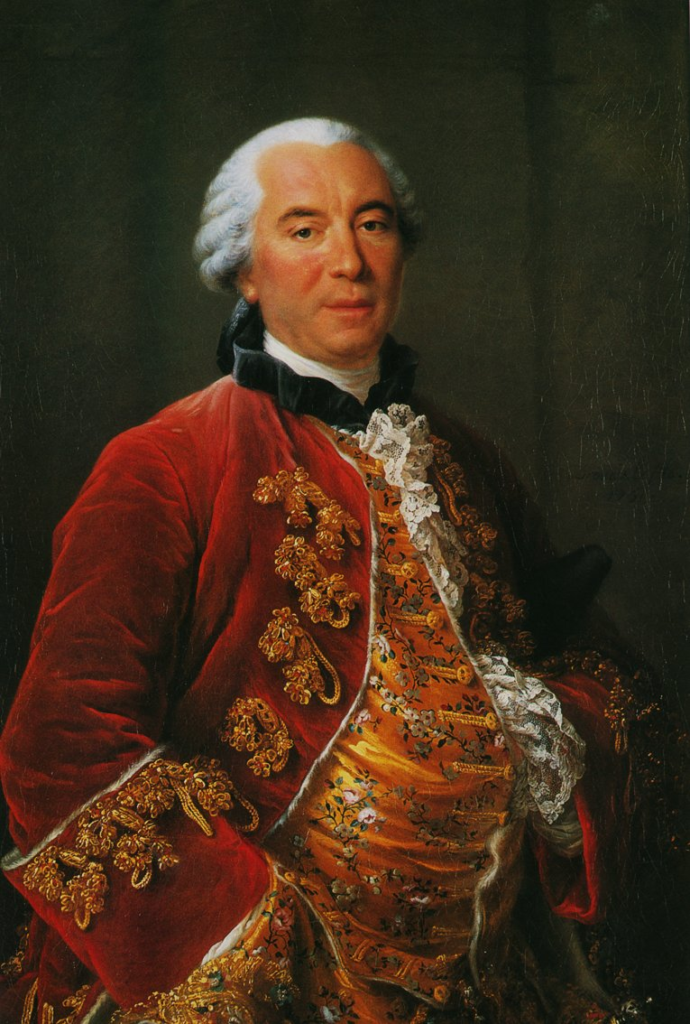
Buffon’s Needle
Drop needles length l randomly on floor of planks of width t
Probability a needle crosses line between planks is 2l / tπ
If we drop n needles and m cross lines, then π ≈ 2ln / tm

Slide 36
What happened?
π ≈ 2ln / tm
m = 1, n = 2
l = 710, t = 904
my approximation = 2 x 710 x 2 / 904 x 1
= 355 / 113
= 3.14159292…

Slide 37
Monte Carlo Simulation
If I know the result
I’m looking for,
I can choose my parameters carefully!

Slide 38
Monte Carlo Simulation
But we can also use random numbers to simulate complex real-life situations and find real solutions to business problems!

Slide 39
Monte Carlo Simulation
How many check-out staff should a supermarket roster for Sunday morning?
How many nurses in Casualty on Saturday evening?

Slide 40
Modelling of disease
We have a good model based on infection, transmission and recovery
When a new disease arises, we don’t know the parameters (infection and recovery rates etc)
Monte Carlo simulation for different parameters can show us what the likely outcomes are

Slide 41
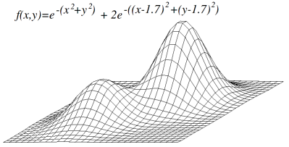
“Hill-climbing”
Local maximum
Global maximum

Slide 42
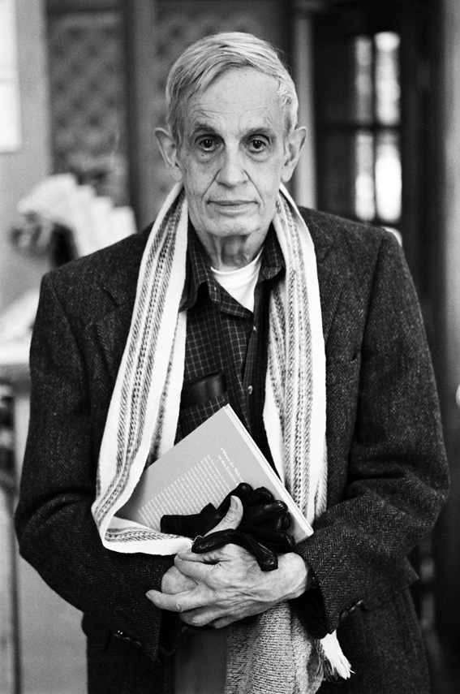
Game Theory
The maths of strategic thinking

Slide 43
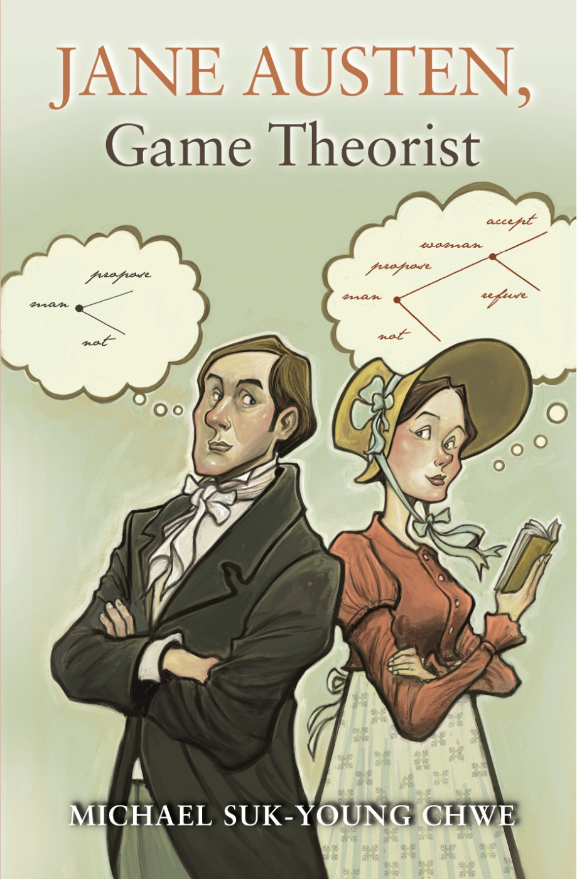

Slide 44
Game Theory
The maths of competitive decision making
I take into account your possible choices when making my decision, and you take mine into account when making yours
Penalty-taker and goalkeeper are each trying to out-guess the other

Slide 45
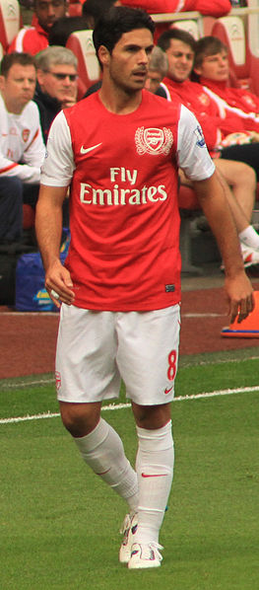
Arsenal v Everton 8/3/14

Slide 46
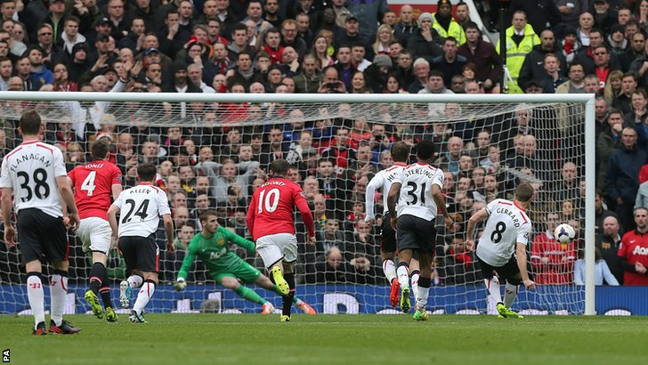
Man Utd v Liverpool 15/3/14
Steven Gerrard: “I maybe got a bit cocky with the last penalty.”
Or just a good game theorist?

Slide 47
Randomised Algorithms
How about an algorithm which gives a solution to our problem, but that solution may be incorrect?

Slide 48
Is a large number n prime?
Testing by trying every potential
divisor takes exponential time
as the size of n increases.
Can we tell in polynomial time?

Slide 49
Fermat’s Theorem
If p is prime, then for any x,
x^{p} – x is a multiple of p
So – to tell whether a large number n is prime, generate lots of random integers x and test this property
If for some x the property fails then n is not prime
If they all satisfy it, then there is some reason to believe that our number n is prime

Slide 50
Carmichael Numbers
If p is prime, then for any x,
x^{p} – x is a multiple of p
However, numbers like 561, 1105, 1729, 2465 and 2821 pass this test for all x but are not prime!
There are infinitely many such Carmichael numbers.

Slide 51
Is a large number n prime?
Randomised algorithm (Miller and Rabin, 1976) will always be right if the input number is prime, and will report a composite number to be prime with small probability
Agrawal, Kayal and Saxena (2004) have found a deterministic polynomial-time algorithm
Randomised algorithms are still much faster!

Slide 52
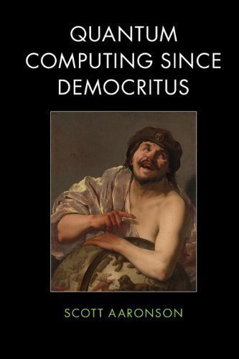
A computer scientist’s view
Randomised algorithms are fine for everyday purposes
like controlling the launch of nuclear missiles
We should only worry about using them for really important applications
like proving theorems in pure mathematics.

Slide 53
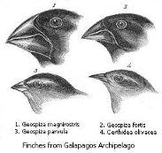
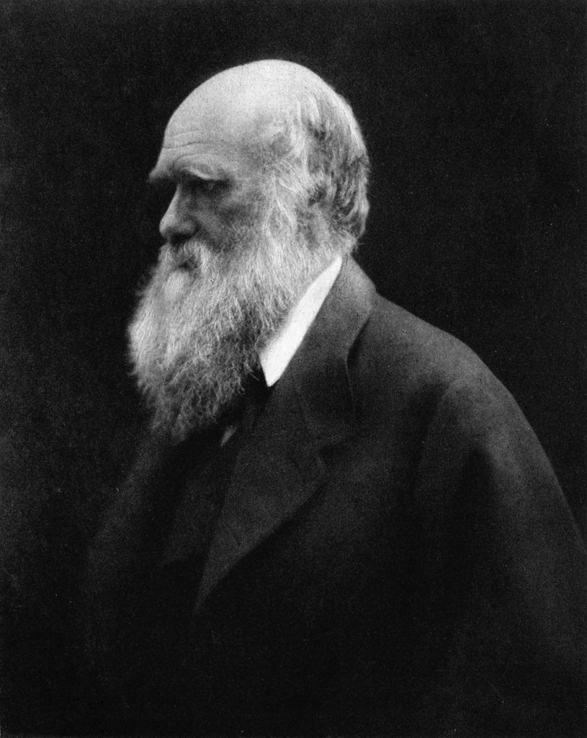
The best problem-solver of all

Slide 54
Evolutionary algorithms
Start with some possible solutions
Make random changes to these
Choose best results as parents of next generation
Repeat for many generations

Slide 55
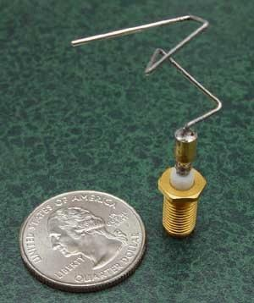
Examples
Timetabling problems
A walking gait for robots
Optimal shape for spacecraft antenna

Slide 56
Evolutionary algorithms
You can solve problems you have no idea how to begin to solve!
☺
But you don’t learn anything about how to solve them!
☹

Slide 57
Random numbers
Address weaknesses of deterministic algorithms
Monte Carlo simulation
Randomised algorithms probably give right answer
Evolutionary and genetic algorithms

Slide 58
Acknowledgments and picture credits
Many thanks to Noel-Ann Bradshaw, and everyone at Gresham College
Slide design – thanks to Aoife Hunt and Noel-Ann Bradshaw
Picture credits
Unless otherwise stated images are my own or Microsoft ClipArt.
Football penalty kick (Steven Pressley for Hearts against Gretna, Scottish Cup Final 2006): Davy Allan, Wikimedia Commons
R.A. Fisher: unattributed, Wikimedia Commons
William Burnside: unattributed, Wikimedia Commons
Buridan’s ass:: W.A. Rogers, New York Herald, c.1900, Wikimedia Commons
I Ching: Song Dynasty (960-1279), Wikimedia Commons
James Gregory: unattributed, Wikimedia Commons
John Machin: unattributed, Wikimedia Commons
S. Ramanujan: Oberwolfach Photo Collection, Wikimedia Commons
Michael Keith, Not a wake, Vinculum Press, 2010
Monte Carlo: Hampus Cullin, Wikimedia Commons
Roulette wheel: Ralf Roletschek, Wikimedia Commons
Comte du Buffon by François-Hubert Drouais: Musée Buffon, Montbard, Wikimedia Commons
Hill-climbing function: Headlessplatter, Wikimedia Commons
Michael Suk-Young Chwe, Jane Austen, Game TheoristL; Princeton University Press, 2013
Mikel Arteta: Ronnie Macdonald, Wikimedia Commons
Steven Gerrard penalty, Manchester Utd v Liverpool, 15 March 2014: BBC
Scott Aaronson, Quantum Computing since Democritus: Cambridge University Press, 2013
Darwin’s Finches: John Gould, from The Voyage of the Beagle, 1845, Wikimedia Commons
Charles Darwin: Julia Margaret Cameron, 1868, Wikimedia Commons
ST5 Satellites X-Band Antenna: NASA, Wikimedia Commons

Slide 59
Thank you for listening
a.mann@gre.ac.uk
@Tony_Mann

