Slide 1
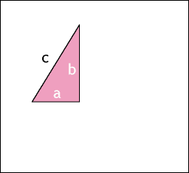
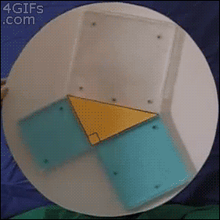
Proof by Computer
and Proof by Human
Tony Mann
15 April 2013

Slide 2
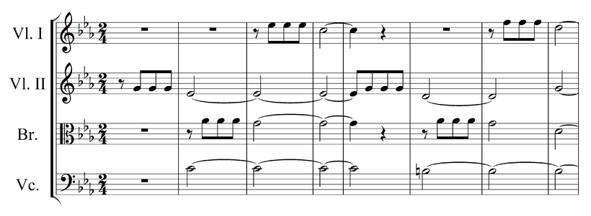
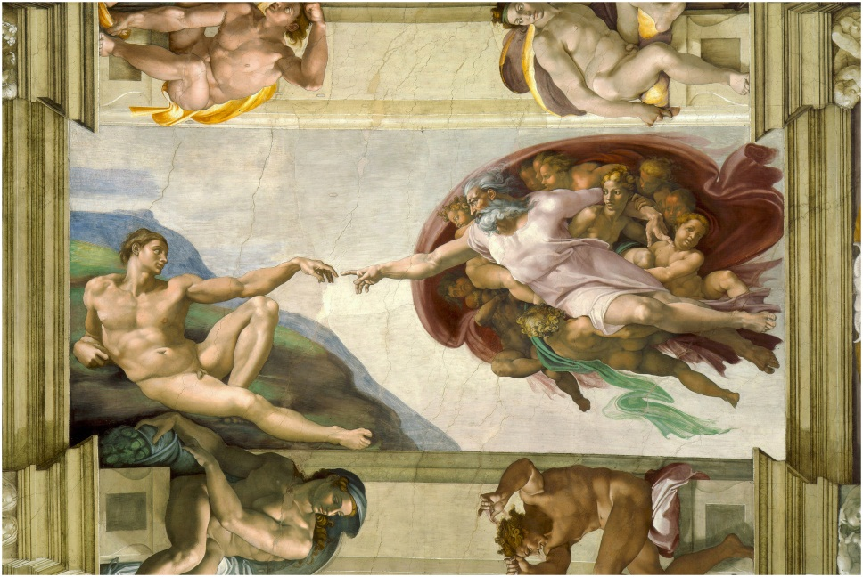

Slide 3
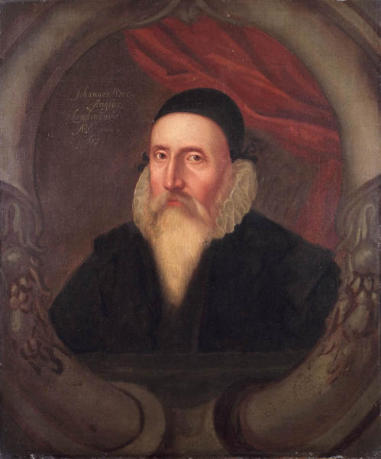
John Dee, 1570
A meruaylous newtralitie haue these thinges Mathematicall, … In Mathematicall reasoninges, a probable Argument, is nothyng regarded: nor yet the testimony of sense, any whit credited: But onely a perfect demonstration, of truthes certaine, necessary, and inuincible: vniuersally and necessaryly concluded: is allowed as sufficient for an Argument exactly and purely Mathematical.

Slide 4
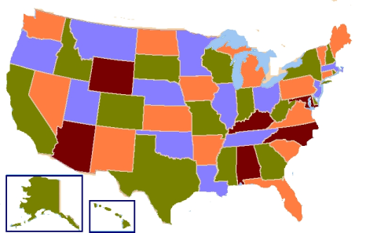
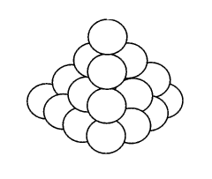
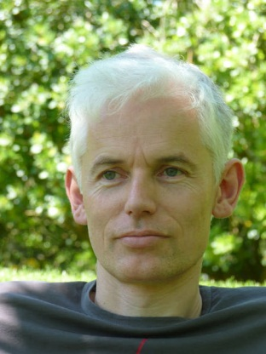
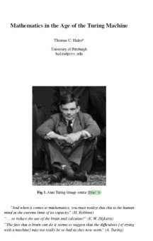
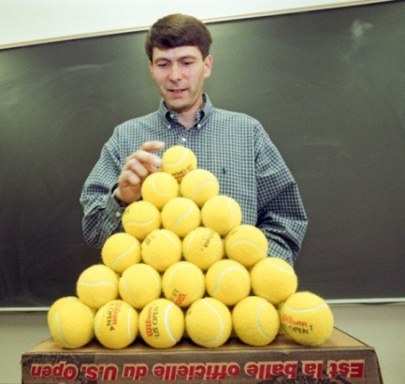
Outline
Some simple proofs
The Four Colour Theorem
The Kepler Conjecture
Reflections

Slide 5
How many dots?

Slide 6
It’s n³ – (n-1)³. Is this a proof?
Richard Phillips, Numbers: facts, figures and fiction (Badsey, 2004)

Slide 7
What is 1+2+3+…+n ?
S = 1 + 2 + 3 + . . . + n
S = n + n-1 + n-2 + . . . + 1
2S = n+1 + n+1 + n+1 + . . . + n+1
2S = n (n+1)
S = ½ n(n+1)

Slide 8
Proof by Mathematical Induction
Step 1 (Basis):
Establish result for starting value – eg n=1
Step 2 (Inductive step):
Show that if the result holds for n=k,
then it also holds for n = k+1

Slide 9
1+2+3+…+n = ½ n(n+1) by induction
Basis: Case n=1:
1 = ½ .1.(1+1) = 1
Inductive step: suppose
1+2+3+…+k = ½ k(k+1)
Then
1+2+3+ … +k + k+1 = ½ k(k+1) + k+1
= ½ (k+1)(k+2)
√
√

Slide 10
Proof by Mathematical Induction
Proves an infinity of results in only two steps!

Slide 11
Reductio ad absurdum
Proof by Contradiction
We show that if our proposition is false, we have a contradiction,
so it must be true

Slide 12
There are infinitely many prime numbers
A prime number is a number
greater than 1 which is
divisible only by itself and 1
For example 13 is prime
but 6 = 2x3 isn’t.

Slide 13
There are infinitely many prime numbers
Proof: Suppose there are only finitely many primes, so we can list them:
2, 3, 5, 7, 11, 13, …, p
where p is the largest prime.
Consider q = 2 x 3 x 5 x 7 x … x p + 1
Each prime divides q with remainder 1
So q isn’t divisible by any of our primes
Either q is prime or it is divisible by primes not in our list
So our list is incomplete. We have a contradiction. There cannot be only finitely many primes.

Slide 14
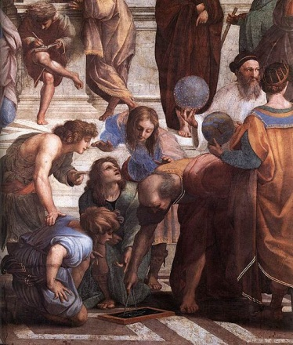
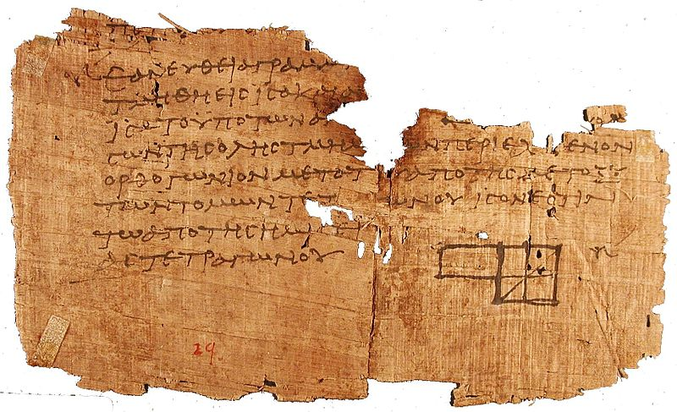
Euclid’s Elements

Slide 15
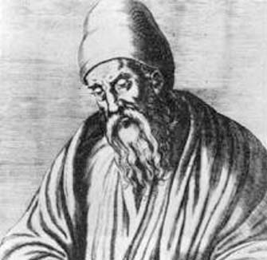
Euclid’s Proposition 1
Given a straight line,
one can construct
an equilateral triangle on it

Slide 16
Euclid’s Axioms
Postulate 1: It is possible to draw a straight line from any point to any point
Postulate 2: It is possible to extend a finite
straight line continuously in a straight line
Postulate 3: It is possible to draw a circle with any centre and any radius
Postulate 4: All right angles equal one another

Slide 17
Euclid’s Proposition 1
A
B
Postulate 3: we can draw a circle centre A radius AB

Slide 18
Euclid’s Proposition 1
C
A
B
Postulate 3: we can draw a circle centre B radius AB

Slide 19
Euclid’s Proposition 1
C
A
B
Postulate 1: we can draw a line drawing any two points so we can join A and C

Slide 20
Euclid’s Proposition 1
C
A
B
Postulate 1: we can join B and C

Slide 21
Euclid’s Proposition 1
C
A
B
Now, AB = AC as they are both radii of the same circle with centre A.
And AB = BC as they are both radii of the same circle with centre B.

Slide 22
Euclid’s Proposition 1
C
A
B
And AC = BC since by Common Notion 1 “Things which equal the same thing also equal one another”.
Hence AB = AC = BC and we have an equilateral triangle.

Slide 23
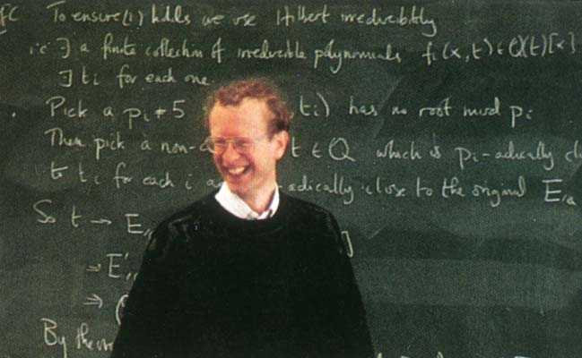
Proofs are checkable!

Slide 24
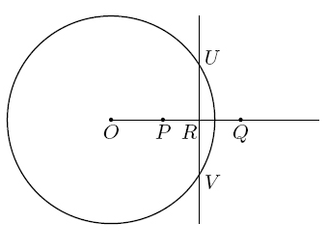
Proposition: There is no point inside a circle
Proof by contradiction
Suppose P is inside the circle.
Take Q such that
OP.OQ = r²
R is midpoint of PQ:
U and V on perpendicular bisector

Slide 25
Proposition: There is no point inside a circle
Now OP = OR – RP
OQ = OR + RQ
= OR + RP
OP.OQ
= (OR – RP)(OR + RP)
= OR² – RP²
We can apply Pythagoras:
OR² = OU² – RU² and RP² = PU² – RU²
So OP.OQ = OU² – RU² – (PU² – RU²) = OU² – PU²
But OU² = r² = OP.OQ so OU² = OU² – PU²
So PU = 0, P is on the circumference!

Slide 26
Proposition: Any two numbers are equal
Proof by induction on the larger of the two numbers.
Basis: If the larger number is one, the smaller must also be 1 (it can’t be anything else) so result is true.
Inductive step: if the result is true for two numbers of which the larger is k, and we are given numbers m and n of which the larger is k+1, then m-1 and n-1 are two numbers of which the larger is k.
So by the inductive hypothesis m-1 = n-1 and hence
m = n. QED.

Slide 27
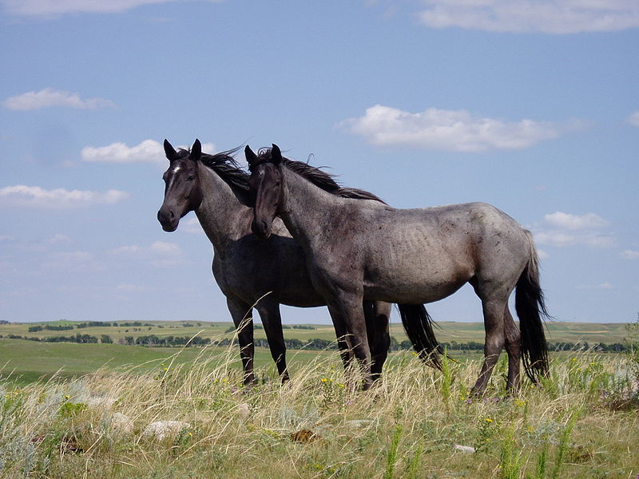
Halmos’s Theorem: If we have a set of n horses, they are all the same colour

Slide 28
Basis
n = 1, result holds
Inductive step
If all sets of k horses are the same colour
and we have a set of (k+1) horses
Consider set of horses 1, 2, …, k – all same colour
Horses 2, 3, …, k+1 – all same colour
So all k+1 horses are the same colour, QED

Slide 29
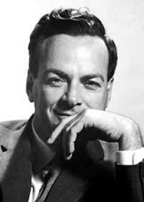
Errors in proofs
“I have mathematically proven to myself so many things that aren’t true.”
“I have discovered a truly marvellous proof of this, which this margin is too narrow to contain.”

Slide 30
Euclid’s Proposition 1
C
A
B
How do we know the circles intersect?

Slide 31
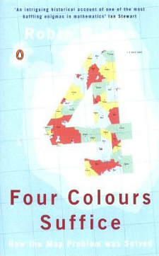
The Four Colour Theorem

Slide 32
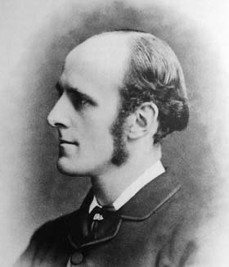
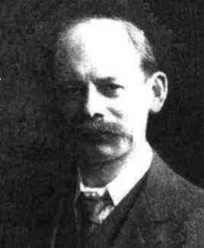
The Four Colour Theorem

Slide 33
Appel and Haken’s Proof (1976)
In my view such a solution does not belong to the mathematical sciences at all.
God wouldn’t let the theorem be proved by a method so terrible as that!

Slide 34
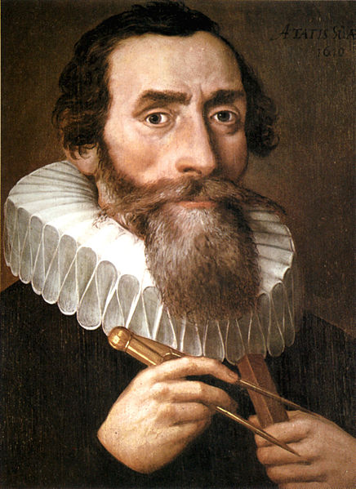
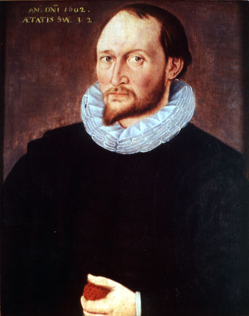
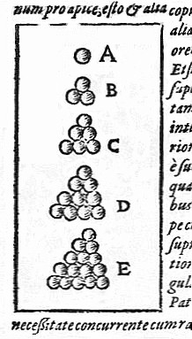
The Kepler Conjecture

Slide 35
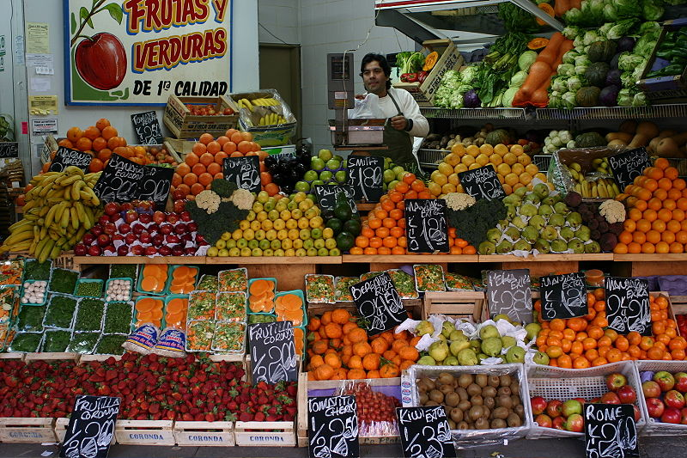
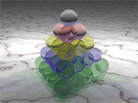
Sphere-packing

Slide 36
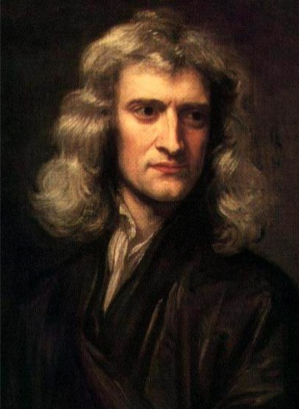
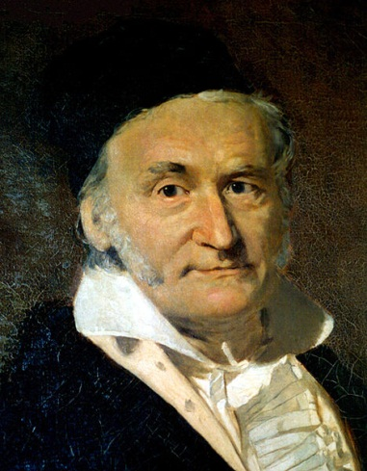
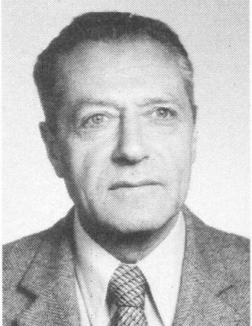
The Kepler Conjecture

Slide 37
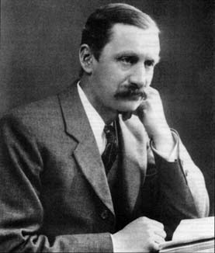
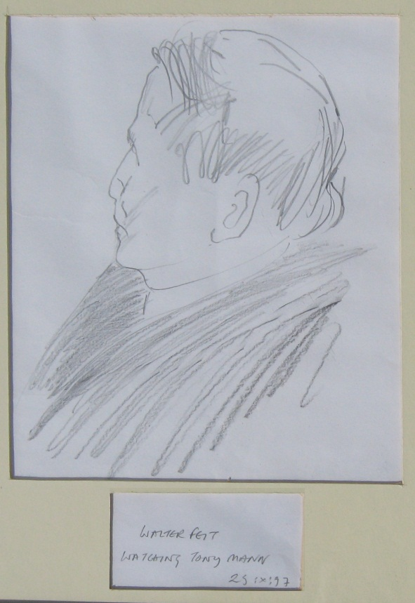
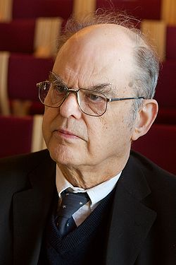
The Feit-Thompson Theorem

Slide 38
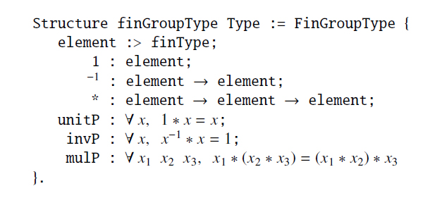
The Feit-Thompson Theorem
Nothing else compares in splendor to the formalization of this theorem.
Theorem Feit_Thompson (gT : finGroupType)
(G : {group gT}) : odd #|G| -> solvable G.

Slide 39
Computer-aided results
There is no finite projective plane of order 10
(Lam et al, 1989)
Catalan Conjecture proved by Mihailescu (2002):
Only integer solution of x^{m} – y^{n} = 1 is 3² – 2³
Counter-example to Euler’s conjecture:
27⁵ + 84⁵ + 110⁵ + 133⁵ = 144⁵ (Lander and Parkin, 1966)

Slide 40
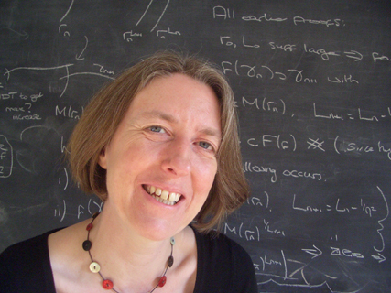
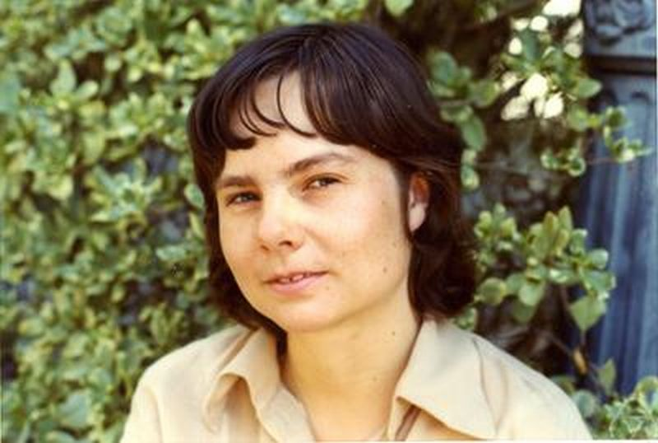
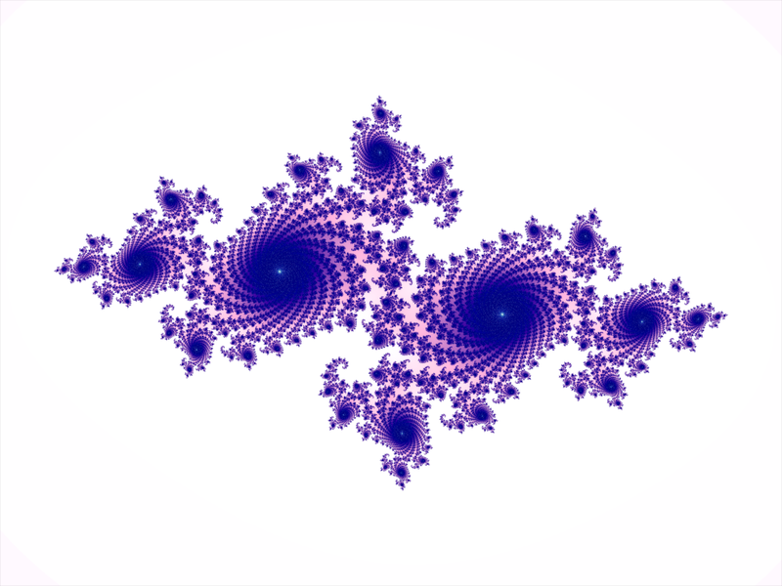
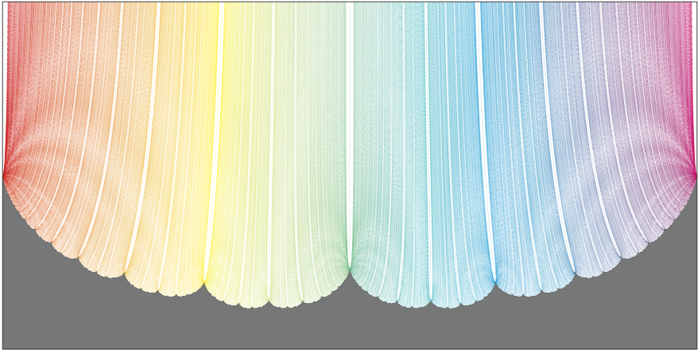
Computer visualisation

Slide 41
Computer-aided speculation
The Birch and Swinnerton-Dyer Conjecture
The Sato-Tate Conjecture

Slide 42
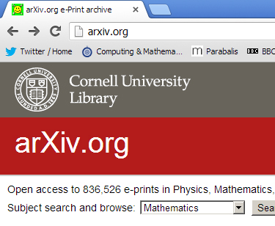
Computers supporting mathematics

Slide 43
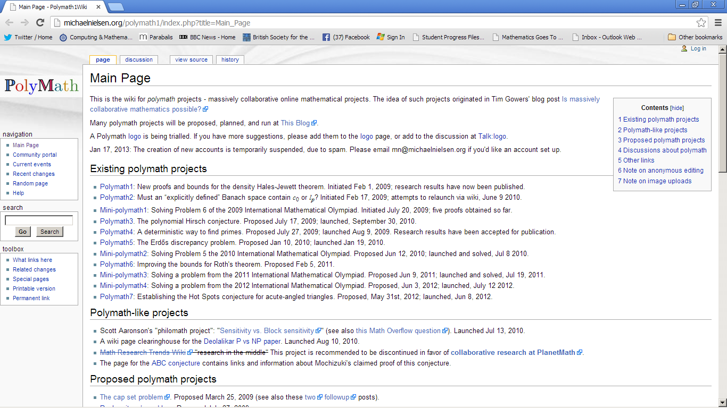
Computers supporting mathematics

Slide 44
Proof and Mathematics
Some true mathematical statements have very long proofs!
“This statement has no proof in Peano arithmetic that contains fewer than 10¹⁰⁰⁰ symbols.” (Gödel)

Slide 45
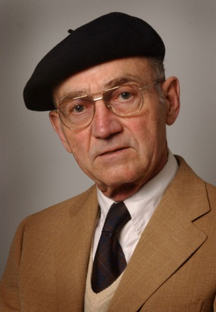
Who checks proofs?
2004: Louis de Branges announces proof of the Riemann Hypothesis
124 pages long

Slide 46
de Branges’s Theorem
1984: de Branges announced proof of the Bieberbach Conjecture (unsolved for 70 years)
Proof eventually verified by team in Leningrad

Slide 47
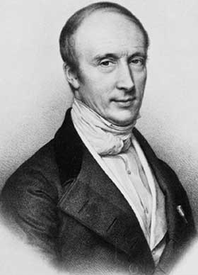
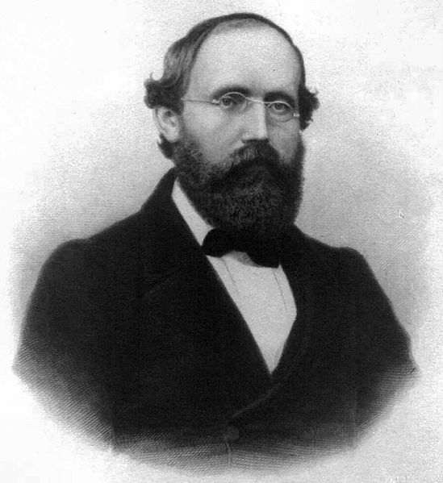
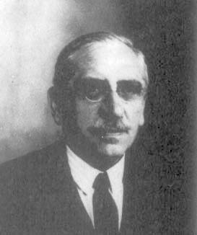
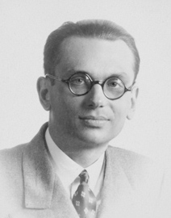
False proofs
http://en.wikipedia.org/wiki/List_of_incomplete_proofs

Slide 48
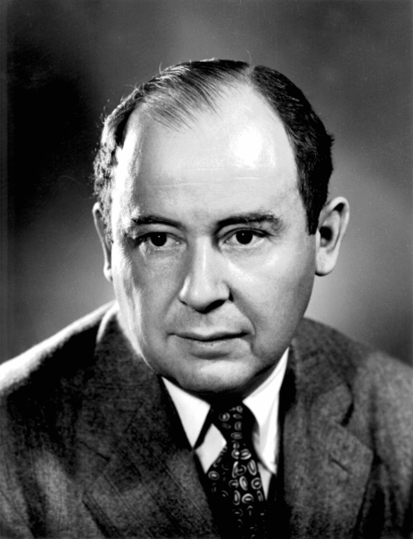
Gödel’s Theorems
“It’s all over!”

Slide 49
Do you believe the Four Colour Theorem?
Kempe’s mistaken contemporaries had a short proof anyone could check
We have a long proof
we can’t check!

Slide 50
Are computer proof assistants the answer?
Some proof assistants can prove
∃n . n < 0 ∧ 0 < n
How?
∃n . t < n is provable
Replace arbitrary name t by n < 0 ∧ 0 !

Slide 51
Soft errors
Eg cosmic ray causes alpha particle to change a value in a computer’s memory
40 such errors in a computer at sea level running for 77 hours

Slide 52
Thomas Hales on soft errors
“admits physical limits to the reliability of any verification process, whether by hand or machine. These limits taint even the simplest theorems, such as our ability to verify that 1 + 1 = 2 is a consequence of a set of axioms.”
One rogue alpha particle brings all my schemes of perfection to nought.

Slide 53
Sir Timothy Gowers on the future
In 25 years, computers will be useful assistants to pure mathematicians
In 50 years, computers will be doing mathematics better than humans

Slide 54
Mathematics
Truthes certaine, necessary, and inuincible:
vniuersally and necessaryly concluded
?

Slide 55
Thank you for listening!
Comment at
www.tonysmaths.blogspot.com
Our courses
a.mann@gre.ac.uk
@Tony_Mann

Slide 56
Acknowledgments and picture credits
Many thanks to Noel-Ann Bradshaw and to everyone at Gresham College
This lecture draws heavily on Thomas Hales, ‘Mathematics in the Age of the Turing Machine’, arXiv:1302.2898v1 (2013) available at www.arXiv.org. Quotations from Thomas Hales come from this survey article.
Slide design: Thanks to Aoife Hunt
Picture and other credits:
Visual proof of Pythagoras’s Theorem: Geek in Heels, http://www.geekinheels.com/; “Water” demonstration of Pythagoras’s Theorem: Magical Maths, http://www.magicalmaths.org/ ; Beethoven’s Fifth Symphony theme, Michelangelo, Euclid’s Elements: Wikimedia Commons; “Quod erat demonstrandum”: Philippe van Lansberge, Triangulorum geometriae libri quatuor (1604), Wikimedia Commons; John Dee, Pierre de Fermat, Johannes Kepler, Thomas Harriot (?), William Burnside, Bernhard Riemann, Henri Lebesgue, Kurt Gödel: unknown painters or photographers, Wikimedia Commons; Quotation from John Dee: Preface to Billingsley’s Euclid, 1570; United States 4-coloured: Tomwsulcer, Derfel73, Dbenbenn Wikimedia Commons; Kepler Conjecture: Greg L, Wikimedia Commons; Sir Tim Gowers: Thegowers, Wikimedia Commons; Thomas Hales: Michigan Photography, simonsfoundation.org; Euclid: Raphael, The School of Athens, Wikimedia Commons; Andrew Wiles: www.simonsingh.net; Horses: François Marchal, Wikimedia Commons; Richard Feynman: Nobel Foundation, Wikimedia Commons; Euclid: MacTutor history of mathematics website; Sphere-packing animation: BlLotwell, Wikimedia Commons; Kepler diagrams: Strena Seu de Nive Sexangula (1611), Wikimedia Commons; Greengrocer’s shop, Buenos Aires: Thomas Hobbs, Wikimedia Commons; Carl Friedrich Gauss: by Gottlieb Biermann, Wikimedia Commons; Newton: by Godfrey Kneller, Wikimedia Commons; Lázló Tóth: Hungarian Academy of Sciences, http://www.math.bme.hu/akademia/; Walter Feit, drawing by Vanilla Beer; John Thompson, Harald Hanche-Olsen, Wikimedia Commons; Feit-Thompson code quoted in Hales, ‘Mathematics in the Age of the Turing Machine’; Wikipedia logo and wordmark, Wikipedia; arXiv, www.arXiv.org; Polymaths, http://michaelnielsen.org/polymath1/index.php?title=Main_Page; Julia set, Eequor, Wikimedia Commons; Maskit embedding, from Caroline Series’s homepage, Warwick University; Caroline Series, George M. Bergman, Wikimedia Commons; Gwyneth Stallard, www.beingamathematician.org; Louis de Branges, Purdue University, Wikimedia Commons; Augustin-Louis Cauchy, lithograph by Zéphirin Belliard after a painting by Jean Roller, Wikimedia Commons; John von Neumann, US Department of Energy, Wikimedia Commons

