Slide 1
Mrs Dalloway said she was going to buy some flowers.

Slide 2
Mrs Dalloway said she was going to buy some flowers. (Belinda Jack)
Mrs Dalloway said she would buy the flowers herself. (Virginia Woolf)

Slide 3
For Lucy had her work cut out for her. The doors would be taken off their hinges; Rumpelmayer’s men were coming. And then, thought Clarissa Dalloway, what a morning — fresh as if issued to children on a beach.
What a lark! What a plunge! For so it had always seemed to her, when, with a little squeak of the hinges, which she could hear now, she had burst open the French windows and plunged at Bourton into the open air. How fresh, how calm, stiller than this of course, the air was in the early morning; like the flap of a wave; the kiss of a wave; chill and sharp and yet (for a girl of eighteen as she then was) solemn... .

Slide 4
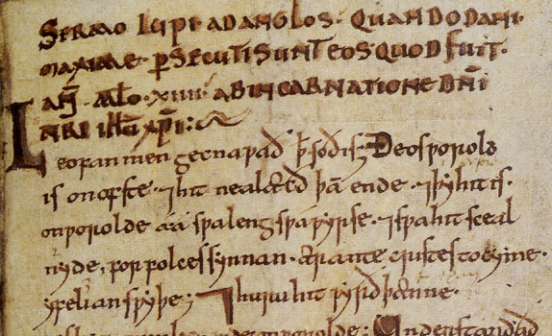
Perhaps the single important manuscript of Wulfstan: Cotton Nero A I, bearing corrections perhaps by Wulfstan himself. This is the introduction to Homily XX, the Sermon to the English.

Slide 5
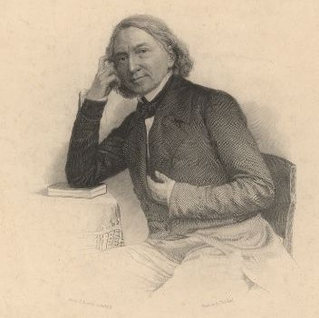

Slide 6
[ARCHETYPE]
|
-----------
| |
[X] [Y]
| |
----- |
| | |
C E B
|
[Z]
|
-----
| |
K M

Slide 11
A form of speech artfully varied from common usage’ (Quintilian, Instit. Orat., IX, i.II)

Slide 12
‘Though studious, he was popular; though argumentative, he was modest; though inflexible, he was candid; and though metaphysical, yet orthodox.’ (Dr Samuel Johnson on the character of Reverend Zacariah Mudge – wonderful name (!), The London Chronicle, May 2, 1769)

Slide 13
By the time it’s empty, life will be full
(Ad. for men’s cologne by Dana)

Slide 14
‘The emotional isolation, the preoccupation with God and themselves, the struggles for freedom, which seem to have possessed many of my friends at the same age, I know almost nothing of.’ (C.P.Snow, The Search)
‘I got, so far as the immediate moment was concerned, away.’ (Henry James, The Turn of the Screw)

Slide 15
‘one ad does not a survey make’ (Peugeot ad.)

Slide 16
I would hear him fly with the high fields
And wake to the farm forever fled from the childless land. (ll. 50-51)
‘Tart, tingling, and even ticklish’ (ad. for Sprite)

Slide 17
Whales in the wake like capes and Alps
Quaked the sick sea and snouted deep
(Dylan Thomas, ‘Ballad for the Long-Legged bait’)
‘Refresh your zest for living’
(French Line Ships’ advertising slogan)

Slide 18
‘A mile before his tent fall down and knee
The way into his mercy’
(Shakespeare, Coriolanus (V, i, 5))
‘The thunder would not peace at my bidding.’
(Shakespeare, King Lear (IV, vi, 103))

Slide 19
If by excluding joy we could shut out grief, the scheme would deserve very serious attention; but since however we may debar ourselves from happiness, misery will find its way at many inlets and the assaults of pain will force our regard, though we may withhold it from the invitations of pleasure, we may surely endeavour to raise life above the middle point of apathy at one time, since it will necessarily sink below it an another. (Rambler, 47)

Slide 20
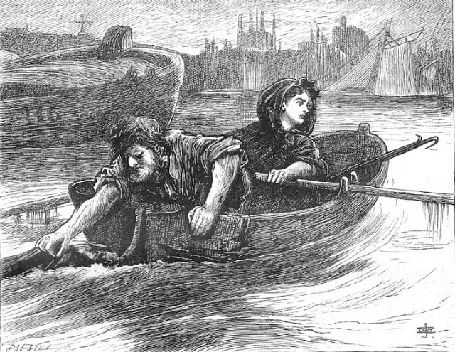

Slide 21
Mr and Mrs Veneering were bran-new people in a bran-new house in a bran-new quarter of London. Everything about the Veneerings was spick and span new. All their furniture was new, all their friends were new, all their servants were new, their plate was new, their carriage was new, their harness was new, their horses were new, their pictures were new, they themselves were new, they were as newly married as was lawfully compatible with their having a bran-new baby, and if they had set up a great-grandfather, he would have come home in matting from the Pantechnicon, without a scratch upon him, French polished to the crown of his head.

Slide 22
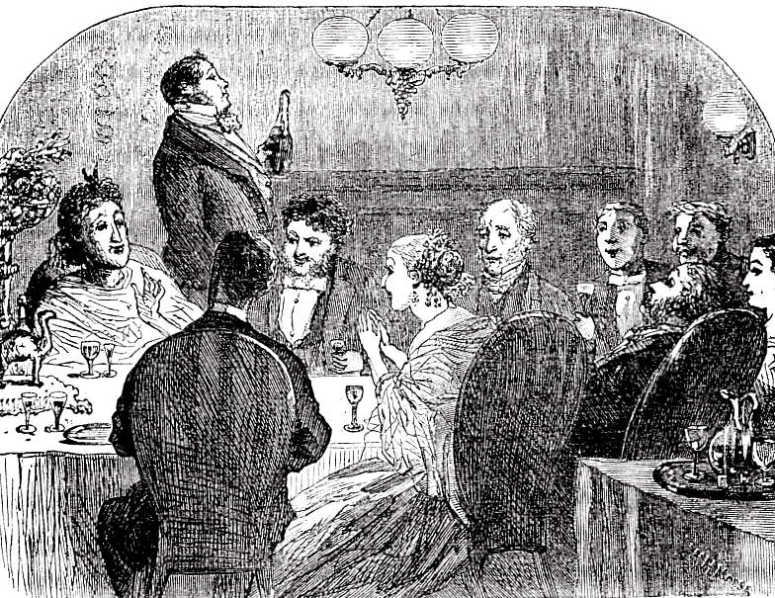

Slide 23
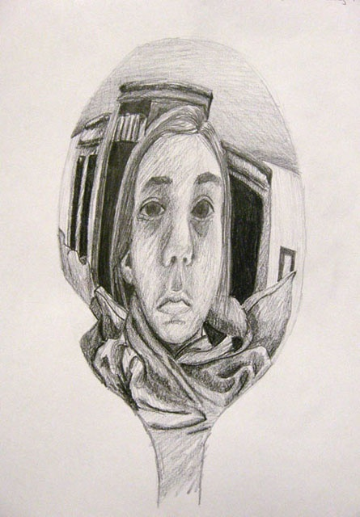

Slide 25
A grey, dusty, withered evening in London city has not a hopeful aspect. The closed warehouses and offices have an air of death about them, and the national dread of colour has an air of mourning. The towers and steeples of the many house-encompassed churches, dark and dingy as the sky that seems descending on them, are no relief to the general gloom; a sundial on a church wall has the look, in its useless black shade, of having failed in its business enterprise, and stopped payment for ever.

