Slide 1
Gresham and Defoe (underwriters):
The Origins of London Marine Insurance
Dr Adrian Leonard, Affiliated Researcher, Centre for Financial History, University of Cambridge.

Slide 2
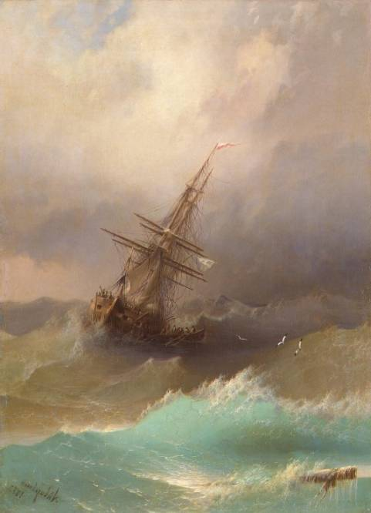
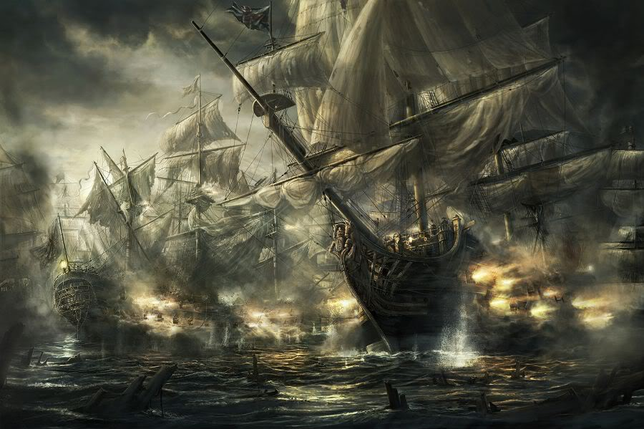
Marine insurance is a financial transaction designed to reduce by sharing or to transfer the risk of economic loss arising from the various perils faced when moving goods from source to market.
Gentium
Maris
Notes:
Normal insurance policies protect against two kinds of risk: those of the seas, and those of men.

Slide 3
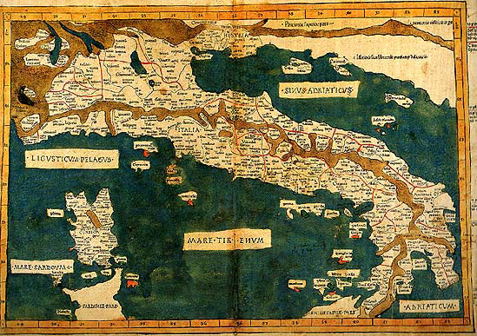

Medieval Italy
Above, the hapless Merchant of Venice. In reality, he probably would have bought some insurance.
Italy: the birthplace of insurance.

Slide 4
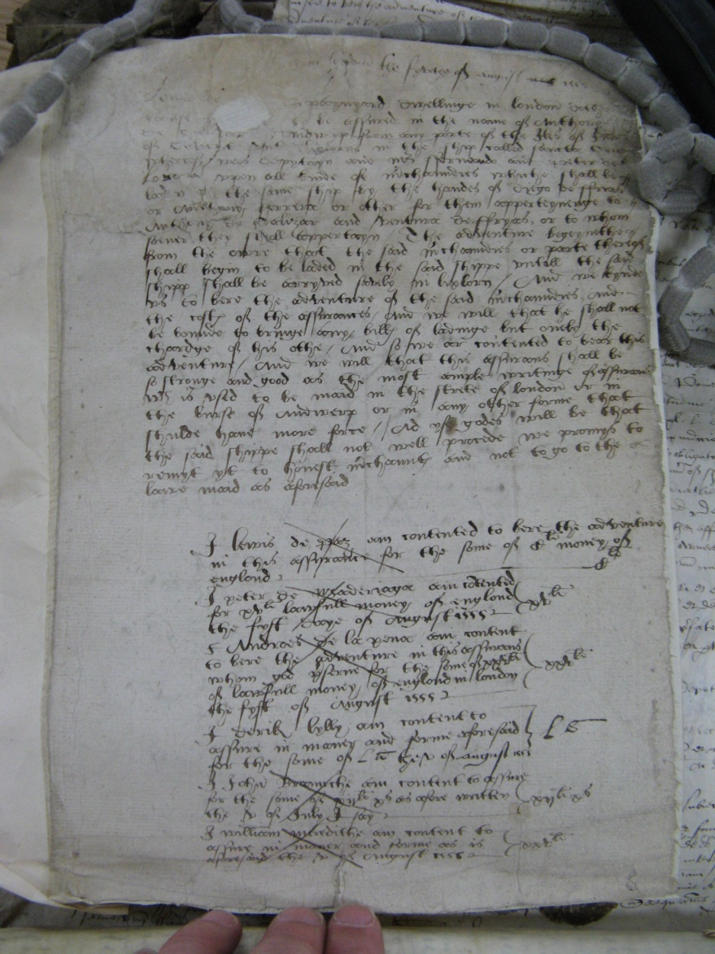
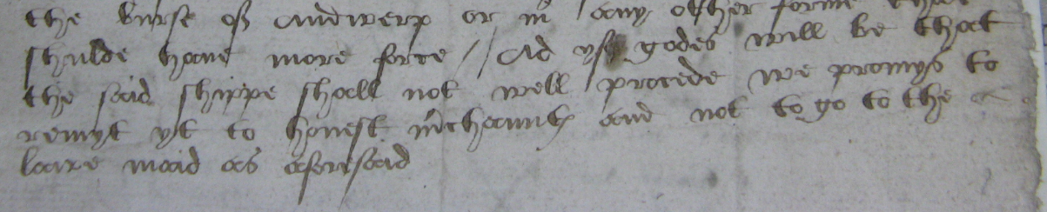
A very early London policy
Policy of Anthony de Salizar, underwritten in London, 5 August 1555.
TNA HCA 24/29 f. 45.
‘yf godes will be that the said shippe shall not well procede’ the parties to the policy ‘promys to remyt yt to honist m’chaunts and not to go to the lawe’

Slide 5
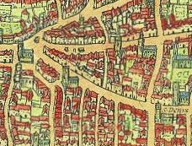
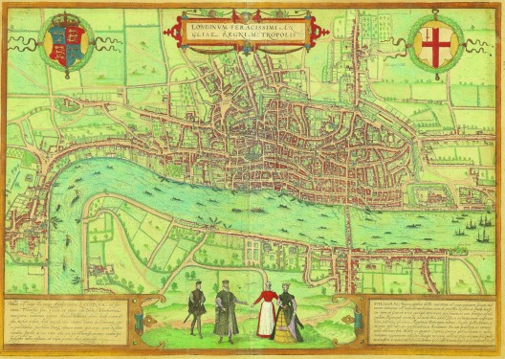
London in 1572
Above,
Lombard Street, the birthplace of London marine insurance
London in 1572, map by Braun and Hogenberg

Slide 6
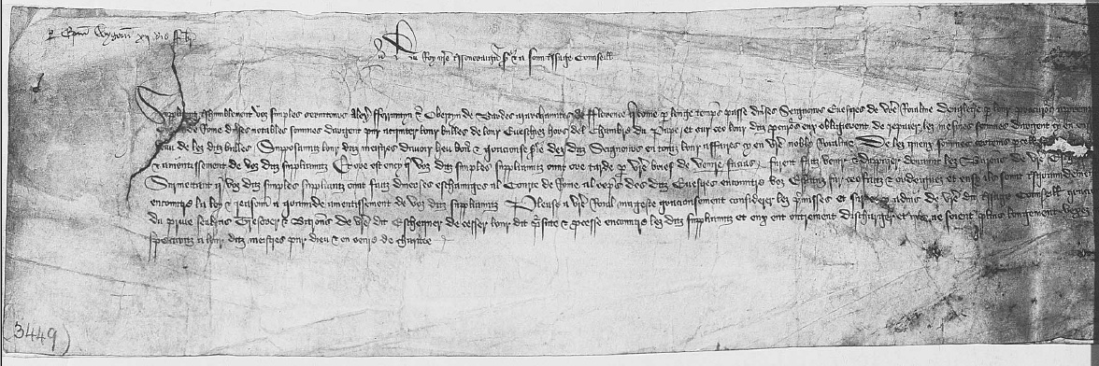
Ferrantyn in the record
A petition to the King in which ‘Alex. Fferrantyn’ and another merchant request letters under the privy seal to the Treasurer and Barons of the Exchequer to cease process against them, in a dispute of the non-payment in England of monies owed and forwarded to the ‘proctors of lords and bishops at the court of Rome to pay for bulls had for their bishops’.
TNA SC/8/11/5523

Slide 7
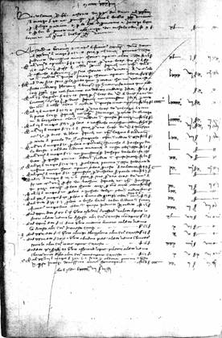


The Borromei Ledgers
A page from the ledgers of the Borromei & Co. bank in London. Note these rare books employ double-entry bookkeeping, one of the inventions of the Italian medieval Commercial Revolution,
a period of mercantile inventiveness which also saw the invention of marine insurance.
Right, the Borromei Coat of Arms and commercial mark.
www.queenmaryhistoricalresearch.org/roundhouse/default.aspx

Slide 8
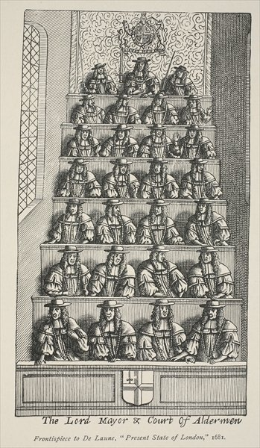
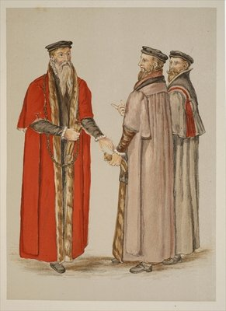
London’s Lord Mayor and Aldermen
The Lord mayor and a pair of Aldermen in about 1550.
Left, the London Aldermen’s court, about 1680. In most instances, this was the place were London insurance disputes were hammered out. Note how fashions have changed.

Slide 9
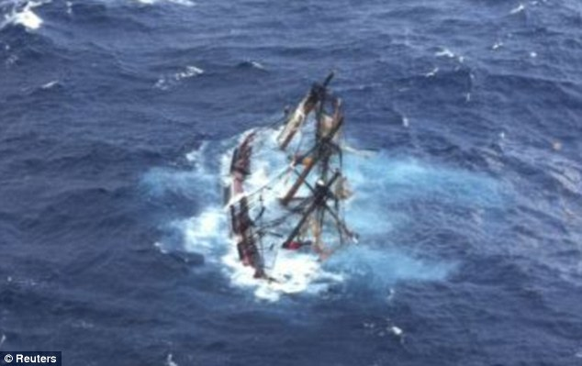
Fraud was an early phenomenon
“To stuff Shyppis, wyth ffals crafty balauncis
As blokkys & stonys, and countyrfayt dalyauncis
And afftyr assure, the said shippys w’ theyr ffeyghth
For grete Summys, tyll they cam on the heygth
Of the Occean, and then cawse theym to drowne
That the assuraunce, mygth ffor nowgth be payd”

Slide 10
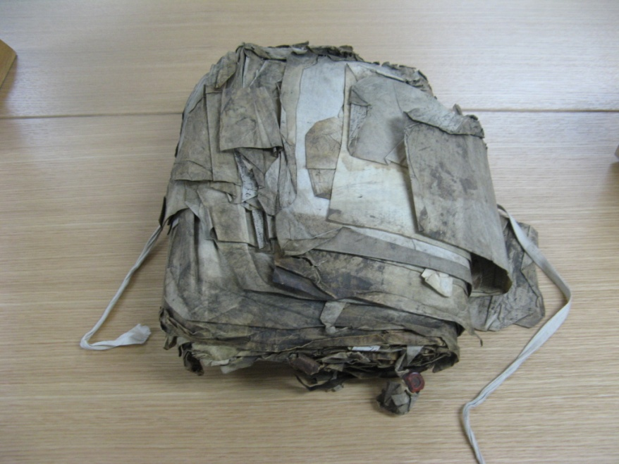
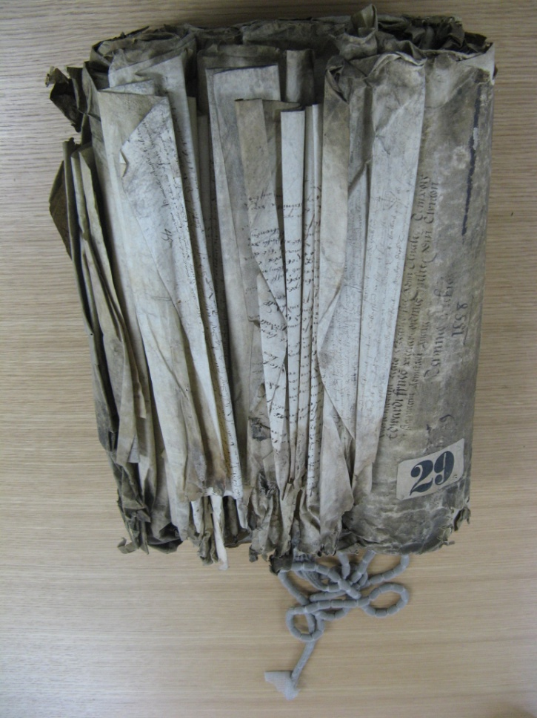
The 16th century records of the High Court of the Admiralty

Slide 11
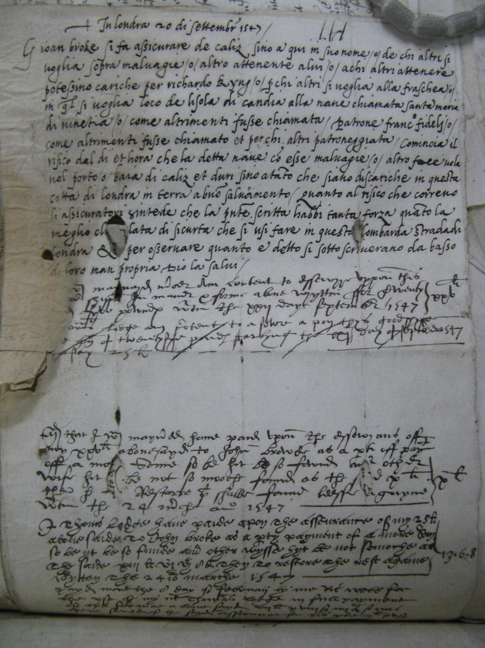
The Brook Policy
The oldest policy in the Admiralty series. Underwritten in 1547, the main text is in Italian. A short policy wording is followed by the scratches of the underwriters.
TNA HCA 24/27/147

Slide 12
Law Merchant
Law Merchant, or Lex Mercatoria. No municipal laws can be sufficient to order and determine the very complicated affairs of traffic and merchandise; neither can they have a proper authority for this purpose: for as these are transactions carried on between subjects of independent states, the municipal laws of one will not be regarded by the other:– for which reason the affairs of commerce are regulated by a law of their own, called the Law Merchant, or Lex Mercatoria, which all nations agree in and take notice of: and in particular it is held to be a part of the law of England, which decides the causes of merchants by the general rules which obtain in all commercial countries.
JohnWeskett, A complete digest of the theory,
laws, and practice of insurance (London: 1781).
Notes:
Weskett’s definition
- Authoritative volume of conventions governing marine insurance practice
- Later Park, others

Slide 13
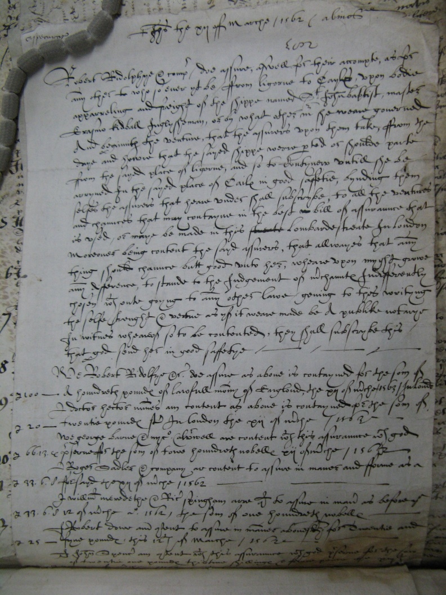
The Ridolfi Policy
A policy underwritten by the traitor Robert Ridolfi in 1562. The policy covers the ship St John Baptist and goods for a voyage from Leghorn to Cadiz, whose master is ‘Erasmus Kidball, Inglysheman’.
TNA HCA 24/35/283

Slide 14
Law Merchant:
The jurisdictional authority clause
Policy of Bartholomew Corsini, underwritten in London, 24 September 1582.
LMA 062/MS22281
Policy of Thomas Newton, underwritten in New York, 27 October 1760.
LMA 063/MS32992/001
Policy of Baltimore Steam Packet Co., underwritten at Lloyd’s, 20 February 1950.
Notes:
Similar continuity of appeal to the authority of the law merchant to the present.
- Marine insurance Law of 1906.

Slide 15
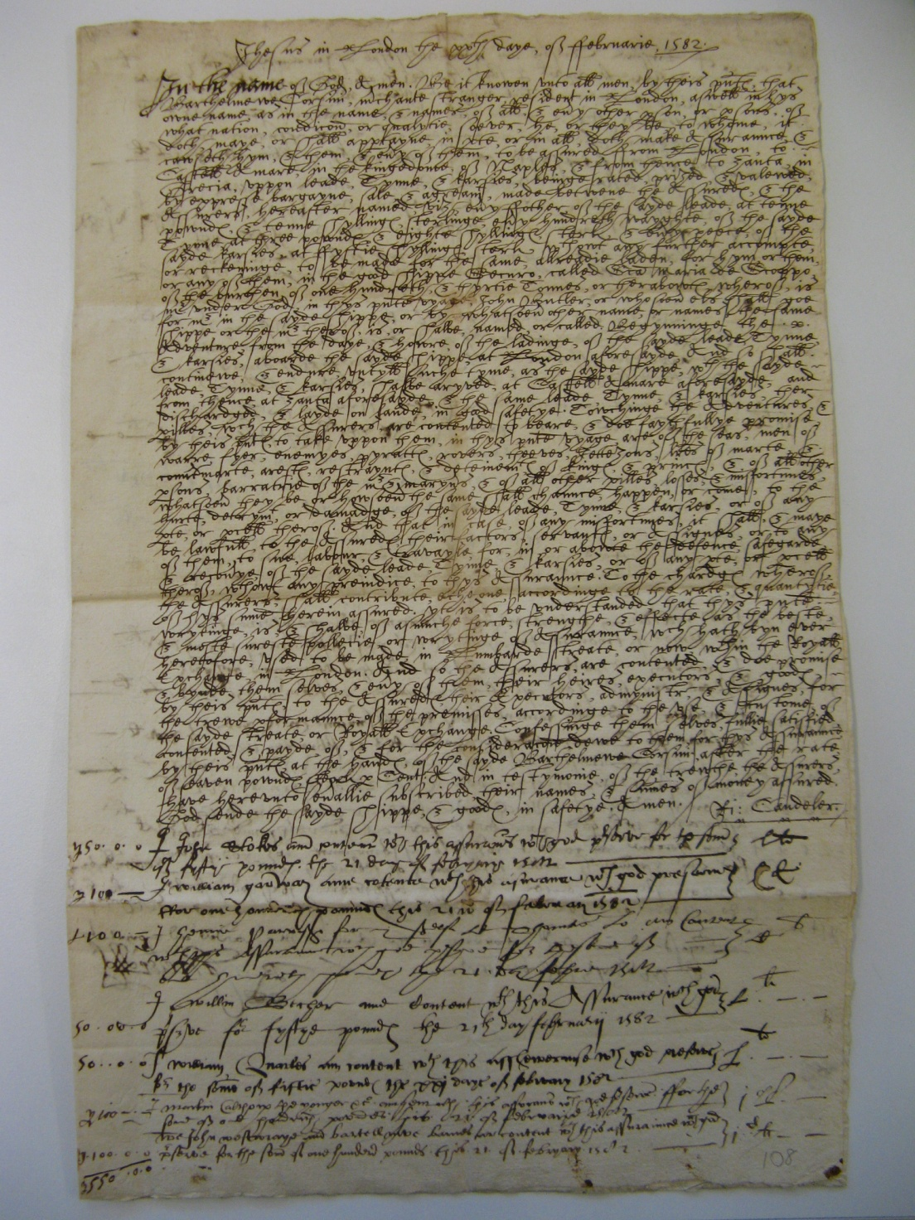
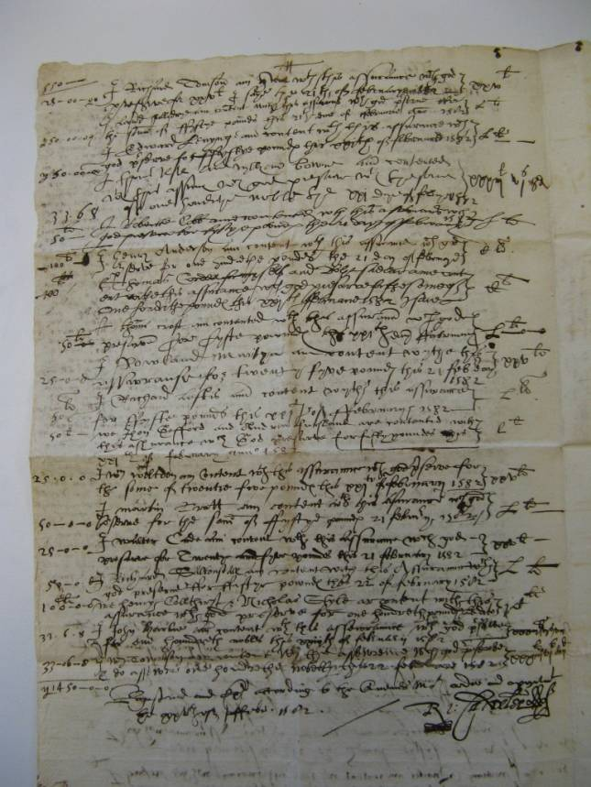
Marine insurance policy of Bartholomew Corsini,
20 February 1582.
LMA 062/MS22281

Slide 16
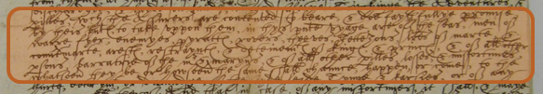
What perils were covered?
Marine insurance policy of Bartholomew Corsini, 20 February 1582.
LMA 062/MS22281
“The seas, men of war, fire, enemies, pirates, rovers, thieves, jettisons, heads of mart and counter-mart, arrest, restraint, & detainme^{n}ts, of kings & princes, & of all other persons, barratry of the master and mariners, and of all other perils, losses, & misfortunes, whatsoever they be, or howsoever the same shall chance, happen, or come to the hurt, detriment, or damage, of the said silks...”

Slide 17
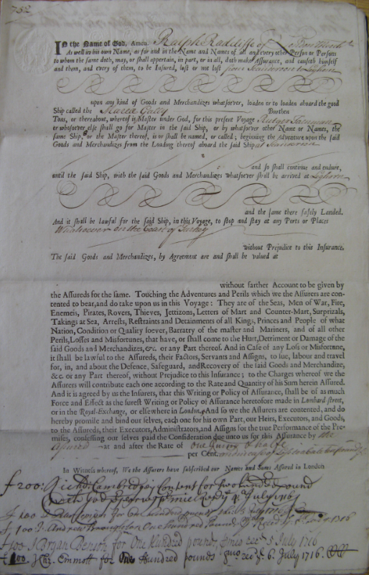
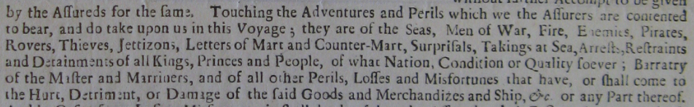
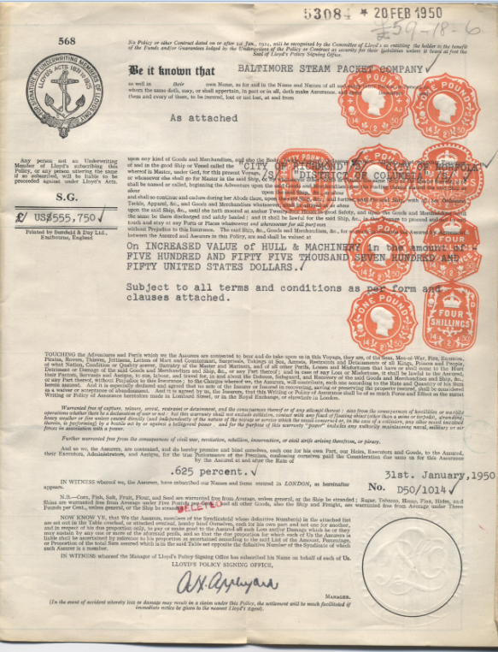

What perils were covered?
Policy of Ralph Radcliffe, underwritten in London, 4 July1716.
HALSC, DE/R/B293/6
Policy for Baltimore Steam Packet Co., underwritten at Lloyd’s
20 February 1950.

Slide 18
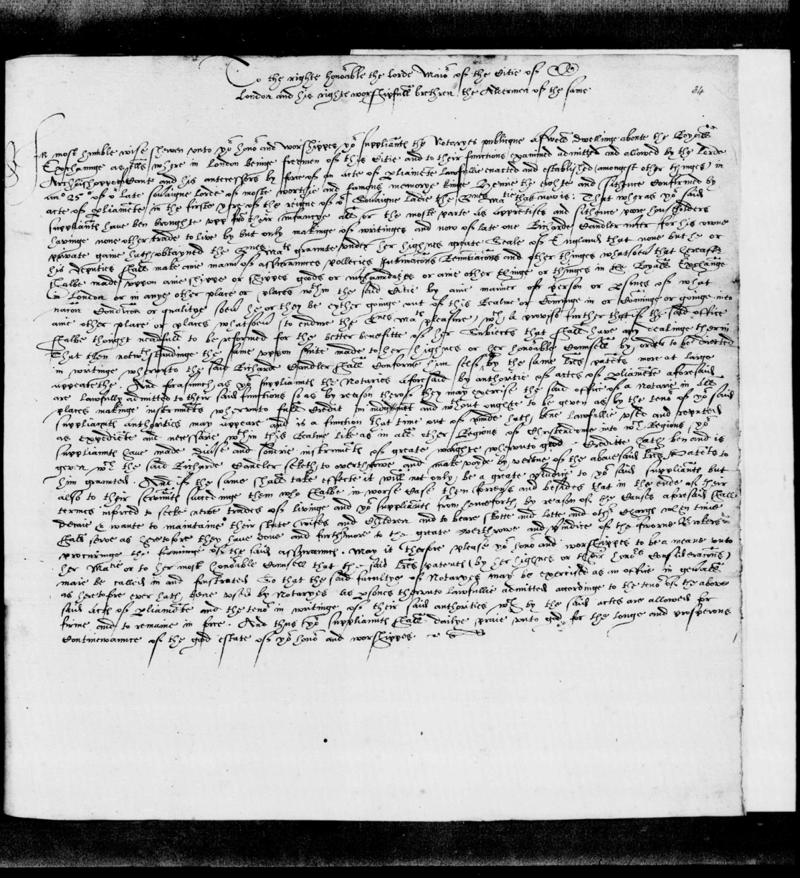
The market in the 1570s
The London notaries’ petition against Candeler’s patent, c. 1575, to Sir James Hawes, Lord Mayor of London.
BL Lansdowne Vol/113 f.33

Slide 19
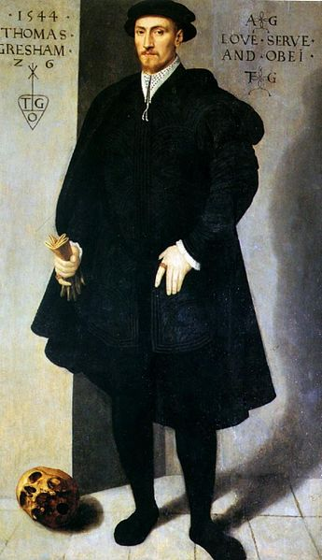
Thomas Gresham
“Shipped in the Cristopher of Dyttemarche, xlij M waight of salte peter, and vij c xx long corners. All wyche goodes doth amount to the some of iiij M li. wyche I have caused to be assewred aftyr the rate of v li. upon the hundred, for the more seurtie of the seyes; wyche I beseche the Lorde to sende in safetie. Lykewise, as there can be gotten ships for London, the rest shall be shipped wythe as much expedycione as maye be.”
Gresham to William Cecil, 23 September 1561

Slide 20
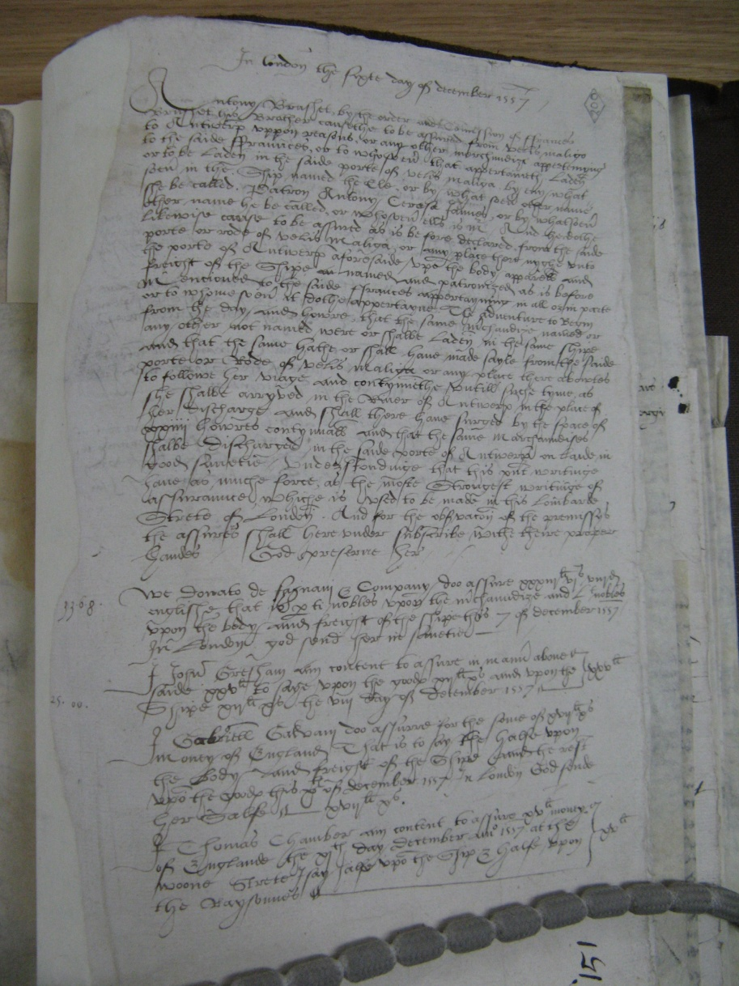
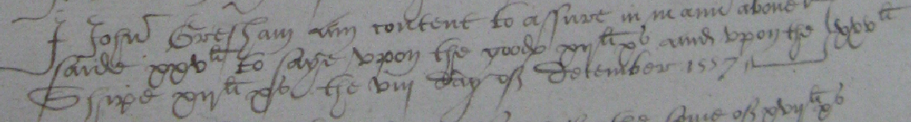
The Gresham Policy
I, John Gresham, am content to assure in name above said xxv ^{li} to laye upon the goods xv ^{li} and upon the shipe xv ^{li} the viii of December 1557.
TNA HCA 24/30/151

Slide 21
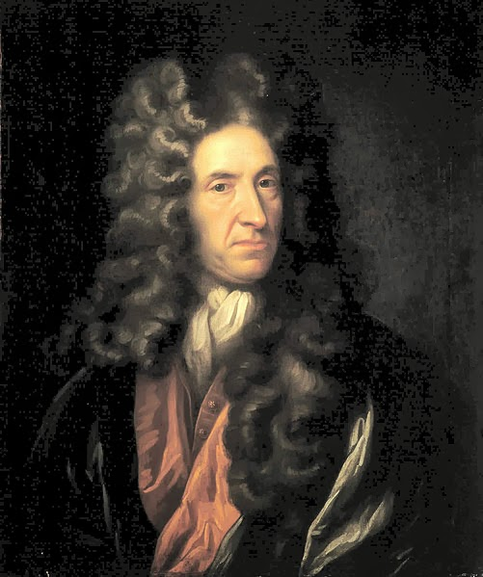
Daniel Defoe, Underwriter
Daniel Defoe (formerly simply Daniel Foe) lost everything speculating in marine insurance at a very inopportune moment in English commercial history. Happily for posterity, he chose to abandon trade, and turn his hand instead to writing.

Slide 22
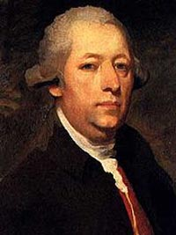
John Walter, Underwriter
Ruined at Lloyd’s by the ravages of war:
‘I was ‘weighed down, in common with about half of those who were engaged in the protection of property [ships and cargo], by the host of foes this nation had to combat in the American War.’

Slide 23
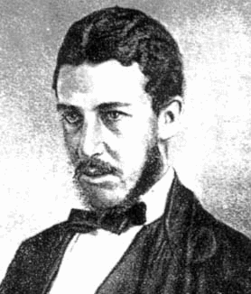
Walter Bagehot, Underwriter
The founder of the Economist, from a shipping family, Bagehot joined Lloyd’s as an underwriting member in 1856, according to the Roll of Lloyd’s. He wrote little about Lloyd’s or the insurance sector in his published works.

Slide 24
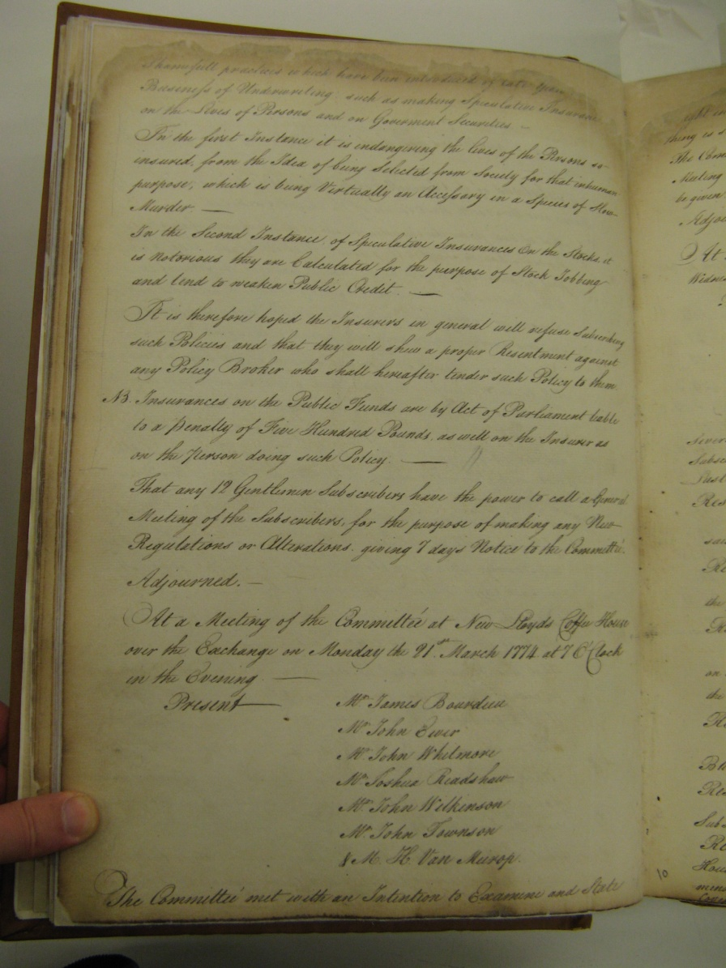
The Minute Book of New Lloyd’s, 1774
‘Shameful practices which have been introduced of late years [to the] Business of Underwriting such as making Speculative Insurance on the Lives of Persons and on Government Securities – In the first Instance it is endangering the lives of the Persons so insured, from the Idea of being Selected from Society for that inhuman purpose, which is being Virtually an Accessory in a Species of Slow Murder’ ... It is therefore hoped that the Insurers general will refuse Subscribing such Policies.’
Minutes of 4 March 1774,
GHL CLC/B/148/A/001, ff. 35-36

Slide 25
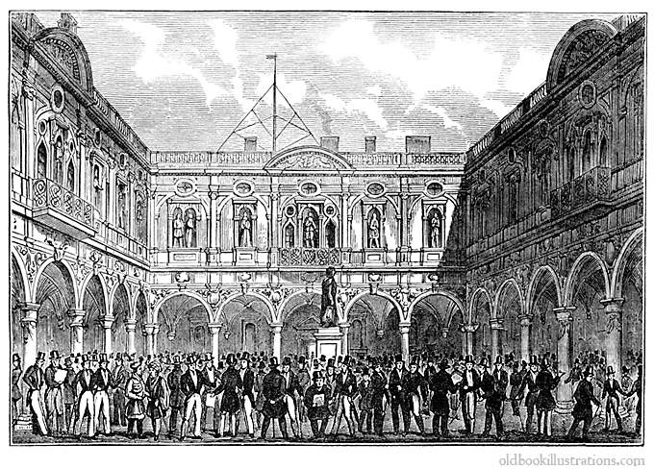
The Home of Insurance for centuries –
London’s Royal Exchange

Slide 26
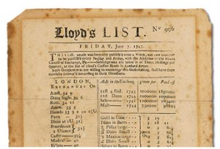
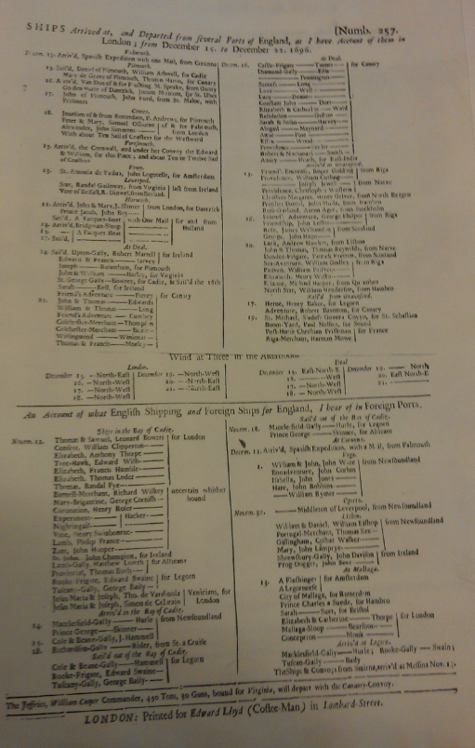
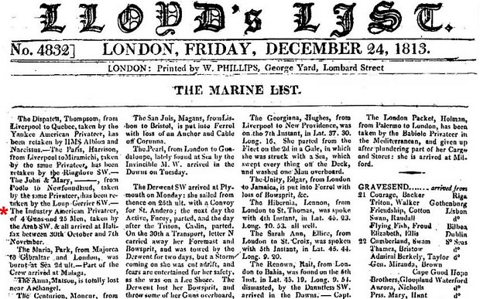
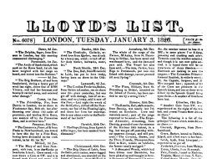
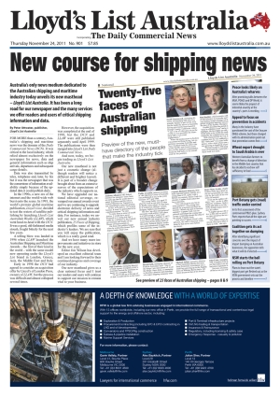
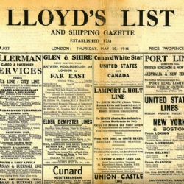
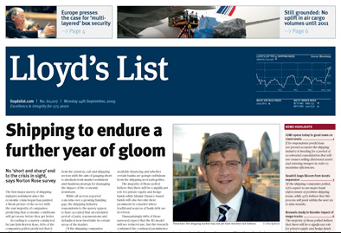
The earliest ‘Ships arrived...’ (1696), and some successors

Slide 27
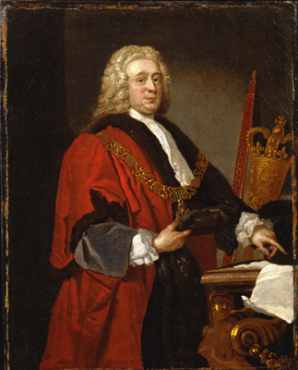
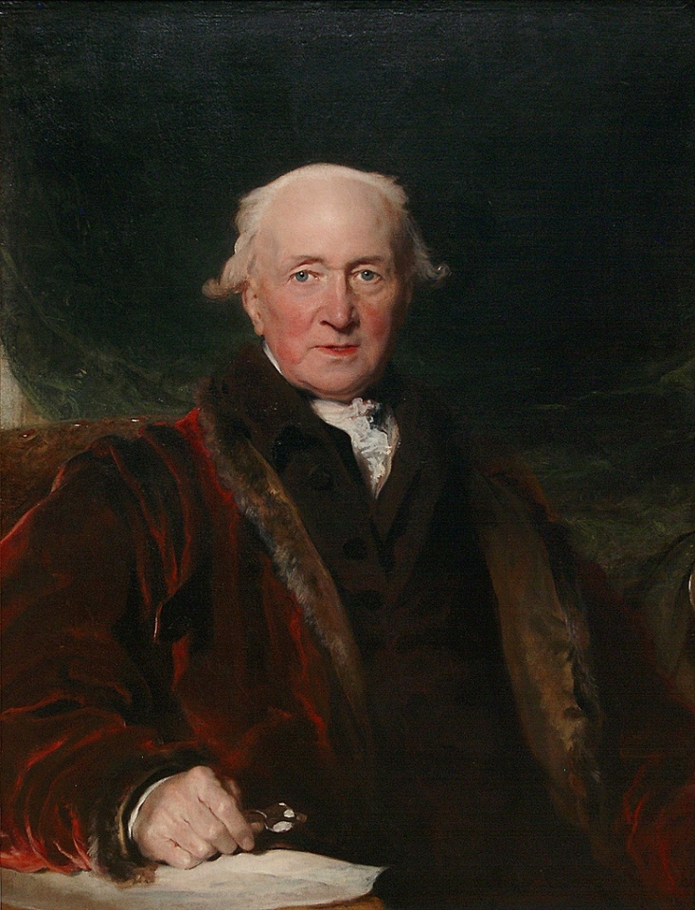
Great Men of London marine insurance
Sir John Barnard, MP
John Julius Angerstein

Slide 28
Thank-you!
Dr. A. B. Leonard,
Centre for Financial History
University of Cambridge abl28@cam.ac.uk

