Slide 1
Cases I Have Known
By
Professor Sir Geoffrey Nice
Gresham Professor of Law

Slide 2
From Court of Appeal Judgment
Disciplinary measures to limit drunkenness in the Royal Naval have a long history. In his acclaimed work on life in the Georgian Navy, "The Wooden World", Dr. N.A.M. Rodger devotes a section of his chapter on shipboard life to the subject of drink. At page 73 he states: "Everybody knew that drink was a factor in crime, most often the chief factor, but it was virtually impossible to do much about it."

Slide 3
From Court of Appeal Judgment
Admiral Smith's divisional system went as far as most officers thought it reasonable or possible to go; the midshipmen of the watch were to "see all men they find far gone in drink, put in their hammacoes."

Slide 4
Račak

Slide 5
Račak

Slide 6
Račak

Slide 7
Račak

Slide 8
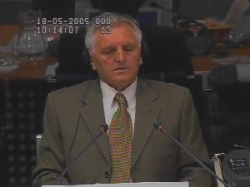
General Obrad Stevanović
Geoffrey NICE: If we now look, please, at your diary... Does the first entry read...
"No corpse, no crime"?
Obrad STEVANOVIC: Yes, that's exactly what it says.
Geoffrey NICE: It's your handwriting. Read, please, the next line for us.
Defence Witness
Obrad Stevanovic
Excerpt from Milosevic Trial Transcript – 02 June 2005

Slide 9
Obrad Stevanovic Transcript
Q. You've taken the solemn declaration. Are you prepared to help this Chamber if I give you that opportunity a little later? Are you prepared to help them? Or are you here to help the accused?
A. I have already said that. I am here to answer questions both put to me by the Defence and the Prosecution, and I will answer them by telling the truth.‘

Slide 11
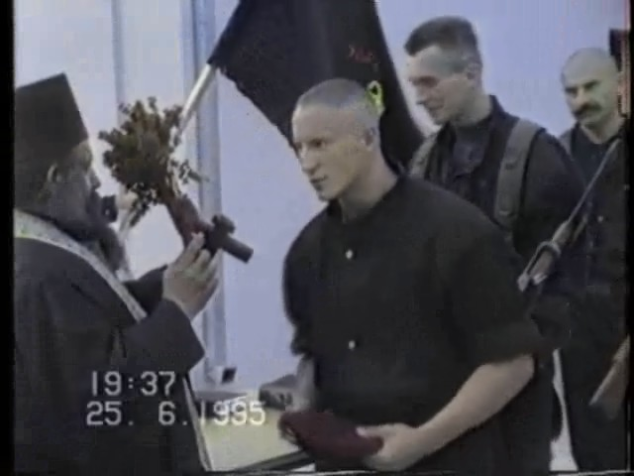
Notes:
Scorpions video:
A few men being blessed
Taking the victims off the lorry, laying them down, whispering words of abuse in their ears
Marching them up the hill
Shooting the first 4
Getting the last 2 to move the bodies and then killing the last 2

Slide 12
Obrad Stevanovic Transcipt
Q. Now, this -- pause there. This video, which is potentially distressing viewing and I'm only going to play very small parts of it, reveals, Mr. Stevanovic, if the evidence is in due course admitted, and that's why I want your assistance, reveals that men were brought from Srebrenica in batches to this group of Skorpions to be executed and they were executed, and what you see here is a lorry load of six young men. This is the same truck with the men in the back. And you can see the red berets.

Slide 13
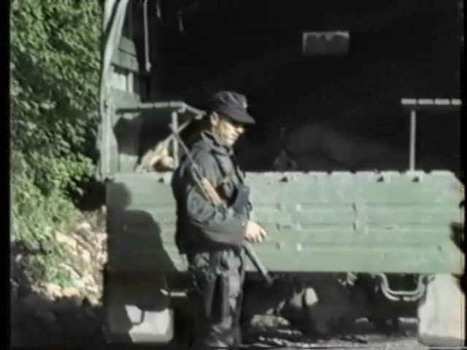
Notes:
Scorpions video:
A few men being blessed
Taking the victims off the lorry, laying them down, whispering words of abuse in their ears
Marching them up the hill
Shooting the first 4
Getting the last 2 to move the bodies and then killing the last 2

Slide 14
Notes:
Scorpions video:
A few men being blessed
Taking the victims off the lorry, laying them down, whispering words of abuse in their ears
Marching them up the hill
Shooting the first 4
Getting the last 2 to move the bodies and then killing the last 2

Slide 15
Obrad Stevanovic Transcript
MR. NICE: The lorry leaves. The men are eventually taken up into the hills. It may be difficult to move it, but I don't need to linger on this. Here they are taken up into the surrounding countryside.
Two remaining not shot are untied. I needn't go into the detail, we needn't view the detail. They're untied, they move the four bodies, and then they are themselves shot, and I'll leave it there.

Slide 16
Obrad Stevanovic Transcript
Yes, I see that, but I don't see or, rather, I haven't seen any Skorpion insignia so far.
You'd recognise the Skorpio insignia, would you, if you saw it?
A. Well, I think it would be clear. I don't know exactly what it looks like, but I assume that there's a picture of a scorpion.
Q. You just guessed that, did you?
A. As I said, in Erdut I had occasion to see several members of this unit. I think they were in uniform and had insignia.

Slide 17
Notes:
Scorpions video:
A few men being blessed
Taking the victims off the lorry, laying them down, whispering words of abuse in their ears
Marching them up the hill
Shooting the first 4
Getting the last 2 to move the bodies and then killing the last 2

Slide 18
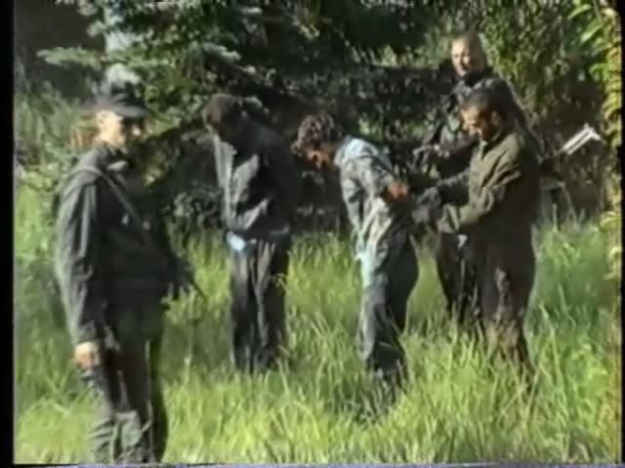
Notes:
Scorpions video:
A few men being blessed
Taking the victims off the lorry, laying them down, whispering words of abuse in their ears
Marching them up the hill
Shooting the first 4
Getting the last 2 to move the bodies and then killing the last 2

Slide 19
Interventions
MR. KAY: We haven't established any foundation for this. To my mind, this looks like sensationalism. There are no questions directed to the witness on the content of that film in a way that he can deal with it ………… It's not cross-examination.
JUDGE ROBINSON: Mr. Nice, there is some merit in that. ……… Who made it, in what circumstances, and what questions are you putting to the witness in relation to it?

Slide 20
Obrad Stevanovic Transcript
Q. I'm suggesting this film shows Skorpions executing prisoners from Srebrenica.
A. As I am upset, I have to say that this is one of the most monstrous images I have ever seen on a screen. Of course I have never seen anything like this in -- live. I am astonished that you have played this video in connection with my testimony because you know full well that this has nothing to do with me or the units I commanded. I attempted to explain this yesterday, and I have also attempted to explain it today. I'm not saying that you do not have the right to do this, but I have to say that I am really upset --

Slide 21
Judge Robinson Question
JUDGE ROBINSON: Do you agree with the -- do you agree with the Prosecutor's suggestion or proposition that this is a film that shows Skorpions executing prisoners from Srebrenica?
THE WITNESS: [Interpretation] Of course I do not intend to cast doubt on what the Prosecutor is saying, but I have not seen a single person I know here, and I have seen no evidence that this is the unit in question.

Slide 22
Obrad Stevanovic Transcript
Q. Is Slobodan Medic, and there are two photographs of him. Do you recognise that man?
A. I recall only the nickname. The nickname Boca is familiar, but I cannot recall his face. I think I saw a man with this nickname in Erdut in 1995 on two or three occasions, but he did not come to see me. I saw him, if I recall rightly, at Mr. Milanovic's place.
……I saw him on two or three occasions, I told you where, but I had nothing to do with him.
JUDGE BONOMY: Well, I'm not clear about that answer. Are you acknowledging, General, that that is Boca?
THE WITNESS: [Interpretation] No, I'm not acknowledging that because I can't recall his face. All I recall is the nickname Boca

Slide 23
Judge Bonomy’s Question
This is a question asked shortly after by Judge Bonomy:
JUDGE BONOMY: I think the question was asked because in relation to some of the earlier documents you made the comment that you could make inquiries. Now, is that not something that can be done in relation to the material that's now been presented to you in this video?
THE WITNESS: [Interpretation] Along those lines, of course, I think I can. I don't know what the response will be from the organs involved, but if you give me a list of names at the end of my testimony, I could check it out and see whether they were members of the MUP or not.
JUDGE BONOMY: Thank you.

Slide 24
Robert Uren

Slide 25
Robert Uren

Slide 26
Future Law Lectures
Srebrenica:
Genocide and Trial
6pm 1st April 2015
Srebrenica:
Justice and Legacy
6pm 6th May 2015

