Slide 1
Gresham College
12th March 2014
Entertainment in London in the 18th Century

Slide 2
Gresham College
12th March 2014
Entertainment in London in the 18th Century
Notes:
Good afternoon – and thanks for giving me the opportunity to talk about entertainment in London in the Georgian era.
I can’t pretend that I can cover the entire spectrum of entertainment, so I will just be looking at the things which I find interesting - or which interested my ancestor!
The talk should take just over 45 minutes and I will then be happy to take any questions.
First, I think it may help if I explain a little bit about my background. Those of you who came to the talk I gave a year ago will already know that I come from a family which never throws anything away – I have diaries going back to the 1650’s, newspaper reports of the death of Oliver Cromwell and of the outbreak of the Great Fire of London– even shopping lists and prescriptions from the 1700’s.

Slide 3
Gresham College
12th March 2014
Entertainment in London in the 18th Century
Notes:
Quite why some of these items have survived is a mystery – after all, who keeps a tax disc once they have sold the vehicle it relates to?
I still have a Road Vehicle Excise Duty Tax Receipt– in other words a tax disc - for a Two-wheeled carriage kept in London in 1743, when it cost a whopping two pounds!
In particular I seem to have virtually every piece of paper written on by my great-great, great-great grandfather

Slide 4
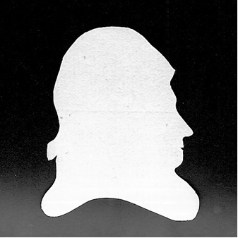
Richard Hall 1729 - 1801
Notes:
His name was RICHARD HALL - born in 1729 and died in 1801.
He owned a shop selling hosiery at Number One London Bridge – the very first shop you came to as you entered the City of London from the South over the original London Bridge.
I have his diaries, his recipes and his note books – as well as his silver cutlery, his chairs, his collections– and even his school books!

Slide 5
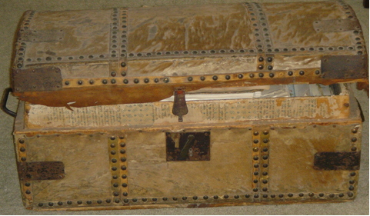
Notes:
So, when I got married, my wife was horrified to find that in addition to getting me, she also got a number of old tea chests and horse hair trunks like this one, overflowing with family papers.

Slide 6
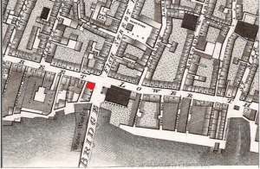
Number One London Bridge
Notes:
As I said my ancestor owned One London Bridge, shown here in red

Slide 7
Number One London Bridge
Notes:
The premises were only a few yards from the Monument, which I have arrowed, marking the source of the outbreak of the Great Fire.
So he was half way between St Pauls to the west and the Tower of London to the east.

Slide 8
Number One London Bridge
Notes:
The shop, with a 4-bedroomed house above, was built by my ancestor in 1767.
Those four bedrooms enabled him to invite guests to stay, and he liked nothing more than showing them the sights of London, faithfully recording in his diary where he went, what it cost, and above all, what the weather was like that day!

Slide 9
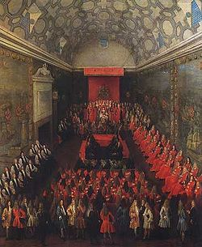
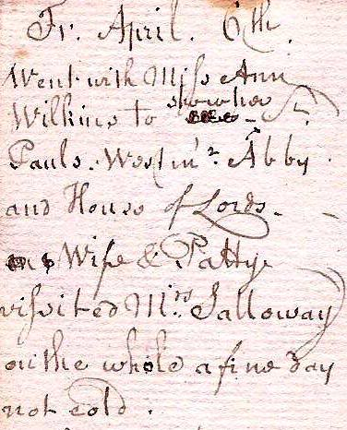
Sight-seeing (St Pauls, Westminster Abbey and the House of Lords)
Notes:
So we have:
Friday April 6th: went with Miss Ann Wilkins to show her St Pauls, Westminster Abbey and House of Lords. Wife and Patty visited Mrs Salloway. On the whole a fine day, not cold” And the picture is of the old House of Lords.
He mentions St Pauls - Going round the cathedral must have been really impressive, because it was only finished 50 years earlier and the white stone would have dazzled in the sunlight

Slide 10
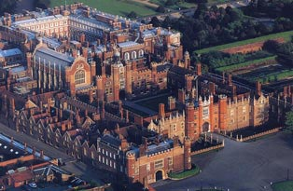
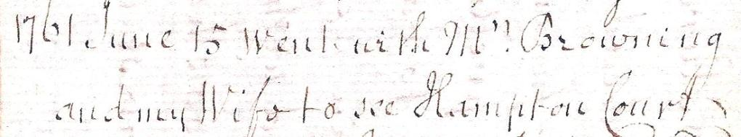
Sight-seeing (Hampton Court Palace)
Notes:
Sometimes he went further afield, either by boat or by carriage. Here is his entry for
June 15th 1761: “went with Mrs Browning and my wife to see Hampton Court”
Obviously the buildings are much as we see them today, although the gardens are much changed as a result of Capability Brown. Brown started working there 3 years after Richards visit, and he transformed the parkland setting.

Slide 11
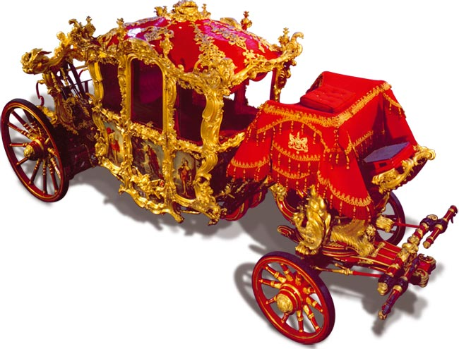
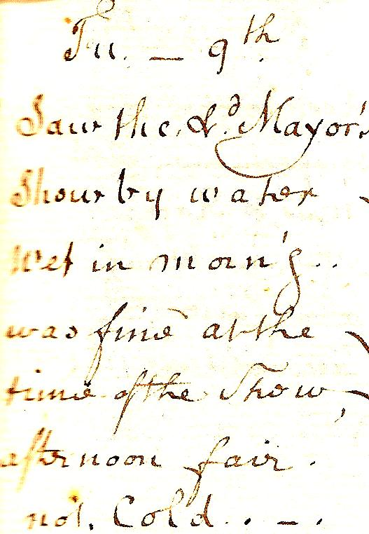
Sight-seeing (The Lord Mayor’s Show)
Notes:
A great spectacle was the Lord Mayors Show early in November – all the apprentices had the day off on what was in effect a Bank Holiday.
“9th November: Saw the Lord Mayor’s Show by water – wet in the morning, was fine at the time of the Show. Afternoon fair, not Cold.”
And I have illustrated it with a picture of the Lord Mayors Coach, made in 1757 and therefore almost brand new at the time of Richards diary entry

Slide 12
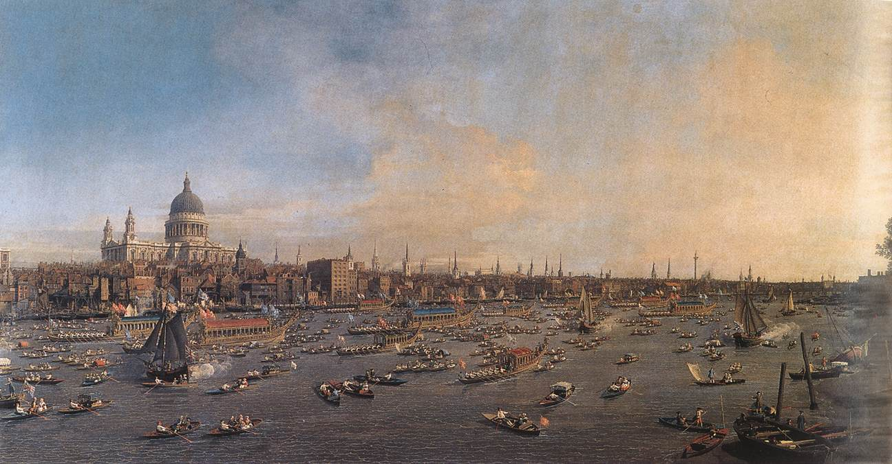
Sight-seeing (The Lord Mayor’s Show)
Notes:
Seeing the show from the water was always popular because the streets were crowded with drunks and pick pockets. Far better to view the show from the river.
This is Canaletto’s view of the Show from the water, showing the myriad of boats on the Thames – shades of 2 years ago with the Royal Barge sailing under Tower Bridge

Slide 13

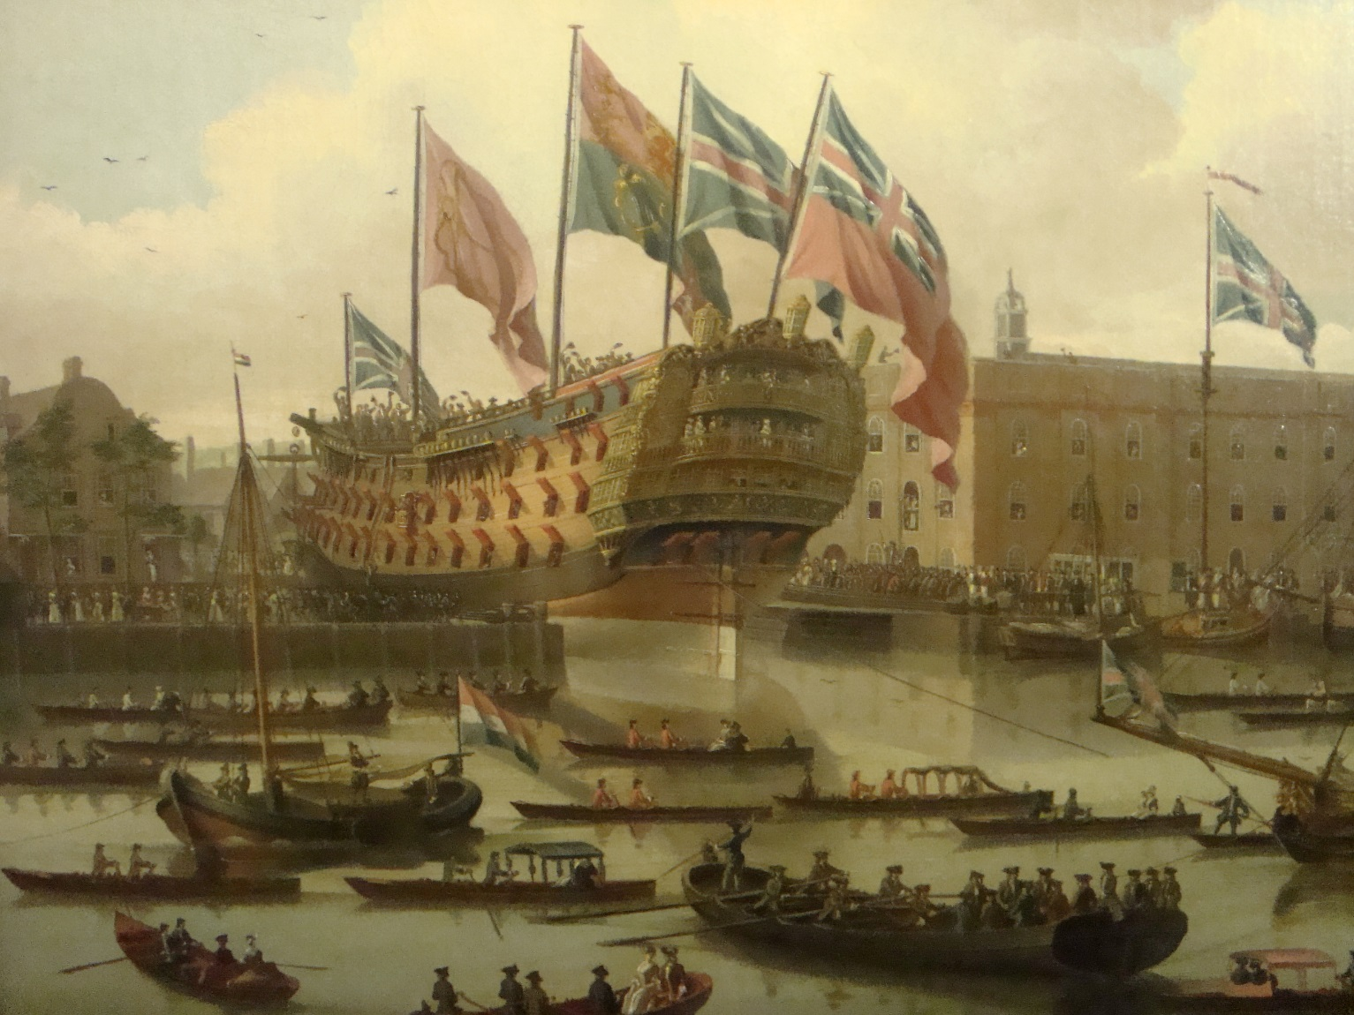
Sight-seeing –
a Ship launch
Notes:
Staying on the water, Britain’s Royal Navy and merchant fleet both expanded greatly in size during the 18th Century and Richard liked to go and see new ships being launched.
So here we have “May 1st 1760, Dined at Mr Foljambs, saw a ship launched”.
The illustration is an extract from a painting at the National Maritime Museum, showing the launching of the Cambridge a few years earlier.

Slide 14
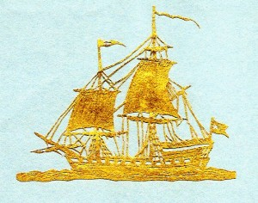
Sight-seeing –
a Ship launch
Notes:
And here is a rather nice paper cut-out which Richard himself made, using gold paper and showing a two-masted ship in full sail.
It’s about one and a half inches long. It really is a very intricate piece of work.
I’ve included the picture as a reminder of how Londoners in the 18th Century were always curious to see what was happening in the world around them, particularly if it was new and showed Britain’s commercial or industrial strength. They wanted to feel involved.

Slide 15
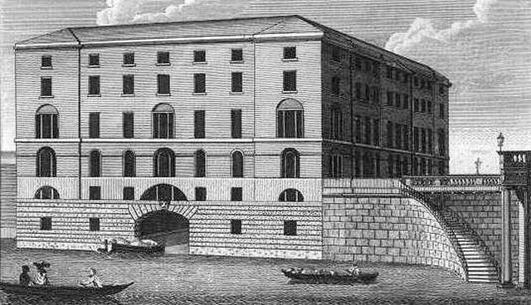
Sight-seeing –
Industrial wonders. The Albion Mills
Notes:
So when the Albion Mill opened in 1786 people flocked to see what was the first factory of its kind to be constructed in London, just by Blackfriars Bridge – Matthew Boulton and James Watt had installed steam engines which drove conveyor belts to bring sackloads of corn from barges moored in the Thames, up to a battery of 20 pairs of grinding stones.
Steam power was used to grind the corn into flour. It also sifted the flour and drove the pulleys which lifted the sacks onto conveyor belts, and moved them to where waggons had pulled up to transport the sacks to the bakers of the City.
Rival windmill owners may have hated this Leviathan – but the public were fascinated by it! The scale of operations was awesome, and it became a real tourist attraction.

Slide 16
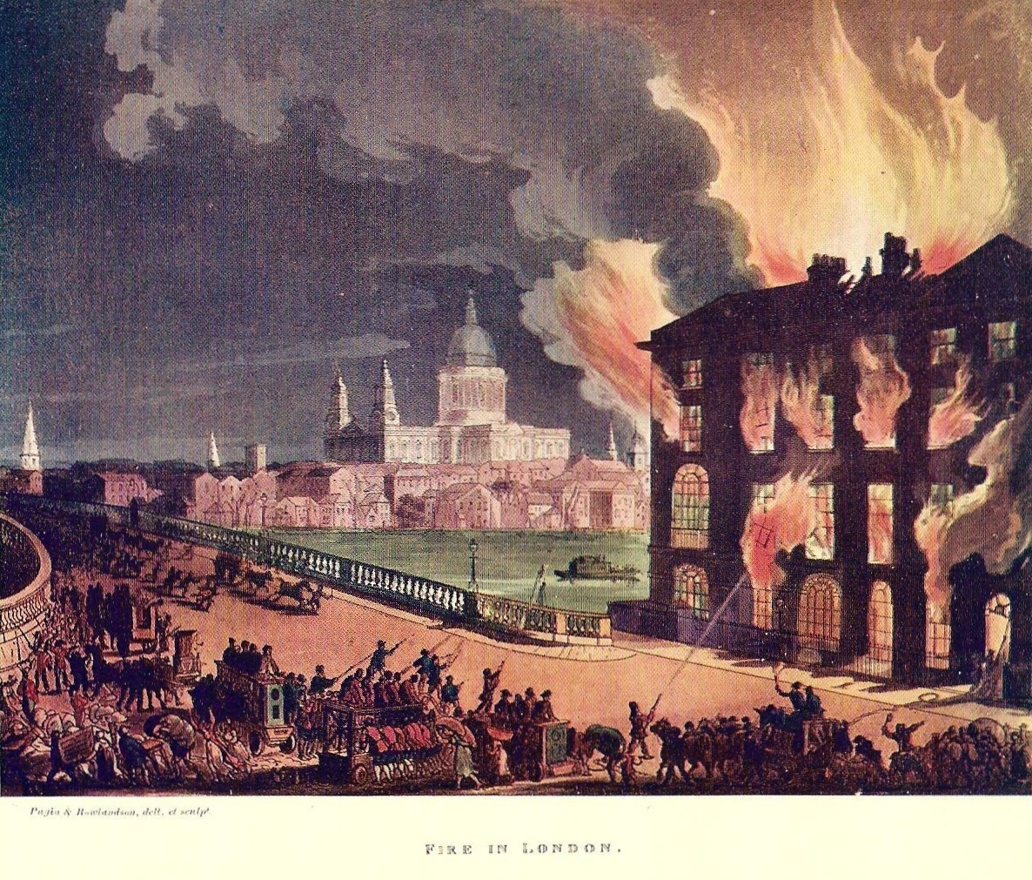
Sight-seeing –
Industrial wonders. The Albion Mills
Notes:
But the crowds were even more impressed when, on the evening of 2nd March 1791, a fire broke out.
I blogged about the event last week - It was low tide, so the fire engines were unable to draw the water up from the river. The blaze took hold, destroying thousands upon thousands of sacks of grain. The roof fell in, sending a column of burning grain high into the sky, where it showered down throughout the morning of 3rd March. The smell of burnt toast must have been un-missable all over London!
So the crowds eagerly gathered to see the smouldering remains, and it is fair to say that the public have always enjoyed watching other people’s misfortunes!

Slide 17
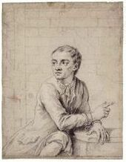
Executions at Tyburn
(The original ‘Jack
the Lad’, Jack Sheppard
went to the gallows
16th November 1724.
Notes:
None more so than when the misfortune involved a public hanging. These were hugely popular and drew crowds of tens of thousands of people.
One of the most popular took place a few years before my ancestor was born – the hanging of Jack Shepherd -the original Jack the Lad. He was a petty thief and house breaker who kept getting caught and then escaping from custody.

Slide 18
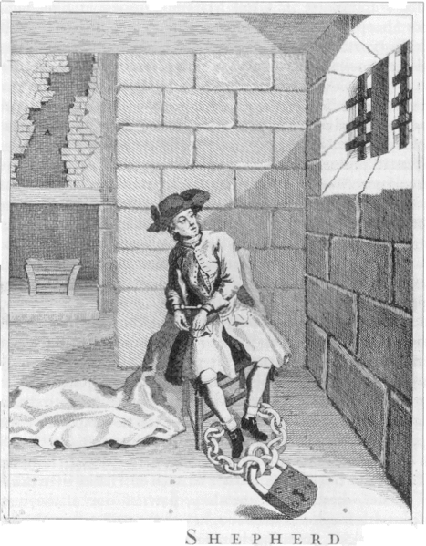
Executions at Tyburn
Notes:
One day his girlfriend was captured and put in jail. He climbed onto the roof of the prison with a rope, removed some of the tiles, lowered the rope to his girlfriend and pulled her to safety.
Instantly, he became a cult figure!
Twice more he was caught, padlocked to the cell floor, but managed to escape and carry on thieving.

Slide 19
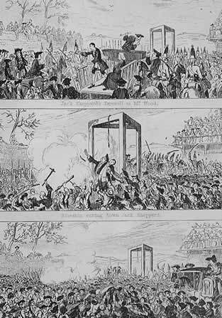
Executions at Tyburn
Notes:
Eventually he was captured again, sentenced to death, and an enormous crowd gathered to see him off.
Books were written for sale where the gallows were erected, songs were sung, his portrait was bought as a souvenir - it was THE place to be in 1724 and it is estimated that 250,000 people turned out to watch – a QUARTER of the entire population of London

Slide 20
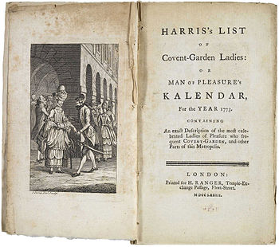
Brothels, bordellos or bagnios
Notes:
Staying with the seamier side of life I don’t think I can mention tourist attractions without mentioning the brothels bordellos or bagnios which thrived in London – especially in the area around COVENT GARDEN. The DISCERNING PUBLIC could even purchase a copy of HARRIS’S LIST so that they knew exactly what they were letting themselves in for when they visited!
As the front page states: “Harris’s list of Covent Garden Ladies - or “Man of Pleasure’s Calendar” for the year 1773. An exact description of the most celebrated ladies of pleasure who frequent Covent Garden, and other parts of the Metropolis

Slide 21
Brothels, bordellos or bagnios
Notes:
So we have
Miss Blackburn. No. 18 Old Compton Street, Soho….This accomplished nymph has just attained her 18th year, and fraught with every perfection, enters a volunteer in the field of Venus.
She plays on the pianoforte, sings, dances, and is mistress of every manoeuvre in the amorous contest that can enhance the coming pleasure; is of the middle stature, fine auburn hair, dark eyes and very inviting countenance...
In bed she is all the heart can wish; her price two pounds

Slide 22
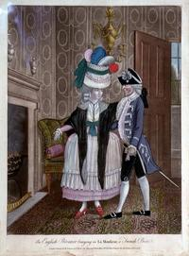
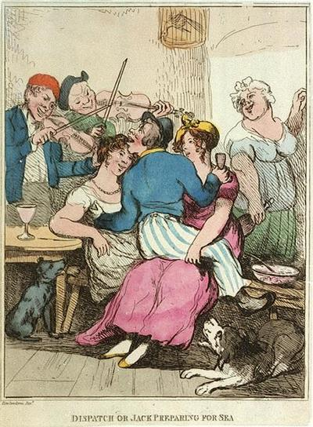
An English privateer Dispatch, or Jack bringing in a French prize preparing for sea
Notes:
Cartoonists loved to caricature the differences between the rich and the poor – differences which meant that the high class courtesan entertained her clients in a fine house, such as on the left, while the Jolly Tar would pick up a girl – or in this case two - in the local tavern.
There was very little censure about prostitution – it was entirely open and it has been suggested that as many as 1 in 5 London women dabbled in the sex trade at sometime or another in their lives.
That is not so much a reflection on promiscuity, as a sad reminder of the very limited employment opportunities for women in the 18th Century.

Slide 23
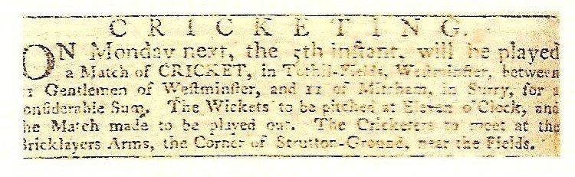
Cricket matches
Notes:
But enough of such bawdy matters!! What of gentlemen playing cricket? Richard kept this newspaper clipping:
“Cricketing: On Monday next the 5th instant, will be played a match of CRICKET in Tuthill Fields Westminster between 11 Gentlemen of Westminster & 11 of Mitcham in Surrey, for a considerable sum. The Cricketers to meet at the Bricklayers Arms… nothing new there then!
Here we have a picture of a batsman with a curved bat - a reminder of the game’s origins where shepherds used their crook to hit a ball made of wood wrapped in sheeps wool. In particular you can see that the ball was bowled underarm – bowling over the arm didn’t come in until the middle of the following century

Slide 24
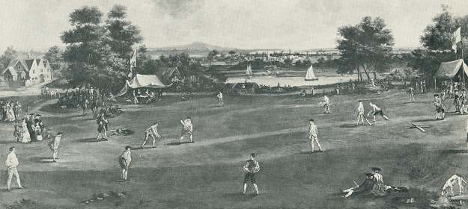
Cricket matches
Notes:
Here is a picture of an 18th Century ground. A rope would mark the playing boundary, but there was no such thing as a six. The game quickly caught on and was the subject of many wagers.
To begin with each club had its own rules but when The Marylebone Cricket Club was formed in 1787 it laid down rules which were quickly adopted by others.

Slide 25
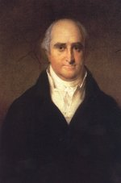
Cricket matches
Notes:
Thomas Lord, shown on the left, was an underarm bowler who raised funds to buy a ground where cricket could be played.
On the right I have shown items from Lords Museum, showing the development of the bat from the hooked stick on the left,
to a sort of paddle,
through to the more modern shape we recognize today.

Slide 26
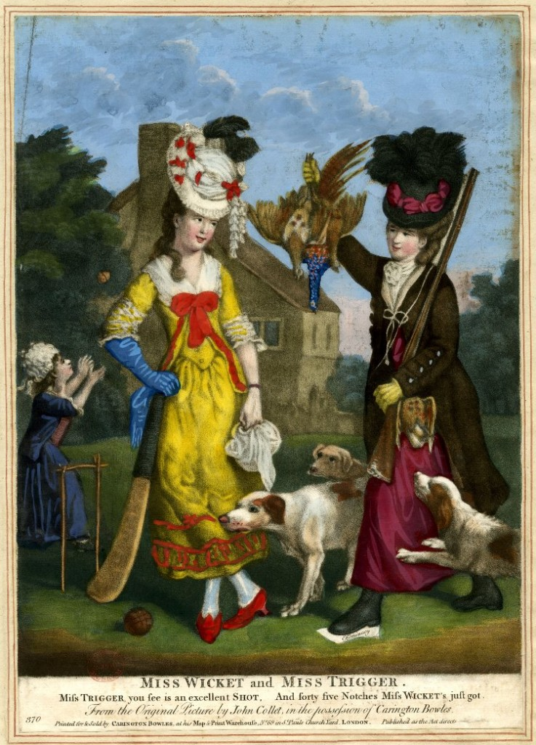
Cricket matches
Notes:
And it wasn’t only a game for the men! Caricaturists were outraged when women dared to play it. This is entitled Miss Wicket and Miss Trigger and according to the caption Miss Wicket has just scored 45 notches or runs.
I would hardly say that her dress was appropriate to the cricket pitch – I can’t really imagine her sprinting 22 yards in that hat!!

Slide 27
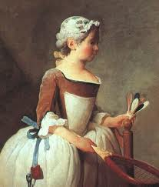
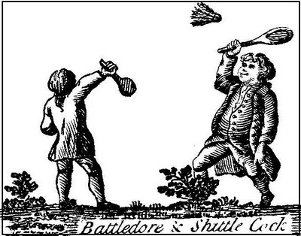
Battledore & Shuttlecock
Notes:
Just as energetic, here we have another game popular with men and women alike, Battledore & Shuttlecock. On the left a young girl holds a racket known as the Battledore.
In her left hand she holds a ball made of cork into which feathers from a duck were fixed (Known as a shuttlecock - “shuttle” because it shuttled back & forth, and “cock” because it was like a bird).
The game developed into badminton and was very popular.

Slide 28
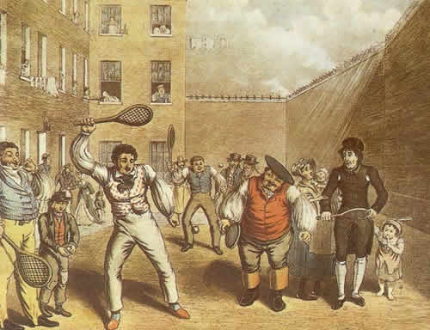
Rackets
Notes:
Another game developed from fives into rackets.
It started in the Debtors Prisons of the Kings Bench and in the Fleet Prison. Prisoners would hit a ball against the prison wall, sometimes at a corner in order to add a sidewall to the game.
In time the game evolved into squash, where the first courts appeared at Harrow School in 1830

Slide 29
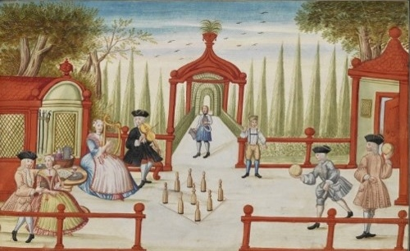
Skittles
Notes:
Slightly less energetic, skittle alleys became popular – here a picture from 1735. In Tudor times it was a game played by monarchs but it spread to all classes and Skittle alleys were often found in public houses.
Different regions had their own rules, the one common link being that there were nine pins, or skittles, to be knocked down, either by a ball or by a wooden disc called a cheese.
Incidentally it was in 1841 that the Mayor of Connecticut in the United States banned nine-pin bowling because it encouraged gambling – and players resorted to using ten pins to get round the legislation. The Americans have played Ten-pin bowling ever since

Slide 30
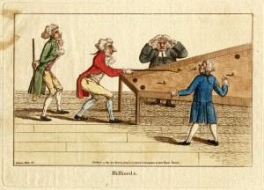
Billiards
Notes:
Moving indoors, BILLIARDS started to come into vogue. It was originally derived from CROQUET, which is of course played outside, but an INDOOR VERSION became popular in the 1700s with green baize imitating the grass.
The table itself was often not square. It might be hexagonal, as this one, from 1787.
The edges were wooden upstands to stop the balls falling off, rather than padded cushions. These came in later

Slide 31
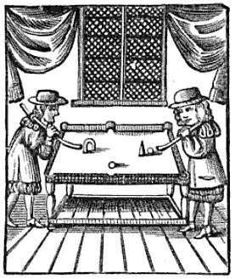
Billiards
Notes:
Its origin with croquet is shown in this old print, with the hoop placed on the table top, but with pockets in the centre and in the corners.
In time the hoops disappeared.

Slide 32
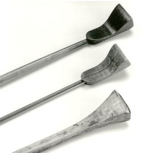
Billiards
Notes:
Players used a mallet like these, as in croquet, but Players doing fine shots found it easier to turn the mallet round and use the Tail (in French, the queue) to play the ball - hence we call them billiard cues today.
Not a lot of people know that..

Slide 33
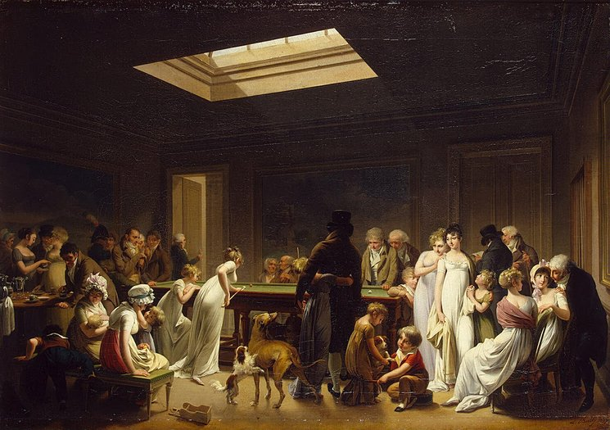
Billiards
Notes:
Once again it was originally a male preserve but women would occasionally outrage the men by having a go, as in this painting from 1807.
Pause

Slide 34
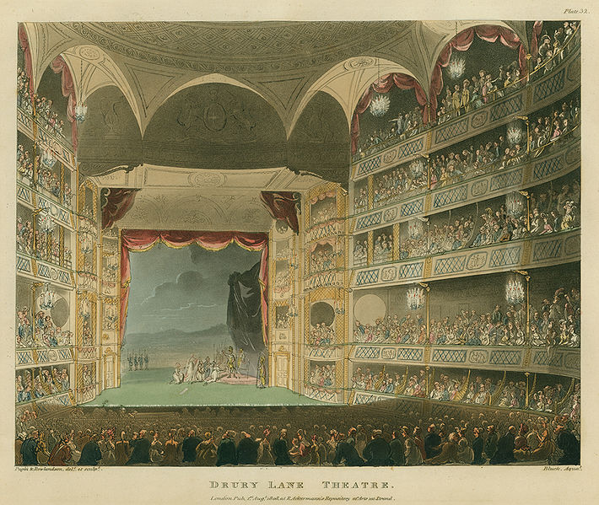
The Theatre
Drury Lane
Covent Garden
Notes:
Richard liked to go to the theatre. There were only 2 theatres (at Covent Garden and at Drury Lane) where plays could be put on because they enjoyed a monopoly – therefore more accurately called a duopoly – no other premises were permitted to put on plays, that is to say where the spoken word was paramount.
So here in this picture we have the Drury Lane Theatre Royal. The trouble was that the theatres kept burning down – small wonder when you think of candles being used in the footlights.
Actors like David Garrick had a huge following. But whereas it was considered an acceptable calling for a man, it was altogether frowned on for women, and the actresses were often courtesans who were available for hire at the end of a performance!
Richard records going to Covent Garden on 4th March 1768 to see a revival of Marlowe’s Dr Faustus. With five adults in the party, it cost 15 shillings to go to the play, and he spent another five pence on macaroons… Richard always did have a very sweet tooth…

Slide 35
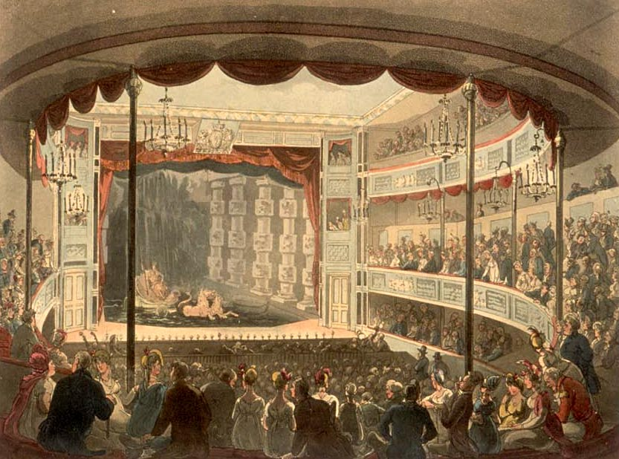
The Theatre
Sadlers Wells
Notes:
Rival theatre owners had to get round the restrictions by using music and dance, with the spoken word taking a subsidiary role.
So we had Dick Sadler who ran tea rooms out at Islington. He first tried to drum up business by extolling the virtues of the Spring Water which he found at the bottom of the garden, (hence Sadlers Wells) but then branched out into pantomime acts, musicals and dancing.

Slide 36
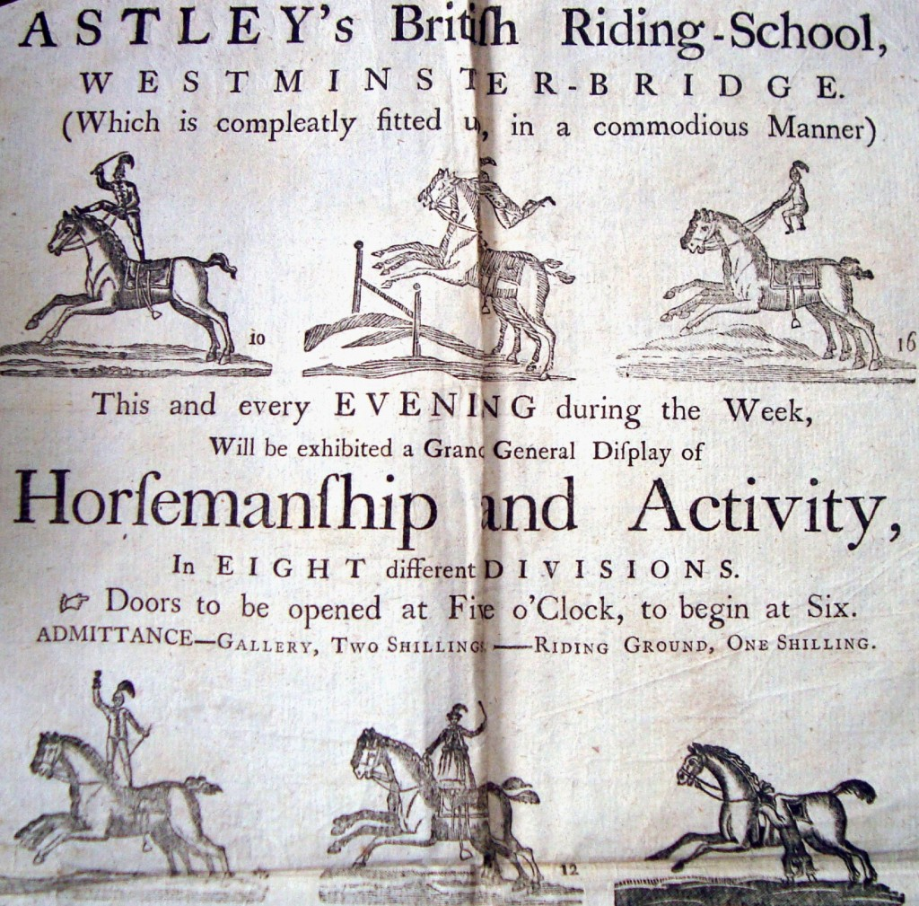
Astleys Circus
The circus ring (1768).
The first to combine music,
acrobats, animals and
clowns at his riding school.
Notes:
In a similar vein: the circus. Here Richard kept the handbill advertising Astleys British Riding School near Westminster Bridge, where people thronged to watch exhibitions of trick riding, juggling on horseback, and so on.
Astley was one of the first to use a circus Ring having a diameter of 42 feet – the tightest circle at which a horse can turn at speed, and using Centrifugal Force to keep the rider upright. It is still the standard size of circus ring used today.
Sitting in the gallery set Richard back two shillings a head, plus of course the cost of a carriage to get him there (three shillings) and, as usual, macaroons costing four pence

Slide 37
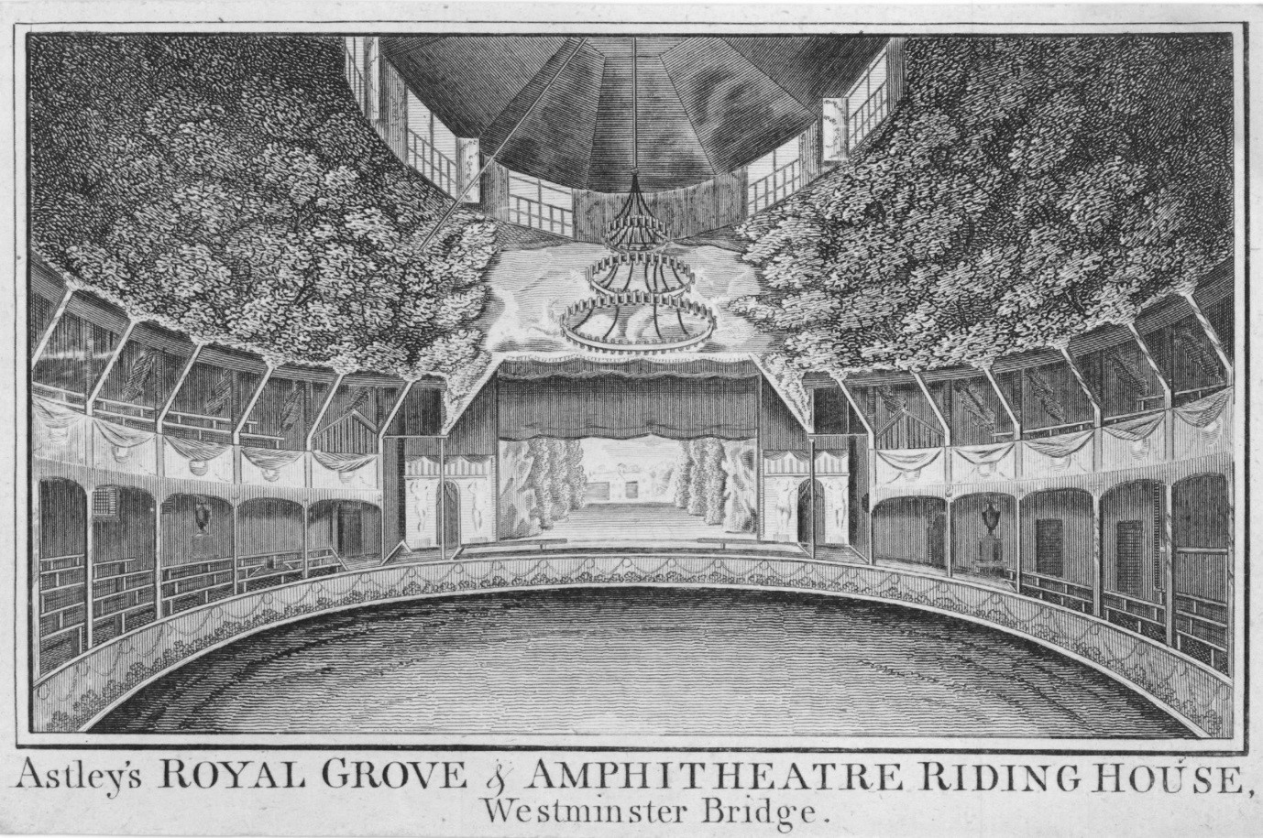
Astleys Circus
.
Notes:
And this is what it was like inside Astley’s circus – a hugely popular venue which was quickly copied by others.

Slide 38
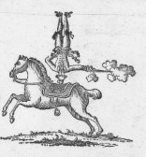
Astleys Circus
Notes:
One of Astley’s tricks was to perform a head-stand on the back of a galloping horse, while firing a pistol….
He also trained his horse to answer questions by scraping the ground with either of its front hooves, apparently answering YES OR NO to questions raised by the audience, or telling the time.

Slide 39
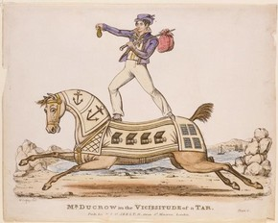
Astleys Circus
Notes:
Astley was a wonderful showman and a skilled rider and he also employed the very best in equestrian performers – here, a man called Ducrow who presented tableaus such as this one with the horse bedecked as if it were a man-o’war.

Slide 40
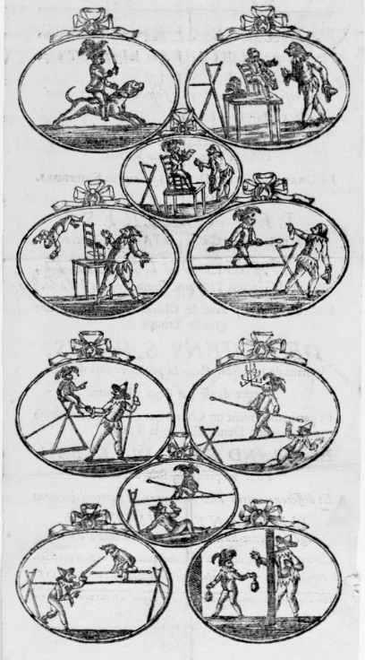
Astleys Circus
Notes:
There was also a monkey called General Jackoo which juggled on horseback, smoked a pipe, and walked a tightrope!
Astley is a real hero of mine – he is generally known as the founder of the modern circus, and I have just brought out a book about him to mark the bicentenary of his death

Slide 41
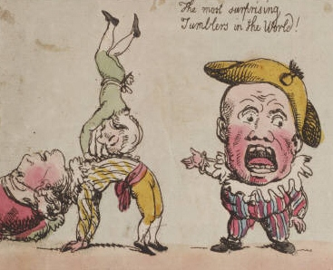
Fairground entertainers and street artists
Notes:
Astley’s shows included jugglers and acrobats – entertainments otherwise associated with fairs and travelling shows.
Here we have Rowlandson’s drawing entitled The Most Surprising Tumblers in the World

Slide 42
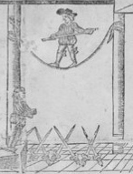
Fairground entertainers and street artists
Notes:
And this is a detail from a handbill for Southwark Fair, with the rope-walker balancing above a pit of upturned swords
– so a slip would have been somewhat hazardous and painful!

Slide 43
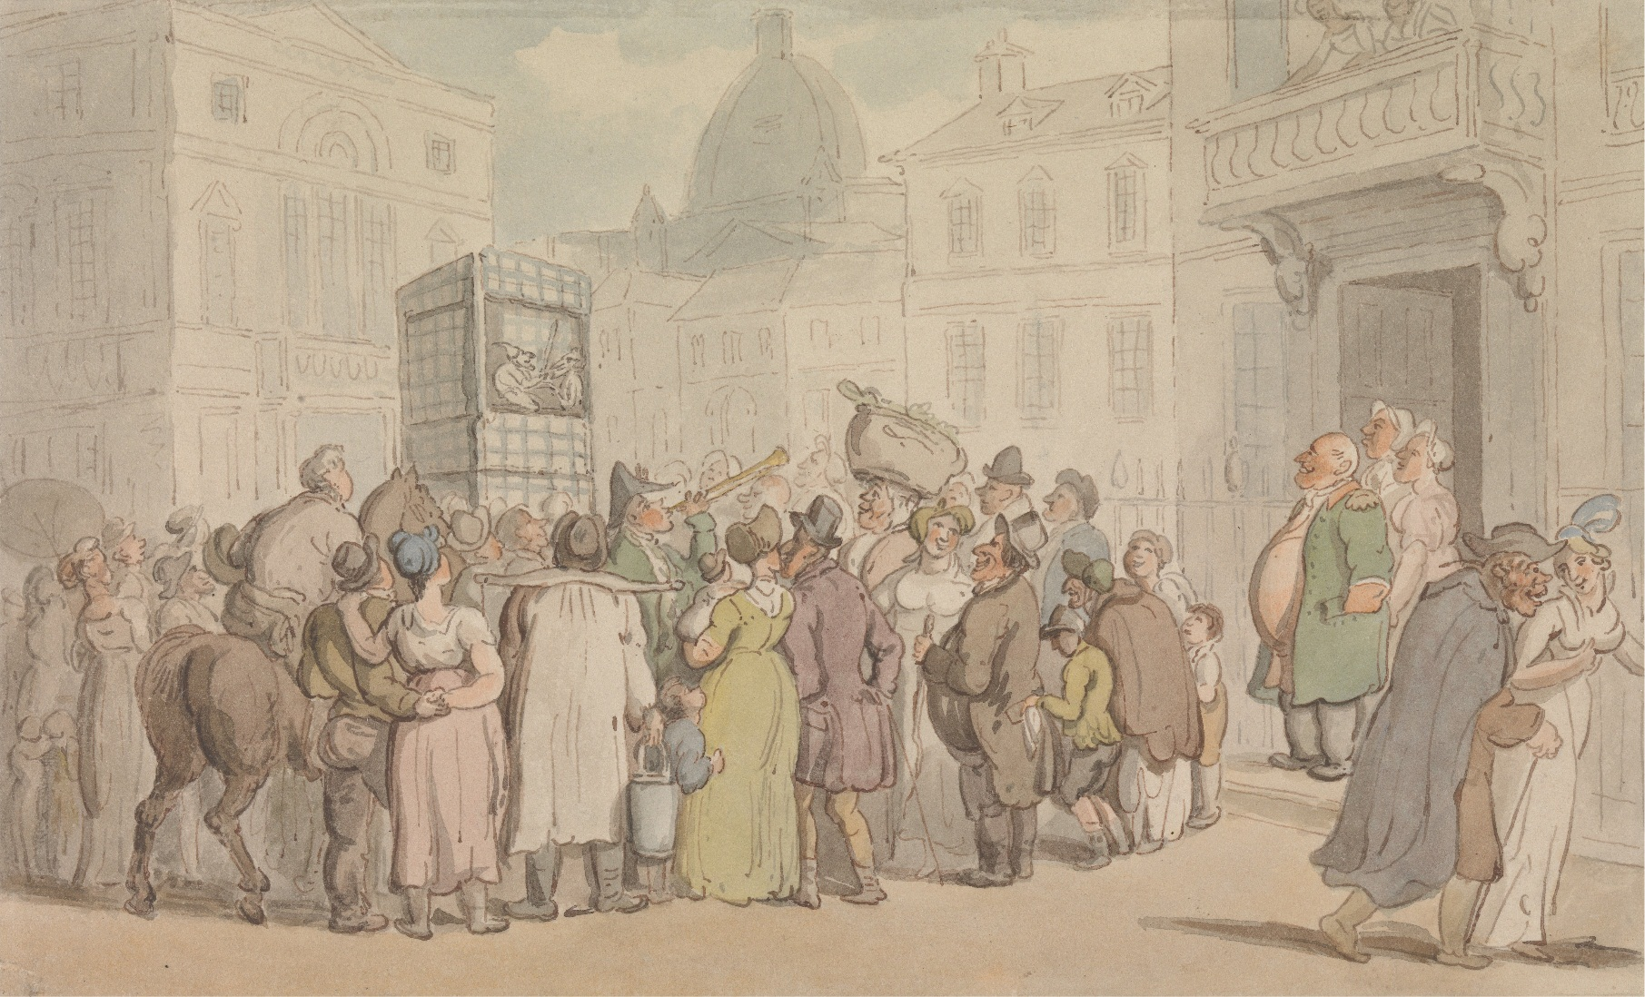
Fairground entertainers and street artists
Notes:
Another typical fairground entertainment was the travelling Punch and Judy Man
– this a sketch by Thos Rowlandson from about 1810

Slide 44
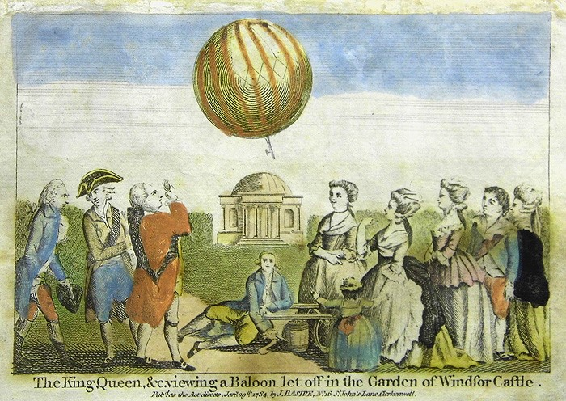
The balloon craze
Notes:
My ancestor loved travelling shows and displays - anything new, especially if it was scientific. From the mid 1780’s onwards there was always a mad scramble to see balloons being launched, manned or otherwise.
This is from an engraving showing the Swiss inventor Argand demonstrating the inflation of a balloon to King George III at Windsor Castle in November 1783

Slide 45
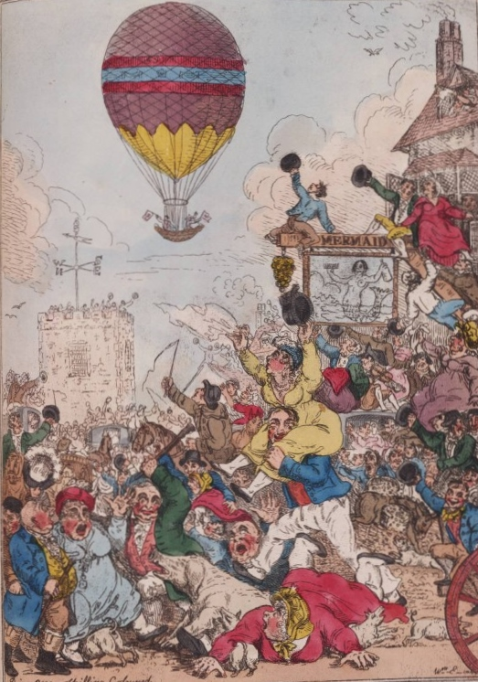
The balloon craze
Notes:
And this, a caricature showing a balloon ascending on the occasion of the birthday of George, Prince of Wales on 12 August 1811.
Occasions like this meant that pick pockets had a field day – everyone was so busy looking to the heavens that no-one noticed their wallets disappearing!

Slide 46
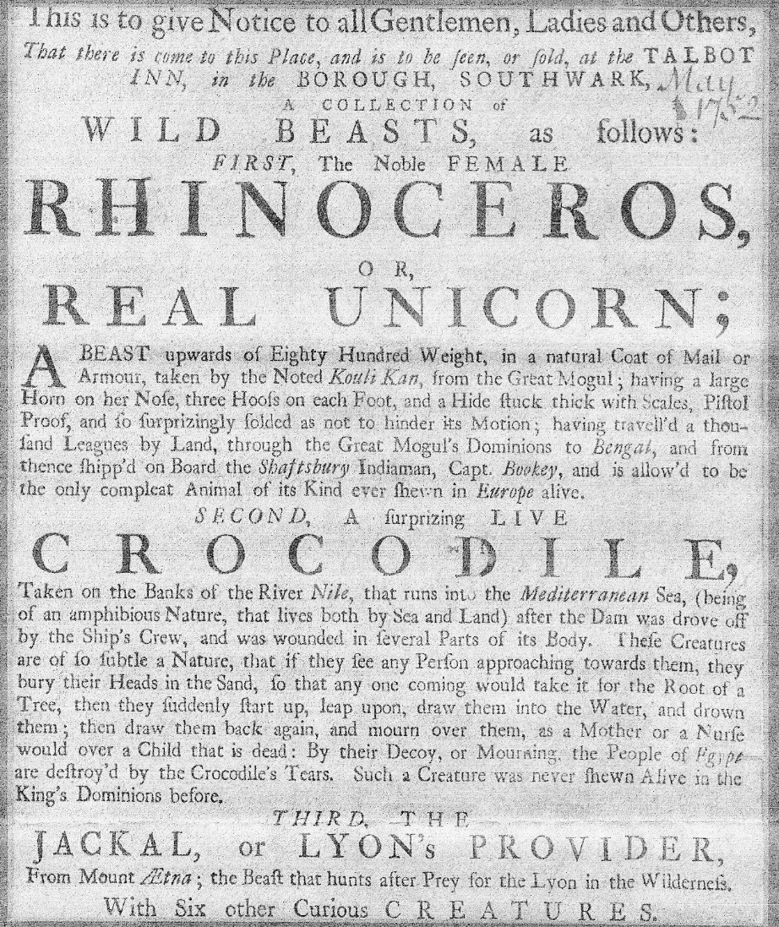
Travelling shows
Notes:
There was a fascination with travelling shows – here in the Talbot Inn in Southwark where my ancestor went to see a Rhinoceros, a crocodile and a jackal in May 1752.
The handbill which Richard kept states “This is to give notice to all Gentlemen, Ladies… and Others … that there is to be seen a collection of wild beasts…”!
It’s hard to imagine the cruelty and squalor of wild animals being dragged around from one public house to the next!

Slide 47
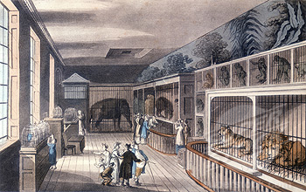
Menageries
Notes:
People flocked to see exotic animals, sometimes kept in appalling conditions. Here is Exeter ‘Change, in The Strand, where big cats and primates were kept in tiny cages.
Pause

Slide 48
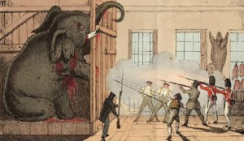
Menageries
Notes:
For many years the star of the show was Chunee the Elephant, 11 feet tall and weighing in at 7 tons, and kept at Exeter Change until 1826.
Eventually the elephant became violent and had to be destroyed.
Poison failed, and it took soldiers firing no fewer than 152 musket balls to kill the poor beast, which was finally finished off with a harpoon.
Public outrage at his treatment led to the formation of the first scientific zoo (the Zoological Society of London) and the opening of Regents Park Zoo in 1828

Slide 49
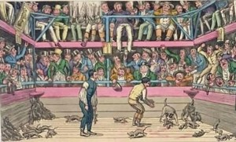
Gambling on animals
Notes:
It was a cruel age, especially where animals were concerned.
Prior to the Cruelty to Animals Act of 1835 there was still bear baiting, and delights such as betting on how long it would take a dog to kill a hundred rats.

Slide 50
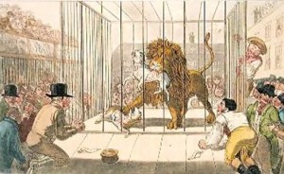
Gambling on animals
Notes:
Or as here, for a lion to kill two dogs put into its cage for the amusement of onlookers.

Slide 51
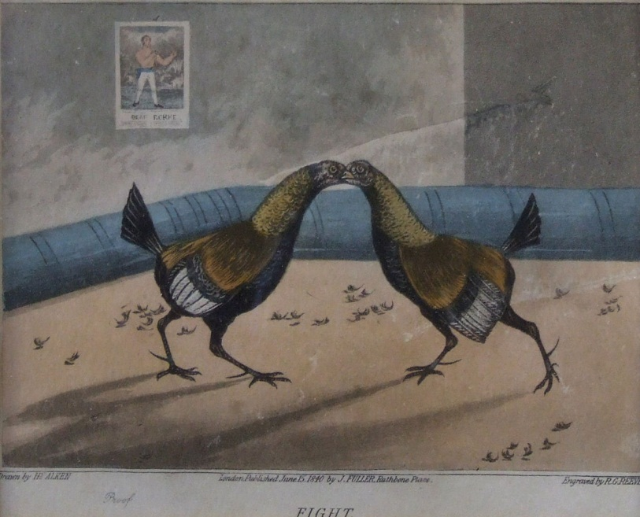

Gambling on cock fights
Notes:
Turning to other forms of gambling lets have a look at cockfighting. Popular since Roman times as shown by this mosaic tile on the right.

Slide 52


Gambling on cock fights
Notes:
It was known as a “ROYAL SPORT” because in previous centuries it had been a favourite of Tudor monarchs. On the left we have an advertisement from 1754 kept by my ancestor:
“At the Old Red Lion cock-pit the backside of Grays Inn Walks this present Monday the 8th of February Will be seen the Royal Sport of Cockfighting”
In the initial rounds 16 PAIRS of birds would fight for 2 guineas a battle. The next round would be for 6 guineas and eventually a winner would emerge after FIVE ROUNDS and win the prize of a hundred guineas. This was known as a ‘Welch tournament’. The prize money of a few guineas a battle was neither here nor there, the real money was to be made on SIDE BETS.

Slide 53


Gambling on cock fights
Notes:
On the right is a picture by William Hogarth entitled The Cock Fight
The birds themselves were fitted with lethally sharp blades like the one on the left, designed to inflict damage on the opponent.

Slide 54

Prize-fighting closer to kickboxing with elements of wrestling.
Elizabeth Stock, 1722
Notes:
Now let’s look at the noble art of fisticuffs! As you will see from this picture there were bouts involving women (Hugely popular with male onlookers because the combatants generally exposed more and more flesh as the fight went on and clothing got ripped!).
The picture is of Elizabeth Stock, who styled herself as the “European Championess”

Slide 55

Prize-fighting
Notes:
There were very few rules - “no biting or gouging” was about as far as it got to being controlled – so it was more like kick boxing with grappling.
So in this picture you can see the boxers wrestling each other trying to get in a punch – the idea of jabbing away from a distance, or using footwork to move back and forth, didn’t develop until much later in the century.
In the early days they just slugged it out for hour after hour!

Slide 56

Prize-fighting
Notes:
In time rules did get introduced. The Yorkshireman George Stevenson, had fought the English champion Jack Broughton in February 1741. This was in a fairground booth on Tottenham Court Road. Unfortunately, Stevenson died a few days after his 45-minute fight, as a result of the injuries which he had sustained. Broughton was very upset by the death and this caused him to draw up a code of rules in order to prevent a recurrence.
Published in August 1743, 'Broughton's Rules' were intended to apply to all bare-knuckle Prize fights and included 'That no person is to hit his adversary when he is down, or seize him by the ham, the breeches, or any part below the waist; a man on his knees to be reckoned down'.
Otherwise much was left to the discretion of referees. Rounds were not of a fixed length but continued until one of the fighters was knocked or thrown to the ground, after which those in his corner were allowed 30 seconds to get him up to scratch – a line drawn across the middle of the ring – failing which his opponent was declared the victor.

Slide 57
Prize-fighting
Notes:
Broughton's rules were universally used for nearly one hundred years. He was perhaps the first man who could justify his claim to be the British Champion, a title he held for many years.
Broughton became wealthy training the sons of the nobility to learn the art of pugilism – and to him goes credit for the introduction of lightweight boxing gloves – known as mufflers - intended to protect the faces of young noblemen from getting badly marked. They were however only ever used in practice bouts, never in Prize fights.
When he died in 1789 Broughton was buried in Westminster Abbey in recognition of his contribution to English boxing.

Slide 58


Prize-fighting
Notes:
The sport enjoyed a huge surge in popularity during the Regency period when it was openly patronized by the Prince Regent, and his brothers.
A match would often be attended by thousands of people, many of whom had wagered money on the outcome. And of course they then purchased items such as souvenir mugs and commemorative prints like these, to take away as mementos.

Slide 59


Places to visit- the British Museum
© British Museum
Notes:
Moving on, I would like to pick up on some of the top tourist attractions, starting with the British Museum, which opened at Montagu House in 1759.
Richard went to see it the following year, and he writes: “October 8th 1760 went with Mr Crouch to see the British Museum”
Entrance was by ticket only, in escorted groups of a dozen, and tickets had to be obtained in advance.
Admission was free, and as it said on the ticket “No money to be given to the servants”

Slide 60



Viewing London (The Monument)
@stphotolondon
Notes:
Another favourite for Richard was showing guests the view from the Monument – just round the corner from where he lived. If the London Eye (or perhaps I should say The Shard) is nowadays famous for offering a view across the London skyline, in the 18th Century the Monument filled the same purpose.
For anyone prepared to climb the 311 steps to the viewing platform at the top, the view would have been unsurpassed – no sky scrapers blocking the view, just a panoramic vista of London and its church spires, leading to the villages beyond.
In time the Monument became a magnet for those intent on committing suicide, and eventually an iron cage had to be put up around the viewing gallery to prevent people jumping off.

Slide 61

Being seen (Vauxhall Gardens)
Notes:
Richard loved to visit Vauxhall Gardens – they were THE place to see and be seen. The rich would dine in the 50-odd supper boxes, while the onlookers could gawp at their social superiors

Slide 62

Being seen (Vauxhall Gardens)
Notes:
Rowlandson drew this picture showing an imaginary gathering of the great and the good – the Prince Regent, the Duchess of Devonshire and her sister, and so on.
But if the gardens were reputable in the full glare of thousands of oil lamps, all lit at the same time, the gardens were also notorious places of assignation on account of all the dark corners and quiet alleyways.

Slide 63

Being seen (Vauxhall Gardens)
Notes:
The gardens were also a popular venue for watching firework displays, often set off from barges in the Thames.

Slide 64


Places to visit– the Tower
Notes:
Another attraction was visiting the Tower of London, just down the road from where Richard lived:
“25th April 1771 went to see the Mint at the Tower”.
In that year he would have been able to see gold guineas being minted.

Slide 65


Places to visit– the Tower
Notes:
Richard must also have seen the Royal Regalia because he brought home the handbill showing the full list of the crown jewels.
Group admission cost one shilling per head, and so on that occasion he paid four shillings to see the regalia, another 2 shillings and three pence to see the lions, and he then slipped a further shilling to the Warden, presumably as a tip for giving him a personal tour.

Slide 66



Places to visit - Cox’s Museum
Notes:
Another favourite of Richard’s - one you may never have heard of, but which was an absolute “MUST SEE” in the 1770s and 80s. COX’S MUSEUM. Richard went there over and over again. Here he records:” November 7th 1774 went with Betty Snooke and Mr Kearse to see Cox’s Museum.
April 25th 1775 went with wife to see Cox’s Museum”
James Cox started off as a jeweller and clock maker but moved on to make huge automata – life-sized models of animals such as tigers made out of silver and covered in precious stones such as rubies and emeralds, and containing mechanism which enabled them to move their heads from side to side, and so on.

Slide 67



Cox’s Museum
Notes:
Perhaps the most famous exhibit was the silver swan, now in the BOWES MUSEUM at Barnard Castle.
It still operates every day and draws gasps of appreciation and enthusiastic applause even after 225 years.
The swan appears to glide across a lake ( in reality glass bars revolve beneath it), the swan turns to one side then the other before lowering its head towards the water and reappearing with a fish in its beak.
Slightly odd, because swans are actually vegetarian and don’t eat fish, but the articulated neck is incredibly well-done and it works with the sort of well-oiled engineering you get when a soft-top Mercedes closes its roof! It really is fun to watch!

Slide 68

Cox’s Museum
Notes:
Mind you, Cox’s wasn’t cheap – it cost ten shillings and sixpence to get in, and another half a guinea (the equivalent of forty five pounds today) to buy the catalogue, but Richard obviously considered it worth it, because this is his copy.
Pause

Slide 69


Don Saltero’s Coffee House
Notes:
My ancestor loved places exhibiting natural curiosities, none more so than Don Salteros Coffee House. Here we have “Was at Don Saltero’s Coffee House at Chelsea, thirteen shillings.”
Don Saltero was in fact John Salter but he thought that Don Saltero gave him a sense of Spanish Mystery and he posed as a sea captain back from foreign parts.
In fact he had been valet to Sir Hans Sloane (the collector who endowed the British Museum) and when he left his masters employment he was given a large amount of bric-a-brac with which to start his own display.
Fossils, shells, coins, old swords reputedly belonging to William the Conqueror – ALL MANNER OF TAT! Entrance was free on condition you either bought a cup of coffee or bought some of the exhibits, which were festooned from the ceiling as well as being stacked in glass cabinets.

Slide 70



Don Saltero’s Coffee House
Notes:
I rather suspect Richard did buy some of the items - either that or he spent an unlikely 13/- just on coffee!– Certainly I still have his shells and fossils, some of which he drew in meticulous detail.

Slide 71


Sir Ashton Lever’s Museum
– known as “The Leverian or “The Holophusicon”
Notes:
Another favourite of my ancestor, and one which I mentioned last time – the Leverian.
“Went with Wife, Daughter and Sophy to see Sir Ashton Levers collection of Curiosities – and curious they indeed are. Dined at a Beefstake house. Fine Day, mild.”
At The Leverian Richard could have seen 25,000 exhibits – mostly natural history exhibits including shells and fossils, stuffed animals and birds, and a load of material brought back from the Pacific by Captain Cook on his voyages round the world.

Slide 72


Sir Ashton Lever’s Museum
– known as “The Leverian or “The Holophusicon”
Notes:
Lever had taken a lease of Leicester House in 1774 (in Leicester Square) and opened it as a museum of curiosities early the following year, calling it the Holuphusicon – a made-up word signifying “the whole of nature”.

Slide 73

Sir Ashton Lever’s Museum
– known as “The Leverian or “The Holophusicon”
Notes:
It cost two guineas for an annual membership, or half a crown per visit, and as the newspaper cutting stated, it had good fires in all Galleries!
Despite the entrance fee, Lever spent more on new exhibits than he ever collected from admission charges.
He sold up in 1786 and the collection was moved to a site near the southern end of Blackfriars Bridge, where it continued to amaze and amuse until finally closing in 1806

Slide 74



The Pall Mall Waxworks
Notes:
Next up, The waxworks – not Madame Tussaud, who started in the early years of the 19th century, but Mrs Wright’s waxwork in Pall Mall, which Richard visited.
He writes: “went with Wife to see Mrs Wright’s Waxworks in Chidley Court, Pall Mall. Penny dined with us. A very fine day, pretty cool”
Entrance cost Richard and his wife a shilling each - Mrs Wright’s party-piece was to make life-sized wax models of famous people and sit them on a settee before allowing the public in – and then would watch the confusion as they realized that they were talking to a model.
The only 2 wax models to have survived are these two, of Admiral Howe and William Pitt the Elder.

Slide 75

The Royal Academy at Somerset House
Notes:
Another place Richard liked to visit was the Royal Academy at its new home in SOMERSET HOUSE, where it moved to in 1780
Pictures were hung almost from floor to ceiling and with the frames touching one another.
So this is what the exhibition looked like – and of course there was fierce rivalry amongst the artists as to who would be able to display their pictures at eye level rather than at ankle height or up on the ceiling!

Slide 76

The Royal Academy at Somerset House
Notes:
One of the most interesting features of the building was the staircase leading to the top floor, with resting places along the way. Here the cartoonist Thomas Rowlandson parodies the dirty old men who were attracted to the exhibition just on the off-chance that ladies would fall down…

Slide 77

The Royal Academy at Somerset House
Notes:
because, as you can see from the close-up, in the 18th Century it was not always the case that ladies wore any under-garments! Partly to deter Peeping Toms, and partly to control crowds, admission was allowed only by the purchase of a catalogue, costing one shilling.

Slide 78


The Pantheon
Notes:
And another very popular place of entertainment – The Pantheon, on the south side of Oxford Street. It opened in 1772 and lasted twenty years before being burnt to the ground. It was a fashionable place for assemblies, masquerades, balls, subscription concerts and even operas.
To begin with it was extremely fashionable – you could only attend if personally invited by a peer of the realm, but gradually it became far less elitist, but also less and less popular.

Slide 79

Almacks
Notes:
But if you are talking about fashionable assemblies look no further than Almacks. It was owned by William Macall who reversed the syllables in his surname, to avoid any prejudices against a Scottish name, and opened in 1765.
It was governed by an elite group of Lady Patronesses who Macall cleverly allowed to determine who was to be permitted entrance and who was not. Patronesses came and went over the years, but their influence was huge, and they could make … or break a person.
An invitation to Almacks in the Regency period had even more cache than being introduced at Court.
But rejection of an application for a voucher could mean social ruin.

Slide 80

Almacks
Notes:
Breeding, manners, and rank were key elements leading to approval, though fortune was not.
My ancestor Richard, being “trade” would certainly never have been admitted!
Almack’s Assembly Rooms consisted of a ballroom, supper rooms, and games rooms.
Balls were held on Wednesday nights during the Season and were surprisingly modest affairs with only meagre refreshments being served - and no wine or spirits.

Slide 81

Gentlemen’s Clubs
Whites
Notes:
On to places where men-only rules applied: Whites developed out of Whites Coffee House and opened in 1736 at premises in St James Street - now occupied by Boodles. In 1811 a bow window was added to the facade. It was in this window that Beau Brummell sat and held court until his downfall in 1816, making sartorial judgments on the passers-by.
It was the pre-eminent club in a century where joining clubs and societies was hugely popular – the first Grand Masonic Lodge opened at the Goose and Gridiron Tavern in 1717. The Hellfire Club started in 1719, by which time the Kit Cat Club had already been going for 20 years.
Other clubs, whether for gambling, socializing and eating – or more usually all three - sprang up throughout London

Slide 82


Gambling -
at cards
Notes:
If you wanted to gamble, playing at cards was the favourite past time. Here I have shown a caricature of a notorious-card sharp called Lady Archer, shown cheating at Faro. In Faro players bet on the next card to be turned up.
She was famous for running a FARO BANK with a CROOKED DECK of cards and she preyed upon wealthy young men come up to Town from the country. Play would start at 11 AT NIGHT and go on until 4 or 5 in the morning. It was technically illegal to run a gambling house but it was years before prosecutions were brought.
Here she is shown FLEECING THE PRINCE REGENT and a horrified James Fox in a print entitled “The Knave wins all”

Slide 83

Gambling -
at cards
Notes:
Here is another etching, by Rowlandson, this one showing Georgiana the Duchess of Devonshire. She was a prodigious gambler at cards.
When she died in 1806 aged 48 she had debts equivalent to three and three quarter million pounds in today’s money.
(When told of the debt, the Duke remarked ”Is that all?”)

Slide 84

Gambling -
at cards
Notes:
Here the Prince Regent exclaims “Damn the Dice! I never got such a plucking in my life!” while Fox replies “Don’t be so furious, try another cast for ten thousand”
£10,000! That’s more than the modern equivalent of three quarters of a million pounds riding on a single throw of the dice.

Slide 85

Gambling -
Odds and Evens
Notes:
Another Rowlandson cartoon entitled Private Amusements shows an early roulette wheel, with gamblers betting on Odds and Evens. London was always a magnet for wealthy young men who would be conned into gambling away their fortune in a single evening. Rowlandson himself was known to sit at the gaming tables for up to 36 hours at a stretch.
The extent of the gambling was stunning – Take Sir John Bland, 6th Baronet, who was born in 1722 and died at the age of 33 in Calais unmarried. When he was 21 he inherited the baronetcy at a time when the family estates included the entire city of Manchester and much of the surrounding countryside.
By the time he died 12 years later he had gambled away every single house, every single field, and he died intestate and penniless.

Slide 86

Tourism - travelling around the country
Notes:
Let’s move on to a different form of leisure activity – tourism. Richard was for ever going off on holiday and describes trips to see Stonehenge and Wilton House, and other excursions to Cambridge, and to Essex.
This is a cut-out made by my ancestor showing the coaching inn at which the Kings Lynn coach is pulling up (you can see the letters L-Y-N on the carriage door).
Travel wasn’t cheap – on one occasion Richard hired a coach for the family to use as they went sight-seeing around the City– two and a half hours coach hire cost 4 shillings (plus ”twopence given to the coachman”).

Slide 87

Tourism - travelling around the country
Notes:
In this caricature entitled 'A cockney & his wife going to Wycombe’ Gillray mocks the idea of mere trades-people aspiring to be tourists.
It shows an apothecary whipping a somewhat emaciated and decrepit horse, complaining to his wife that he cannot get the beast to go any faster. The underlying sentiment is that if you are trade, you should stay at home and not parade your ignorance in front of others.

Slide 88


Tourism - travelling around the country
Notes:
Meanwhile Richard recorded a trip to Brighton.
“August 1st set out in the Brighthelmstone Machine “ (Brighthelmstone was the old spelling for Brighton) “and through Divine Goodness was preserved to that place. A very fine day, warm”

Slide 89

Tourism - travelling around the country
Notes:
What did he do when he got to Brighton? - Well he tried his hand at swimming. Bathers were segregated, men at one end of the beach, women at the other.
Bathing was usually done in the nude so you changed out of your clothes in the swimming hut, which was then trundled into the briny and out you stepped.
A person called a “dipper” would then seize you and plunge you under water! Richard tried it once, hated it, and vowed never to have anything further to do with water!

Slide 90



Home entertainment - a quiet smoke….
Notes:
Rather than going out to be entertained, men could of course meet up for a quiet smoke. Here my ancestor records “Wife and Patty visited Mrs Cooper. Mr Rogers smoaked a pipe”
The illustration is from a Hogarth print, showing a man lighting a Clay churchwarden pipe – up to thirty inches long. The stems easily broke, as can be seen from the pile of broken ends on the floor.

Slide 91

Home entertainment - making jigsaw puzzles,
Notes:
In the latter years of the century people might choose to stay at home making jigsaw puzzles- these were first invented by Thomas Spilsbury in 1760 and quickly caught on.
Spillsbury started making what he called “dissected pictures” (later, jig saws) purely in order to teach children Geography, by sticking a map onto a wooden board and then carefully cutting out each country’s outline.
Here we have a map of Europe broken up into its national boundaries.

Slide 92



Home entertainment - some currant wine.
Notes:
Equally of course people would stay indoors and enjoy a drink. In 1780 my ancestor retired to live in the Cotswolds. He would order port wine to be sent down as a quarter pipe, which I gather was the equivalent of around 150 litres!
Richard would bottle off the wine before sending the empty barrel back up to London so that it could be refilled and returned on the next delivery. Here he writes that in 1796 on April 23 – he sent to London an empty cask to be filled with currant wine. May 16 it came back, full.
At the bottom on the left I have shown an extract from Richard’s household accounts for 1797. For those of you who came to my talk here a year ago, a reminder that Richard spent three times as much on wine as he paid in taxation
So, Taxes in 1797 were £2/8/3 while wine came in at £8/3/5 (Ah, those were the days!)

Slide 93

And then there was…. shopping!
Notes:
And finally, to end with, a reminder that London is, and always has been, a mecca for the serious shopper. Some of us may not equate shopping with entertainment, but there you go!
We tend to think of large stores as a Victorian development but the first Wedgwood showroom opened in early 1768 near the docks.
The showroom was a huge success. The wife of Wedgwood’s nephew wrote that the showroom was so crowded that there was “no getting to the door of the shop for coaches.”
Five years later, the first printed catalogue of the stock was published, and in 1774 the Wedgwood showroom moved to more prestigious premises in York Street in Westminster’s St. James’s Square.

Slide 94
And then there was…. shopping!
Notes:
London really was somewhere where you could buy absolutely everything, and for visitors up from the country it must have been an Aladdin’s Cave!
When Richard was living in London he would invite his brother in law William to stay – which he did for six weeks at a time! He would come up to Town every Spring - just as Richard would go to the Cotswolds to stay with his brother in law every autumn.
On one such visit to London William listed the items which he purchased,

Slide 95

And then there was…. shopping!
Notes:
so we have: GLOVES ,

Slide 96

And then there was…. shopping!
Notes:
Necklace & ear-rings,

Slide 97

And then there was…. shopping!
Notes:
A pair of silver salts

Slide 98

And then there was…. shopping!
Notes:
Paste sprig for the hair,

Slide 99

And then there was…. shopping!
Notes:
Hairbrush & looking glass,

Slide 100

And then there was…. shopping!
Notes:
a ring with garnets,

Slide 101

And then there was…. shopping!
Notes:
A bonnet

Slide 102

And then there was…. shopping!
Notes:
handkerchiefs

Slide 103

And then there was…. shopping!
Notes:
Shoe buckles

Slide 104

And then there was…. shopping!
Notes:
18 yards finest silk

Slide 105

And then there was…. shopping!
Notes:
Silk waistcoat

Slide 106


And then there was…. shopping!
Notes:
Stockings. He also shaved 44 times at a cost of 18/- and bought a “gold band button & loop for my hat”

Slide 107
And then there was…. shopping!
Notes:
…. in all £150 worth of expenditure in just 44 days!
That is equivalent to £12,000 spent on ornaments and fancy clothes in modern money!
If you had it, you flaunted it! The 18th Century really was a time when the poor were very poor – and the rich were incredibly wealthy
That £150 in six weeks has to be seen in context of the fact that a farm worker was expected to get by on twenty pounds a year

Slide 108


Entertainment in the 18th Century
Notes:
That concludes my talk – I find it interesting to see how little our leisure activities have changed in 200 years.
If anyone is interested in either of my books – one a social history called the Journal of a Georgian Gentleman, the other about Philip Astley – I have a few copies available in the hall outside.

Slide 109
Entertainment in the 18th Century
Notes:
Thanks very much for listening. Please feel free to ask questions.

