Slide 1
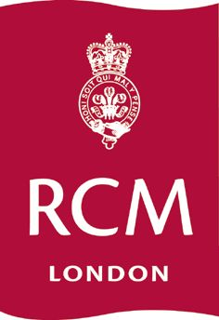
Celebrating the Past: Treasures from the Royal College of Music Collections 6 April 2011
Ingrid Elizabeth Pearson
Deputy Head, Graduate School
Royal College of Music, London

Slide 2
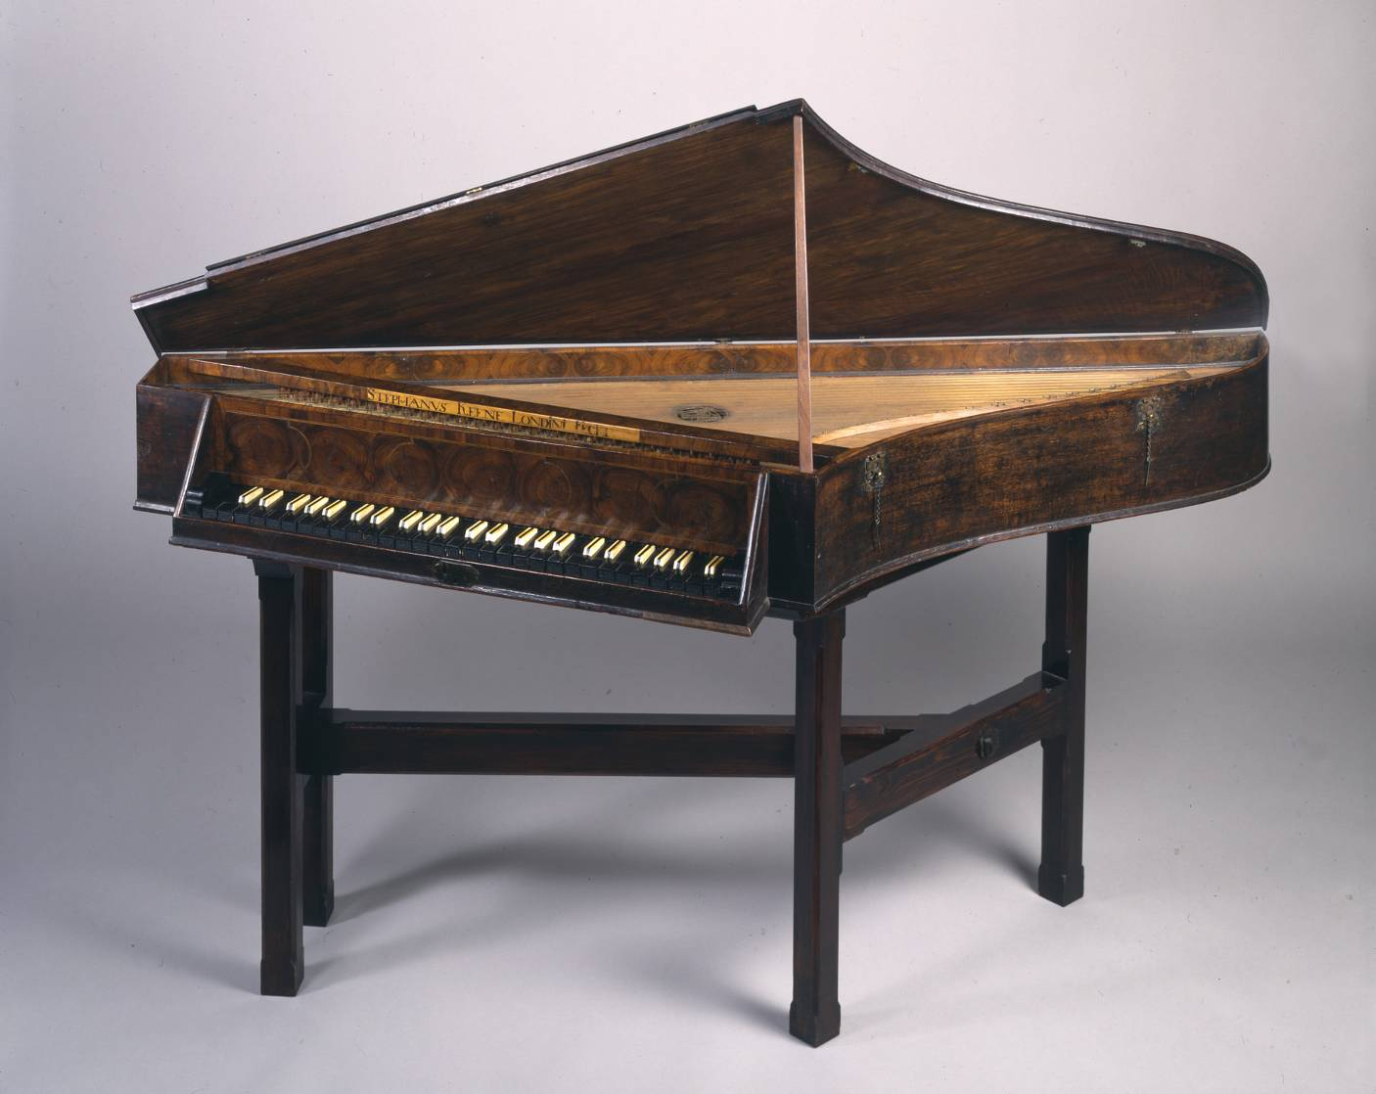
Spinet by Stephen Keene RCM 179

Slide 3
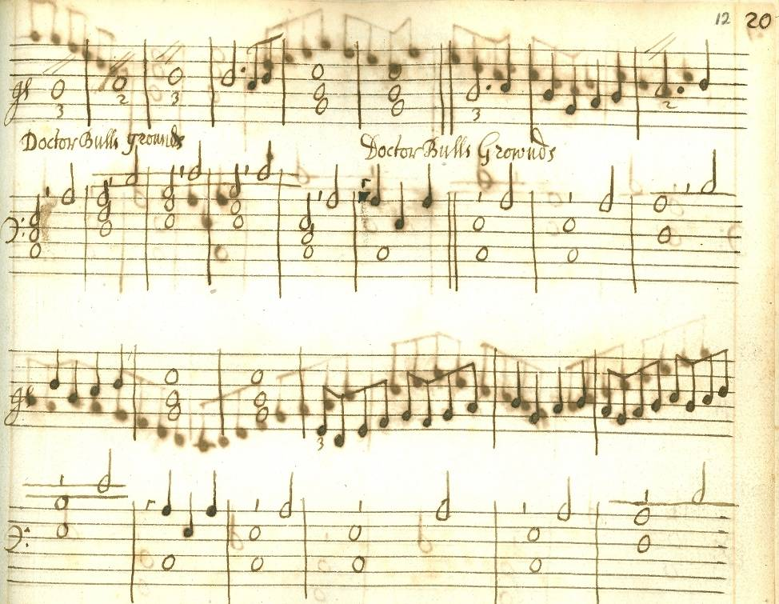
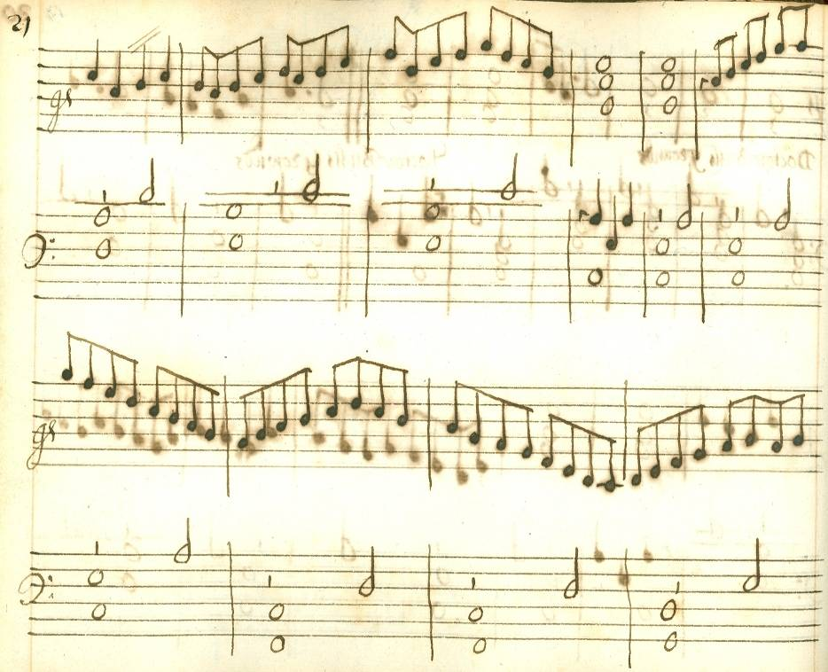
first pages of Doctor Bulls Grownds RCM 2093

Slide 4
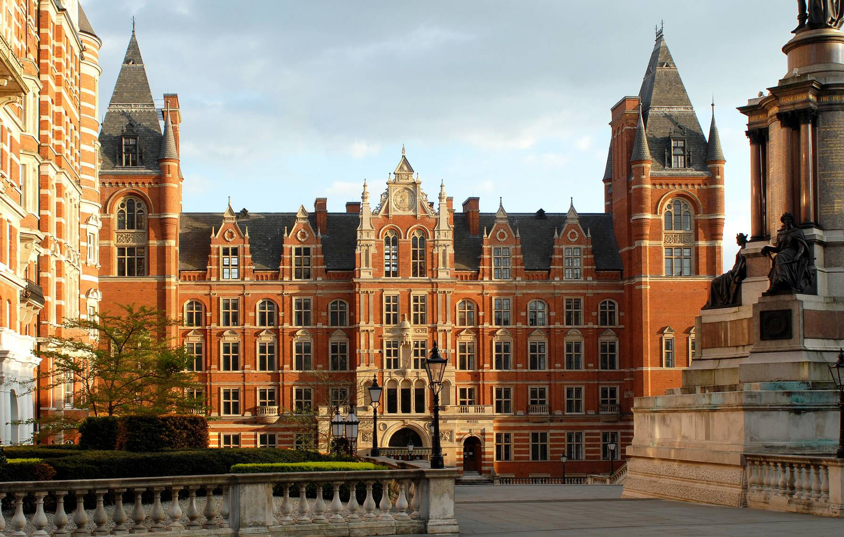
Royal College of Music 2011

Slide 5
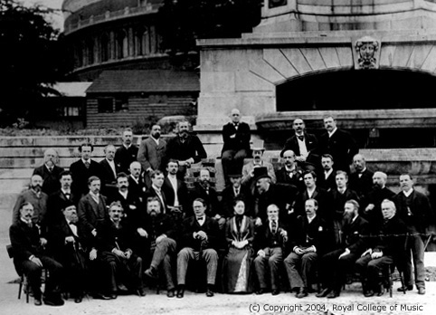
Sir George Grove and his colleagues 8 July 1890

Slide 6
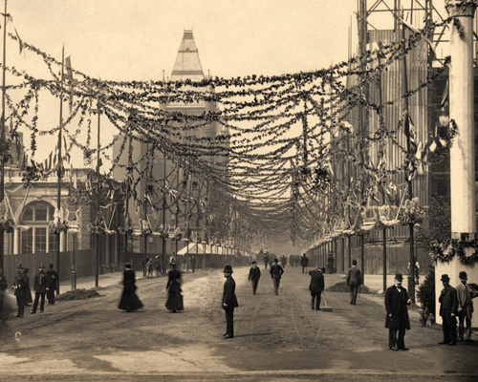
Prince Consort Road at the State opening of Blomfield’s new RCM building 2 May 1894

Slide 7
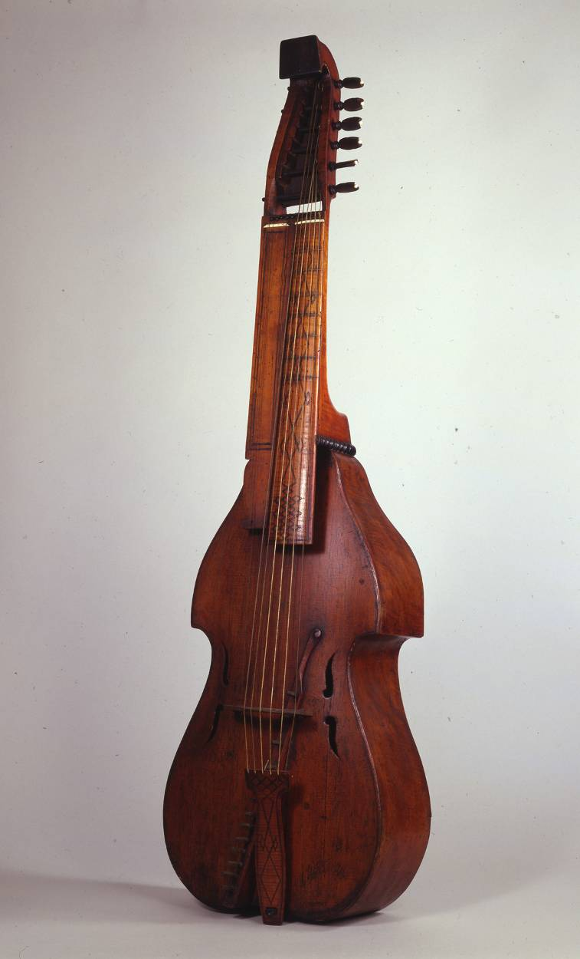
Baryton by Magnus Feldlen RCM 204

Slide 8
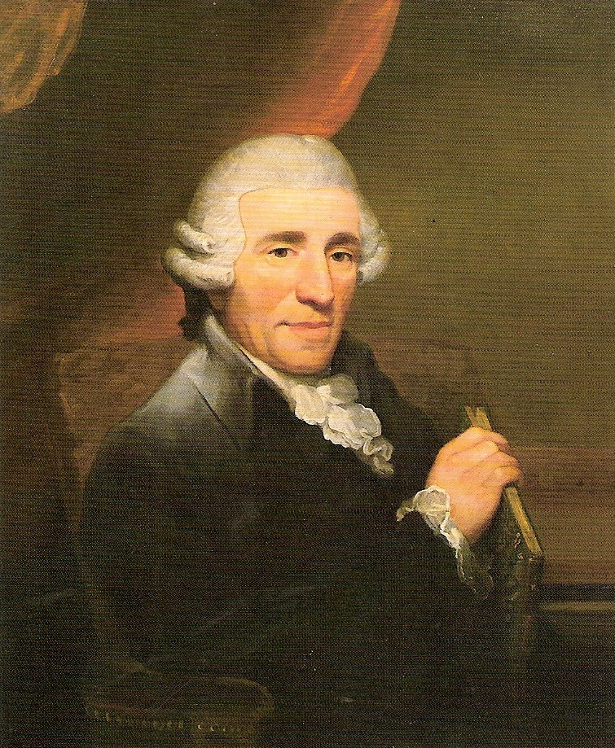
Joseph Haydn by Thomas Hardy 1791

Slide 9
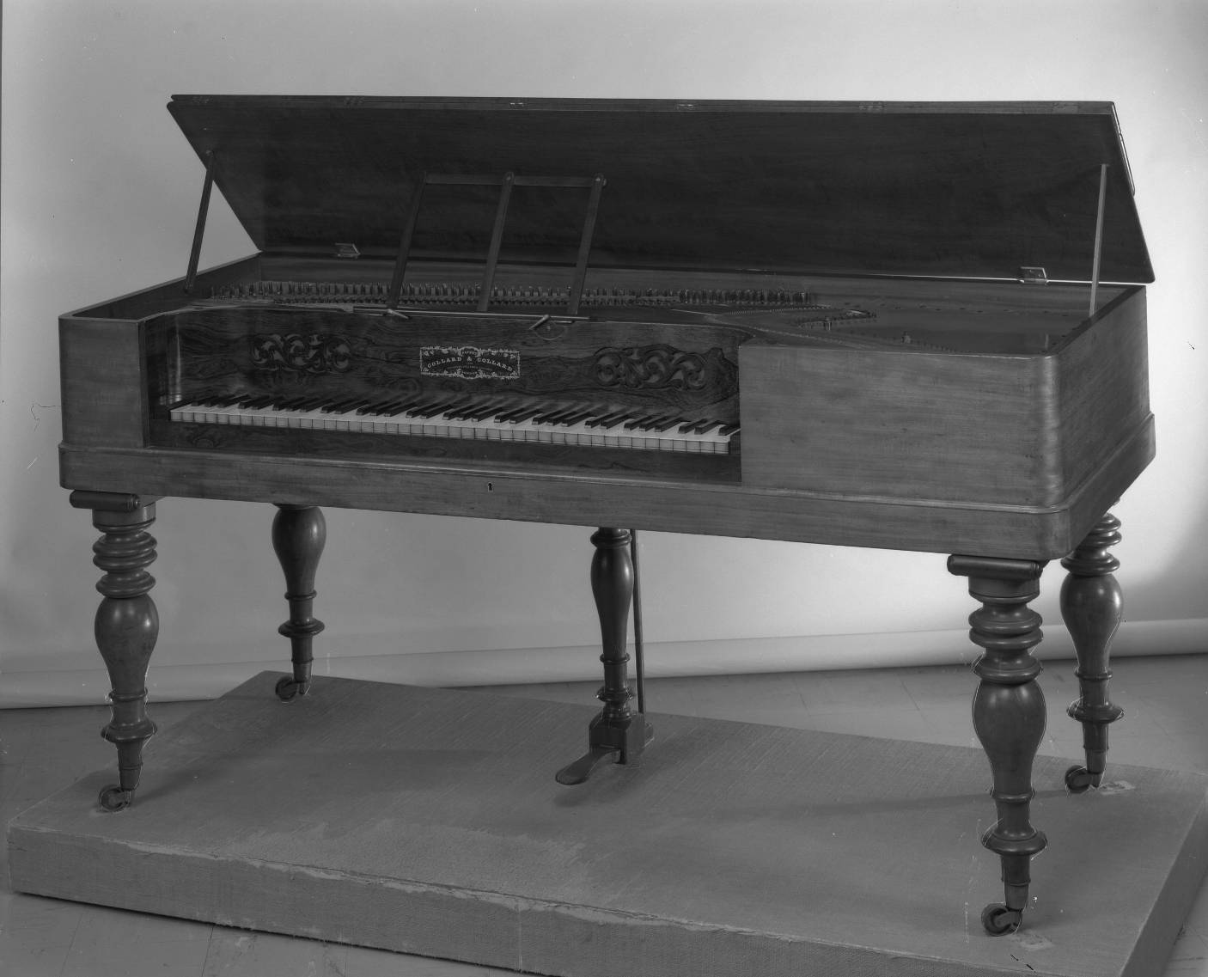
Square piano by Collard & Collard RCM 313

Slide 10
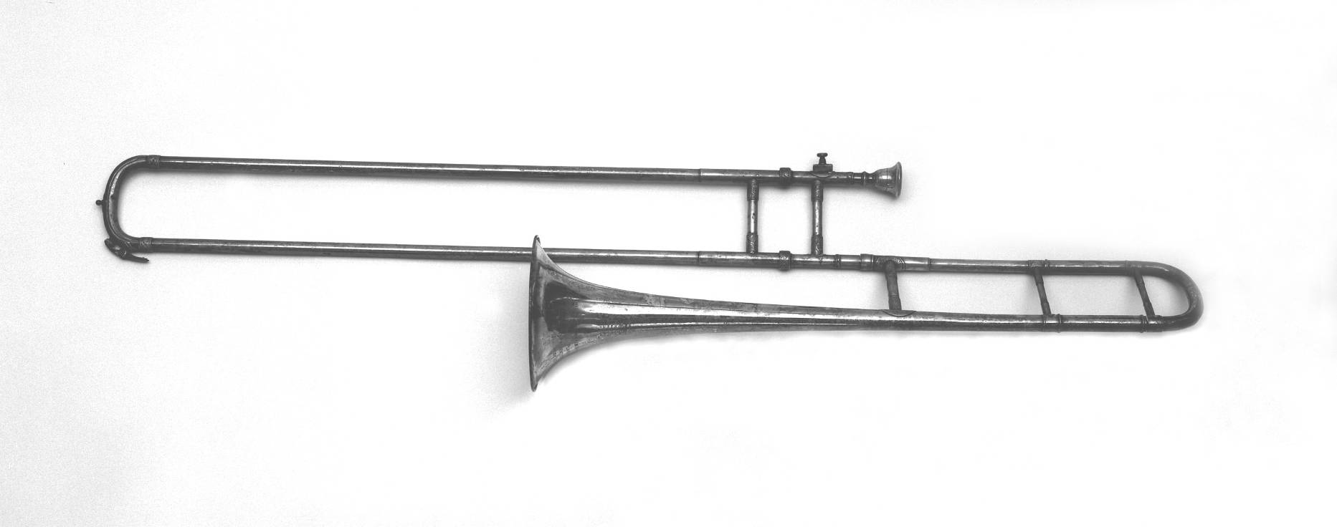
Sir Edward Elgar’s tenor trombone RCM 219

Slide 11
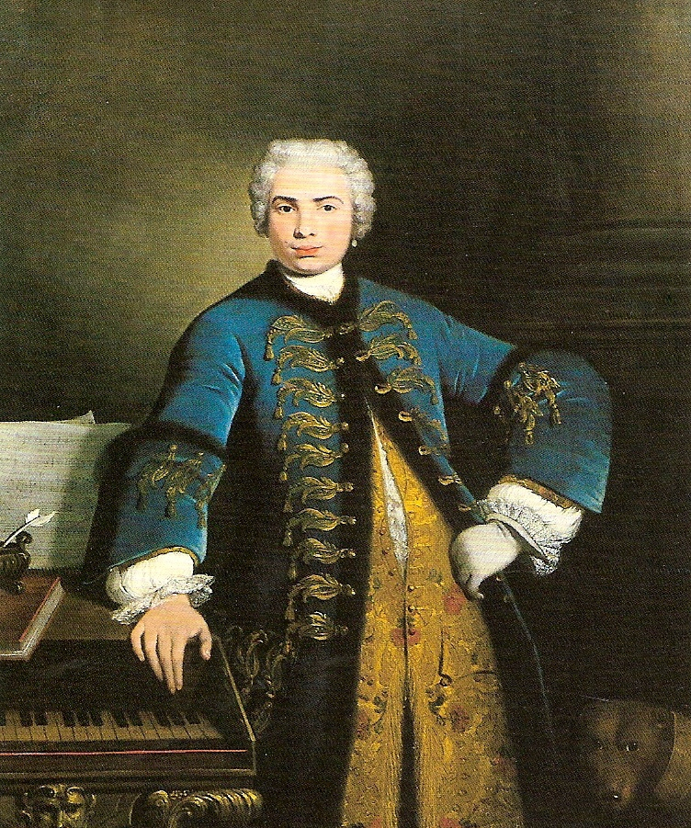
Farinelli by Bartolommeo Nazari 1734

Slide 12
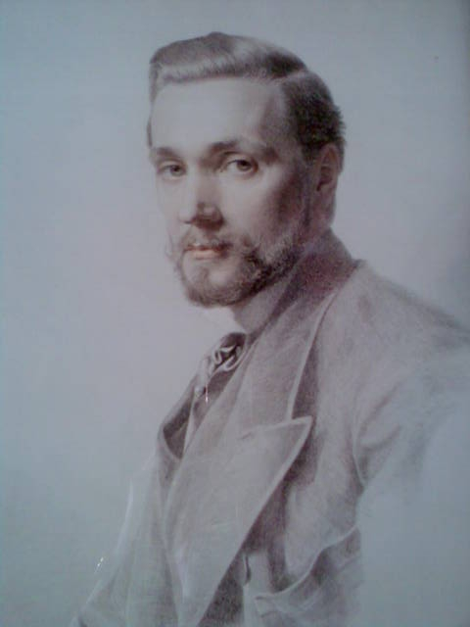
Sir George Hunter Donaldson by Frederick Sandys 1878

Slide 13
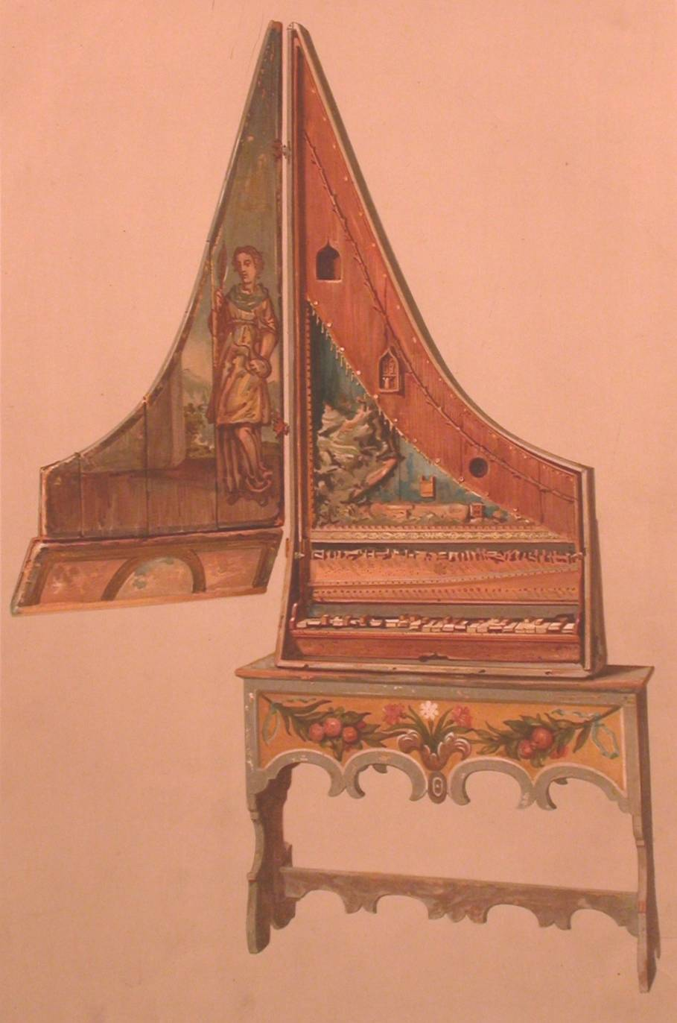
Clavicytherium c. 1480 RCM 1 as it appeared in Donaldson’s own catalogue of 1894

Slide 14
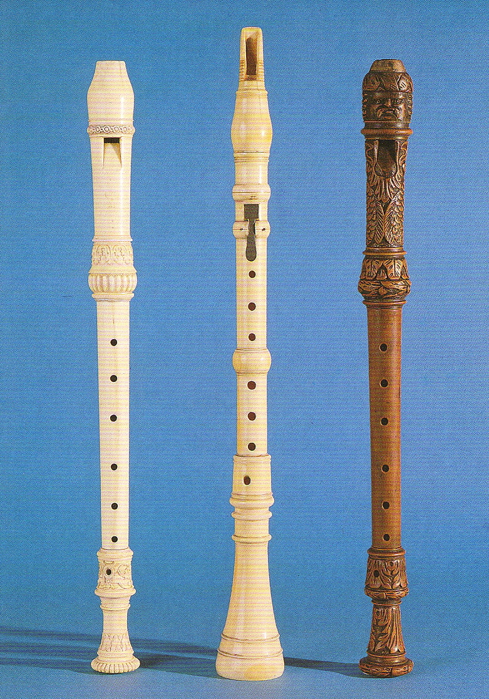
L to R: Jakob Denner treble recorder RCM 63 G. H. Scherer clarinet in D RCM 101 J. W. Oberlender treble recorder RCM 96

Slide 15
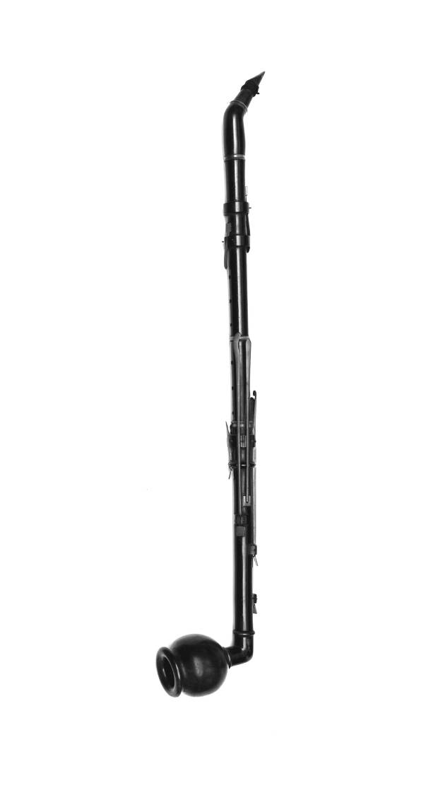
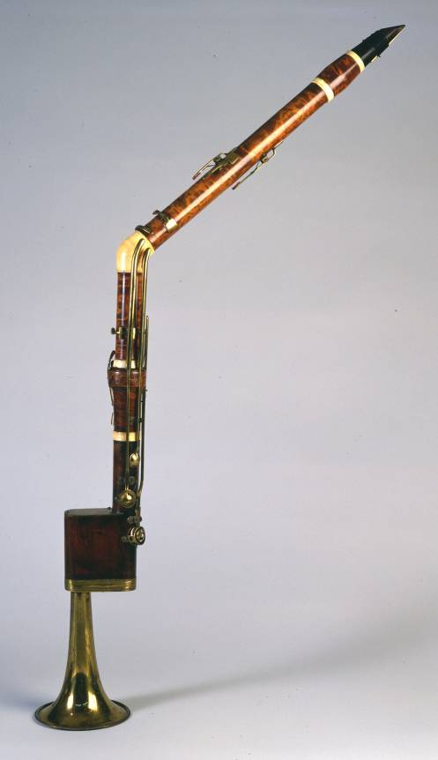
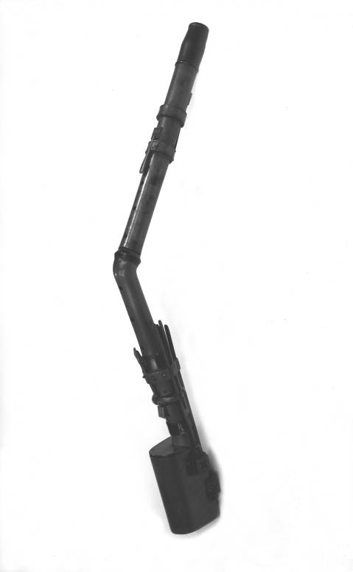
Basset horns L to R: anon c. 1800 RCM 87 Griesbacher c 1800 RCM 242 Doleisch 1803 RCM 90

Slide 16
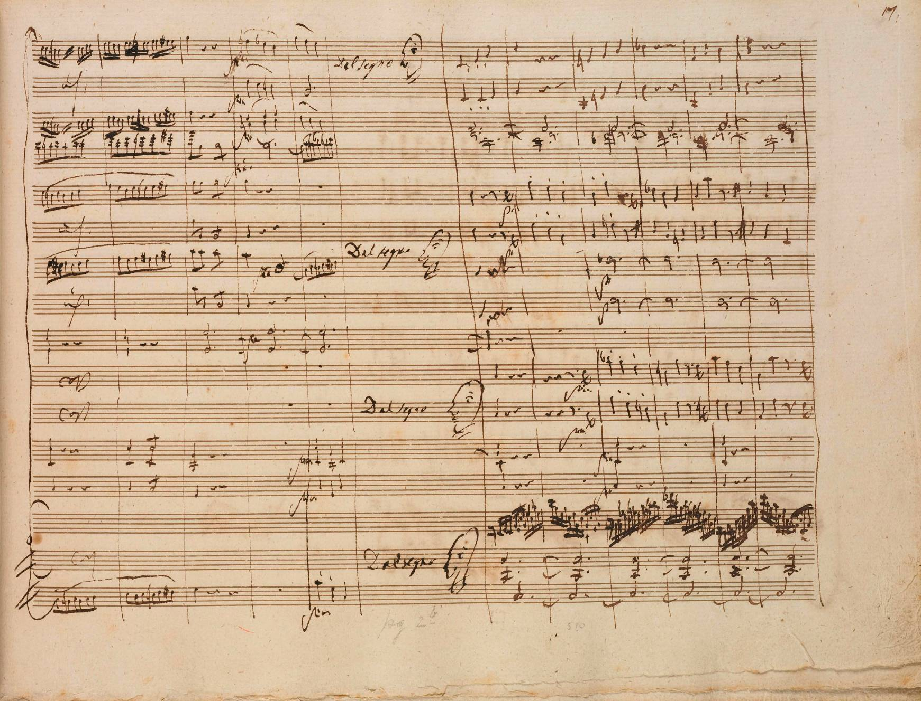
K 491 i RCM MS 402

Slide 17
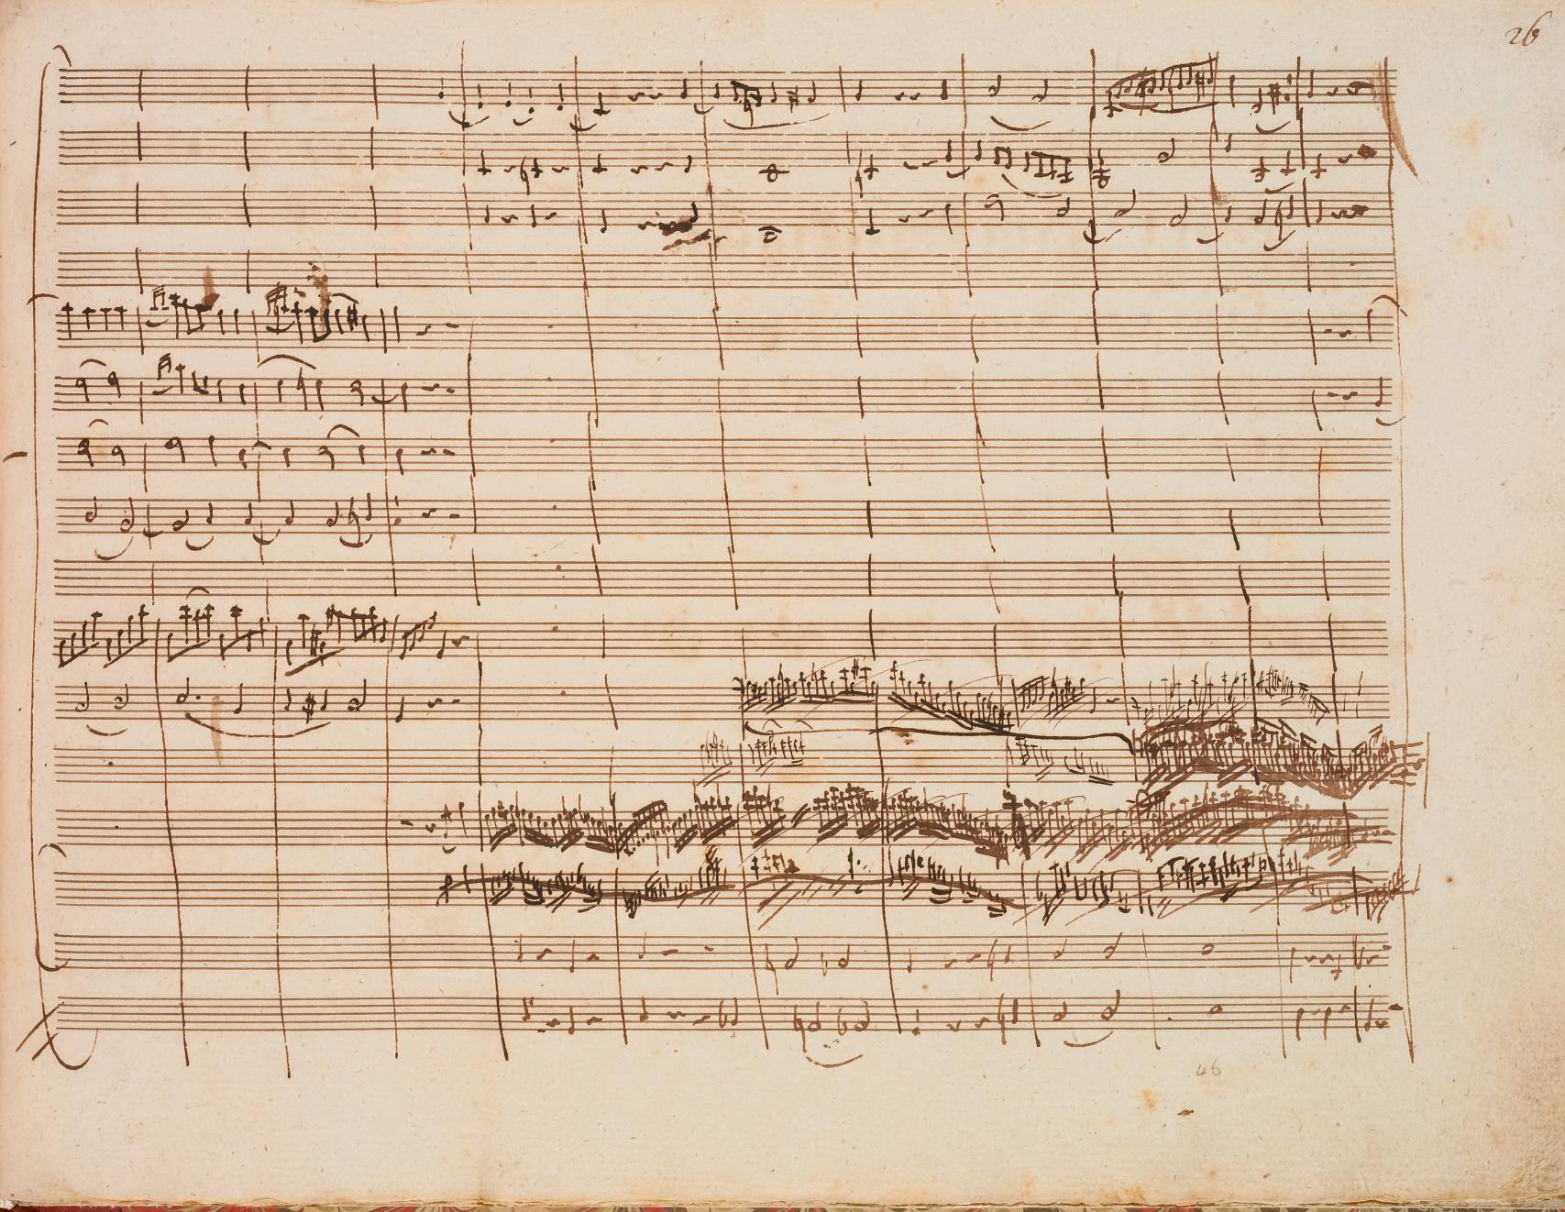
K 491 iii RCM MS 402

Slide 18
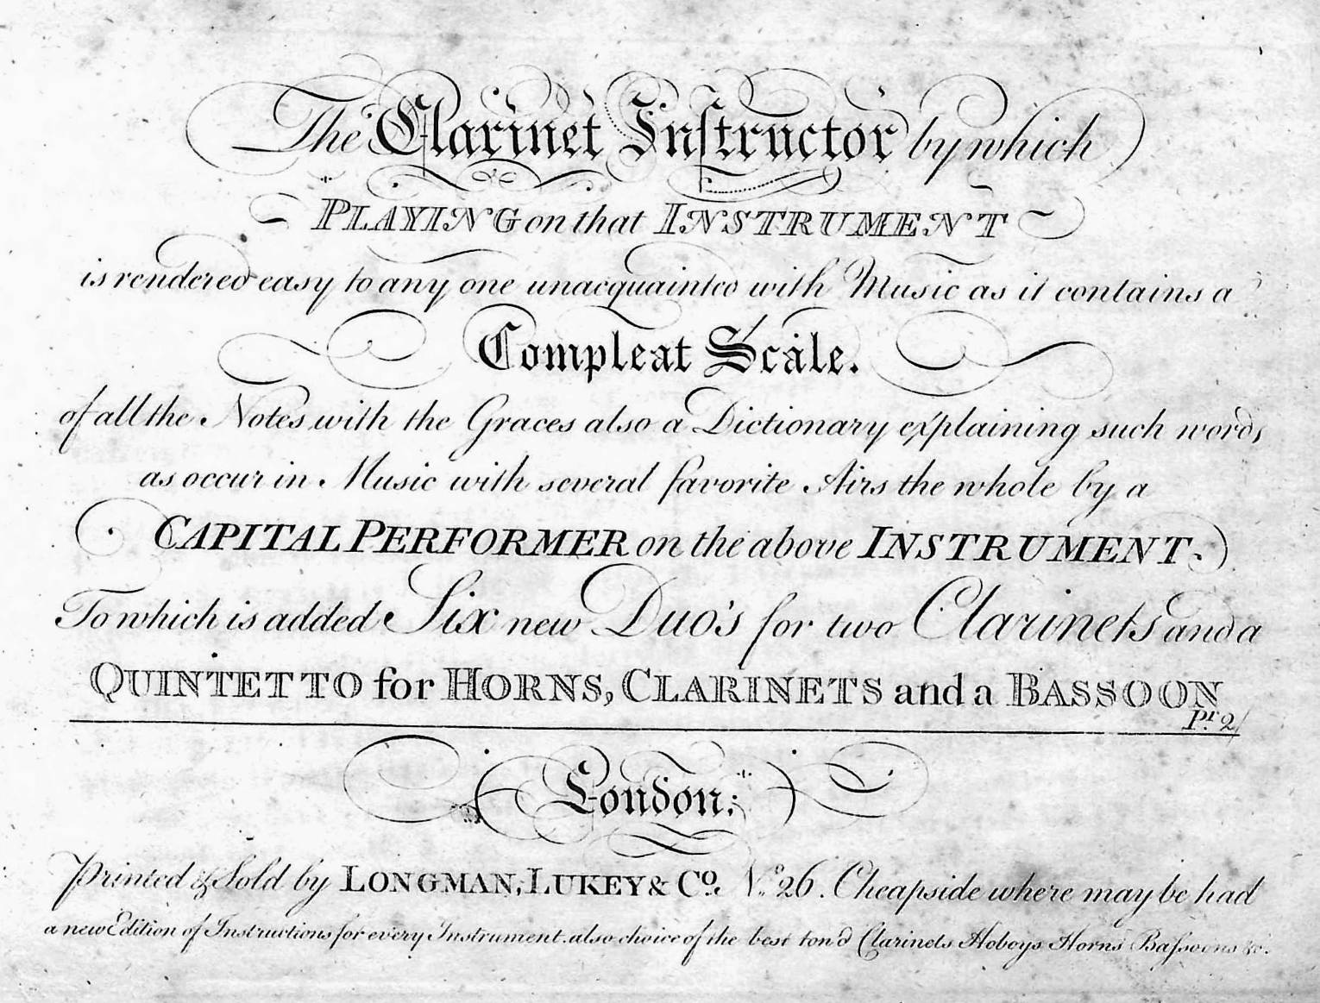
The Clarinet Instructor c. 1772

Slide 19
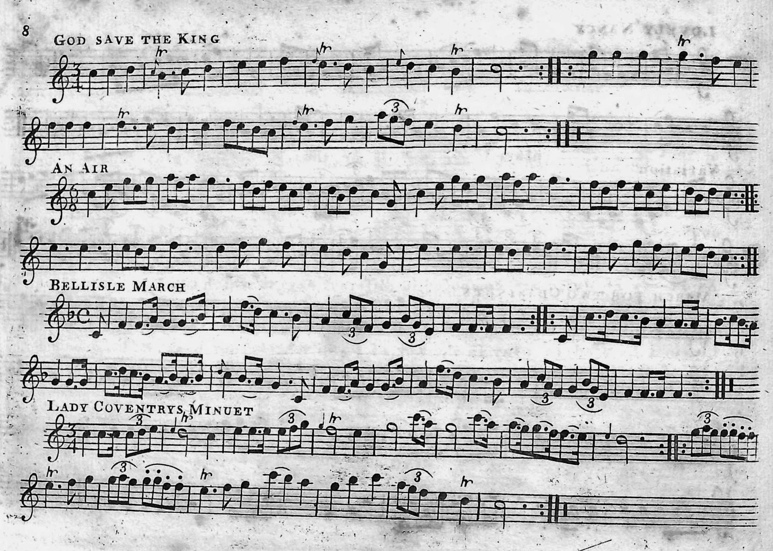
The Clarinet Instructor c. 1772

Slide 20
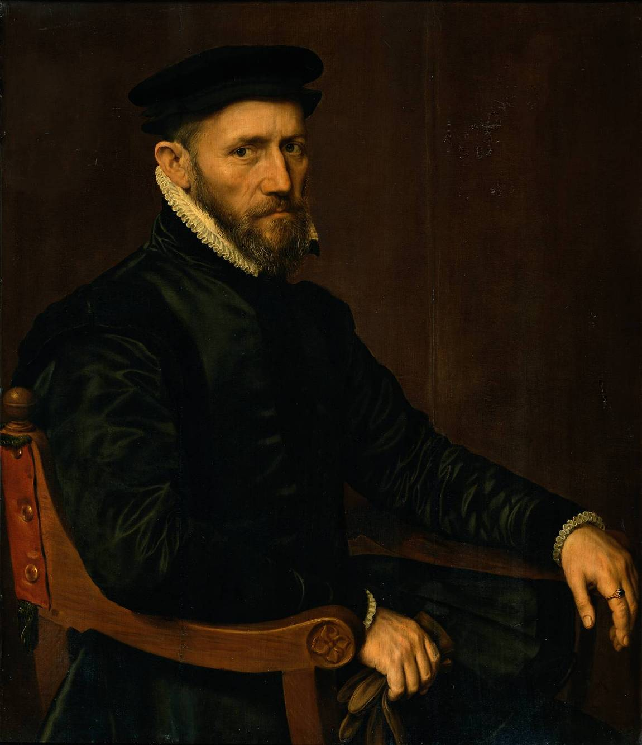
Sir Thomas Gresham by Anthonis Mor van Dashorst 1564 Rijksmuseum Amsterdam SK-A-3118

