Slide 1
Current Trends in European and Middle Eastern Mortality
Jon Anson
Ben-Gurion University of the Negev, Beer Sheva, Israel
Visiting Fellow, Royal Flemish Academy of Belgium for Science and the Arts, Brussels, Belgium
Symposium on Mortality Past and Present: Celebrating the 350th Anniversary
of the publication of John Graunt’s Bills of Mortality,
Gresham College, Barnard's Inn Hall, Holborn, City of London, EC1N 2HH,
Thursday November 29th 2012

Slide 2
Outline
Life expectancy at birth increased by over 50 years since Graunt, infant mortality down to one per cent of earlier level
Western Europe continuous improvement since mid-19th century. Elsewhere story not always so hopeful
Need to distinguish mortality at young ages from mortality in mid-adulthood. Eastern Europe young age mortality declined, mid-adulthood male mortality in crisis
Arab League countries three different patterns
Gulf States: male mortality at West European level. Female mortality a little higher. Age patterns similar to W. Europe
Mediterranean basin mortality slightly higher, pattern similar
Afro-Arabian countries (second line) mortality stalled at levels of early 20th century Europe

Slide 3
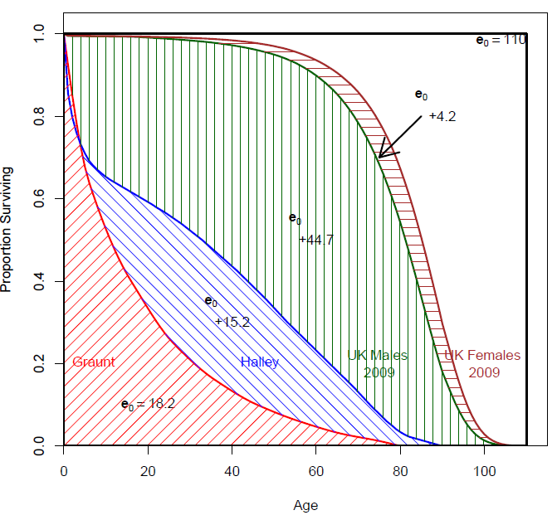
Survivorship Curves and Life Expectancy

Slide 4
The Life Table (and life expectancy)
Advantages
1. Free of population structure, built up from age-specific mortality rates (m_{x})
2. Sorts populations by average level of mortality
3. Good index of mortality decline, and of social development in general
Disadvantages
1. Strictly synthetic, time- specific
2. Can be misleading, people die over very broad age range, modal age at death usually above e₀
3. e₀ is NOT the average age at death in the population
Notes:
4

Slide 5
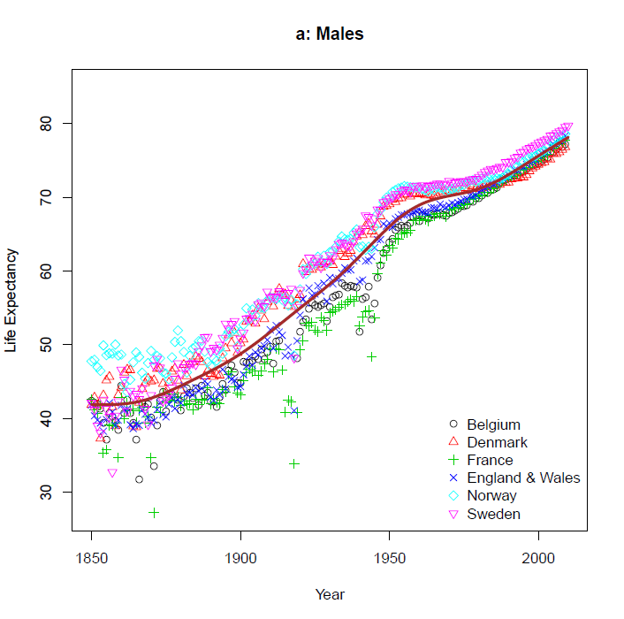
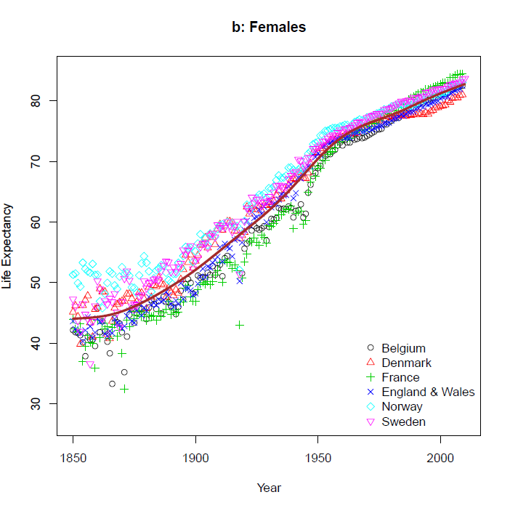
Long Term Trends in Life Expectancy

Slide 6
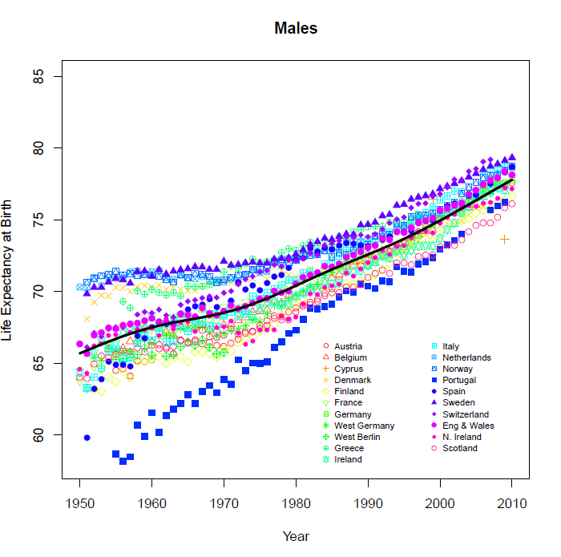
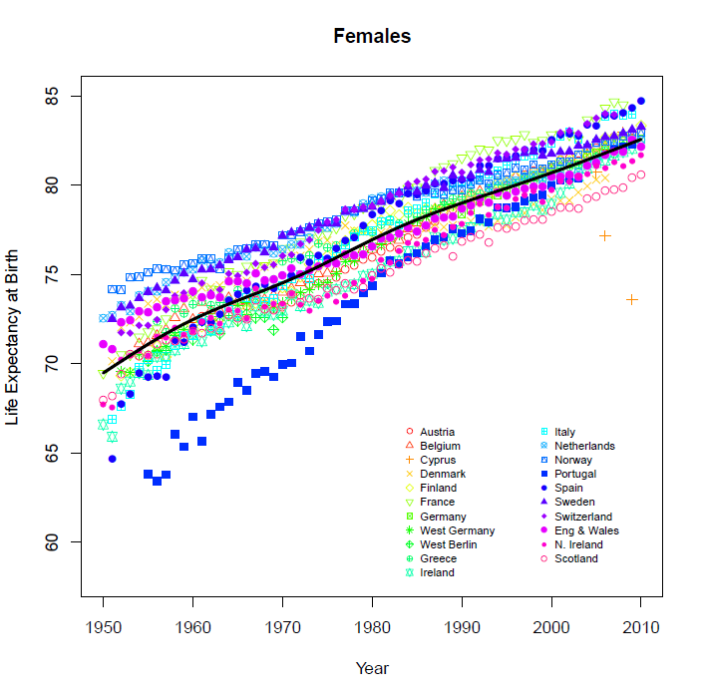
Life Expectancy Trends in Western Europe since 1950

Slide 7
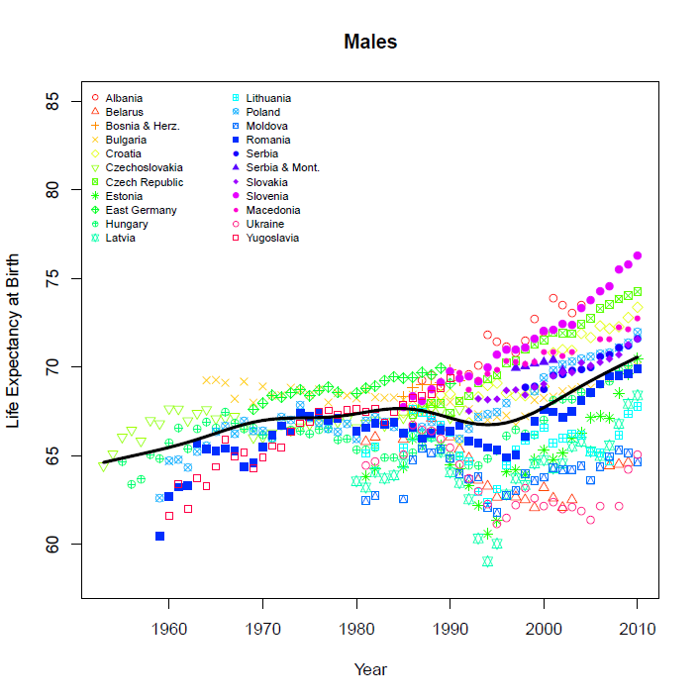
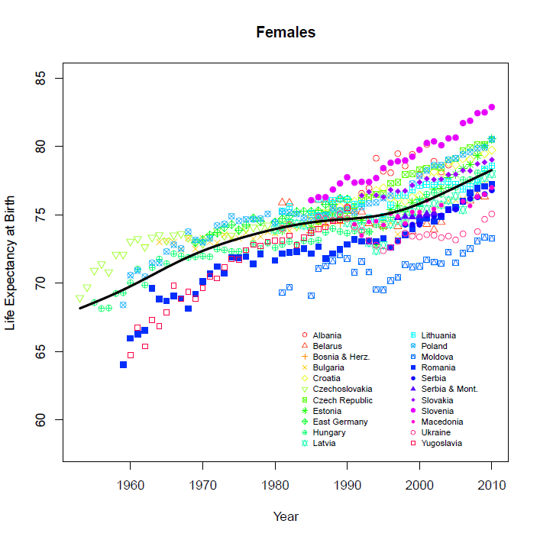
. . . and in Eastern Europe

Slide 8
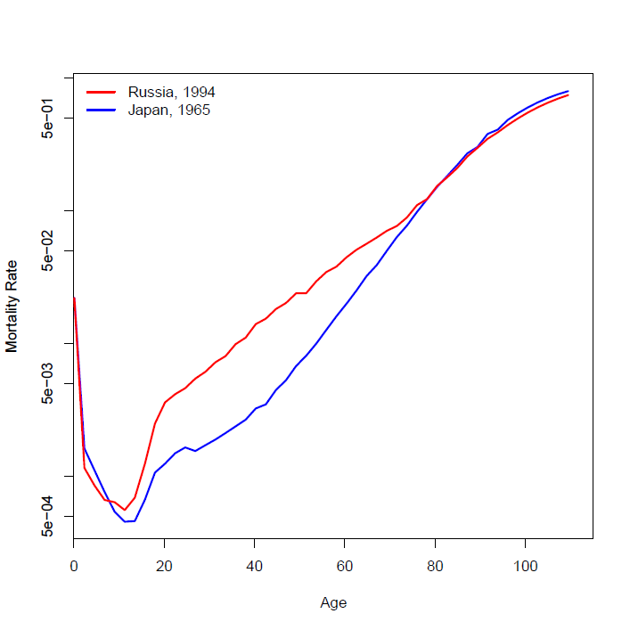
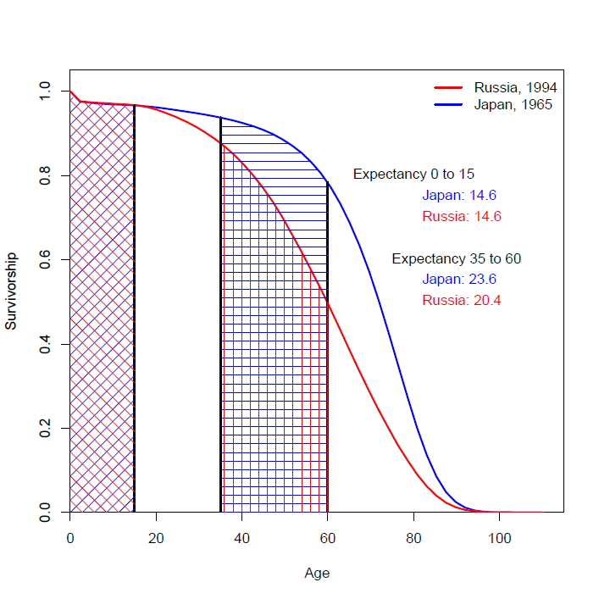
Mortality Divergence in mid-Adulthood
Mortality Curves
Survivorship Curves

Slide 9
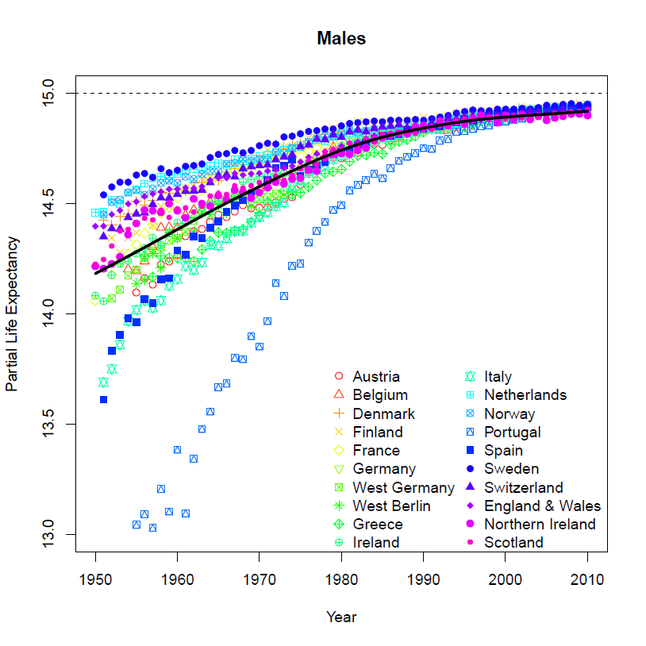
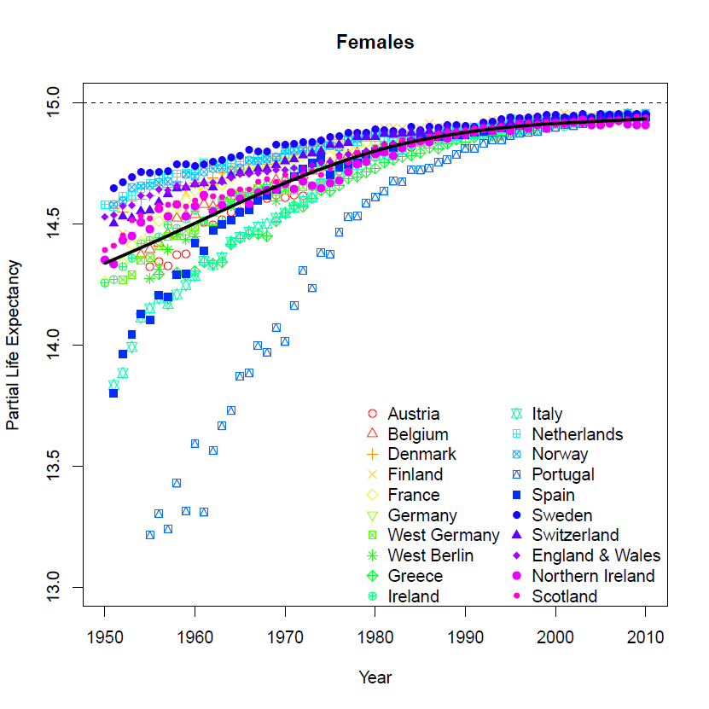
Partial Life expectancies, Ages 0 to 15 a. Western Europe

Slide 10
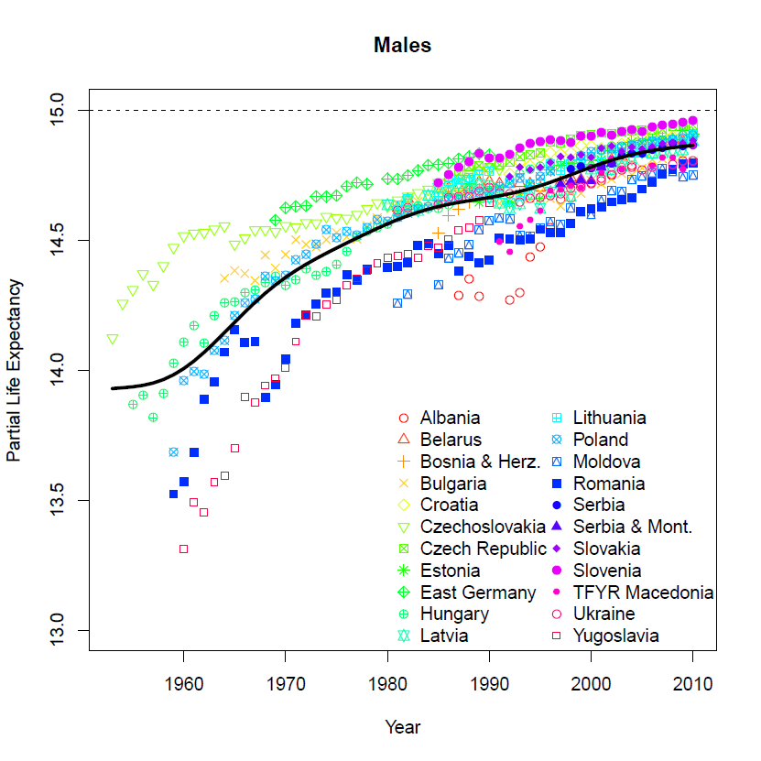
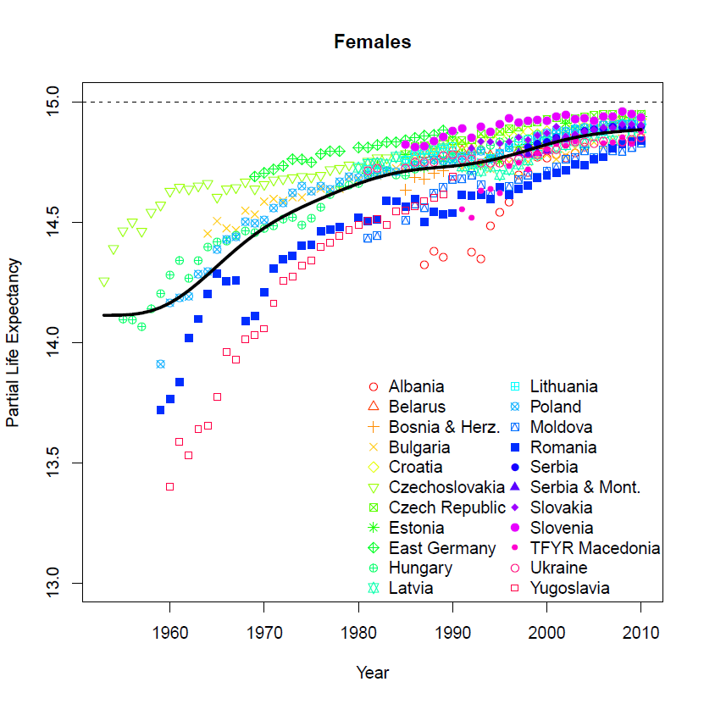
b: Eastern Europe

Slide 11
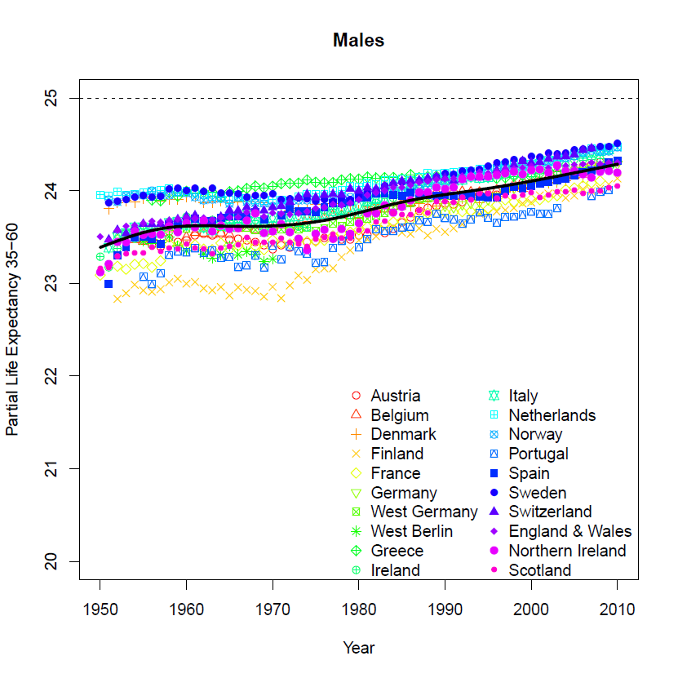
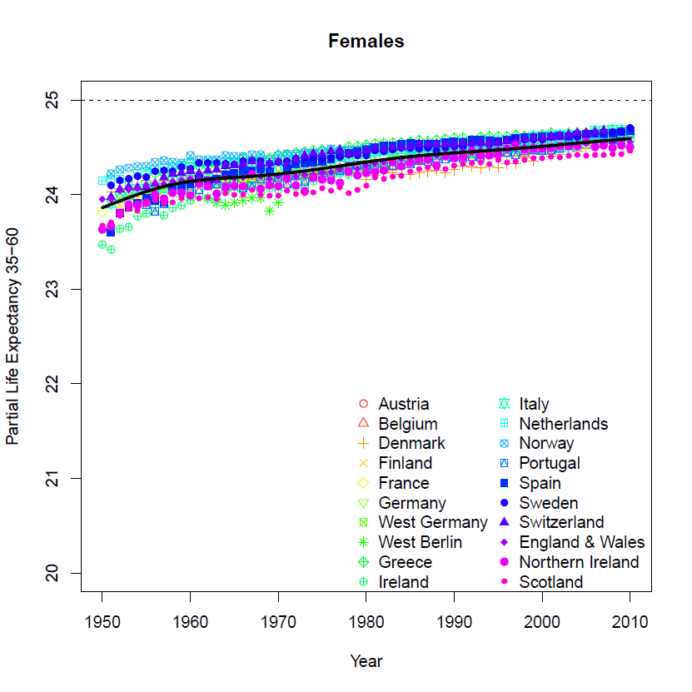
Partial Life expectancy in Mid-Adulthood a: Western Europe

Slide 12
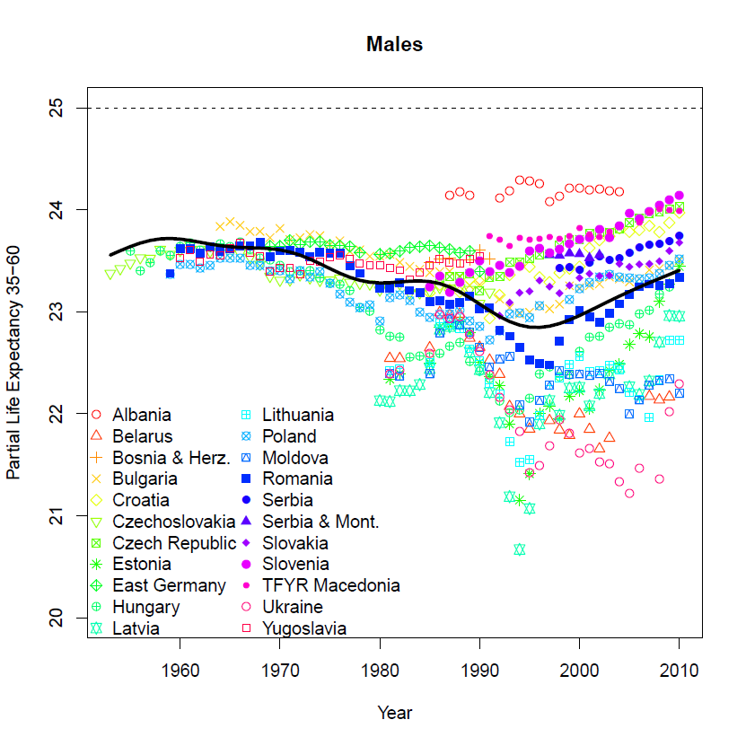
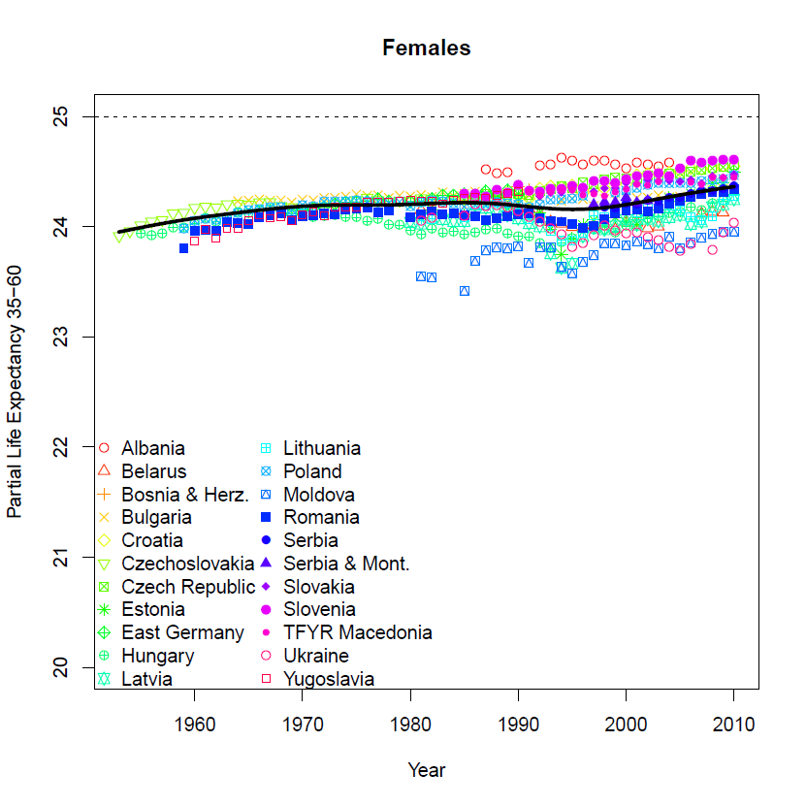
b: Eastern Europe

Slide 13
Why ages 35 to 60 (mid adulthood)?
At young ages major causes:
Infancy
Disease
Accidents
“Natural” level of mortality in given environment. Longevity potential of the population
Mortality curve declines, rises to plateau then rises into old age. As rises growth in mature causes
Cancer
Heart and circulatory
When does mortality begin to rise?

Slide 14
Why mid-adulthood?
Rise in mortality linked to behaviours in response to and in interaction with environment
Premature / preventable vs. delayed deaths
Not just physical response to environment, also psychological,
Hope and despair
Sense of coherence - view of life as:
Comprehensible
Manageable
Meaningful
So mortality in mid adulthood is degree of realisation of the potential seen at young ages

Slide 15
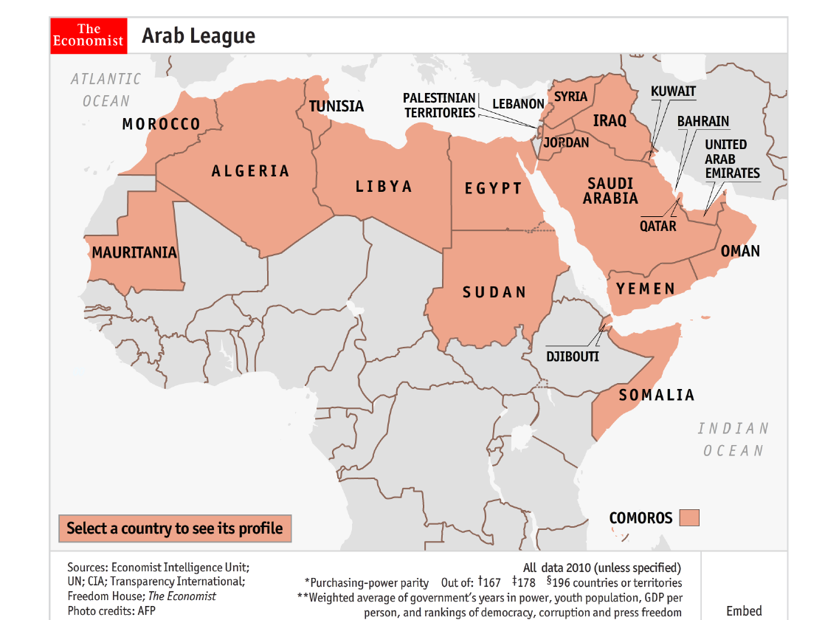
The States of the Arab Middle East
Source:http://www.economist.com/blogs/dailychart/2011/02/arab_league_map

Slide 16
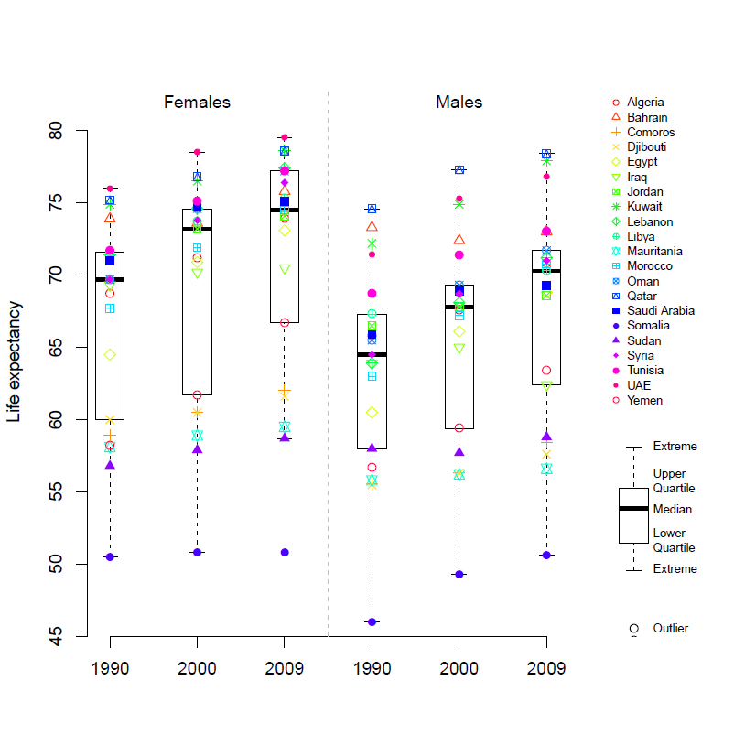
Mortality Trends in the Arab Middle East, 1990-2009 a: Life expectancy at birth

Slide 17
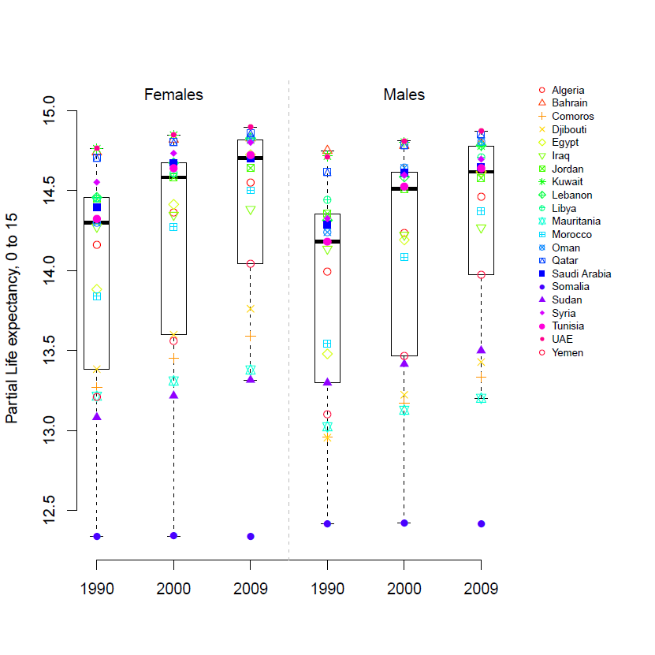
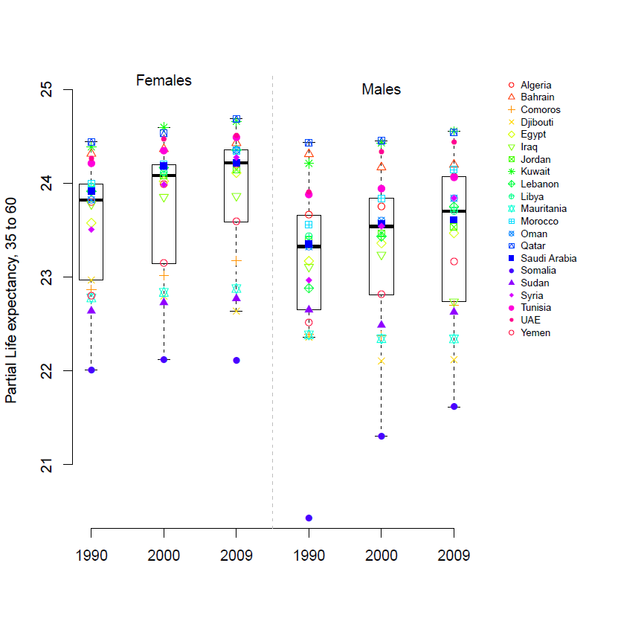
b: Partial life expectancies
Ages 0 to 15
Ages 35 to 60

Slide 18
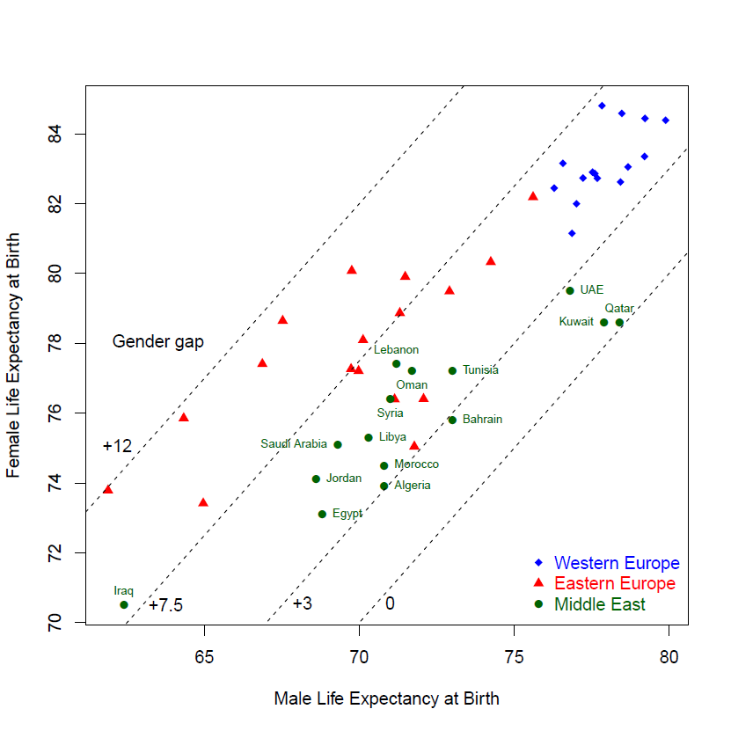
Life Expectancies in the Regions, 2009

Slide 19
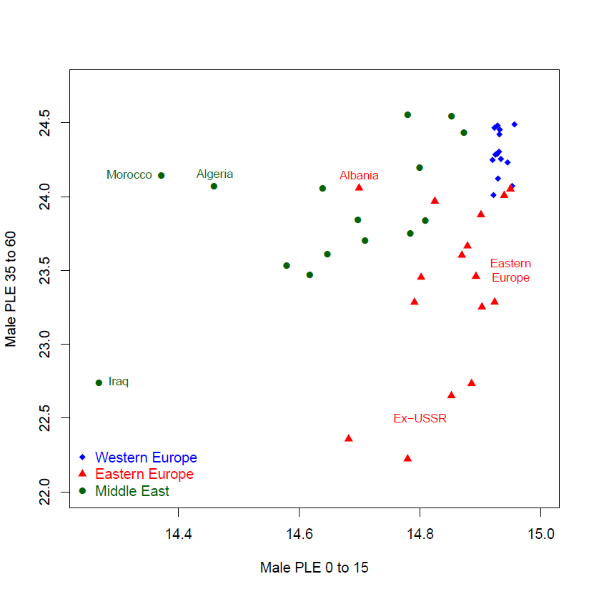
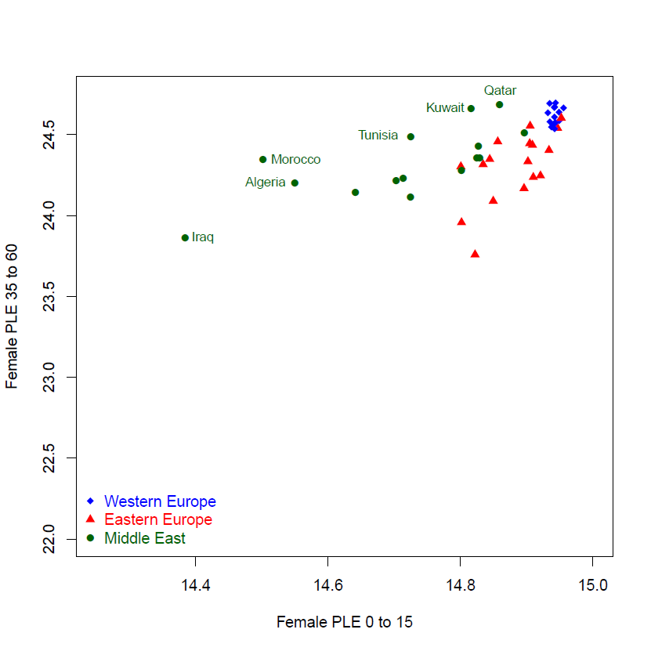
Males
Females

Slide 20
Conclusion
Life table big step forward in social science – provides universal standard for comparing levels of mortality over time and space
Western Europe consistent decline since middle of 19th century. Late 20th century convergence, very little variation
Eastern Europe increase for women, for men only in last decade. No convergence, distinguish East Europe from ex-Soviet Union
Arab Middle East: distinguish Gulf states > Med basin > second line African states

Slide 21
Conclusion II
Distinguish mortality at young ages (potential) from middle ages (realisation)
Crisis in East Europe is crisis of middle-age men. Potential increasing, realisation decreasing, particularly in ex-SU
Major feature of Arab states: small gender gap = low life expectancy of women.
Advances in W. Europe highlight tragedy of other countries
Africa south of Mediterranean coast states, mortality unchanged 20 years, at level of early 20th century Europe
East Europe, particularly ex-Soviet Union
Mortality is a social phenomenon. Social collapse reflected in mortality crises

