Slide 1
Peter Guthrie Tait
A Knot’s Tale

Slide 2

Are you ready for the adventure?
#TaitAdventure

Slide 3
Three men…

Slide 4
Two boxes…

Slide 5
One experiment…

Slide 6
One theory…

Slide 7
One envelope…

Slide 8
Smoke….
…without fire

Slide 9
The power of intuition

Slide 10
A new era of mathematics
“inversion”
“perversion”
“screwing of all kinds”

Slide 11
Produced on location in Edinburgh

Slide 12
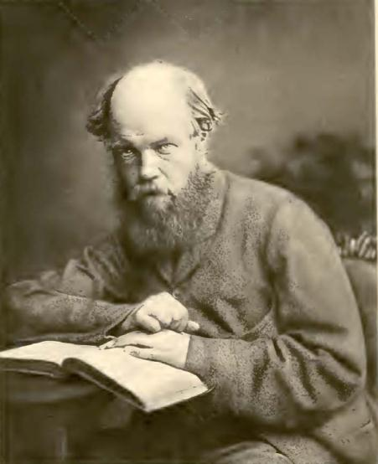
Starring…
Peter Guthrie Tait
as the Knotfather

Slide 13
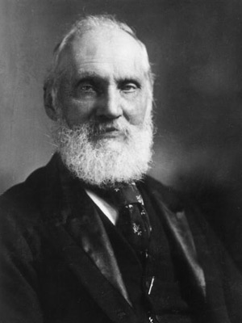
Featuring…
Lord Kelvin
as the ideas man

Slide 14
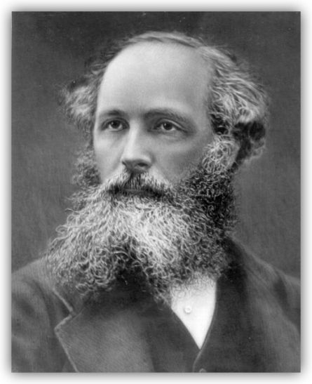
Featuring…
James Clerk Maxwell
as the best friend

Slide 15
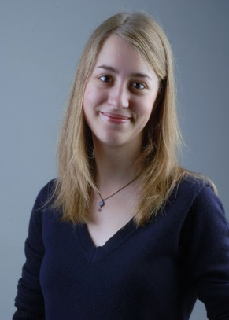
Featuring…
and Julia Collins
as the narrator

Slide 16
With thanks to
Andrew Ranicki for Tait research assistance

Slide 17
2012, Edinburgh

Slide 18
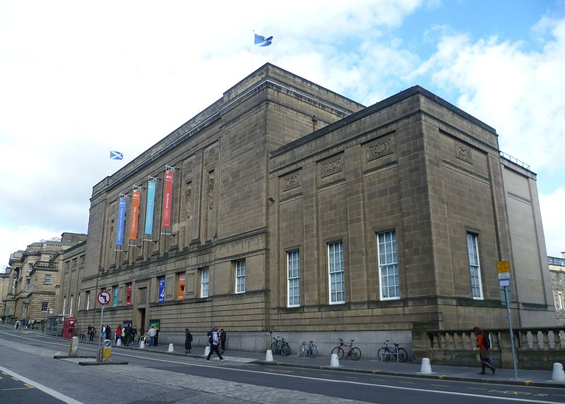
The National Library of Scotland.

Slide 19
I am searching for an envelope.
An envelope with a conjecture, unopened for 100 years after it was sealed.

Slide 20
By accident, I find this scribble.

Slide 21
1867, a lab in Edinburgh

Slide 22

Two men stand in a lab, expectantly.
The air is thick with pungent smoke.

Slide 23
The men are Tait and Thomson, and their experiment will change mathematical history.

Slide 24
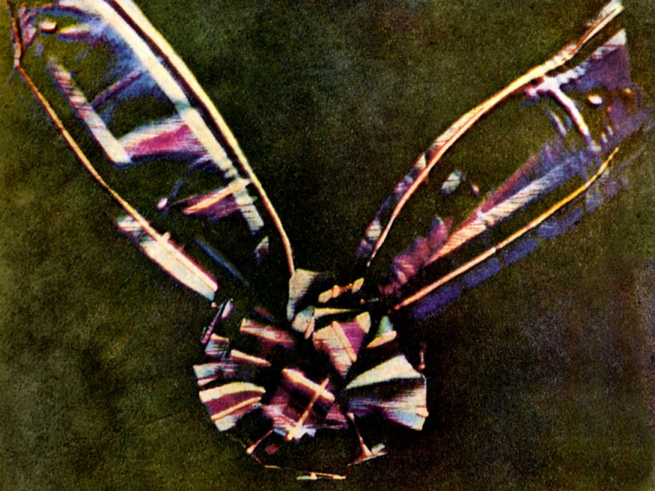
It is an exciting time in science.
Maxwell has been developing his theory of electromagnetism and his kinetic theory of gases.
It is 6 years since he developed the first colour photograph.

Slide 25
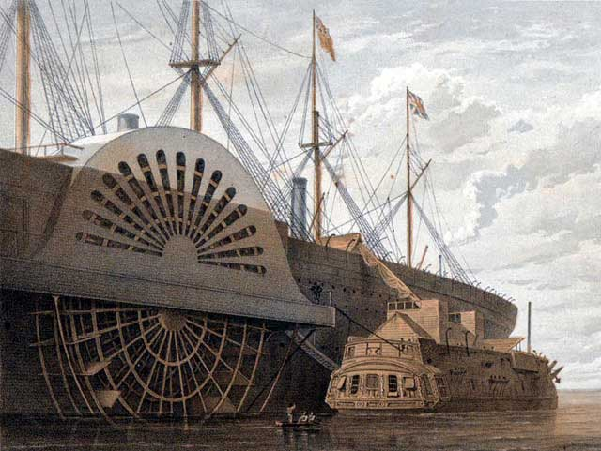
Thomson has just laid the first transatlantic telegraph cables, for which he has become Lord Kelvin.

Slide 26
It’s been 8 years since Darwin published On the Origin of Species.
Tait and Thomson have just published their Treatise on Natural Philosophy, redefining much of physics in terms of energy.
Notes:
Darwin published Origin of Species in 1859.

Slide 27

One of the big questions of the day was : What do atoms look like?
Notes:
The aether was a continuous medium, so how did it produce solid hard discrete atoms? If atoms were like balls, how did it account for the variety of matter?

Slide 28
This is the story of one answer to that question, and the man who was the catalyst for it.

Slide 29
1831, Dalkeith and Edinburgh

Slide 30
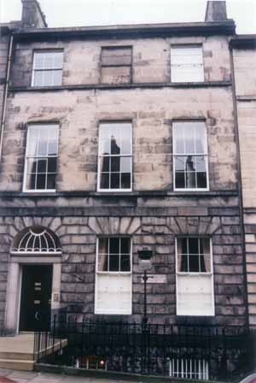
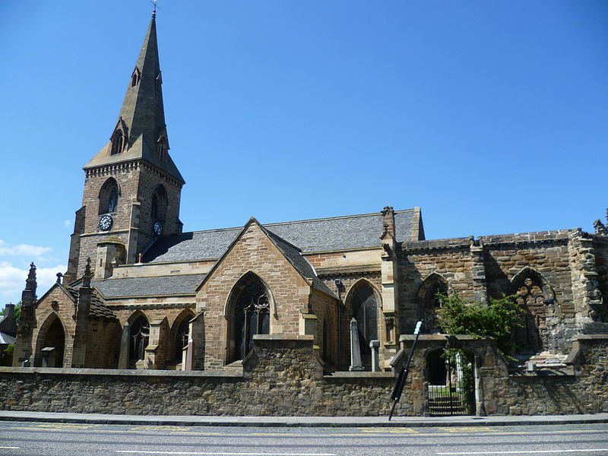
Two boys are born in Scotland in 1831, only a few months and miles apart.
Notes:
Tait in Dalkeith (15 miles south of Edinburgh) and Maxwell in Edinburgh, 1831. Tait older by 2 months.

Slide 31
Both Tait and Maxwell lose a parent in their youth and are educated by another family member.
Notes:
Tait loses his father, age 6, and is educated by his uncle. Maxwell loses his mother, age 8, who had been homeschooling him, so is educated by his father and aunt.

Slide 32
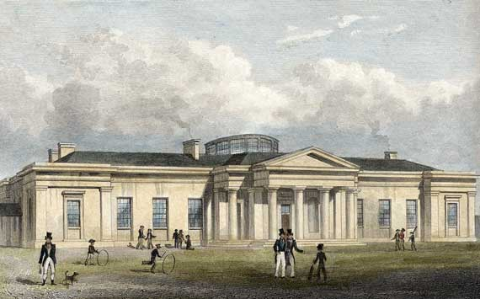
They go to school at Edinburgh Academy and become friends, despite being in different years.
Notes:
Maxwell is only in the year above because Tait’s year was full. Finds it difficult to adjust to school.

Slide 33
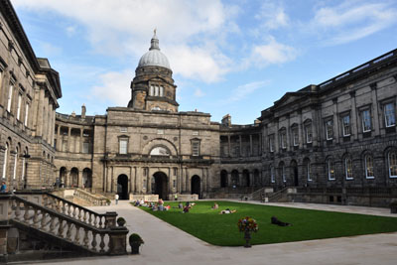
Aged 16, they go to the University of Edinburgh to study mathematics and natural philosophy.
Notes:
Tait enters himself for the top classes, although it should take 3 years to move up!

Slide 34
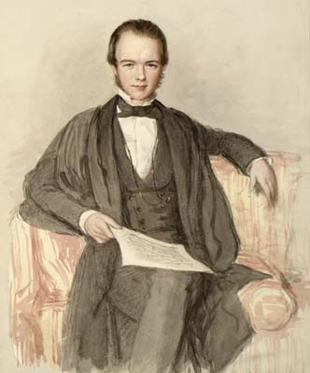
After only a year, Tait decides he is ready for Cambridge and enters Peterhouse in 1848.
Maxwell is left behind.

Slide 35
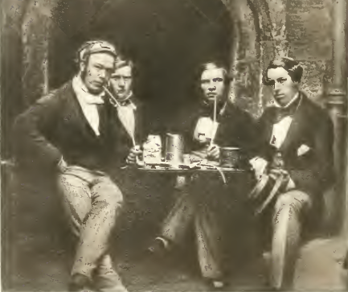
In January 1852, Tait becomes the youngest ever person to be Senior Wrangler in the Tripos (aged 20 years and 8 months).
Notes:
Only bettered in 1936 by a 19 year & 9 months old man. Maxwell is second wrangler.

Slide 36
After graduating, Tait wins a Fellowship at Peterhouse and begins coaching other students.
“I could coach a coal scuttle to be Senior Wrangler!”
Notes:
After accepting a student whom his mentor Hopkins claimed to be failing, and getting him better results than any of Hopkins’ students. However, he hated the idea of teaching students to pass exams instead of learning, and when in Edinburgh tried to avoid the same system being used.

Slide 37
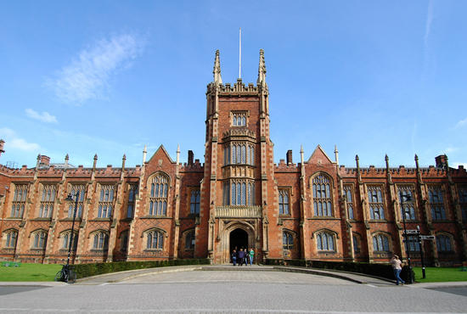
In 1854 Tait becomes a professor at Queen’s College, Belfast, while in 1856 Maxwell becomes a professor at the University of Aberdeen.
Notes:
Tait works on quaternions with Hamilton and applies them to work on Helmholtz’s paper on fluid motion. Maxwell works on explaining Saturn’s rings. Both get married.

Slide 38
In 1859 the friends both apply for the newly vacant Chair of Natural Philosophy in Edinburgh. Only one of them can succeed…

Slide 39
Tait gets the job, on the basis of his teaching.
“There is another quality which is desirable in a Professor in a university like ours, and that is the power of oral exposition proceeding on the supposition of imperfect knowledge or even total ignorance on the part of the pupils.”
Notes:
The hiring committee had never even heard Tait lecture before.

Slide 40
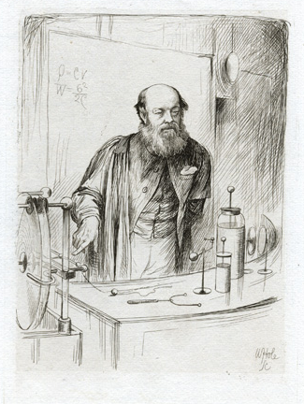
Tait indeed became a “lecturing machine”. His classes were renowned for their enthusiasm, lucidity, demonstrations and interest.
Notes:
Always made a dramatic entrance to a lecture, with his tall form and black robes. Students sent in their difficulties in writing before the lecture. He never did any experiments purely for show, but always with an educational purpose. Yet his experiments were amazing: balancing egg shells on jets of water, inch-long sparks in the air and giant magnets.

Slide 41
One student was J.M.Barrie.
“Never, I think, can there have been a more superb demonstrator. I have his burly figure before me. The small twinkling eyes had a fascinating gleam in them; he could concentrate them until they held the object they looked at; when they flashed round the room he seemed to have drawn a rapier. I have seen a man fall back in alarm under Tait’s eyes, though there were a dozen benches between them. These eyes could be merry as a boy’s, though, as when he turned a tube of water on students who would insist on crowding too near an experiment…”

Slide 42
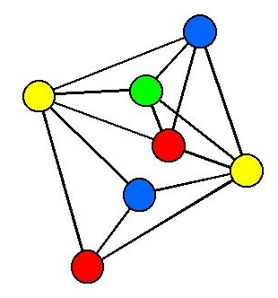
Tait also worked tirelessly on maths and physics ideas, including quaternions, thermodynamics, thermoelectricity, the kinetic theory of gases and the four-colour problem.
Notes:
Made a conjecture that would have implied the 4-colour theorem: that every 3-connected planar cubic graph has a Hamiltonian cycle. The counterexample eventually found had 69 edges and 46 vertices. Tait always followed his intuition – in life and in maths and science.

Slide 43
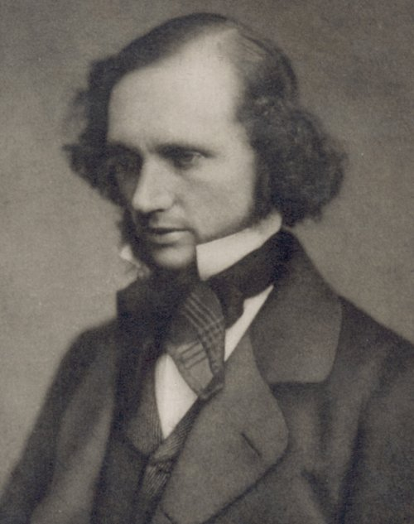
He became friends with William Thomson, who was Professor of Natural Philosophy at Glasgow.
Notes:
Thomson also lost his mother at age 6 and had gone to Peterhouse, Cambridge. In the 1850s he had been involved with trying to lay the first transatlantic telegraph cables, which finally succeeded in 1866, when he became knighted.

Slide 44
“We never agreed to differ, always fought it out. But it was almost as great a pleasure to fight with Tait as to agree with him.” Kelvin

Slide 45
One day Tait invites Thomson to his laboratory...

Slide 46
January 1867, back in the lab…

Slide 47
In his laboratory, in 1867, Tait has set up an amazing experiment. Two big cardboard boxes are oozing with thick pungent smoke from holes cut in the front.
Notes:
The smoke was produced by a strong solution of ammonia placed in a dish containing common salt and sulphuric acid. It made particles of ammonium chloride.

Slide 48
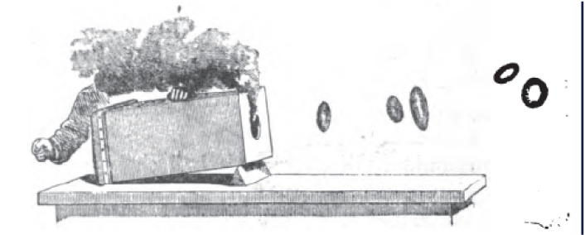
Kelvin stands watching, as Tait hits a towel stretched over the end of the box.

Slide 49
Rings of smoke emerged, at first violent and wobbly but quickly stabilising, sailing gracefully across the room “like solid rings of india-rubber”.
Notes:
They would emerge violent and wobbly, quickly stabilising. Elliptical rings quickly became circular.

Slide 50
Using a second cannon, Tait is able to make two rings bounce off each other, or fit one inside the other. Kelvin is amazed.

Slide 51
Tait explains Helmholtz’s theory that closed vortex lines in a fluid are a stable configuration. Once a ring is formed it remains a ring forever.

Slide 52

Suddenly, Kelvin has an idea.
Remember he’s been thinking about atoms…

Slide 53
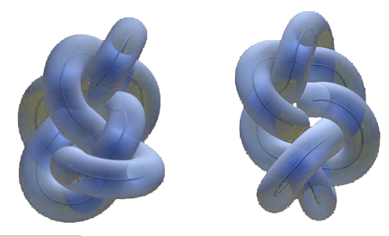
“What if atoms are knotted vortices of the æther?”

Slide 54
The æther was an ideal fluid, so vortices would never dissipate. They were discrete objects in a continuous system. And different configurations meant different chemical elements.

Slide 55
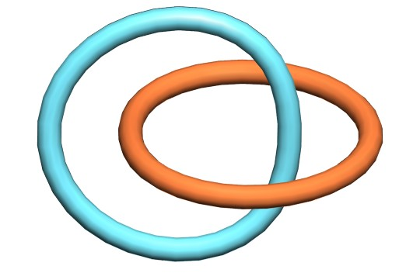
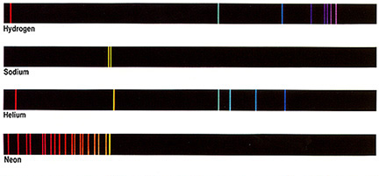
For example, sodium atoms might be two linked rings, which would explain why the emission spectrum had two lines in it.

Slide 57
Tait is initally skeptical.
“The enormous number of lines in the spectra of certain elementary substances show that…the form of the corresponding vortex atoms cannot be regarded as very simple. Hence the difficulty, ‘What has become of all the simpler vortex atoms?’ or ‘Why have we not a much greater number of elements than those already known to us?’.”
Notes:
He had wanted to apply vortex theory to electricity. He was also thinking about the emission lines, and that the knots/links in question are going to have to be very complicated…

Slide 58
However, Tait is soon won over by the beauty and simplicity of the theory. He sets to work investigating the mathematical theory of knots…

Slide 59
1870s, Edinburgh

Slide 60
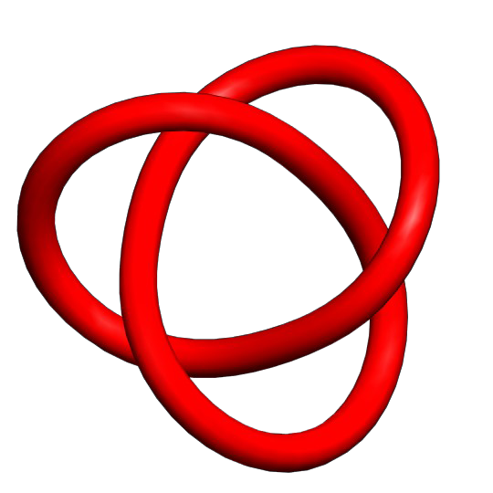
A mathematical knot is a closed loop of string, with no free ends.

Slide 61
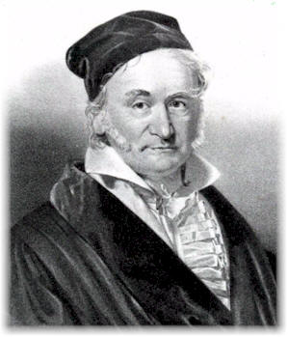
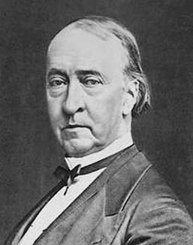
The only people to have studied knots before Tait were Gauss and his student Listing.

Slide 62
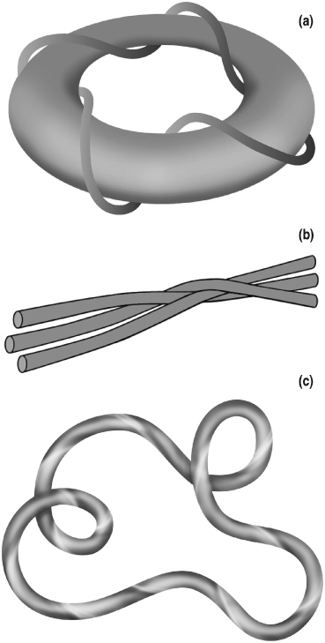
Gauss investigated different knots and braids.
He invented the linking integral to count the number of times two knots twisted around each other.

Slide 63
Listing studied methods of distinguishing knots.
He also investigated symmetries of knots, including inversion (rotation) and perversion (mirroring).

Slide 64
For example, he conjectured that the mirror images of trefoils were different knots.

Slide 65
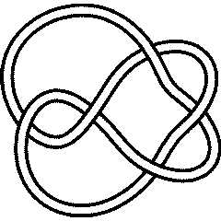
Tait invented his own notation to describe knots.
B
ACBECADBED | A
E
C
D
A

Slide 66
He tried to find all knots of each crossing number (or knottiness) by writing down all the possible ‘words’ of the knots.

Slide 68
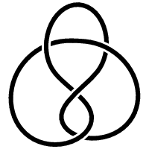
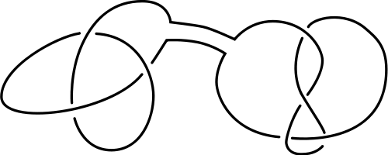
During his investigations, Tait noticed various things.
“The crossings may be taken throughout alternately over and under.”
(except for multiple knots on the same string.)

Slide 69
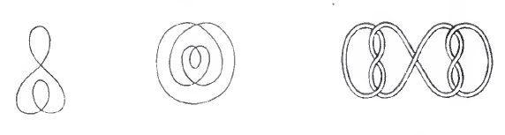
Some crossings can be removed without changing the knots. These he called ‘nugatory’.

Slide 70
“If the crossings are alternately over and under then no reduction is possible unless there be nugatory crossings.”

Slide 71
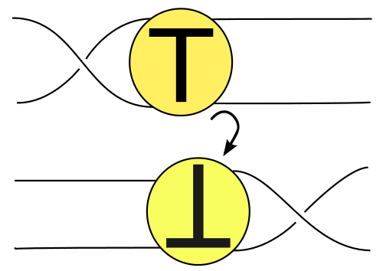
Two diagrams of the same knot are related by a series of “flypes”.

Slide 72
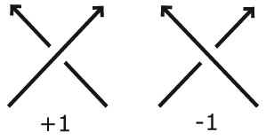
If we walk around the knot then the crossings come in two varieties.

Slide 73
Knots which are amphicheiral (their own mirror images) must have equal numbers of positive and negative crossings.
(In particular, there must be an even number of crossings.)

Slide 74

Tait wrote down his ideas, sealed them in an envelope and took it to the Royal Society of Edinburgh for safekeeping...

Slide 75
Using his conjectures, he made a systematic list of all the knots with up to 7 crossings.
There were originally 579 ‘words’ which eventually represented only 8 different knots.

Slide 76
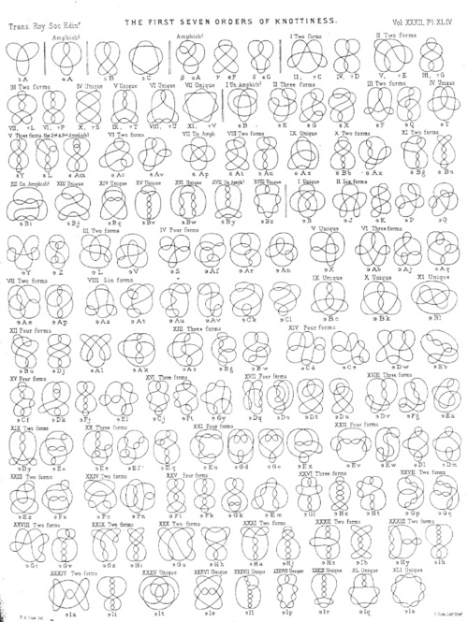
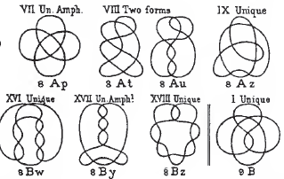
Notes:
Narrowed it down from 579 to 8 distinct knots.

Slide 77
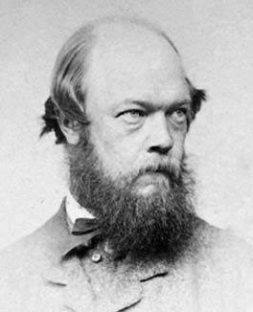
Tait’s work became a sensation at the Royal Society of Edinburgh and he really believed he was on the road to a periodic table of knotted elements.

Slide 78
With the help of two friends, Kirkman and Little, he made tables of knots with up to 10 (alternating) crossings.
They didn’t make a single mistake.
Notes:
For 9 crossings, there were 43,387 different possible knots, initially.

Slide 79
A hundred years later…

Slide 80
Although the vortex theory of atoms turned out to be wrong, knot theory flourished as an important area of mathematics.
Notes:
Aether disproved by Michelson-Morley experiment in 1887.

Slide 81
And yet, nobody in all that time had been able to prove whether Tait was right or wrong about the conjectures he made.

Slide 82
Until one day, in 1984, on the other side of the world, one man made a breakthrough in knot theory. His name was Vaughan Jones, and he invented the Jones polynomial.

Slide 83
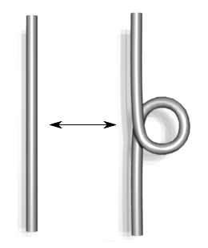
The Jones polynomial was able to eliminate the ambiguity in the writhe introduced by nugatory crossings.

Slide 84
Using the Jones polynomial, 3 of Tait’s conjectures were proved true in 1987 by Kauffman, Murasugi and Thistlethwaite:
- A reduced alternating diagram has the smallest number of crossings.
- An alternating knot with zero writhe is amphicheiral.
- An alternating amphicheiral knot must have an even number of crossings.

Slide 85
By a magical coincidence, it was in 1987 that Tait’s envelope of conjectures was found at the Royal Society of Edinburgh.

Slide 86
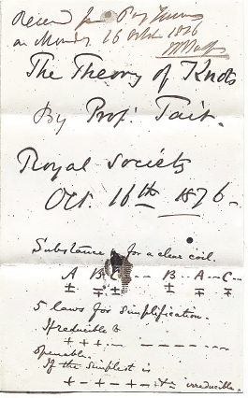
However, only one of his conjectures was in the envelope.

Slide 87
The only other sheet inside was a completely unrelated piece of mathematics.

Slide 88
The final conjecture was only proved true in 1991 by Menasco and Thistlethwaite:
- Any two alternating diagrams of the same knot are related by a sequence of flypes.

Slide 89
However, Tait never realised that ‘prime’ non-alternating knots existed.

Slide 90
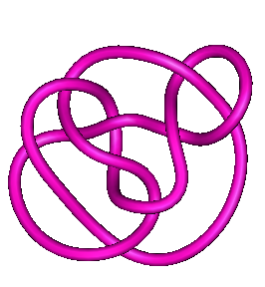
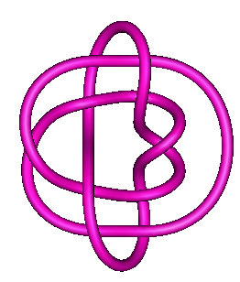
In 1974 Perko showed that these two knots were actually the same knot, even though they were not related by flypes.

Slide 91
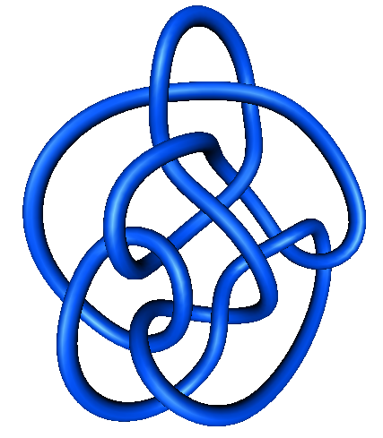
And in 1998 Hoste and Thistlethwaite showed that there was indeed an odd crossing-number amphicheiral knot. This is the only known such knot.

Slide 92
We still don’t have a general method of deciding whether a knot is amphicheiral or when two diagrams represent the same knot.

Slide 93
Knot tables of up to 11 crossings were only completed in 1969.
We now have tables of knots with up to 22 crossings, of which there are
6,217,553,258.

Slide 94
Knots are once again being used in science.

Slide 95
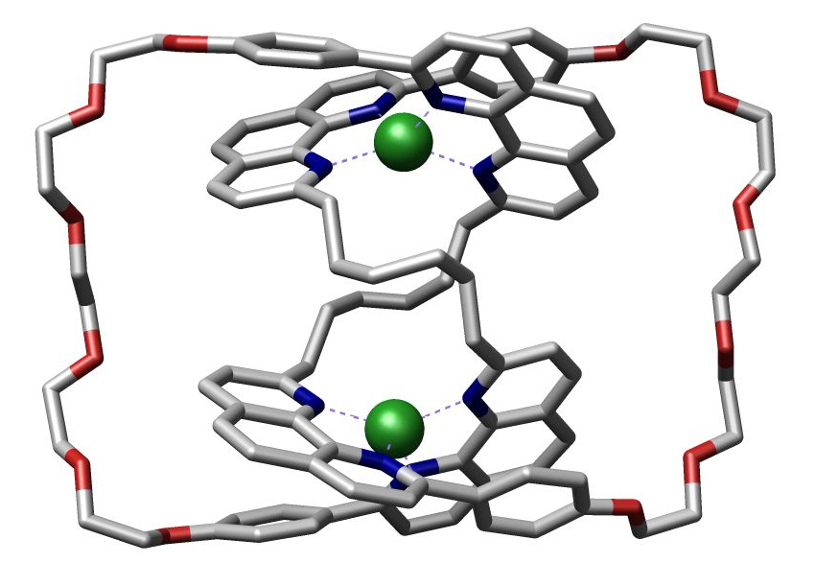
This trefoil-shaped molecule was first made in 1989, and a pentafoil knot was made for the first time by the Edinburgh chemist David Leigh.

Slide 96
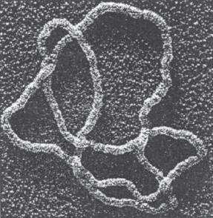
This figure-8 knot is made out of DNA. Your body has to untangle knots every day, and we still don’t understand how.

Slide 97
In string theory, particles are once again being thought of as 1-dimensional strings.

Slide 98
From 1879-1901 Tait was General Secretary of the Royal Society of Edinburgh, twice winning the Keith Medal for his mathematics.
Notes:
Keith medal only awarded every 8 years in maths. Few have won it twice.

Slide 99
In 1880 Tait was offered a Fellowship in the Royal Society. He declined on the grounds that another of his friends had been refused membership.
Notes:
Tait always stuck up for his friends, even if they were in the wrong – as Kelvin frequently was.

Slide 100
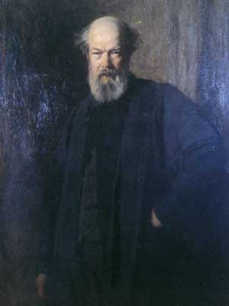
Tait resigned his Chair in March 1901 at the age of 70, having taught over 9000 pupils the ‘great truths’ of science.

Slide 101
On 4 July 1901, Peter Guthrie Tait passed peacefully away.
Many people wrote heartfelt obituary notices.

Slide 102
“In his loveable simplicity and warmth of heart one sometimes forgot his great gifts of intellect.” Former colleague

Slide 103
“There was, to the last, a delightful boyishness of heart such as is assuredly a precious thing to possess.” Edinburgh University Student magazine

Slide 104
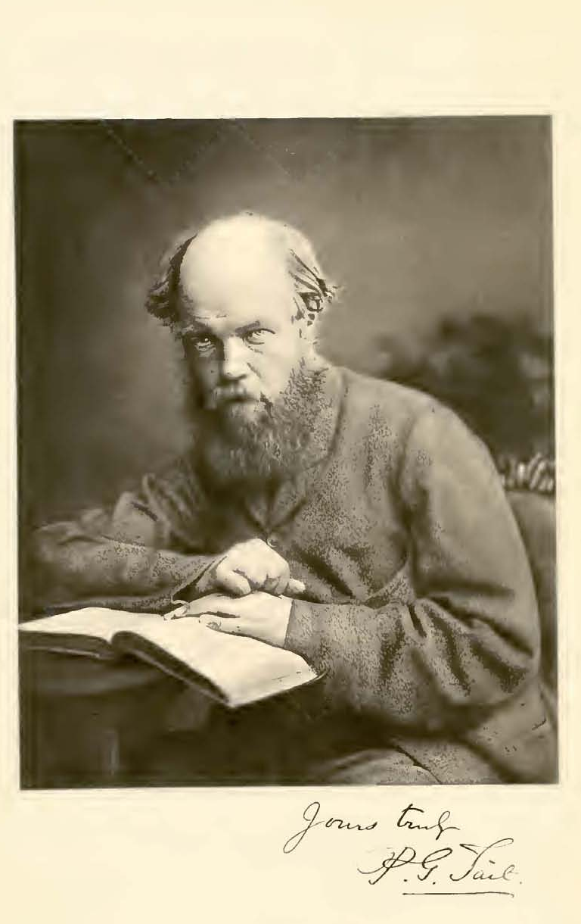
Tait was a great man, a great scientist, a great mathematician, and a catalyst for some of the best scientists of his day.
He should not be forgotten.

Slide 105
The End

Slide 106

@haggismaths

