Slide 1
Long Finance
Spring Conference 2013
How to Innovate, What to Regulate Achieving Real Change on the Road to Long Finance

Slide 2
Welcome
Matt Hale
Regional Environmental Executive,
Bank of America Merrill Lynch

Slide 3
Introduction
Professor Michael Mainelli
Chairman, Z/Yen Group

Slide 4
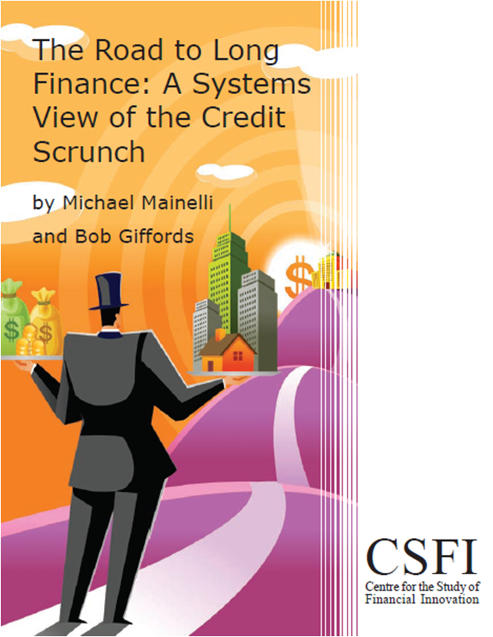
About Long Finance
‘When would we know our financial system is working?’
Objectives:
Expand Frontiers
Change Systems
Deliver Services
Build Communities
Programmes:
London Accord
Financial Centre Futures
Meta-Commerce
Eternal Coin

Slide 5




Long Finance Programmes
Founded 2005
55 contributing organisations
Over 360 reports free to access on the website
Long Finance’s ‘sustainable finance’ programme
London Accord
Financial Centre Futures
Meta-Commerce
Eternal Coin

Slide 6

Definitionally Indefinite
The introduction of a new good - that is one with which consumers are not yet familiar - or of a new quality of a good.
The introduction of a new method of production, which need by no means be founded upon a discovery scientifically new, and can also exist in a new way of handling a commodity commercially.
The opening of a new market, that is a market into which the particular branch of manufacture of the country in question has not previously entered, whether or not this market has existed before.
The conquest of a new source of supply of raw materials or half-manufactured goods, again irrespective of whether this source already exists or whether it has first to be created.
The carrying out of the new organization of any industry, like the creation of a monopoly position (for example through trustification) or the breaking up of a monopoly position.

Slide 7
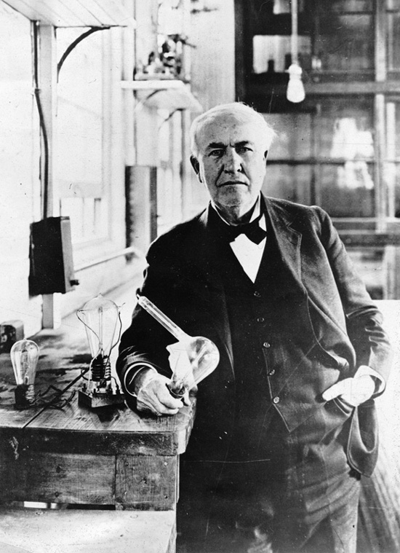

Ando <> Edison

Slide 8
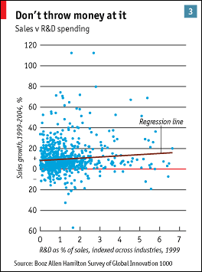
Process = Failure
[Source: The Economist, Survey: The Company, “The Tortoise and the Hare”, 26 January 2006]

Slide 9

Kealey’s Economic Laws Of Civil R&D
The percentage of national GDP spent increases with national GDP per capita
Public and private funding displace each other
Public funds displace more than they do themselves provide, i.e. as a multiple

Slide 10
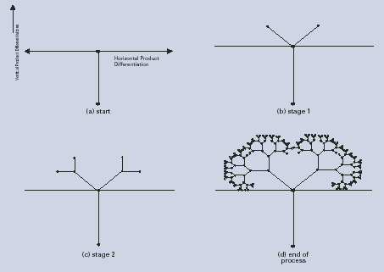
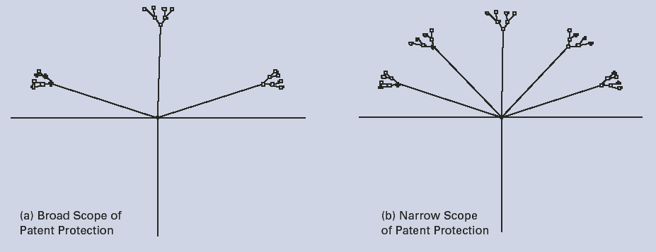

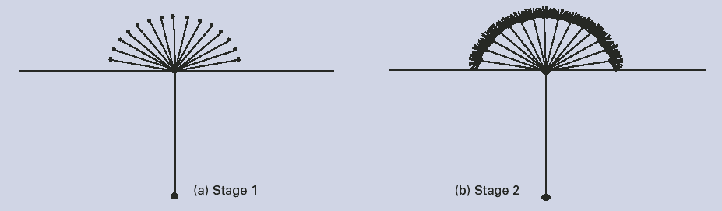
Innovation Trees
Proprietary De Facto Standard
Patent (or Standard) Clustering
Innovation Without Standards
[Source: DTI Economics Paper Number 12, 2005]

Slide 11
Biologically Diverse Innovation

Slide 12
Agenda
14:30 – 14:35 Welcome - Matt Hale, Bank of America Merrill Lynch
14:35 – 14:45 Introduction – Professor Michael Mainelli, Z/Yen Group
14:45 – 15:15 Keynote: “Financial Innovation: The Bright and Dark Sides” - Professor Thorsten Beck, Tilburg University
15:15 – 15:55 Panel: “Financial Innovation: the Good, the Bad and the Ugly”
15:55 – 16:20 Break
16:20 – 16:35 Presentation: “Investment Opportunities in Green Technology” – Rt Hon Gregory Barker, Minister of State for Department of Energy & Climate Change
16:35 – 17:20 Panel: “Six Degrees of Innovation: Investing in Green Technology”
17:20 – 17:30 Closing remarks
17:30 – 18:30 Reception

Slide 13
Keynote Address
“Financial Innovation: The Bright and Dark Sides”
Professor Thorsten Beck
Professor of Economics, Tilburg University

Slide 14


Financial Innovation:
The Bright and the Dark Sides
Thorsten Beck

Slide 15
Motivation
“Everybody talks about financial innovation, but (almost) nobody empirically tests hypotheses about it.” Frame and White (2004)
I wish somebody would give me some shred of evidence linking financial innovation with a benefit to the economy.” Paul Volcker

Slide 16
This presentation
What is financial innovation?
What does theory tell us?
How do we measure it?
What is the impact?
Conclusions for finance and growth debate
Based on: Beck, Chen, Lin and Song (2012): Financial Innovation: The Bright and Dark Sides

Slide 17

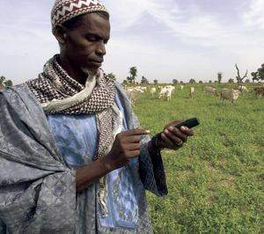
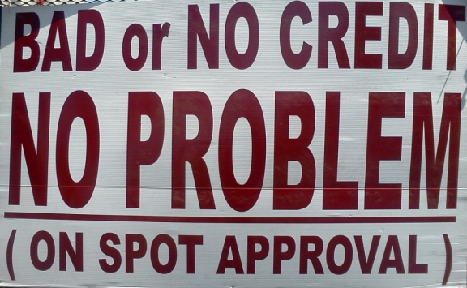
What is financial innovation? (1)

Slide 18
What is financial innovation? (2)
New process improve efficiency:
  Credit scoring has enabled more effective screening and therefore going down-market, but: credit overexpansion
  New delivery channels: mobile banking, agency banking etc.
  High frequency trading: higher efficiency by arbitraging away price gaps, but: higher volatility? More crashes?
New products to meet demand:
  New securities: risk diversification vs. regulatory arbitrage and mis-selling (Lehman Brother certificates, anyone?)
  Rainfall insurance in developing countries
New financial institutions to support new investment needs and bring additional competition
  Investment banks to support railroad expansion
  Venture capital funds to support IT companies
  Mobile phone companies offering mobile payment services
  Internet banks have lower costs, but…. Icesave deposits, anyone?

Slide 19
What does theory tell us?
Innovation-growth hypothesis – the bright side: financial innovations reduce agency costs, facilitate risk sharing, complete the market, and ultimately improve allocative efficiency and economic growth
Innovation-fragility hypothesis – the dark side: financial innovations as the root cause of the recent Global Financial Crisis
  credit expansion that helped feed the boom and subsequent bust in housing prices
  engineering securities perceived to be safe but exposed to neglected risks
  helping banks and investment banks design structured products to exploit investors’ misunderstandings of financial markets
  regulatory arbitrage
Not necessarily exclusive views

Slide 20
…and how do we measure it?
Most papers assess specific innovations (new securities, credit scoring etc.)
What about general impact?
Patent data not available, therefore look at input data
OECD’s Analytical Business Enterprise Research and Development (ANBERD) database
Enterprise and bank surveys via the OECD/Eurostat International Survey of Resources Devoted to R&D
“major changes aimed at enhancing your competitive position, your performance, your know-how or your capabilities for future enhancements. These can be new or significantly improved goods, services or processes for making or providing them. It includes spending on innovation activities, for example on machinery and equipment, R&D, training, goods and service design or marketing.”

Slide 21
Financial innovation
Data available (for large X-section) 1996 to 2006
32 countries (o/w 26 OECD), almost all high-income
2 indicators
  Financial R&D Intensity (Value Added)
  Financial R&D Intensity (Cost)
Positive correlation with Private Credit to GDP

Slide 22
Financial innovation is relatively low
Compare to:
Service R&D Intensity (Value Added): 0.428
Manufacturing R&D Intensity (Value Added): 2.113

Slide 23
Financial innovation over time

Slide 24
Do these data make sense? (1)

Slide 25
Do these data make sense? (2)

Slide 26
Do these data make sense? (3)

Slide 27
The “effects” of financial innovation
GDP per capita growth and growth opportunities
Growth and growth volatility of industries with different needs of external finance or R&D intensity
Bank fragility
Bank profitability during current crisis

Slide 28
The “effects” of financial innovation
GDP per capita growth and growth opportunities
  Countries with higher levels of financial innovation convert growth opportunities more strongly into GDP per capita growth
Growth and growth volatility of industries with different needs of external finance or R&D intensity
  Industries more reliant on external finance and R&D grow faster, but also more volatile in countries with higher levels of financial innovation
Bank fragility
  In countries with higher levels of financial innovation, banks are more fragile, especially smaller banks, less traditional banks and faster growing banks
  This effect comes through higher volatility
Bank profitability during current crisis
  Banks in countries with higher levels of financial innovation suffered higher profit reductions during recent crisis

Slide 29
Policy implications
Financial innovation is an important part of the finance-growth relationship
But it also increases risks and fragility in the financial system
Needed: adjustment of regulatory framework
  Should certain forms of financial innovation take place outside deposit-taking banks?
  Higher capital charges for certain new products?
  Constant supervisory upgrading necessary

Slide 30
Financial innovation, financial development and growth – some broader considerations

Slide 31
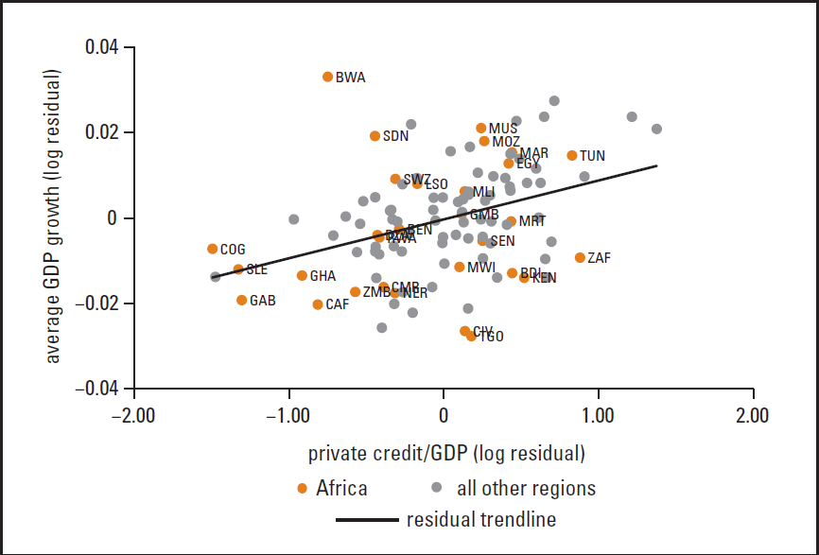
Finance is pro-growth

Slide 32
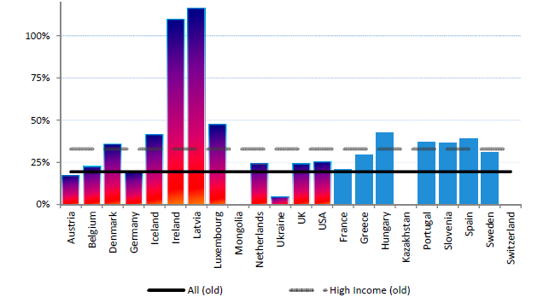
…but also fragile
Output losses relative to potential output;
Source: Laeven and Valencia (2010)

Slide 33
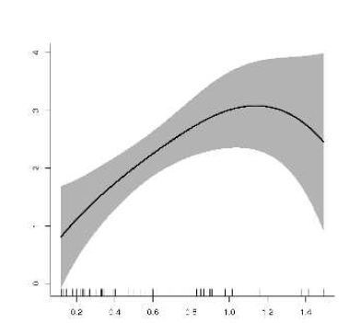
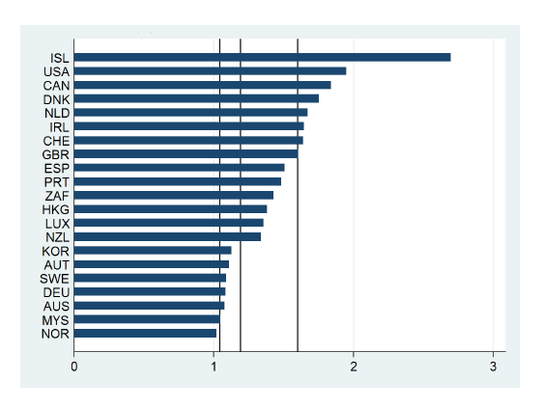
Too much finance?
Arcand, Berkes and Panizza, 2012

Slide 34
What went wrong in the developed world?
Finance helps only to get to the technology frontier, but not beyond (Aghion et al., 2005)
Financial institutions have moved beyond financial intermediation to other activities (Demirguc-Kunt and Huizinga, 2010)
Most of financial deepening in high-income countries has gone to households, not enterprises (Beck et al., 2012)
Financial system has grown too big at expense of real economy (Bolton et al., 2011; Philippon, 2010)

Slide 35
What kind of financial sector – financial intermediation vs. financial center view
Financial intermediation or facilitator view
  Finance as “meta-sector” supporting rest of economy
Financial center view
  One of many sectors
  Nationally centered financial center stronghold based on relative comparative advantages such as skill base, favorable regulatory policies, subsidies, etc.

Slide 36
What kind of financial sector – financial intermediation vs. financial center view
Private Credit to GDP vs. Value added of financial sector in GDP
Long-term: intermediation matters, not sector size
  Higher growth and lower volatility
Short-term: size is associated with higher volatility in high income countries, intermediation with higher growth in low-income countries
Kneer (2012): evidence for brain drain from skill-intensive industries to financial sector

Slide 37
Implications for regulatory reform debate
Back to basics!
Focus on intermediation
It’s about services, not specific institutions
Over-reaching of financial sector due to financial safety net subsidy
  Financial safety net reform
  Start with resolution
Financial innovation: yes, but within an appropriate regulatory framework

Slide 38
Thank you
Comments and suggestions?
T.Beck@uvt.nl
www.thorstenbeck.com

Slide 39
Panel Discussion 1
“Financial Innovation: the Good, the Bad and the Ugly”
Professor Thorsten Beck
Tilburg University
Barbara Ridpath
John Authers
Financial Times
Professor Michael Mainelli (Chair)

Slide 40

Break
Please come back
to your seats by 16:20

Slide 41
Presentation
“Investment Opportunities in Green Technology”
Rt Hon Gregory Barker
Minister of State, Department of Energy & Climate Change

Slide 42
Panel Discussion 2
“Six Degrees of Innovation:
Investing in Green Technology”
Rt Hon Gregory Barker
Minister of State for Department of Energy & Climate Change
Chris Hewett
Finance Innovation Lab
Professor Richard Templer
Climate-KIC UK
Professor Michael Mainelli (Chair)

Slide 43
Closing Remarks
Professor Michael Mainelli
Chairman, Z/Yen Group

Slide 44
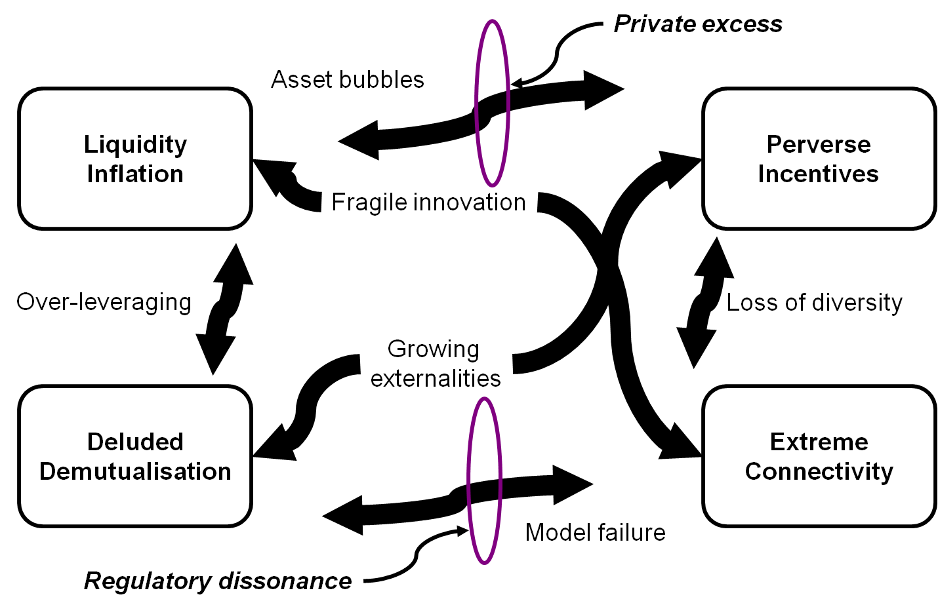
Bright or Dark?
Systemic Scrunch

Slide 45
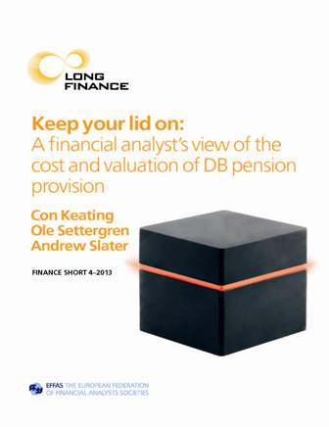

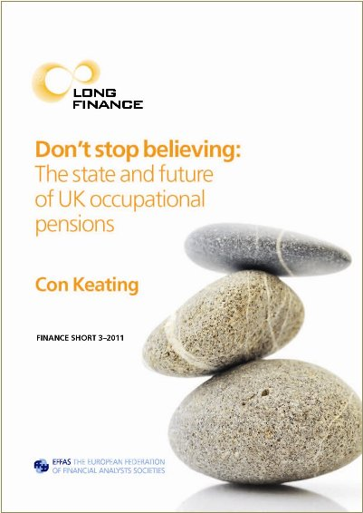

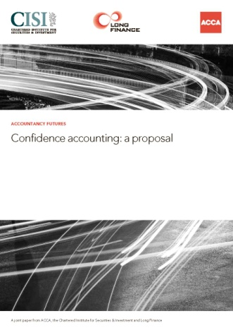
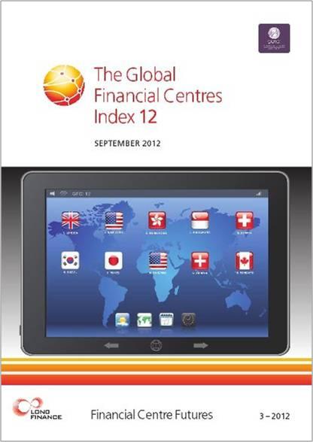
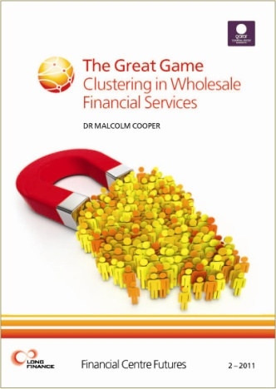
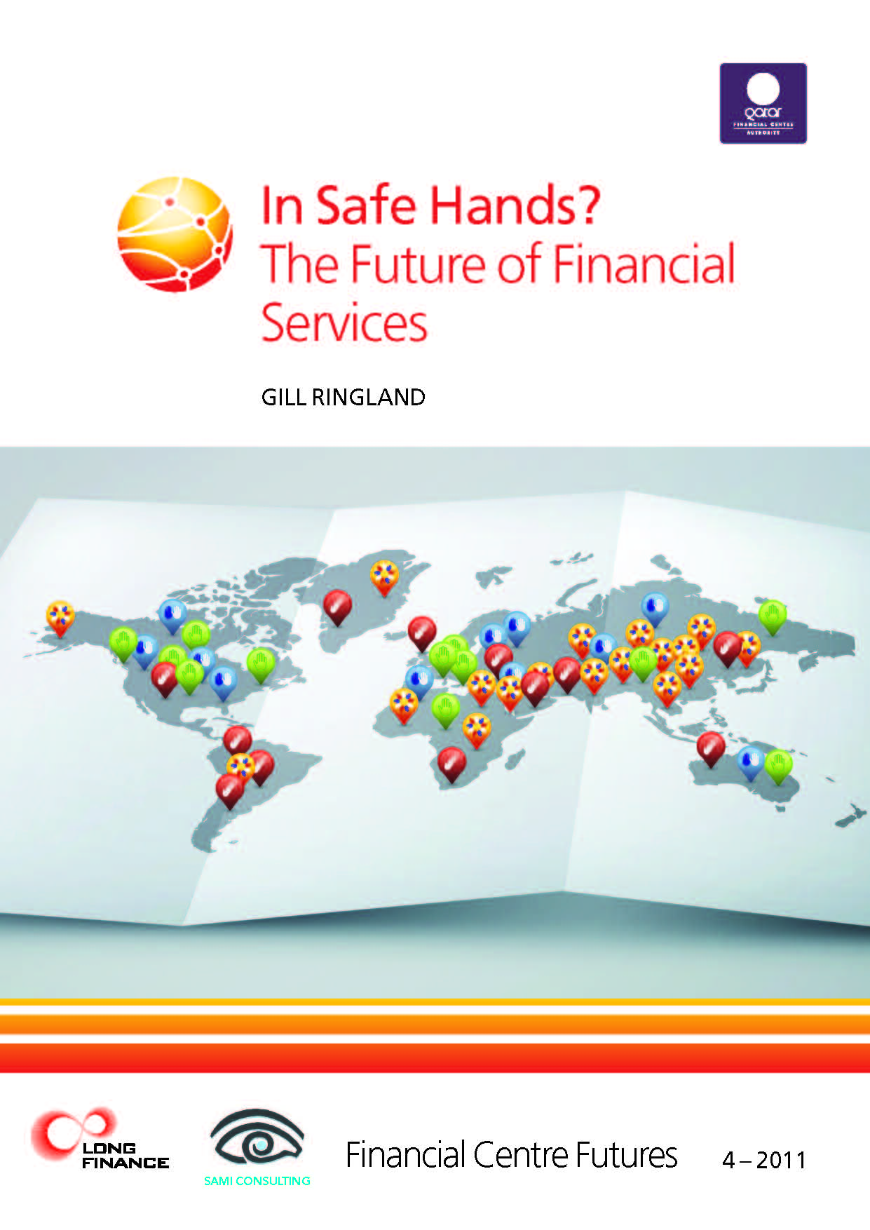
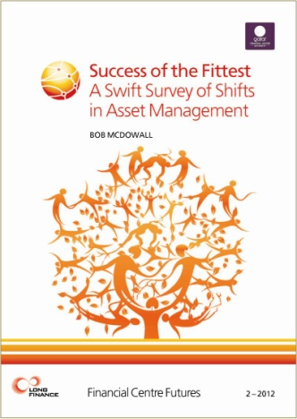

Long Finance Publications

Slide 46
Outlook 2013
Events
  The Anglosphere Beyond Churchill: An Exploration of Commonwealth & Commerce – 20 March 2013
  Rethinking the Economics of Pensions – 21 March 2013
  What Makes a Good Professional – 23 April 2013
  www.longfinance.net/events.html
Publications
  Con Keating et al, “Keep Your Lid On: A Financial Analyst’s View of the Cost and Valuation of DB Pension Provision” – February 2013
  GFCI 13 – 25 March 2013
  www.longfinance.net/publications.html
Long Finance Online Community - hear first about the latest news and events
  www.longfinance.net/online-community.html

Slide 47




Thanks To Our Sponsors

