Slide 1
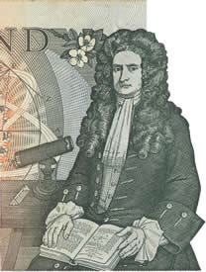
Occupational structure and population change before and during the British Industrial Revolution
Presentation for the launch event for the
4th edition of the Cambridge Economic History of Modern Britain.
Gresham College, London, 24th September 2014
Leigh Shaw-Taylor
Email: lmws2@cam.ac.uk
Research funded by two Leverhulme Trust grants, two E.S.R.C. grants, the Isaac
Newton Trust and with additional funding from the British Academy
http://www.geog.cam.ac.uk/research/projects/occupations/

Slide 2
Structure of the presentation
The Chapter
Shaw-Taylor, L., and Wrigley. E.A., 'Population change and occupational structure;, in R. Floud, P. Johnson, J. Humphries (eds.) Cambridge Economic History of Modern Britain (4th edn. 2014), pp. 53-88.
Historiographical Background
Occupational Structure of Britain 1700-1911
Population change geography and urbanisation 1600-1871
Occupational structure 1381-1911 – some more tentative recent work

Slide 3
Three key publications of the second half of the twentieth century
Deane, P., and Cole, W.A., British economic growth 1688-1959: Trends and structure (1962).
Wrigley E.A., Schofield RS., The population history of England and Wales 1541­-1871. A reconstruction. (1981).
N.F.R. Crafts, British economic growth during the industrial revolution (1985).

Slide 4
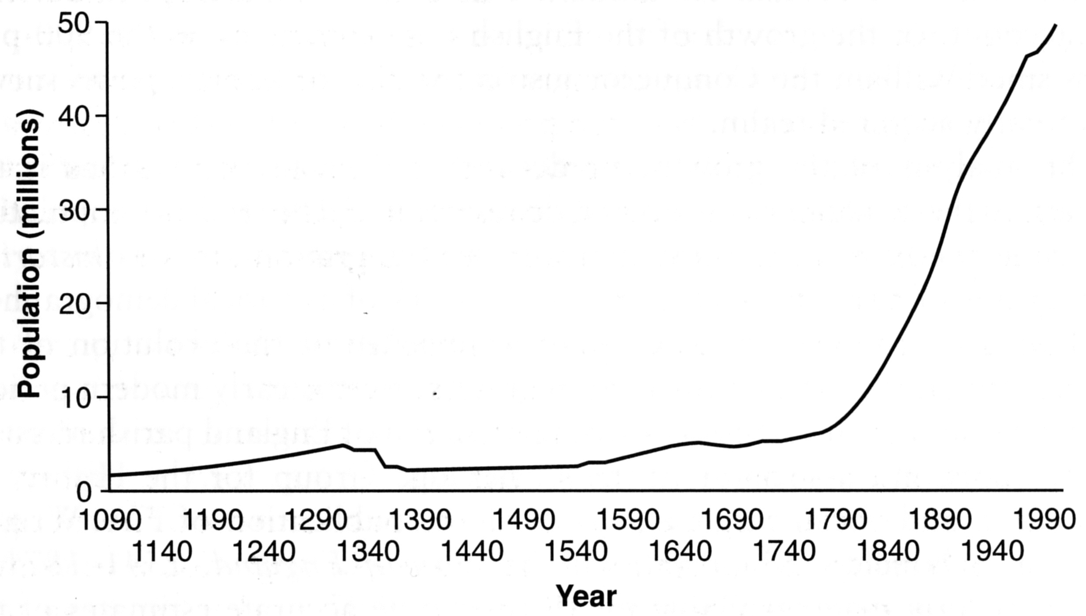
The long-term growth of England’s population
The Industrial Revolution clearly marked a fundamental turning point in the carrying capacity of the economy
Source: Hinde, A., England’s population: A history since the Domesday survey (2003)

Slide 5
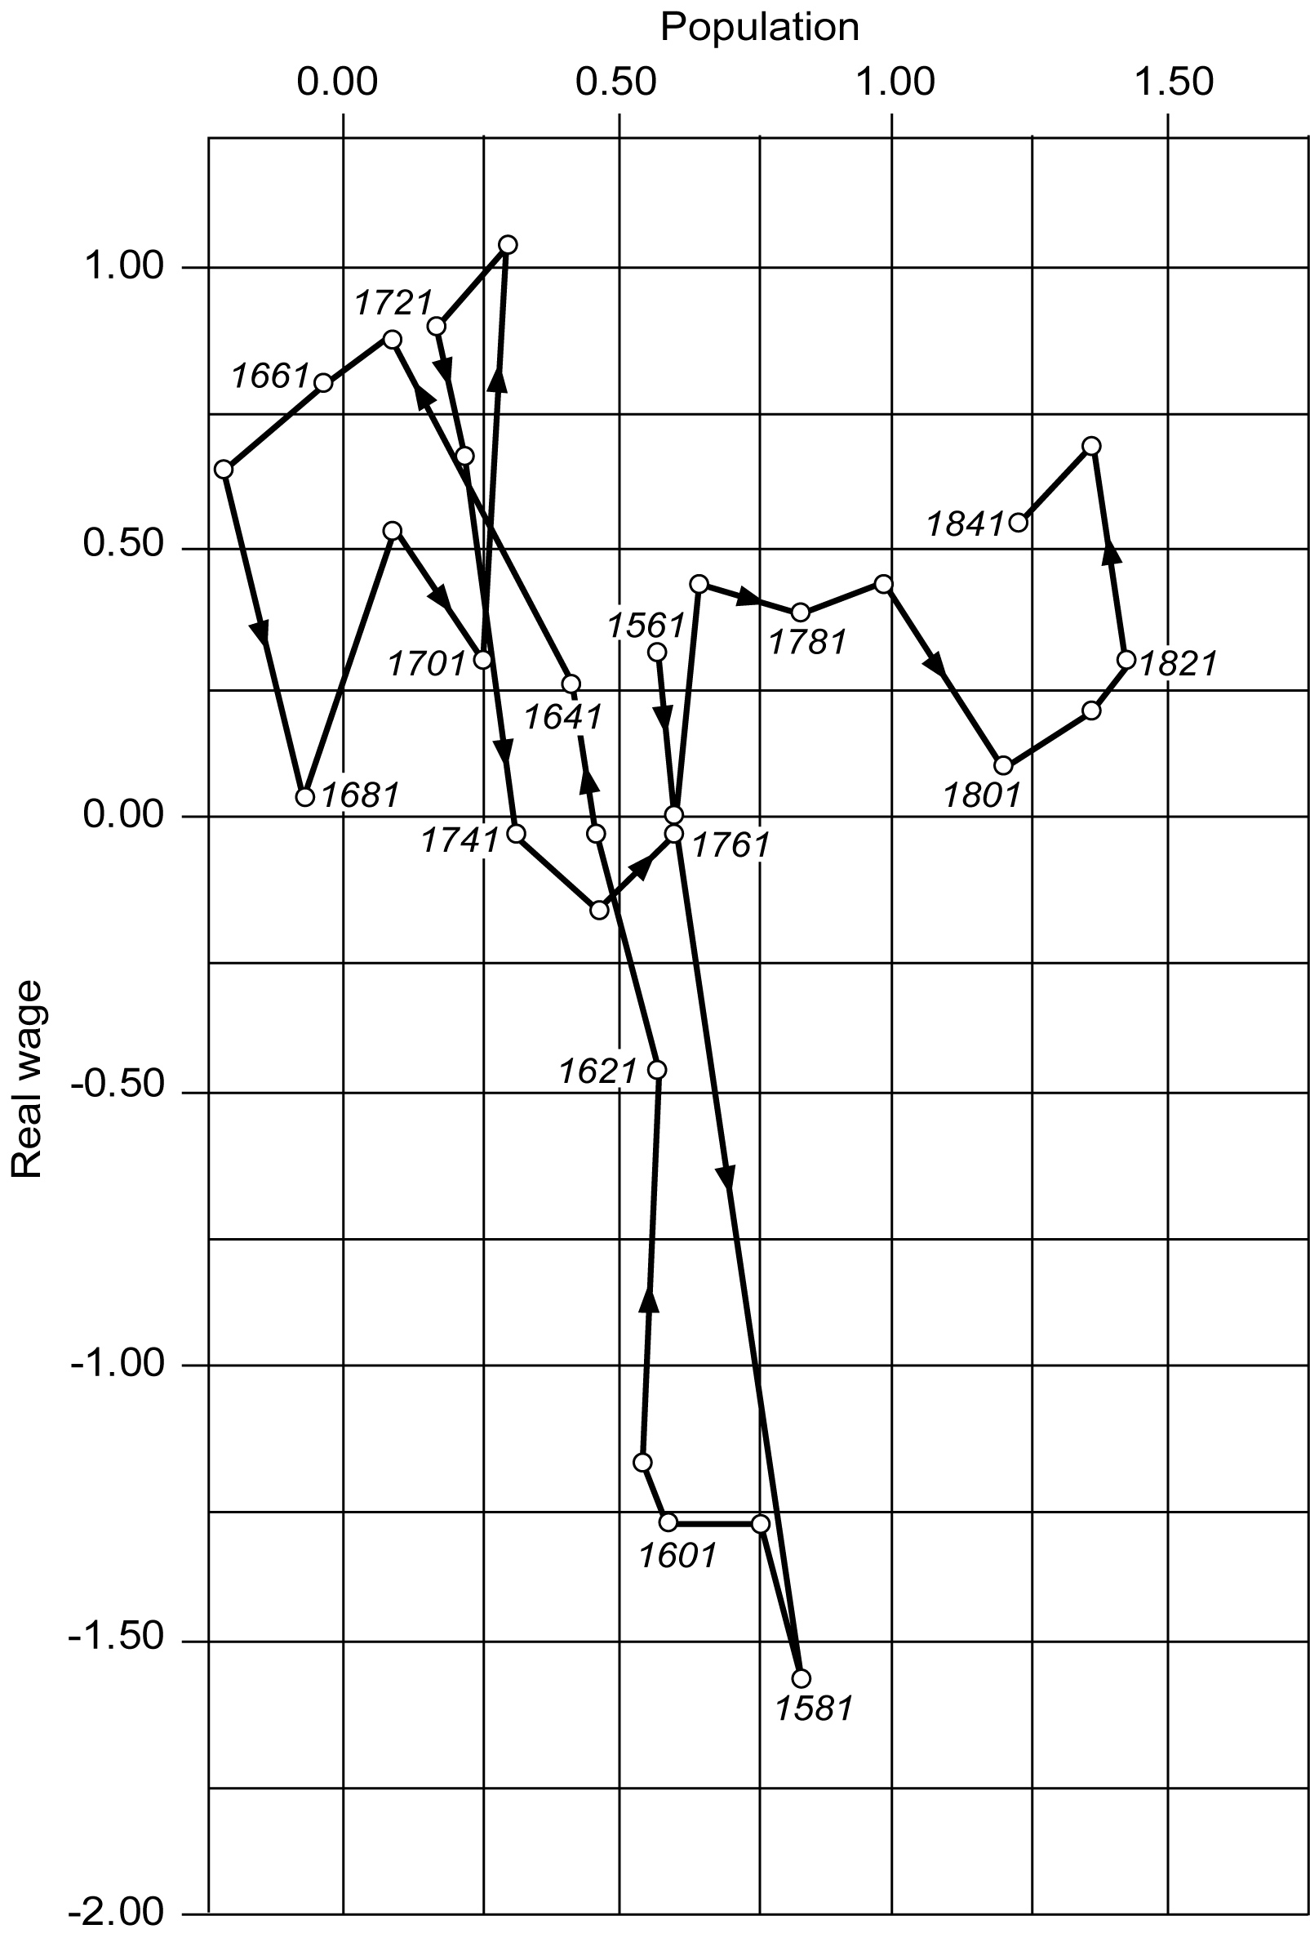
Real wages growth and population growth 1551-1841
Revised version of original Wrigley and Schofield graph comparing rate of change of population and real wage index. PBH until 1770 then Feinstein index
Pre-industrial Malthusian relationship until c.1760.
Then a slow increase in real wages until around 1850. Annual average 1780-1850 = 0.2%
Rapid growth from 1850 to 1880 (not shown) of 1.4 % per year. Adapting Kuznets we might call this ‘modern wage growth’

Slide 6
Old and new accounts of GDP per capita growth during the British Industrial Revolution

Slide 7
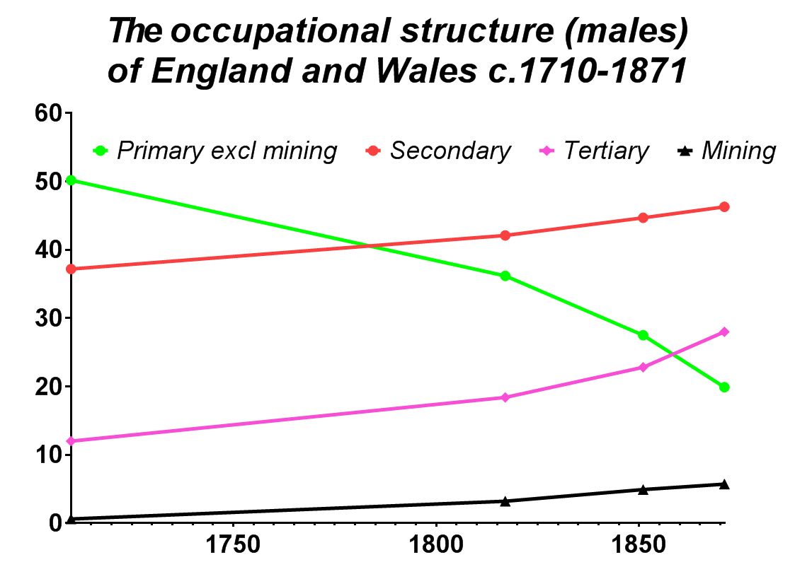
Baptism data from c.1,100 parish registers. Robust estimates but, may be subject to modest corrections from Sebastian Keibek.
Census data
1851-1871.
Baptismal data from all (c.11,400) parish registers. Highly robust estimates.

Slide 8
Working assumptions for modelling female employment before 1851
The sub-sectoral sex ratios known for 1851 hold good in 1381-1817 except where stated otherwise:
Assume the ratio of females to males in agriculture was 50% higher in 1770 than in 1851 and 100% higher c.1710 and at all earlier dates.
Assume the sex ratio in textiles was 3.0 before Kay’s flying shuttle in the 1720s
Assume the sex ratio in textiles was 3.5 in 1770 (after Kay’s flying shuttle but before the mechanisation of spinning took hold.
Assume the mechanisation of spinning was complete by c.1817.
Note that these assumptions, whilst deriving from the secondary literature are tentative working assumptions. They are not substitutes for solid empirical data. But these are some years away at best. In the mean time estimates which explicitly include women will be closer to reality than those which do not. A very high priority for further research on the long-run development of the economy is real data on female employment.

Slide 9
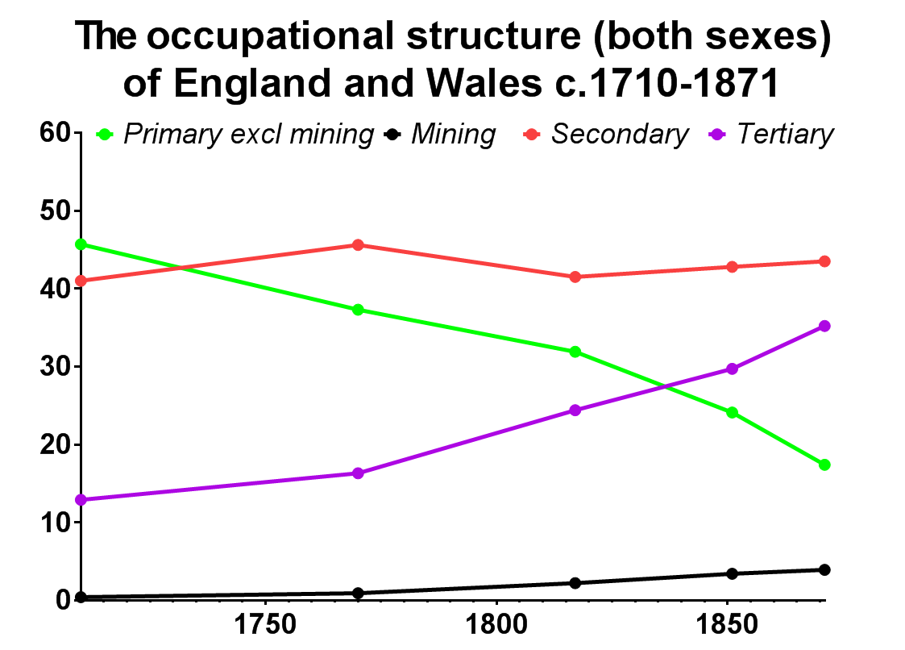
Plausible assumptions about female employment suggest the secondary sector’s share of employment was astonishingly stable during the Industrial Revolution
Structural change in employment during the Industrial Revolution now appears as a shift in relative employment from agriculture to services
The rise in secondary sector employment largely predates the eighteenth century

Slide 10
Key conclusions on occupational structure 1700-1871
Employment in the secondary sector c.1700 was twice as large as previous revisionism had suggested at 37% of the male labour force.
The structural shift towards secondary sector employment during the classic Industrial Revolution was therefore modest 37% – 46 % 1700- 1871.
It follows that secondary sector productivity growth, and hence secondary sector technological change was substantially larger than Crafts suggested – though still nowhere near the rates Deane and Cole suggested.
Most of the growth in the relative importance of the secondary sector conventionally associated with the Industrial Revolution clearly took place before 1700
The major structural change in employment was a relative shift from agriculture to the tertiary sector.
Taken as a whole, tertiary sector growth during the period has been neglected. Clearly, the growth of service sector employment was a fundamentally important component of the Industrial Revolution.
The new data on tertiary sector growth will increase growth rates somewhat over the current Crafts and Harley figures but will not restore the Deane and Cole picture.

Slide 11
English population Geography 1600-1871
London’s relative expansion was predominantly early modern but surged forward again in the C19th.
The rise of the industrial counties was predominantly in the C18th and C19th but clearly gaining ground vis a vis the more agricultural counties before 1700.

Slide 12
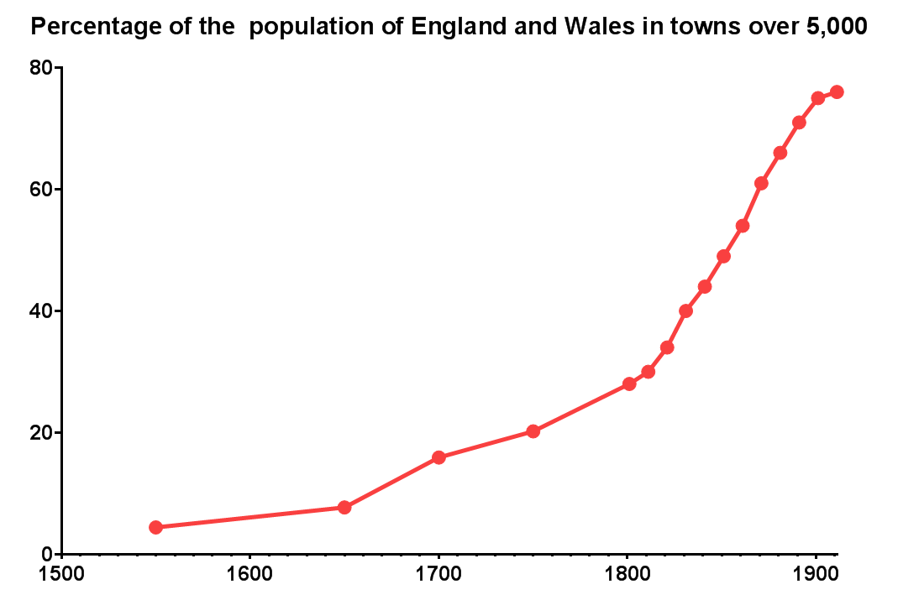
The economy underwent a profound spatial restructuring during the Industrial Revolution.
In 1750 25% of the population lived in towns of over 5,000 and there was only one town over 100,000. By 1851 the urbanisation rate had risen to 49% and by 1901 to 75% by which time there were 34 towns over 100,000.
But, note that urbanisation was underway from the mid-sixteenth century, which suggests that occupational structure had already begun its structural shift away from agriculture at that date

Slide 13
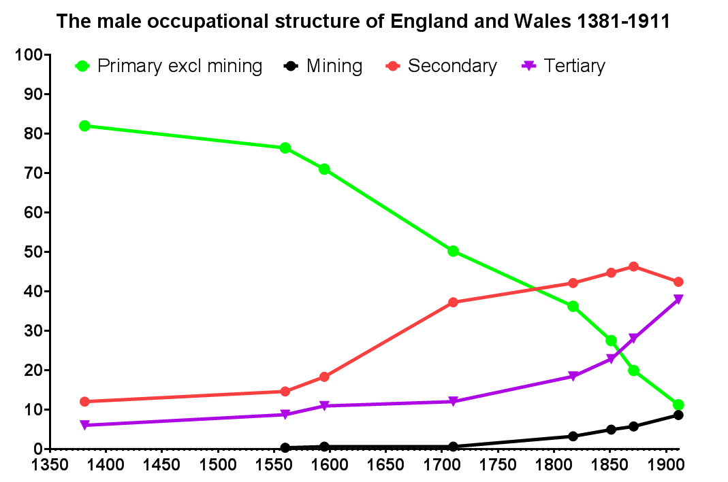
Tentative estimates
Hard data
Coroner’s inquests, 1560s and 1590s. N= c.300. Data from Steve Gunn and Tomas Gromelski
Sample is small so tentative only
R.M. Smith, highly preliminary estimates from 1377-81 poll taxes

Slide 14
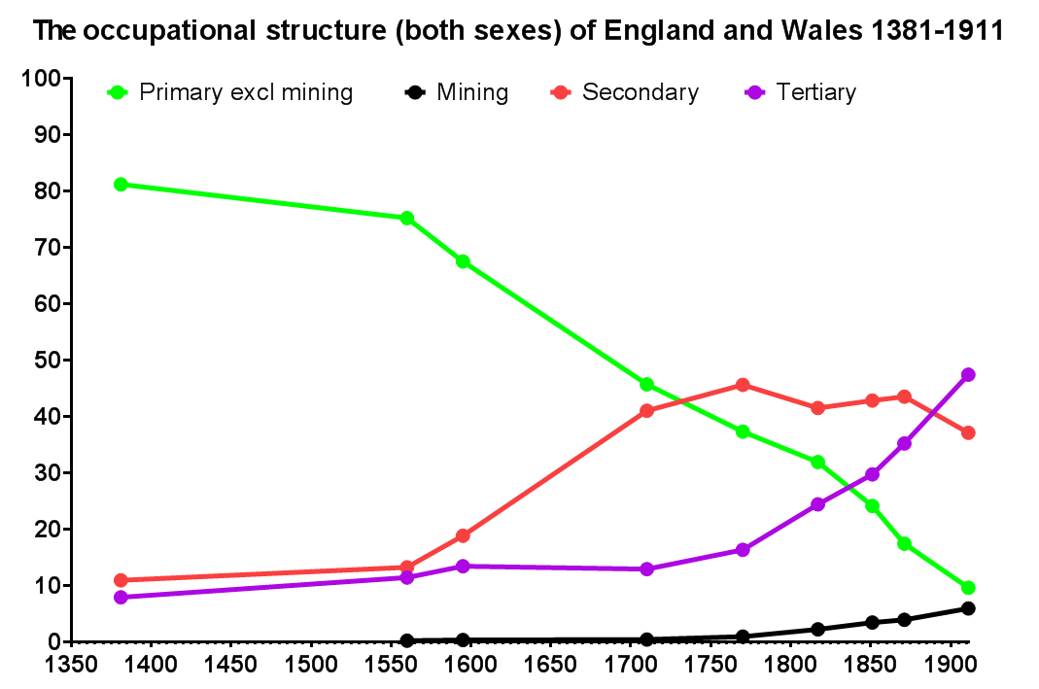
‘Rapid’ labour-intensive structural shift from agriculture to the secondary sector - Industrialisation.
Structural change largely from agriculture to the tertiary sector. Technologically intensive Increases in output per head in the secondary sector – Industrial Revolution.
Slow labour-intensive structural change.
V. Modest diversification of secondary sector consumption but significant improvement in diets.
Early movement away from Malthusian cliff after Black Death improved labour:land balance.
Increased consumption of secondary sector goods primarily by middling sort
Interpolated data point for 1770
Incomes of all classes probably rose. Definitely so from the mid C19th
Escape from Malthusian constraints

Slide 15
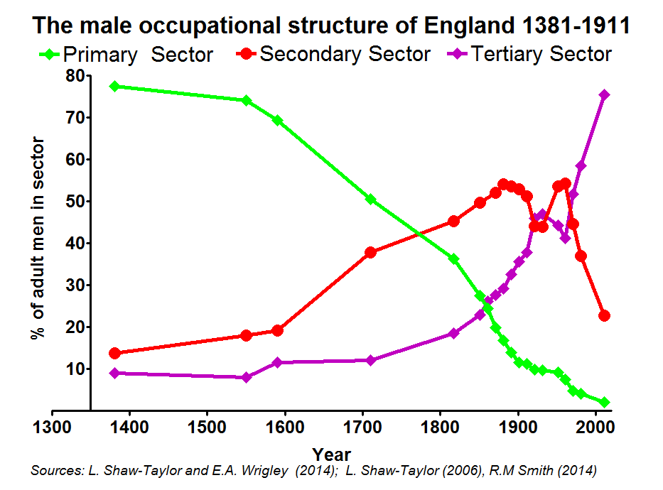
The male occupational Structure of England and Wales c.1381 – 2011
Tentative estimates
Hard data
With the anomalous exception of the inter-war period the tertiary sector’s share of employment has been growing since 1700 and probably a good deal longer that.
With the exception of the C20th interwar period, the tertiary sector has been growing as a share of employment since 1700 and probably longer

Slide 16
Our chapter is based on the work of many people over the last eleven years:
Occupational coding: E.A. Wrigley and R.S. Davies
Population data: E.A. Wrigley. Research assistance: S. Bottomley
Historical Cartography and GIS resource creation: A.E.M. Satchell.
Database construction: P.M. Kitson and G. Newton
Management of early register data collection: J. Field
Data collection for early registers: O. Dunn, J. Field and P.M. Kitson
Management of 1813-20 data collection: P.M. Kitson.
Collection of 1813-20 data: J. Barker, R. Churchley, O. Dunn, S. Hennesey, P.M. Kitson , N. Modha, L. Monaghan-Pisano, G. Stanning, T. Swain, A. Warren, L. Ward, M. Ward, M. Westlake.
Input of published census material: R. Tyler and E. Potter.
Spatial matching of datasets: J. Day, P.M. Kitson, G. Newton, A.E.M. Satchell, E.A. Wrigley. Research assistance from: S. Basten, S. Bottomley, Z. Crisp, G. Wade, S. Thompson, D. Walsh and R.M. Whyte.
GIS mapping: A.E.M. Satchell and J. Field.
1381 Poll tax estimates: R.M. Smith. Data from Steve Broadberry.
Coroners’ inquest data 1560s and 1590s. Data from Steven Gunn and Tomas Gromelski.
Other research assistance: Ellen Potter, Mischa Davenport and Annette MacKenzie.
Errors: Leigh Shaw-Taylor

