Slide 1



More complex than Graunt could imagine: theoretical and practical thoughts about tempo effects in the conventional period life table
Marc Luy
Mortality Past and Present: Celebrating the 350th Anniversary of the publication of
John Graunt’s Bills of Mortality, London, 29 November 2012
Notes:
Titelseite 1

Slide 2
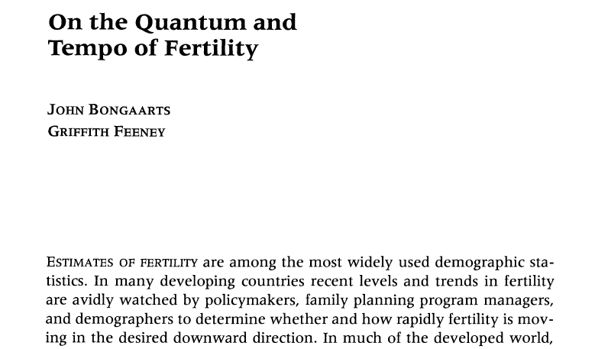

Bongaarts’ and Feeney’s tempo approach

Slide 3
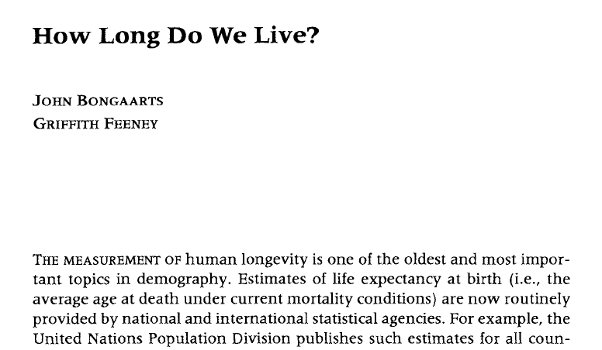
Bongaarts’ and Feeney’s tempo approach

Slide 4
Contents of the presentation
What is the tempo distortion in period mortality?
Classifying the tempo approach between period and cohort analysis
An empirical example: differences in life expectancy between eastern and western Germany, 1960-2010
Conclusions

Slide 5
(1)
What is the tempo distortion in
period mortality?

Slide 6
Mortality tempo effect illustrated in the Lexis diagram:
Population with mortality reduction in year t1
Luy, M. 2008: “Mortality tempo-adjustment: theoretical considerations and an empirical application“, in Barbi, E. et al. (eds.): How long do we live?, Leipzig, Springer: 203-233.

Slide 7
Mortality tempo effect illustrated in the Lexis diagram:
Population with mortality reduction in year t1
Population with constant number of births and constant mortality conditions until t0
Luy, M. 2008: “Mortality tempo-adjustment: theoretical considerations and an empirical application“, in Barbi, E. et al. (eds.): How long do we live?, Leipzig, Springer: 203-233.

Slide 8
Mortality tempo effect illustrated in the Lexis diagram:
Population with mortality reduction in year t1
Birth intervals 0.2 years
Luy, M. 2008: “Mortality tempo-adjustment: theoretical considerations and an empirical application“, in Barbi, E. et al. (eds.): How long do we live?, Leipzig, Springer: 203-233.

Slide 9
Mortality tempo effect illustrated in the Lexis diagram:
Population with mortality reduction in year t1
All deaths occur at age 62.5
Luy, M. 2008: “Mortality tempo-adjustment: theoretical considerations and an empirical application“, in Barbi, E. et al. (eds.): How long do we live?, Leipzig, Springer: 203-233.

Slide 10
Mortality tempo effect illustrated in the Lexis diagram:
Population with mortality reduction in year t1
In t1 linear rise of age at death at the rate of 0.2 years
Luy, M. 2008: “Mortality tempo-adjustment: theoretical considerations and an empirical application“, in Barbi, E. et al. (eds.): How long do we live?, Leipzig, Springer: 203-233.

Slide 11
Mortality tempo effect illustrated in the Lexis diagram:
Population with mortality reduction in year t1
From t2 on
all deaths occur at age 62.7
Luy, M. 2008: “Mortality tempo-adjustment: theoretical considerations and an empirical application“, in Barbi, E. et al. (eds.): How long do we live?, Leipzig, Springer: 203-233.

Slide 12
Mortality tempo effect illustrated in the Lexis diagram:
Population with mortality reduction in year t1
Time interval between
the deaths increases
Luy, M. 2008: “Mortality tempo-adjustment: theoretical considerations and an empirical application“, in Barbi, E. et al. (eds.): How long do we live?, Leipzig, Springer: 203-233.

Slide 13
Mortality tempo effect illustrated in the Lexis diagram:
Population with mortality reduction in year t1
Deaths of cohort E are shifted to t2
Luy, M. 2008: “Mortality tempo-adjustment: theoretical considerations and an empirical application“, in Barbi, E. et al. (eds.): How long do we live?, Leipzig, Springer: 203-233.

Slide 14
Mortality tempo effect illustrated in the Lexis diagram:
Population with mortality reduction in year t1
What is the consequence for the age-specific death rates in t0, t1, and t2?
Luy, M. 2008: “Mortality tempo-adjustment: theoretical considerations and an empirical application“, in Barbi, E. et al. (eds.): How long do we live?, Leipzig, Springer: 203-233.

Slide 15
Mortality tempo effect illustrated in the Lexis diagram:
Population with mortality reduction in year t1
Example: 20.000 persons of each cohort survive until age 62;
In every cohort 1.000 deaths occur at age 62
Luy, M. 2008: “Mortality tempo-adjustment: theoretical considerations and an empirical application“, in Barbi, E. et al. (eds.): How long do we live?, Leipzig, Springer: 203-233.

Slide 16
Mortality tempo effect illustrated in the Lexis diagram:
Population with mortality reduction in year t1
N(t0) = 97.500
D(t0) = 5.000
M(t0) = 0,05128
Luy, M. 2008: “Mortality tempo-adjustment: theoretical considerations and an empirical application“, in Barbi, E. et al. (eds.): How long do we live?, Leipzig, Springer: 203-233.

Slide 17
Mortality tempo effect illustrated in the Lexis diagram:
Population with mortality reduction in year t1
N(t0) = 97.500
D(t0) = 5.000
M(t0) = 0,05128
N(t1) = 98.400
D(t1) = 4.000
M(t1) = 0,04065
Luy, M. 2008: “Mortality tempo-adjustment: theoretical considerations and an empirical application“, in Barbi, E. et al. (eds.): How long do we live?, Leipzig, Springer: 203-233.

Slide 18
Mortality tempo effect illustrated in the Lexis diagram:
Population with mortality reduction in year t1
N(t0) = 97.500
D(t0) = 5.000
M(t0) = 0,05128
N(t1) = 98.400
D(t1) = 4.000
M(t1) = 0,04065
N(t2) = 98.500
D(t2) = 5.000
M(t2) = 0,05076
Luy, M. 2008: “Mortality tempo-adjustment: theoretical considerations and an empirical application“, in Barbi, E. et al. (eds.): How long do we live?, Leipzig, Springer: 203-233.

Slide 19
Mortality tempo effect illustrated in the Lexis diagram:
Population with mortality reduction in year t1
N(t0) = 97.500
D(t0) = 5.000
M(t0) = 0,05128
N(t1) = 98.400
D(t1) = 4.000
M(t1) = 0,04065
N(t2) = 98.500
D(t2) = 5.000
M(t2) = 0,05076
Luy, M. 2008: “Mortality tempo-adjustment: theoretical considerations and an empirical application“, in Barbi, E. et al. (eds.): How long do we live?, Leipzig, Springer: 203-233.

Slide 20
Mortality tempo effect illustrated in the Lexis diagram:
Two populations with different mortality reduction in year t1
Population A (62,7)
Population A (62,7)
Population A (62,5)
Population A (62,5)
Population B (62,5)
Population B (62,5)
Population B (62,1)
Population B (62,1)
Luy, M. 2008: “Mortality tempo-adjustment: theoretical considerations and an empirical application“, in Barbi, E. et al. (eds.): How long do we live?, Leipzig, Springer: 203-233.

Slide 21
Mortality tempo effect illustrated in the Lexis diagram:
Two populations with different mortality reduction in year t1
Population A (62,7)
Population A (62,7)
Population A (62,5)
Population A (62,5)
Population B (62,5)
Population B (62,5)
Population B (62,1)
Population B (62,1)
Population B (62,1)
Population B (62,1)

Slide 22
Mortality tempo effect illustrated in the Lexis diagram:
Two populations with different mortality reduction in year t1
Population A (62,7)
Population A (62,7)
Population A (62,5)
Population A (62,5)
Population B (62,5)
Population B (62,5)
Population B (62,1)
Population B (62,1)
Population B (62,1)
Population B (62,1)

Slide 23
Mortality tempo effect illustrated in the Lexis diagram:
Two populations with different mortality reduction in year t1
IMPORTANT:
the conventional death rates
are not wrong!
Population A (62,7)
Population A (62,7)
Population A (62,5)
Population A (62,5)
Population B (62,5)
Population B (62,5)
Population B (62,1)
Population B (62,1)
Population B (62,1)
Population B (62,1)

Slide 24
Mortality tempo effect illustrated in the Lexis diagram:
Two populations with different mortality reduction in year t1
BUT:
Do we want that such a paradoxical situation can occur?
Population A (62,7)
Population A (62,7)
Population A (62,5)
Population A (62,5)
Population B (62,5)
Population B (62,5)
Population B (62,1)
Population B (62,1)
Population B (62,1)
Population B (62,1)

Slide 25
Mortality tempo effect illustrated in the Lexis diagram:
Two populations with different mortality reduction in year t1
MOREOVER:
Are users of period rates aware that such
a paradoxical situation can occur?
Population A (62,7)
Population A (62,7)
Population A (62,5)
Population A (62,5)
Population B (62,5)
Population B (62,5)
Population B (62,1)
Population B (62,1)
Population B (62,1)
Population B (62,1)

Slide 26
Mortality tempo effect illustrated in the Lexis diagram:
Two populations with different mortality reduction in year t1
Population A (62,7)
Population A (62,7)
Population A (62,5)
Population A (62,5)
Population B (62,5)
Population B (62,5)
Population B (62,1)
Population B (62,1)
Population B (62,1)
Population B (62,1)

Slide 27
Mortality tempo effect illustrated in the Lexis diagram:
Two populations with different mortality reduction in year t1
Population A (62,7)
Population A (62,7)
Population A (62,5)
Population A (62,5)
Population B (62,5)
Population B (62,5)
Tempo-adjusted death rates:
Population B (62,1)
Population B (62,1)
Population B (62,1)
Population B (62,1)

Slide 28
(2)
Classifying the tempo approach between
period and cohort analysis

Slide 29
Cohort and period analysis in the Lexis diagram
Cohort analysis
Period analysis
Three different methodological combinations:
1) Translation measures: translation of period measures into cohort measures
2) Cross-sectional cohort averages: period measures for cohort-specific conditions
3) Tempo measures: period measures, adjusted for period-specific changes in the timing of cohorts (= period tempo)
Luy, M. 2010: “Tempo effects and their relevance in demographic analysis”, Comparative Population Studies – Zeitschrift für Bevölkerungswissenschaft 35(3): 415-446

Slide 30
Translation measures in the Lexis diagram
Translation measures: Translation of period measures into cohort measures and vice versa
Fertility: Ryder (1964)
Mortality: Schoen and Canudas-Romo (2005), Goldstein and Wachter (2006)
Lagged Cohort Measures: „Lagged Cohort Fertility Rate“ (LCFR), „Lagged Cohort Life Expectancy“ (LCLE)
Age
Calendar year
Luy, M. 2010: “Tempo effects and their relevance in demographic analysis”, Comparative Population Studies – Zeitschrift für Bevölkerungswissenschaft 35(3): 415-446

Slide 31
Cross-sectional cohort averages in the Lexis diagram
Cross-sectional cohort av.:
Period measures in order to characterize current (period-specific) cohort conditions
Fertility: „Average Completed Fertility“ (Ward and Butz 1980)
Mortality: „Cross-Sectional Average Length of Life“ (Brouard 1986, Guillot 2003)
Age
Calendar year
Luy, M. 2010: “Tempo effects and their relevance in demographic analysis”, Comparative Population Studies – Zeitschrift für Bevölkerungswissenschaft 35(3): 415-446

Slide 32
Tempo measures in the Lexis diagram
Tempo measures:
Period measures, standardized for period-specific changes in the timing of cohorts
(= period tempo)
Fertility: „Tempo-adjusted TFR“ (Bongaarts and Feeney 1998)
Mortality: „Tempo-adjusted life expectancy“ (Bongaarts and Feeney 2002, 2003)
Age
Calendar year
Luy, M. 2010: “Tempo effects and their relevance in demographic analysis”, Comparative Population Studies – Zeitschrift für Bevölkerungswissenschaft 35(3): 415-446

Slide 33
(3)
An empirical example: differences in
life expectancy between eastern and
western Germany, 1960-2010

Slide 34
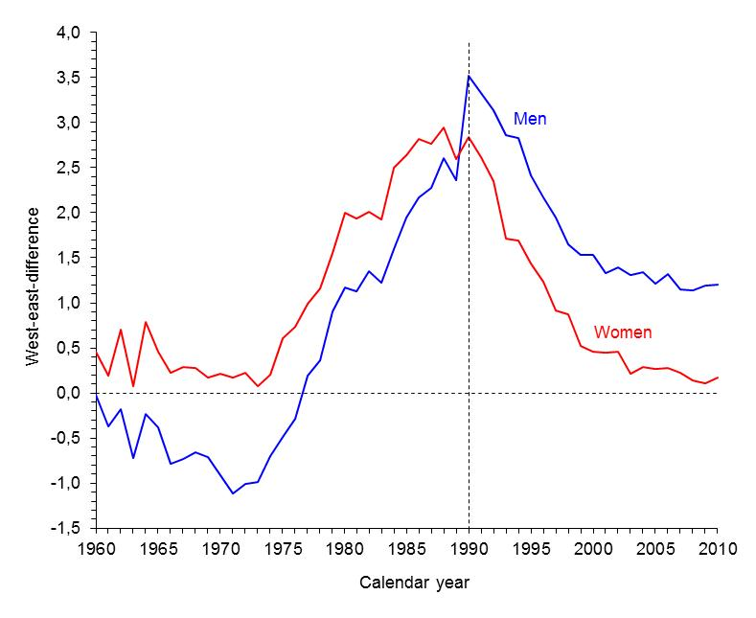
West-east German difference in life expectancy at birth, 1960-2010
Luy, M., 2006: “Mortality tempo-adjustment: an empirical application“, Demographic Research 15(21): 561-590.
Data: http://www.lebenserwartung.info

Slide 35
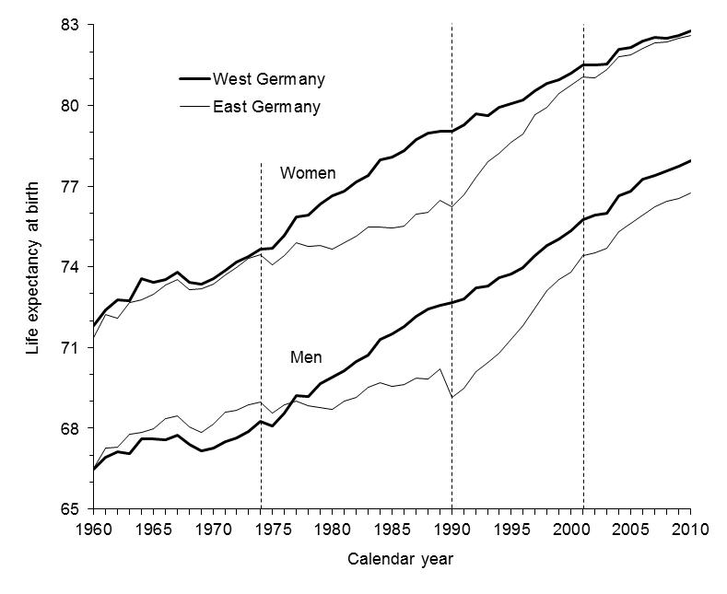
Trends in life expectancy at birth,
West and East Germany, 1960-2010
Luy, M., 2006: “Mortality tempo-adjustment: an empirical application“, Demographic Research 15(21): 561-590.
Data: http://www.lebenserwartung.info

Slide 36
Trends in life expectancy at birth,
West and East Germany, 1960-2010
Luy, M., 2006: “Mortality tempo-adjustment: an empirical application“, Demographic Research 15(21): 561-590.
Data: http://www.lebenserwartung.info

Slide 37
Trends in life expectancy at birth,
West and East Germany, 1960-2010
Luy, M., 2006: “Mortality tempo-adjustment: an empirical application“, Demographic Research 15(21): 561-590.
Data: http://www.lebenserwartung.info

Slide 38
Trends in life expectancy at birth,
West and East Germany, 1960-2010
Luy, M., 2006: “Mortality tempo-adjustment: an empirical application“, Demographic Research 15(21): 561-590.
Data: http://www.lebenserwartung.info

Slide 39
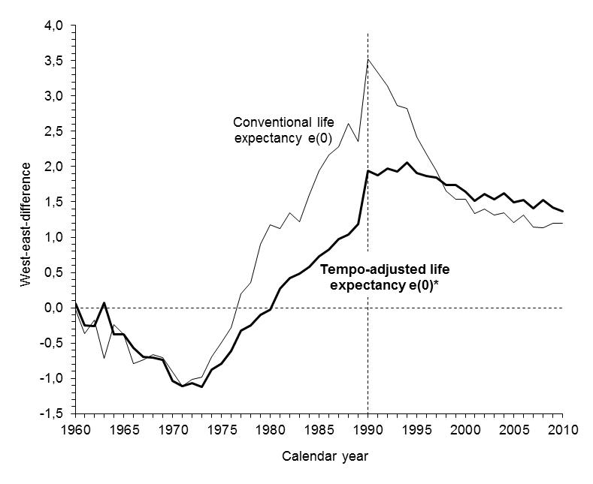
West-east German difference in life expectancy at birth for conventional life expectancy e₀(t) and tempo-adjusted life expectancy e₀*(t), men 1960-2010 (no mortality under age 30)
Maximum differences
3.52
2.06
1.37
1.20
Luy, M., 2006: “Mortality tempo-adjustment: an empirical application“, Demographic Research 15(21): 561-590.
Data: http://www.lebenserwartung.info

Slide 40
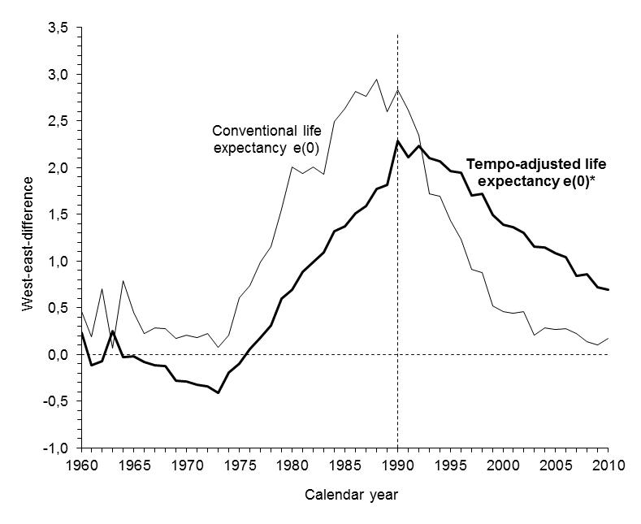
West-east German difference in life expectancy at birth for conventional life expectancy e₀(t) and tempo-adjusted life expectancy e₀*(t), women 1960-2010 (no mortality under age 30)
2.95
Maximum differences
2.28
0.69
0.17
Luy, M., 2006: “Mortality tempo-adjustment: an empirical application“, Demographic Research 15(21): 561-590.
Data: http://www.lebenserwartung.info

Slide 41
(4)
Conclusions

Slide 42
Conclusions
Using the conventional period life expectancy for analysing mortality conditions of real people can be misleading

Slide 43
Conclusions
Using the conventional period life expectancy for analysing mortality conditions of real people can be misleading
The (additional) use of alternative measures is useful and necessary

Slide 44
Conclusions
Using the conventional period life expectancy for analysing mortality conditions of real people can be misleading
The (additional) use of alternative measures is useful and necessary
A lot of methodological work is still needed for understanding and adjusting the tempo distortion in period mortality

Slide 45
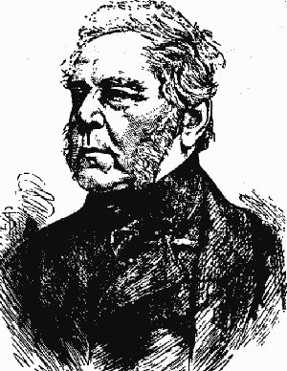
Thank you, John
…for giving us ideas that fascinate us even 350 years later.

