Slide 1
Modern art in churches

Slide 2
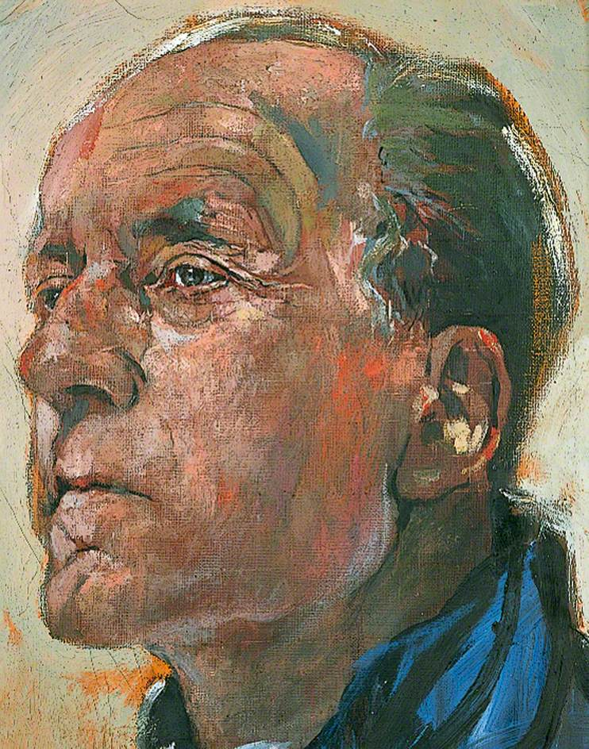

Slide 3
Walter Hussey, Vicar of St Matthew’s, Northampton; Dean of Chichester, by Graham Sutherland.

Slide 4
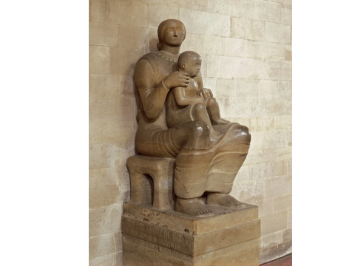

Slide 7
Henry Moore
Madonna and child, St Matthew’s, Northampton
Stone altar, St Stephen’s, Walbrook, London
Mother and child, St Paul’s Cathedral, London

Slide 10
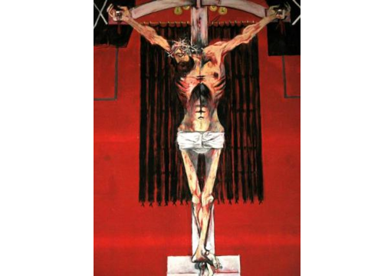

Slide 14
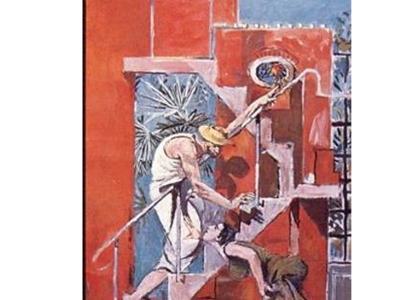

Slide 15
Graham Sutherland
The Thorn
The Crucifixion, St Matthew’s, Northampton
The Crucifixion, St Aidan’s, East Acton, London
The Crown of Thorns, detail
Christ in Majesty, Coventry Cathedral
The Lion of St Mark, detail of tapestry
Noli me tangere, Chichester Cathedral

Slide 18
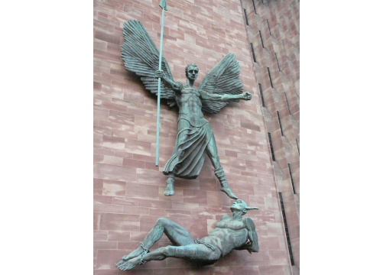

Slide 19
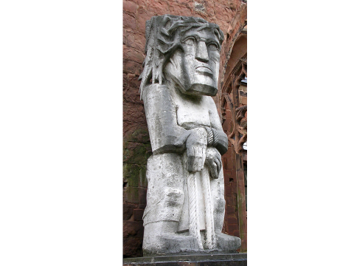

Slide 22
Jacob Epstein Christ in Majesty, Llandaff Cathedral St Michael and the devil, Coventry Cathedral Ecce Homo, Coventry Cathedral Lazarus, New College, Oxford

Slide 23
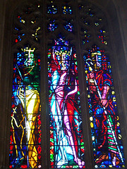

Slide 25
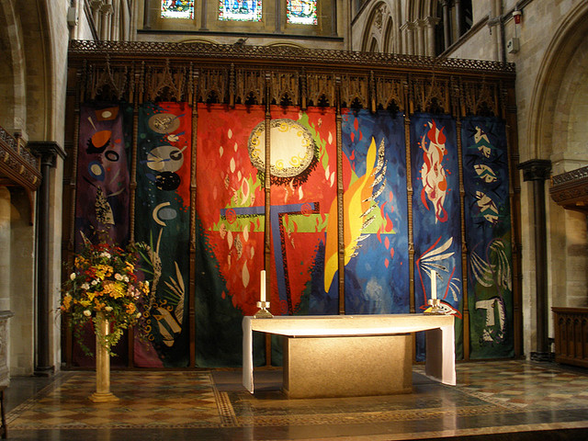

Slide 27
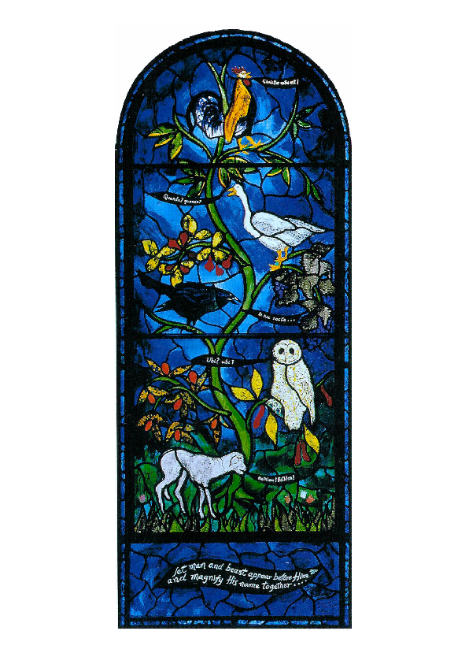

Slide 28
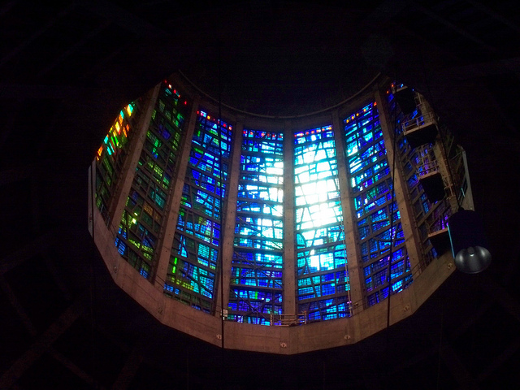

Slide 29
John Piper
Oundle School Chapel
Baptistry Window, Coventry Cathedral
Reredos tapestry, Chichester Cathedral
Benjamin Brittan Memorial Window, Aldeburgh
Nativity Window, St Mary’s, Iffley
The Lantern, Roman Catholic Cathedral, Liverpool

Slide 33
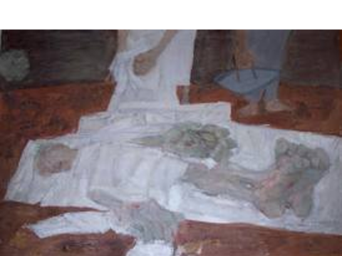

Slide 34
Ceri Richards
The Sacrament chapel, Liverpool Roman Catholic Cathedral
Window in Derby Cathedral
The Supper at Emmaus, St Edmund Hall Chapel, Oxford
The Deposition, St Mary’s, Swansea

Slide 35
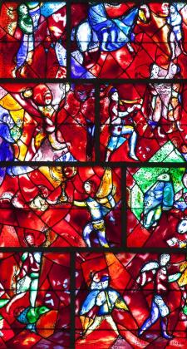

Slide 37
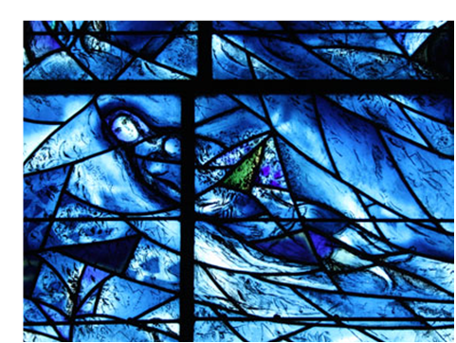

Slide 38
Marc Chagall
Psalm 150 window, Chichester Cathedral
East Window, Tudely Church
Detail, Tudely

Slide 39
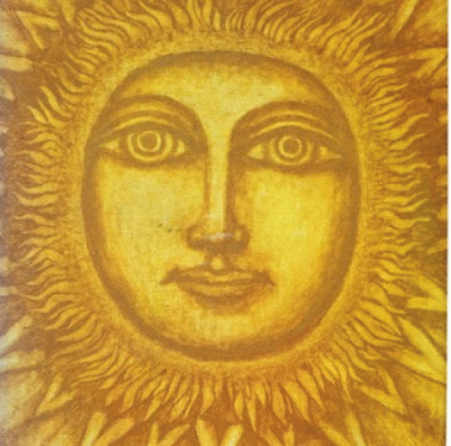

Slide 40
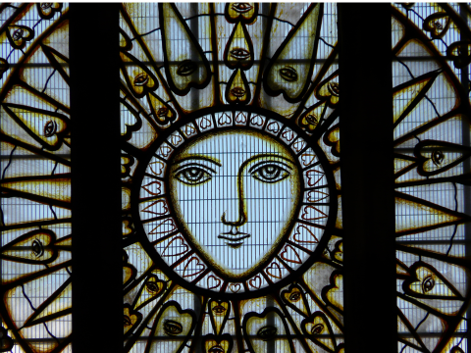

Slide 41
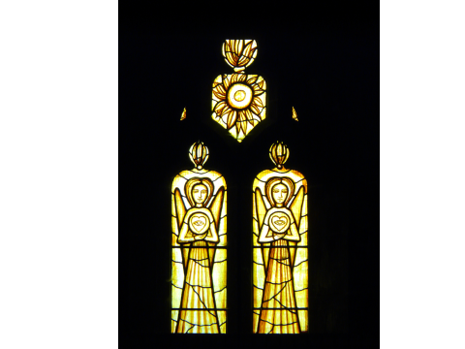

Slide 42
Cecil Collins
Altar frontal, Chichester Cathedral
East Window, All Saints’, Basingstoke
“The eye of the heart” side windows, All Saints’, Basingstoke

Slide 43
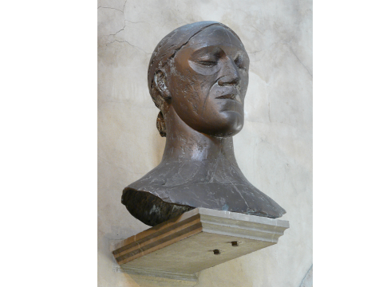

Slide 44
Elizabeth Frink
Head of Christ, All Saints’, Basingstoke
This and the Collins windows in the church commissioned by Keith Walker, who had previously been a Canon of Chichester.
Walking Madonna, Salisbury Cathedral
Detail, walking Madonna
The Risen Christ, Liverpool Anglican Cathedral

Slide 49
Craigie Aitchson
Crucifixion, Liverpool Anglican Cathedral

Slide 52
Hildergart Nicholas
Cross, John Radcliffe Hospital Chapel, Oxford
The prodigal, Bournemouth General Hospital chapel

Slide 55
Norman Adams
The Stations of the Cross, Milton Keynes
The Stations of the Cross, St Mary’s Roman Catholic Church, Mulberry Street, Manchester

Slide 56
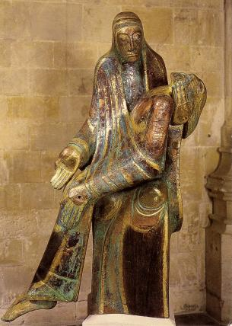

Slide 57
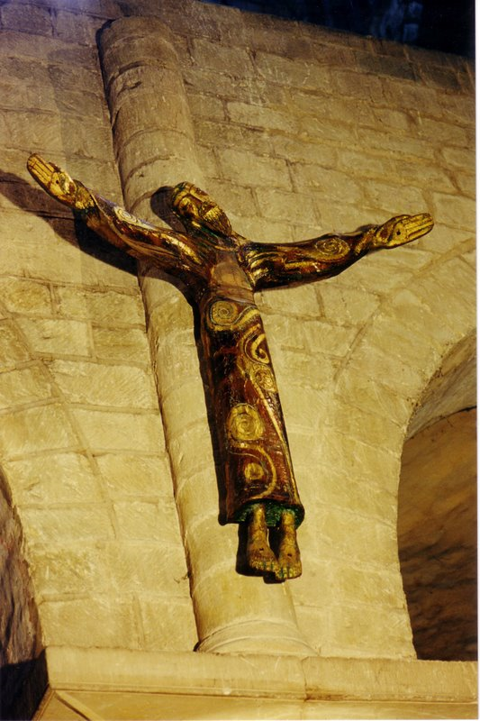

Slide 58
Peter Ball
The Pietà, Winchester Cathedral
Crucifix, Winchester Cathedral

Slide 59
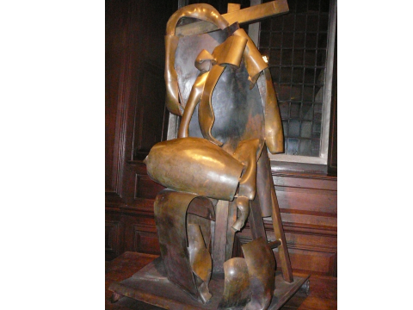

Slide 60
Anthony Caro
Descent from the cross, Christ’s College, Chapel, Cambridge

Slide 62
Shirazeh Houshiary
East Window, St Martin in the Fields

Slide 64
Mark Cazalet
The Tree of Life, Chelmsford Cathedral

Slide 66
Nicholas Mynheer,
Angels guarding the aumbry, St Mary’s, Iffley

Slide 69
Roger Wagner
The flowering tree, St Mary’s, Iffley

Slide 72
Maggie Hambling
Resurrection Spirit, St Dunstan’s, Mayfield

Slide 73
These images are discussed in
The Image of Christ in Modern Art
Richard Harries
Ashgate

