Slide 1
The Honourable The Irish Society
The modern era, 1913 - 2013

Slide 2
What is the Irish Society?
The Irish Society is a property-owning charity, governed by Trustees from the City of London, operating in County Londonderry under a Royal Charter and which uses the income from its assets and its influence for the benefit of the citizens of County Londonderry in general and Londonderry and Coleraine in particular.

Slide 3
Londonderry Guildhall

Slide 4
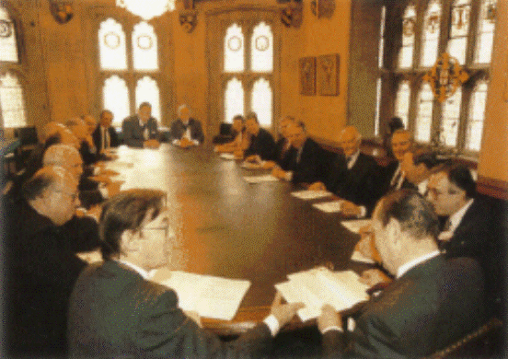
The Irish Chamber, Guildhall Yard

Slide 5
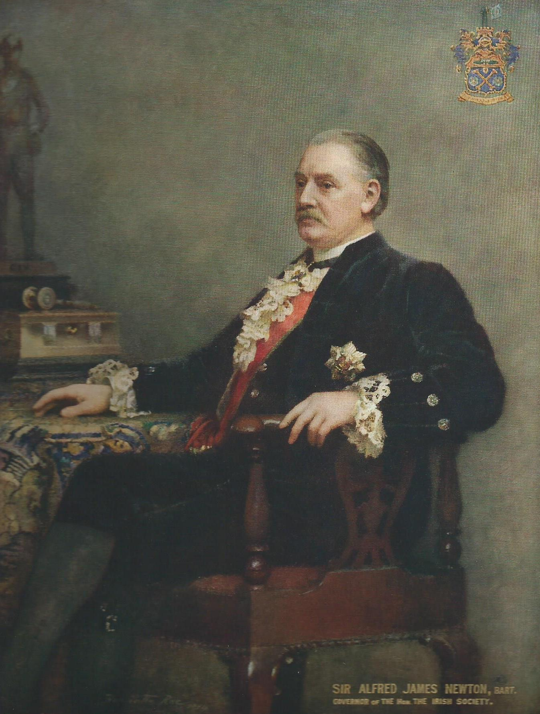
Sir Alfred Newton, Governor

Slide 6
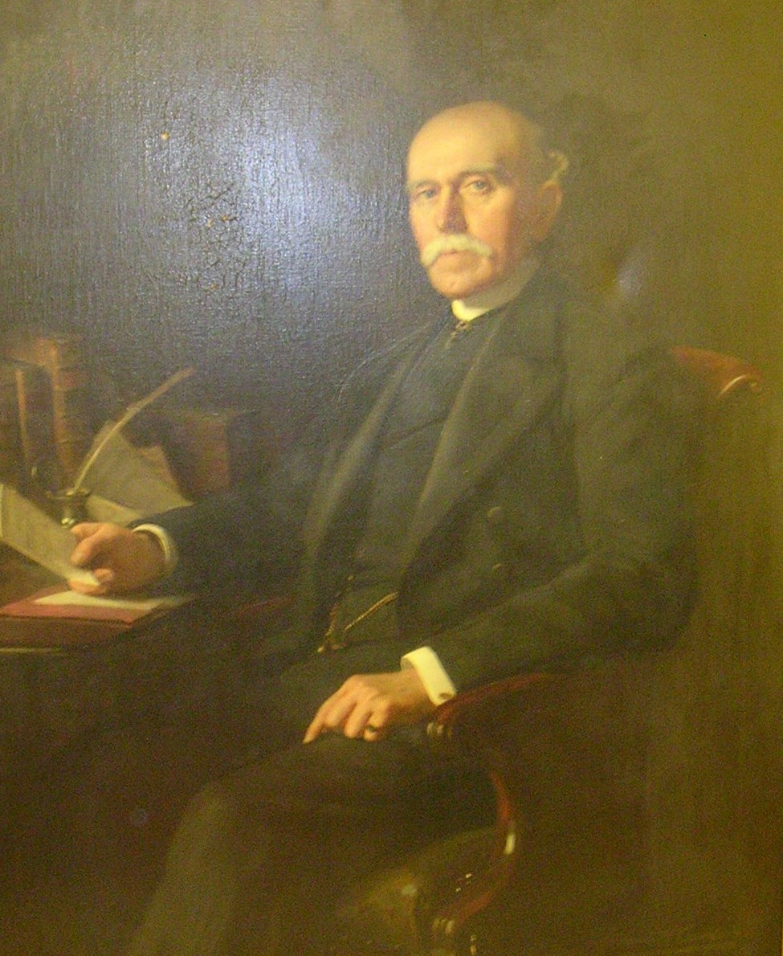
Durie Miller, Secretary

Slide 7
Londonderry Property

Slide 8
Lough Foyle reclamations

Slide 9
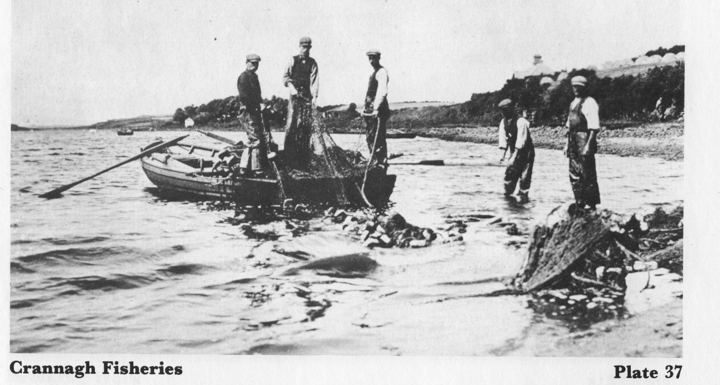
Commercial salmon fishing

Slide 10
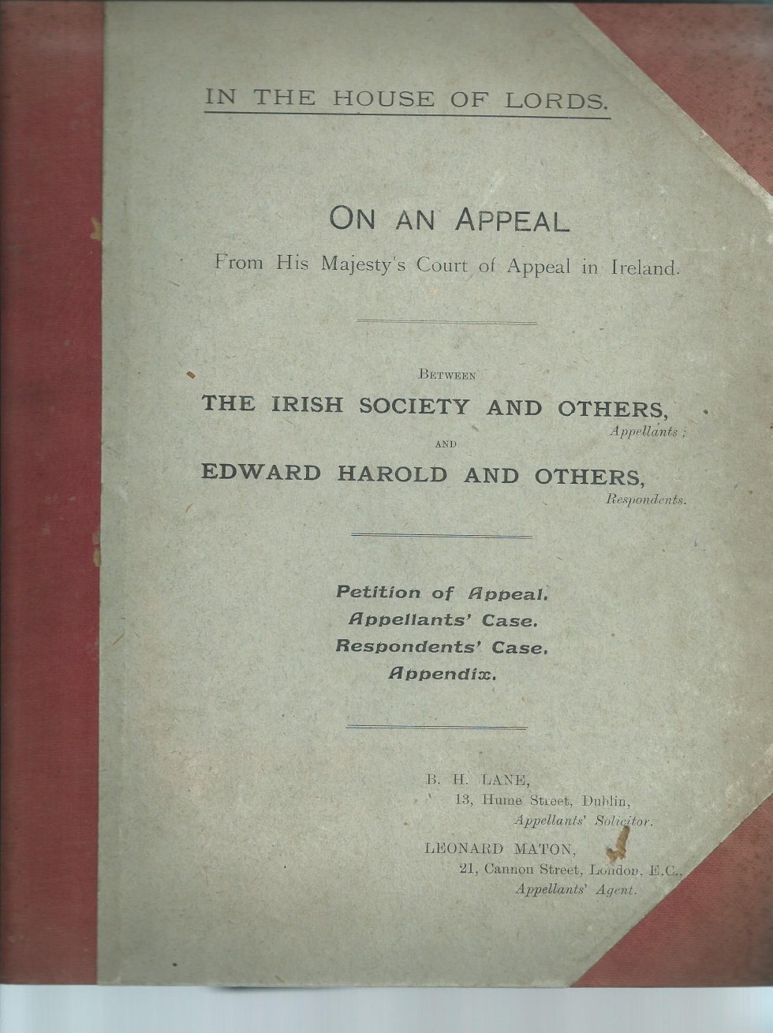
House of Lords Appeal, 1911

Slide 11
Foyle tidal fishery

Slide 12
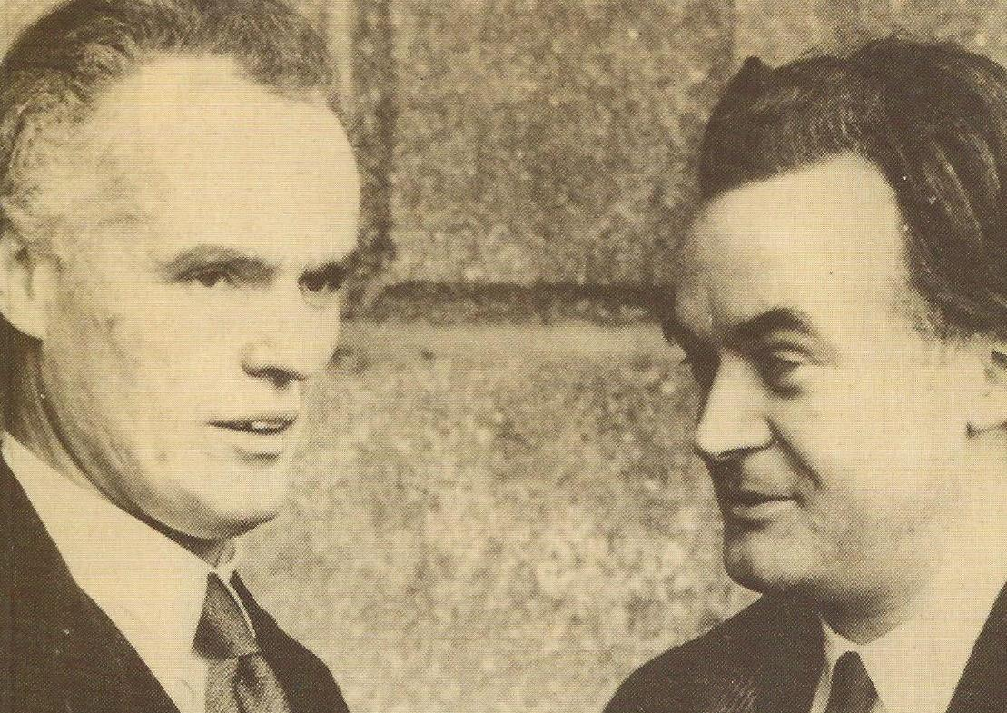
The Foyle Fishery Case

Slide 13
St Columb’s Cathedral

Slide 14
Walls of Londonderry
Transferred for guardianship to NI government, June 1955

Slide 15
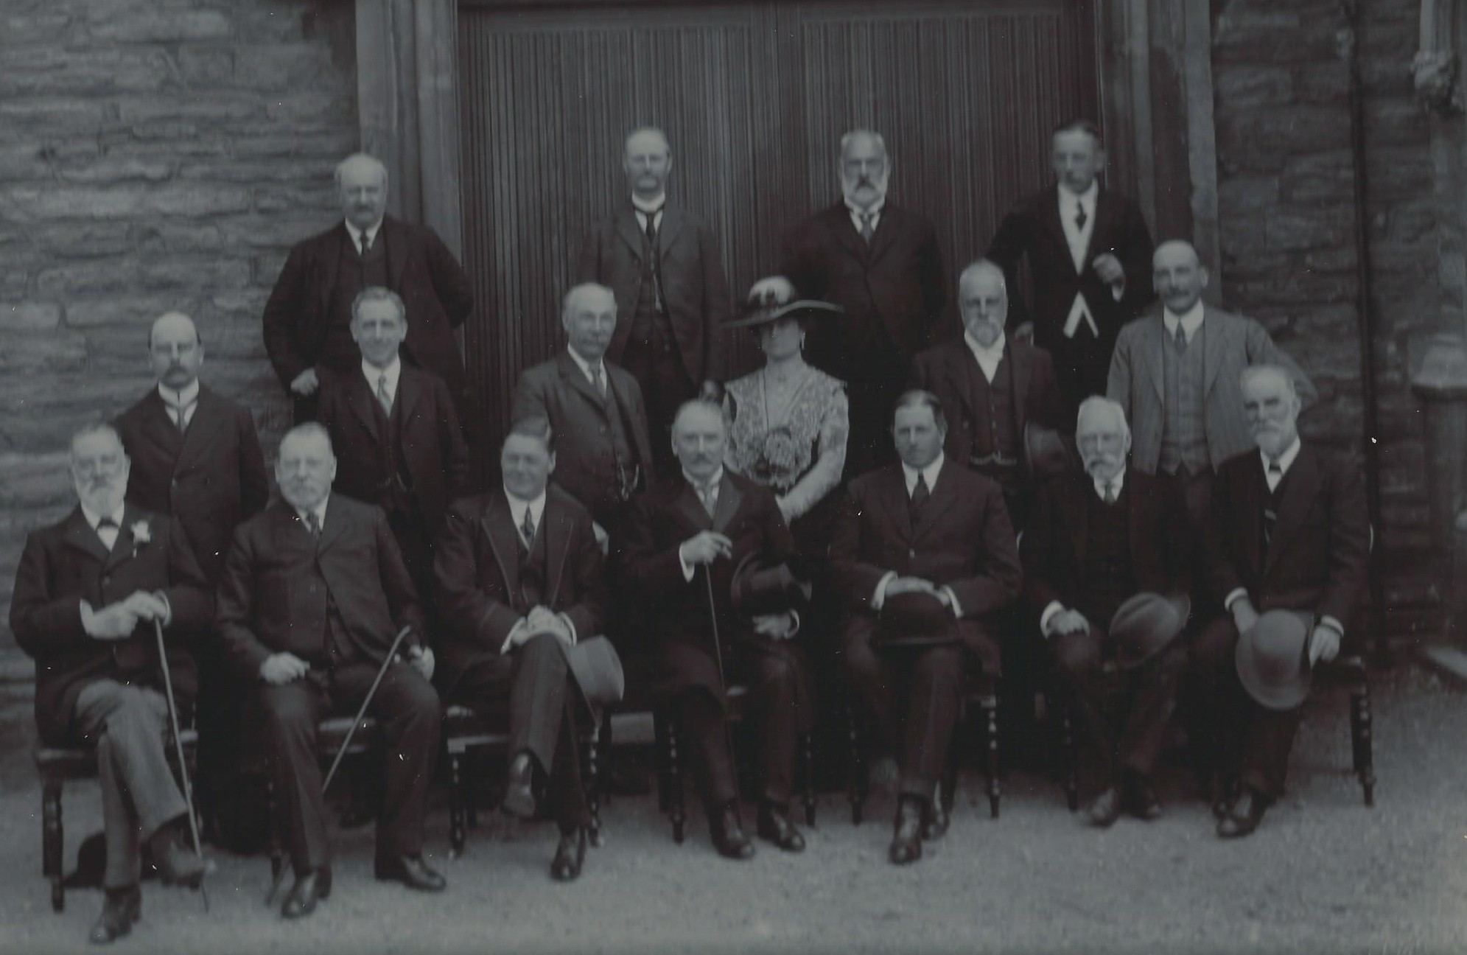
1913 Visitation

Slide 16
Irish Society Londonderry office

Slide 17
Culmore Primary School

Slide 18
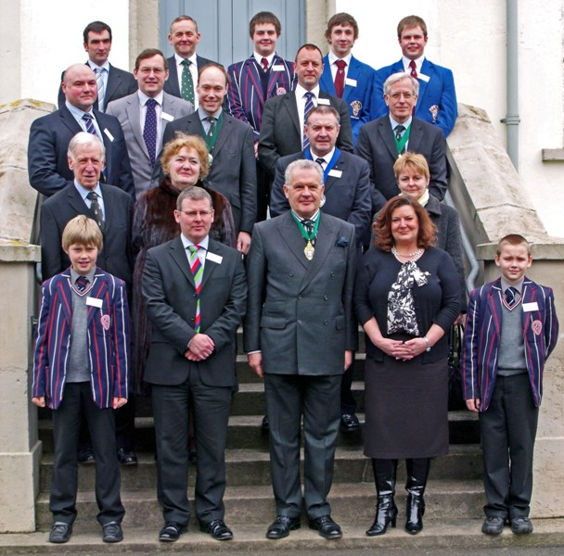
Coleraine Academical Institution

Slide 19
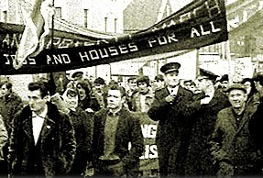
NI Civil Rights march

Slide 20
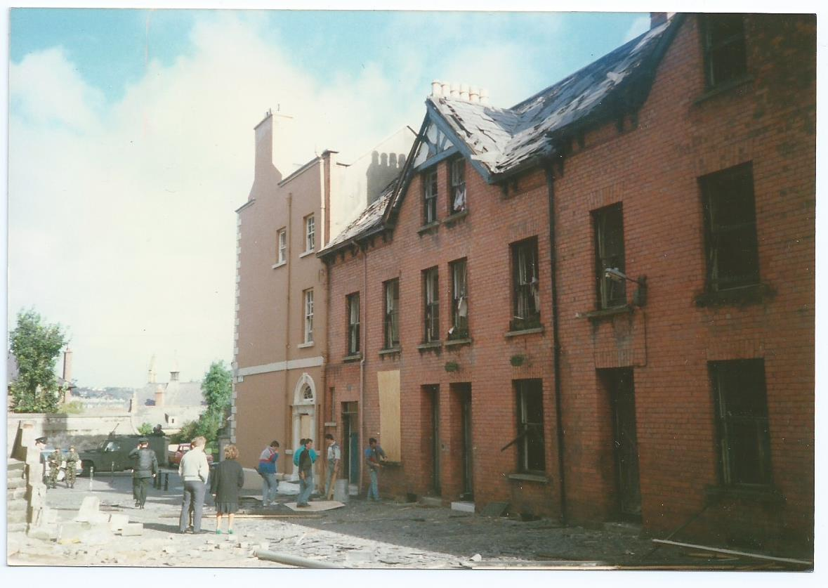
Office bomb damage, March 1988

Slide 21
Cutts House, Coleraine

Slide 22
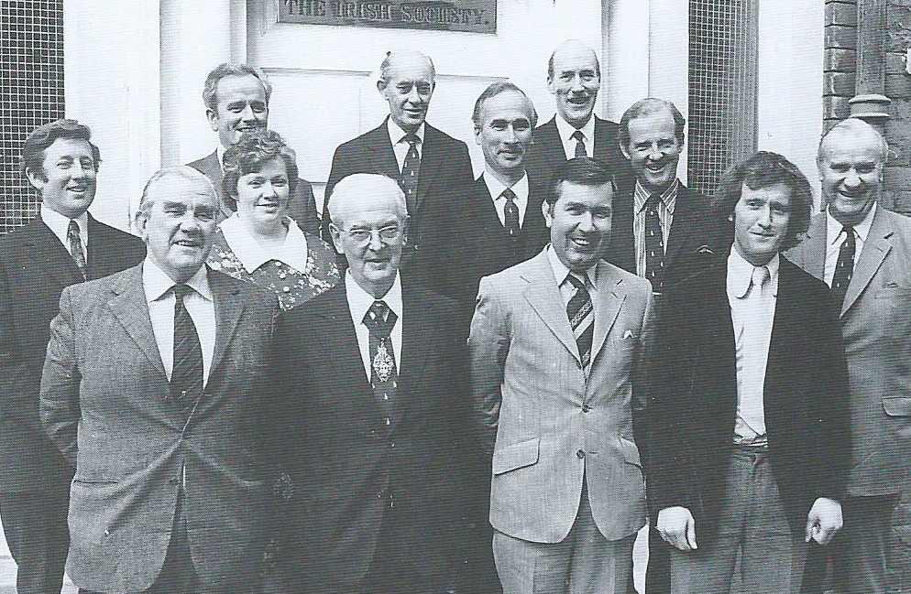
Local Advisory Committee 1974

Slide 23
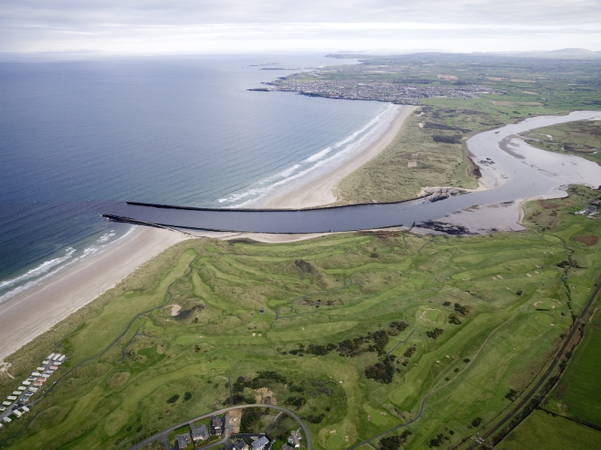
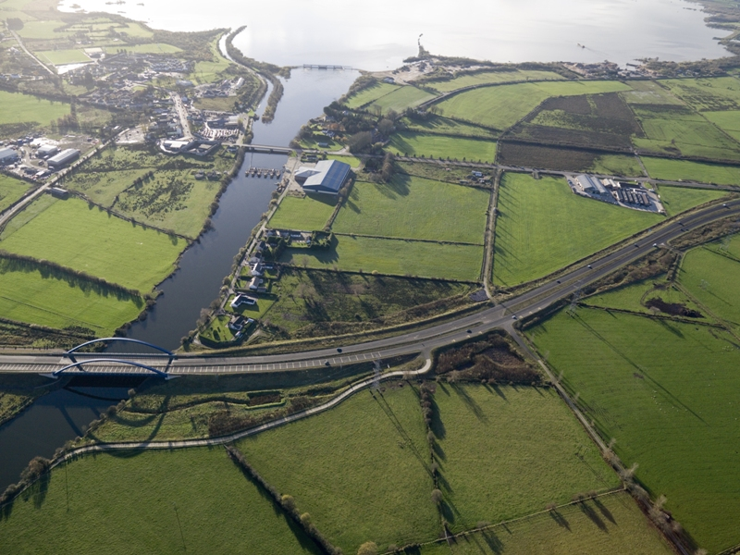
Lower Bann river
Barmouth & Toome Bridge

Slide 24
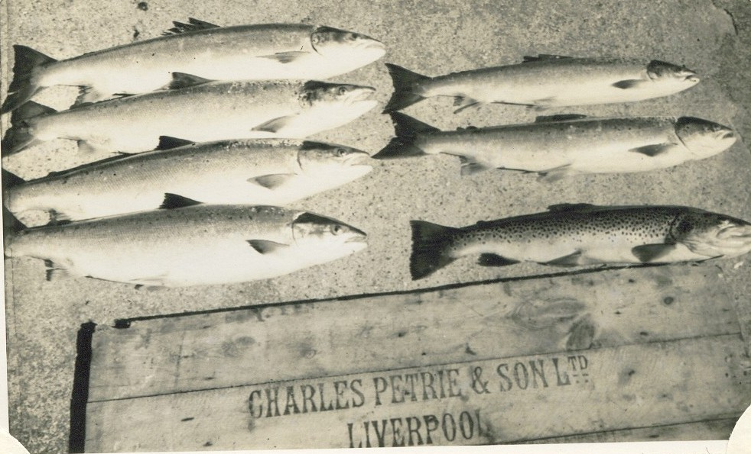
Commercial salmon catch

Slide 25
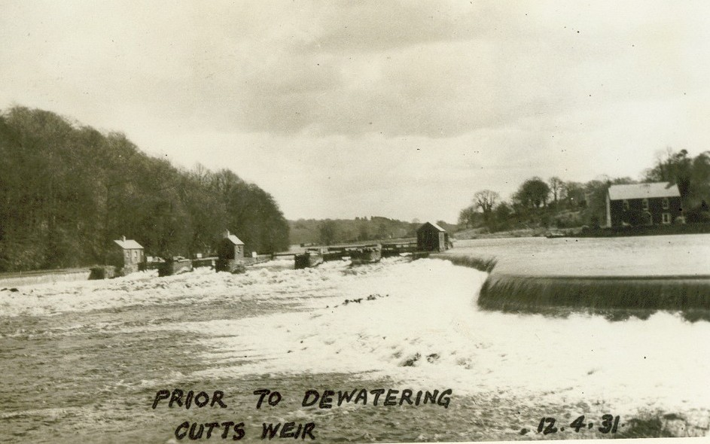
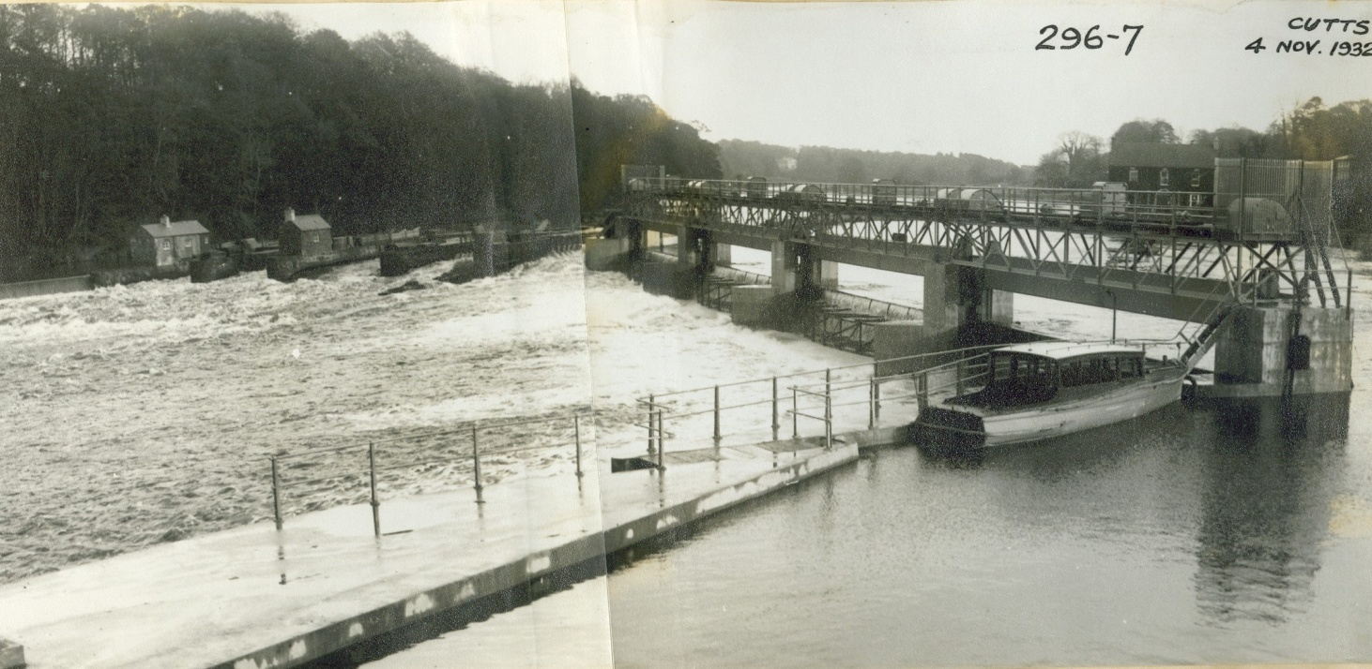
The Cutts,
1931 & 1932

Slide 26
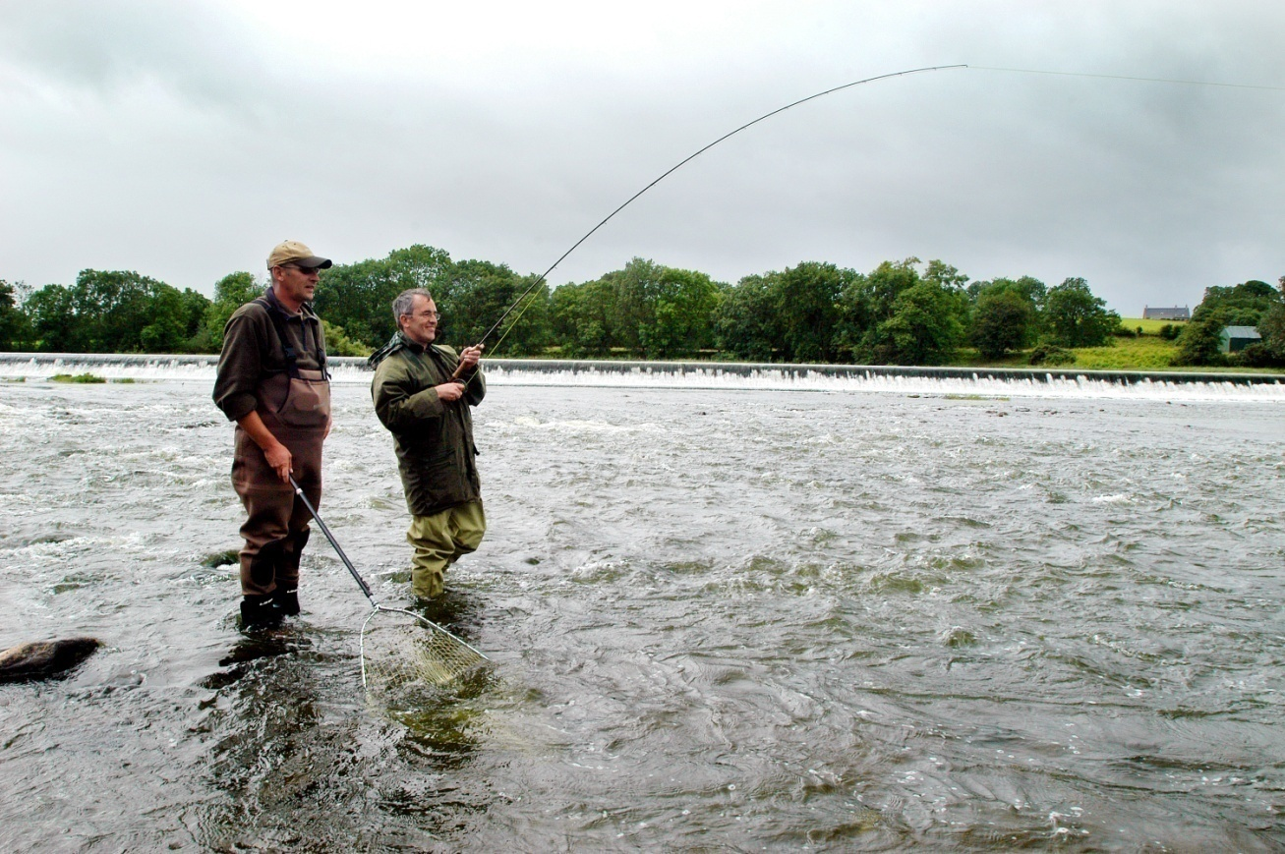
Carnroe

Slide 27
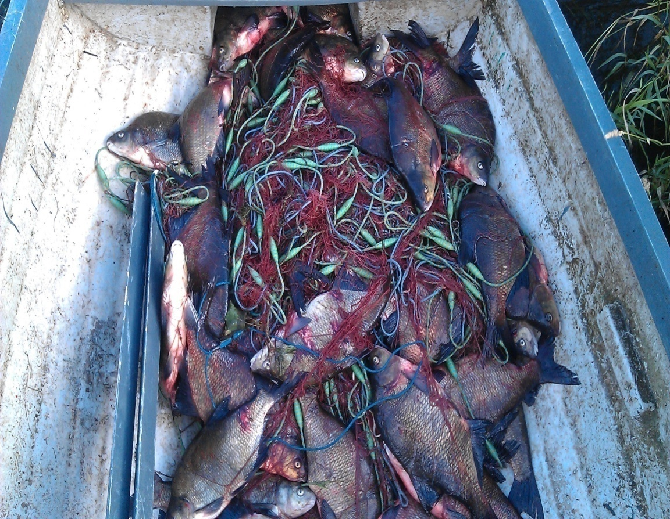
Bailiffing

Slide 28
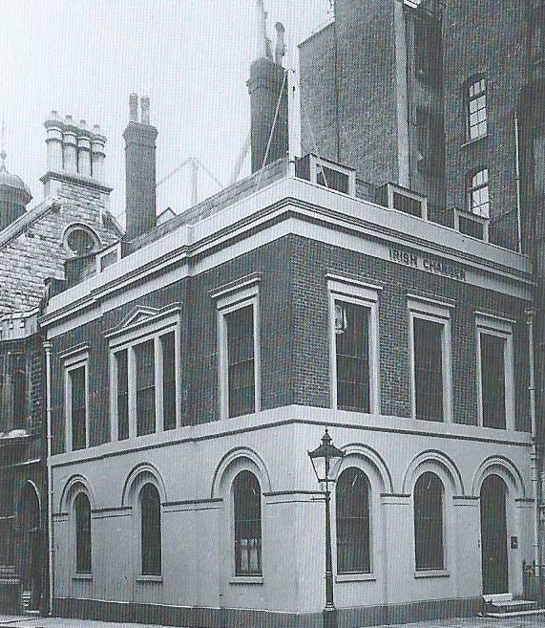
Sale of the Irish Chamber

Slide 29
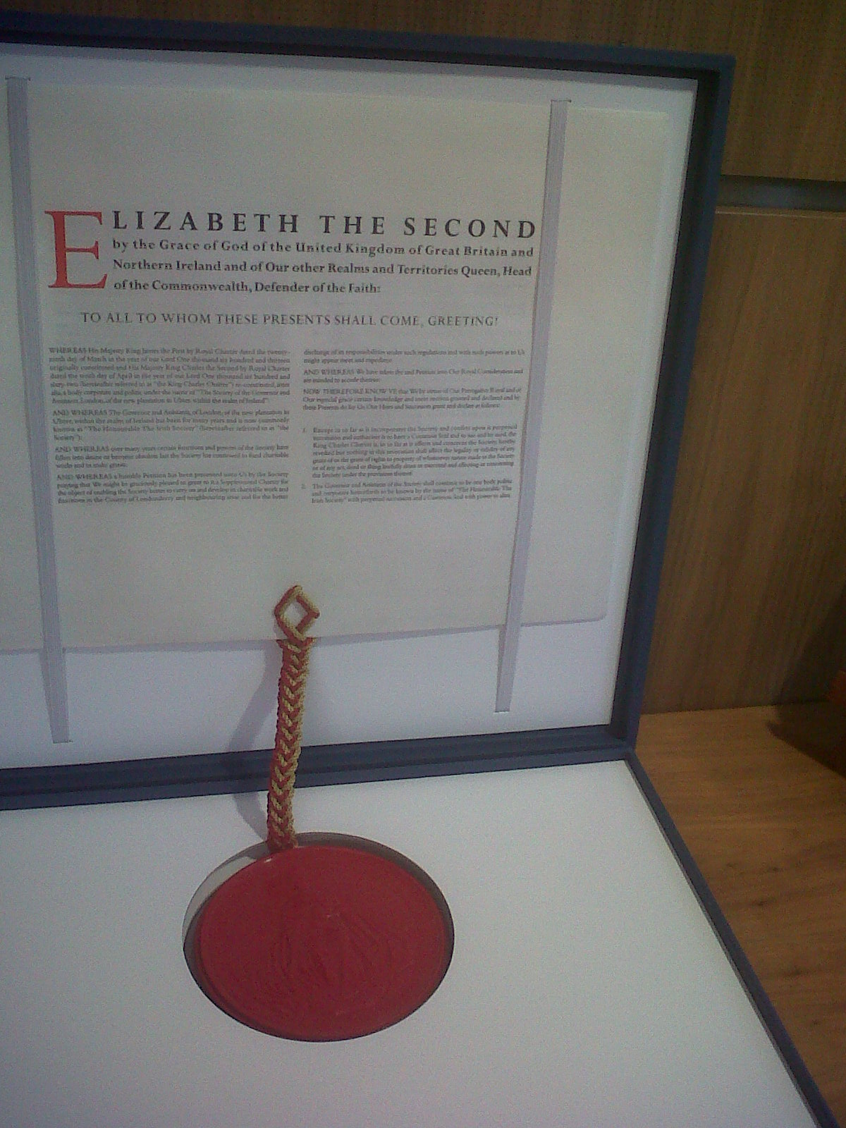
Supplemental Royal Charter

Slide 30
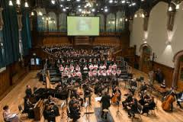
‘At Sixes & Sevens’

Slide 31
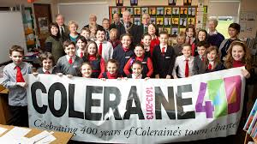
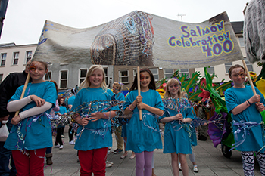
Coleraine ‘400’

Slide 32
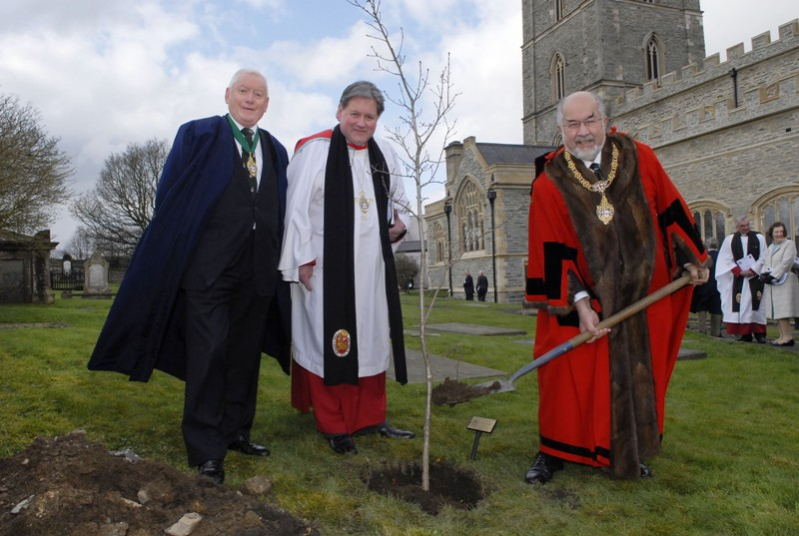
Oak tree planting

Slide 33
The Great Parchment Book of 1639

Slide 34
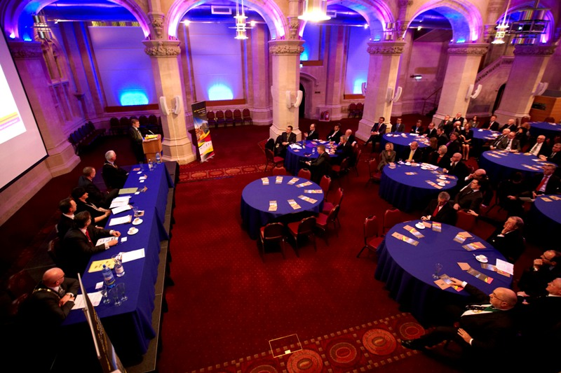
London Investment Seminar, Feb 2013

Slide 35
Livery Companies

Slide 36
Some Current Properties

Slide 37
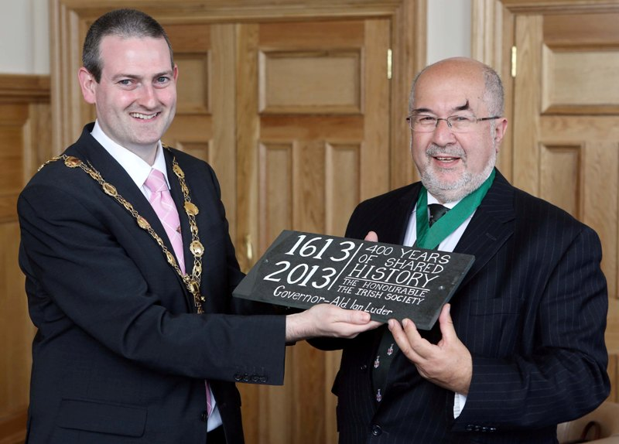
The Special Relationship

