Slide 1
Probability and its limits
Raymond Flood
Gresham Professor of Geometry

Slide 2
Overview
Sample spaces and probability
Pascal and Fermat
Taking it to the limit
Random walks and bad luck
Einstein and Brownian motion

Slide 3
Experiments and Sample Spaces
Experiment: Toss a coin
Sample space = {Heads, Tails}
Experiment: Keep tossing a coin until you obtain Heads. Note the number of tosses required.
Sample space = {1, 2, 3, 4, 5 …}
Experiment: Measure the time between two successive earthquakes.
Sample space = set of positive real numbers

Slide 4
Equally Likely
In many common examples each outcome in the sample space is assigned the same probability.
Example: Toss a coin twice
Sample space = {HH, HT, TH, TT}
Assign the same probability to each of these four outcomes so each has probability ¼.

Slide 5
Equally Likely
In many common examples each outcome in the sample space is assigned the same probability.
Example: Toss a coin twice
Sample space = {HH, HT, TH, TT}
Assign the same probability to each of these four outcomes so each has probability ¼.
An event is the name for a collection of outcomes.
The probability of an event is:$\frac{the number of outcomes in the event }{the number of outcomes in the sample space}$
Event of zero heads {TT} has probability ¼
Event of exactly one heads {HT, TH} has probability $\frac{2}{4}$ = ½
Event of two heads {HH}has probability ¼

Slide 6
Dice are small polka-dotted cubes of ivory constructed like a lawyer to lie upon any side, commonly the wrong one
Sample space = {1, 2, 3, 4, 5, 6}
Possible events
(a) The outcome is the number 2
(b) The outcome is an odd number
(c) The outcome is odd but does not exceed 4
In (a) the probability is 1/6
In (b) the probability is 3/6
In (c) the probability is 2/6

Slide 7
Birthday Problem
Suppose that a room contains 4 people. What is the probability that at least two of them have the same birthday?
It is easier to count the complementary event that none of the four have the same birthday and find its probability. Then we get the probability we want by subtracting it from one.
Size of Sample space = 365 x 365 x 365 x 365
Size of event that none of the four have the same birthday
= 365 x 364 x 363 x 362
Probability that none of the 4 people have the same birthday is: $\frac{365 x 364 x 363 x 362 }{365 x 365 x 365 x 365 }$ = 0.984
probability that at least two of them have the same birthday is
1 – 0.984 = 0.016

Slide 8
Birthday Problem
Suppose that a room contains 4 people. What is the probability that at least two of them have the same birthday?
n | Probability that at least two of them have a common birthday
4 | 0.016
16 | 0.284
23 | 0.507
32 | 0.753
40 | 0.891
56 | 0.988
100 | 0.9999997

Slide 9
Founders of Modern Probability
Pierre de Fermat (1601–1665)
Blaise Pascal (1623–1662)

Slide 10
A gambling problem: the interrupted game
What is the fair division of stakes in a game which is interrupted before its conclusion?
Example: suppose that two players agree to play a certain game repeatedly to win £64; the winner is the one who first wins four times.
If the game is interrupted when one player has won two games and the other player has won one game, how should the £64 be divided fairly between the players?

Slide 11
Interrupted game: Fermat’s approach
Original intention: Winner is first to win 4 tosses
Interrupted when You have won 2 and I have won 1.
Imagine playing another 4 games
Outcomes are all equally likely and are (Y = you, M = me):
YYYY YYYM YYMY YYMM
YMYY YMYM YMMY YMMM
MYYY MYYM MYMY MYMM
MMYY MMYM MMMY MMMM
Probability you would have won is 11/16
Probability I would have won is 5/16

Slide 12
Interrupted game: Pascal’s triangle

Slide 13
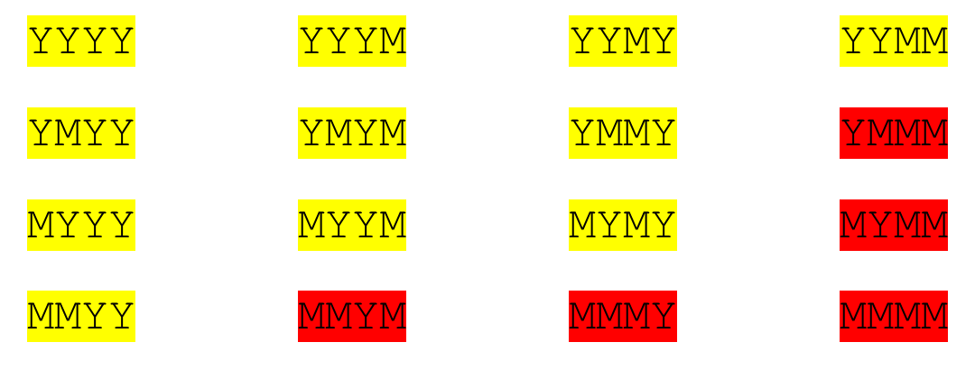
Interrupted game: Pascal’s triangle

Slide 14
Interrupted game: Pascal’s triangle

Slide 15
Toss coin 10 times

Slide 16
Law of large numbers
Picture source: http://www.dartmouth.edu/~chance/teaching_aids/books_articles/probability_book/Chapter8.pdf

Slide 17
Symmetric random walk
At each step you move one unit up with probability ½ or move one unit down with probability ½.
An example is given by tossing a coin where if you get heads move up and if you get tails move down and where heads and tails have equal probability
1/2
1/2

Slide 18
Coin Tossing

Slide 29
Law of long leads or arcsine law
In one case out of five the path stays for about 97.6% of the time on the same side of the axis.

Slide 30
Law of long leads or arcsine law
In one case out of five the path stays for about 97.6% of the time on the same side of the axis.
In one case out of ten the path stays for about 99.4% on the same side of the axis.
Quote from William Feller Introduction to Probability Vol 1.

Slide 31
Law of long leads or arcsine law
In one case out of five the path stays for about 97.6% of the time on the same side of the axis.
In one case out of ten the path stays for about 99.4% on the same side of the axis.
A coin is tossed once per second for a year.
In one in twenty cases the more fortunate player is in the lead for 364 days 10 hours.
In one in a hundred cases the more fortunate player is in the lead for all but 30 minutes.

Slide 32
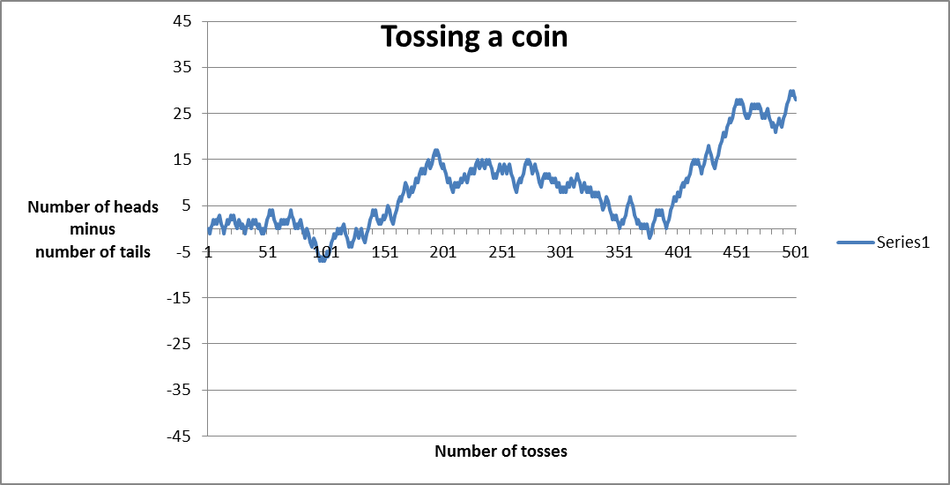
Number of ties or crossings of the horizontal axis
We might expect a game over four days to produce, on average, four times as many ties as a one day game
However the number of ties only doubles, that is, on average, increases as the square root of the time.

Slide 33
Antony Gormley's Quantum Cloud It is constructed from a collection of tetrahedral units made from 1.5m long sections of steel. The steel section were arranged using a computer model using a random walk algorithm starting from points on the surface of an enlarged figure based on Gormley's body that forms a residual outline at the centre of the sculpture

Slide 34
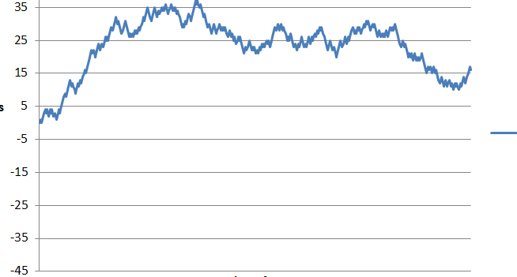
Ballot Theorem
Suppose that in a ballot candidate Peter obtains p votes and candidate Quentin obtains q votes and Peter wins so p is greater than q.
Then the probability that throughout the counting there are always more votes for Peter than Quentin is $\frac{p−q}{p+q}$ which is the $\frac{surplus}{total}$
Example: p = 750 and q = 250
Probability Peter always in the lead is $\frac{750−250}{750+250}$ = ½

Slide 35
Albert Einstein (1875–1955)
1905, Annus Mirabilis
Quanta of energy
Brownian motion
Special theory of Relativity
E = mc², asserting the equivalence of mass and energy

Slide 36
Brownian motion

Slide 37
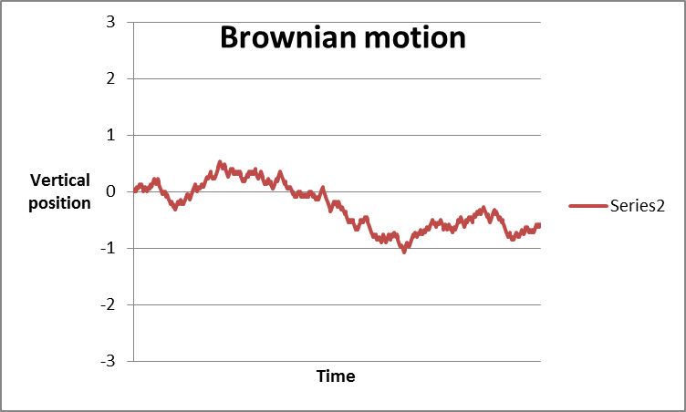
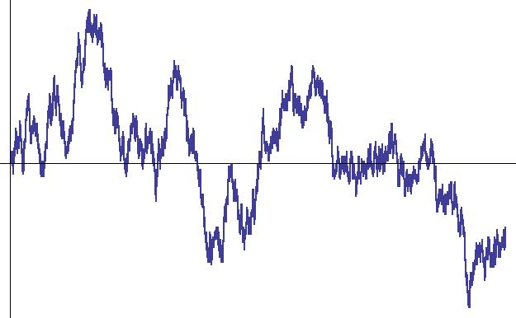
From random walks to Brownian motion
We now want to think of Brownian motion as a random walk with infinitely many infinitesimally small steps.
If we are using a time interval of length t let the time between steps be $t/n$and at each of those points we let the jump have size $1/{\sqrt{n}}$.
1/2
1/2

Slide 38
1 pm on Tuesdays at the Museum of London
Butterflies, Chaos and Fractals
Tuesday 17 September 2013
Public Key Cryptography: Secrecy in Public
Tuesday 22 October 2013
Symmetries and Groups
Tuesday 19 November 2013
Surfaces and Topology
Tuesday 21 January 2014
Probability and its Limits
Tuesday 18 February 2014
Modelling the Spread of Infectious Diseases
Tuesday 18 March 2014

