Slide 1

Professionally 'Green': Environmental Challenges and UK Professional Bodies
Carolyn Roberts
Frank Jackson Foundation Professor of Environment
The Knowledge Transfer Network
Visiting Researcher, University of Oxford

Slide 2
Membership of UK Political Parties
House of Commons Library Note, January 2015

Slide 3
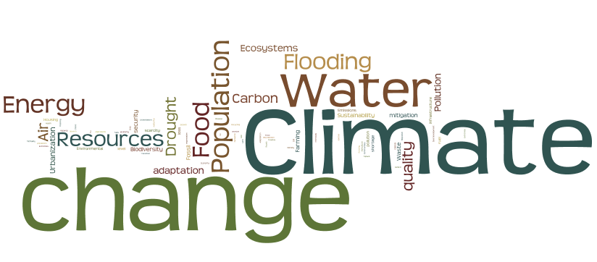

Slide 4

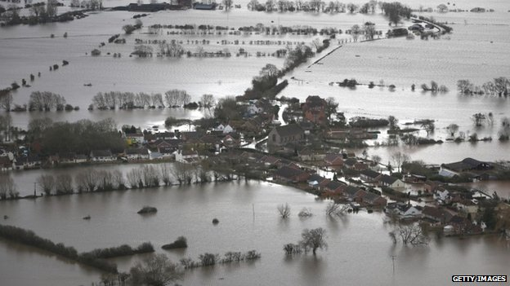
The Flooding of the Somerset Levels, 2013-14

Slide 5
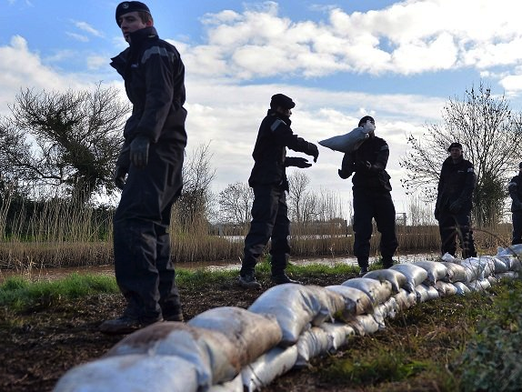

Slide 6
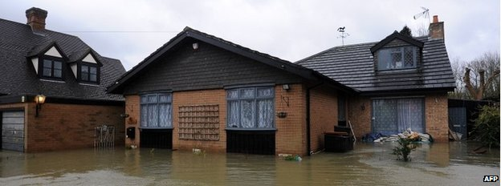
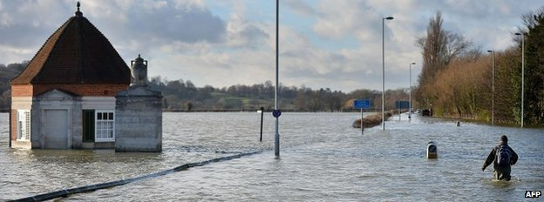

Slide 7
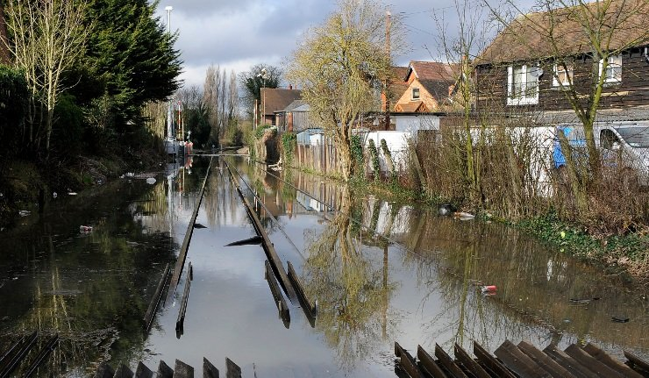

Slide 8
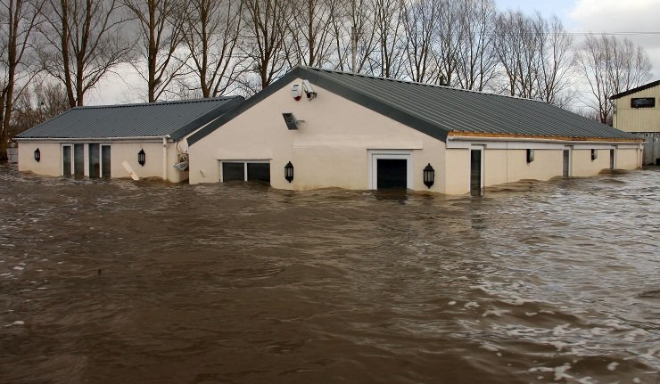

Slide 9
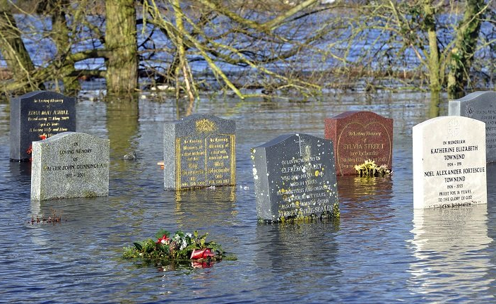
Graveyard headstones half-submerged in flood water in a church in the village of Moorland, Somerset Levels (Photo: EPA)

Slide 10
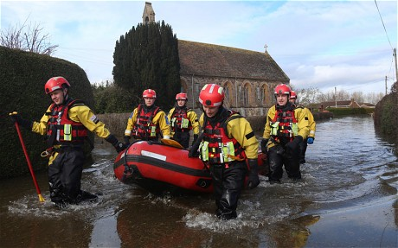

Slide 11
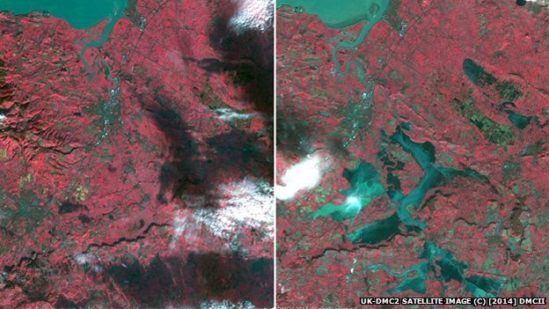
Satellite image – before the event
Satellite image – after the event

Slide 12
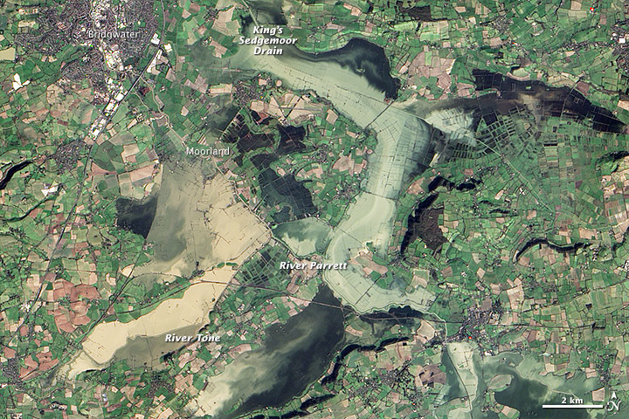

Slide 13
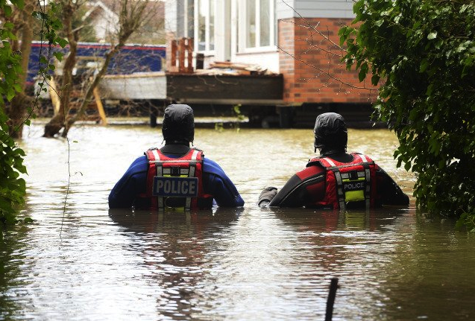

Slide 14
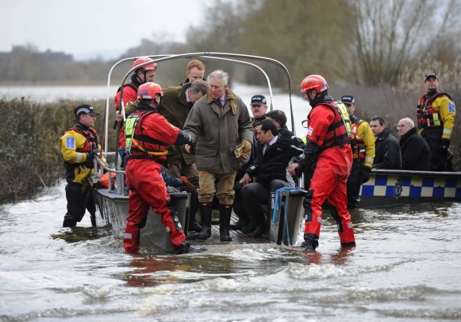

Slide 15
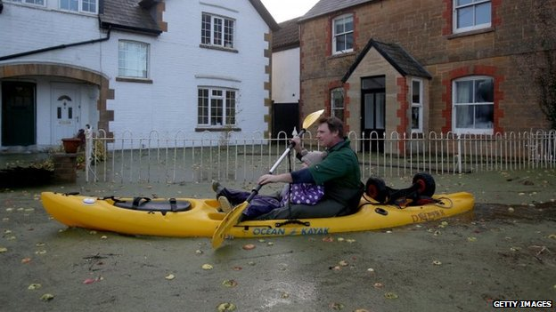
Muchelney was the first village to be completely cut-off by flood water

Slide 16
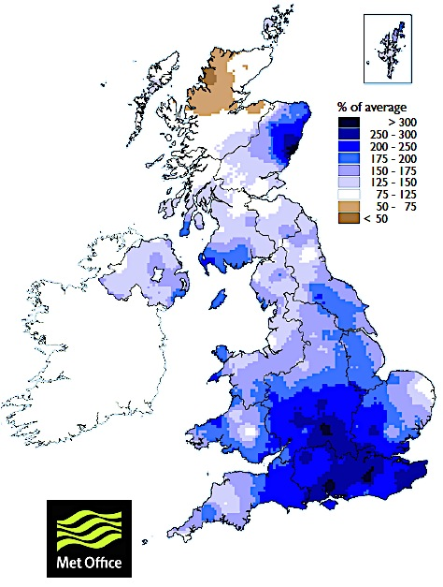
January 2014 rainfall

Slide 17
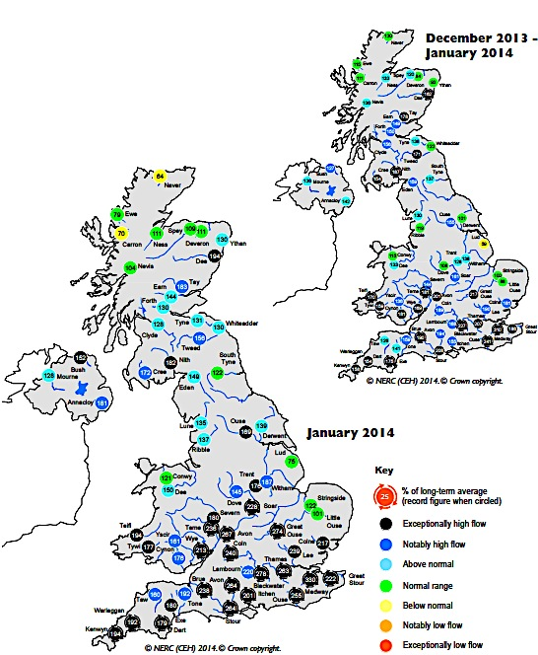
Winter 2013-14 river flow

Slide 18
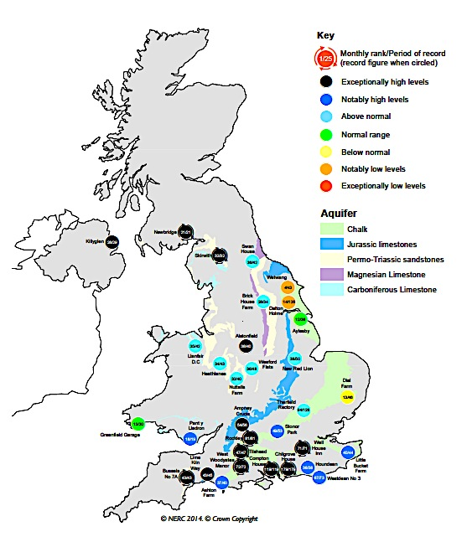
Ground-
water, January 2014

Slide 19
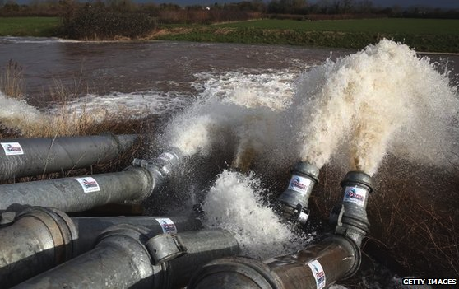

Slide 20
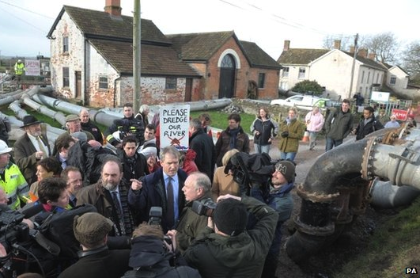
Environment Secretary Owen Paterson was confronted by angry residents during his visit

Slide 21
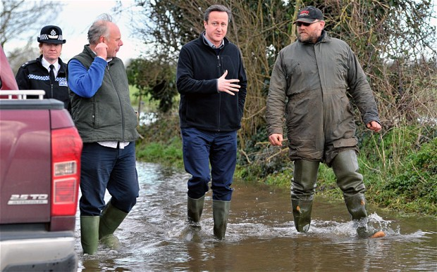

Slide 22
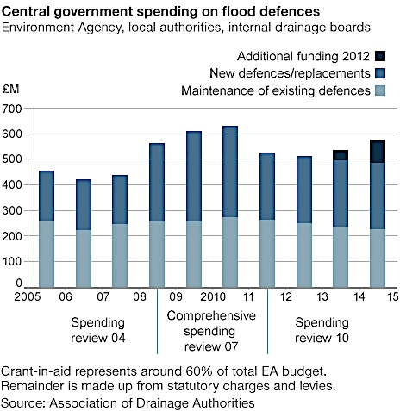

Slide 23
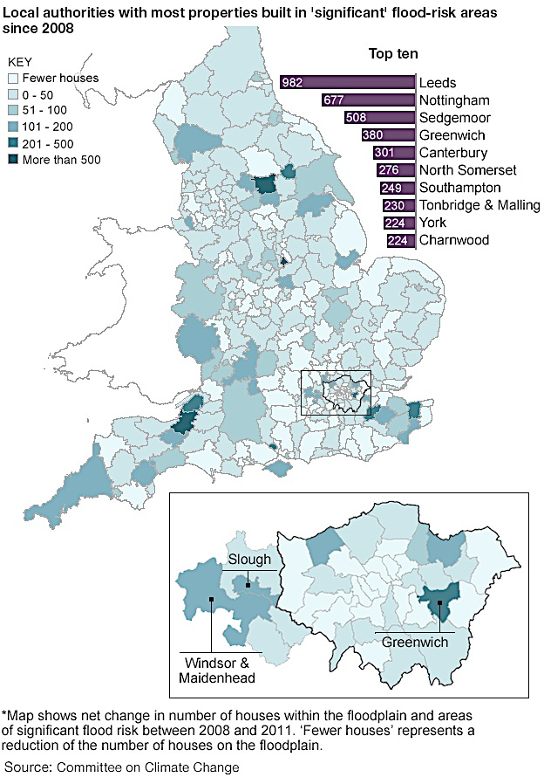

Slide 24
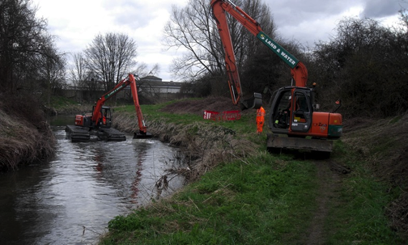
Possible Solutions - Dredging
Advantages
Disadvantages
Visibly increases the cross-sectional area of river flow
Traditional approach of the last hundred years
Immediate impact
Relatively cheap
Very limited impact on volumes of water transmitted to sea, as channel gradient is unaffected
Channel soon reverts through sedimentation, requiring repeat dredging
Does nothing about sea level rise
Ecologically damaging to riverine flora and fauna

Slide 25
Possible Solutions – Tidal sluice gates
Advantages
Disadvantages
Blocks off rivers to high tides, through a barrier at Bridgewater Lagoon and others
Allows longer pumping periods at certain times in the tidal cycle
Would mitigate against storm surges, and sea level rise
Visibly reassuring
Opportunity to generate hydro power
Changes in lagoon ecology from salt to brackish
May take some time to design and construct
Expensive
May encourage further development in flood prone areas

Slide 26
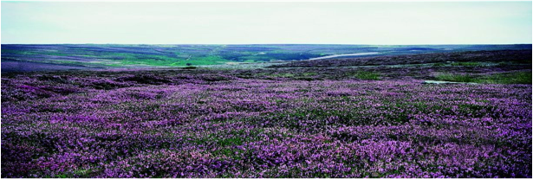
Possible Solutions – Vegetation alteration in the upland catchment
Advantages
Disadvantages
Reduction of runoff from restored moorland reduces flooding downstream
Restoration of more ‘natural’ vegetation brings ecological benefit to catchment
Reduced soil erosion
Can be multipurpose, improving public access, scenery, informal tourism
Will provide some level of flood reduction at every return period
Slow to achieve, and large areas of land required; complex negotiations
Some loss of agricultural production
Untried impact at this scale, as a means of reducing runoff from catchments
Largely invisible

Slide 27
Possible Solutions – blocking upstream drainage channels, and other SUDS
Advantages
Disadvantages
Increases infiltration and reduces runoff at least for frequent floods
Improves water availability in dry periods
Reinstates wetlands, regrows peatland and sequesters carbon
Ecological and water quality improvements
Reduced soil erosion
Relatively cheap
Uncertain impact at large scale
Requires negotiation with landowners

Slide 28
Possible Solutions – Raising embankments and increasing pumping
Advantages
Disadvantages
Immediate and visible effect up to a particular level of flooding
Ecologically weak solution
Expensive to run system
If flooding exceeds the embankment, then the ensuing flood lasts longer
Maintenance needs
Floods are routed further downstream, and intensified
Concrete and straight channels are unsightly

Slide 29
Possible Solutions – Floodproofing houses
Advantages
Disadvantages
Locally effective up to about one metre of floodwater
Can be tackled sequentially, as resources permit
Cost ccan be shared with residents
Expensive
Beyond one metre depth of water, limited advantage
Loss of use of houses for a period
Agricultural land not protected
Access issues

Slide 30
Possible Solutions – Sacrificial flood areas and managed retreat
Advantages
Disadvantages
Minimal cost; some compensation payable immediately, or in the event of flooded agricultural areas
Reduces need for ongoing maintenance of channels
Ecological benefits
Flood damage cost reduction in protected areas
Some earthworks
Loss of agricultural production and some homes
Not enough space available for a full sacrificial scheme
Contractually challenging
Local residents could challenge

Slide 31

‘Wicked’ Problems
Are poorly formulated and complex
With interconnected physical/scientific and human/sociological dimensions…
Where what happens in one place and time affects what happens somewhere else, at a different time
Involving many different stakeholders…
Who don’t agree about what is important…
And who use the terminology in different ways…
And who cannot agree if the problem has been solved
Based on Horst Rittel and Melvin Webber, 1973

Slide 32
‘Super Wicked’ Problems
……… and
Time is running out
Those who cause the problem also seek to provide a solution
The central authority needed to address the problem is weak or non-existent
Policy responses make decisions that disregard the future and reflect short time horizons
Levin et al, 2012

Slide 33

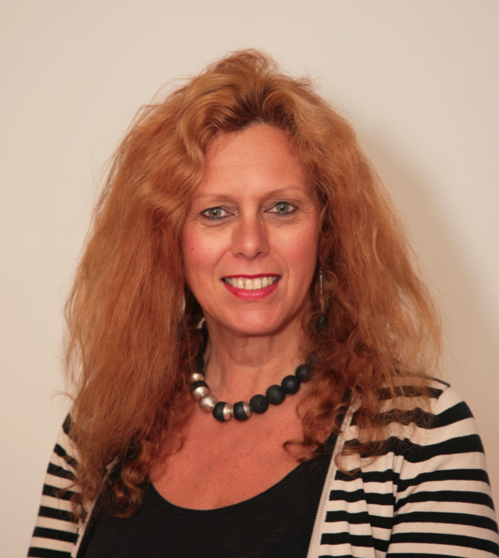
Sue Illman
Immediate Past President
Landscape Institute

Slide 34
Effective gathering and expression of stakeholders opinions embraces..
Inclusivity
Transparency
Learning
Efficiency
Efficacy
Legitimacy
Davies et al (2003)

Slide 35
Environmental Organisations
Professional Bodies
Non-governmental bodies, Voluntary bodies and charities
Trade Associations
Learned Societies
Livery Companies
Governmental Bodies and Agencies
Notes:
On some environmental listings we see Migration Watch, devoted to monitoring immigration into the UK, and

Slide 36
350.Org
Animal Defenders International
Arcus Foundation
Ashden Awards for Sustainable Energy
Association for Environment Conscious Building
Association for the Conservation of Energy
Association for the Study of Literature and Environment
Barn Owl Centre of Gloucestershire
Bat Conservation Trust
Bicycology
Bike For All
Biofuelwatch

Slide 37
Bioregional
Biosphere Expeditions
Bioversity International
Born Free Foundation
Botanic Gardens Conservation International
Botanical Society Of The British Isles
British Bryological Society
British Conifer Society
British Hydropower Association
British Marine Life Study
British Naturalists Association
British Photovoltaic Association
British Trust For Conservation Volunteers

Slide 38
British Trust For Ornithology
Bumblebee Conservation Trust
Butterflies of Ireland
Campaign Against Depleted Uranium
Campaign For Better Transport
Campaign For National Parks
Campaign For Protection Of Rural Wales
Campaign To Protect Rural England
Campaign Whale
Carbon Disclosure Project
Carbon Trust
Care For The Wild International
Centre For Alternative Technology

Slide 39
Centre for Sustainable Design
Christian Ecology Link
Climate Care
Climate Catalyst Programme, New Economics Foundation
Climate Outreach and Information Network
Climate Reality Project
Community Centered Conservation
Compassion in World Farming
Conservation International
Countryside Management Association
Deep Green Resistance
Durrell Wildlife Conservation Trust

Slide 40
Earth Champions
Earth First
Earth Liberation Front
Earth Liberation Prisoner Support Network
Earthwatch
Earthwire
Ellen MacArthur Foundation
Energy Efficiency Partnership For Homes
Energy Saving Trust
Environmental Investigation Agency
Environmental Justice Foundation
Environmental Law Foundation
Environmental Protection UK
Environmental Rock

Slide 41
Ethical Consumer
Fairtrade Foundation
Farming and Wildlife Advisory Group
Fauna and Flora International
Fish Legal
Fisheries Society of the British Isles
Forest Knights
Forest Peoples Programme
Forest Stewardship Council
Forests and the European Union Resource Network
Forum For The Future
Foundation For International Environmental Law and Environment

Slide 42
Frack Free Arun [West Sussex]
Frack Off
Frack Off Scotland
Friends of the Earth
Friends of the Earth Cymru
Froglife
Galapagos Conservation Trust
Global Action Plan
Global Witness
Great Transition Initiative
Green Alliance
Green Jobs Hub
Green Party UK

Slide 43
Greenpeace
Greenphase
Groundwork UK
Guardian Environment Network
Hawk and Owl Trust
Hawk Conservancy Trust
Hebridean Whale And Dolphin Trust
How Can I Recycle This?
International Coalition to Ban Uranium Weapons
International Network for Sustainable Energy
International Rivers
International Tree Foundation
International Union for Conservation of Nature

Slide 44
International Water Association
John Muir Trust
Keep Britain Tidy
Landlife
Landscape Information Hub
League Against Cruel Sports
Living Earth
Long Distance Walkers Association
Low Level Radiation Campaign
Marine Conservation Society
Mountain Wilderness
National Biodiversity Network
National Energy Foundation
National Federation for Biological Recording

Slide 45
National Society for Clean Air
National Trust for Places of Historic Interest or Natural Beauty
Neotropical Bird Club
Noisenet.Org
Off-Grid
Oneclimate
Open Spaces Society
Panthera Corporation
People & Planet
Pesticide Action Network UK
Plane Stupid
Plantlife International

Slide 46
Population Matters
Poverty and Conservation Learning
Project Aware
Rainforest Alliance
Rainforest Concern
Rainforest Trust
Ramblers
Recycling for Charities
Red Squirrels in South Scotland
Renewable Energy Association
Renewable UK
Residents Action on Fylde Fracking
Renewable Energy Association

Slide 47
Renewable UK
Residents Action On Fylde Fracking
Ribble Estuary Against Fracking
Royal Botanic Gardens, Kew
Royal Geographical Society
Royal Society For The Protection Of Birds
Rushlight
Sage – Oxford’s Christian Environmental Group
Save The Rhino
Scottish Countryside Rangers Association
Scottish Hydrogen & Fuel Cell Association
Scottish Renewables
Scottish Solar Energy Group

Slide 48
Scottish Wildlife Trust
Sea Watch Foundation
Self Sustaining Building
Society for the Environment
Soil Association
Spaceguard Centre & Observatory
Stop Climate Chaos Coalition
Surfers Against Sewage
Sustainable Energy Academy
Sustainable Tourism Scotland
The Brooke
The Civic Trust
The Climate Project
The Corner House

Slide 49
The Donkey Sanctuary
The Jane Goodall Institute
The John Ray Initiative
The Mammal Society
The Nature Conservancy
The Renewable Energy Centre
The Resource Foundation
The Sustainable Building Association
The Wildlife Trusts
The Woodland Trust
Tortoise Trust
Transition Network
Trees 4 Scotland
Trees For Cities

Slide 50
Ugly Animal Preservation Society
UK Environmental Law Association
UK Rivers Network
Walkers Are Welcome
Waste Watch
Water Witness
Wetlands International
Whale And Dolphin Conservation Society
Whitley Fund for Nature
Wildfowl and Wetlands Trust
Wildlife And Countryside Link
Wildlife Conservation Society
Wildscreen
Wolf Preservation Foundation

Slide 51
Woodland Trust
World Animal Net Directory
World Business Council For Sustainable Development
World Conservation Union
World Renewable Energy Congress
World Resources Institute
World Society For The Protection of Animals
Worldwatch Institute
WWF (World Wide Fund for Nature)
Yes 2 Wind
Young Peoples Trust for the Environment
Zoological Society of London

Slide 52


Diverse examples…
Tortoise Trust
Earth First!
The Tortoise Trust campaigns actively against illegal collecting and trade of tortoises, against pet store abuse, and for improved education and for more sensible and effective conservation legislation
It has two very active rehoming and adoption programmes
Earth First! Is a non-hierarchical organisation promoting direct action to confront, stop and eventually reverse the forces that are responsible for the destruction of the Earth and its inhabitants. EF! Is a convenient banner for people who share similar philosophies
Information on blockading, CCTV destruction, coax cable cutting, genetic crop decontamination, office occupations, sabotage, squatting, tunnelling…
Notes:
Single issue groups
I particularly like the Ugly Animal Preservation Society

Slide 53
Deep Green Resistance
..views mainstream environmental activism as being largely ineffective. DGR believes that industrial civilization is endangering all life on the planet, and that a broad range of tactics are needed to achieve environmental and social justice in decisive material ways. It advocates a radical shift in society's structure and function and calls for humans to actively fight for the Earth.
DGR's goals are to deprive the rich of their ability to steal from the poor and to stop those in power from destroying the planet. DGR argues that these effects are systemic to the culture of civilization and thus aims to stop industrial civilization altogether.

Slide 54
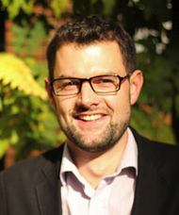
Adam Donnan
Chief Executive
Institution of Environmental Sciences

Slide 55
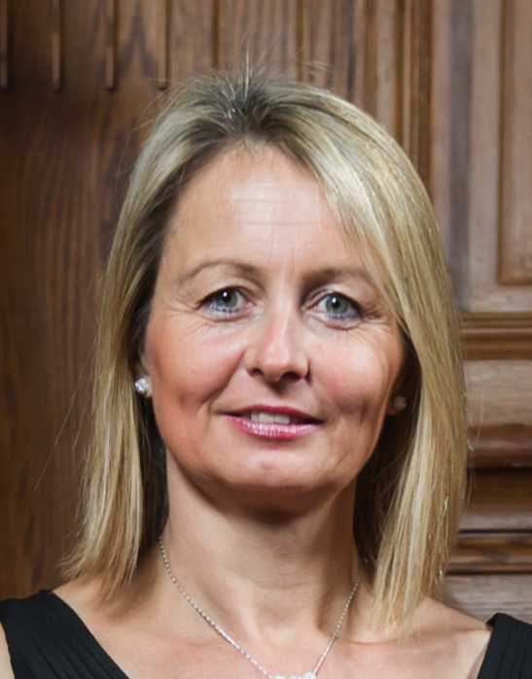
Francesca Berriman MBE
Chief Executive
Chartered Institute of Architectural Technologists

Slide 56
Professional bodies
“A body acting to safeguard the public interest”
“Organizations which represent the interest of the professional practitioners”
“A group of people in a learned occupation who are entrusted with maintaining control or oversight of the legitimate practice of the occupation”
“A group certifying the capabilites or professional standards of those involved in the profession”
“A group promoting the research that underlies the profession”

Slide 57
More professional bodies..
Arboricultural Association, Chartered Association of Building Engineers, Chartered Institute of Building, Chartered Institute of Ecology and Environmental Management, Chartered Institution of Highways and Transportation, Chartered Institution of Wastes Management, Chartered Institution of Water and Environmental Management, Institute of Agricultural Management, Institute of Chartered Foresters, Institute of Environmental Management and Assessment, Institution of Engineering and Technology, Energy Institute, Institute of Fisheries Management, Institute of Materials, Minerals and Mining, Institute of Water, Institution of Agricultural Engineering, Institution of Chemical Engineers, Institution of Civil Engineers, Institution of Engineering Designers, Institution of Mechanical Engineers, Royal Institution of Chartered Surveyors, Society of Environmental Engineers, Society of Operations Engineers, Royal Town Planning Institute, Landscape Institute, Chartered Institute of Environmental Health, Royal Institute of British Architects, Chartered Institute of Transport, Institute of Structural Engineers, Royal Agricultural Society of England, Society for Radiological Protection, British and International Golf Greenkeepers Association, Institute of Groundsmanship, Institute of Field Archaeologists, Institution of Engineering and Technology…

Slide 58
Learned Societies
Usually promote an academic discipline or disciplines, through conferences and publications
Have members who are active researchers, either elected or being qualified
Often have royal patronage
Notes:
. An example can be used to illustrate this. In a dispute between a lawyer and his/her client or between a patient and his/her physician, the Law Society of England and Wales or the General Medical Council will inevitably find itself plunged into a conflict of interest in (a) its wish to defend the interests of the client, while also (b) wishing to defend the interests, status and privileges of the professional. It is clearly a tough call for it do both.

Slide 59
Examples of Learned Societies
The Royal Society
The Royal Geographical Society
The Geological Society of London
British Archaeological Association
British Ecological Society
British Science Association
British Mycological Society
British Naturalists Society
Linnaean Society
Royal Academy of Engineering
Royal Anthropological Institute of GB and NI
Royal Entomological Society of London
Royal Meteorological Society
Royal Scottish Geographical Society
Royal Society of Chemistry
Society of Biology
Zoological Society of London
Institute of Physics

Slide 60

Livery Companies with Environmental Interests (21)
Fishmongers
Skinners
Ironmongers
Vintners
Brewers
Masons
Plumbers
Tylers and Brickmakers
Fruiterers
Paviors
Gardeners
Farmers
Scientific Instrument Makers
Engineers
Fuellers
Environmental Cleaners
Chartered Architects
Constructors
Water Conservators
World Traders
and the Watermen and Lightermen (Company without Livery)

Slide 61

The Worshipful Company of Water Conservators
promotes and spreads awareness of the science, art and practice of water and environmental management and hopes to play an informative role to the Government, the City and the public about the many and important ways that water affects our lives
The Water Conservators are passionate about sustaining and conserving the public requirements of clean water, both for domestic and industrial purposes
The Worshipful Company seeks to support and promote advancement of education within the industry
Court Lunches, Banquets and other meetings provide a professional and social atmosphere for meeting industry colleagues.

Slide 62

Trade Associations with environmental interests
The Association for Environment Conscious Building is the leading network for sustainable building professionals in the United Kingdom. Membership of the AECB includes local authorities, housing associations, builders, architects, designers, consultants, and manufacturers. The Association was founded in 1989 to increase awareness within the construction industry of the need to respect, protect, preserve and enhance the environment and to develop, share and promote best practice in environmentally sustainable building.
Notes:
Some with very grandiose aspirations
Some animal promotion organisations that bleed out into (literally sometimes) into scientific or hobby groups

Slide 63

Professional Bodies (40+)
Charterships
Research
Trade Associations
Charitable giving
NGOs and Charities
(212+)
Discussion forum
Conferences
Public Awareness
Lobbying Government
CPD and Training
Learned Societies (18+)
Livery Companies (21)
Notes:
Cacophony of overlapping fiefdoms

Slide 64

Institute of Environmental Management and Assessment
IEMA’s role is to support individuals and organisations to set, recognise and achieve global sustainability standards and practice.
Our members lead and deliver sustainability in their organisations at all levels, using IEMA standards as their foundation. Equipped with their extensive knowledge and skills, they improve environmental and sustainability performance and drive competitiveness, productivity, resilience and growth.
Through the services we provide, IEMA members continuously improve their knowledge, their influence and their network so that they can play a leading role in making their businesses more profitable, less wasteful and future-proof.

Slide 65
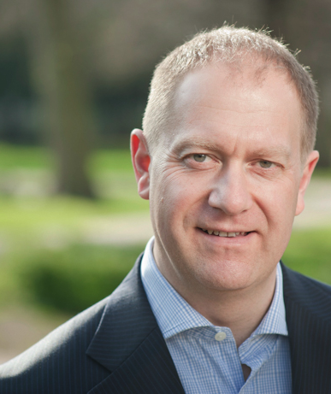
Martin Baxter
Executive Director, Policy and Engagement
Institute of Environmental Management and Assessment

Slide 66

Chartered Institution of Water and Environmental Management
Working for the public benefit for a clean, green and sustainable world, CIWEM is the only independent, chartered professional body and registered charity with an integrated approach to environmental, social and cultural issues…As the leading professional body CIWEM sustains the excellence of the people who develop and protect our environment now and for future generations.
CIWEM's aims and objectives are
To advance the science and practice of water and environmental management for the public benefit.
To promote education, training, study and research in the said science and practice for the public benefit and to publish the useful results of such research.
To establish and maintain for the public benefit appropriate standards of competence and conduct on the part of members of the Institution.

Slide 67
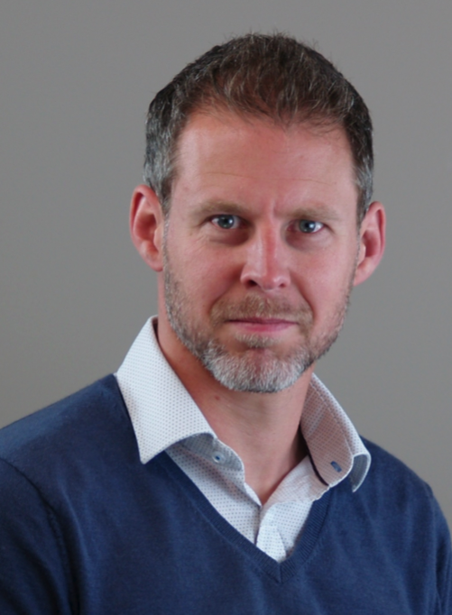
Alastair Chisholm
Head of Policy and Communications
Chartered Institution of Water and Environmental Management

Slide 68
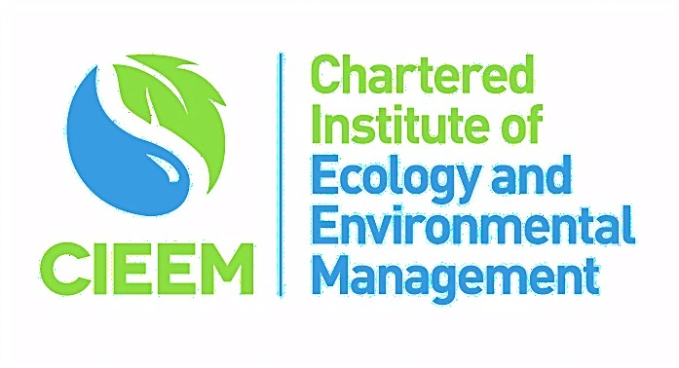
Chartered Institution of Ecology & Environmental Management
…the leading professional membership body representing and supporting ecologists and environmental managers in the UK, Ireland and abroad. Our Vision is of a society which values the natural environment and recognises the contribution of professional ecologists and environmental managers to its conservation
Established in 1991 and receiving our Royal Charter in 2013, we have members drawn from across the employment sectors including local authorities, government agencies, NGOs, environmental consultancy, academia and industry. The diversity of our membership is our greatest strength, enabling us to take an integrated and holistic approach to furthering the management and enhancement of biodiversity and the ecological processes essential to a fully functional biosphere.

Slide 69
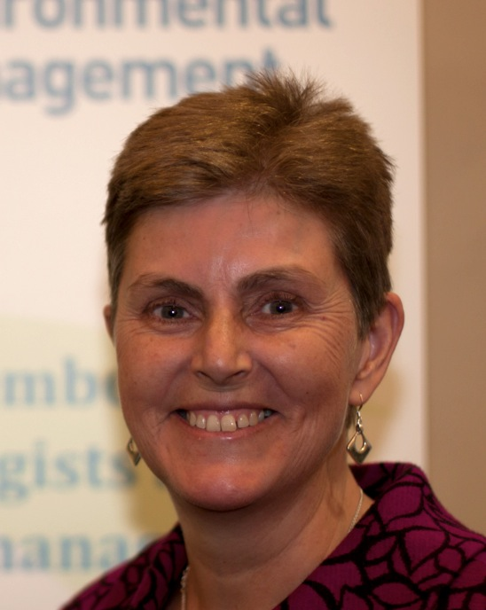
Sally Hayns
Chief Executive
Chartered Institute of Ecology and Environmental Management

Slide 70

Institution of Civil Engineers
We rely on civil engineers every day for a variety of things: from supplying energy and clean water to our homes, to processing and recycling our waste, to finding solutions to problems like pollution….In short, we help civil engineers to shape the world. We do this by: Being a qualifying body - providing an internationally recognised civil engineering qualification; being a centre of excellence for civil engineering knowledge; promoting the civil engineering profession by ensuring that everyone understands the positive impact that civil engineers have on society. In the UK, we talk to national and local government and to the media. Our experts give informed comment to journalists, politicians and the public.
Civil engineering plays a crucial role in creating the infrastructure needed for modern life around the world. Practitioners in the civil enginering sector apply knowledge and experience to create projects that meet human needs and clean up environmental problems….Our vision is for the civil engineering industry and profession to play its full role in the creation and maintenance of sustainable communities in harmony with their natural environment.

Slide 71
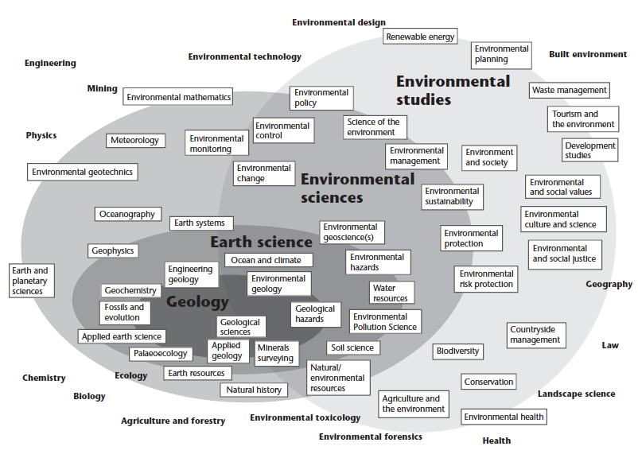
Institute of Fisheries Management
Quality Assurance Agency, 2007

Slide 72
Institution of Civil Engineers
Quality Assurance Agency, 2007

Slide 73

The Landscape Institute
The Landscape Institute is the Royal Chartered institute for landscape architects
As a professional body and educational charity, we work to protect, conserve and enhance the natural and built environment for the public benefit
We champion landscape and the landscape profession, through advocacy and support to our members, in order to inspire great places where people want to live, work and visit
We work with government to improve the planning, design and management of urban and rural landscape
We accredit university courses and promote professional development to ensure that landscape architects deliver the highest standards of practice

Slide 74
Landscape Institute
Quality Assurance Agency, 2007

Slide 75

Furthering the interests of individual professionals
Promoting and protecting the profession or the subject generally
Safeguarding society at large and the public interest

Slide 76
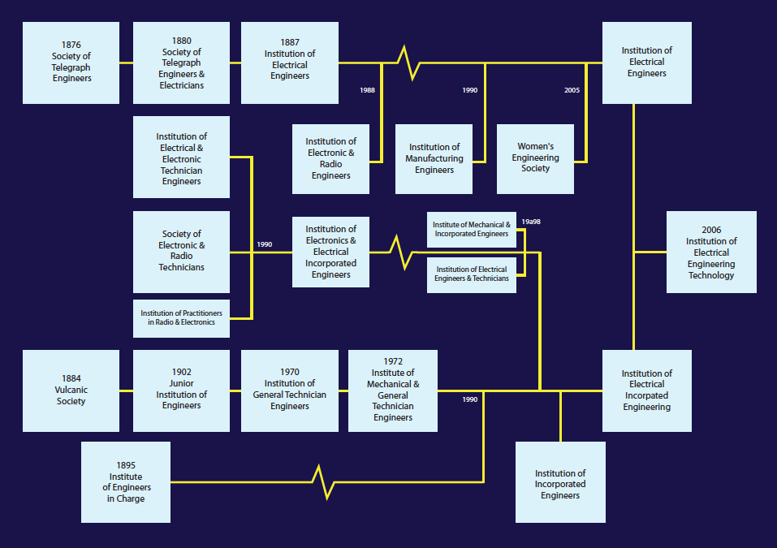
Evolution of the Institution of Engineering Technology

Slide 77
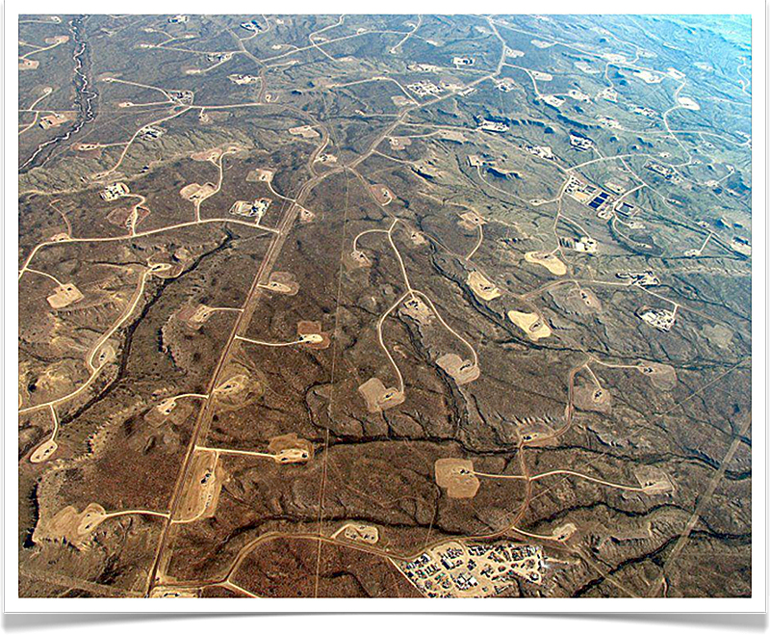
Fracking in Wyoming, USA

Slide 78
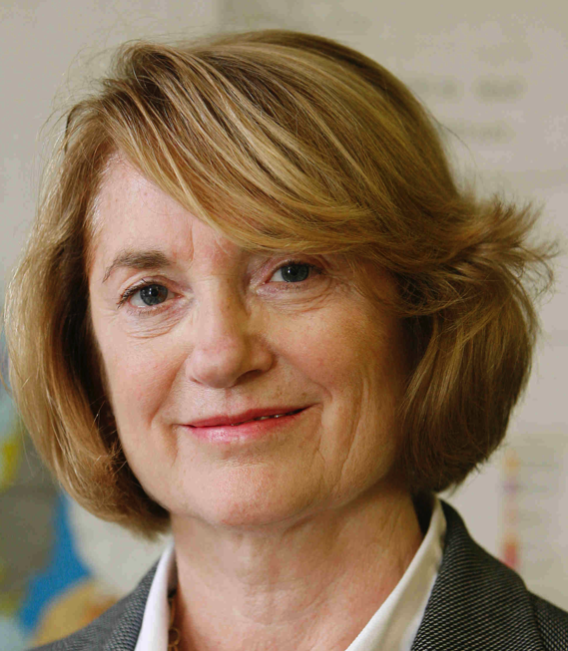
Jennifer Blumhof
Vice President, Institution of Environmental Sciences
And Chair of the Registration Authority, Society for the Environment

Slide 79
Adam Donnan
Chief Executive
Institution of Environmental Sciences

