Slide 1
Public Key Cryptography: Secrecy in Public
Raymond Flood
Gresham Professor of Geometry

Slide 2
Overview
Key terms and guidelines
Caesar ciphers
Substitution cipher
Polyalphabetic cipher
Enigma
Modern ciphers
Stream ciphers
Block ciphers
Diffie-Hellman key exchange
RSA Public key cryptography

Slide 3
Cipher System
Encryption
key
Decryption
key
Message
Encryption
algorithm
Cryptogram
Decryption
algorithm
Message
SENDER
Alice
RECEIVER
Bob

Slide 4
Symmetric versus asymmetric cryptography
A symmetric or conventional cipher system is one where it is easy to deduce the decryption key from the encryption key. For many symmetric cipher systems these two keys are the same and the systems are known as secret key or one-key systems.
An asymmetric or public key cipher system is one in which it is practically impossible to deduce the decryption key from the encryption key.

Slide 5
Security
Worst case conditions
The cryptanalyst has a complete knowledge of the cipher system
The cryptanalyst has obtained a considerable amount of the ciphertext.
The cryptanalyst knows the plaintext equivalent of a certain amount of ciphertext.
Key Distribution
Cover time
Number of keys

Slide 6
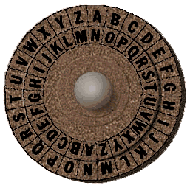
Caesar Cipher
Write the 26 letters of the alphabet in a circle – the outer ring below
Each letter in the alphabet is shifted 13 clockwise – the inner ring below
GRESHAM COLLEGE
becomes
TERFUNZ PBYYRTR

Slide 7
Caesar Cipher with encryption key 3
Encryption
Key is 3
Decryption
Key is 23
MESSAGE
Rotate
clockwise
By 3
PHVVDJH
Rotate
clockwise
by 23
MESSAGE
SENDER
RECEIVER

Slide 8
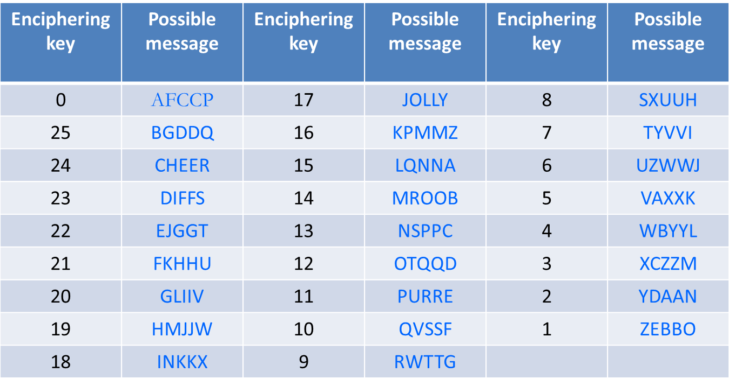
Caesar Cipher weaknesses
Vulnerable to exhaustive key search or brute force attack as only 26 keys to try.
Cryptogram: AFCCP

Slide 9
Caesar Cipher weaknesses
Vulnerable to exhaustive key search or brute force attack as only 26 keys to try.
Need only knowledge of one plaintext letter and corresponding ciphertext letter to determine the key.

Slide 10
Caesar Cipher is an Additive Cipher
Write A as 0, B as 1, C as 2, …, up to Z as 25.
Suppose the encryption key is y.
Encryption is achieved by replacing the letter with number x by the letter which is the remainder of dividing x + y by 26.
This is written (x + y) mod 26
Example: Suppose the encryption key is 18.
Then to encrypt J = 9 we obtain
(9 + 18) = 1 mod 26 So J is encrypted as B

Slide 11
Simple Substitution Ciphers
Write the alphabet in a randomly chosen order underneath the alphabet in alphabetical order.
A B C D E F G H I J K L M N O P Q R S T U V W X Y Z
P H Q G I U M E A Y L N O F D X J K R C V S T Z W B
GRESHAM is encrypted as MKIREPO
The encryption and decryption keys are equal and are the order in which the blue letters above are written.
The encryption algorithm is: replace each letter by the one below it.
The decryption algorithm is: replace each letter by the one above it.

Slide 12
Simple Substitution Cipher
Number of keys = 26 × 25 × 24 × 23 × • • • × 3 × 2 × 1
(written as 26! and called 26 factorial)
= 403,291,461,126,605,635,584,000,000
Key is long and difficult to memorise
Using key phrase to generate keys. Suppose key phrase is Gresham College free public lectures.
Remove repetitions from the key phrase and complete by adding in alphabetical order the missing letters.
greshamcolfpubitdjknqvwxyz
The number of keys deducible from key phrases is many fewer than the 26! possible simple substitution keys but still enough to preclude a brute force attack.

Slide 13
Statistics of the English Language an analysis of the letters occurring in the words listed in the main entries of the Concise Oxford Dictionary (11th edition revised, 2004)
E | 11.1607% | 56.88 | M | 3.0129% | 15.36
A | 8.4966% | 43.31 | H | 3.0034% | 15.31
R | 7.5809% | 38.64 | G | 2.4705% | 12.59
I | 7.5448% | 38.45 | B | 2.0720% | 10.56
O | 7.1635% | 36.51 | F | 1.8121% | 9.24
T | 6.9509% | 35.43 | Y | 1.7779% | 9.06
N | 6.6544% | 33.92 | W | 1.2899% | 6.57
S | 5.7351% | 29.23 | K | 1.1016% | 5.61
L | 5.4893% | 27.98 | V | 1.0074% | 5.13
C | 4.5388% | 23.13 | X | 0.2902% | 1.48
U | 3.6308% | 18.51 | Z | 0.2722% | 1.39
D | 3.3844% | 17.25 | J | 0.1965% | 1.00
P | 3.1671% | 16.14 | Q | 0.1962% | (1)
The third and sixth column represents proportions, taking the least common letter (q) as equal to 1. The letter E is over 56 times more common than Q in forming individual English words

Slide 14
Statistics of the English Language
Sorted by frequency
In alphabetical order

Slide 15
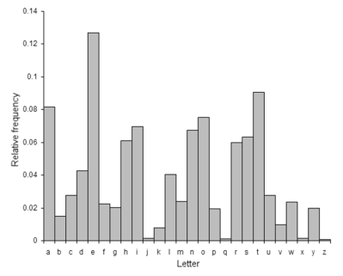
Key: ??????????????????????????
AIJ EHBNQJOHK UGKKOVH OBNHPPHENQGP HAAIJN CGK MIBH OBNI UHNCISK IA HBKQJOBM KHEQJH EIUUQBOEGNOIB, RHEGQKH IA ONK OUTIJNGBEH OB SOTPIUGNOE, EIUUHJEOGP GBS UOPONGJY GAAGOJK. QT QBNOP JHEHBNPY NCHKH UHNCISK CGVH JHPOHS IB NCH HXECGBMH IA G KHEJHN FHY IJ TJINIEIP RHNWHHB EIJJHKTIBSHBNK. BIW, CIWHVHJ, G BHW GTTJIGEC RGKHS IB UGNCHUGNOEK, EGPPHS TQRPOE FHY EJYTNIMJGTCY, OK QKHS GBS NCOK QBSHJPOHK UQEC IA UISHJB EIUUHJEH GBS CIW YIQ TGY IVHJ NCH OBNHJBHN.
a | b | c | d | e | f | g | h | i | j | k | l | m | n | o | p | q | r | s | t | u | v | w | x | y | z
2 | 7 | 4 | 0 | 6 | 1 | 7 | 13 | 8 | 7 | 5 | 0 | 1 | 7 | 6 | 4 | 3 | 1 | 3 | 3 | 4 | 1 | 1 | 0 | 1 | 0
Frequency analysis of ciphertext

Slide 16
Key: greshamcolfpubitdjknqvwxyz
FOR CENTURIES MASSIVE INTELLECTUAL EFFORT HAS GONE INTO METHODS OF ENSURING SECURE COMMUNICATION, BECAUSE OF ITS IMPORTANCE IN DIPLOMATIC, COMMERCIAL AND MILITARY AFFAIRS. UP UNTIL RECENTLY THESE METHODS HAVE RELIED ON THE EXCHANGE OF A SECRET KEY OR PROTOCOL BETWEEN CORRESPONDENTS. NOW, HOWEVER, A NEW APPROACH BASED ON MATHEMATICS, CALLED PUBLIC KEY CRYPTOGRAPHY, IS USED AND THIS UNDERLIES MUCH OF MODERN COMMERCE AND HOW YOU PAY OVER THE INTERNET.
a | b | c | d | e | f | g | h | i | j | k | l | m | n | o | p | q | r | s | t | u | v | w | x | y | z
2 | 7 | 4 | 0 | 6 | 1 | 7 | 13 | 8 | 7 | 5 | 0 | 1 | 7 | 6 | 4 | 3 | 1 | 3 | 3 | 4 | 1 | 1 | 0 | 1 | 0
Frequency analysis of ciphertext

Slide 17
Simple Substitution Cipher or Monoalphabetic Cipher
Remove English language spacing.
How long is long enough?
Vulnerable because of the structure of language and frequency analysis.
Try instead simple substitution on bigrams that is, consecutive pairs of letters.

Slide 18
Polyalphabetic Ciphers
Attempt to flatten out the frequency histogram.
The ciphertext character used to represent a plaintext letter can vary throughout the cryptogram.
The same ciphertext character can represent different plaintext letters.

Slide 19
Vigenère Cipher
Plaintext
AGEDTWENTYSIXVIGENERE
Key
CHARLESVCHARLESVCHARL
CipherText
CNEUEAWIVFSZIZABGUEIP

Slide 20
Vigenère Cipher
Plaintext
AGEDTWENTYSIXVIGENERE
Key
CHARLESVCHARLESVCHARL
CipherText
CNEUEAWIVFSZIZABGUEIP

Slide 21
Vigenère Cipher
Plaintext
AGEDTWENTYSIXVIGENERE
Key
CHARLESVCHARLESVCHARL
CipherText
CNEUEAWIVFSZIZABGUEIP

Slide 22
Vigenère Cipher
Plaintext
AGEDTWENTYSIXVIGENERE
Key
CHARLESVCHARLESVCHARL
CipherText
CNEUEAWIVFSZIZABGUEIP

Slide 23
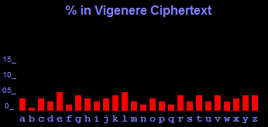
Aged twenty six, Vigenère was sent to Rome on a diplomatic mission. It was here that he became acquainted with the writings of Alberti, Trithemius and Porta, and his interest in cryptography was ignited. For many years, cryptography was nothing more than a tool that helped him in his diplomatic work, but at the age of thirty nine, Vigènere decided that he had amassed enough money to be able to abandon his career and concentrate on a life of study. It was only then that he began research into a new cipher.

Slide 24
Enigma Machine

Slide 25
Enigma Cipher System
The Enigma was polyalphabetic with period 26 × 26 × 26 = 17,576.
In each state of the Enigma the substitution alphabet would be a swapping of pairs of letters and in particular no letter could be enciphered into itself
Rotor settings 17,576 ways
Rotor order 6 ways
Plugboard connecting seven pairs of letters
1,305,093,289,500 ways
Total number of keys for the Enigma is
17,576 × 6 × 1,305,093,289,500

Slide 26
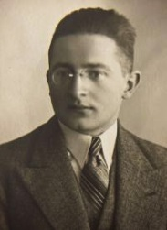
Poles break the Enigma System
Code books were distributed to give the day-key
Day-key used to transmit new key chosen by the sender e.g. particular day-key is RGF. Sender uses it to transmit chosen new key KJE and does so twice.
Then perhaps KJEKJE is transmitted using RGF and gives, say, ACKJDG
Further transmissions are made using KJE
Marian Rejewski
1905 - 1980
Picture probably 1932, the year he first solved the Enigma machine.

Slide 27
Fingerprints!
 | 1st | 2nd | 3rd | 4th | 5th | 6th
1st message | M | P | L | S | H | M
2nd message | N | W | U | Y | A | F
3rd message | K | L | U | N | Q | F
4th message | E | W | Z | Q | A | Y

Slide 28
Fingerprints!
 | 1st | 2nd | 3rd | 4th | 5th | 6th
1st message | M | P | L | S | H | M
2nd message | N | W | U | Y | A | F
3rd message | K | L | U | N | Q | F
4th message | E | W | Z | Q | A | Y
1st letter | A | B | C | D | E | F | G | H | I | J | K | L | M | N | O | P | Q | R | S | T | U | V | W | X | Y | Z
4th letter |  |  |  |  | Q |  |  |  |  |  | N |  | S | Y
1st letter | A | B | C | D | E | F | G | H | I | J | K | L | M | N | O | P | Q | R | S | T | U | V | W | X | Y | Z
4th letter | L | G | R | I | Q | M | X | P | H | C | N | W | S | Y | V | Z | D | A | J | U | O | K | F | B | T | E

Slide 29
Fingerprints!
 | 1st | 2nd | 3rd | 4th | 5th | 6th
1st message | M | P | L | S | H | M
2nd message | N | W | U | Y | A | F
3rd message | K | L | U | N | Q | F
4th message | E | W | Z | Q | A | Y
1st letter | A | B | C | D | E | F | G | H | I | J | K | L | M | N | O | P | Q | R | S | T | U | V | W | X | Y | Z
4th letter |  |  |  |  | Q |  |  |  |  |  | N |  | S | Y
1st letter | A | B | C | D | E | F | G | H | I | J | K | L | M | N | O | P | Q | R | S | T | U | V | W | X | Y | Z
4th letter | L | G | R | I | Q | M | X | P | H | C | N | W | S | Y | V | Z | D | A | J | U | O | K | F | B | T | E
A → L → W → F → M → S → J → C → R → A | 9 links
B → G → X → B | 3 links
D → I → H → P → Z → E → Q → D | 7 links
K → N → Y → T → U → O → V → K | 7 links

Slide 30
Modern Algorithms Combining bit-strings
Various ways of writing a message as a string of bits e.g. ASCII – American Standard Code for Information Interchange
Exclusive OR, often written XOR or ⊕ is a way of combining two bits as follows:
0 ⊕ 0 = 0, 0 ⊕ 1 = 1, 1 ⊕ 0 = 1, and 1 ⊕ 1 = 0
It is identical to addition modulo 2
We can combine two bit-streams of the same length by XORing the pair of bits in identical positions
1 0 0 1 1
1 1 0 0 1
1 ⊕ 1 0 ⊕ 1 0 ⊕ 0 1 ⊕ 0 1 ⊕ 1
0 1 0 1 0

Slide 31
Modern Algorithms Stream Ciphers
Uses a short key with a keystream generator.
To encrypt: the plaintext is combined with the keystream using XOR.
To decrypt: the ciphertext is combined with the keystream using XOR.
Easily implemented and fast in operation.
A stream cipher is good for a noisy channel because of lack of error propagation.
Vulnerable to a known plaintext attack.

Slide 32
Modern Algorithms Block Ciphers
The bit-string is divided into blocks of a given length.
If the blocks are encrypted individually and independently we call this ECB (Electronic Code Book) mode.
To avoid statistical attack arrange for the encryption of each blockto depend on all the message blocks that go before it using Cipher Feedback (CFB) mode or Cipher Block Chaining (CBC) mode.

Slide 33
Cipher Block Chaining
The major advantage of CBC mode over ECB mode lies in its ability to hide statistical properties of the plaintext blocks.

Slide 34
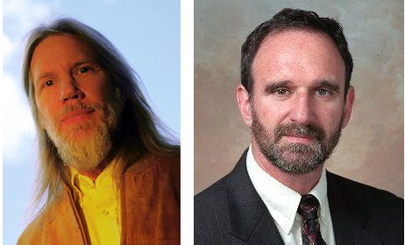
Whitfield Diffie and Martin E. Hellman
Abstract: Two kinds of contemporary developments in cryptography are examined. Widening applications of teleprocessing have given rise to a need for new types of cryptographic systems, which
minimize the need for secure key distribution channels and supply the equivalent of a written signature. This paper suggests ways to solve these currently open problems.

Slide 35
Discrete logarithms.
Pick a prime, say 17.
If y = 10^{x} mod 17 then x is the discrete logarithm of y
5 = 10⁷ mod 17 and 14 = 10³ mod 17
Here 7 is the discrete logarithm of 5.
Here 3 is the discrete logarithm of 14.
Knowing x it is easy to calculate y.
But hard to find x if we know y, for example,
8 = 10^{X} mod 17

Slide 36
Diffie-Hellman key exchange
Find a one-way function – popular choice is of discrete logarithms, say, y = 10^{x} mod 17
Knowing x it is easy to calculate y, for example,
5 = 10⁷ mod 17 and 14 = 10³ mod 17
But knowing y it is hard to find x, for example,
8 = 10^{X} mod 17

Slide 37
Diffie-Hellman key exchange
Find a one-way function – popular choice is of discrete logarithms, say, Y = 10^{x} mod 17
Knowing X easy to calculate Y, for example,
5 = 10⁷ mod 17 and 14 = 10³ mod 17
But knowing y it is hard to find x, for example,
8 = 10^{X} mod 17
Alice’s private key is 7 and public key is 5 - she sends 5 to Bob
Bob’s private key is 3 and public key is 14 – he sends 14 to Alice

Slide 38
Diffie-Hellman key exchange
Find a one-way function – popular choice is of discrete logarithms, say, Y = 10^{x} mod 17
Knowing X easy to calculate Y, for example,
5 = 10⁷ mod 17 and 14 = 10³ mod 17
But hard to find X if we know Y, for example,
8 = 10^{X} mod 17
Alice’s private key is 7 and public key is 5 - she sends 5 to Bob
Bob’s private key is 3 and public key is 14 – he sends 14 to Alice
Message key for Alice is 14⁷ mod 17
Message key for Bob is 5³ mod 17

Slide 39
Diffie-Hellman key exchange
Find a one-way function – popular choice is of discrete logarithms, say, Y = 10^{x} mod 17
Knowing X easy to calculate Y, for example,
5 = 10⁷ mod 17 and 14 = 10³ mod 17
But hard to find X if we know Y, for example,
8 = 10^{X} mod 17
Alice’s private key is 7 and public key is 5 - she sends 5 to Bob
Bob’s private key is 3 and public key is 14 – he sends 14 to Alice
Message key for Alice is 14⁷ mod 17
Message key for Bob is 5³ mod 17
They are the same! Each is
10^{3 x 7} mod 17 = 10^{7 x 3} mod 17
Both equal to 6 which is their common secret key.

Slide 40
Public key generation
Source: http://gdp.globus.org/gt4-tutorial/multiplehtml/index.html

Slide 41
Public key asymmetric systems
Source: http://gdp.globus.org/gt4-tutorial/multiplehtml/index.html

Slide 42
RSA Algorithm
Ronald Rivest, Adi Shamir and Leonard Adleman

Slide 43
RSA Algorithm
Setup Bob chooses two secret prime numbers. We will call them p and q. To be secure, the numbers must be at least 100 decimal digits long.
Bob calculates n = p * q.
Bob finds a number e where the greatest common divisor of e and (p - 1) * (q - 1) is 1.
Bob finds a number d where d * e = 1 mod ((p - 1) * (q - 1)).
Bob publishes n and e as the public key. He keeps d secret and destroys p and q.
Encryption: Ciphertext = Me mod n Decryption: Message = C^{d} mod n

Slide 44
Digital Signatures
Source: http://gdp.globus.org/gt4-tutorial/multiplehtml/index.html

Slide 45
Extortionists using ‘ransomware’ are hijacking files that you can only get back by stumping up. Donna Ferguson looks at what happens when CryptoLocker strikes

Slide 46
References
David Kahn, The Codebreakers (Scribner, 1995)
Simon Singh, The Code Book (Fourth Estate, 1999)
Fred Piper and Sean Murphy, Cryptography, A Very Short Introduction (OUP, 2002).
Whitfield Diffie and Martin Hellman, New Directions in Cryptography,
http://www-ee.stanford.edu/~hellman/publications/24.pdf

Slide 47
1 pm on Tuesdays at the Museum of London
Butterflies, Chaos and Fractals
Tuesday 17 September 2013
Public Key Cryptography: Secrecy in Public
Tuesday 22 October 2013
Symmetries and Groups
Tuesday 19 November 2013
Surfaces and Topology
Tuesday 21 January 2014
Probability and its Limits
Tuesday 18 February 2014
Modelling the Spread of Infectious Diseases
Tuesday 18 March 2014

