Slide 1
Symmetries and Groups
Raymond Flood
Gresham Professor of Geometry

Slide 2
Overview
Group of Symmetries of the equilateral triangle
Compare the group of symmetries of a square and a rectangle
Symmetries of the platonic solids
Subgroups and Lagrange’s Theorem.
Modular Arithmetic and Fermat’s Little Theorem.
RSA encryption
Infinite groups and some applications.

Slide 3
Equilateral triangle

Slide 4
Equilateral triangle with labels
1
2
3

Slide 5
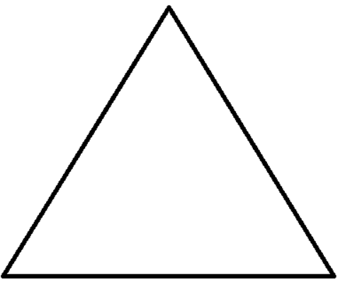
The Identity symmetry, I, of the equilateral triangle
1
I
2
3
2
3

Slide 6
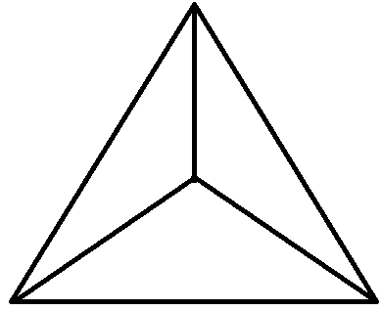
R is the transformation rotate by 120° anticlockwise
1
3
R
2
3
1
2

Slide 7
R² is the transformation rotate by 240° anticlockwise
1
3
2
R
R
2
3
1
2
3
1

Slide 8
R³ is the transformation rotate by 360° anticlockwise It is the same as the identity I
1
2
3
1
3
2
R
R
2
3
1
2
3
1

Slide 9
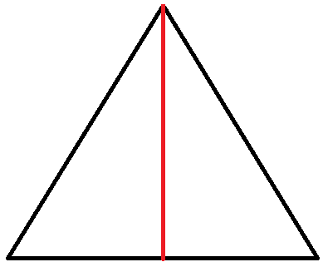
T is the transformation that turns the triangle over, keeping the top vertex fixed.
1
1
T
2
3
3
2

Slide 10
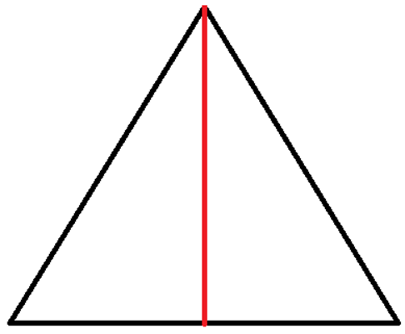
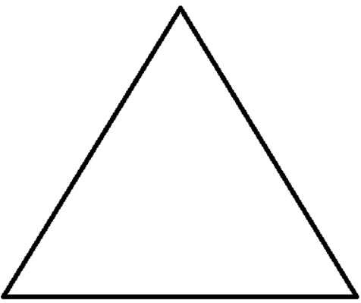
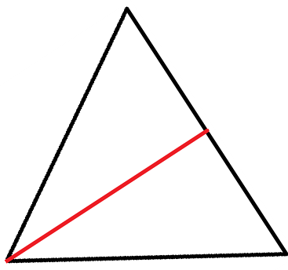
One symmetry transformation followed by another symmetry transformation is a symmetry transformation, Example of TR
1
3
3
R
T
2
3
1
2
2
1
3
So TR is the same as turning over leaving the bottom left vertex fixed
2
1

Slide 11
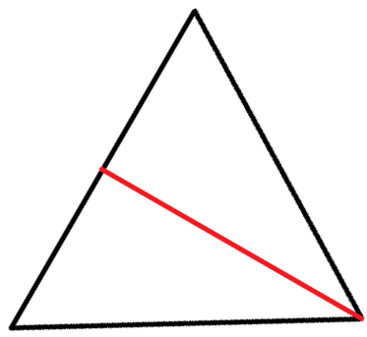
One symmetry transformation followed by another symmetry transformation is a symmetry transformation, example of RT
1
1
2
T
R
2
3
3
2
1
3
So RT is the same as turning over leaving the bottom right vertex fixed
2
1
3

Slide 12
TR is not equal to RT
3
TR is
2
1
2
RT is
3
1

Slide 13
Six symmetries of the equilateral triangle
I: Do nothing
R: rotate 120° anticlockwise about the centre of the triangle
R²: rotate 240° anticlockwise about the centre of the triangle
T: turns the triangle over, keeping the line joining the top vertex to the centre fixed
TR: turns the triangle over, keeping the line joining the bottom left vertex to the centre fixed
RT: turns the triangle over, keeping the line joining the bottom right vertex to the centre fixed.

Slide 14
Composition table for the symmetries of the equilateral triangle.
Do first | I | R | R² | T | RT | TR
I | I | R | R² | T | RT | TR
R | R | R² | I | TR | T | RT
R² | R² | I | R | RT | TR | T
T | T | RT | TR | I | R | R²
RT | RT | TR | T | R² | I | R
TR | TR | T | RT | R | R² | I
(TR)R² = TR³ = TI = T

Slide 15
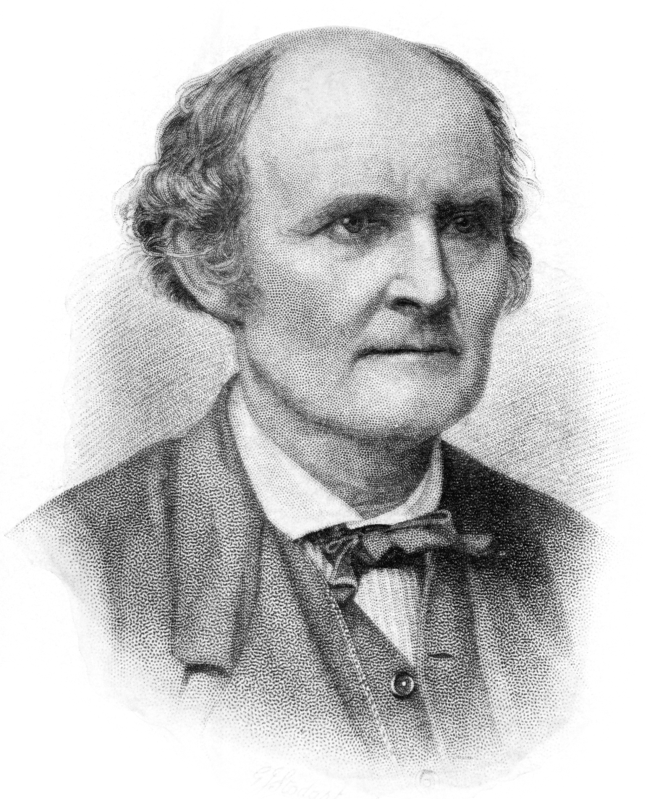
Arthur Cayley 1821– 95

Slide 16
Composition table for the symmetries of the equilateral triangle
Do first | I | R | R² | T | RT | TR
I | I | R | R² | T | RT | TR
R | R | R² | I | TR | T | RT
R² | R² | I | R | RT | TR | T
T | T | RT | TR | I | R | R²
RT | RT | TR | T | R² | I | R
TR | TR | T | RT | R | R² | I
Two elements of order 3: R and R²
Three elements of order 2: T, RT and TR
One element of order 1: I, the identity

Slide 17
The Symmetries of an equilateral triangle form a group
There is a way of combining two symmetries and when we do the combining we get another symmetry.
There is a symmetry, called the identity, which when combined with any other leaves it unchanged.
Every symmetry has an inverse, i.e. another symmetry so that when the two are combined you get the identity.
Combining symmetries is associative so that if A, B and C are three symmetries then
(AB)C = A(BC)

Slide 18
A group is a set G together with an operation * that combines any two elements g and h of G to give an element written g*h of G.
An Identity exists: There is a special element in G called the identity written I with the property
I*g = g and g*I = g for all g in G.
Inverses exist: For every g in G there is a h in G with g*h = I and h*g = I
Associative law: For any g, h and k in G
g*(h*k) = (g*h)*k

Slide 19
r is rotating 60° anticlockwise about the centre
The Symmetry group has
the 6 elements:
{I, r, r², r³, r⁴, r⁵ }

Slide 20
r is rotating 60° anticlockwise about the centre
 | I | r | r² | r³ | r⁴ | r⁵
I | I | r | r² | r³ | r⁴ | r⁵
r | r | r² | r³ | r⁴ | r⁵ | r
r² | r² | r³ | r⁴ | r⁵ | r | r²
r³ | r³ | r⁴ | r⁵ | r | r² | r³
r⁴ | r⁴ | r⁵ | r | r² | r³ | r⁴
r⁵ | r⁵ | r | r² | r³ | r⁴ | r⁵
The Symmetry group has the 6 elements: {I, r, r², r³, r⁴, r⁵}
r and r⁵ of order 6
r² and r⁴ of order 3
r³ of order 2

Slide 21
Abelian groups are groups in which the order of combining elements does not matter. Named after Niels Henrik Abel 1802–1829

Slide 22
ABEL PRIZEWINNERS
2003: Jean-Pierre Serre (France)
2004: Michael Atiyah (UK) and Isadore Singer (USA)
2005: Peter Lax (Hungary/USA)
2006: Lennart Carleson (Sweden)
2007: Srinivasa Varadhan (India/USA)
2008: John Thompson (USA) and Jacques Tits (France)
2009: Mikhail Gromov (Russia)
2010: John Tate (USA)
2011: John Milnor (USA)
2012: Endre Szemerédi (Hungary)
2013: Pierre Deligne (Belgium)

Slide 23
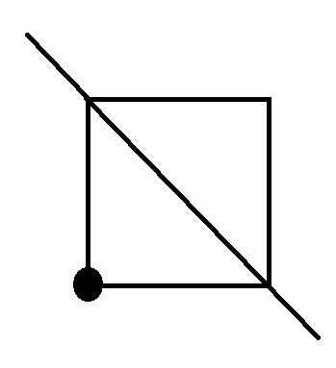
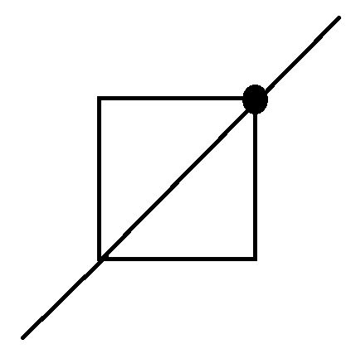
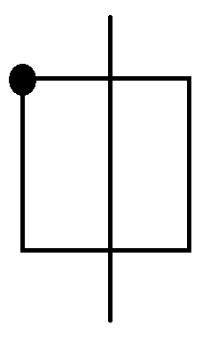
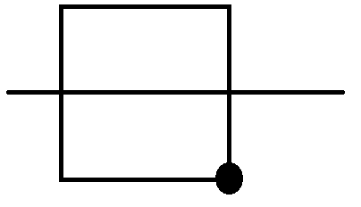
Symmetries of a square

Slide 24
Symmetries of a rectangle
Identity, I
Rotate by
180°, R
Turn about
vertical axis, V
Turn about
Horizontal axis, H

Slide 25
Symmetries of a rectangle
Identity, I
Rotate by
180°, R
Turn about
vertical axis, V
Turn about
Horizontal axis, H
 | I | R | V | H
I | I | R | V | H
R | R | I | H | V
V | V | H | I | R
H | H | V | R | I

Slide 26
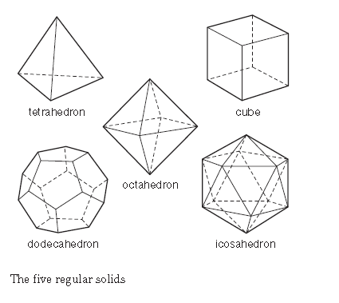
The Five regular or Platonic Solids
Tetrahedron – four faces each an equilateral triangle
Cube – six faces, each a square
Octahedron – eight faces each an equilateral triangle
Dodecahedron – twelve faces each a regular pentagon
Icosahedron – twenty faces each an equilateral triangle

Slide 27
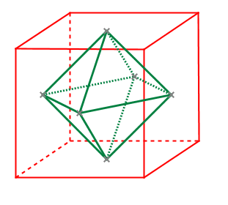
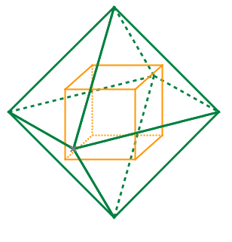
Symmetries of the Five regular or Platonic Solids
SOLID | Number of Faces, F | Number of edges in a face, E | Number of symmetries = 2EF
Tetrahedron | 4 | 3 | 24
Cube | 6 | 4 | 48
Octahedron | 8 | 3 | 48
Dodecahedron | 12 | 5 | 120
Icosahedron | 20 | 3 | 120
Centres of the faces of a cube form the vertices of an octahedron
Centres of the faces of an octahedron form the vertices of a cube
Similarly for a dodecahedron and icosahedron.

Slide 28
Subgroup – a little group inside the big group
A subgroup of a group is a subset of the group elements which is itself a group under the group operation.
Below {I, R, R²} is a subgroup of the group of symmetries of the equilateral triangle.
Do first | I | R | R² | T | RT | TR
I | I | R | R² | T | RT | TR
R | R | R² | I | TR | T | RT
R² | R² | I | R | RT | TR | T
T | T | RT | TR | I | R | R²
RT | RT | TR | T | R² | I | R
TR | TR | T | RT | R | R² | I

Slide 29
Subgroup – a little group inside the big group
A subgroup of a group is a subset of the group elements which is itself a group under the group operation.
Below {I, T} is a subgroup of the group of symmetries of the equilateral triangle.
Do first | I | R | R² | T | RT | TR
I | I | R | R² | T | RT | TR
R | R | R² | I | TR | T | RT
R² | R² | I | R | RT | TR | T
T | T | RT | TR | I | R | R²
RT | RT | TR | T | R² | I | R
TR | TR | T | RT | R | R² | I

Slide 30
Lagrange’s theorem
Definition: the order of a group is the number of elements it contains.
Symmetry group of equilateral triangle has order 6
Symmetry group of square has order 8
Symmetry group of rectangle has order 4
Lagrange’s Theorem:
The order of a subgroup divides the order of the group.
Example: The group of symmetries of the equilateral triangle has order 6 and the subgroups {I, R, R²} has order 3 which divides 6 and {I, T} has order 2 which divides 6.

Slide 31
The order of an element divides the order of the group.
Consider the subset:
{g, g times g, g times g times g times, … , identity}
it forms a subgroup with size the order of g
 | I | R | R² | T | RT | TR
I | I | R | R² | T | RT | TR
R | R | R² | I | TR | T | RT
R² | R² | I | R | RT | TR | T
T | T | RT | TR | I | R | R²
RT | RT | TR | T | R² | I | R
TR | TR | T | RT | R | R² | I
Two elements of order 3:
R and R²
Three elements of order 2:
T, RT and TR
One element of order 1:
I, the identity

Slide 32
The order of an element divides the order of the group.
Consequence:
Denote the order of the group as |G|.
In any group any element combined with itself |G| times will give the identity.
Suppose the order of the group is 12, and the order of the element, g, is 4.
Then g combined with itself 4 times gives the identity so g combined with itself 12 times will also give the identity.

Slide 33
Remainders form a group under addition
Pick integer n. The remainders are the remainders on dividing integers by n which are {0, 1, 2, … , n-1}
Denote the group operation by ⊕ defined as:
a ⊕ b is the remainder obtained when a + b is divided by n.
Suppose n is 24: The group is
{0, 1, 2, 3, 4, 5, 6, 7, 8, 9, 10, 11, 12, 13, 14, 15, 16, 17, 18, 19, 20, 21, 22, 23}
7 ⊕ 21 = 4 15 ⊕ 10 = 1
The identity is 0.
The inverse of 7 is 17 because 7 ⊕ 17 = 0

Slide 34
Non-zero remainders of a prime form a group under multiplication
Pick a prime p.
The group operation is ⊗: a ⊗ b is the remainder obtained when a × b is divided by p.
Example p = 7
Group is {1, 2, 3, 4, 5, 6} with operation ⊗
So 2 ⊗ 5 = 3 4 ⊗ 4 = 2
The identity is 1.
The inverse of 2 is 4, of 3 is 5, and of 6 is 6.

Slide 35
Fermat’s Little Theorem
Pick any prime, p and any integer, k, smaller than p.
Raise k to the power of p -1 and find its remainder on dividing by p.
The answer is always 1 no matter what p is or k is!
In any group any element combined with itself |G| times will give the identity.
Pick your p = 17, k = 10
Then we know that 10^{17 – 1} = 10¹⁶ leaves a remainder of 1 when divided by 17.
k^{p} has the same remainder as k when divided by p for any prime p and integer k.

Slide 36
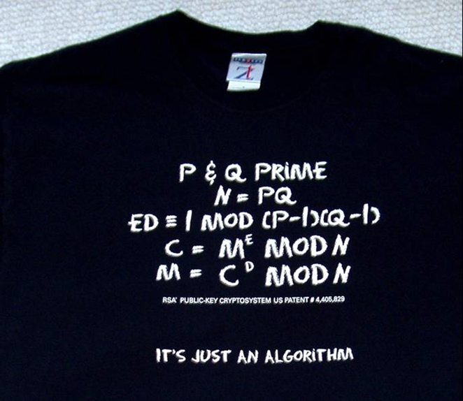
Non-zero remainders relatively prime to n under multiplication
Suppose n is 35 = 5 x 7.
The group, G, is then
{1, 2, 3, 4, 6, 8, 9, 11, 12, 13, 16, 17, 18, 19, 22, 23, 24, 26, 27, 29, 31, 32, 33, 34}
Its order is 24 = (p-1)(q-1) = 4 x 6 = 24
Any element of G raised to the power of 24 has a remainder of 1 on dividing by 35.
In the RSA algorthm e and d are chosen so that ed is a multiple of 24 plus 1.
Public key N and E
Private key D
This shows M^{ed} = M^{multiple} ^{of 24 plus 1} = M^{multiple} ^{of 24} M = 1 M = M

Slide 37
1 pm on Tuesdays at the Museum of London
Butterflies, Chaos and Fractals
Tuesday 17 September 2013
Public Key Cryptography: Secrecy in Public
Tuesday 22 October 2013
Symmetries and Groups
Tuesday 19 November 2013
Surfaces and Topology
Tuesday 21 January 2014
Probability and its Limits
Tuesday 18 February 2014
Modelling the Spread of Infectious Diseases
Tuesday 18 March 2014

