Slide 1
The Girl of the Period: Dress, Morality and Visual Culture in the mid-Nineteenth Century
Lynda Nead
Pevsner Professor of History of Art
Birkbeck, University of London

Slide 2
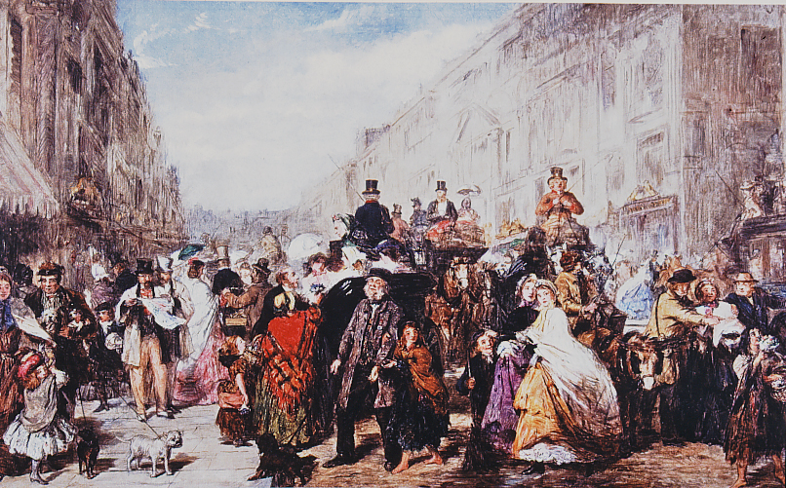

Slide 3
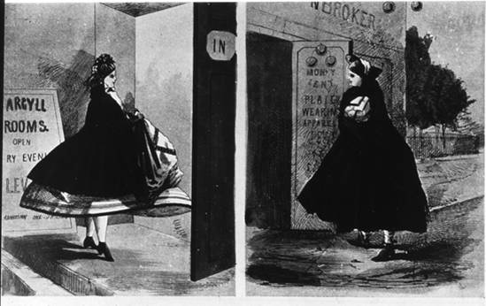

Slide 4
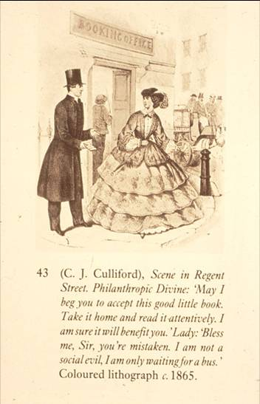

Slide 5
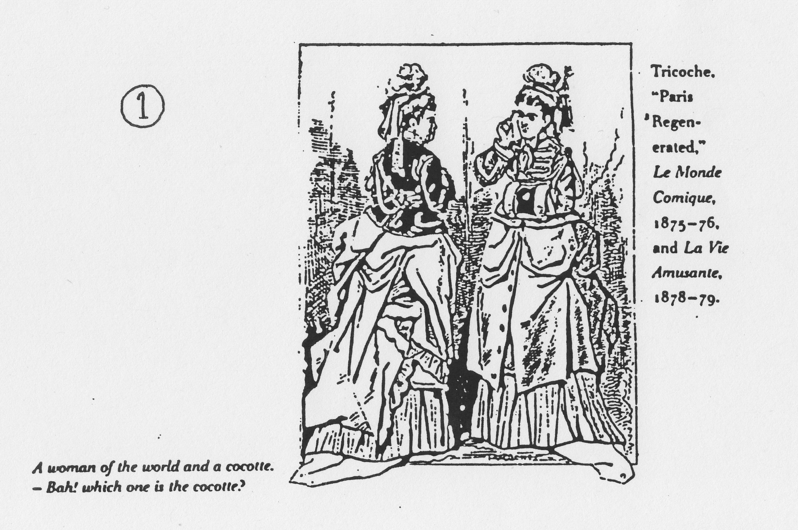

Slide 6
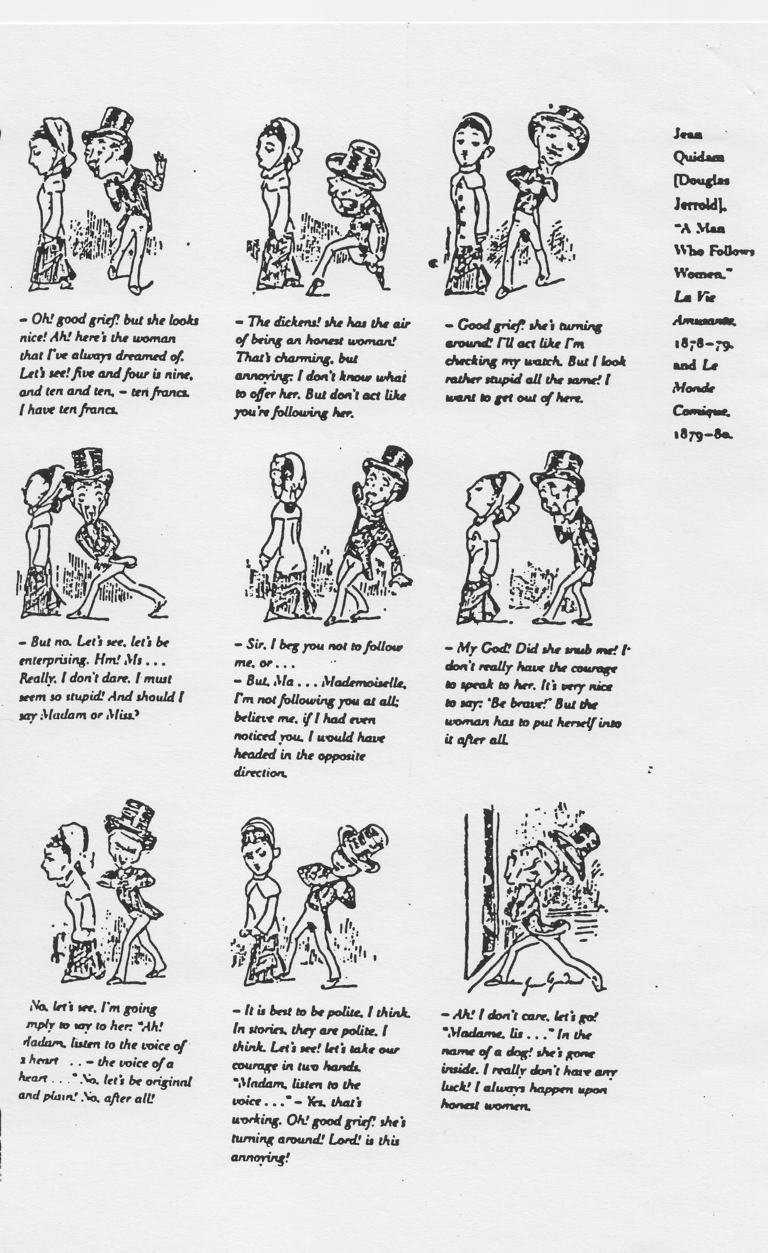

Slide 7
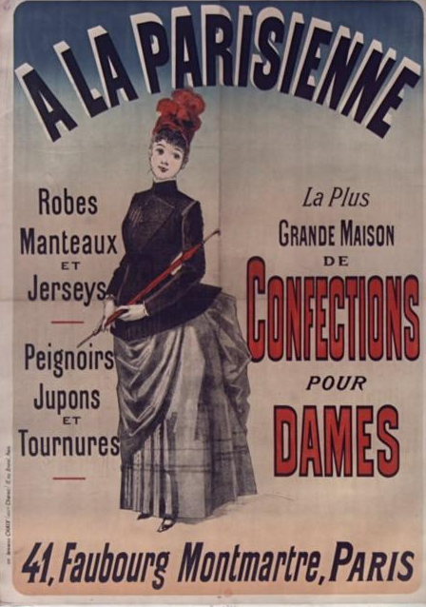

Slide 10
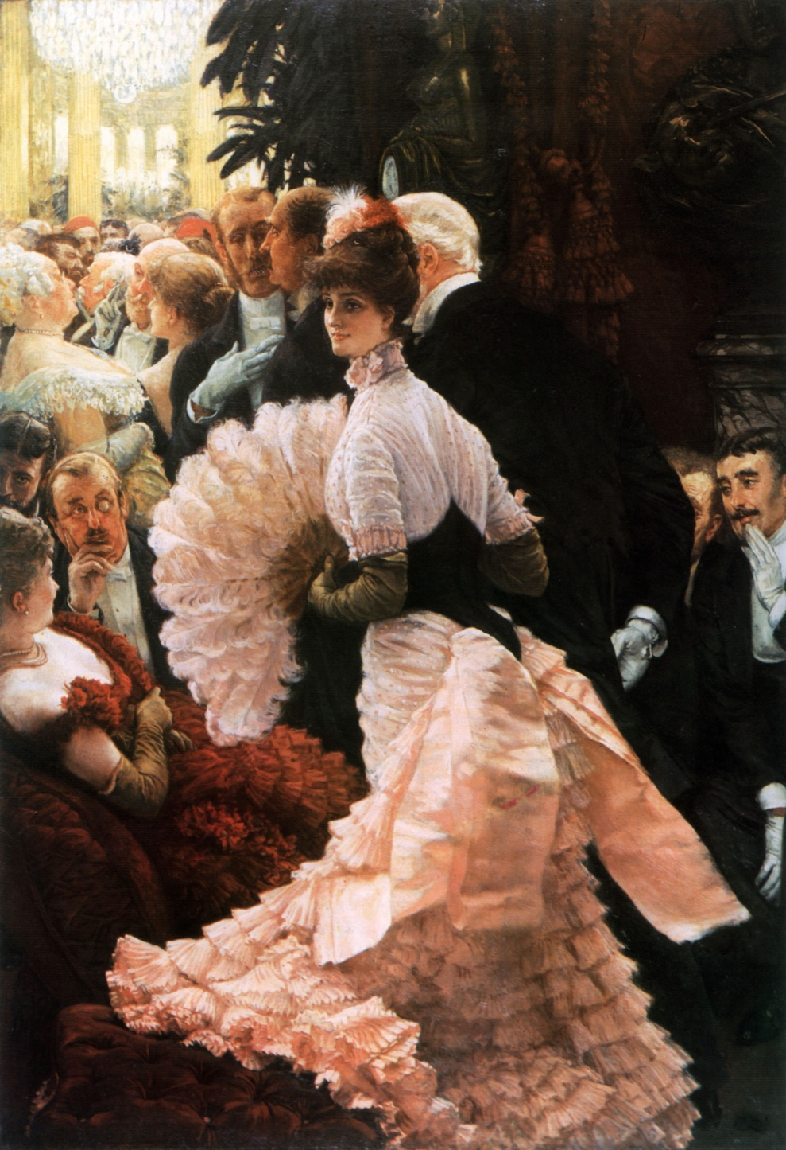

Slide 12
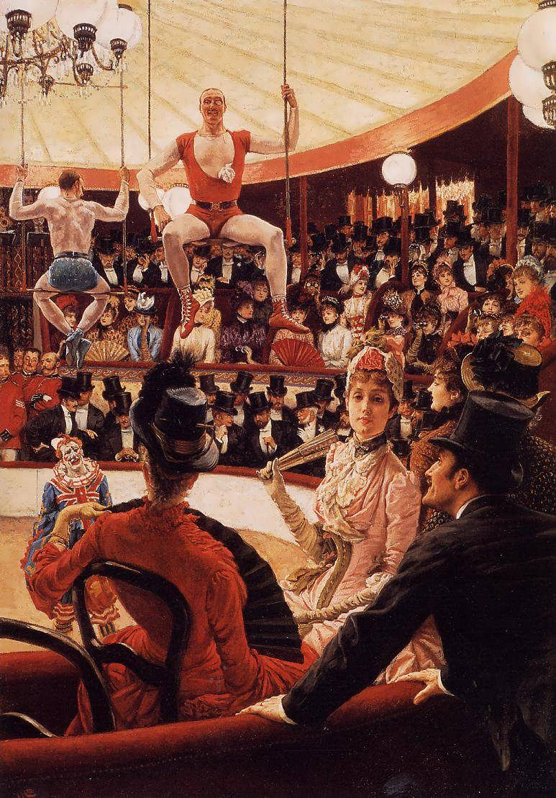

Slide 14
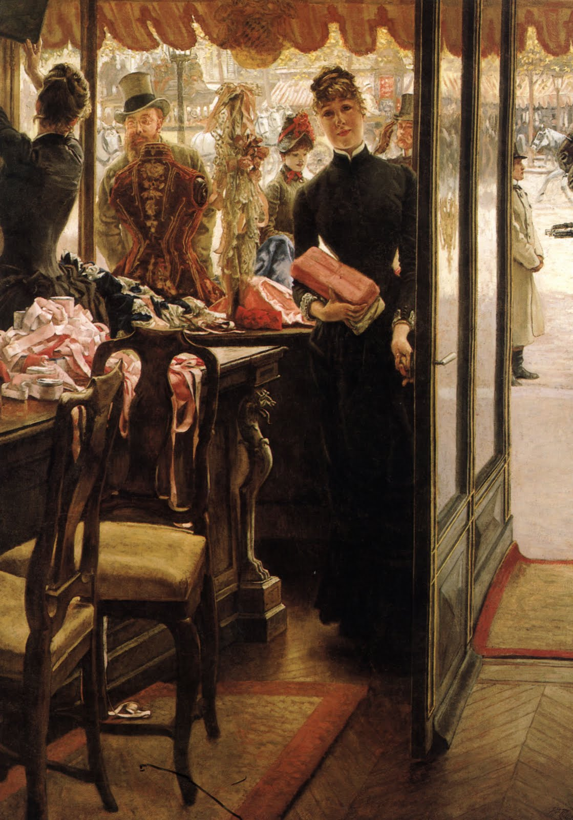

Slide 17
‘Common Sense’, letter to The Times, 21 January 1862, p. 10:
‘…that Blanche ever looked kindly at a strange joli garcon who appeared struck with her appearance; or that Isabel ever designedly showed rather more than her very neat ankle to a young officer crossing the street. It never occurs to them that bonnets of the “kiss me quick” build, loud stockings, exaggerated tournures, capes and crinolines; vagrant ringlets straying over the shoulder, better known as “follow me, lads”, and suchlike decoys, are all unmistakeably intended to attract the notice and attention of the male sex…Blanche and Isabel take a good deal of notice of the young men in a quiet way when they walk out alone, and are not at all displeased of being taken notice of themselves…Many little harmless and interesting adventures may occur to the dear girls during their morning walks of which they say nothing at all when they return home.’

Slide 19
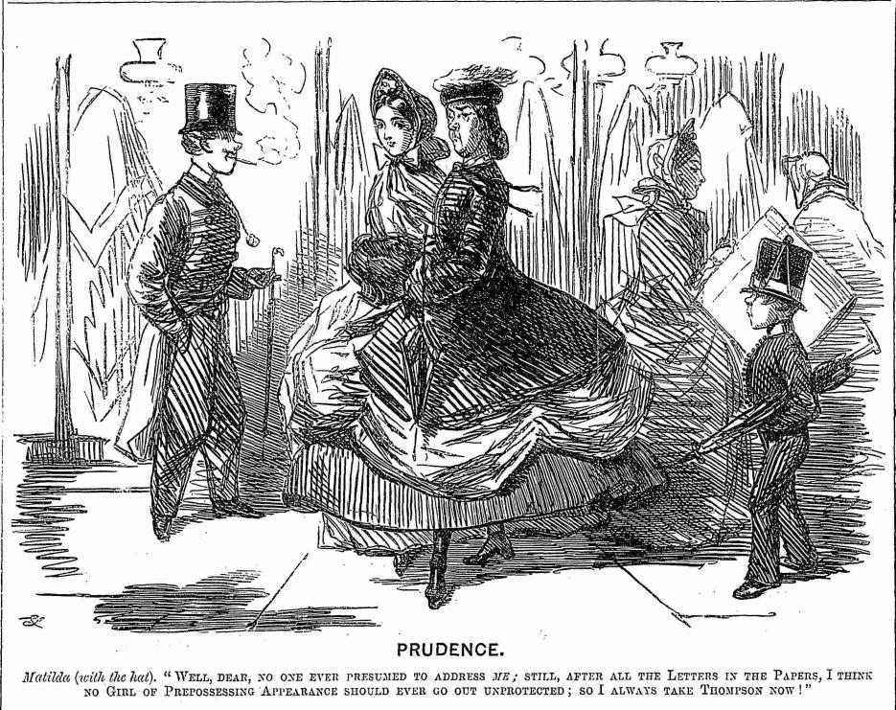

Slide 20
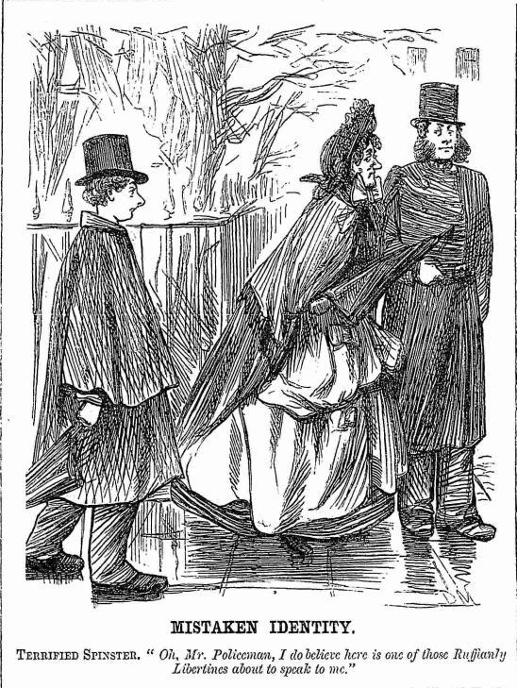

Slide 21
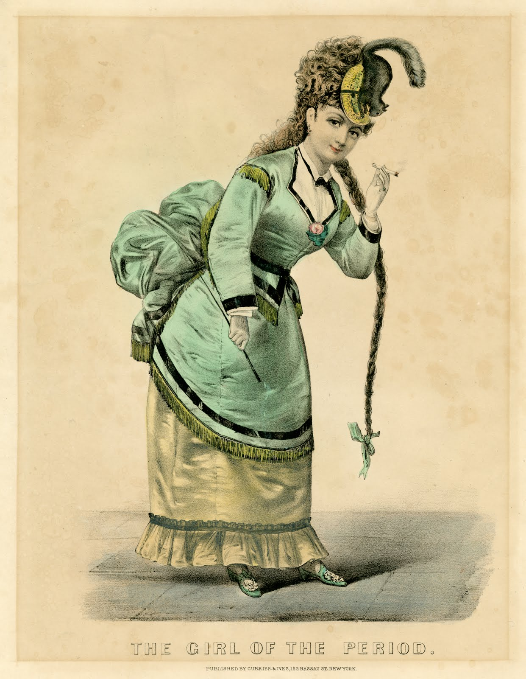

Slide 22
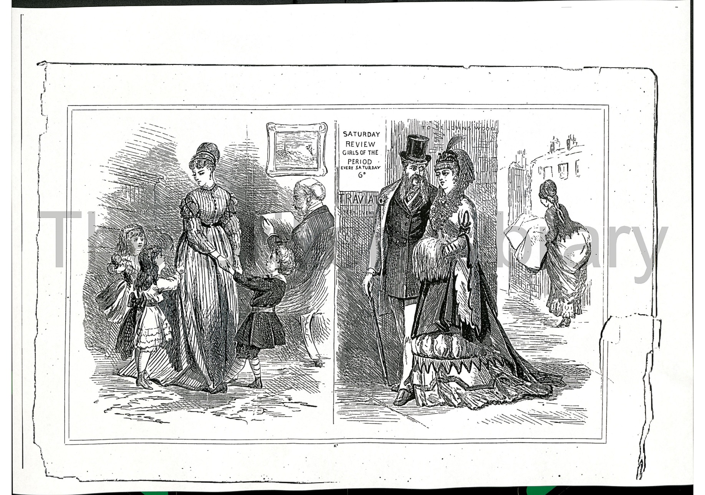

Slide 23
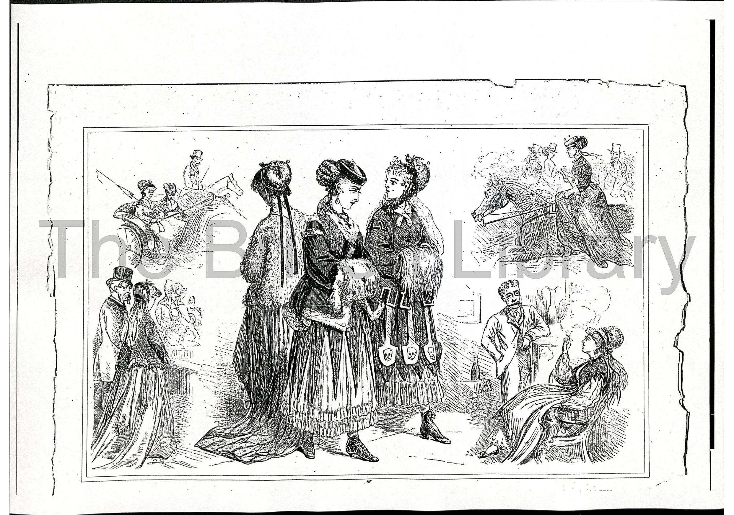

Slide 24
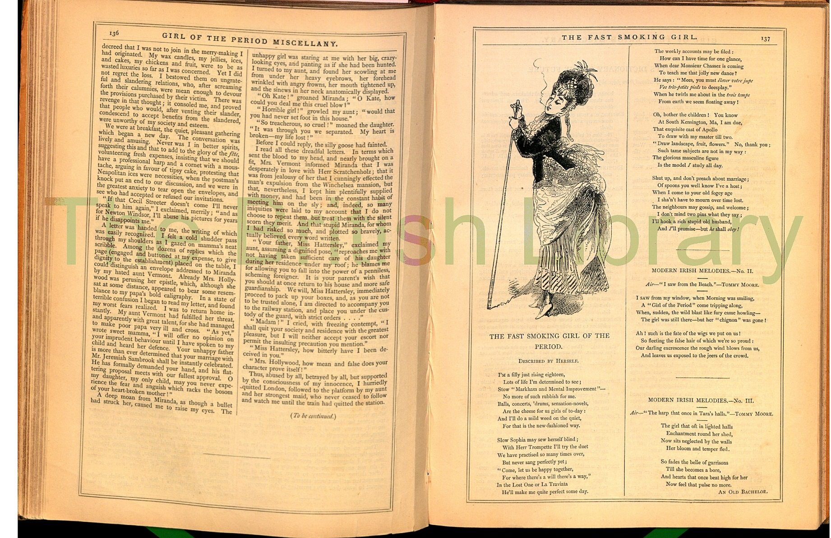

Slide 25
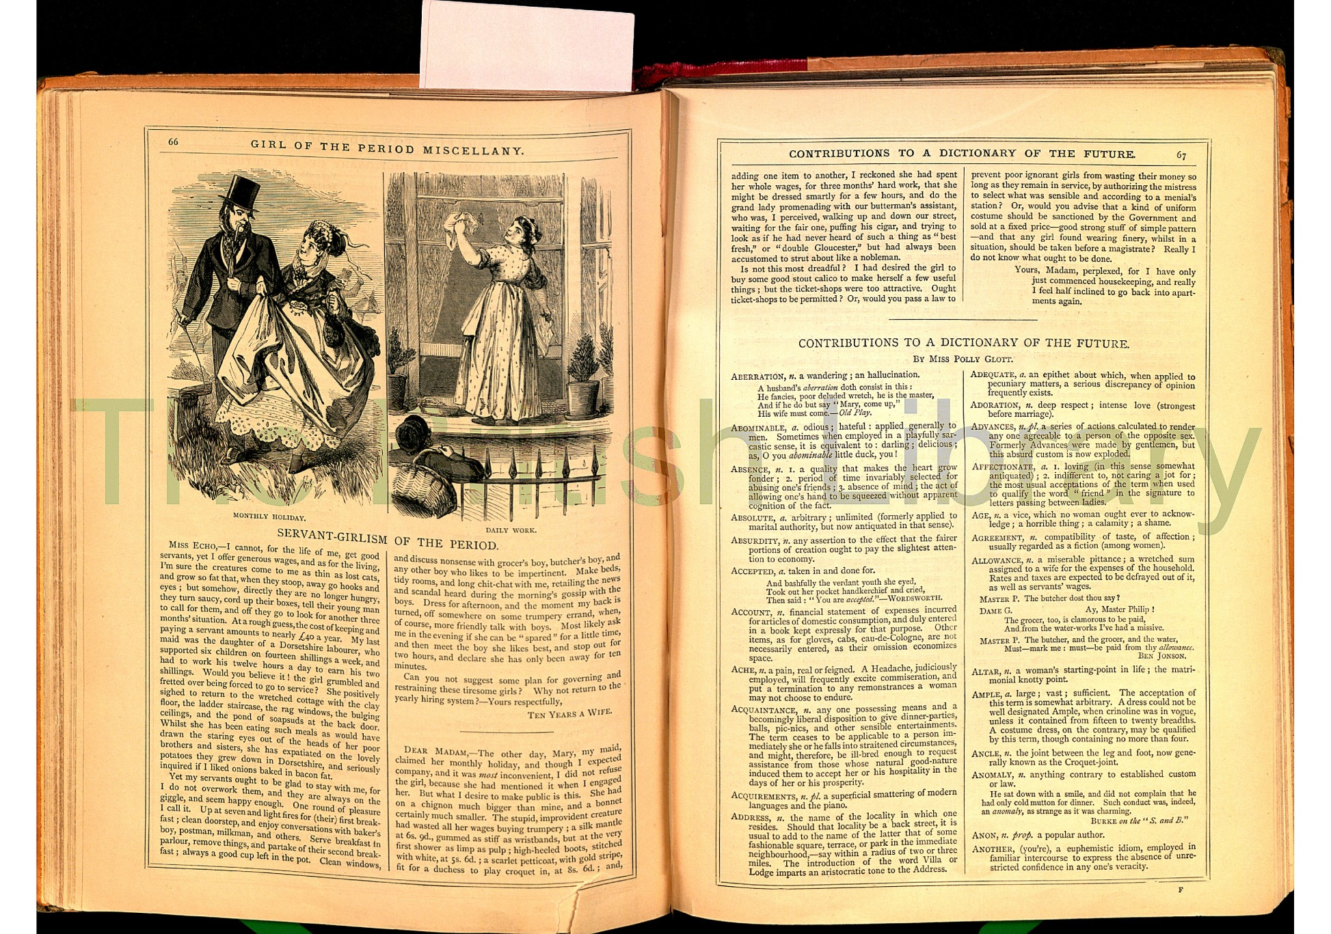

Slide 26
