Slide 1
The replanning of London after the Second World war
Peter J. Larkham

Slide 2
CAUTION
Some may find images of wartime destruction distressing.
COPYRIGHT
Many of these images are copyright and are used in this presentation with acknowledgement and for education purposes; they should not be reproduced without copyright holders’ permission.

Slide 3
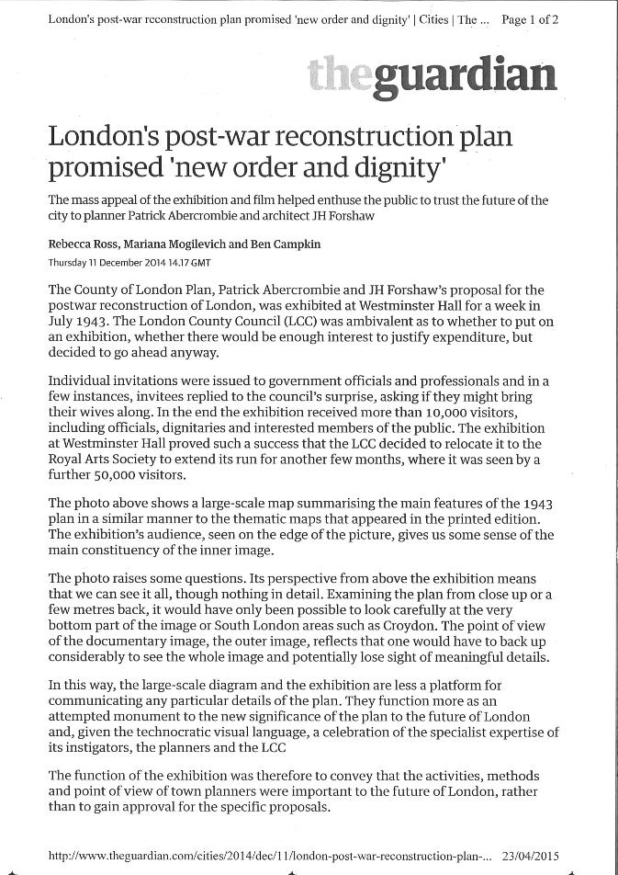
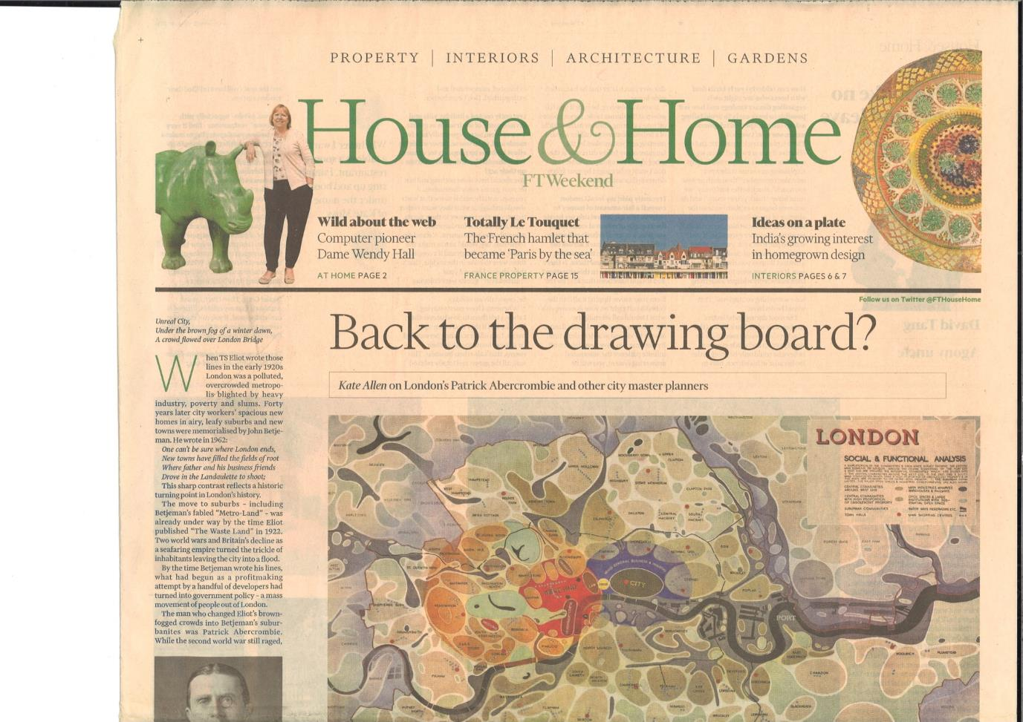
The continuing interest in London’s post-war replanning!

Slide 4
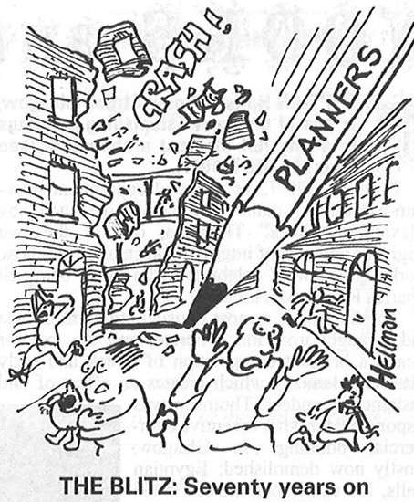
An appropriate time to be reviewing the processes of replanning and reconstruction, and their long-term impact
The unpopularity of plannng?
Hellman, Private Eye, 30/9/2010

Slide 5
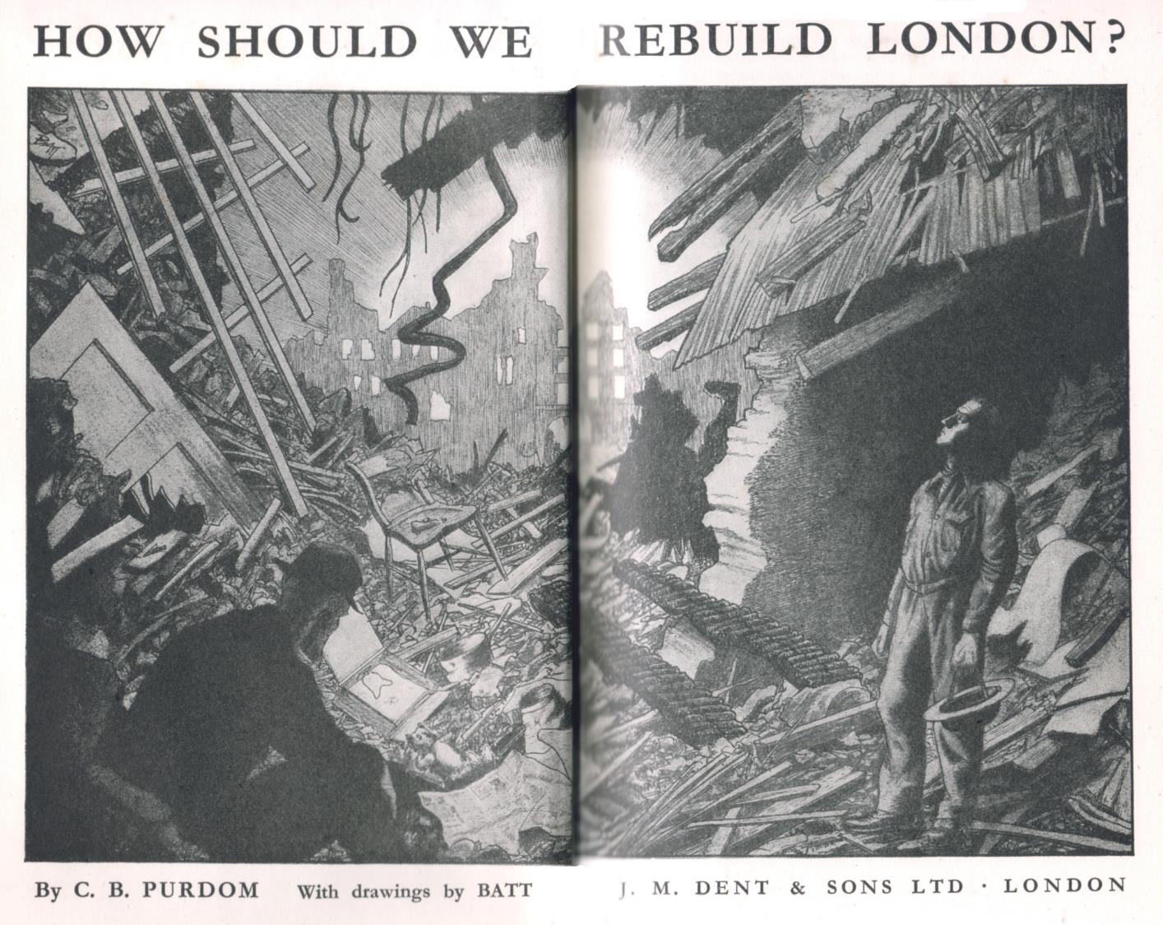

Slide 6
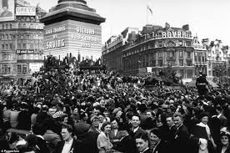
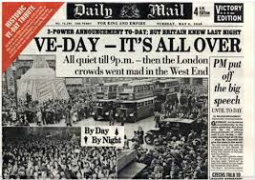
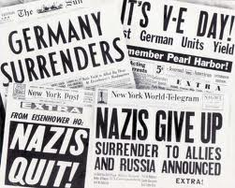
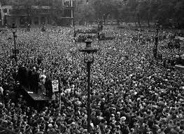
The end of the war (almost)
VE Day: May 8
Daily Mail

Slide 7
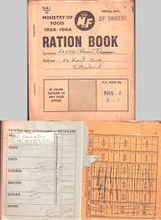
The end of the war
Perhaps the fighting ended, but the effects lingered -
Persistence of:
Rationing (food rationing ends 4 July 1954,
building materials 1954/5)
Conscription (last wartime conscripts not released
until 1949)
National Service (not ended until May 1963)

Slide 8
Total war?
“I want fires everywhere. Thousands of them!
Then they’ll unite in one gigantic area conflagration ...
explosive bombs don’t work, but it can be done with incendiary bombs –
total destruction of London” (Hitler, 1940)
By September 1940, “night raiding was widespread and hardly any of the
larger industrial centres and ports of England and Scotland escaped”
(The Aeroplane, 6/9/1940)

Slide 9
The impact of the war
Town | Tonnage of high explosive, 9/1940 - 5/1941 | Major attacks (over 100 aircraft), 9/1940 - 5/1941 | Acres of war damage | Number of houses destroyed
London (County) | 18,291 | 71 | 1,312* | 47,314
Liverpool/Birkenhead | 1,957 | 8 | 284 | 7,386
Birmingham | 1,852 | 8 | ? | 5,065
Plymouth/Devonport | 1,228 | 8 | 193 415* | 3,593
Glasgow/Clydeside | 1,329 | 5 | ? | ?
Portsmouth | 687 | 3 | 182 430* | 4,393
Hull | 593 | 3 | 136 246* | 3,324
Coventry | 818 | 2 | 274* | 4,185
Belfast | 440 | 2 | ? | ?
Sheffield | 335 | 1 | 108 | 2,906
Newcastle/Tyneside | 152 | 1 | ? | ?
Cardiff | 115 | 1 | ? | ?
Bath+ | 400 HE bombs | 2 major raids but under 100 aircraft | ? | 1,214
Exeter+ | 220 HE bombs | 1 major raid but under 100 aircraft | 40 75* | 1,700
Norwich+ | ? | small raids | 78 41* | 117
Many British towns and cities were bombed, but in varying degrees of severity.
Data difficult to obtain and inconsistent.
Notes: + Historic towns targeted by smaller "Baedeker raids" in 1942
* Area of "Declaratory Order" under 1944 Act; often includes areas of slum clearance as well as bomb damage
Source: principally from National Archives files (air raids/civil defence, and reconstruction)

Slide 10
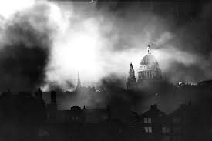
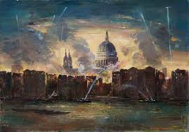
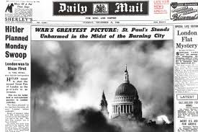
Iconic images of the Blitz (St Paul’s in smoke: London-centric)
(Images from The Times, Daily Mail, BBC.co.uk)

Slide 11
(Remember the impact outside the UK, though)
Damage | Britain | Italy | Germany | Japan
Civilian deaths | 60,595 | 59,796 | c600,000 | >900,000
Cities suffering significant raids | c. 45 | c. 50 | 70 | 62
Area destroyed (km²) | c. 15 | c. 100 | 333 | 425
Proportion of built-up area destroyed | 3% | c. 25% | 39% | c. 50%
Housing units destroyed | tens of thousands | tens of thousands | 2,164,800 | 2,500,000
(Hewitt, 1983, Table 1)

Slide 12
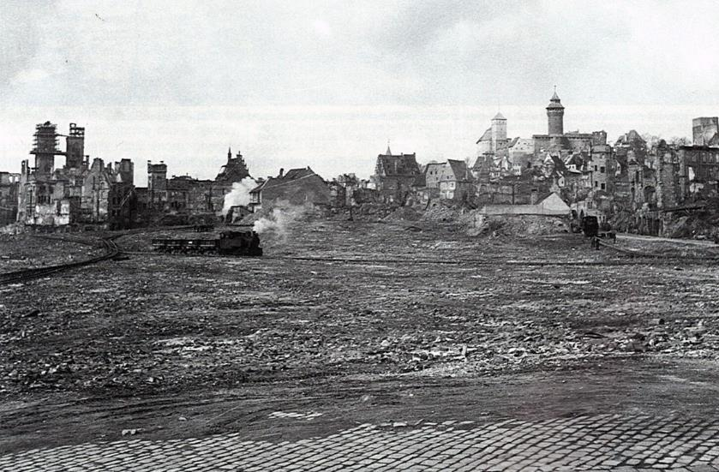
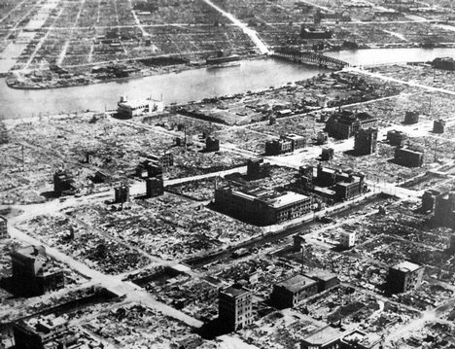
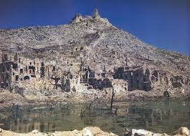
Destruction in Nuremberg (City Press Department)
Tokyo after firebomb raid
Scale of destruction outside UK: bigger air raids, ground warfare
Cultural destruction: Monte Cassino in ruins (pinterest.com)

Slide 13
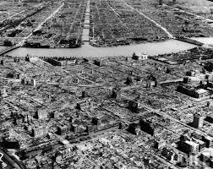
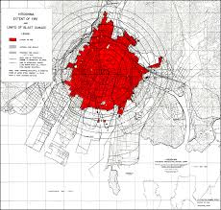
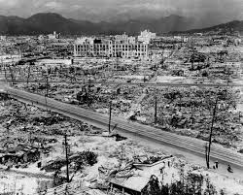
Hiroshima: nuclear bomb damage
(newsclick.in)
Hiroshima blast map (US Strategic Bombing Survey)
(ww2db.com)

Slide 14
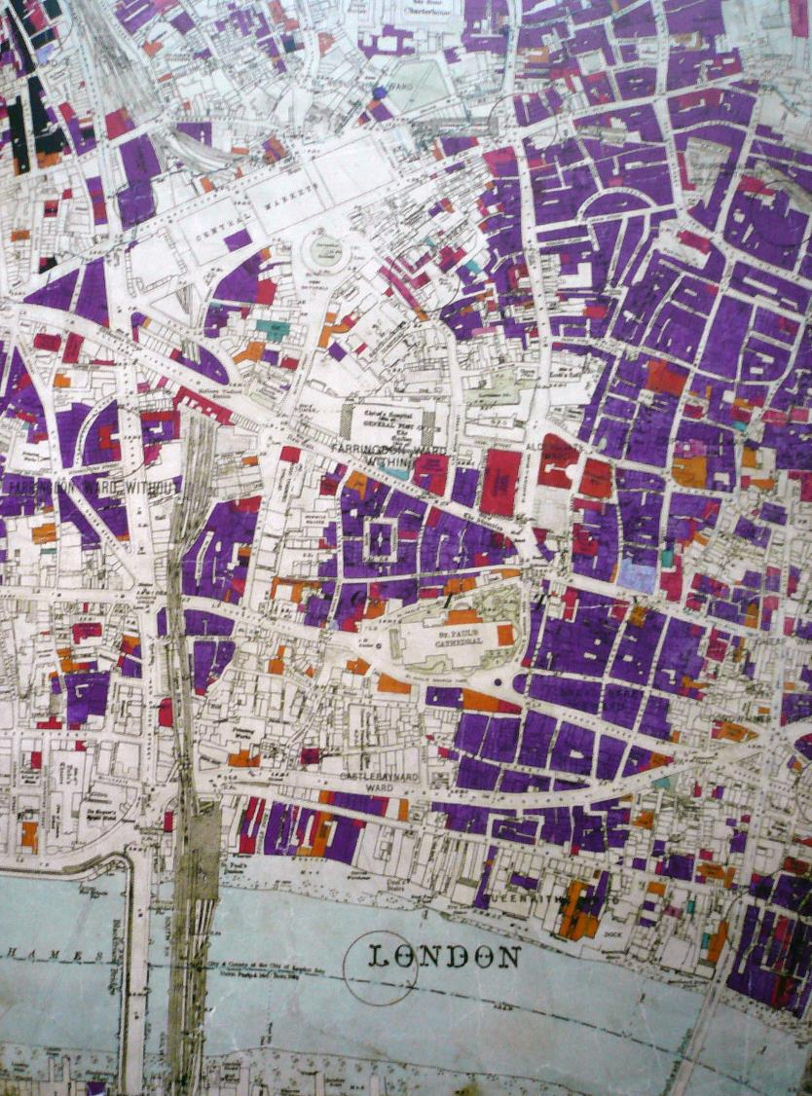
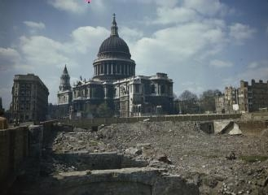
Bombed London
City of London: bomb damage maps showing location and severity of damage (London Topographical Society, 2005)
Rubble around St Paul’s (Ministry of Information/IWM)

Slide 15
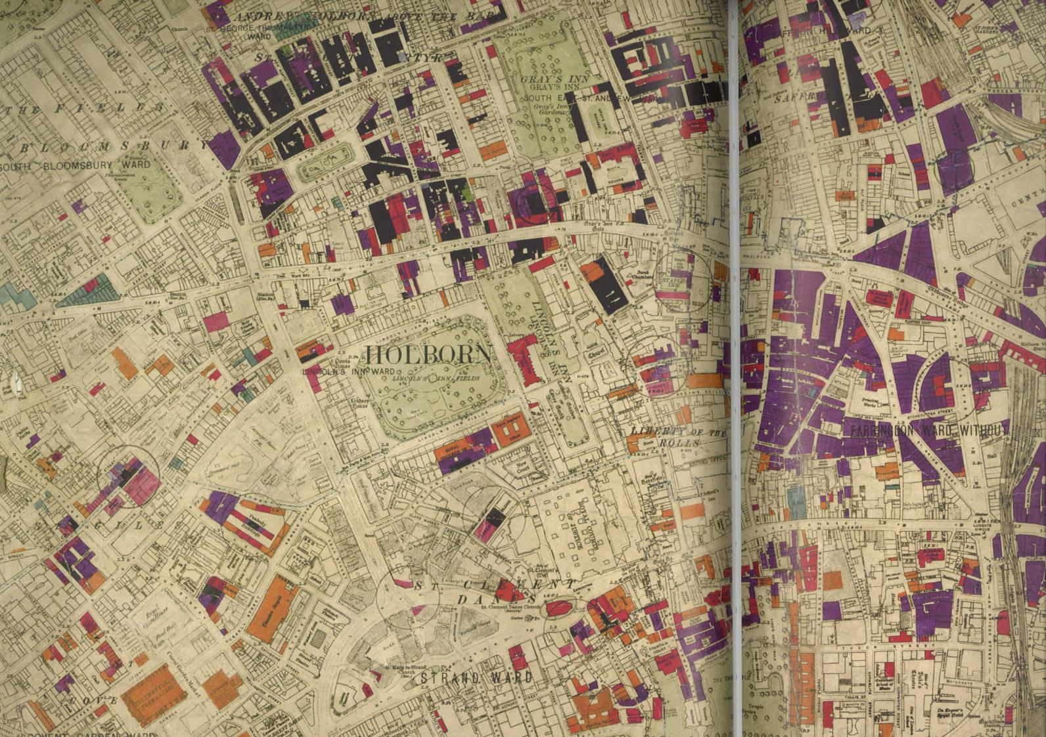
LTS, 2005

Slide 16
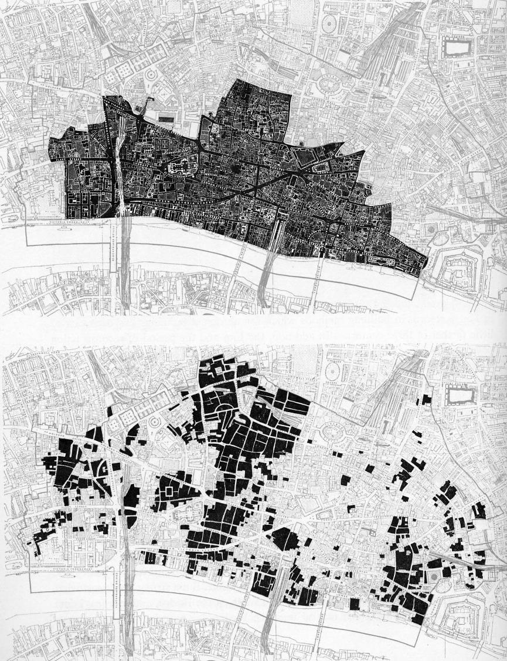
Bombed London
City of London: comparing bombing destruction and the Great Fire, 1666
(Holden and Holford, 1951)

Slide 17
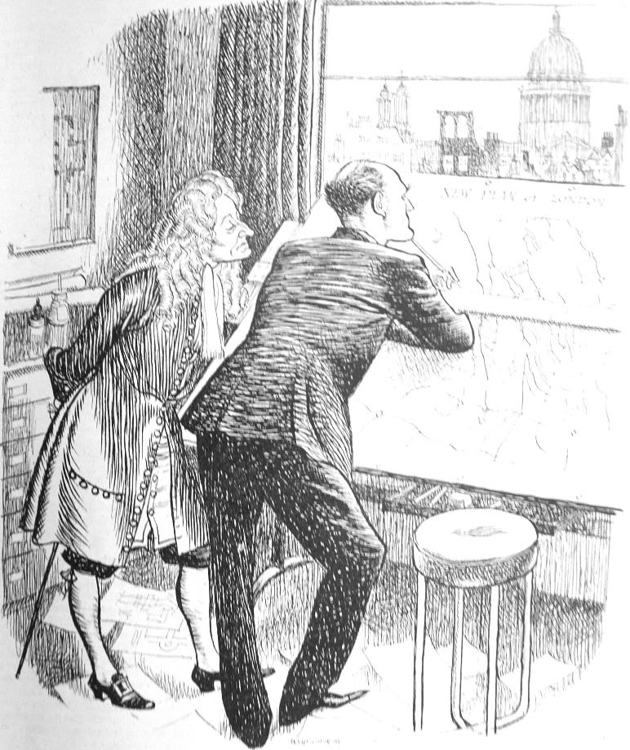
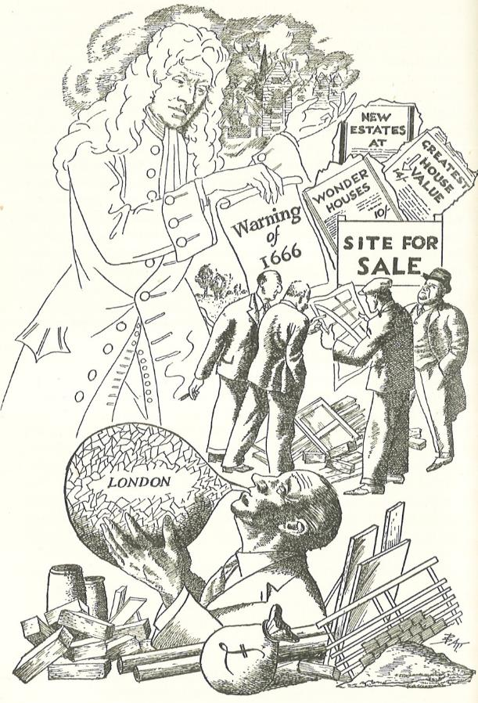
The 1666 comparison was inevitable and VERY common
“ ‘twixt Reith and Wren” (Punch 15/1/1941)
(Gibbon, 1945)

Slide 18
Lord Reith, (briefly) Minister for Planning and Reconstruction
(BBC)

Slide 19
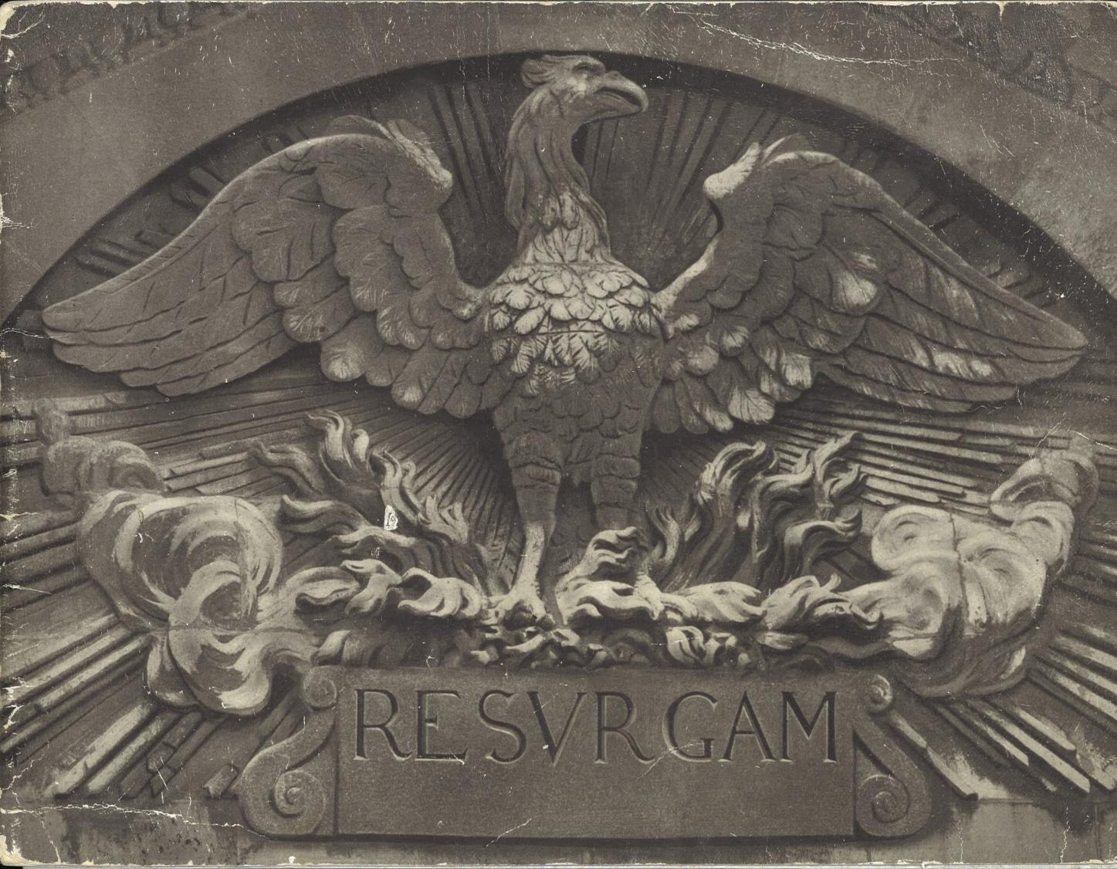
Cover of Resurgam (Ministry of Information c. 1942)

Slide 20
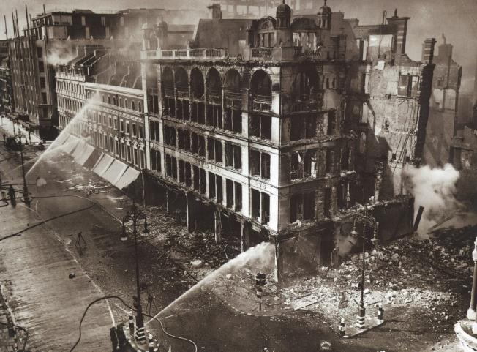
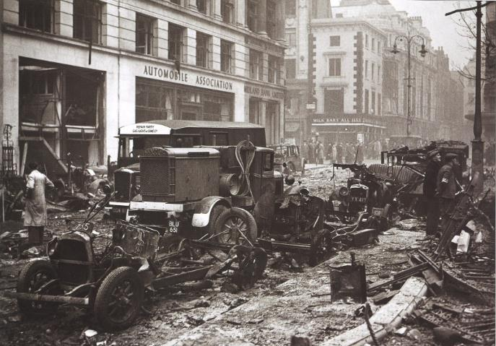
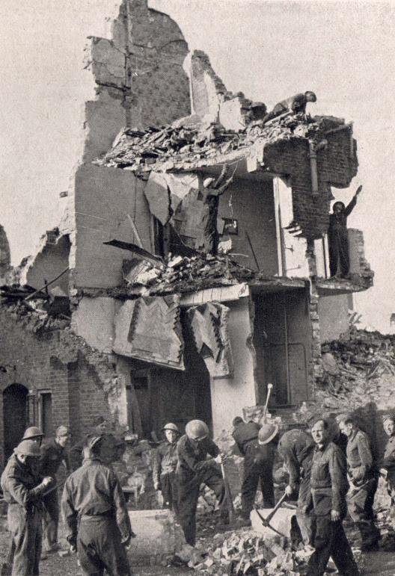
Bombing of John Lewis, Oxford Street, September 1940 (Daily Mail)
Rubble and ruins in Leicester Square (Daily Mail)
Coping in the immediate aftermath: firefighting, rubble clearance, restoring services
Pioneer Corps clearance
(Britain Under Fire)

Slide 21
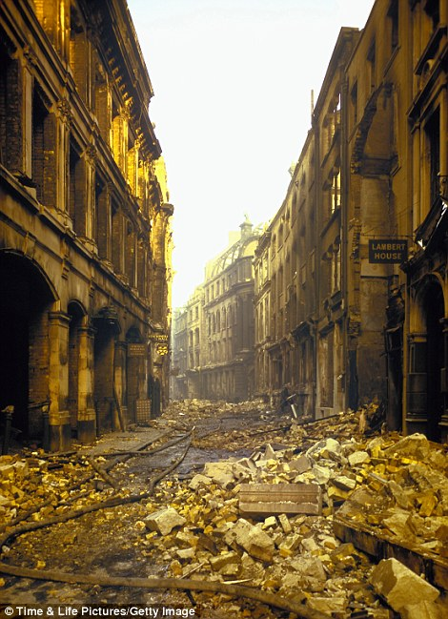
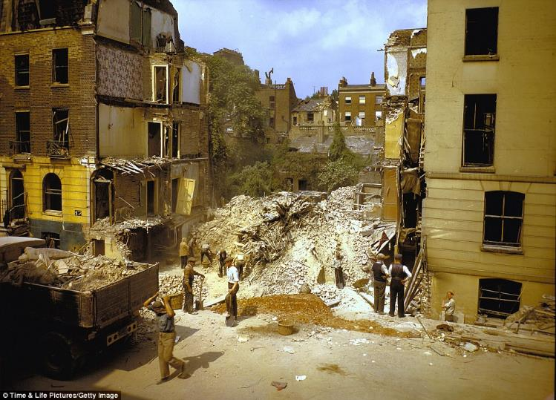
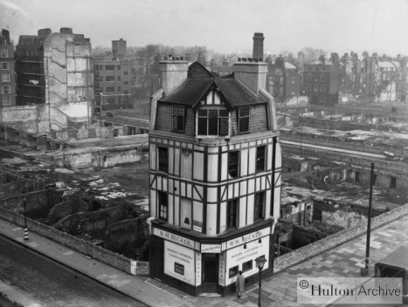

Slide 22
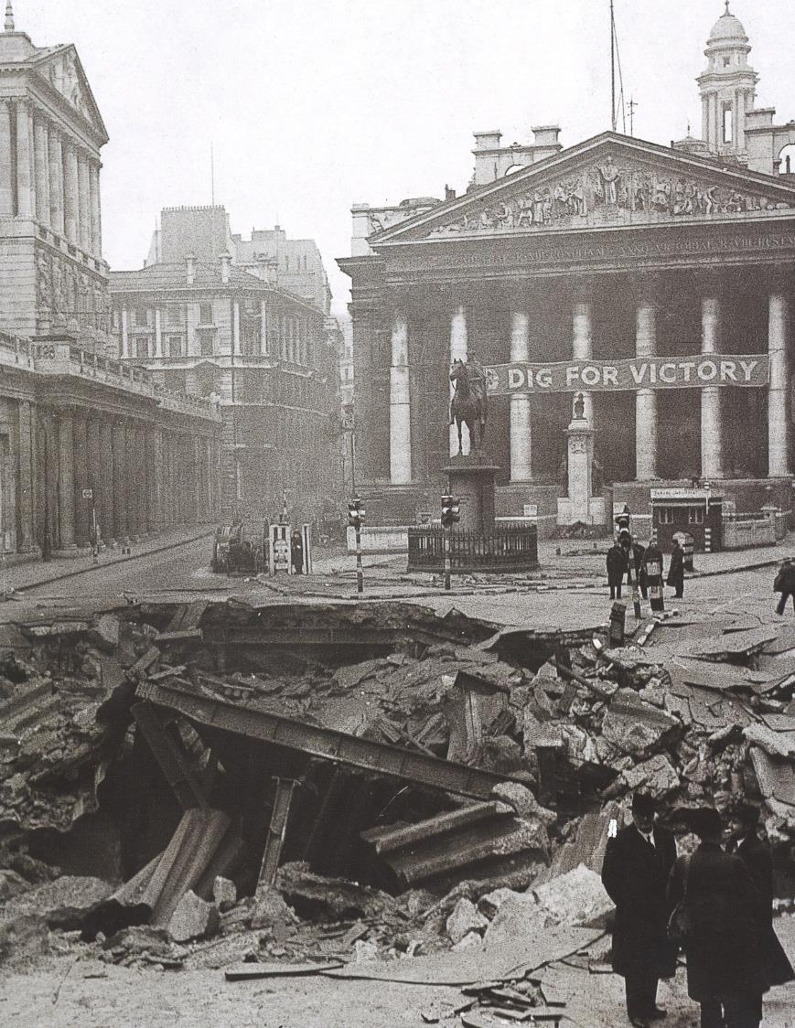
The Blitz’s biggest bomb crater, Bank tube station, 50 killed (Daily Mail)

Slide 23
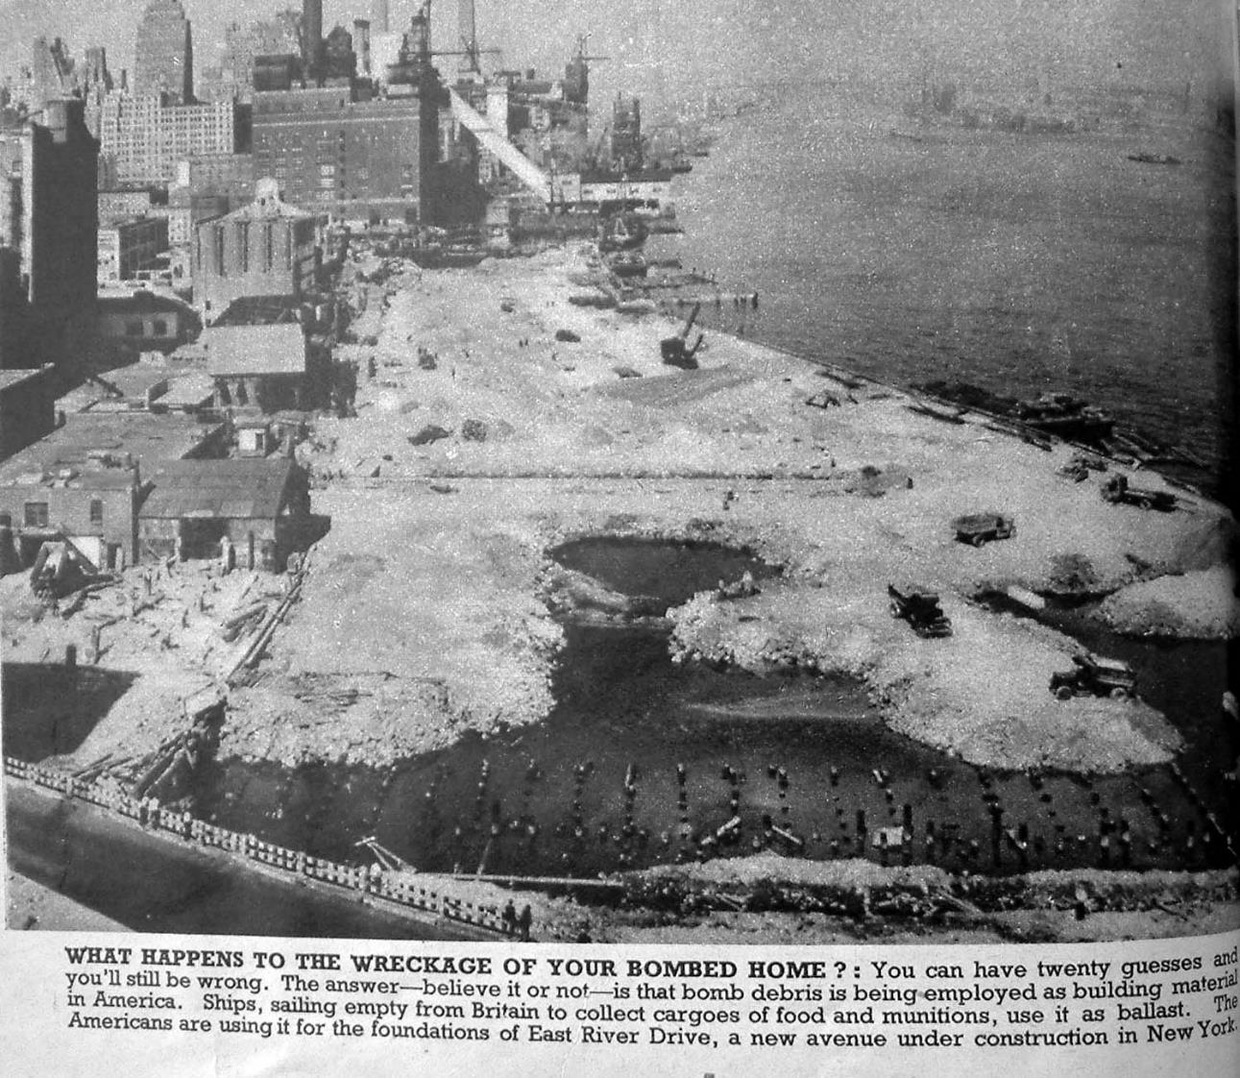
What happened to all of the rubble? (Picture Post)

Slide 24
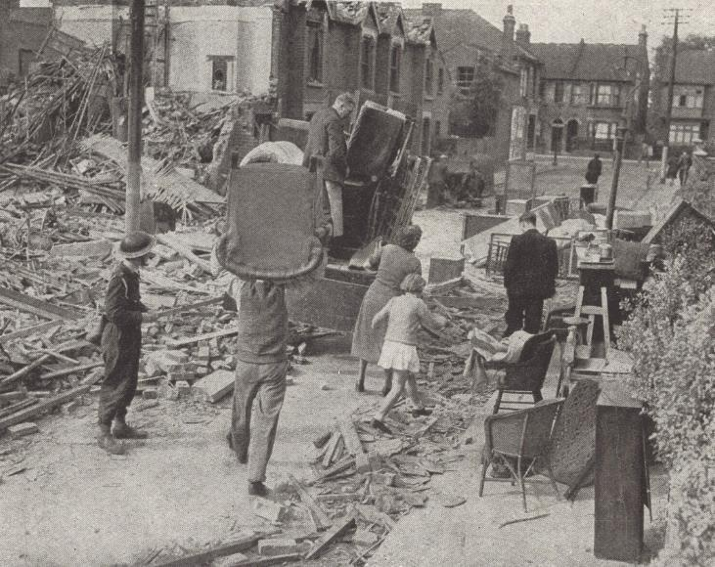
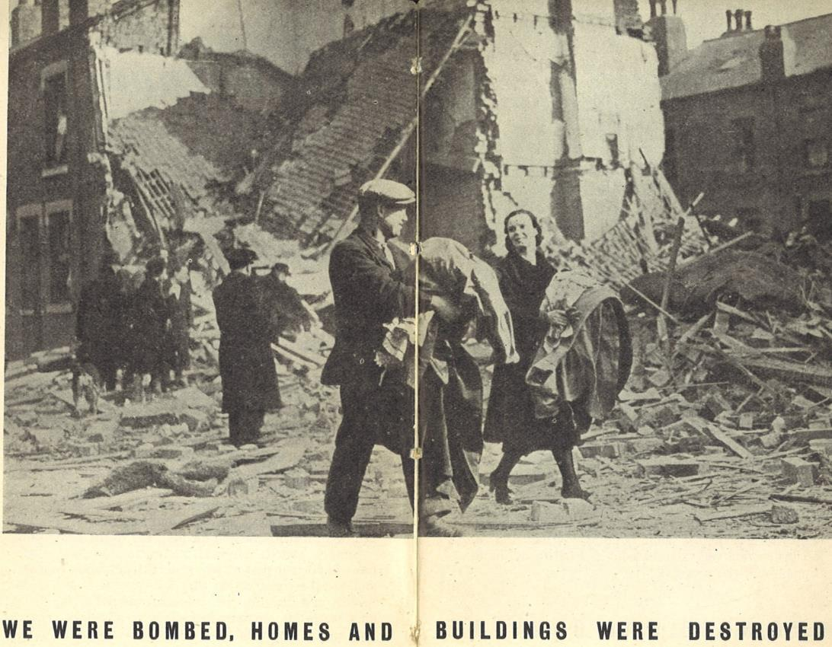
The human cost of bombing cities
“Evicted by Hitler” (Britain under fire)
(Planning for Reconstruction)

Slide 25
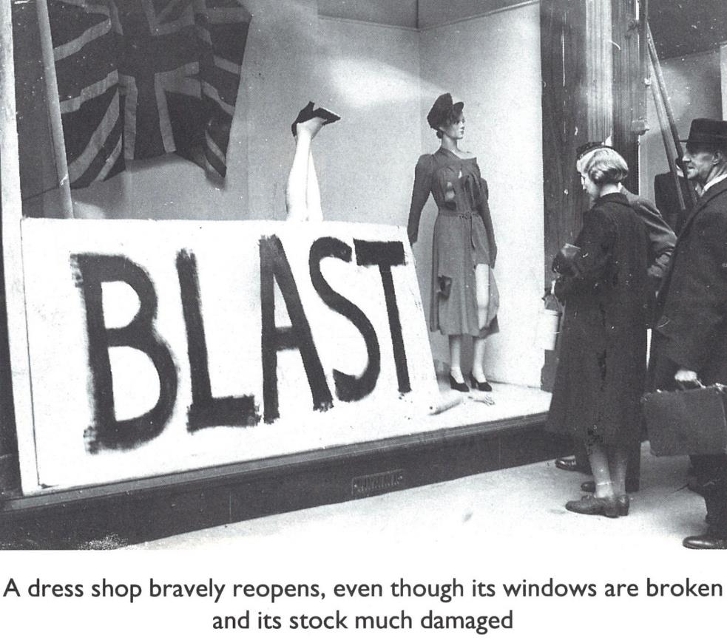
Coping? The “Blitz spirit” – though later historians have queried this (Ziegler, 1995)

Slide 26
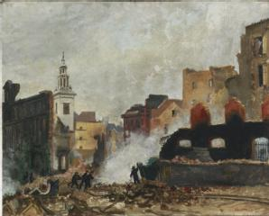
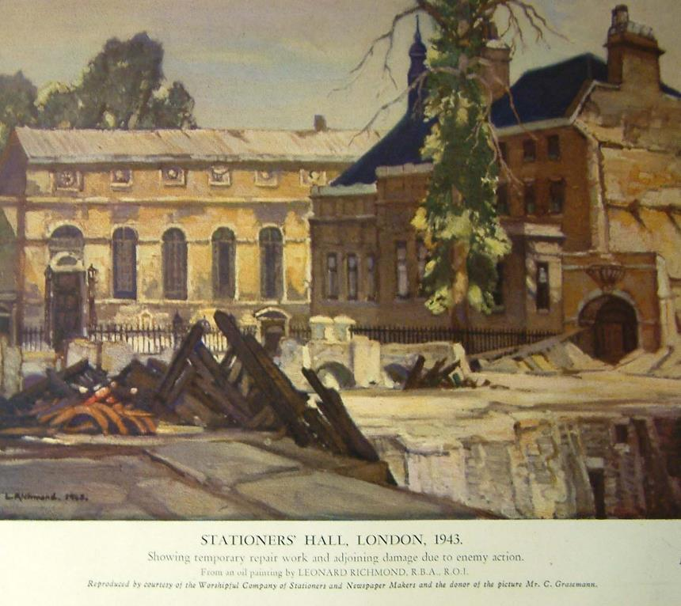
Air raid damage as art?
“An evening in the City 1941”, B. Hailstone,
(IWM collection)
“Stationers’ Hall, London, 1943”, L. Richmond (The Builder, 1944)

Slide 27
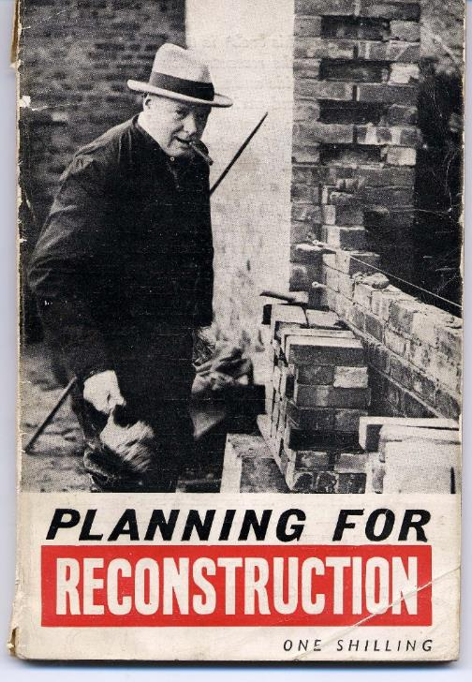
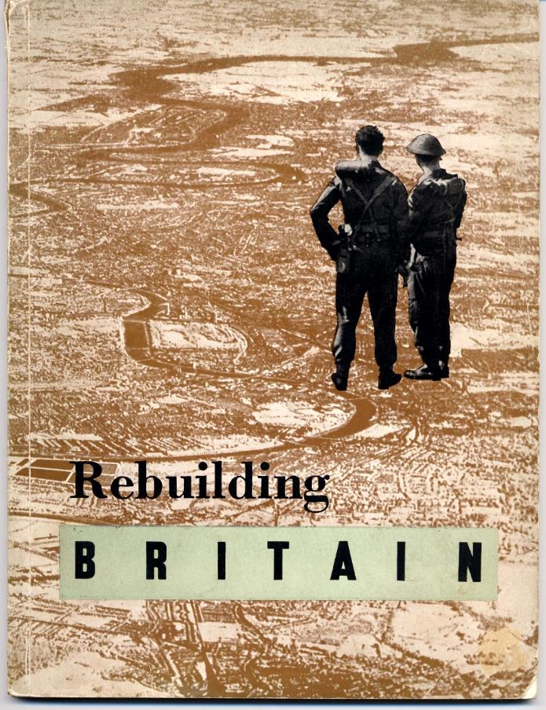
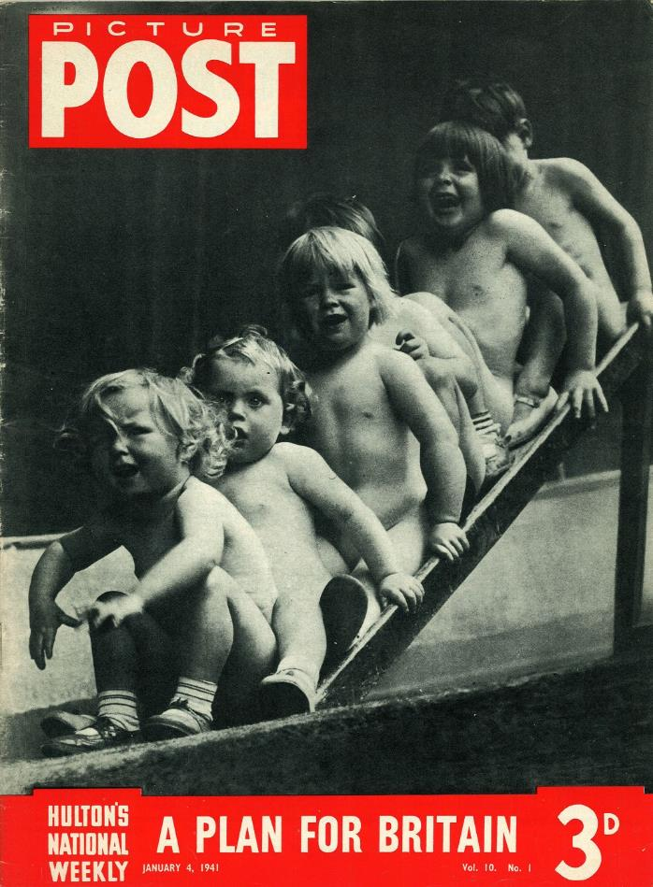
A public rhetoric of
reconstruction / replanning

Slide 28
The opportunity?
(Tubbs, 1942)

Slide 29
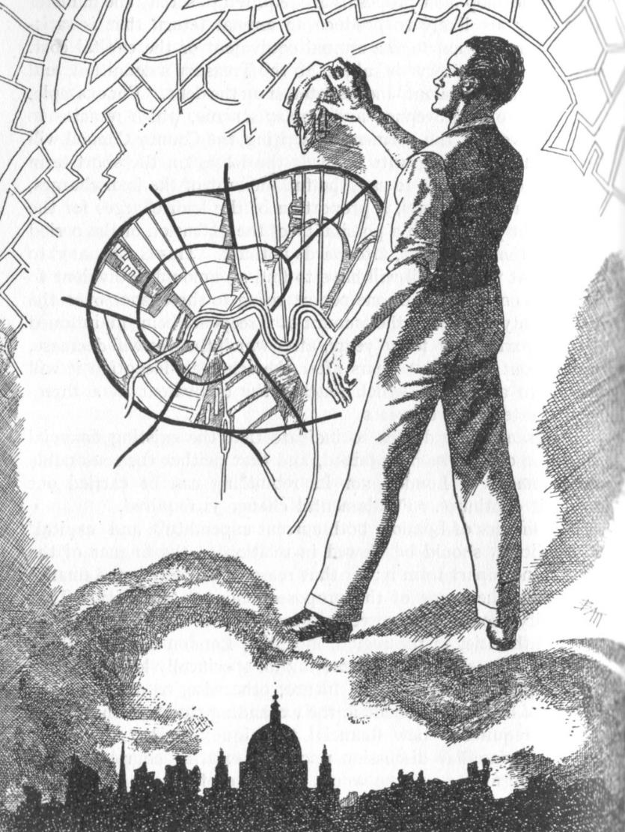
“The vision” (by cartoonist Batt, in Purdom, 1946, and clearly of London)

Slide 30
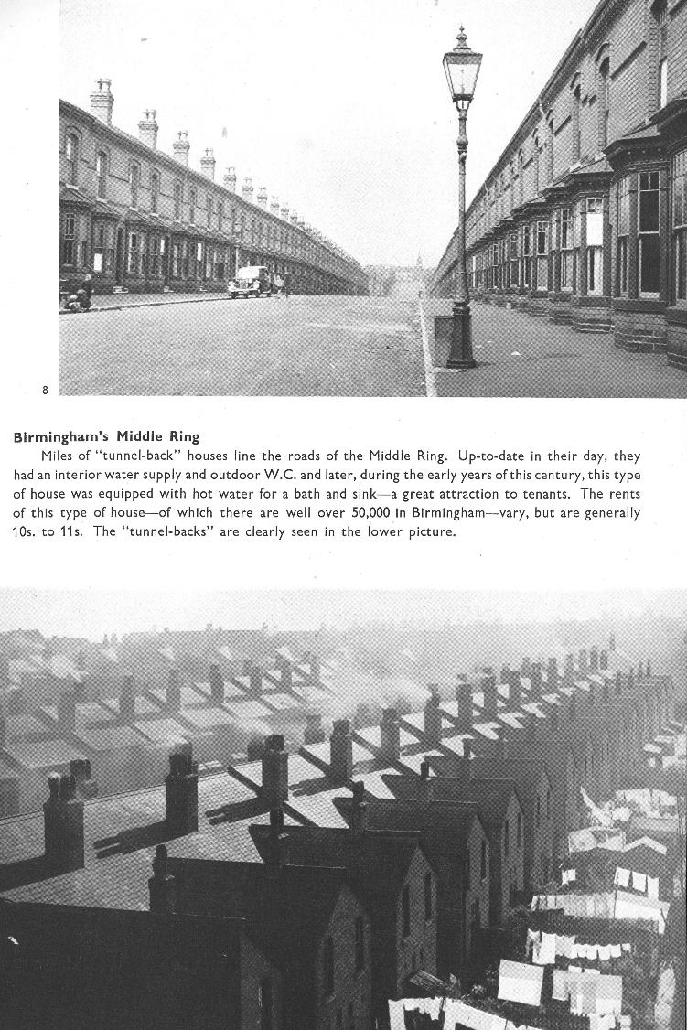
But war wasn’t the origin of planning!
Key inter-war issues included
slum housing
For example, blind backs, back-to-backs,
courtyards, tunnel-back terraces (examples in
Birmingham photographed by Bill Brandt for the Bournville Village Trust)

Slide 31
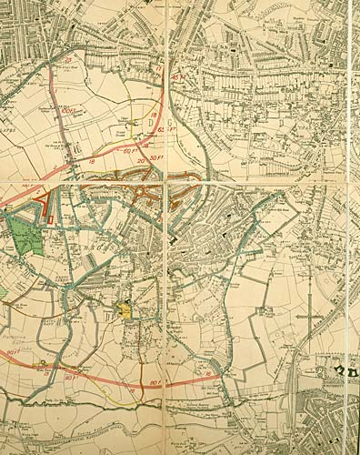
But war wasn’t the origin of planning!
Responses included Town Planning Schemes
Birmingham was first, and take-up was slow.
Quinton, Harborne & Edgbaston Town Planning Scheme 1913 (Birmingham Archives)

Slide 32
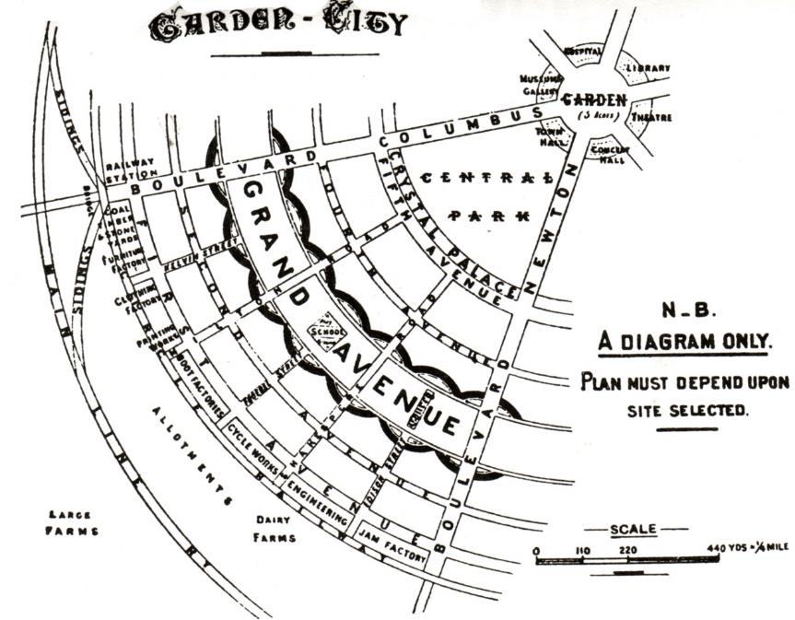
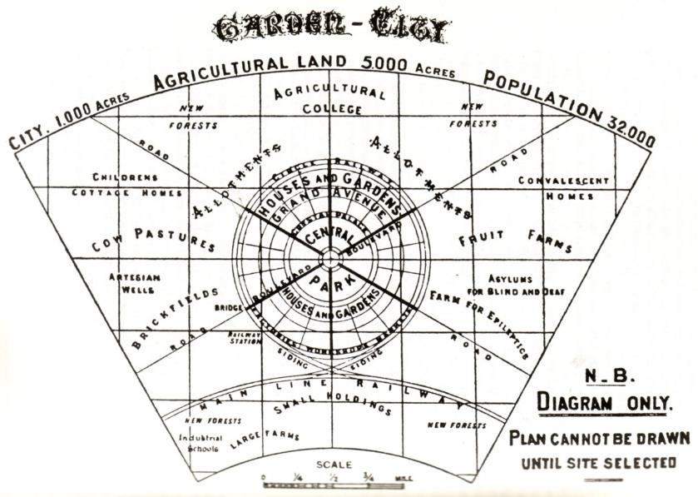
But war wasn’t the origin of planning!
Responses included the “garden city” (Howard, 1902)

Slide 33
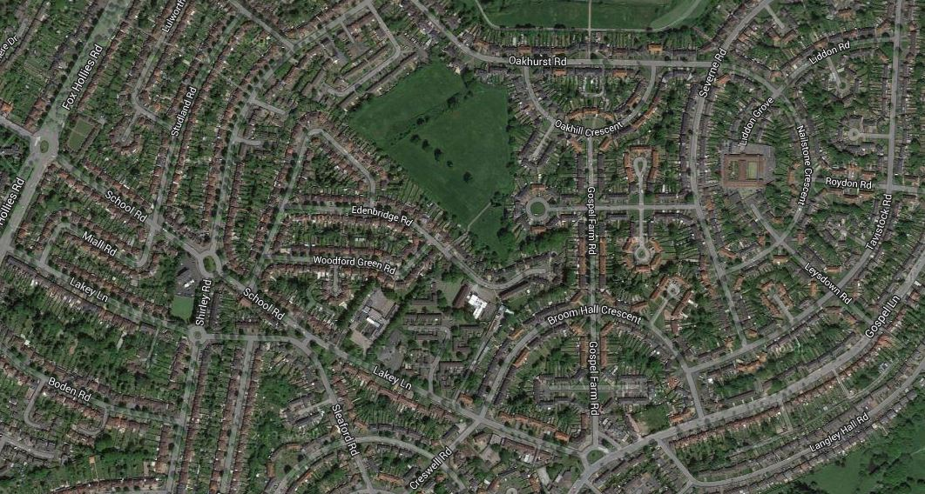
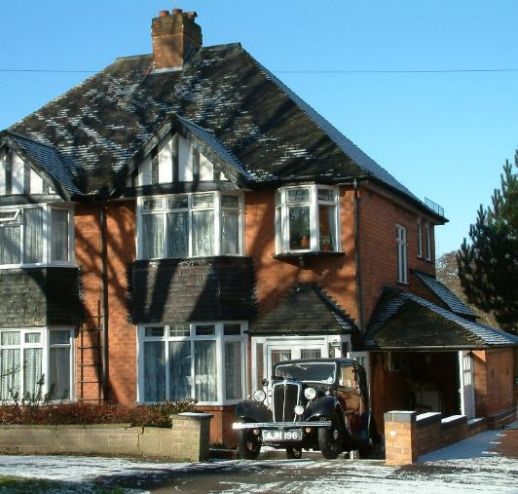
But war wasn’t the origin of planning!
Key inter-war issues included suburban sprawl
Google / author

Slide 34
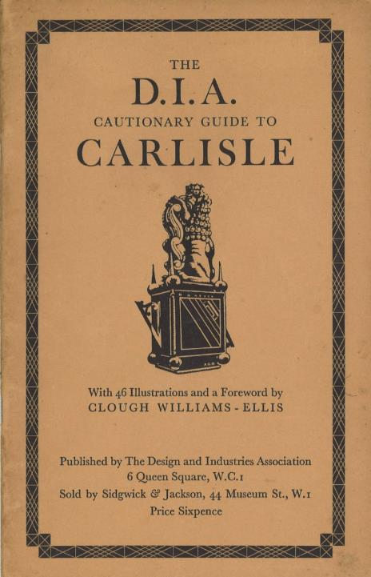
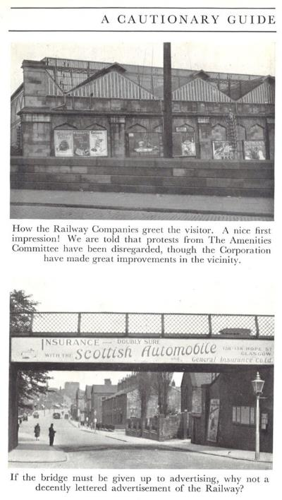
But war wasn’t the origin of planning!
Key inter-war issues included environmental quality
For example the DIA “cautionary guides” by Clough Williams-Ellis, the formation of the CPRE, growth of the National trust etc

Slide 35
But war wasn’t the origin of planning!
Responses included a series of county and region scale plans
Many involved, or were influenced by, Professor Patrick Abercrombie
(RIBA)

Slide 36
But war wasn’t the origin of planning!
Responses included the Green Belt (for London at least)
The Metropolitan Green Belt was the first such area of protected open land to be proposed in the UK, by the Greater London Regional Planning Committee in 1935 and the Green Belt (London and Home Counties) Act.
(Mais, 1939)

Slide 37
The post-war future
The number and nature of post-war plans – whether written/published during or immediately after the war.
We know of at least 250 for the UK, between 1940 and 1952. Most are “settlement-level” (but some focus on, for example, town centres rather than the whole town); some are county or even regional scale.

Slide 38
Who made the plans?
Often attributed to “authors”, often high-profile consultant planners.
But over 50% were written by local authority staff, many of whom are un-named.
“Authorship” is divisive, as most were team productions.
Some written by local pressure groups, individuals, or even via newspaper campaigns.

Slide 39
Consultant (with qualifications etc²) | Number of plans
Sharp, Thomas CBE MA DLitt MTPI FRIBA PPILA; TPI President 1945-6 | 11
Abercrombie, Sir Patrick MA DLitt FRIBA FILA; TPI President 1925-6 | 9
Davidge, William R. MTPI AMInstCE FRIBA FSI; TPI President 1926-7 | 8
Chapman, W. Dobson MA MTPI LRIBA FILA; TPI President 1943-4 | 5
Lloyd, T. Alwyn OBE Hon LLD FRIBA FILA FSA; TPI President 1933-4 | 5 (3 with Jackson)
Lock, Max ARIBA MTPI | 4
Adshead, Stanley D. MA MArch FRIBA; TPI President 1918-19 | 4
Edwards, A. Trystan FRIBA | 4
Holden, Charles LittD FRIBA MTPI | 4
Jackson, Herbert | 3 (with Lloyd)
Jellicoe, [later Sir] Geoffrey CBE RA PPILA FRIBA MTPI | 3
Chitty, Anthony M. MA FRIBA AMTPI | 3 (2 with Hening)
Nickson, Richard MA FRIBA (Abercrombie’s business partner from 1946) | 3 (with Abercrombie)
Gibberd, Frederick ARIBA AMTPI | 2
Hening, Robert MBE | 2 (with Chitty)
Holford, [later Lord] William BArch MA DCL Hon LLD ARA PPRIBA PPILA; TPI President 1953-4 | 2
James, Charles Holloway RA FRIBA | 2 (with Pierce)
Lutyens, Sir Edwin OM KCIE PRA FRIBA Hon LLD etc | 2
Minoprio, Anthony BArch MA FRIBA AMTPI | 2 (with Spencely)
Needham, Charles William Cashmore FRIBA | 2
Pierce, S. Rowland FRIBA | 2 (with James) + LRRC membership
Spencely, H.G.C. BArch FRIBA AMTPI | 2 (with Minoprio)
Thompson, F. Longstreth BSc FSI AssocMInstCE PPTPI | 2 (but seems not to have written reports)
Williams Ellis, Clough MC CBE FRIBA MTPI PPILA Hon LLD | 2
London-related plans
(… and there are many more who worked on just one plan)

Slide 42
Abercrombie, P. (1945) Greater London Plan 1944, HMSO,
London
Abercrombie, P. and Nickson, R. (1946) A plan for
Bournemouth, Poole and Christchurch, The Corporation
Bournemouth
Abercrombie, P. and Nickson, R. (1946) “Dover replanning
scheme” Architect and Building News 17/10/47
Abercrombie, P. (1947) “The Ministry of Town and Country
Planning announce that a development plan for
Birmingham now being drawn up by Sir Patrick
Abercrombie is expected to be published at the end of the
year” Architect and Building News 20/6/47
Abercrombie, P. et al. (c. 1947) engaged by Redditch UDC “to
provide a master plan for the development of the town”
Abercrombie, P. and Nickson, R. (1949) Warwick: its
preservation and redevelopment, Architectural Press,
London
Abercrombie, P., Owens, J. and Mealand, H.A. (1945) A plan
for Bath: report prepared for the Bath and District Joint
Planning Committee, Pitman, Bath
Abercrombie, P. and Plumstead, D. (1949) A civic survey and
plan for the City and Royal Burgh of Edinburgh: prepared
for the Town Council, Oliver & Boyd, Edinburgh
Professor Sir Patrick Abercrombie (RIBA)
Forshaw, J.H. and Abercrombie, P. (1943) County of London
Plan prepared for the LCC, Macmillan, London
Lutyens, E. and Abercrombie, P. (1945) A plan for the City
and County of Kingston upon Hull, A. Brown, London &
Hull
Watson, J.P. and Abercrombie, P. (1943) A plan for
Plymouth, Underhill, Plymouth
Plus regional plans for the Clyde Valley (1946), the West Midlands (1948), North Staffordshire (1949)
Plus overseas plans for Cyprus (1947), parts of Palestine (1947), Nicosia (1948), Hong Kong (1948), and Dublin (1941)

Slide 43
“He would breeze in unpredictably, a neat bundle of energy and humane enthusiasm, hand out intuitive notes and diagrams for the skilful team to flesh out, then buzz down to Aston Tirrold for a couple of nights with his beloved daughter Deborah, taking in a few CPRE inspections on the way” (Brett, 1985, p. 102).

Slide 44
The commissioners of plans
Most were local authorities (London Boroughs)
Some from organisations (RIBA etc), some individual

Slide 45
Conflict?
Especially local-centre, municipality/Ministry: for example, on Abercrombie’s Greater London Plan, the Ministry felt that his text was incomplete and inappropriate; the whole thing was inadequate for publication.
“The text had to be very considerably re-cast by our officers who could be ill spared, and the maps to make the Report intelligible have had to be prepared and are still not finished. Whatever allowances are made for the Professor, we have, I think, strong grounds for complaint” (undated memo to the Ministry Secretary, HLG 104/3).

Slide 46
Conflict?
And a Ministry comment on the City of London Improvements and Town Planning Committee’s report:
“We are not only disappointed, we are frankly alarmed. Never since 1666 has there been such an opportunity to replan parts of the City, and, if the plans we saw are adopted, this opportunity will once again be missed. Indeed, it will be more than missed, it will be deliberately passed by” (memo to Pepler, 12/1942, HLG 769/973).

Slide 47
Cost of replanning?
Location | Consultant | Date of contract | Fee (£) | Cost as at 2003 prices¹
Plymouth | Abercrombie | 1941 | 840 | 28,073
City of Westminster | Davidge | 1943 | 1,575 | 46,541
Clyde Valley | Abercrombie | 1943² | 5,000 | 147,750
Middlesbrough | Lock | 1943 | 940 | 27,777
Norwich | Thompson+ James & Pierce | 1943² | 2,000 | 59,100
Dudley | Alwyn Lloyd | 1944 | 475
Birkenhead | Reilly | 1944 | 1,050 | 29,106
Worcester | Minoprio/Spencely | 1944 | 670 | 18,572
Exeter | Sharp | 1944 | 1,050 | 29,106
Warwick | Abercrombie/Nickson | 1945 | 520; 3,200³ | 14,190 79,200
Oxford | Sharp | 1948⁴ | 2,625 | 61,950
Salisbury | Sharp | 1949⁴ | 1,050 | 23,761
Chichester | Sharp | 1949⁴ | 1,312 | 29,404
Bedford | Lock | 1950 | 5,000⁵ | 108,350

Slide 48
Plan production:
So most plans were written (or at least coordinated) by established, male, professional, well-educated, “establishment figures”.
Very little input from women (though some contributors, such as the sociologist Ruth Glass, did establish their own careers). Some planners were marginalised (eg Max Lock, in Hull)
Producing plans was expensive, nevertheless even some small places (with limited income from rates) employed expensive planners.
Planning histories have tended to focus on the “great plans” of the “great planners”

Slide 49
Plan communication
“Reconstruction, on the bold, big scale we want, can only succeed if it has the good-will of the people behind it. It will only have that good-will if the people are fully informed of the growth of our plans and made to feel that they are participating in these works and not merely having them foisted upon them” (Architect & Building News, 14 February 1941, page 116).

Slide 50
Plan communication
Large-scale (and expensive) models (Forshaw, Lord Latham, Abercrombie)

Slide 51
Plan communication
Year | Places | Number
1940 | Coventry | 1
1942 | Bristol, London (Royal Academy), LB Bermondsey, Portsmouth | 4
1943 | Belfast, Bristol, Clydebank, Edinburgh, Great Yarmouth, Hull, London (2), County of London, London (Royal Academy), Greater London, LB Stepney, Oxford, Preston | 14
1944 | Bilston, Bristol, Grimsby, Leicester, Lincoln, County of London, London (Royal Academy), City of London (2), LB Kensington, LB Tottenham, Macclesfield, Plymouth (2), Tewkesbury, Walsall, Worcester | 17
1945 | Bath, Bedford, Chelmsford, Coventry, Glasgow, Gravesend, LB Brentford, LB Hackney, LB Hornsey, LB St Pancras, Manchester, Middlesbrough, Middleton, Northampton, Richmond, Sheffield, Swindon, Taunton, Windsor, Wolverhampton, Wolverton | 21
1946 | Bilston, Birkenhead, Cheshunt, Crewe, Dover, Exeter, Glasgow (2), Hull, Knutsford, LB Pimlico, LB Twickenham, Mablethorpe, Sudbury, Welshpool | 15
1947 | Leamington Spa, Liverpool, City of London, Warwick, Weston super Mare, Worcester | 6
1948 | Coventry, Hartlepool, LB Lambeth, LB Poplar, LB Westminster, Oxford | 6
1949 | Chichester, Glasgow | 2
1950
1951 | Aberdeen, City of London | 2
unknown | Cardiff, Dudley | 2

Slide 52
Plan communication
Large, and often popular, exhibitions (County of London Plan presentation 1943)

Slide 53
LRRC, 1943: author’s collection

Slide 54
Building Now exhibition (A&BN 1946)

Slide 55
Plan communication
Books and pamphlets for public sale – from very expensive to free

Slide 56
Plan content – and how to get the message across
High verbal content, data-rich, but most were exceptionally well illustrated, many printed in colour
Early plans were radical
Many were phased over 20-50 years
Key concerns were housing, infrastructure, town centres, leisure/recreation – but many proposed large “civic centres”!
From about 1947 the radical quality faded, as “1947 Act” Development Plans were phased in

Slide 57
City of London (1944) Improvement Committee Report
Colour visions (“seductive images”) – expensive,
largely by architectural illustrators

Slide 58
Not all were very helpful, even when commissioned from the best architectural illustrators such as J.D.M. Harvey.
City of London (1944) Improvement Committee Report

Slide 59
Heavy use of maps – but are they clear to readers unused to interpreting maps?

Slide 60
Striking, but perhaps difficult-to-interpret, diagrams (the “egg diagram” for the County of London Plan)

Slide 61
Focus on zoning and land uses
County of London Plan

Slide 62
Focus on infrastructure
10-year plan for new roads (Holden & Holford)

Slide 63
Focus on housing
Soho planned redevelopment (City of Westminster Plan)

Slide 64
Key issues and examples of plans
So much is written on Abercrombie and the “trio” of City, County and Region plans that here I focus on some perhaps less-known plans.

Slide 65
Royal Academy (1942) London replanned

Slide 66
Royal Academy (1942) London replanned

Slide 67
Royal Academy (1942) London replanned

Slide 68
Royal Academy (1942) London replanned

Slide 73
(Remember, this is before Heathrow, Gatwick and London City! Croydon was then the major airport.
Airliners were small.)

Slide 74
Royal Academy (1944) Road, rail and river in London

Slide 75
Royal Academy (1944) Road, rail and river in London
The best illustrators (A.C. Webb, P.D. Hepworth)

Slide 76
Royal Academy (1944) Road, rail and river in London
The best illustrators (Webb, Hepworth) focusing on major (road) infrastructure

Slide 77
Lindy & Lewis perspective 1944

Slide 78
“Here is a planning doodle presented in an elaborate form, exhibited as though it were a serious and finished proposal and publicised widely in the daily press. Its authors cannot therefore shelter behind the protest, as they have attempted to do, that it is merely an amateur spare time effort: they must expect to be judged by the severe standards that the magnitude of the problem of replanning the venerable City of London imposes on professional full-time planners” (Architect’s Journal, 1944)

Slide 79
Bailly’s plan (Builder 1944) – one of those about which very little is known!

Slide 80
Kent, E.C. and Samuely, F.J. (1944)
Even at the time, there was a need to make comparisons across a complex and confusing multiplicity of plans
(Kent and Samuely, 1944)

Slide 81
The example of bombed churches
(Larkham and Nasr, 2012)

Slide 82
Holford: model (showing churches) (IWM collection)

Slide 83
The Temple, H.S. Merritt (IWM collection)
St Alban, interior, Guildhall Library (Milne, 2001, 100)
St Paul and St Vedast (Hanslip Fletcher)
“Completely destroyed”? Propagandistic language? Substantial remains survived for most.

Slide 84
The debates over repair, rebuild, sell off…

Slide 86
Ministry views and priorities
(NA WORK 14,2262)

Slide 87
Laid out as garden (photo in common use in contemporary architectural publications)
All Hallows Barking by the Tower, Fletcher, 1944
All Hallows Barking as rebuilt, NMR
One example: as bombed, temporary response, rebuilding.

Slide 88
The very different response for St Alban.
St Alban across Wood St, (Guildhall Library: Milne, 2001, 89)
(National Archives)

Slide 89
(Much later) Innovative re-use (Cunningham, 1988)

Slide 90
Christ Church as garden
(Bombed churches, 1945)

Slide 91
St Mary Aldermanbury prior to demolition Guildhall Library (Milne, 2001, 77)
Its site today.

Slide 92
Plaque on site noting removal and rebuilding of remains in Fulton, USA, as a memorial to Winston Churchill.

Slide 93
The rebuilding
A very slow start – impact of recession and rationing
Public dissatisfaction at speed of implementation - but
High speed of change from late 1950s quickly leads to a pro-conservation backlash!
Variety in what was built – includes traditional, modern, new materials and prefabrication

Slide 94
Area around St Paul’s, 1938 (Aerofilms)

Slide 95
Area around St Paul’s, 1988 (Britain from Above)

Slide 96
The Barbican
A long, slow project
(Mappinglondon.co.uk)

Slide 97
Familiar, traditional, “safe” styles for new housing
(County of London Plan)

Slide 98
High rise and Modernism (in two very different artistic styles) (County of London Plan, Greater London Plan)

Slide 99
The end of the “reconstruction era”?
Financial problems following 1973 oil crisis
Rise of explicit concern for heritage following 1967 Civic Amenities Act
Major projects interrupted.

Slide 100
The end of the “reconstruction era”?
“The ones that got away”: unimplemented plans such as the reconstruction of Whitehall (National Archives; Sharr & Thornton, 2013).

Slide 101
Responses to the “reconstruction replanning”?

Slide 102
“Have you noticed a veiled hostility to the Department … ?” (Punch, 7/6/1943)

Slide 103
Persistence in the urban landscape: Lowndes St, left as bombed until sold for £1.5m in 1990; gap in Tottenham Court Road (Estates Gazette: author)

Slide 104
Replacement of reconstruction: how long does such massive investment last?
Need to respond to changing socio-economic situations; fashions; property market especially for housing in London etc.
(Building Design, 2005; Britain from Above)

Slide 105
Replacement of reconstruction: how long does such massive investment last?
Need to respond to changing socio-economic situations; fashions; property market especially for housing in London etc.
The “new” Paternoster Square (Wikipedia)

Slide 106
Conclusion: the impact of the London plans
Plans were produced, public expectation raised, but delivery was very slow (until the mid 1950s).
Potential problem of multiplicity of plans; some complex and not easy for public to understand.
Reinforcing ideas of ‘nesting’ of plans from local to regional scales.
Perception of rebuilding as being large-scale projects, often infrastructure-driven (eg ring roads).
“Persistence of the plan” – enduring influence despite replacement by subsequent generations of plan-making.

Slide 107
Conclusion: other issues
Persistence of bomb sites / visible ‘heritage’ of wartime damage.
Eventually, in the 1960s, the rate and scale of change led to the conservation movement.
Continuing intense development pressures in London, as the capital city, leading to ‘re-development of the reconstruction’.

Slide 108
Thank you. Time for discussion and questions
(Punch, 1942)

