Slide 1
Imports and exports in Tudor London
Ceramic studies

Slide 2
Agas copperplate map of 1553-9

Slide 3
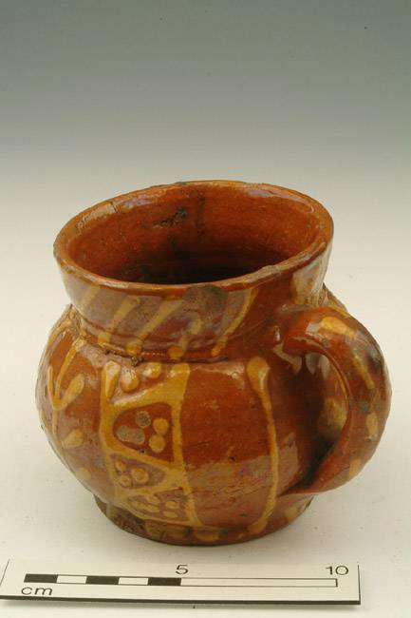
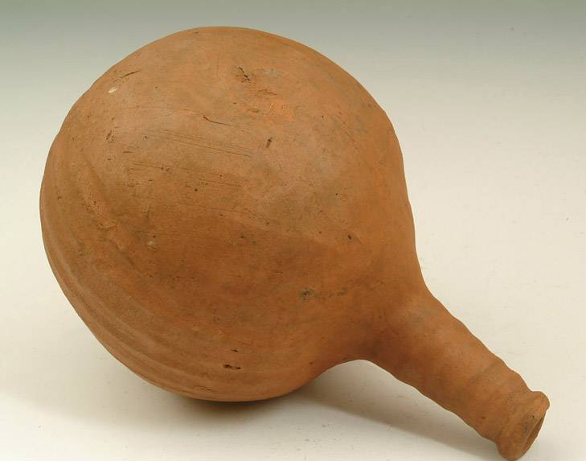
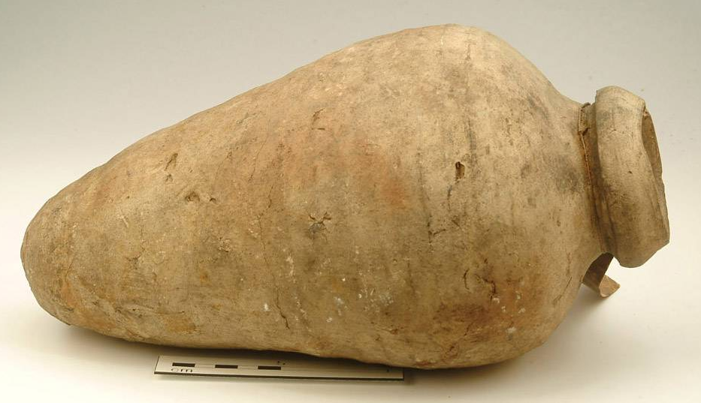
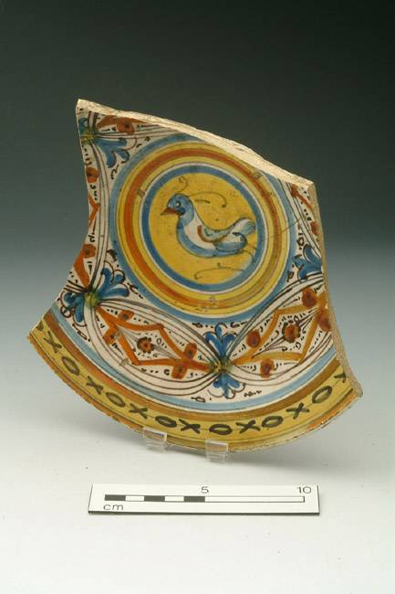

Slide 4
The Hanseatic League in London
Hans Holbein the Younger: Portrait of the merchant
Georg Gisze, 1532 (Berlin State Museums)

Slide 5
The Steelyard (Stahlhof), London’s Hanse depot
Wyngaerde’s Panorama, mid 16th
century

Slide 6
Siegburg stoneware

Slide 7
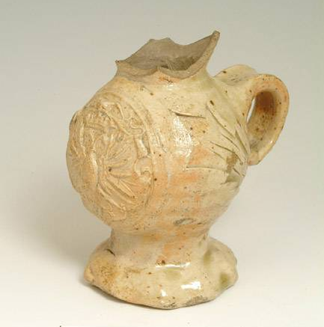

Slide 8
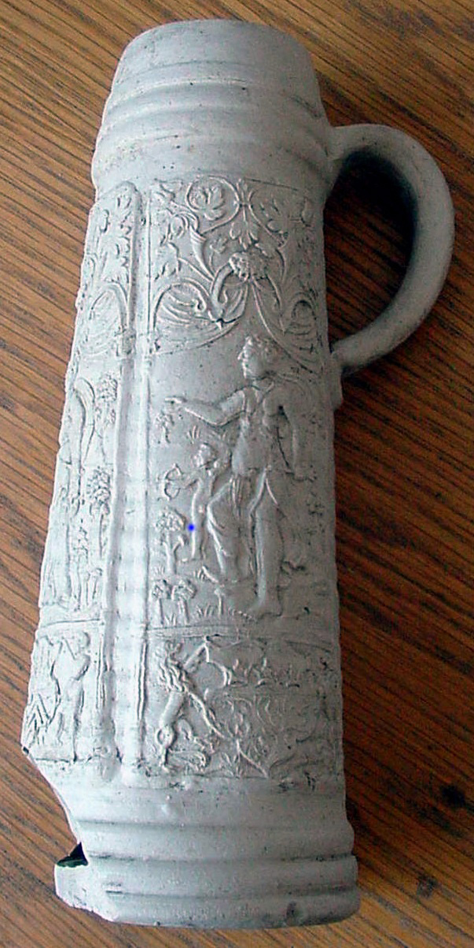
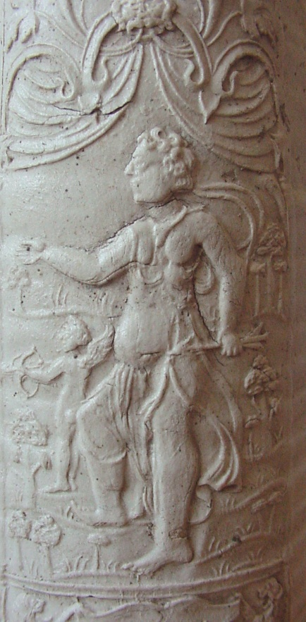
Leonard St (LNJ06)
Found in Lombard St EC3
Dated 1573

Slide 9
Found on site of Holywell Priory,
dated 1582, with applied arms of
the Hanse

Slide 11
Langerwehe stoneware

Slide 12
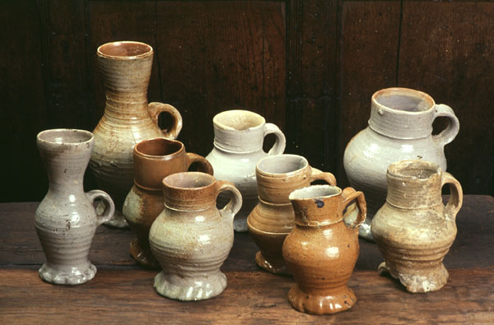
Aachen/Raeren stoneware
Exeter Archaeology

Slide 13
Pieter Brueghel the Elder – Peasant Wedding (c 1568)
Kunsthistorisches Museum, Vienna

Slide 14
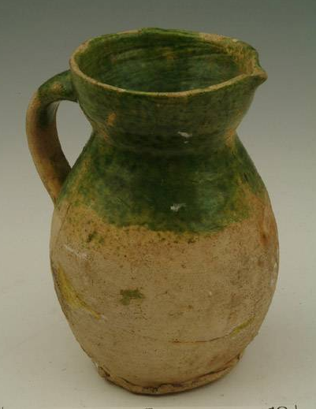

Slide 16
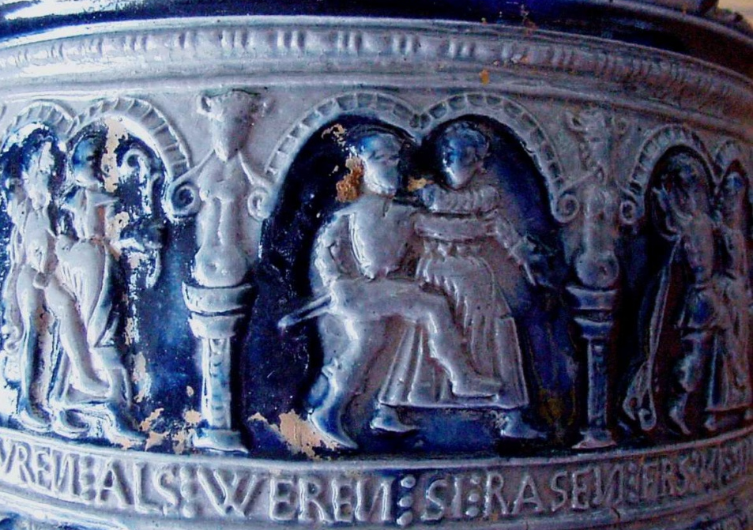
Found in Walbrook
(WAO06)

Slide 17
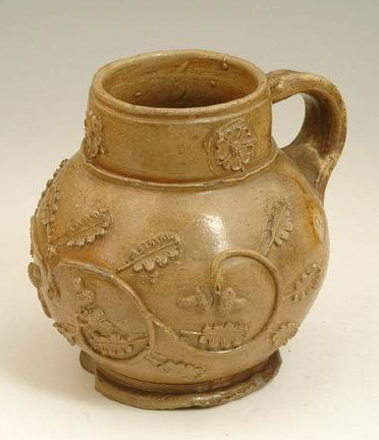
Cologne stoneware

Slide 18
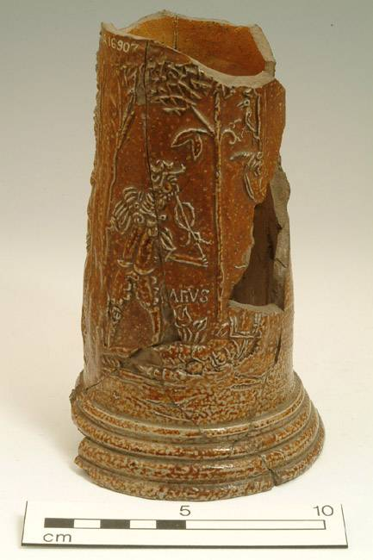
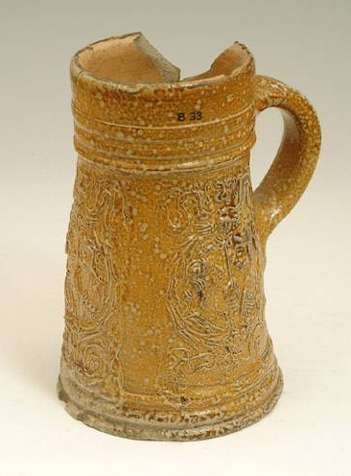

Slide 19
Frechen stoneware

Slide 21
Werra slipware

Slide 22
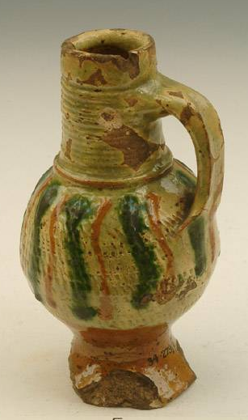
Weser slipware

Slide 23
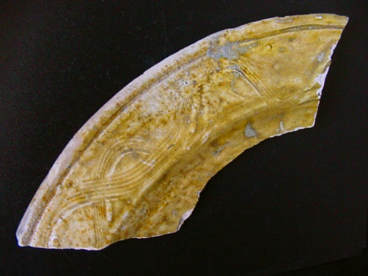
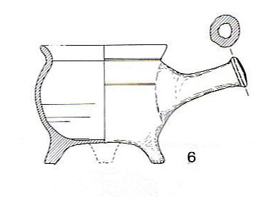
German lead-glazed earthenwares and Harmon Raignold, an immigrant potter

Slide 24
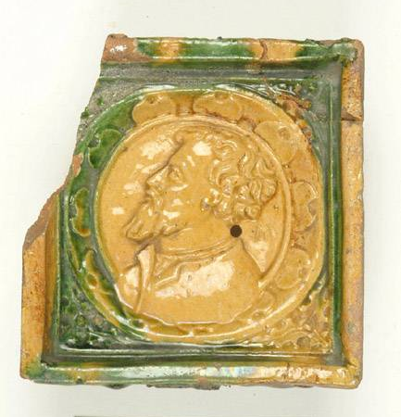
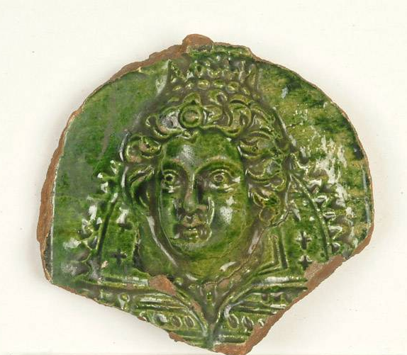
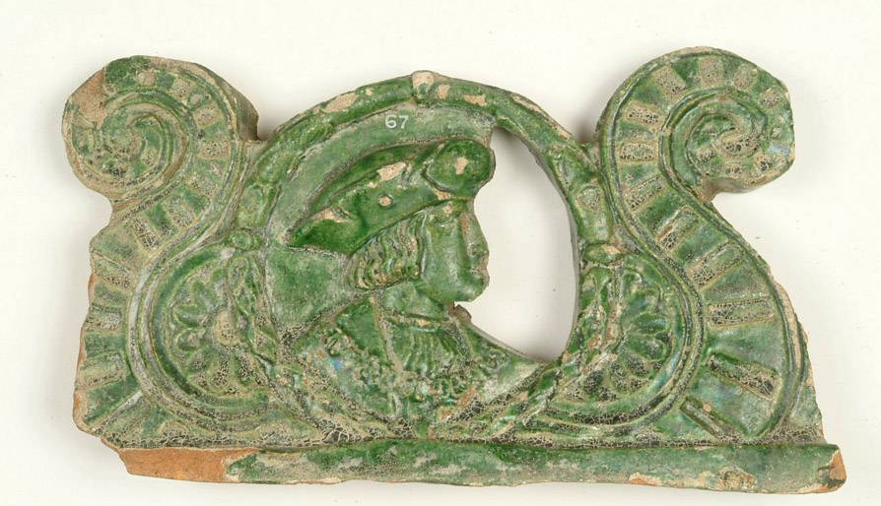
Ceramic tile stoves

Slide 25
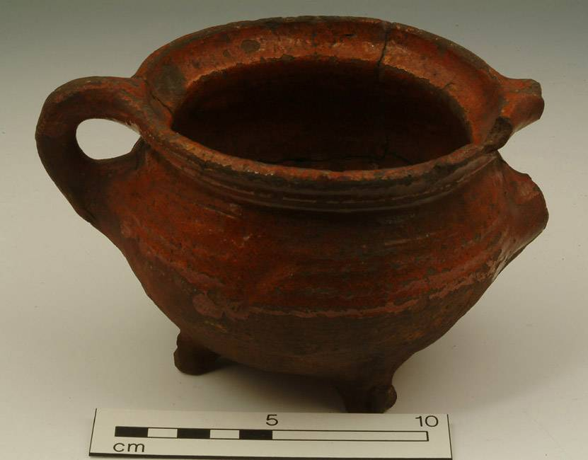
Low Countries redwares
Pieter Aertsen: Christ and the
Adulteress (1559)

Slide 26
Slip-coated bowl
Joachim Buckelaer: Christ in the House of Martha and Mary (1565)

Slide 27
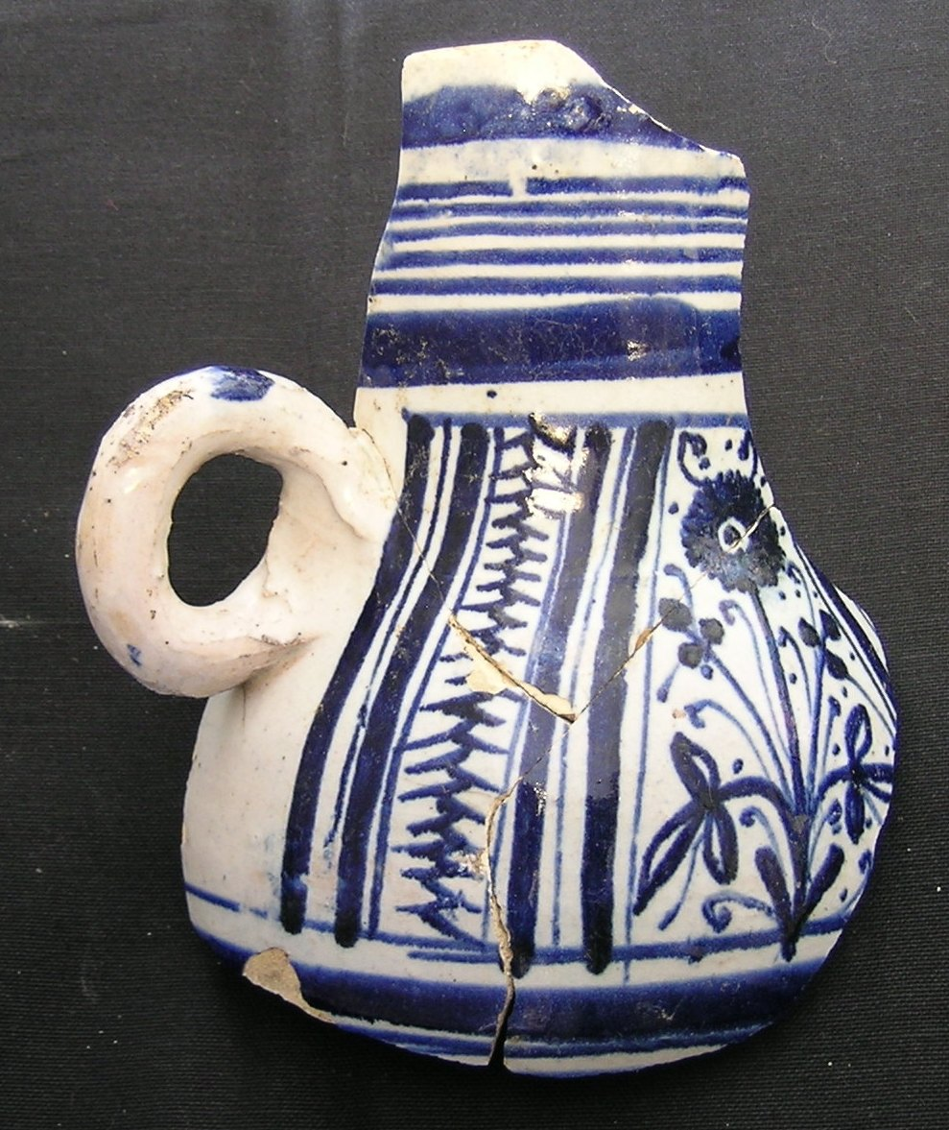
Regis House, King William Street (KWS94)

Slide 28
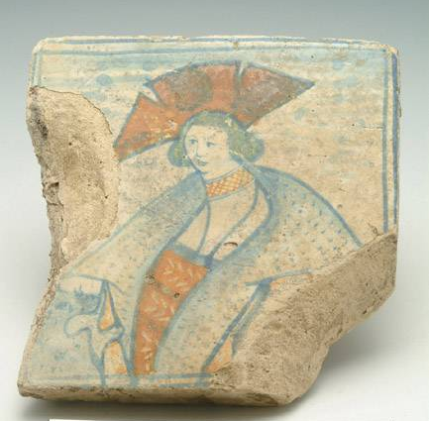

Slide 29
France - pottery of the Beauvaisis
Surrey-Hampshire border ware
Exeter Archaeology, found in Fore St

Slide 30
Beauvais sgraffito
Exeter Archaeology, found in Fore St

Slide 31
Martincamp-type ware

Slide 32
Pottery of the Saintonge

Slide 33
Palissy-type ware
Found at Blackfriars
(VAL88)
Metropolitan Museum of
Art, New York

Slide 34
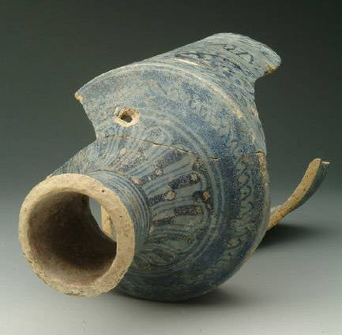
Italian imports - Ligurian and Montelupo maiolica

Slide 35
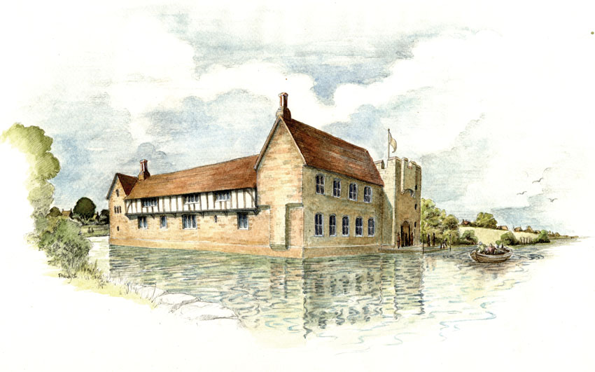
Geffrye Museum

Slide 36
Deruta maiolica

Slide 37
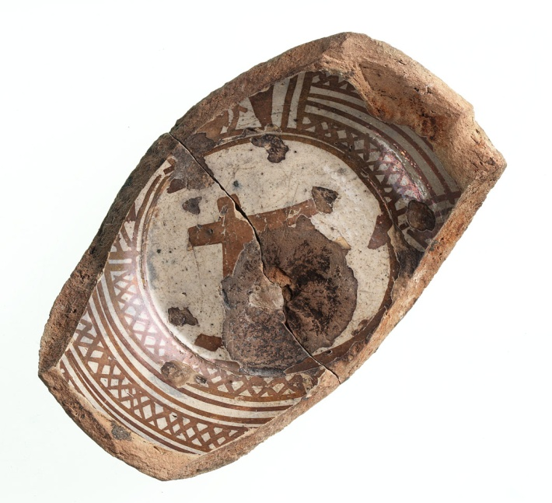
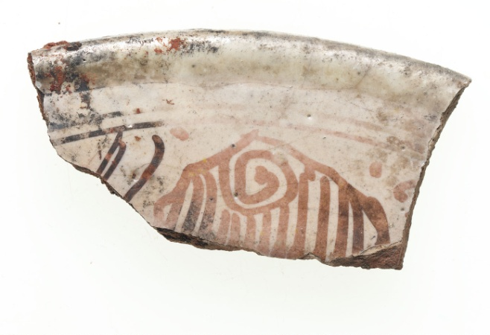
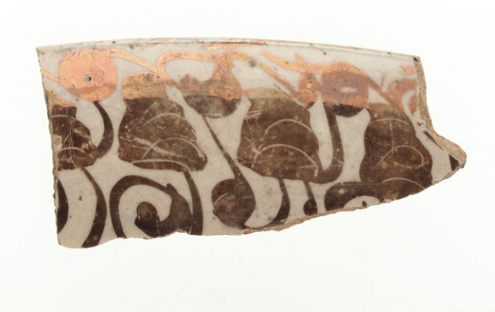
Spain – Valencian lustrewares

Slide 38
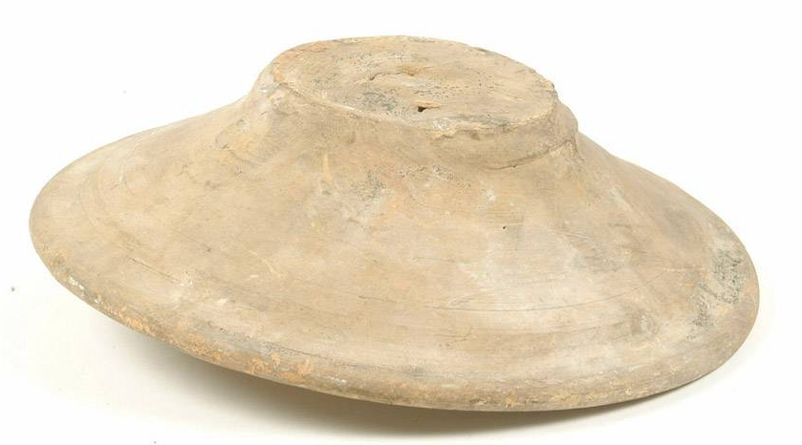
Plain Spanish tin-glazed ware
Exeter Archaeology, found in
Paul Street

Slide 39
Velázquez: The Waterseller of
Seville (1623)

Slide 40
Chinese late Ming porcelain

Slide 42
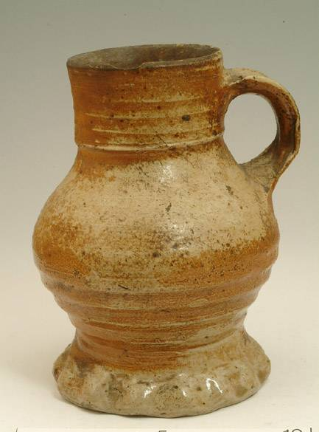
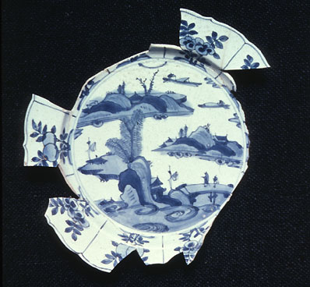
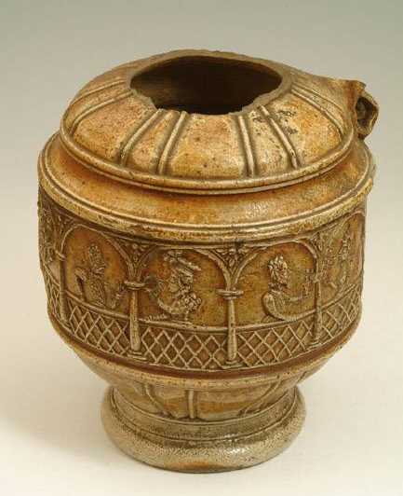
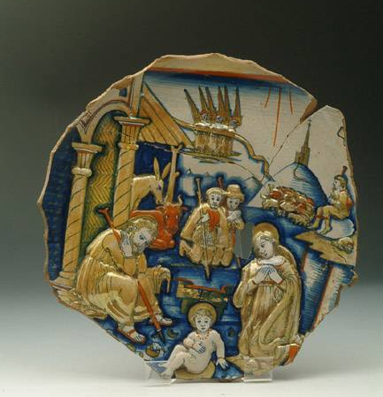
Riches from around the world

