Slide 1
Finds from the Naval Victualling Yard
Roy Stephenson
Archaeological Archive Manager

Slide 2
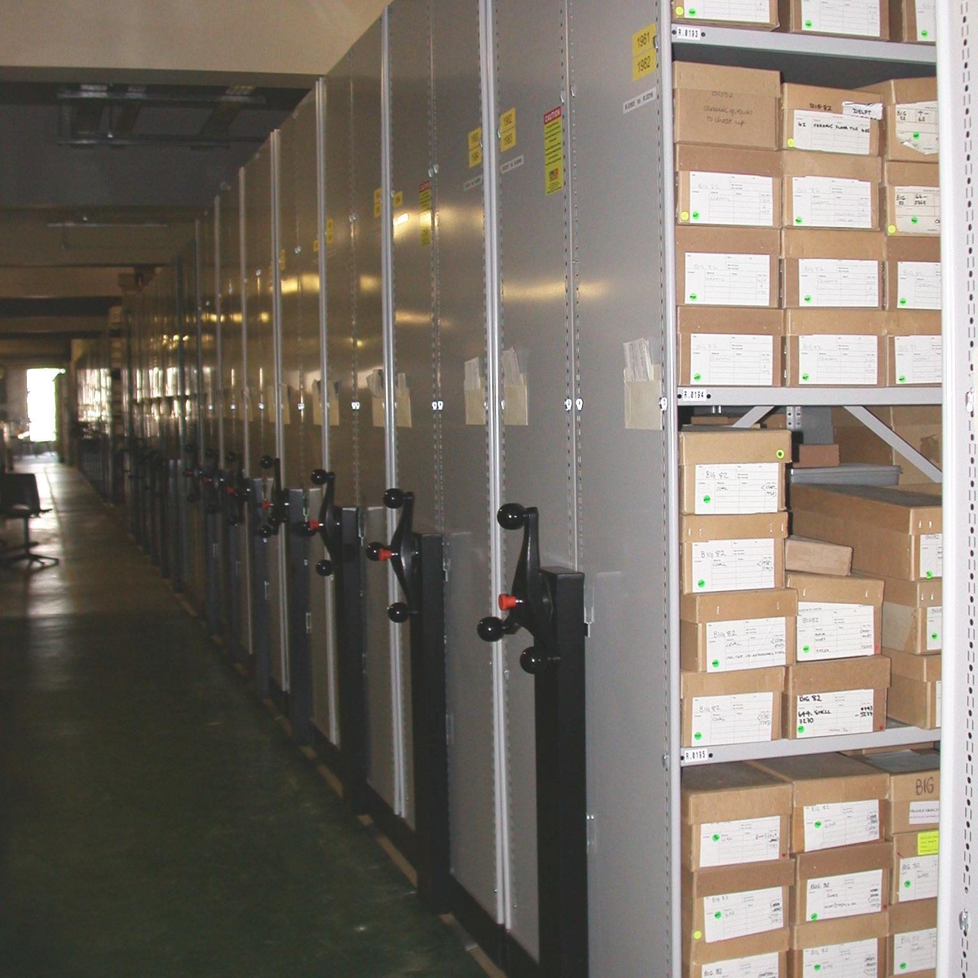
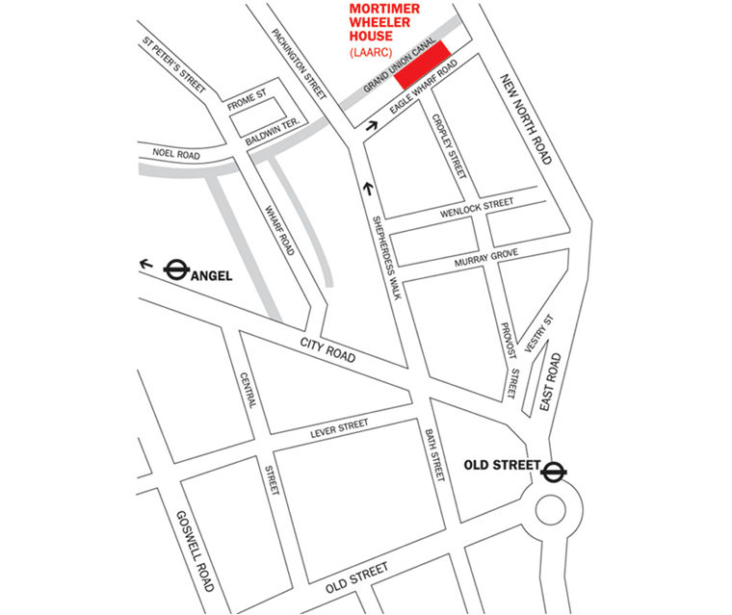
LAARC
Curation
Research
Access and Learning
Leadership

Slide 3
The Royal Naval Victualling Yard at East Smithfield was founded in 1560 and remained on site until 1785 when victualling operations were finally fully transferred to Deptford. The excavations on the site, called the Royal Mint, took place between 1976 and 1988. A fully integrated report has been written to take into account all the strands of evidence for the development of the Yard. This approach aims to achieve a greater understanding of the site’s history through a combination of stratigraphic, documentary, finds and environmental evidence. The volume is the third of three on the archaeology of the site. It follows a MoLAS Studies Series Paper on the Black Death cemetery of 1348–50, and a monograph on the Cistercian Abbey of St Mary Graces 1350–1538 and the manor house 1538–60.

Slide 4
The Royal Navy Victualling Yard, East Smithfield, London
MoLA Monograph Series
Authors: Grainger I and Phillpotts C
Publication late 2009/early 2010

Slide 5
On May 21st 1661 Samuel Pepys recorded in his diary, ‘Up early, and, with Sir R. Slingsby (and Major Waters the deaf gentleman, his friend, for company's sake) to the Victualling-Office (the first time that I ever knew where it was)’.

Slide 6
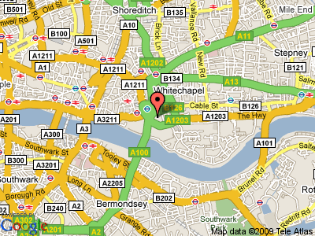
The Royal Mint is a two hectare (4.94 acre) site to the north-east of the Tower of London, lying between Royal Mint Street to the north, East Smithfield to the south, Cartwright Street to the east, and Tower Hill to the west. After the closure of the Victualling Yard in 1785 the buildings became government warehouses before the Royal Mint was transferred to the site from the Tower of London in 1806. The Royal Mint was gradually transferred to its present home in Llantrisant.

Slide 7
Queen Elizabeth I bought the manor of East Smithfield with the former monastery of St Mary Graces from Sir Arthur Darcy for £1200 in 1560, to serve as a central depot for the victualling of the navy.

Slide 8
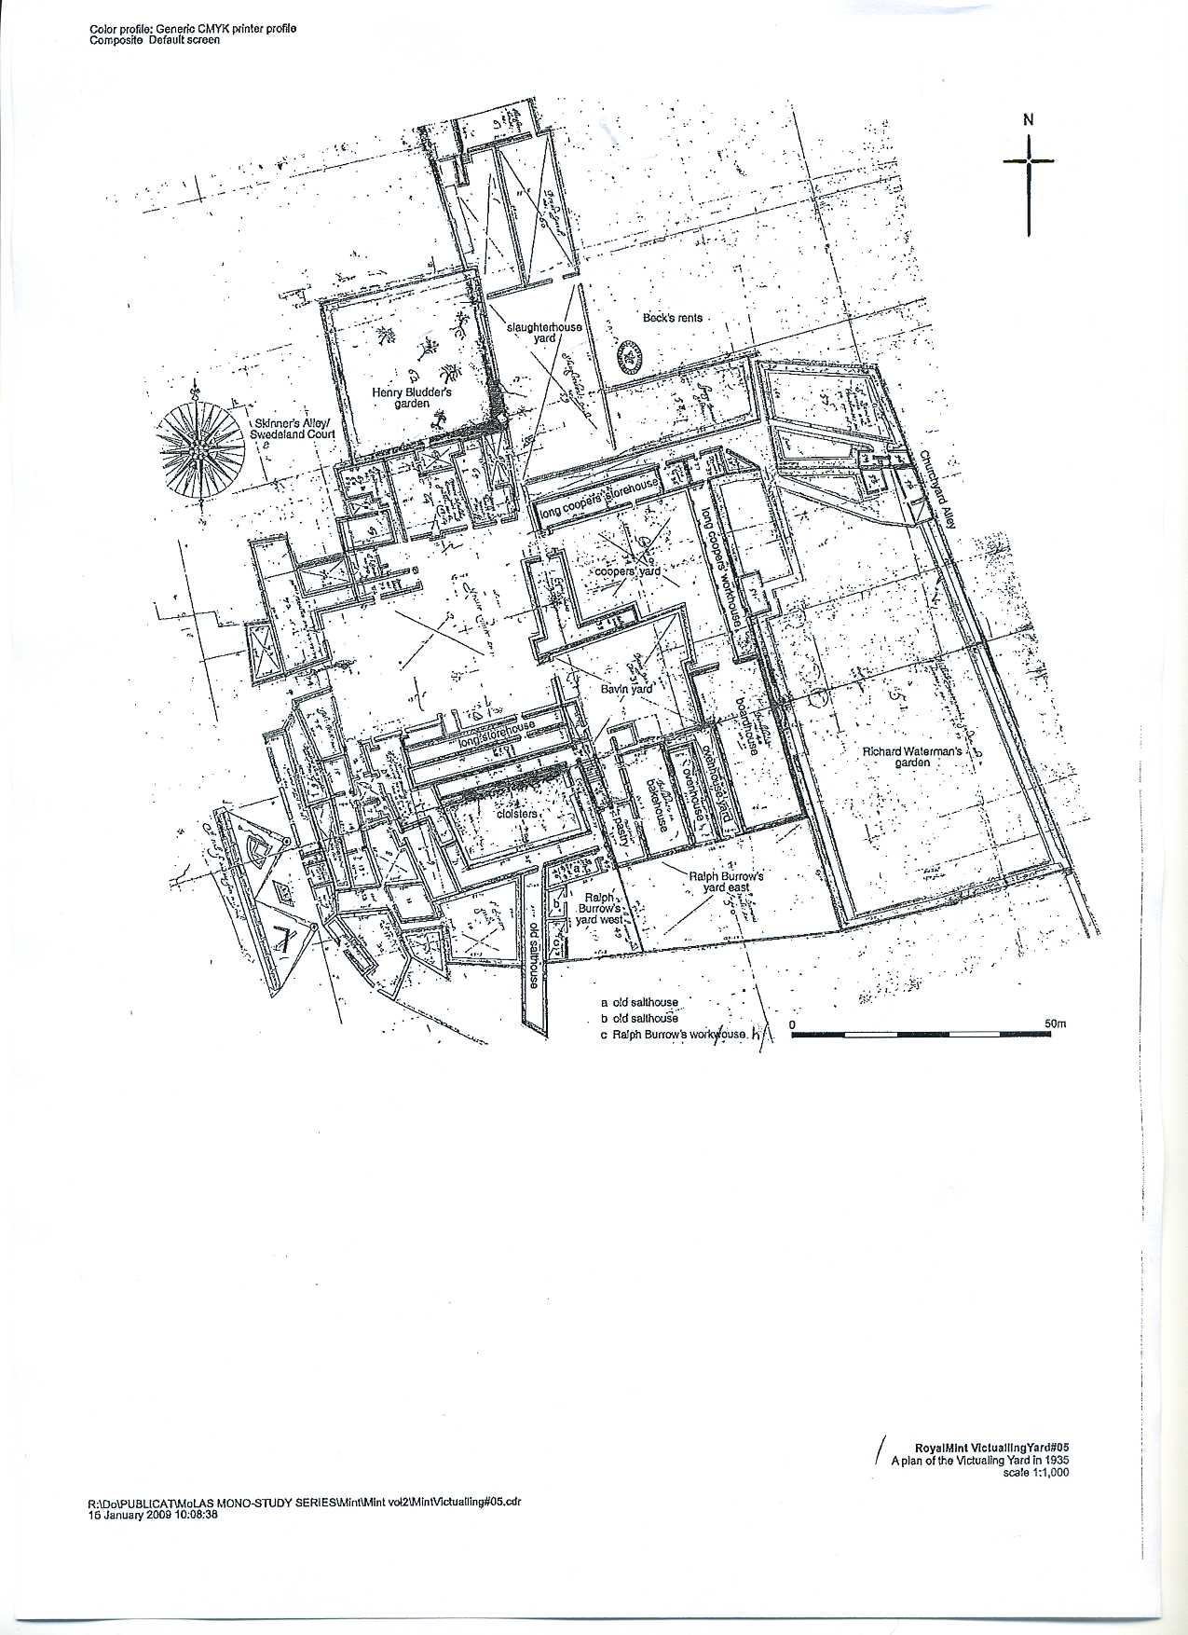
1635 plan

Slide 9
The frequent complaints from their occupants as to the unsuitability of the buildings at Tower Hill for the purposes of victualling begs the question of why the site was chosen for that purpose in 1560?
Until the middle of the 16th century there was no separate and permanent victualling department for the Navy. Officials were appointed to supply the ships of particular fleets for individual campaigns. Edward Baeshe was appointed as the first General Surveyor for the Victuals for the Seas in 1546. He was in charge of a series of officers in each of the naval dockyards, and a network of agents in all the counties of the kingdom, operating a system of ‘purveyance’,
At this time the Navy probably already had a presence on Tower Hill. In c1560 regulations stated that principal officers of Navy were to meet at least weekly ‘at our house at towerhill’. The ordinances were to be kept in the ‘consultation house’ there.
A precedent for the centralised victualling service lay in the arrangements to supply the requirements of the royal palaces like Greenwich.

Slide 10
The Tower Hill site was probably the largest close to the Thames, the City with its existing markets and supply routes, the weekly meeting place of the principal officers of the Navy, and other rented stores to the east of the capital, available at the time.
That the buildings at Tower Hill rapidly became unsuitable and required constant repairs, and that the location became inconvenient for the demands placed upon the victualling service by the greatly expanded 17th and 18th century navies, can scarcely be blamed on those who chose the site to help provide for the much smaller Tudor navy.

Slide 11
functions
The Yard’s activities can be grouped under five main functions or spatial groups: administration; baking; meat processing; storage; and coopering. To these might be added a sixth spatial group of domestic occupation: a number of individuals, normally officers of the Yard, had dwellings in there. Brewing only appears to have been undertaken on site prior to c.1600.

Slide 12
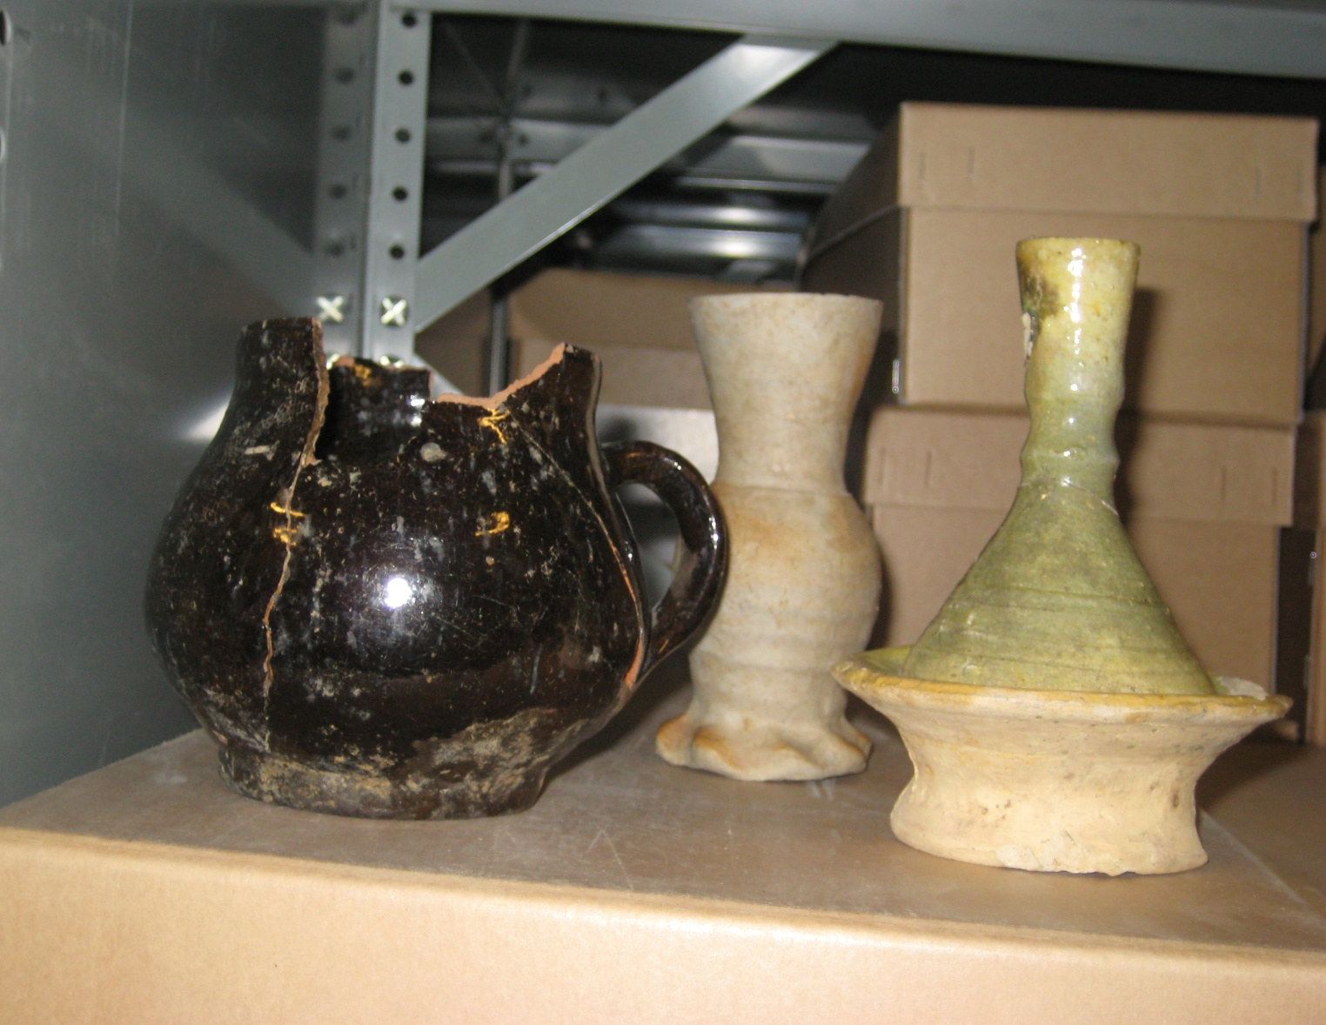
Group from Yard

Slide 13
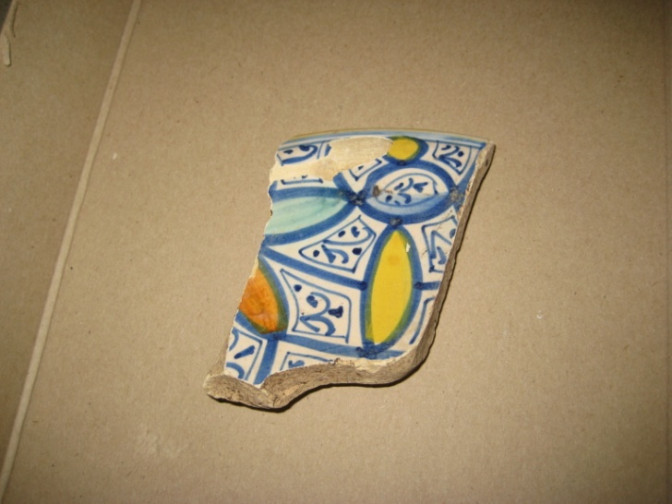
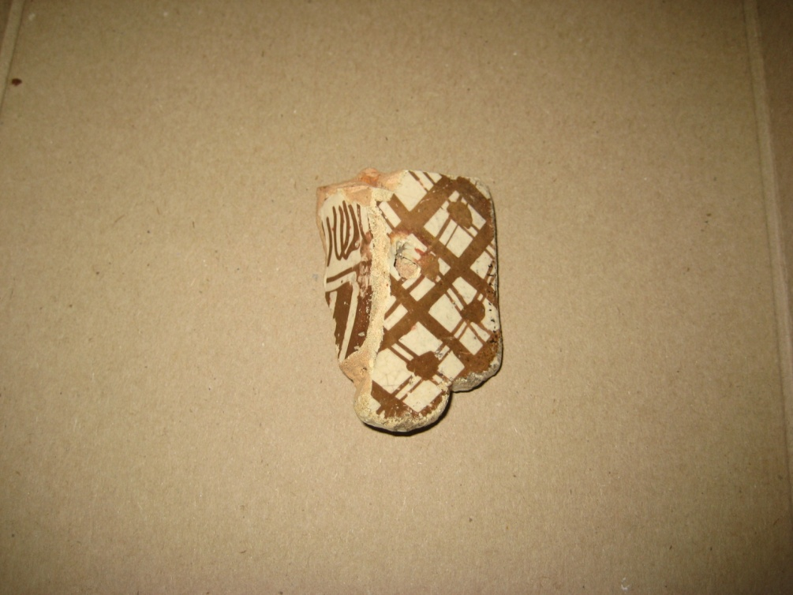
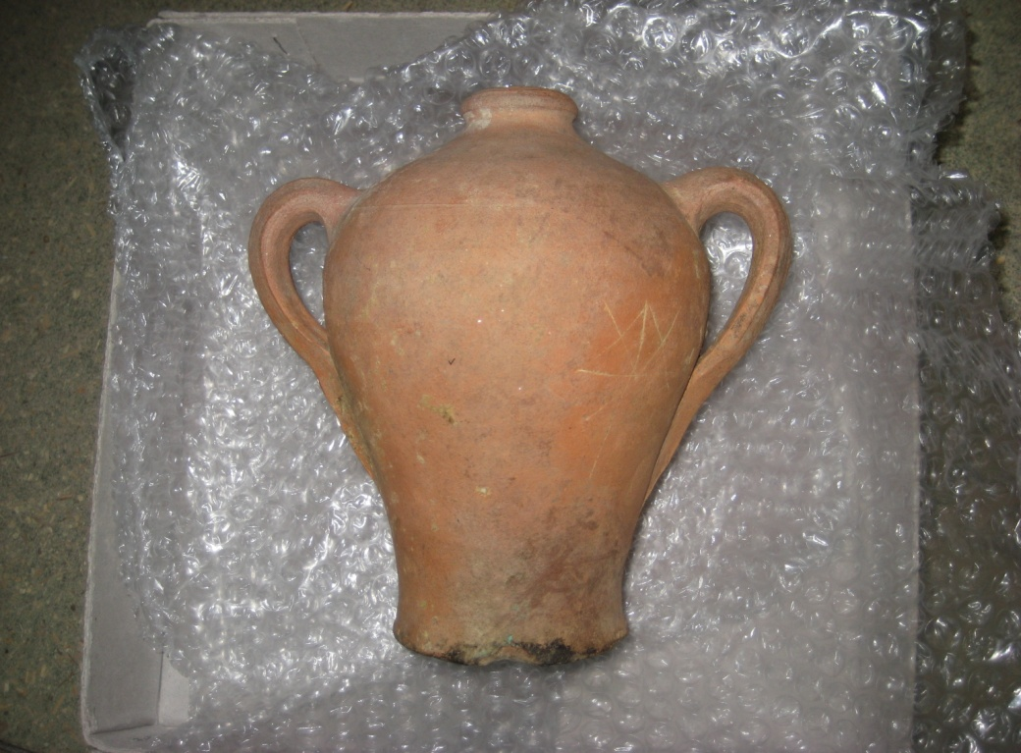
Imported pottery

Slide 14
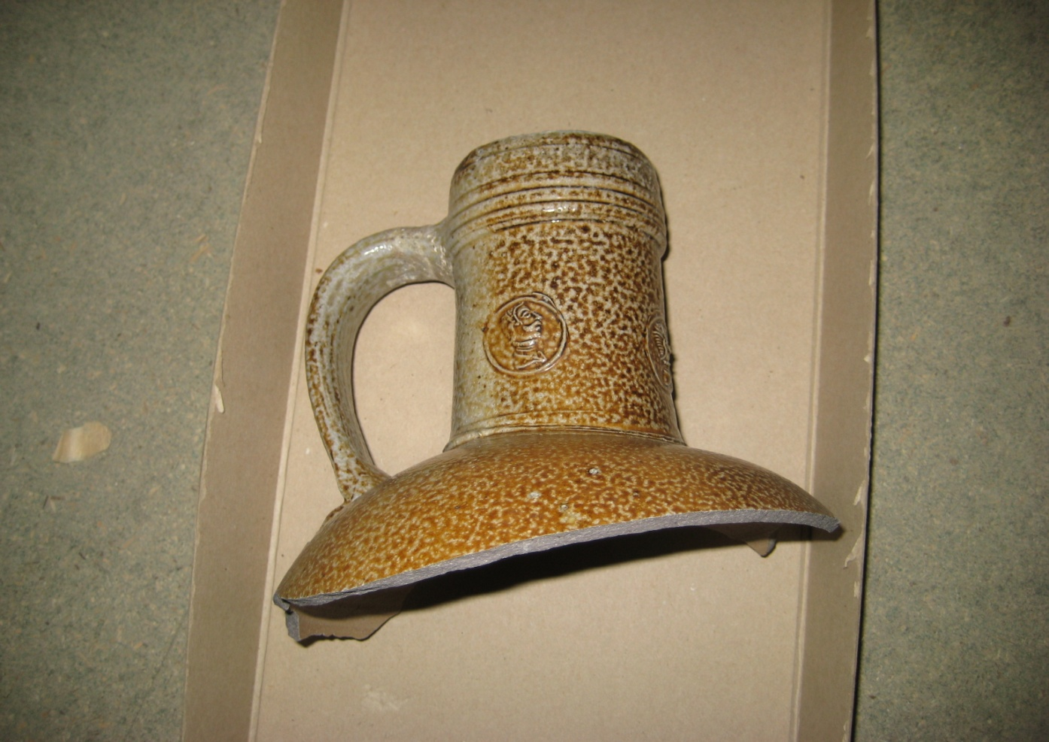
Rhenish Stoneware

Slide 15
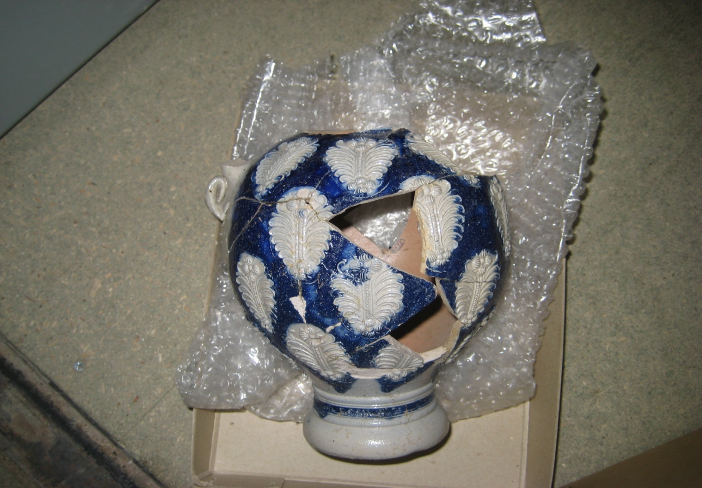
Westerwald Stoneware

Slide 16
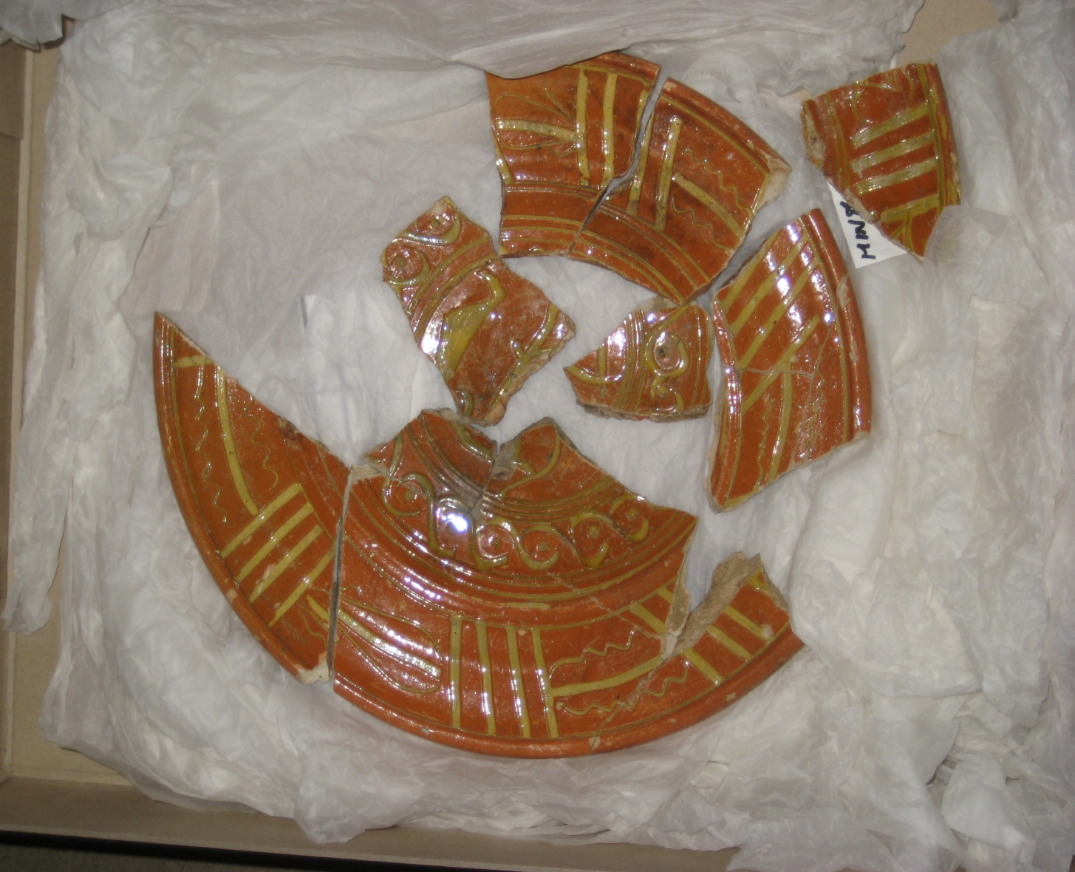
Beauvais Sgraffito ware

Slide 17
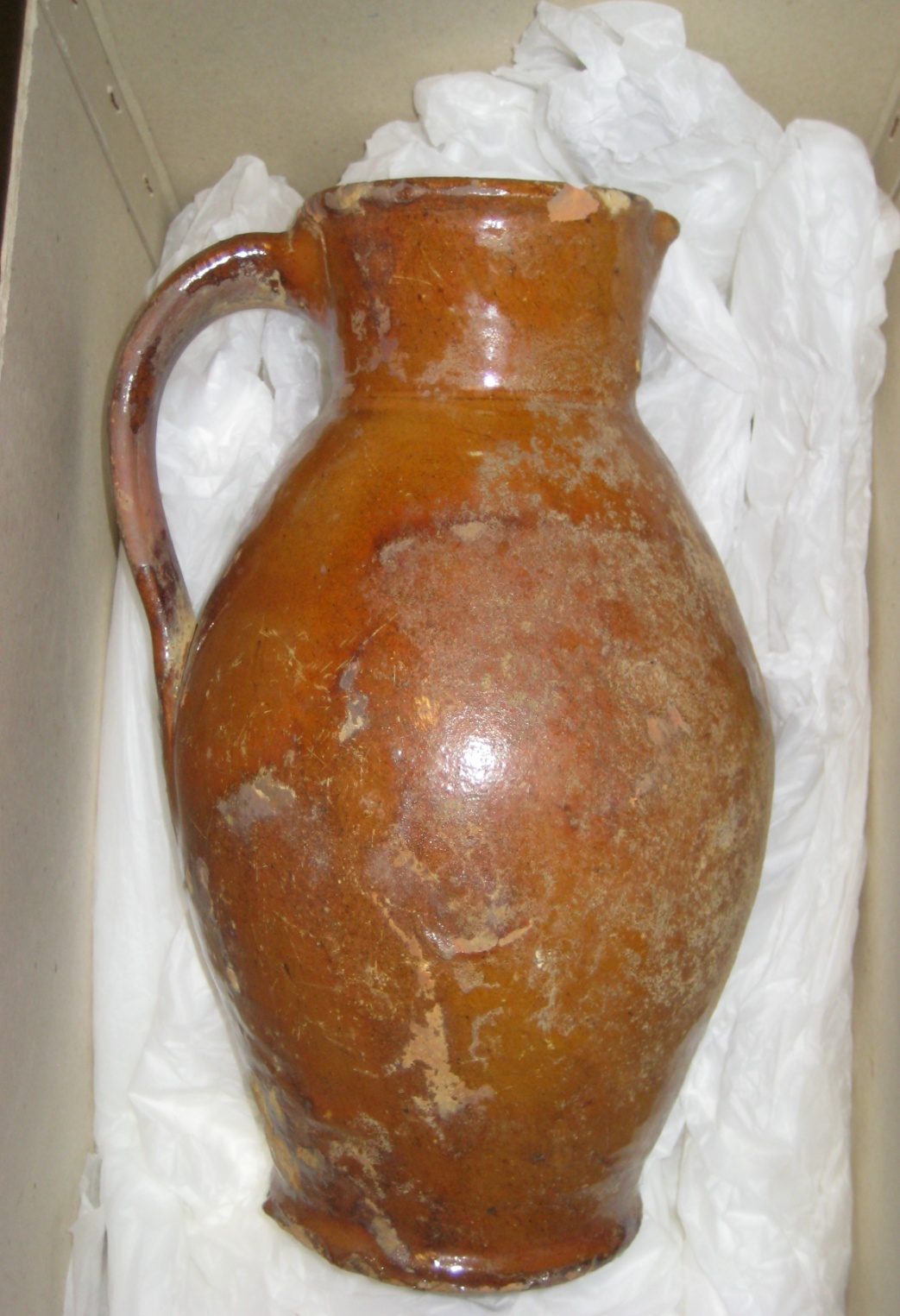
Post-Medieval redware

Slide 18
The Victualling Department apparently failed one of its first great tests: the provisioning of the fleet against the Armada in 1588. The Armada was expected a year before, but only 6020 pieces of beef were available, and 2300 stockfish, and the provisions for 1000 men for a month were clearly not ready . However the Tower Hill establishment should not bear too much of the blame for this failure, a slaughterhouse was not built there until 1596, and there is but one reference to a storehouse for ling in 1600, to suggest that fish were stored there. The Victualling Department found no difficulty in supplying 13000 men in 1596, or 9200 men in 1597.

Slide 19
Breakdown of the fabric and forms from horn core pit in Becks Rents (OA30) by rim EVES
Form | Fabric types
 | BORD | METS | NIMS | PMR | RBOR | TGW | WEST
Bowl |  |  | 0.13 | 012 |  |  | 0.09
Chamber pot | 0.21 |  |  |  | 0.15 | 0.17
CHR? |  |  |  |  |  | 0.09
Jar |  |  |  | 0.20
Jug |  | 0.12 |  | 0.20
Plate |  |  |  |  |  | 0.20
Total EVEs | 0.21 | 0.12 | 0.13 | 0.52 | 0.15 | 0.46 | 0.09
% of Total | 13 | 7 | 8 | 31 | 9 | 27 | 5

Slide 20
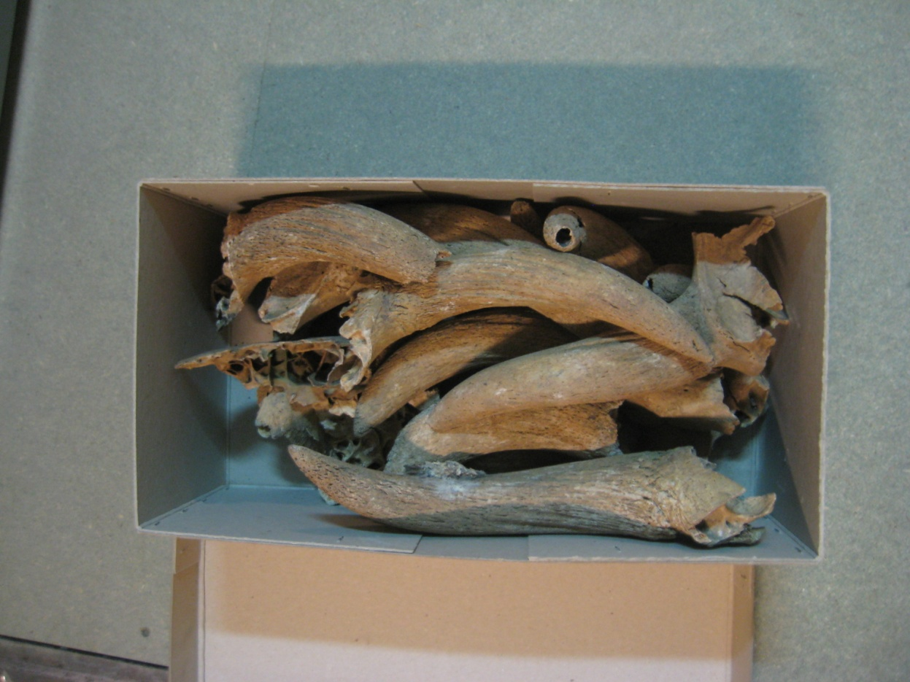
Horn cores

Slide 21
Horn cores
The horn cores very probably derived from the cattle slaughtered in the Yard, and were regarded as a convenient local building resource.
They are not in themselves necessarily indicative of any particular function for the vats or pits concerned., but the big horn core lined pits in Churchyard Alley was a tanning vat used for the preparation of cattle and pig hides procured from the Yard.
Yet despite the historical and archaeological evidence for the Yard’s slaughtering facilities and their output, If the 1,459 horn cores, representing some 730 cattle, are divided into 40 oxen a day (the requirement for the slaughterhouse when built in 1595), they comprise only 19 days worth of slaughterhouse waste. Much of the waste must have been removed entirely from site.

Slide 22
The Royal Navy Victualling Yard, East Smithfield, London
MoLA Monograph Series
Authors: Grainger I and Phillpotts C
Publication late 2009/early 2010

