Slide 1
The Disordered Brain what happens when decision making goes wrong?
Neil Harrison
University of Sussex
Formerly: Institute of Cognitive Neuroscience
& Wellcome Trust Centre for Neuroimaging

Slide 2
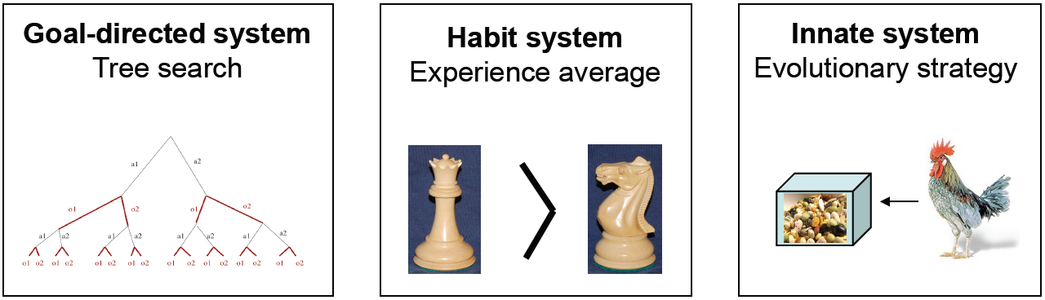
Multiple decision making systems
What happens when one or other breaks down?
or one becomes more or less dominant than the others?

Slide 3
Multiple decision making systems
What happens when one or other breaks down?
or one becomes more or less dominant than the others?

Slide 4

Cavendish - Vermont 1840

Slide 5

Cavendish - Vermont 1990
Rutland & Burlington Railroad
Notes:
September 13, 1848 at a construction site of the Rutland & Burlington Railroad.

Slide 6
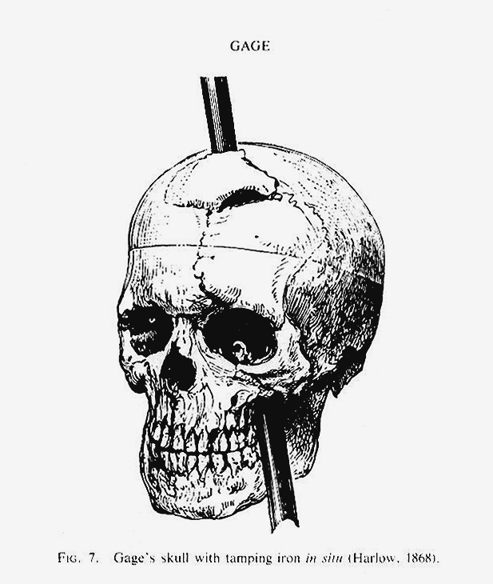
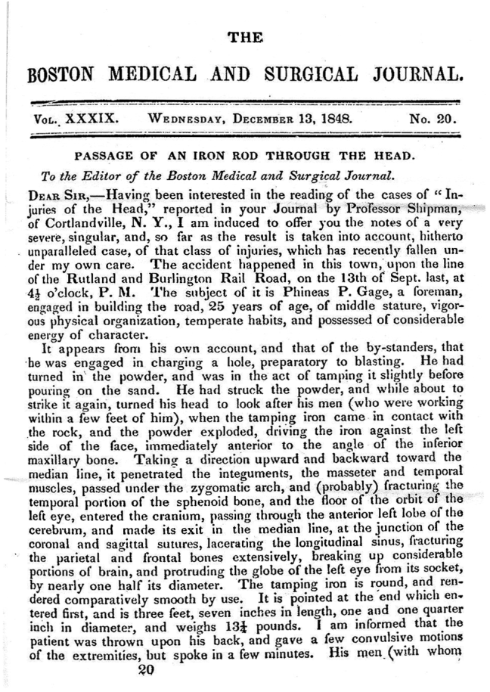
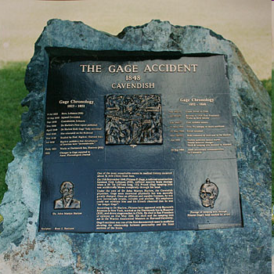
Cavendish - Vermont 1848

Slide 7
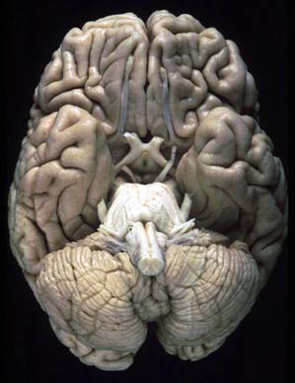
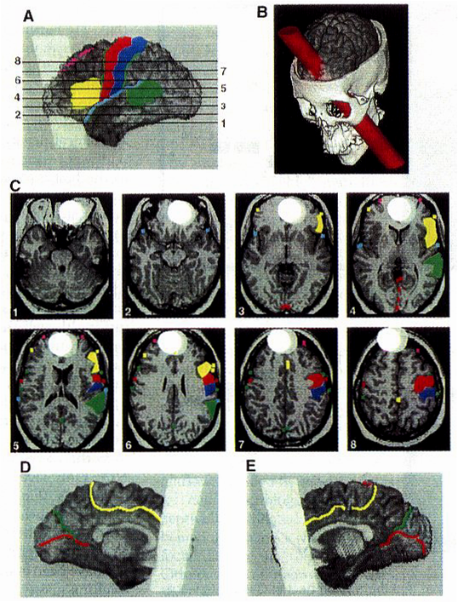
Phineas Gage

Slide 8
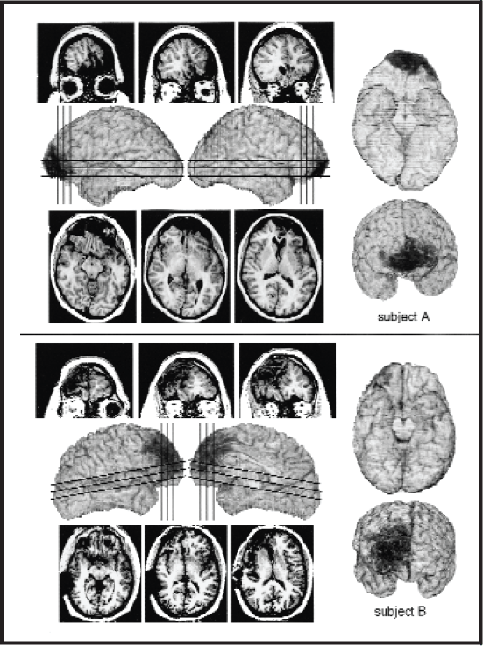
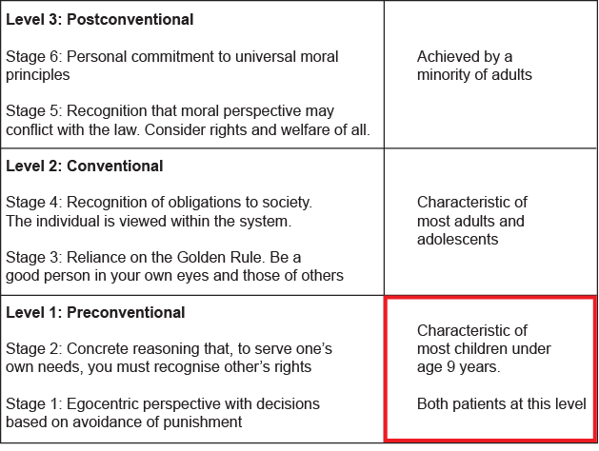
Orbito-frontal cortex damage
- Severely impaired social behaviour
- Insensitive to future consequences of actions
- Impaired autonomic response to punishment
Impaired decision making & autonomic response
Impaired social & moral reasoning – psychopathy?
Kohlberg’s levels of moral reasoning
Notes:
Impulsivity, “acquired sociopathy”, Impaired smell, taste, flavour, reward, satiety, Impairment - Flexible relearning

Slide 9
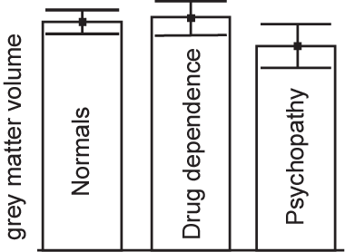
Orbito-frontal cortex damage in Psychopathy
Psychopaths have smaller
Orbito-frontal cortices
Raine et al (2000) Arch Gen Psych. 57:119-27

Slide 10
Multiple decision making systems
What happens when one or other breaks down?
Or if one becomes more or less dominant than the others?

Slide 11
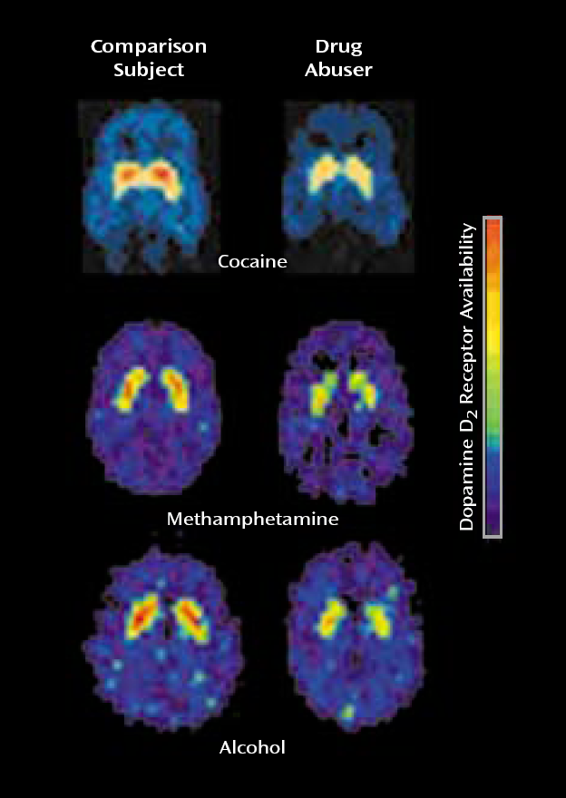
Drug addictions
Change in behaviour
- Loss of self-directed/willed behaviours
- Increase in automatic sensory-driven behaviours
(e.g. Habits )
How does this happen?
drugs of abuse increase brain dopamine
(the chemical used by the brain to signal reward)
- ‘hijack’ the brain’s reward system
(drug becomes salient at the expense of all other rewards)
Notes:
Goals guide habits most fundamentally by providing the initial outcome-oriented impetus for response repetition. In this sense, habits often are a vestige of past goal pursuit
Goal-directed action is operationally defined by the sensitivity of responses to the outcome. Yin et al [, 2004 #48] showed that the progression from goal-directed to habitual responding was disrupted by lesions of the dorsolateral striatum. Rather than progressing to habits, lesioned animals remained sensitive to devaluation of the outcome throughout training. In contrast, progression to habitual responding occurs normally in rats with lesions to the dorsomedial striatum. The same results were obtained using a LiCl devaluation paradigm [Yin, 2004 #48] or an omission procedure [Yin, 2006 #47] to test for goal directed responding. Such evidence suggests that the dorsolateral striatum, but not the dorsomedial striatum, is responsible for the SR associations that are thought to underlie habitual responding. Furthermore, DA innervation of the dorsolateral striatum is absolutely required for habit formation in instrumental conditioning [Faure, 2005 #27].
Habit formation is also frequently referred in the context of addiction, a classically considered DA-mediated dysregulated behaviour highly relevant to our topic. There is indeed a development of habits in drug-seeking behaviour. It has been shown recently that although the DA system via the ventral striatum plays a critical role in this behaviour, the dorsal striatum plays a key role at the stage of habit formation [Belin, 2008 #50]. This DA mediated behaviour is also modulated by the control of the subthalamic nucleus, since subthalamic nucleus lesions can reduce motivation for drugs of abuse such as cocaine, while increasing motivation for food [Baunez, 2005 #49] and subthalamic nucleus deep brain stimulation can reduce compulsive medication use and pathological gambling in PD patients [Witjas, 2005 #53].

Slide 12
Multiple decision making systems
What happens when one or other breaks down?
Or if one becomes more or less dominant than the others?

Slide 13
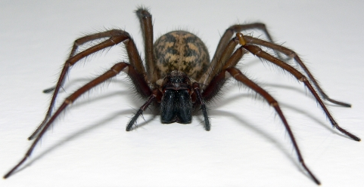

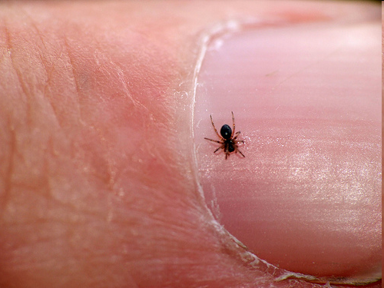

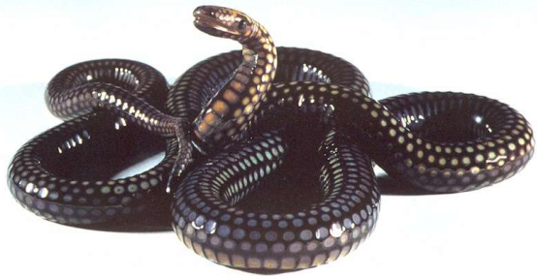


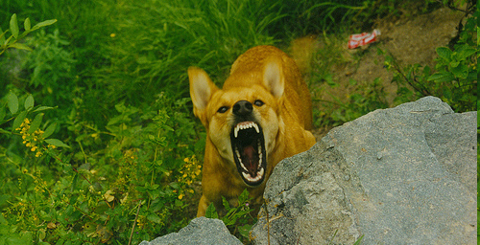
Specific phobias
- Disorder where anxiety is evoked to a specific (not currently dangerous) stimulus.
Experiencing the stimulus induces overwhelming anxiety, panic & dread
Even contemplating seeing the object evokes over-whelming anxiety
Great efforts to avoid any chance of experiencing evoking stimuli
Often results in severe functional impairment
Common phobias
Systematic desensitisation

Slide 14
Multiple decision making systems
What happens when one or other breaks down?
or one becomes more or less dominant than the others?

Slide 15
Poor economists: People are pretty irrational
Imagine that the United States is preparing for the outbreak of an unusual Asian disease, which is expected to kill 600 people.
Two alternative programs to combat the disease have been proposed.
Assume that the exact scientific estimates of the consequences of the programs are as follows:
If Program A is adopted, 200 people will be saved
If Program B is adopted, there is a one-third probability that 600 people will be saved and a two-thirds probability that no people will be saved.
A
If Program A' is adopted, 400 people will die
If Program B' is adopted, there is a one-third probability that nobody
will die and a two-thirds probability that 600 people will die
B’
Tversky & Kahnemann 1981
Notes:
Imagine that the United States is preparing for the outbreak of an unusual
Asian disease, which is expected to kill 600 people. Two alternative
programs to combat the disease have been proposed. Assume that
the exact scientific estimates of the consequences of the programs are
as follows:
If Program A is adopted, 200 people will be saved
Imagine that the United States is preparing for the outbreak of an unusual
Asian disease, which is expected to kill 600 people. Two alternative
programs to combat the disease have been proposed. Assume that
the exact scientific estimates of the consequences of the programs are
as follows:
If Program A' is adopted, 400 people will die
If Program B' is adopted, there is a one-third probability that nobody
will die and a two-thirds probability that 600 people will die

Slide 16
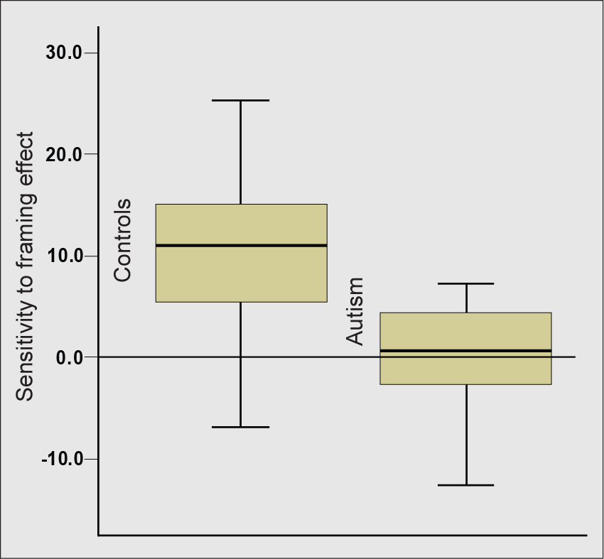
Individuals with Autism are less susceptible to the framing bias!

