Slide 1
The imperfect brain: Rationality and the limits of knowledge
Quentin Huys
Wellcome Trust Neuroimaging Centre
Gatsby Computational Neuroscience Unit
Medical School
UCL

Slide 2
Why are choices hard?
Time present and time past
Are both perhaps present in time future,
And time future contained in time past.
T. S. Eliot

Slide 3
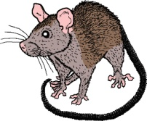
The future, in the long term
goodness of an action = immediate reward + all future reward
Notes:
Explain why want to choose actions based on total future rewards
goodness of an action = immediate reward
+ future reward
- examples
-> our chocies now affect our future options
-> Bentham: maximise thy utility
= choose now such that total future goodness is maximised

Slide 4
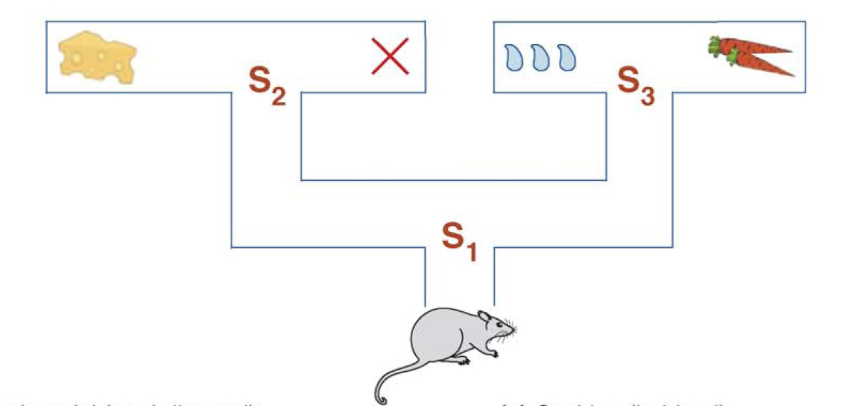
Making optimal decisions
Niv et al. 2007

Slide 5
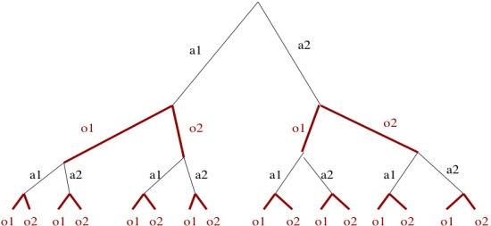
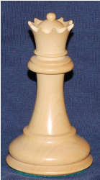
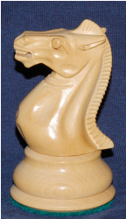
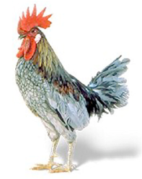
Many decision systems in parallel
Goal-directed system
Tree search
Habit system
Experience average
Innate system
Evolutionary strategy

Slide 6
Evaluating the future: Think hard Goal-directed decisions
L -> S2 ; L -> cheese +4
L -> S2 ; R -> X 0
R -> S3 ; L -> water +1
R -> S3 ; R -> carrot +2
General solution: search a tree
Notes:
1. THINK HARD. goal-directed, model-based: just think about the
consequences of actions
- take actions *because of their consequences*
- only works for tiny problems, e.g. watering plants, shortest path in
a simple maze.
- Tolman's mazes and cage escapes
- abstract rule learning: dlpfc recordings (human imaging?)

Slide 7
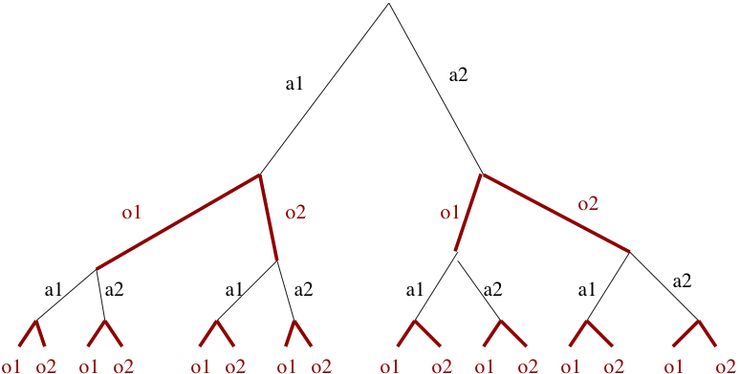
Often, this is not feasible. Take chess.
Each move 30 odd choices
30⁴⁰?
MANY!!!
Legal boards ~10¹²³
Can’t just do full tree search.

Slide 8
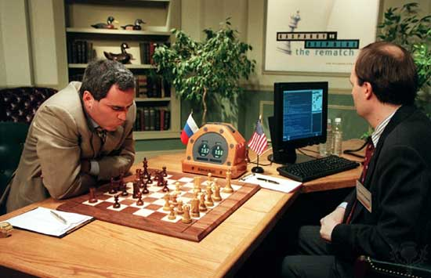
So…?
How do players do it?
How did Deep Blue beat Kasparov?

Slide 9
Evaluating the future… just try it out? Habits
+4
0
-2
+2
V(state) = V(state) + learning rate x prediction error
Prediction should be: reward + V(next state)
But it is: V(state)
Prediction error reward + V(next state) - V(state)
Choose action more if expected value higher
Notes:
2. JUST TRY IT, LEARN FROM ERRORS. habits: learn over repetition
- show in matlab simulation of grid world
- keep tally of long-term consequences of actions
- choose actions because *in the past* they tended to be good. *NOT*
because now they lead to desired outcome.
- monkey recordings: Schultz
- human recordings: Zaghloul et al. 2009
- some example optimal behaviours?

Slide 10
Evaluating the future… just try it out? Habits
+4
0
-2
+2
V of all states = 0
R V
V(state) = V(state) + learning rate x prediction error
T1 V(s1) = V(s1) + .1 x (0 + V(s2) - V(s1)) = 0
T2 V(s2) = V(s2) + .1 x (4 - V(s2)) = .4
T3 V(s1) = V(s1) + .1 x (0 + V(s2) - V(s1) = .04
Notes:
2. JUST TRY IT, LEARN FROM ERRORS. habits: learn over repetition
- show in matlab simulation of grid world
- keep tally of long-term consequences of actions
- choose actions because *in the past* they tended to be good. *NOT*
because now they lead to desired outcome.
- monkey recordings: Schultz
- human recordings: Zaghloul et al. 2009
- some example optimal behaviours?

Slide 11
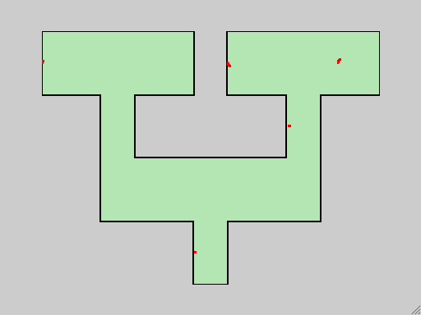
Evaluating the future: habit learning over time
+4
0
-2
+2

Slide 12
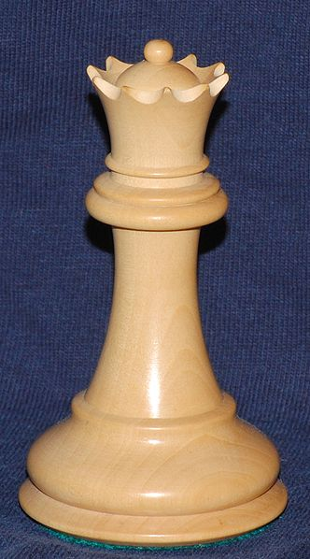
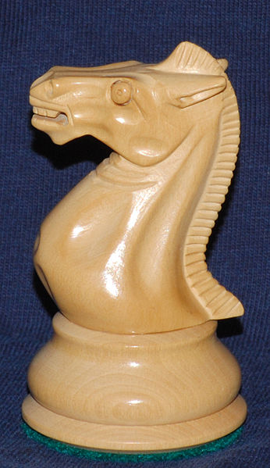
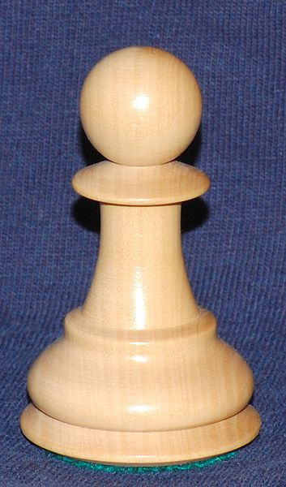
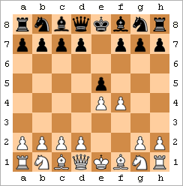
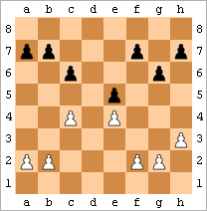
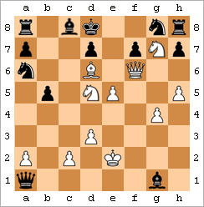
Use clever heuristics, position evaluation…
Notes:
Explain heuristics

Slide 13
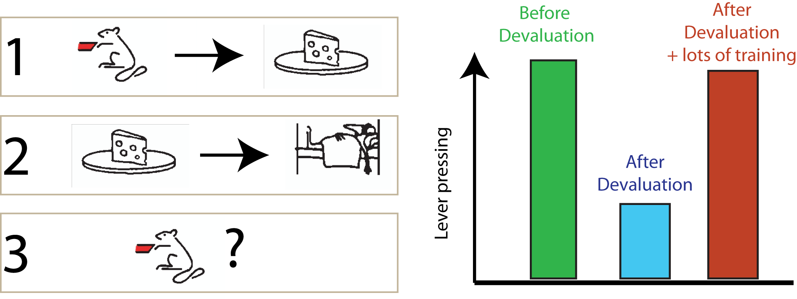
Devaluation
Goal-directed vs. habitual behaviour

Slide 14
Evaluating the future… actually, let’s not! Innate simple strategies
Choose randomly at S1
Then just go for food if hungry
Or for water if thirsty
Notes:
3. FORGET THE FUTURE. innate reflexes: forage ranomly, eat food when it's
in front of you, run away from predators.
- show in matlab simulation of grid world
- example
- Hirsch & Bolles 1981: responses to predators even after breeding
in captivity over multiple generations
- anxiety: bandler / organization of fear responses in PAG
- Mobbs: PAG
- Amygdala & fearful faces?

Slide 15
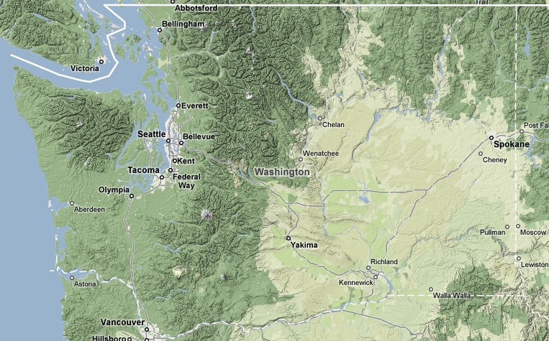
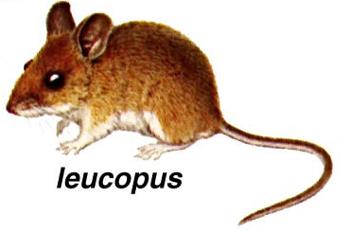
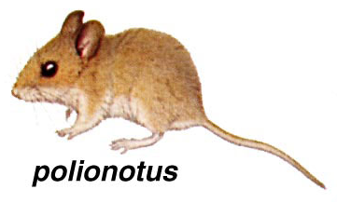
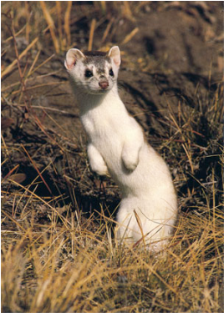
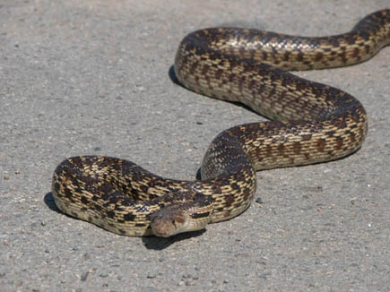
Innate evolutionary strategies

Slide 16
Innate evolutionary strategies
more
survive
more
survive
fewer
survive
Hirsch and Bolles 1980

Slide 17
Many decision systems in parallel
Multiple decision systems “Controllers”
Competition and collaboration
Goal-directed system
Tree search
Habit system
Experience average
Innate system
Evolutionary strategy

Slide 18
Poor economists. People are pretty irrational.
Imagine that the United States is preparing for the outbreak of an unusual Asian disease, which is expected to kill 600 people.
Two alternative programs to combat the disease have been proposed.
Assume that the exact scientific estimates of the consequences of the programs are as follows:
Notes:
Imagine that the United States is preparing for the outbreak of an unusual
Asian disease, which is expected to kill 600 people. Two alternative
programs to combat the disease have been proposed. Assume that
the exact scientific estimates of the consequences of the programs are
as follows:
If Program A is adopted, 200 people will be saved
Imagine that the United States is preparing for the outbreak of an unusual
Asian disease, which is expected to kill 600 people. Two alternative
programs to combat the disease have been proposed. Assume that
the exact scientific estimates of the consequences of the programs are
as follows:
If Program A' is adopted, 400 people will die
If Program B' is adopted, there is a one-third probability that nobody
will die and a two-thirds probability that 600 people will die

Slide 19
Poor economists. People are pretty irrational.
Imagine that the United States is preparing for the outbreak of an unusual Asian disease, which is expected to kill 600 people.
Two alternative programs to combat the disease have been proposed.
Assume that the exact scientific estimates of the consequences of the programs are as follows:
If Program A is adopted, 200 people will be saved
If Program B is adopted, there is a one-third probability that 600 people will be saved and a two-thirds probability that no people will be saved.
Notes:
Imagine that the United States is preparing for the outbreak of an unusual
Asian disease, which is expected to kill 600 people. Two alternative
programs to combat the disease have been proposed. Assume that
the exact scientific estimates of the consequences of the programs are
as follows:
If Program A is adopted, 200 people will be saved
Imagine that the United States is preparing for the outbreak of an unusual
Asian disease, which is expected to kill 600 people. Two alternative
programs to combat the disease have been proposed. Assume that
the exact scientific estimates of the consequences of the programs are
as follows:
If Program A' is adopted, 400 people will die
If Program B' is adopted, there is a one-third probability that nobody
will die and a two-thirds probability that 600 people will die

Slide 20
Poor economists. People are pretty irrational.
Imagine that the United States is preparing for the outbreak of an unusual Asian disease, which is expected to kill 600 people.
Two alternative programs to combat the disease have been proposed.
Assume that the exact scientific estimates of the consequences of the programs are as follows:
If Program A' is adopted, 400 people will die
If Program B' is adopted, there is a one-third probability that nobody
will die and a two-thirds probability that 600 people will die
Notes:
Imagine that the United States is preparing for the outbreak of an unusual
Asian disease, which is expected to kill 600 people. Two alternative
programs to combat the disease have been proposed. Assume that
the exact scientific estimates of the consequences of the programs are
as follows:
If Program A is adopted, 200 people will be saved
Imagine that the United States is preparing for the outbreak of an unusual
Asian disease, which is expected to kill 600 people. Two alternative
programs to combat the disease have been proposed. Assume that
the exact scientific estimates of the consequences of the programs are
as follows:
If Program A' is adopted, 400 people will die
If Program B' is adopted, there is a one-third probability that nobody
will die and a two-thirds probability that 600 people will die

Slide 21
Poor economists. People are pretty irrational.
Imagine that the United States is preparing for the outbreak of an unusual Asian disease, which is expected to kill 600 people.
Two alternative programs to combat the disease have been proposed.
Assume that the exact scientific estimates of the consequences of the programs are as follows:
Notes:
Imagine that the United States is preparing for the outbreak of an unusual
Asian disease, which is expected to kill 600 people. Two alternative
programs to combat the disease have been proposed. Assume that
the exact scientific estimates of the consequences of the programs are
as follows:
If Program A is adopted, 200 people will be saved
Imagine that the United States is preparing for the outbreak of an unusual
Asian disease, which is expected to kill 600 people. Two alternative
programs to combat the disease have been proposed. Assume that
the exact scientific estimates of the consequences of the programs are
as follows:
If Program A' is adopted, 400 people will die
If Program B' is adopted, there is a one-third probability that nobody
will die and a two-thirds probability that 600 people will die

Slide 22
Poor economists. People are pretty irrational.
Imagine that the United States is preparing for the outbreak of an unusual Asian disease, which is expected to kill 600 people.
Two alternative programs to combat the disease have been proposed.
Assume that the exact scientific estimates of the consequences of the programs are as follows:
If Program A is adopted, 200 people will be saved
If Program B is adopted, there is a one-third probability that 600 people will be saved and a two-thirds probability that no people will be saved.
A
If Program A' is adopted, 400 people will die
If Program B' is adopted, there is a one-third probability that nobody
will die and a two-thirds probability that 600 people will die
B’
Tversky & Kahnemann 1981
Notes:
Imagine that the United States is preparing for the outbreak of an unusual
Asian disease, which is expected to kill 600 people. Two alternative
programs to combat the disease have been proposed. Assume that
the exact scientific estimates of the consequences of the programs are
as follows:
If Program A is adopted, 200 people will be saved
Imagine that the United States is preparing for the outbreak of an unusual
Asian disease, which is expected to kill 600 people. Two alternative
programs to combat the disease have been proposed. Assume that
the exact scientific estimates of the consequences of the programs are
as follows:
If Program A' is adopted, 400 people will die
If Program B' is adopted, there is a one-third probability that nobody
will die and a two-thirds probability that 600 people will die

Slide 23
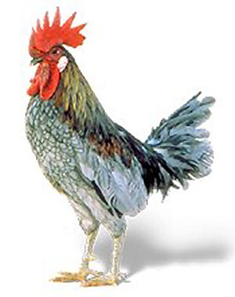
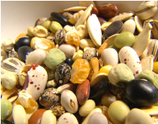
And chicken pretty stupid?
Hershberger 1986

Slide 24
Clever innate strategies
X
If Program A is adopted, 200 people will be saved
If Program B is adopted, there is a one-third probability that 600 people will be saved and a two-thirds probability that no people will be saved.
If Program A' is adopted, 400 people will die
If Program B' is adopted, there is a one-third probability that nobody
will die and a two-thirds probability that 600 people will die

Slide 25
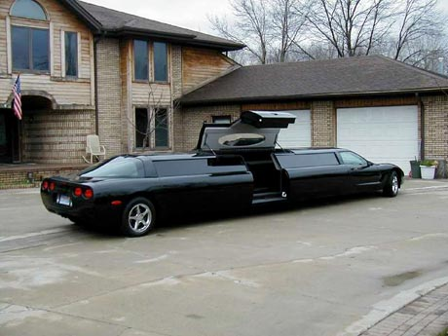
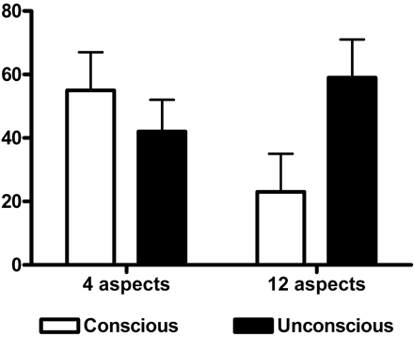
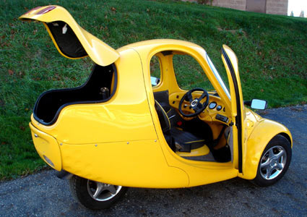
Simple is better at times: cars
Car A: 75% +ve
Car B: 50% +ve
Car C: 50% +ve
Car D: 25% +ve
Asian disease: time
Dijksterhuis et al. 2006

Slide 26
Sometimes knowledge hurts
“We added balsamic vinegar to one of these”
+BV
“We added balsamic vinegar to the light one”
+BV

Slide 27
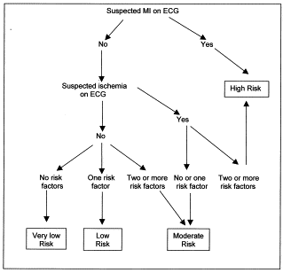
Simple is better at times: doctors
20 cases for which truth known
Cardiologists
General physicians
A&E physicians
Physicians overly cautious, but
still miss many -> complications
Melly et al. 2002

Slide 28
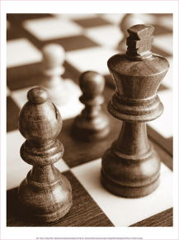
Discussion
Habit system
Experience average
Goal-directed system
Tree search
Decisions are often hard
Time future in time present
Uncertainty
Multiple decision systems
Complex to simple
Neither is perfect
Brains has to decide between deciders
Not always easy, not always right
Psychiatry
Innate system
Evolutionary strategy
+BV

Slide 29
I can resist anything but temptation
How many excuses does the drunkard
find when each new temptation comes!
It is a new brand of liquor which the
interests of intellectual culture in such
matters oblige him to test; moreover it is
poured out and it would be a sin to waste it;
or it isn’t drinking but because he is cold; or
it is Christmas day; or it is just this once…
William James
Long-term vs impulsive behaviours:
“locking away” money
Getting to bed early
Alcohol, drugs
The pub, disulfiram
Buying sweets
Get rid of p’s
imagined
arousal
real
arousal
Ariely and Loewenstein 2006

Slide 30
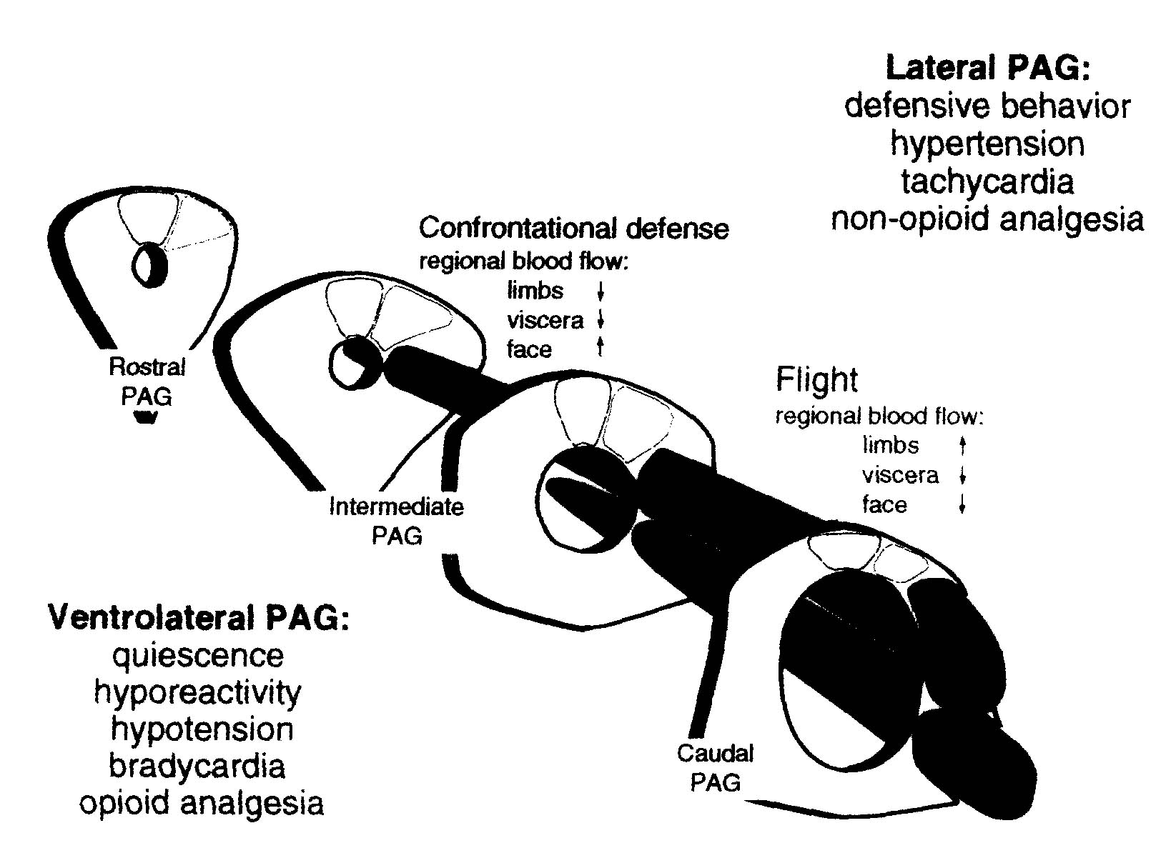
Innate evolutionary strategies in the brain
Old brain
Bandler and Shipley 1994

Slide 31
Let’s play XOX
Can go through all possible board settings
9! to 230 symmetries etc.
For each, consider all following positions
Chose move that gets you closest to winning or keeps you furthest from winning (minimax/maximin)
…
9 initial choices
x 8
…
(really just 3)
(really just 5)
x 7

