Slide 1
What’s Happened to Childhood?
Hugh Cunningham

Slide 2
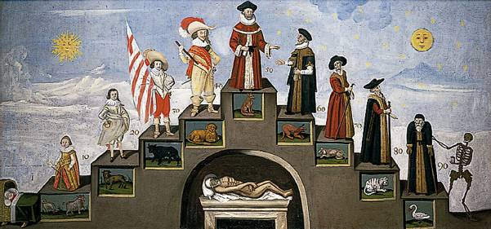

Slide 3
Isaac Watts (1715)
There is an hour when I must die,
Nor do I know how soon ‘twill come.
A thousand children, young as I,
Are call’d by death to hear their doom.

Slide 4
William Blake ‘Songs of Innocence’ (1789)
‘I have no name;
I am but two days old.’
What shall I call thee?
‘I happy am,
Joy is my name.’
Sweet joy befall thee!

Slide 5
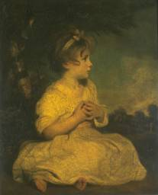
Joshua Reynolds The Age of Innocence

Slide 7
W. Clarke Hall (1897)
‘The great Juggernaut car of unscrupulous commercialism, private greed, and domestic inhumanity rolled upon its way with none to hinder. Tracing our way back down the dim avenues of the years, we see the white and mouldering bones of the child victims which its cruel wheels have crushed’.
Year by year ‘the number of its victims becomes more few, the shout of the happy, rescued children more loud and more glad’.

Slide 8
City Sparrows
Sixty years ago, when [Victoria] came to the throne…the children of the nation were, in thousands of instances, being done to death, morally and physically, in wretched homes, in which they slowly pined and starved to death; in factories closely confined, and set to watch the droning, turning wheels, until released sick and faint at night, they crept wearily home with no heart to rejoice in their childhood - no thought but to rest. And worse still, down in the dark mines underground, little, helpless, naked children toiled in the coal-pits. Think what that must have been, you children who love the bright sunshine and the green fields.

Slide 9
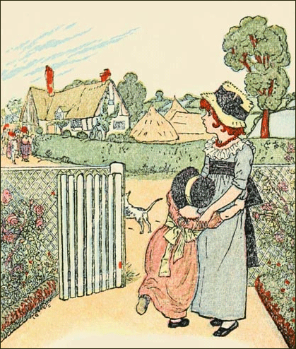
Kate Greenaway Hark, Hark, the Dogs do Bark

Slide 11
Lloyd de Mause, The History of Childhood (1974)
‘The further back in history one goes, the lower the level of child care, and the more likely children are to be killed, abandoned, beaten, terrorized, and sexually abused.’
The 6 stages of parent-child relations:
infanticidal intrusive
abandonment socialisation
ambivalent helping

Slide 12
UNICEF Survey 2013
Over first decade of 21st century in Britain:
Decline in infant mortality
Decline in child poverty levels
Decline in being bullied
Decline in incidence of fighting
Decline in drunkenness
Decline in cannabis use
Decline in being overweight
86% self-reported life satisfaction

